Slide 1

Building a Restaurant Management System: A PHP Code Approach

Slide 2








Introduction to Restaurant Management Systems
In this presentation, we will explore the of building a
using . This
system will streamline operations, enhance customer experience, and improve overall efﬁciency. We will cover various components such as
, , and
.

Slide 3






Key Features of the System
A robust Restaurant Management System should include
,
,
. These features
and
help in managing daily operations effectively. Additionally, integrating
ensures a smooth checkout process,
enhancing the
.

Slide 4
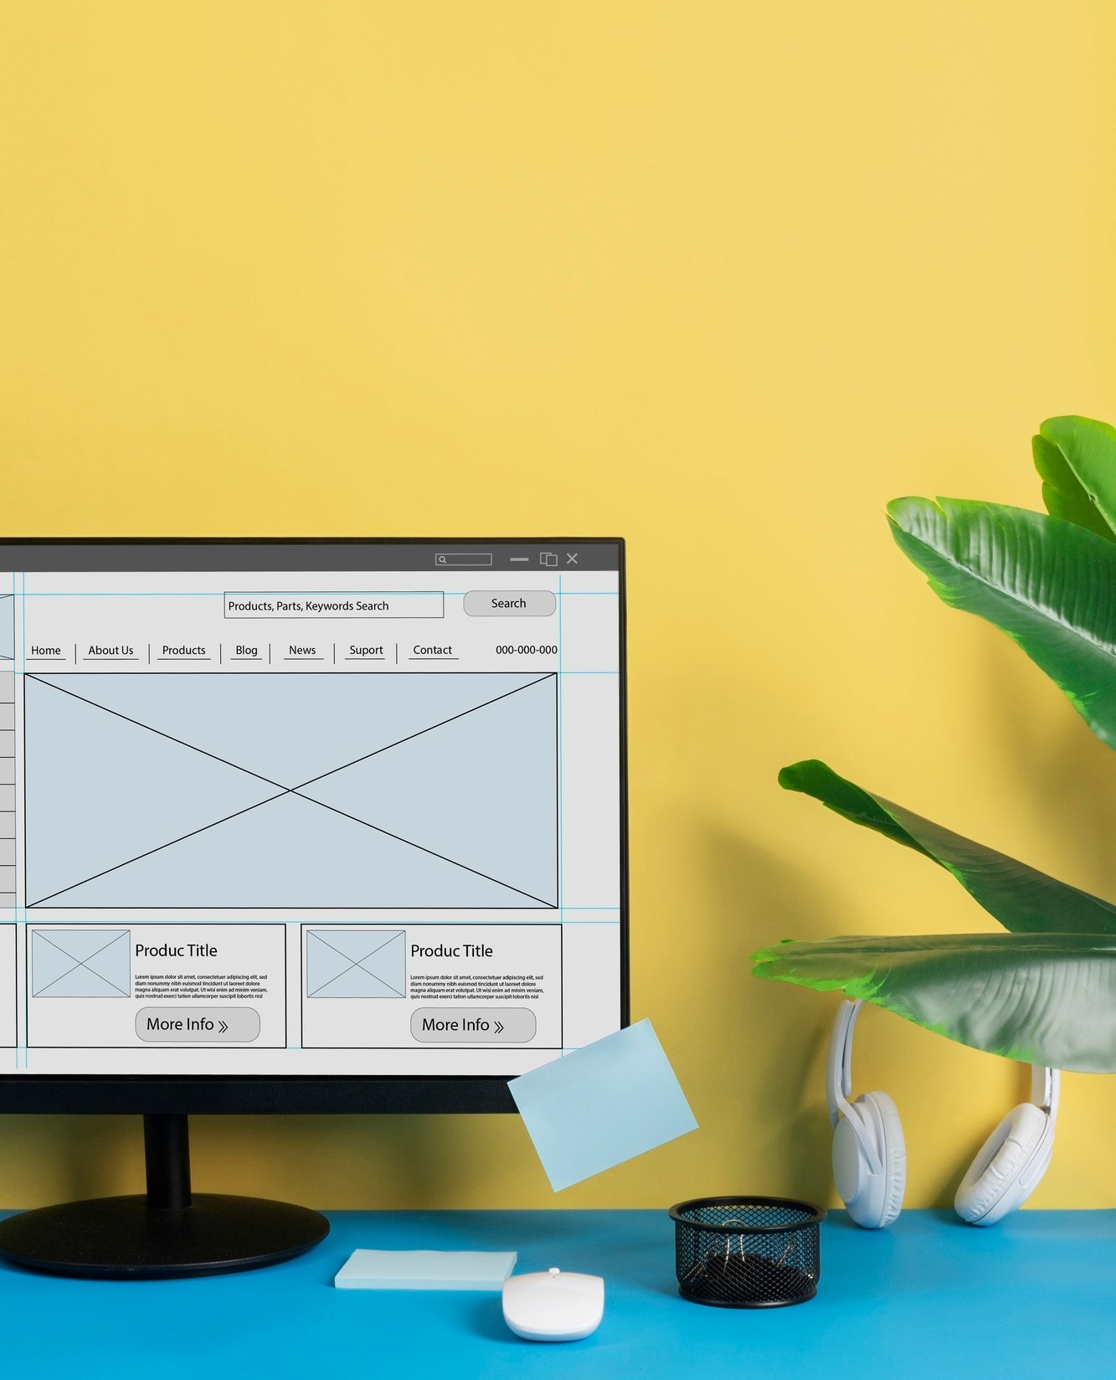







Database Design and Structure
The is crucial for
storing data efﬁciently. Key tables include , ,
, and . Using with allows for dynamic data retrieval
and manipulation, ensuring that the system remains responsive and reliable.

Slide 5
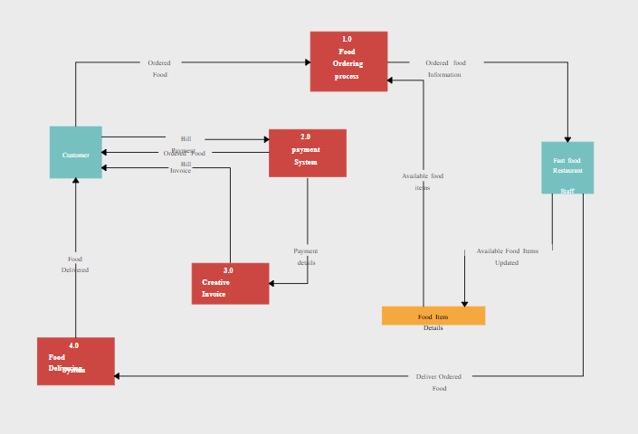
Data flow diagram for
Restaurant Management System

Slide 6





Building the User Interface
Creating an intuitive is vital for both staff and customers. Utilize
, , and alongside
PHP to develop a seamless experience. Features like ensure accessibility on various devices, making the system user-friendly.

Slide 7


Implementing Order Processing
Efﬁcient involves
capturing customer orders, updating inventory, and generating invoices.
Implementing real-time updates can signiﬁcantly improve the workﬂow. This ensures that both customers and staff have access to the latest order information.

Slide 8
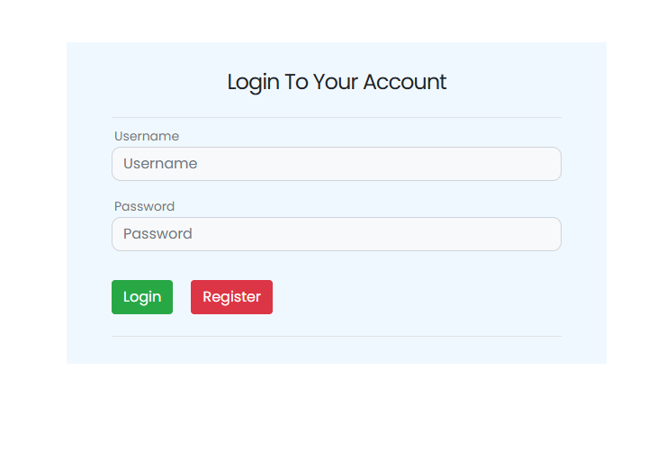
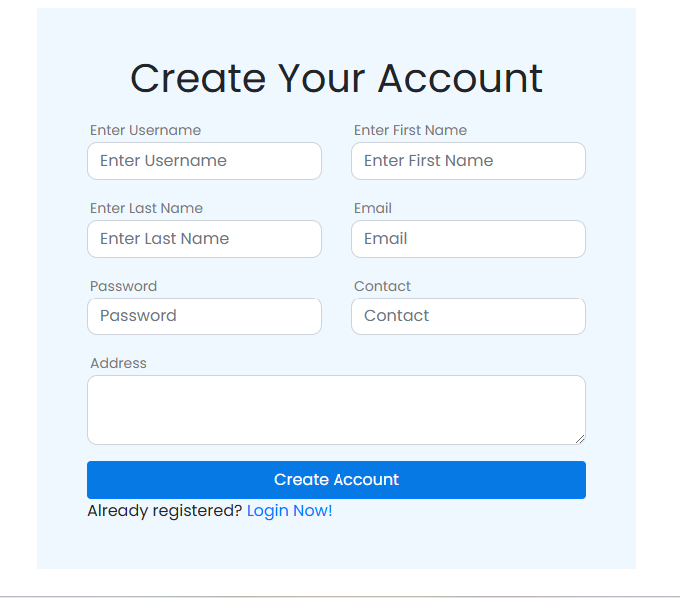
WEBSITE
SCREENSHOTS

Slide 9
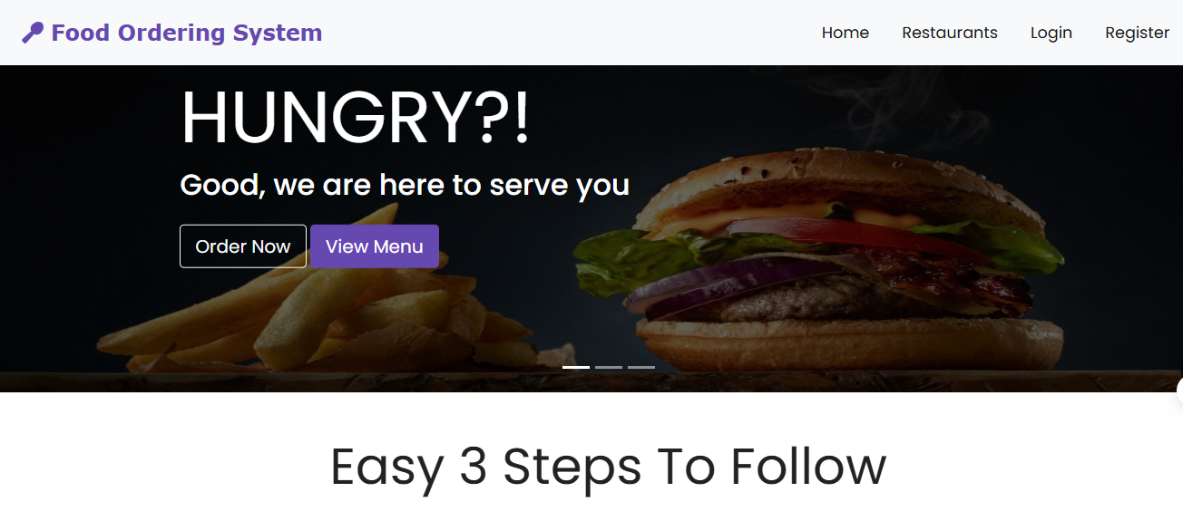
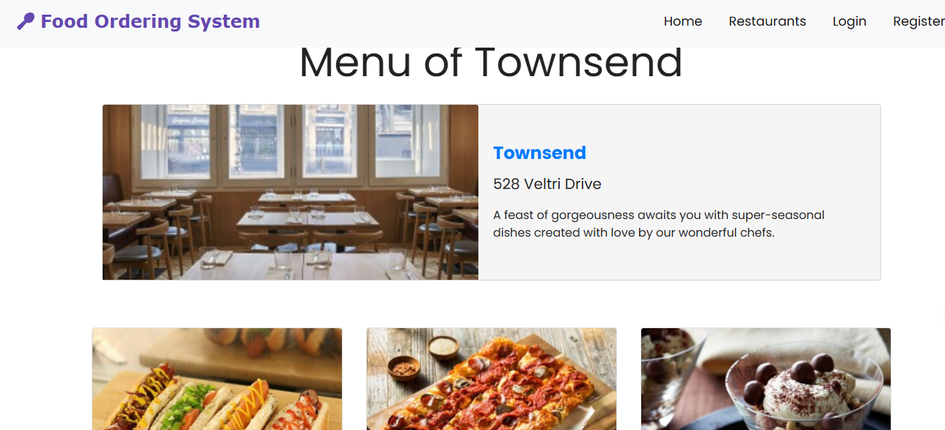
LOGIN AND
ORDER DASHBOARD

Slide 10

Conclusion and Future Enhancements
In conclusion, a well-designed Restaurant Management System using PHP can greatly enhance operational efﬁciency.
Future enhancements could include
, and
,
for better decision-
making. Embracing technology is key to staying competitive in the industry.

