Slide 1
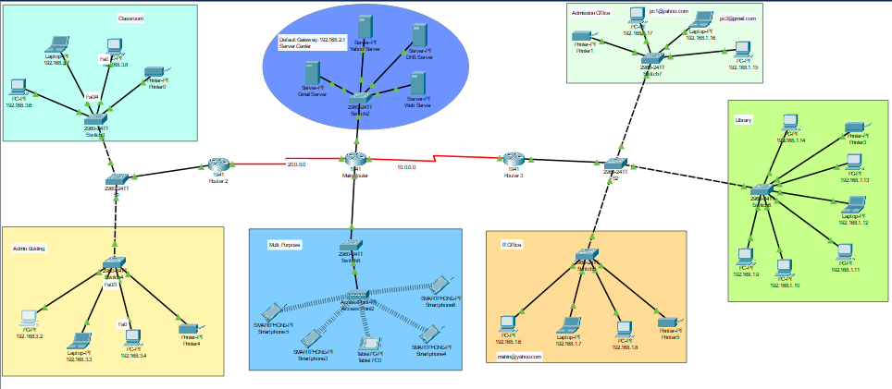
Campus Area Network(CAN)

Slide 2


Green University of Bangladesh
Department of Computer Science and Engineering
Semester: Fall 2024, BSc in CSE(DAY)
Section:221-D10
Computer Networking
Submitted to, Sudip Chandra Ghoshal
Lecturer
Dept. of CSE Green University of Bangladesh
Submitted by, Md Jubayerul Hasan Mahin (213902127)
Md. Nahid Hossen (221002610)
Dept. of CSE Green University of Bangladesh

Slide 3
Contents
Introduction
Network Topology
Protocol Summary
Device Configuration
Network Performance
Challenges and Solutions
Conclusion and Future Work

Slide 4
Introduction
Objective:
To design and simulate a functional Campus Area Network (CAN) that ensures seamless connectivity, efficient routing, and robust performance for various departments.
Key Goals:
Enable communication between departments.
Provide centralized services (e.g., DHCP, DNS, file sharing).
Ensure scalability and manageability.

Slide 5
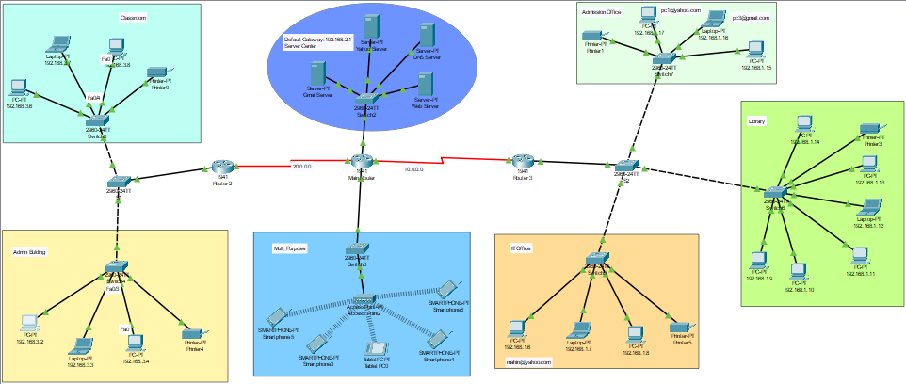
Network Topology
Diagram Overview:
The network is divided into six sections:
Server Center
Library
Admission Office
IT Office
Admin Building
Multi-Purpose Area
Core devices: 3 routers and multiple switches.
Highlights:
Hierarchical topology with modular sections.
Redundant links for reliability.
Classroom

Slide 6
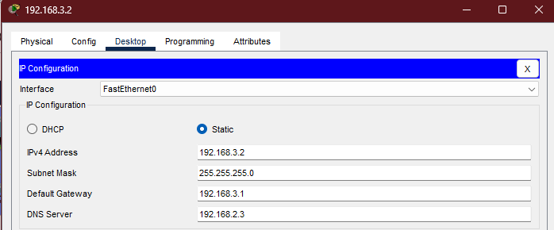
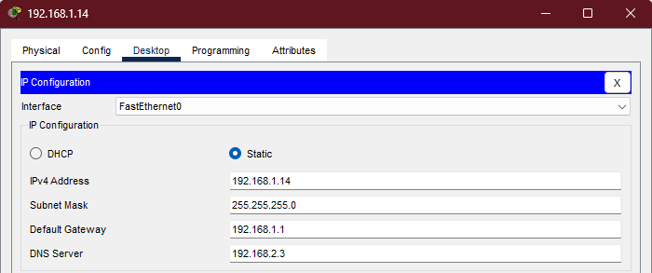
Device Configuration
Key Configurations:
Routers: Configured for static/dynamic routing protocols.
Switches: VLANs for segmenting traffic.
Servers: Centralized DHCP, DNS, and file-sharing services.
Example:
Library devices: IP range 192.168.1.14.
Default Gateway: 192.168.3.1 & 192.168.1.1.

Slide 7
Network Performance
Testing Results:
Ping Tests: Verified connectivity between all devices.
Traceroute: Ensured proper routing paths.
Traffic Simulation: Measured latency and throughput under load.
Observations:
All devices successfully communicated.
Efficient routing between subnets.

Slide 8
Challenges and Solutions
Challenges Faced:
Misconfigured routing tables.
VLAN misalignment on switches.
One inactive link (red line).
Solutions Implemented:
Conducted thorough troubleshooting.
Corrected VLAN and routing configurations.
Ensured all links were active and functional.

Slide 9
Conclusion and Future Work
Conclusion:
Successfully designed a scalable and efficient CAN.
Network supports essential services and departmental operations.
Future Enhancements:
Integrate wireless access points for mobility.
Implement advanced security measures (e.g., firewalls, intrusion detection).
Expand IoT device support.

Slide 10
Thank You So Much !

