Slide 1

Data Com Conversion

Slide 2


Green University of Bangladesh
Department of Computer Science and Engineering
Semester: Spring 2024, BSc in CSE(DAY)
Section:221-D21
Data Com Conversion
Submitted to, Md. Mamunur Rahman
Lecturer Lab
Dept. of CSE Green University of Bangladesh
Submitted by, Md. Atif Sarkar (201002274)
Md Jubayerul Hasan Mahin (213902127)
Dept. of CSE Green University of Bangladesh
2

Slide 3

Introduction to Error Detection and Correction Techniques in Data Transmission
Types of errors
Error detection and correction
Data corruption

Slide 4
Exploring Parity Check and Bit Stuffing Techniques for Error Detection
Parity Check
Bit Stuffing
Adds an extra bit (parity bit) to a data block for error detection.
Two types: Even Parity and Odd Parity.
Even Parity: Makes the total number of 1s in the data block (including parity bit) even.
Odd Parity: Makes the total number of 1s in the data block (including parity bit) odd.
Detects only single-bit errors.
Simple and efficient for basic error detection.
Used to prevent data patterns from being misinterpreted as control characters.
Inserts extra bits (stuffing bits) into the data stream.
Receiver removes the stuffing bits before processing the data.
Common techniques:
Byte Stuffing: Inserts a bit (e.g., 0) after a specific pattern (e.g., five consecutive 1s).
Bit Stuffing: Inserts a bit (e.g., 0) after a certain number of consecutive 1s (e.g., six consecutive 1s).
Improves data integrity by avoiding confusion with control characters.

Slide 5
Cyclic Redundancy Check (CRC) for Error Detection
CRC: The Data Guardian: Cyclic Redundancy Check (CRC) is a superhero in the digital world,
safeguarding data integrity during transmission or storage.
Checksum Power: CRC works by calculating a special value called a checksum based on the original data.
Math Magic: Under the hood, CRC uses clever math tricks (polynomial division) to create the checksum..
Not Perfect, But Powerful: While CRC is excellent at detecting errors, it's not foolproof. Some errors might slip through undetected.
However, it's a widely used and reliable first line of defense for ensuring your precious data arrives safe and sound.

Slide 6
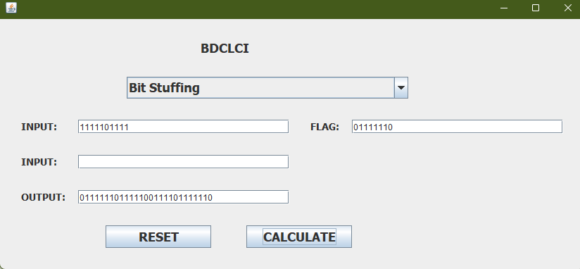
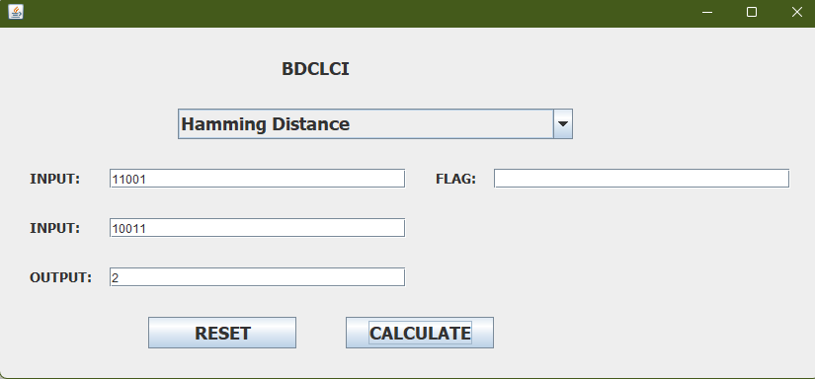
Interactive Demonstration of Error Detection Techniques
1. Parity Check Simulation:
3. Hamming Distance Visualization:

Slide 7
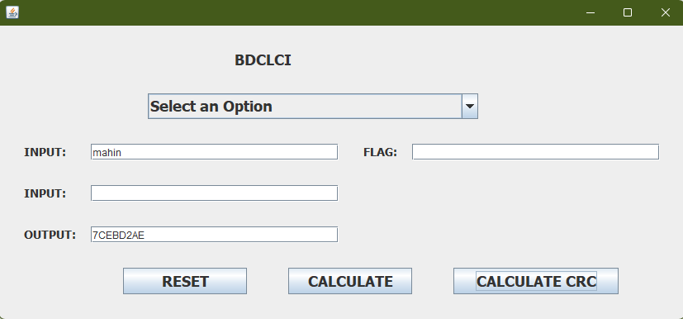
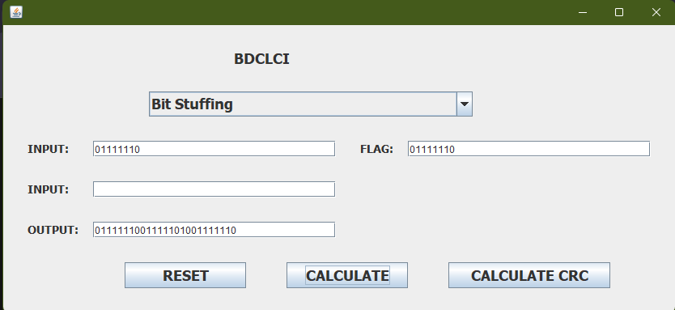
Interactive Demonstration of Error Detection Techniques
3. CRC:
4.Bit-stuffing:

Slide 8

Error Detection Techniques in Everyday Applications
Data Validation: This involves checking user inputs and ensuring they fit specific criteria
Checksums and Error-Correcting Codes: These techniques add redundant data to information being transmitted or stored
Range Checks and Limits: Applications can define acceptable boundaries for data.

Slide 9
Future Scope
Enhanced Error Detection and Correction Techniques:
Integrate advanced error detection and correction algorithms like Reed-Solomon, Turbo, and LDPC codes to enhance the tool's comprehensiveness and suitability for diverse communication systems and data integrity applications.
User-Friendly Interface Enhancements:
Develop a more intuitive and interactive GUI with visual aids, real-time data transmission visualization, and step-by-step guides for error detection and correction.
Support for Real-Time Data Transmission:
Enhance the app for real-time data transmission and error detection in networks. Add live monitoring, logging, and packet analysis features for network admins and engineers.
Educational and Training Modules:
Develop engaging educational modules and interactive tutorials in the app to teach error detection and correction techniques, integrating quizzes, exercises, and case studies for effective learning.

Slide 10

Thank You So Much Everyone for your kind information

