Slide 1
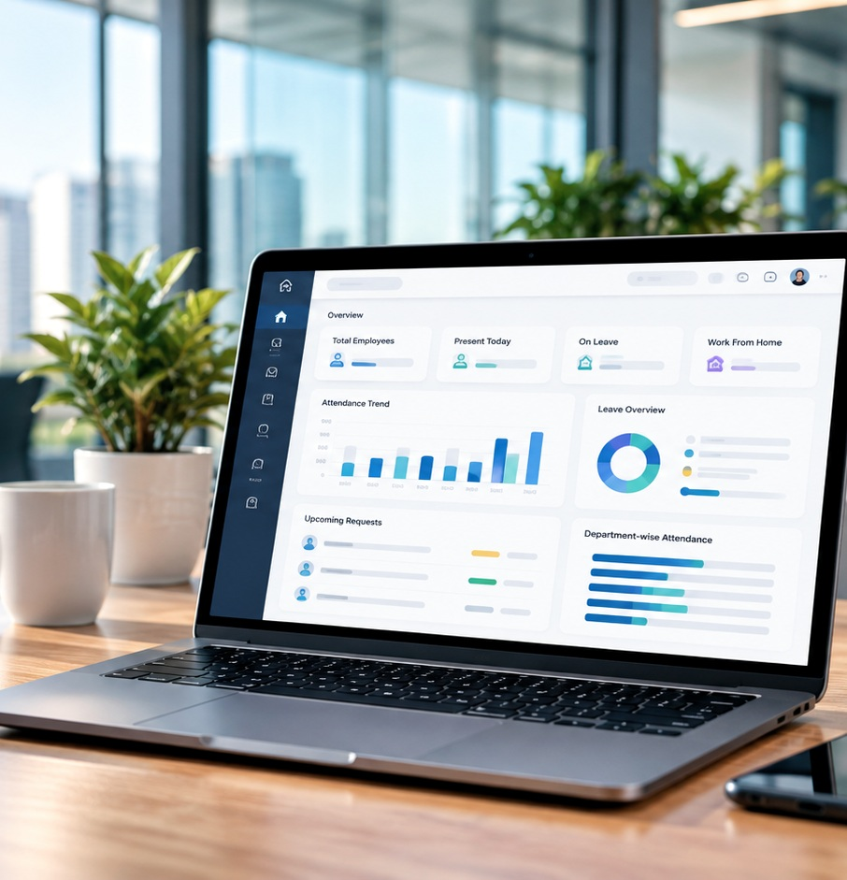
✣
Workforce AI
Workforce AI
AI-Powered Workforce Management System
Workforce AI • Overview
Employees
Present
On Leave
248
231
17
✥
A centralized application for workforce management.
Weekly attendance
Requests
12
Pending
▣
Designed to organize employee information and workforce operations.
◉
Provides role-specific interfaces and workforce visibility.
✧
Includes an AI Assistant and workforce analytics capabilities.
Presented by:
Project Mentor:
Organization / Team:
Your Name
Mentor Name
Infosys

Slide 2
Project Overview
2
Workforce AI brings all workforce operations into one platform, with role-specific access and AI-powered insights.
▦
⚙
●
↗
⟶
⟶
⟶
One Platform
Multiple Workforce
Functions
Role-Specific
Access
Better Workforce
Visibility
♟
◷
▦
₹
⌁
Employee & Workforce
Management
Attendance &
Time Tracking
Leave, Shifts &
Timesheets
Payroll &
Performance
Dashboards, Analytics
& AI Assistant
One connected experience for day-to-day workforce operations

Slide 3

Business Problem
3
Current workforce management processes face several challenges.
♧
Workforce information can be fragmented across separate tools.
◷
Attendance and working hours require consistent tracking.
▦
Leave requests and timesheets need organized review workflows.
◉
Managers and HR need visibility into workforce activity.
⬟
Employee information requires appropriate access controls.

Slide 4
Project Objectives & Proposed Solution
4
Our Objectives
From Scattered Tools to One Platform
1
Centralize important workforce operations.
▤
☁
⌁
⟶
⟶
2
Organize attendance, leave, timesheet, and employee workflows.
Current State
Workforce AI
Centralized Platform
Better Visibility
3
Provide separate experiences for HR, managers, and employees.
Multiple tools
Manual processes
Limited visibility
Organized workflows
Role-based access
Workforce summaries
Analytics
Supported AI insights
4
Present workforce summaries and analytics.
5
Provide AI-assisted workforce information and insights.
Centralize workflows • Clarify access • Improve visibility

Slide 5
Application Features at a Glance
5
A complete suite of features for modern workforce management.
▦
Organization Overview Dashboard
♟
Workforce Directory
◷
Attendance & Time Tracking
▣
Leave Management
⌁
Shift Management
Key metrics and at-a-glance view.
Employee information and search.
Clock-in/out, overtime, and alerts.
Requests, approvals, and balances.
Scheduling and shift allocation.
▤
Weekly Timesheets
₹
Payroll
◎
Performance Management
⌁
Analytics
✧
AI Assistant
Submit, review, and track hours.
Calculations and payroll-related workflows.
Reviews and ratings.
Charts, trends, and insights.
Ask questions and get supported insights.
♟ Notifications & Audit Logs | Keep everyone informed and ensure transparency

Slide 6
Three User Roles
6
Each role has a tailored experience and access to relevant information.
♟
HR / Administrator
♟
Manager
♟
Employee
Organization-level workforce overview.
Team-related workforce visibility.
Personal workforce information.
Workforce administration and employee information.
Attendance and leave review.
Attendance and time tracking.
Shift and timesheet workflows.
Leave requests.
Access to relevant reports and administrative workflows.
Team performance activities where permitted.
Timesheets and personal dashboard information.
▣
Available actions and information depend on role permissions.

Slide 7
Dashboard, Analytics and AI Assistant
7
From real-time data to intelligent insights.
Dashboard
Analytics
AI Assistant
Workforce AI • Overview
Workforce AI • Overview
Workforce AI • Overview
Employees
Present
On Leave
Workforce trends
AI Assistant
248
231
17
Weekly attendance
How many team members are on leave?
Requests
12
17 employees are marked on leave today.
Pending
Ask a workforce question…
Staff count and present/absent status.
Charts and summaries.
Natural-language questions.
Leave, overtime, and departments.
Workforce patterns.
Database assistant, where implemented.
Pending requests.
Department-wise views.
Workforce insights.
Attendance trends.
▦
Data Displayed
(Dashboard)
⟶
⌁
Data Analyzed
(Analytics)
⟶
✧
AI-Assisted Responses
(AI Assistant)

Slide 8
High-Level System Architecture
8
A secure, modular and scalable architecture.
♟
♟
♟
Key Tech Stack
HR
Manager
Employee
Role-Specific Web Interface
✥
Frontend
React + TypeScript
React + TypeScript
Backend API & Application Logic
⚙
Backend
FastAPI + Python
FastAPI (Python)
✧
Authentication & RBAC
JWT-based authentication • Role-based access
▤
Database
AI Assistant
MongoDB
MongoDB
Workforce records
▣
Security
JWT + Role-Based Access

Slide 9
Business Value & Future Scope
9
Delivering value today, with room for more tomorrow.
Business Value (Current)
Future Scope
✓
Centralized access to workforce functions.
➜
Further integration with enterprise HR systems.
✓
Organized attendance, leave, and timesheet workflows.
➜
Enhanced workforce reporting.
✓
Clearer workforce visibility through dashboards.
➜
Improved AI-assisted analysis.
✓
Role-specific access to relevant information.
➜
Additional workflow automation based on business requirements.
✓
AI-assisted information access where supported.
Key Takeaways ✧ Centralization | ♟ Role-Based Access | ▦ Workforce Intelligence

Slide 10
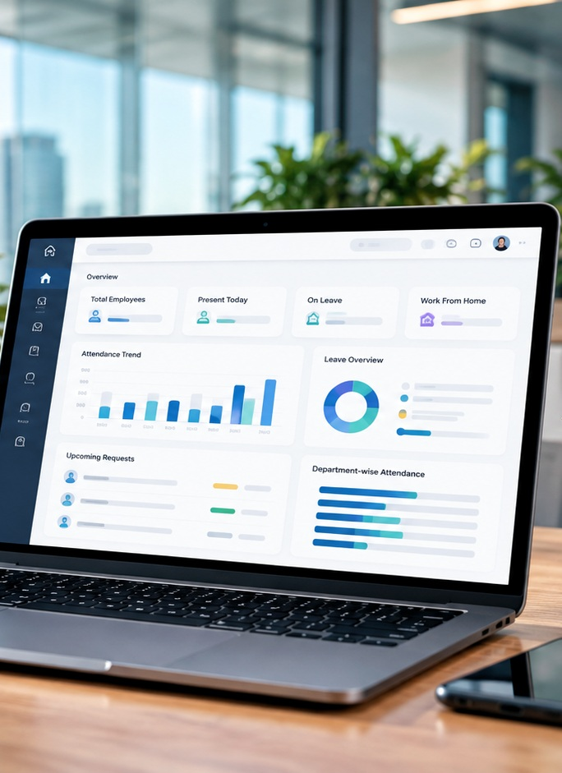
10
✣ Workforce AI
Thank You
Workforce AI • Overview
Questions & Discussion
Workforce trends
Workforce AI — AI-Powered Workforce Management System

