Slide 1
Micro_WAT

Slide 2
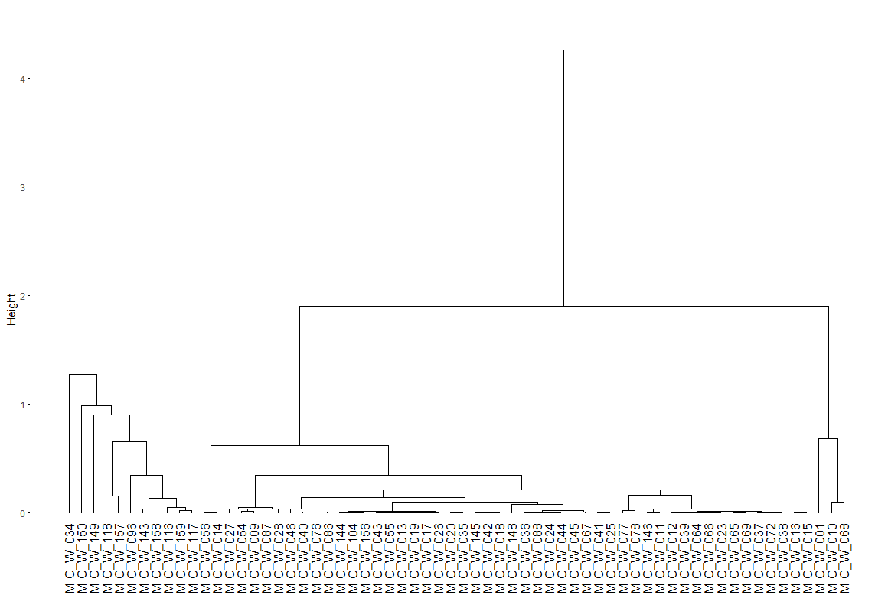
Subcluster 1
Subcluster 2
Subcluster 3
Subcluster 5
Subcluster 4
Cluster 3
Cluster 1
Cluster 2

Slide 3
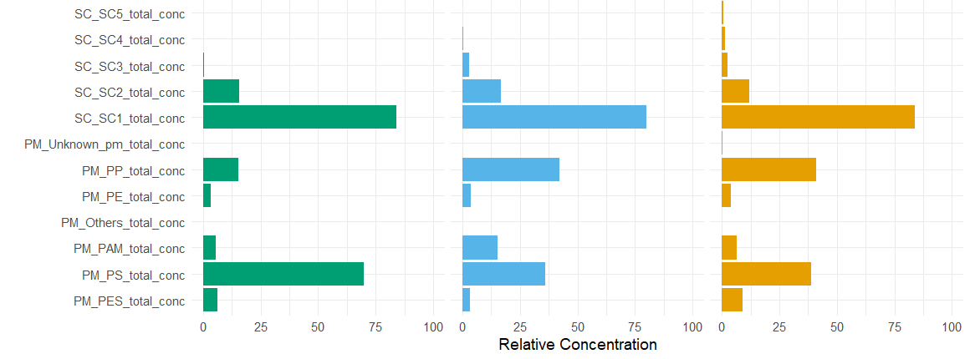

Slide 4
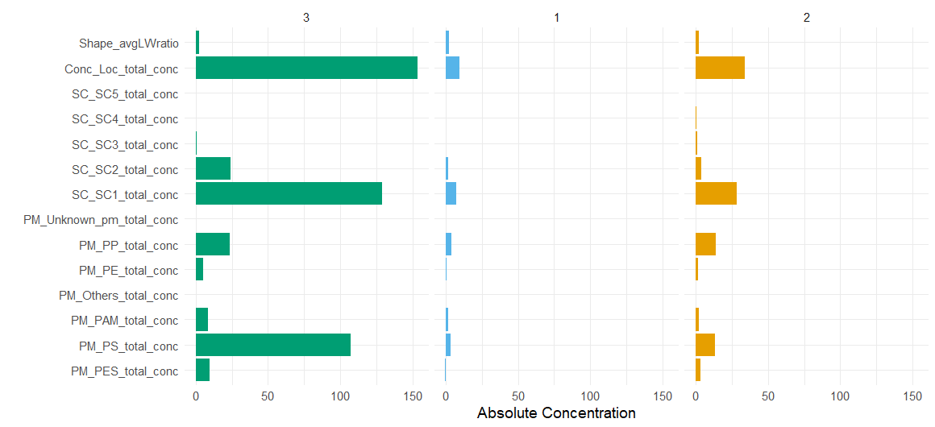

Slide 5
*
*
*
*
*
*
*
*

Slide 6
Subcluster 1
Subcluster 2
Subcluster 5
Subcluster 3
Subcluster 4
*
Cluster 3
Cluster 1
Cluster 2
*
*
*
*
*
*
*
*
*
*
*

Slide 7
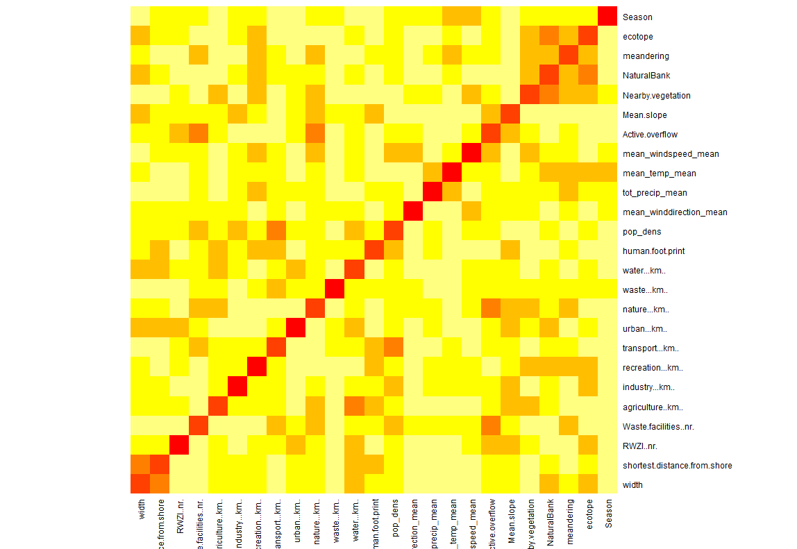

Slide 8
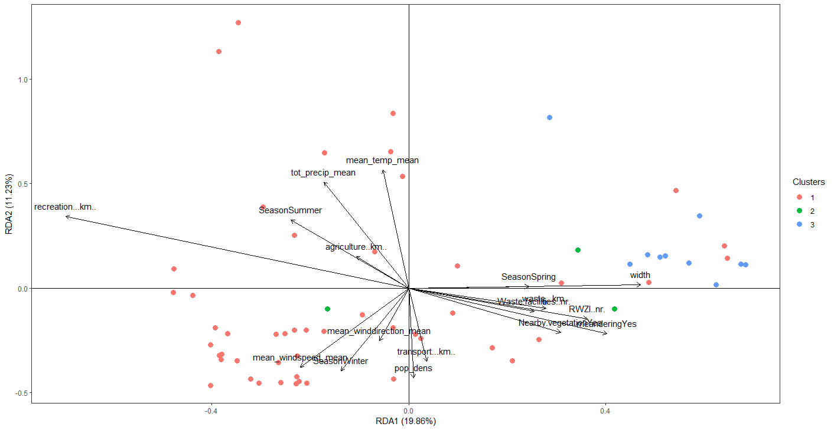
Notes:
Scaling 2

Slide 9
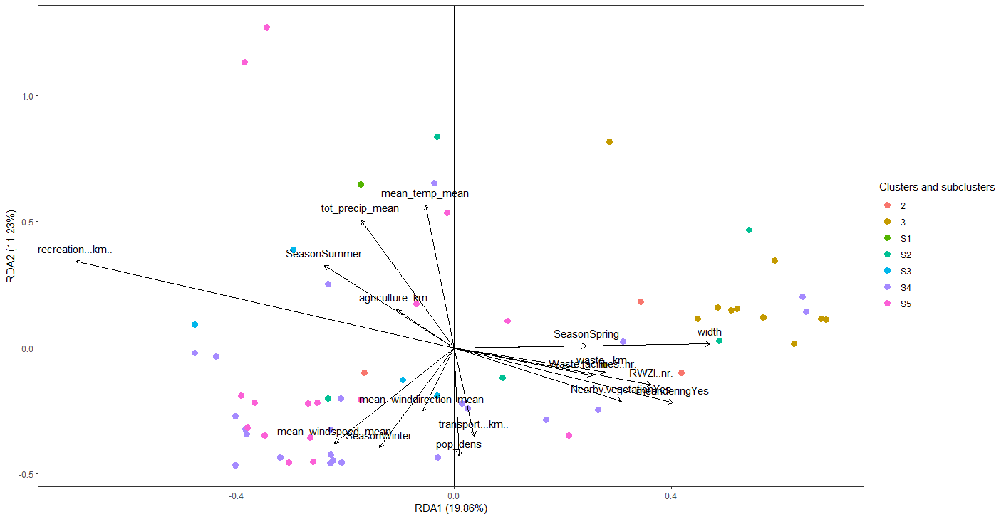

Slide 10
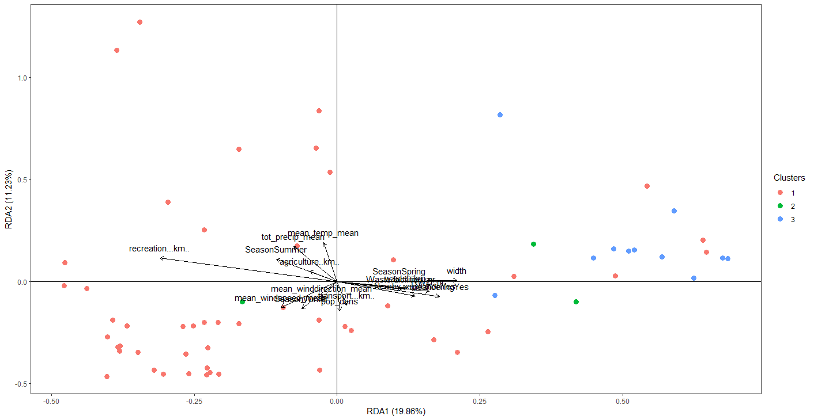
Notes:
Scaling 1

Slide 11
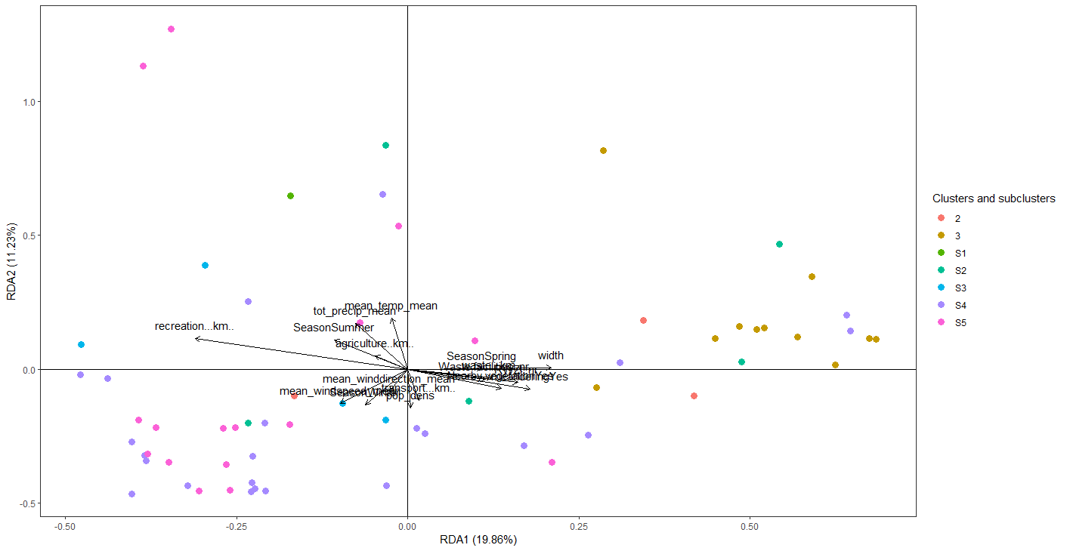
Notes:
Scaling 1

Slide 12
Macro_WAT

Slide 13
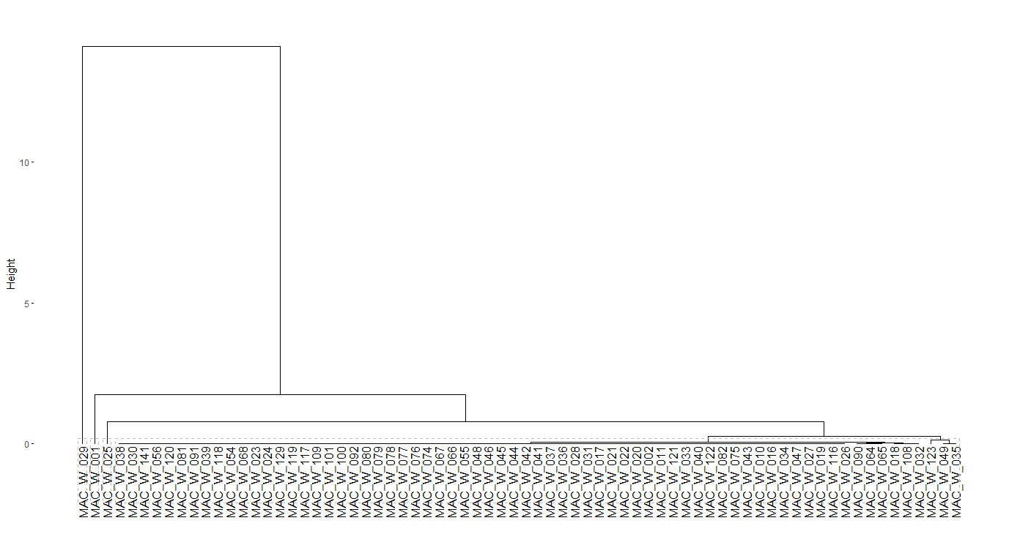
Notes:
With all samples

Slide 14
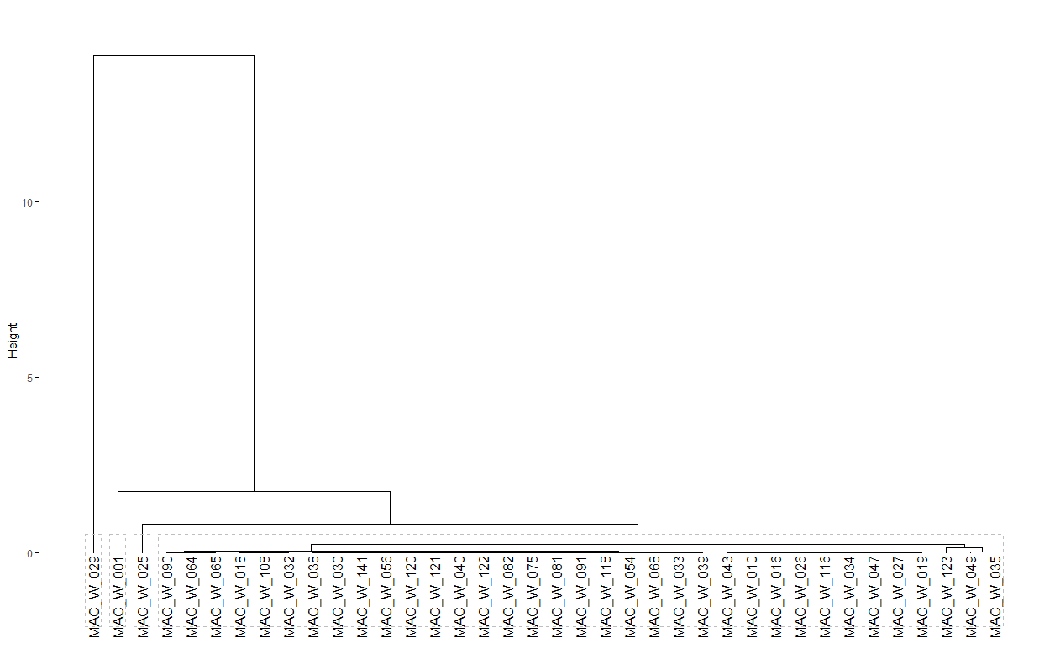

Slide 15
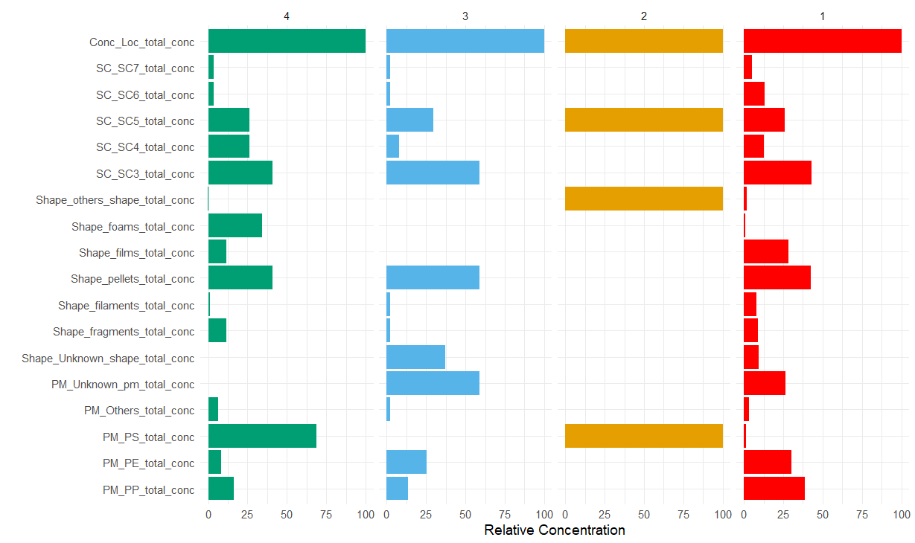

Slide 16
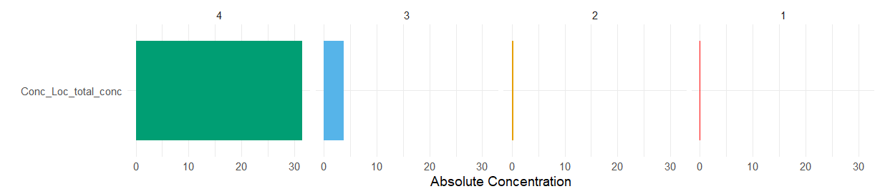

Slide 17
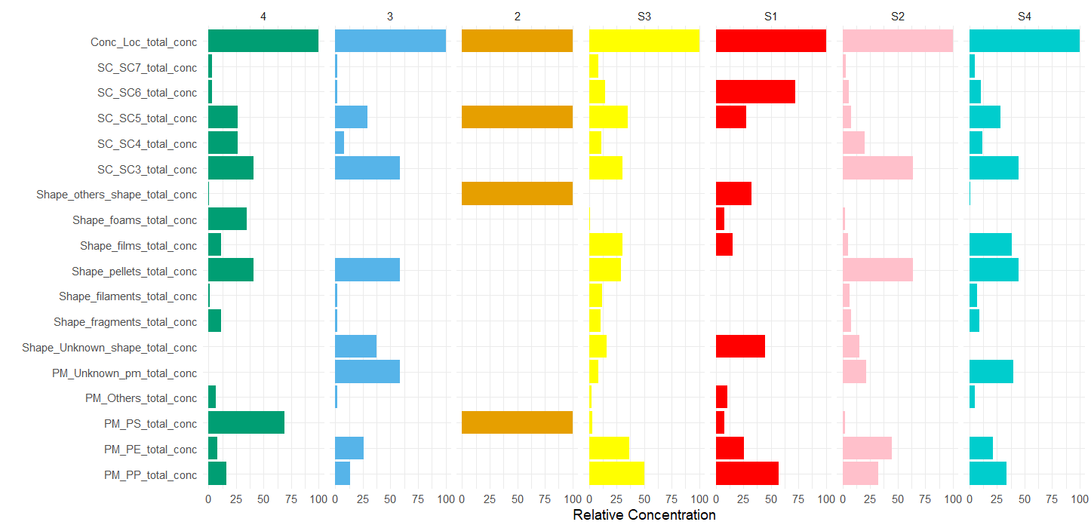

Slide 18
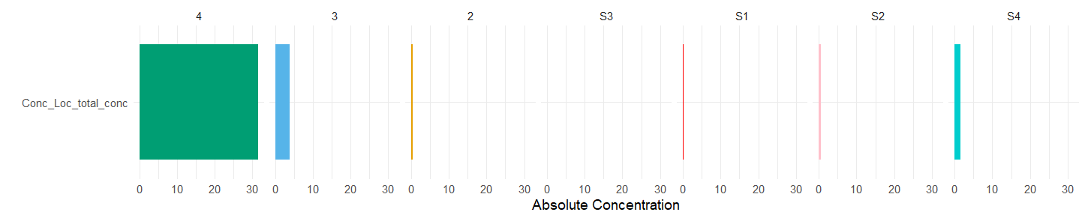

Slide 19
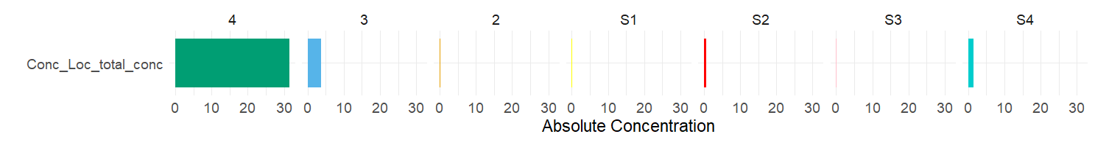
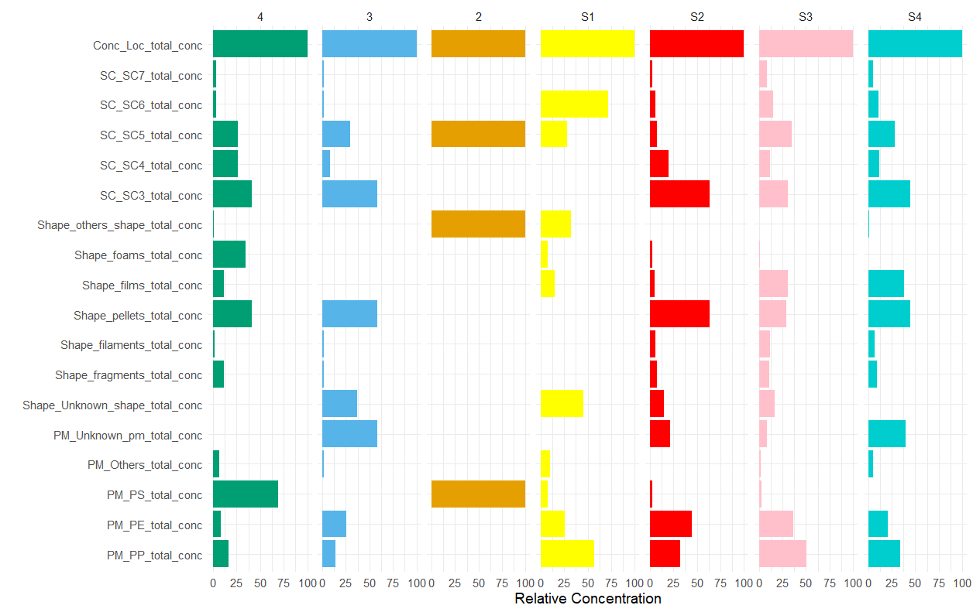
Cluster 4
Cluster 3
Cluster 2
Cluster 1
Subcluster 1
Subcluster 4
Subcluster 2
Subcluster 3

Slide 20
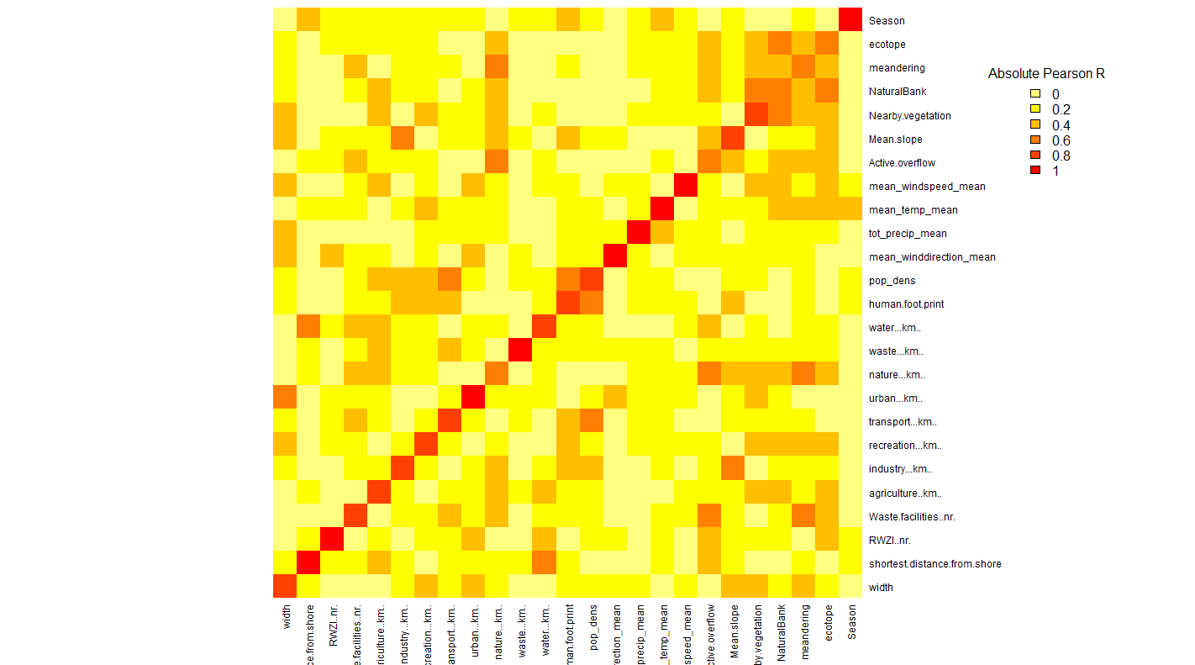

Slide 21
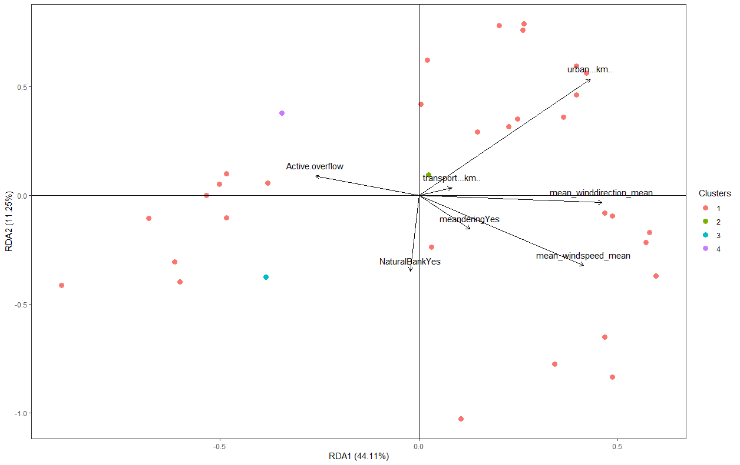

Slide 22
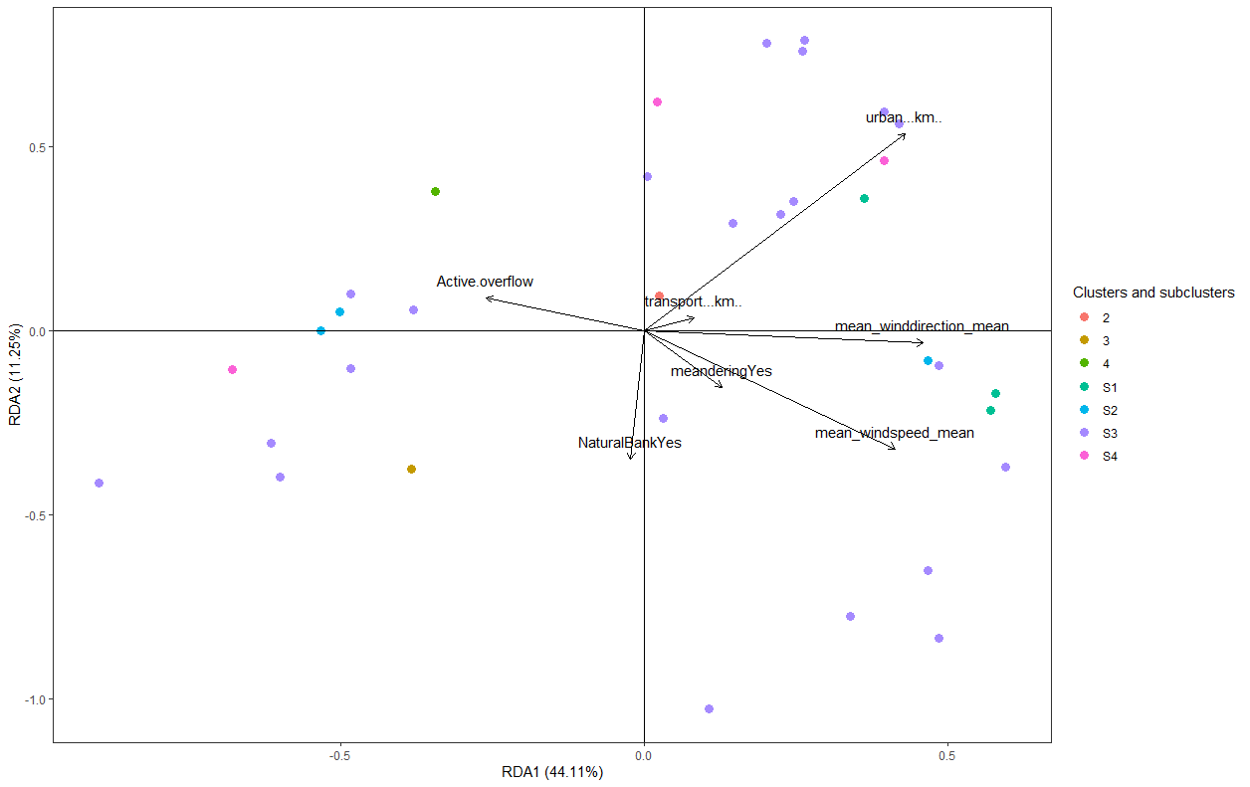

Slide 23
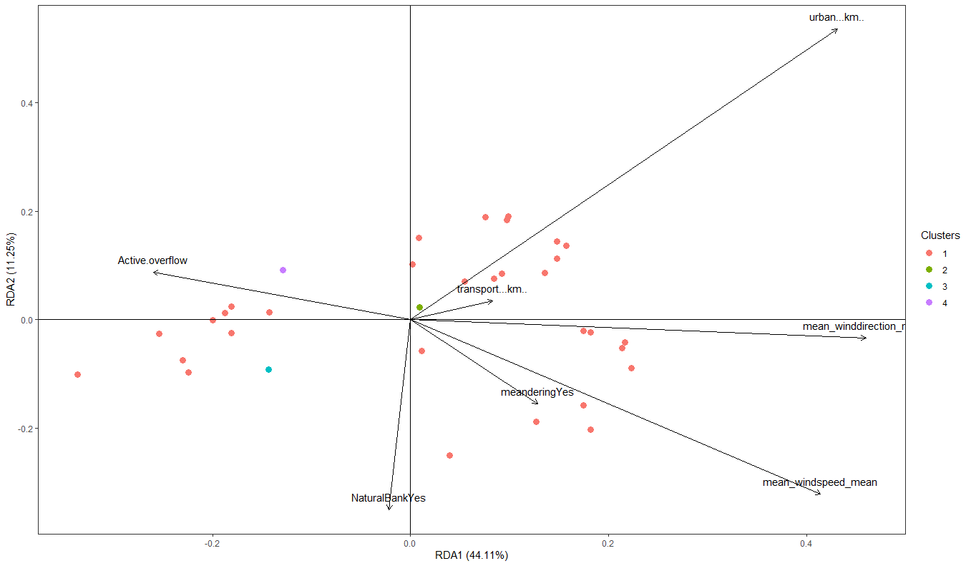
Notes:
Scaling 1

Slide 24
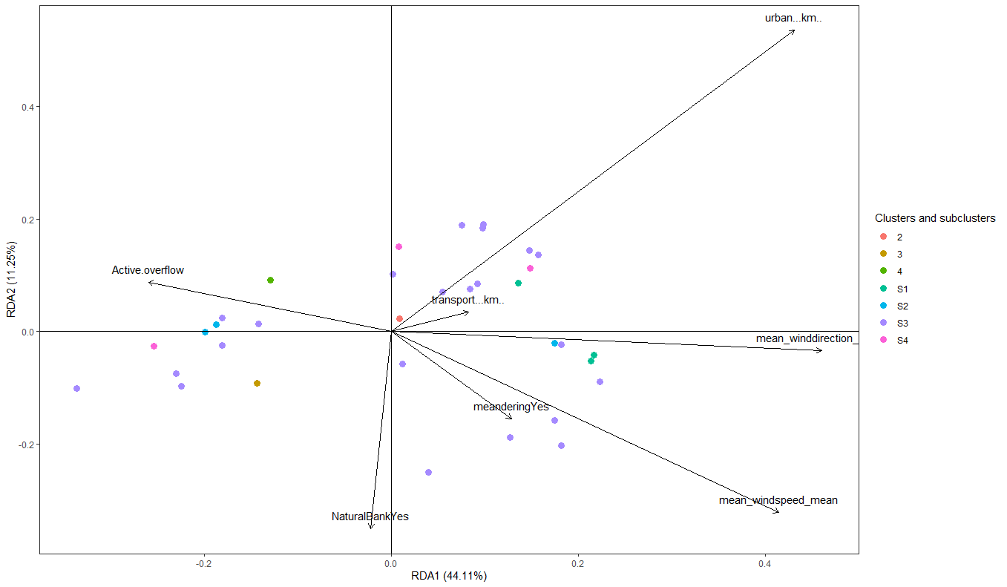
Notes:
Scaling1

Slide 25
Micro_SED

Slide 26
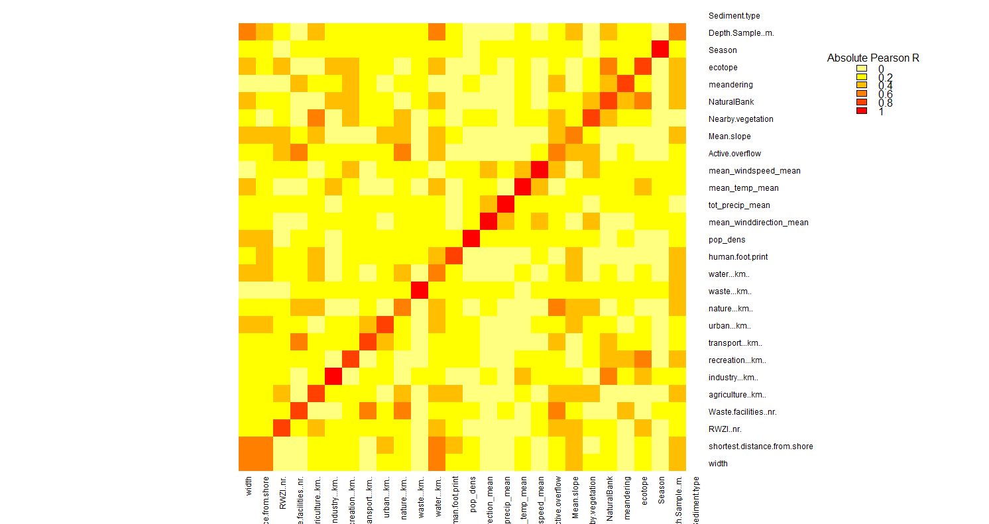

Slide 27
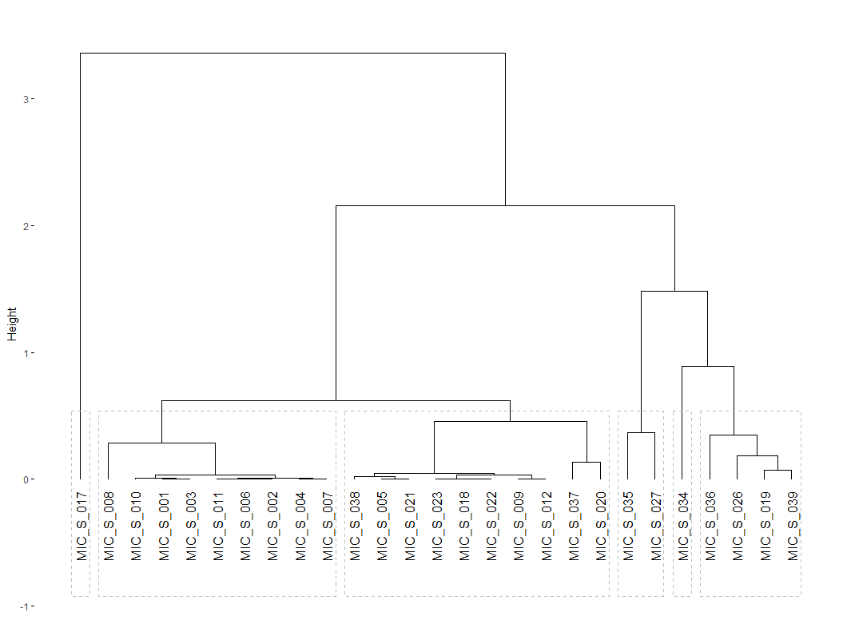

Slide 28
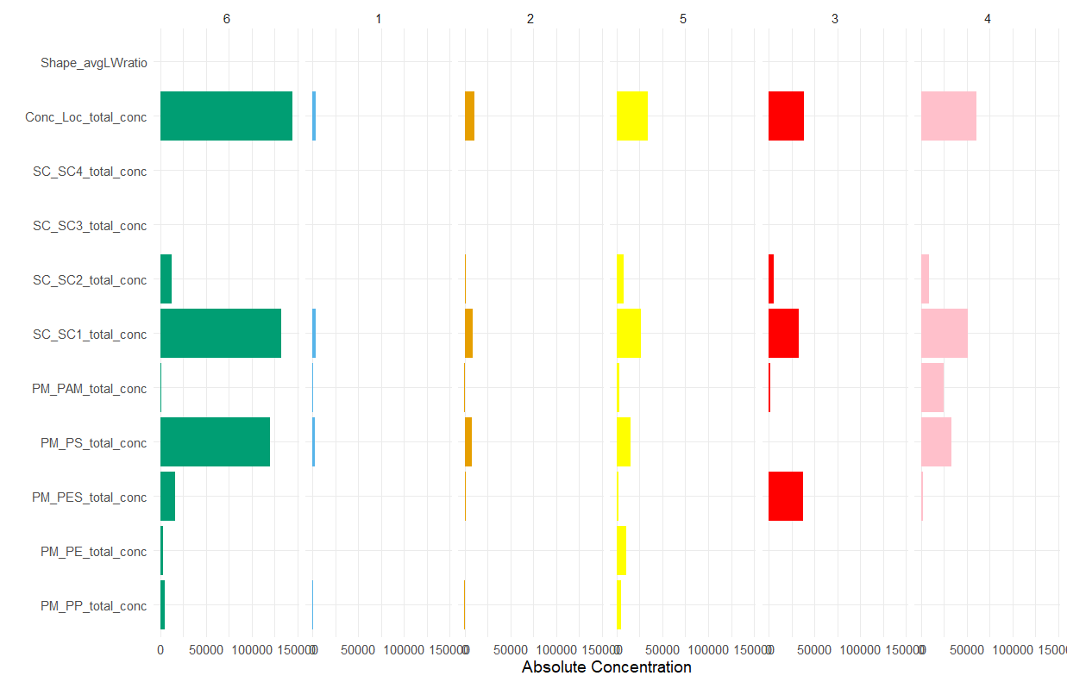

Slide 29
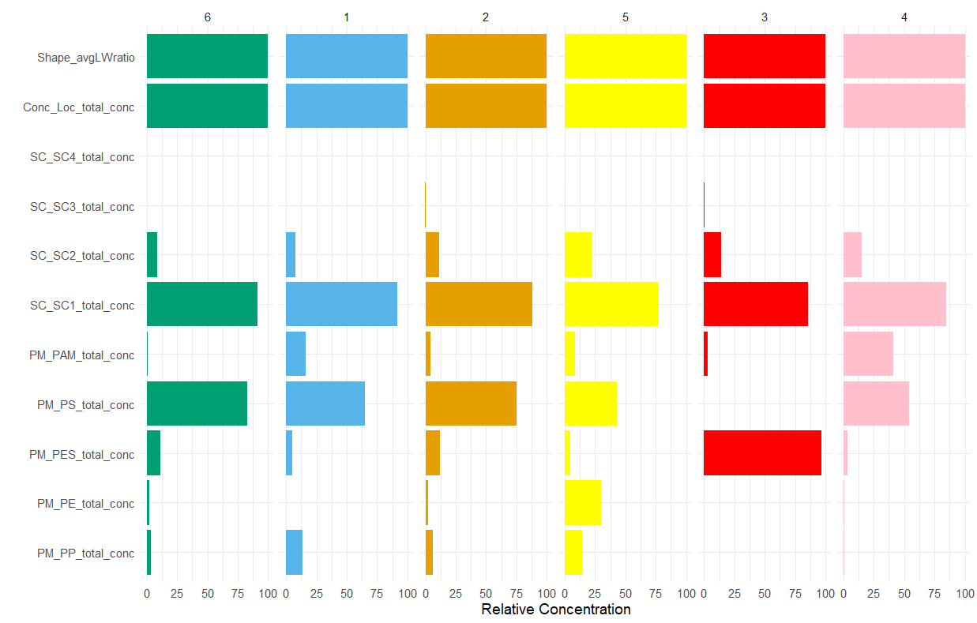

Slide 30
Cluster 5
Cluster 6
Cluster 1
Cluster 2
Cluster 3
Cluster 4

Slide 31
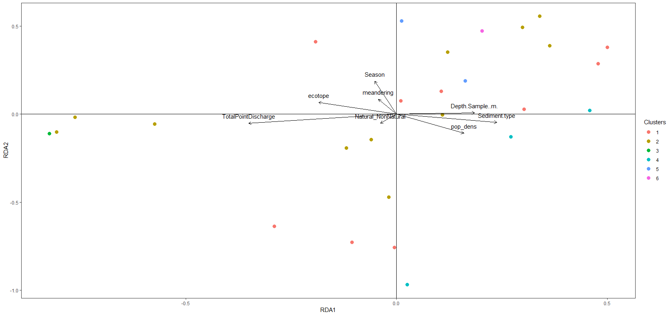
Notes:
Scaling 1

Slide 32
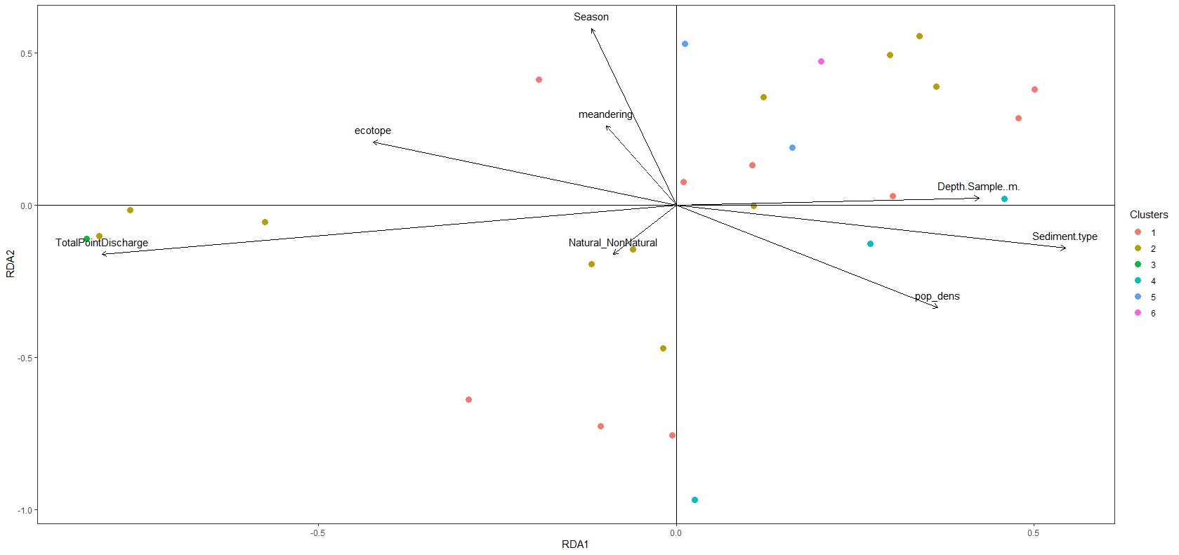
Notes:
Scaling 2

