Slide 1
Application of the ADMM Algorithm for a High-Dimensional Partially Linear Model
BY:
KIRUTHIKA K - CB.SC.U4AIE24329
M MITHUL PRANAV - CB.SC.U4AIE24331
MAALIKA P - CB.SC.U4AIE24332
RITHAN S - CB.SC.U4AIE24348

Slide 2
Introduction

Slide 3
Partially linear models
Parametric (Linear) Part: The term X T β is a standard linear regression component. X represents the variables that are assumed to have a straightforward linear relationship with the response variable Y, and β is the vector of coefficients for those variables. This part of the model is easy to interpret; each coefficient in β represents the change in Y for a one-unit change in the corresponding variable in X.
Non-Parametric (Non-Linear) Part: The term B T γ models the variables that have a more complex, non-linear relationship with the response Y. Instead of assuming a straight-line effect, this part allows the model to learn an arbitrary smooth function from the data. To do this, the paper uses a
B-spline basis function approach, where the unknown function is approximated by a weighted sum of B-spline basis functions, represented by the matrix B. The vector γ contains the spline coefficients that are estimated from the data.
Error Term (ϵ): This represents the random, unexplained variation in the data.

Slide 4
Problem Statement

Slide 5
The primary challenge is to effectively estimate a model in a high-dimensional setting, where the number of variables (p) is much larger than the number of data samples (n).
The problem requires a method that can simultaneously estimate both the parametric (linear) coefficients and the non-parametric (non-linear) function within a partially linear model.
The estimation must also incorporate linear constraints on the model's parameters to improve accuracy and reflect prior knowledge of the system.

Slide 6
Objectives

Slide 7
To develop an efficient and accurate method for estimating both the parametric (linear) coefficients and the non-parametric (non-linear) function in a high-dimensional partially linear model.
To achieve this by applying the ADMM algorithm to solve the model's constrained optimization problem, which is transformed into an unconstrained problem using an augmented Lagrangian function.
To provide a theoretical guarantee for the method by proving the convergence of the algorithm to the optimal solution using a variational inequality framework.

Slide 8
Dataset Description

Slide 9
CPS 1985 Dataset (for the Partially Linear Model)
This dataset is from the 1985 Current Population Survey (CPS85) and is used in the provided research paper to analyse the factors that determine workers' wages. It contains 534 samples with 11 variables related to workers' characteristics.
The dataset is structured for a partially linear model as follows:
Response Variable (Y): The natural logarithm of the worker's wage, used to stabilise variance and reduce the effect of outliers.
Non-Parametric Variable (U): The worker's years of experience, as its effect on wages is not assumed to be strictly linear.
Parametric Variables (X): A set of other characteristics assumed to have a linear relationship with log-wages, including:
Years of education
Age,
Gender,
Race,
Union membership,
Marital status
Occupation
Sector

Slide 10
Wine Quality Datasets (Red and White)
These two datasets, one for red wine and one for white wine, are used for predicting wine quality based on physicochemical tests. The data comes from Portuguese "Vinho Verde" wines. The quality is rated on a scale from 0 (very bad) to 10 (excellent) by wine experts.
Both datasets share the same set of 11 input variables:
Fixed Acidity: Non-volatile acids that don't evaporate easily.
Volatile Acidity: High levels can lead to an unpleasant, vinegar-like taste.
Citric Acid: Can add freshness and flavor.
Residual Sugar: The amount of sugar left after fermentation stops.
Chlorides: The amount of salt in the wine.
Free Sulfur Dioxide and Total Sulfur Dioxide: Prevent microbial growth and oxidation.
Density: An indicator of the wine's alcohol and sugar content.
pH: Describes the acidity or basicity of the wine.
Sulphates: A wine additive that can contribute to sulfur dioxide levels.
Alcohol: The percentage of alcohol content.

Slide 11
Methodology

Slide 12
B-Spline Function
A B-spline is a piecewise polynomial function defined by a set of basis functions that are combined to approximate a smooth curve through a dataset.
Key components of a B-spline:
Degree: The degree of the polynomial segments (e.g., degree 2 for quadratic, degree 3 for cubic).
Knots: Points that divide the domain into intervals where polynomial segments are defined. Knots can be uniformly or non-uniformly spaced.
Basis Functions: Localized functions that are non-zero only over a small range of the domain, defined by the knots and degree. The B-spline curve is a weighted sum of these basis functions.
Control Points or Coefficients: Weights (gamma in the code) that determine the contribution of each basis function to the final curve.

Slide 13

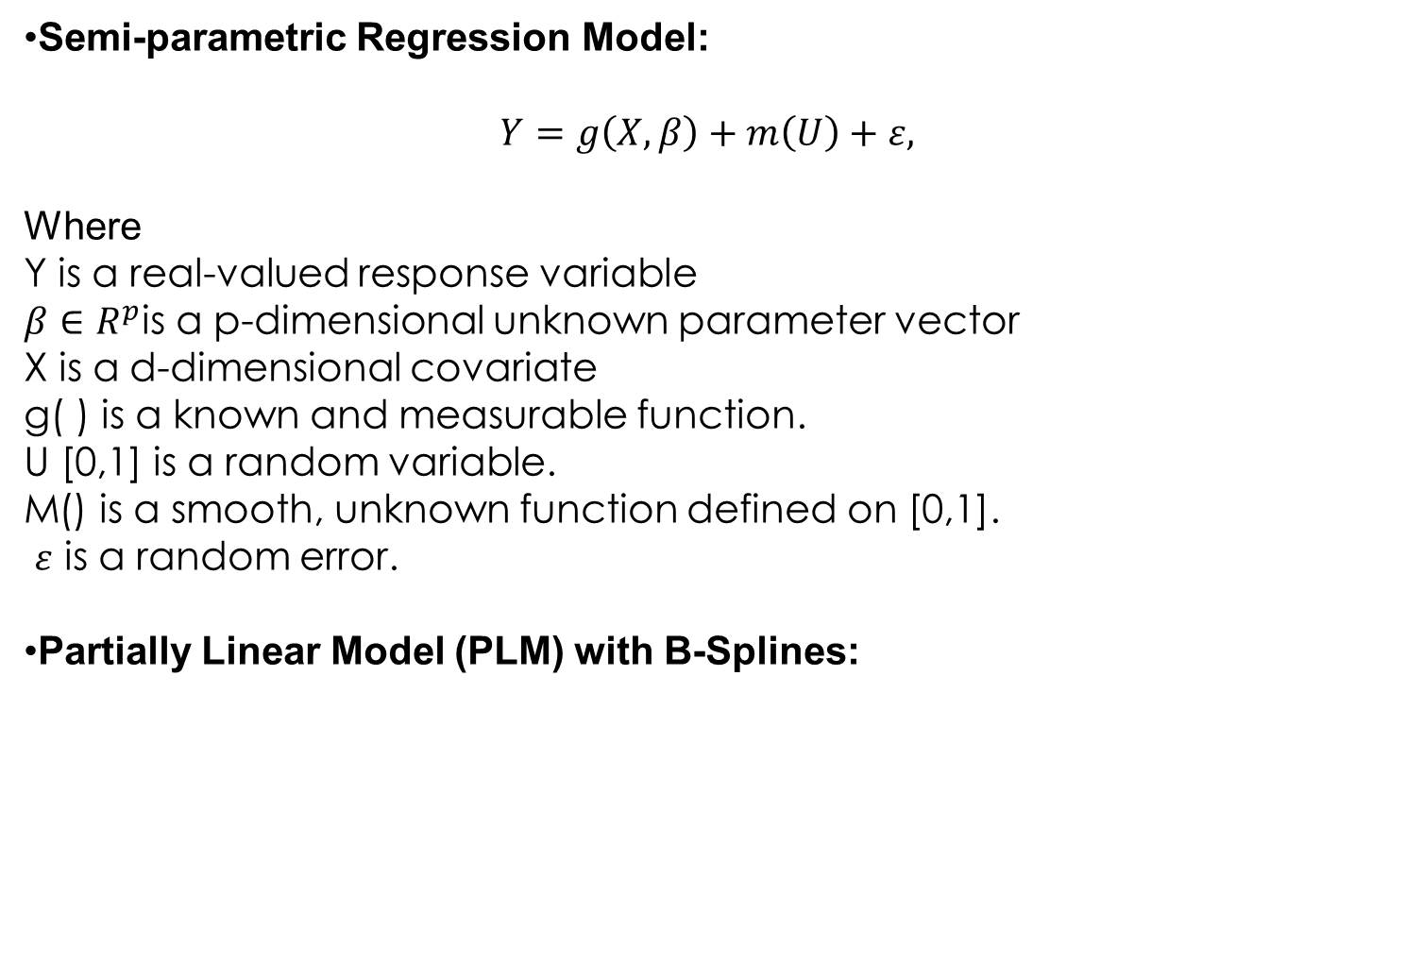
Model and Optimization Equations
Semi-parametric Regression Model:
$$Y=g\left(X,β\right)+m\left(U\right)+ε,$$
Where
Y is a real-valued response variable
$β∈R^{p}$is a p-dimensional unknown parameter vector
X is a d-dimensional covariate
g( ) is a known and measurable function.
U [0,1] is a random variable.
M() is a smooth, unknown function defined on [0,1].
$ε$ is a random error.
Partially Linear Model (PLM) with B-Splines:
$$Y=X^{T}β+B^{T}γ+ε$$

Slide 14
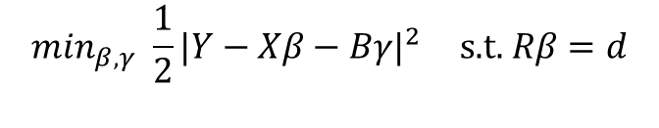

Approximated Model for an Individual Sample:
$$Y_{i}=X_{i}^{T}β+B{\left(Z_{i}\right)}^{T}γ+ε_{i}$$
Optimization Equation:
$$min_{β,γ} \frac{1}{2}|Y−Xβ−Bγ|^{2} \text{s}\text{.}\text{t}\text{. }Rβ=d$$

Slide 15


ADMM Update Equations
Update equation for beta
$$ℒ_{ρ}\left(β\right)=\frac{1}{2}|Y−Xβ−Bγ^{n+1}|^{2}+\left\langle λ^{n},Rβ−d\right\rangle +\frac{ρ}{2}|Rβ−d|^{2}$$
$$∇_{βℒ_{ρ}}=−X^{⊤}\left(Y−Xβ−Bγ^{n+1}\right)+R^{⊤}λ^{n}+ρR^{⊤}\left(Rβ−d\right)$$
$$∇_{βℒ_{ρ}}=0 ⇒ \left(X^{⊤}X+ρR^{⊤}R\right)β=X^{⊤}\left(Y−Bγ^{ n+1}\right)+R^{⊤}\left(ρd−λ^{n}\right)$$
$$β^{ n+1}={\left(X^{⊤}X+ρR^{⊤}R\right)}^{−1}\left[X^{⊤}\left(Y−Bγ^{n+1}\right)+R^{⊤}\left(ρd−λ^{n}\right)\right]$$
Update equation for gamma:

Slide 16

$$γ^{n+1}=\arg{\min_{γ}\left\{\frac{1}{2}|Y−Xβ^{n}−Bγ|^{2}\right\}}$$
$$\frac{∂L_{p}\left(β,γ,λ\right)}{∂γ}=−B\left(Y−Xβ^{n}−Bγ\right)=0$$
$$γ^{n+1}={\left(B^{T}B\right)}^{−1}B^{T}\left(Y−Xβ^{n}\right)$$
Update equation for lambda
$$\dot{λ^{n+1}}=λ^{n}+ρ\left(Rβ^{n+1}−\dot{d}\right)$$

Slide 17
Workflow

Slide 18
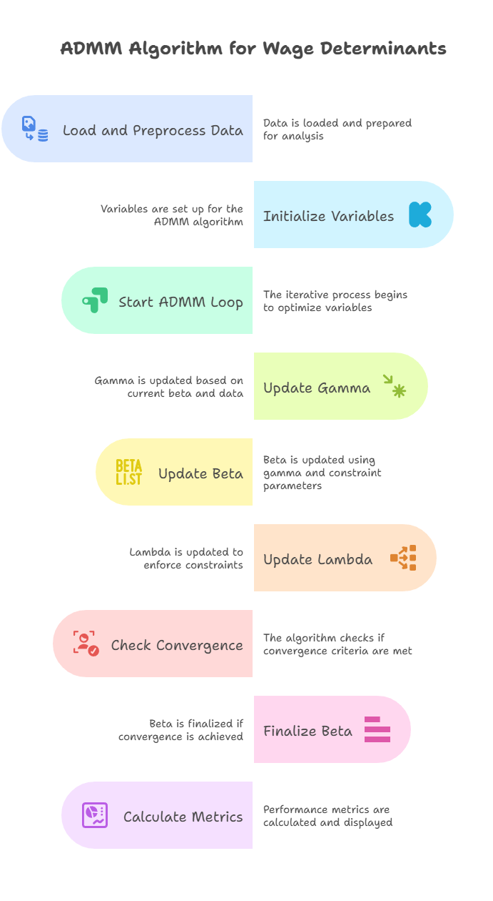

Slide 19
Results

Slide 20
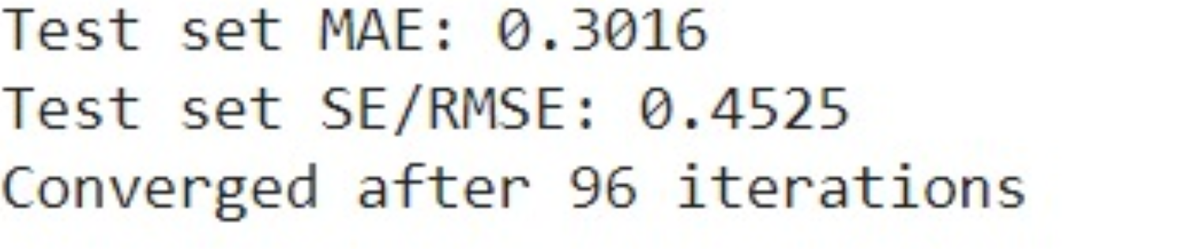
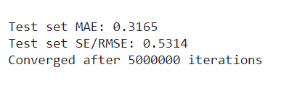
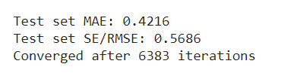
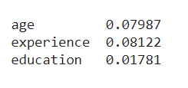
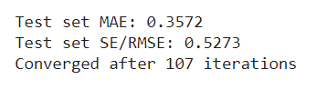
CPS85 Wage Data
Linear and Non-Linear(Experience)
All Variables as Linear
Experience, Age and Education as Non-Linear
Degree of Non-Linearity
Linear and Non-Linear(age)

Slide 21
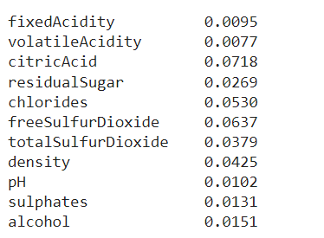
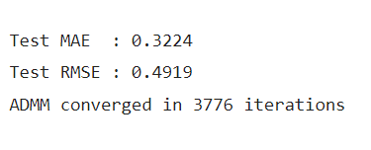
Red Wine Dataset
All Variables of Linear
Degre of Non-Linearity

Slide 22
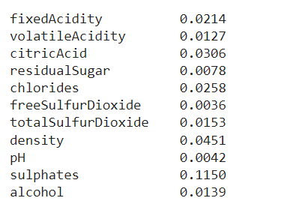

White Wine dataset
All Variables of Linear
Degree of Non-Linearity

Slide 23
Conclusion
A partially linear model with a restricted profile and used the least squares method to estimate the parameters to minimize the error. By constructing an augmented Lagrangian function under linear constraint conditions, the constrained optimization problem was transformed into an unconstrained optimization problem. The model was solved with the ADMM. The ADMM algorithm has the advantage that some large global problems can be solved by decomposing them into several smaller, more easily solvable local problems and then coordinating the solutions of the resulting subproblems to obtain the solution of the large global problem.

Slide 24
Thank You

