Slide 1

Introduction
Work-Life Balance is the equilibrium between personal and professional life.

Slide 2

Importance of Work life balance
Maintaining a work-life balance is essential for physical and mental well-being

Slide 3
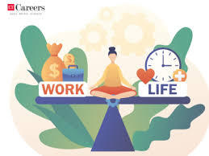
Strategies for achieving work life balance
Effective time management, setting boundaries and prioritizing tasks are key strategies

Slide 4
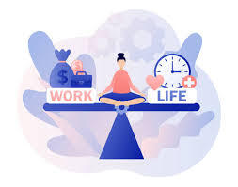
Benefits of Work Life Balance
Enhanced productivity, reduced stress and improved relationships are some of the great benefits to achieve.

Slide 5

Conclusion
Achieving work-life balance leads to a happier and fulfilling life.

