Slide 1

Learning R the hard way
Maani Beigy, MD-MPH

Slide 2

HELLO!
I am Maani Beigy
Who R U ?

Slide 3

Introduction
Why R?

Slide 4
Introduction: excellent
free
available
Open-source
importing and
manipulating
data
reproducible
research
packages
statistical modelling
machine learning
visualization

Slide 5
Introduction: excellent
fantastic community
Cutting edge tools
functional programming
integrated development environment (IDE)
RSTUDIO
create interactive websites:
Shiny
Writing
apps
Metaprogramming facilities
domain-specific languages (DSL)
SQL, mongoDB, C, C++

Slide 6
Introduction: bad
Much of the R code
more focused on results
Inconsistency
Lots of changes
Metaprogramming
a double-edged sword
profligate user
of memory
poorly written R code
can be terribly slow

Slide 7
Introduction:
Data Science
Subject Matter Expertise
Traditional Software
(Danger Zone)
Traditional Research
Math & Statistics
Computer Science
Data Science
Unicorn
Machine Learning

Slide 8
Goals
Part 1
To provide an introduction to R software environment and programming
Part 2
To provide a hands-on experience with R statistical analyses
</>

Slide 9
Part 1
</>
R software environment and programming

Slide 10
What is R?
Programming language and software environment for statistical computing and graphics
Widely used among statisticians and data scientists
  Excellent statistical facilities
Nearly everything you may need in terms of statistics has already been programmed and made available in R
  either as part of the main packages or as a user-contributed packages

Slide 11
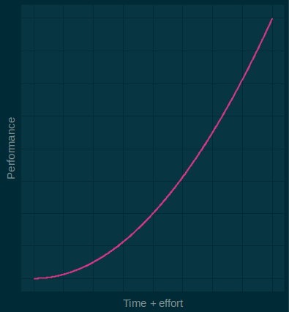
Learning R
R has a steep learning curve

Slide 12
History of R
R is an implementation of S programming language.
S was created by John Chambers in 1976 at Bell Labs.
R: Open source platform similar to S developed by Robert Gentleman and Ross Ihaka (U of Auckland) during the 1990s.
Since 1997, R has been developed by the R Development Core Team.

Slide 13
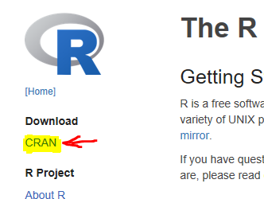
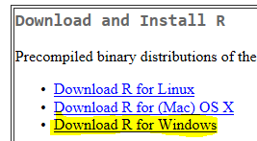
Download R
To obtain and install R on your computer:
  Go to the R homepage https://www.r-project.org/
  Click CRAN under Download
  Choose a “mirror site”
  Click Download R for Windows
  Click base
  Click Download R 3.5.2 for Windows
Note: Updated versions of R are available every few months.

Slide 14
Install and Use R
To install R click the downloaded file. The simplest procedure is to accept all default settings.
After installation, the R icon will appear on your desktop.
Lunch R by double-clicking the icon.
You will see the following R Windows

Slide 15
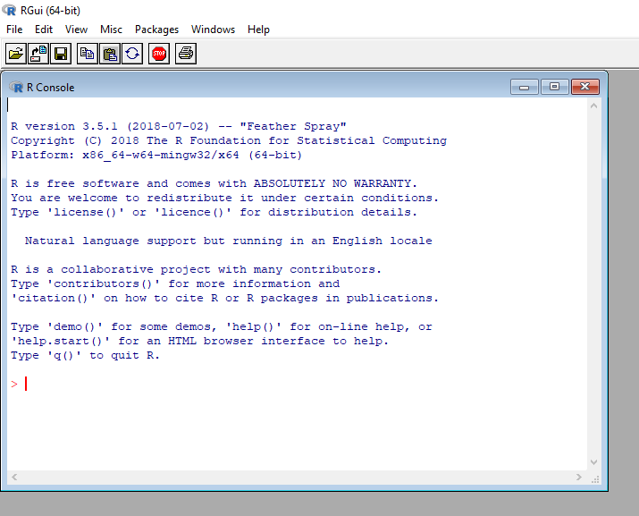
Install and Use R
Please type the following commands on R console and see what happens:
  citation()

Slide 16
Install and Use RStudio
Say

Slide 17
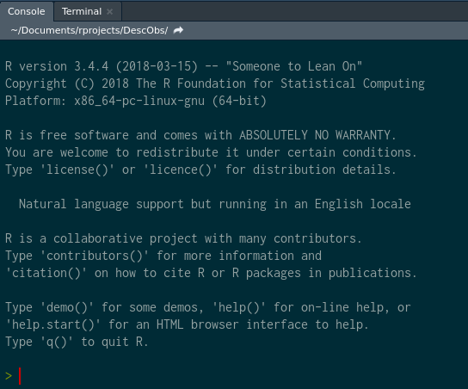
Install and Use RStudio

Slide 18
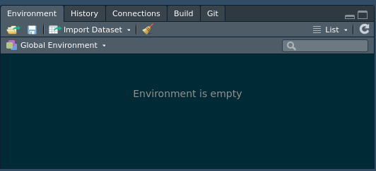
Install and Use RStudio

Slide 19
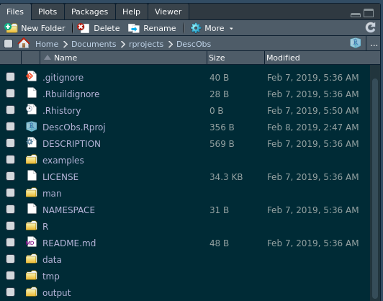
Install and Use RStudio

Slide 20
Hello World!
> print("hello world")
[1] "hello world"

Slide 21
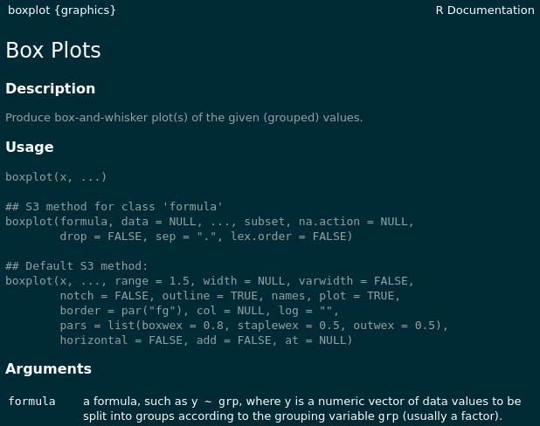
help("")
help("boxplot") or simply ?boxplot

Slide 22
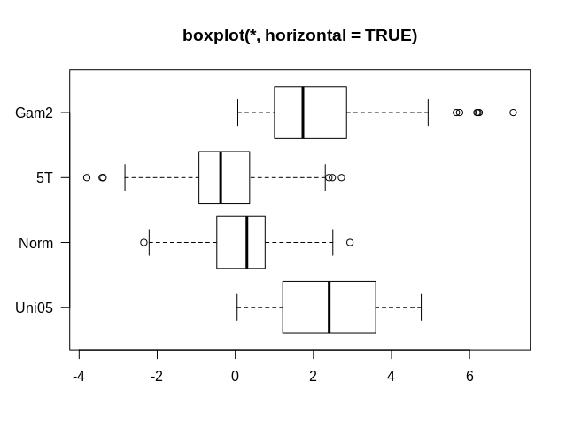
example("")
example("boxplot")

Slide 23
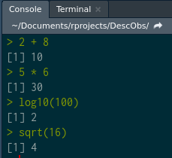
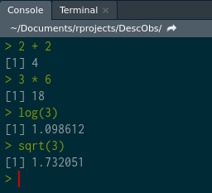
Typing Commands
?Arithmetic

Slide 24
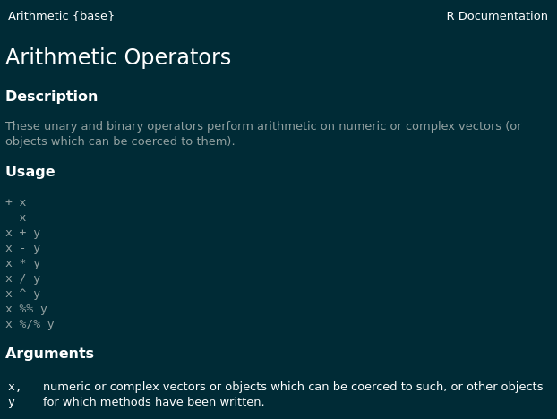
Typing Commands

Slide 25
Typing Commands
quotient and remainder
To determine the quotient and remainder of a division, use the floor division and modulo operators, respectively
> 20 %/% 6 # quotient by floor division (%/%)
[1] 3
> 20 %% 6 # remainder by modulo (%%)
[1] 2

Slide 26
Assignment Operation
To assign a value to a variable use <- not =
> weight <- 72
> weight
[1] 72
To assign within a function use =
> mean(x = 1:100, na.rm = TRUE)
[1] 50.5

Slide 27
Assignment Example
> weight <- 72
> height <- 182
> BMI <- (weight)/(height/100)^2
> BMI
[1] 21.73651
> bmi
Error: object 'bmi' not found

Slide 28
Functions (if else)
Write a function for BMI
> BMI <- function(weight, height) {
if (height > 2.5) {
stop('height is not in meters')
} else (weight)/(height)^2
}

Slide 29
Data structures
dim | Homogeneous | Heterogeneous
1d | Atomic Vector | List
2d | Matrix | Data frame
nd | Array

Slide 30
Data structures:
Atomic Vector
> a <- 8.4
> b <- "foo"
> str(a)
num 8.4
> str(b)
chr "foo"
> class(a)
[1] "numeric"
> class(b)
[1] "character"
> typeof(a)
[1] "double"
> typeof(b)
[1] "character"

Slide 31
Data structures:
Atomic Vector
Atomic vectors are usually created with c(), short for combine:
> dbl_var <- c(1, 2.5, 4.5)
# With the L suffix, you get an integer rather than a double
> int_var <- c(1L, 6L, 10L)
# Use TRUE and FALSE (or T and F) to create logical vectors
> log_var <- c(TRUE, FALSE, T, F)
> chr_var <- c("foo", "bar")

Slide 32
Data structures:
Atomic Vector: is.atomic()
> dbl_var <- c(1, 2.5, 4.5)
> typeof(dbl_var)
[1] "double"
> int_var <- c(1L, 6L, 10L)
> typeof(int_var)
[1] "integer"
> log_var <- c(TRUE, FALSE, T, F)
> typeof(log_var)
[1] "logical"
> chr_var <- c("foo", "bar")
> typeof(chr_var)
[1] "character"

Slide 33
Data structures:
Numeric Vector
> is.numeric(dbl_var)
[1] TRUE
> is.double(dbl_var)
[1] TRUE
> is.integer(dbl_var)
[1] FALSE
> is.numeric(int_var)
[1] TRUE
> is.integer(int_var)
[1] TRUE
> is.atomic(int_var)
[1] TRUE

Slide 34
Data structures:
Coercion
> c <- c("a", 1)
> str(c)
chr [1:2] "a" "1"
> is.vector(c)
[1] TRUE
> is.atomic(c)
[1] TRUE
> is.character(c)
[1] TRUE
> is.factor(c)
[1] FALSE

Slide 35
Data structures
dim | Homogeneous | Heterogeneous
1d | Atomic Vector | List
2d | Matrix | Data frame
nd | Array

Slide 36
Data structures:
Lists or Recursive Vector
You construct lists by using list()
> d <- list(
1:10,
"foo",
c(TRUE, FALSE, TRUE, TRUE),
C(7.2, 16.8)
)
> str(d)
List of 4
$ : int [1:10] 1 2 3 4 5 6 7 8 9 10
$ : chr "foo"
$ : logi [1:4] TRUE FALSE TRUE TRUE
$ : num [1:2] 7.2 16.8

Slide 37
Data structures:
Lists or Recursive Vector
> e <- list(list(list(list(1:10))))
> e <- list(
list(
list(
list(
1:10
)
)
)
)

Slide 38
Data structures:
Lists or Recursive Vector
> str(e)
List of 1
$ :List of 1
..$ :List of 1
.. ..$ :List of 1
.. .. ..$ : int [1:10] 1 2 3 4 5 6 7 8 9 10

Slide 39
Data structures:
Lists or Recursive Vector
> f <- list(
"foo", list(
"bar", list(
"spam", list(
"eggs", 1:10
)
)
)
)

Slide 40
Data structures:
Lists or Recursive Vector
> str(f)
List of 2
$ : chr "foo"
$ :List of 2
..$ : chr "bar"
..$ :List of 2
.. ..$ : chr "spam"
.. ..$ :List of 2
.. .. ..$ : chr "eggs"
.. .. ..$ : int [1:10] 1 2 3 4 5 6 7 8 9 10

Slide 41
Data structures:
Lists or Recursive Vector
> is.vector(f)
[1] TRUE
> is.atomic(f)
[1] FALSE
> is.recursive(f)
[1] TRUE
> is.list(f)
[1] TRUE

Slide 42
Data structures:
Coercion
> g <- list(
list(1, 2),
c(3, 4)
)
> h <- c(
list(1, 2),
c(3, 4)
)
What is the difference?

Slide 43
Objects
R can be written as
  Object Oriented Programming (OOP)
To list all objects in your current workspace
> ls()
[1] "a" "b" "BMI" "c" "chr_var" "d" "dbl_var" "e" "f"
[10] "g" "h" "height" "int_var" "log_var" "weight" "x" "y
To remove some objects that are no longer needed :
> rm(height, weight)
> ls()
[1] "a" "b" "BMI" "c" "chr_var" "d" "dbl_var" "e" "f"
[10] "g" "h" "int_var" "log_var" "x" "y"

Slide 44
Attributes
All objects can have arbitrary additional attributes
  used to store metadata about the object
Use structure() function to return a new object with modified attributes
> i <- structure(
.Data = 1:10,
description = "This is a vector",
label = "id of people"
)

Slide 45
Attributes ...
> i
[1] 1 2 3 4 5 6 7 8 9 10
attr(,"description")
[1] "This is a vector"
attr(,"label")
[1] "id of people"
> str(i)
atomic [1:10] 1 2 3 4 5 6 7 8 9 10
- attr(*, "description")= chr "This is a vector"
- attr(*, "label")= chr "id of people"
> typeof(i)
[1] "integer

Slide 46
Attributes ...
> attr(i, "label")
[1] "id of people"
> attributes(i)
$description
[1] "This is a vector"
$label
[1] "id of people"

Slide 47
Attributes ...
Stable attributes
  Names
    a character vector giving each element a name
  Dimensions
    used to turn vectors into matrices and arrays
  Class
    used to implement the S3 object system

Slide 48
Names
> k <- structure(
.Data = 1:4,
"names" = c("a", "b", "c", "d")
)
> k
a b c d
1 2 3 4
> str(k)
Named int [1:4] 1 2 3 4
- attr(*, "names")= chr [1:4] "a" "b" "c" "d"
> typeof(k)
[1] "integer"

Slide 49
Names ...
> l <- c(
a = 1, b = 2, c = 3, d = 4
)
> l
a b c d
1 2 3 4
> str(l)
Named num [1:4] 1 2 3 4
- attr(*, "names")= chr [1:4] "a" "b" "c" "d"
> typeof(l)
[1] "double"
> names(l)
[1] "a" "b" "c" "d"

Slide 50
Factors
One important use of attributes is to define factors.
A factor is a vector that can contain only predefined values
  used to store categorical data.
Factors are built on top of integer vectors using two attributes:
  the class “factor”
    which makes them behave differently from regular integer vectors
  the levels
    which defines the set of allowed values.

Slide 51
Factors ...
> m <- factor(
x = c(0, 1, 0, 0, 0, 1, 1, 1, 0, 1, 0, 1, 0),
levels = c(0, 1),
labels = c("male", "female")
)
> class(m)
[1] "factor"
> typeof(m)
[1] "integer"
> str(m)
Factor w/ 2 levels "male","female": 1 2 1 1 1 2 2 2 1 2 ...
> summary(m)
male female
7 6

Slide 52
Dimensions
> n <- structure(
.Data = 1:10,
"dim" = c(2, 5),
"dimnames" = list(
c("foo", "bar"), c("a", "b", "c", "d", "e")
)
)
> n
a b c d e
foo 1 3 5 7 9
bar 2 4 6 8 10
> class(n)
[1] "matrix"
> typeof(n)
[1] "integer"

Slide 53
Data structures
dim | Homogeneous | Heterogeneous
1d | Atomic Vector | List
2d | Matrix | Data frame
nd | Array

Slide 54
Matrices and arrays
Adding a "dim" attribute to an atomic vector
  allows it to behave like a multi-dimensional array.
A special case of the array is the matrix,
  which has 2 dimensions.
# Two scalar arguments to specify rows and columns
> o <- matrix(1:6, ncol = 3, nrow = 2)
# One vector argument to describe all dimensions
> p <- array(1:12, c(2, 3, 2))

Slide 55
Matrices and arrays ...
# Two scalar arguments to specify rows and columns
> o <- matrix(1:6, ncol = 3, nrow = 2)
# One vector argument to describe all dimensions
> p <- array(1:12, c(2, 3, 2))
> o
[,1] [,2] [,3]
[1,] 1 3 5
[2,] 2 4 6
> p
, , 1
[,1] [,2] [,3]
[1,] 1 3 5
[2,] 2 4 6
, , 2
[,1] [,2] [,3]
[1,] 7 9 11
[2,] 8 10 12

Slide 56
Matrices and arrays ...
> o <- matrix(1:6, ncol = 3, nrow = 2)
> dim(o) # gets the dimensions of matrix o
[1] 2 3
> o[2,1] # subsets the item in row 2, column 1
[1] 2
> o[2,] # subsets all items in row 2
[1] 2 4 6
> t(o) # transposes matrix o
[,1] [,2]
[1,] 1 2
[2,] 3 4
[3,] 5 6
> o %*% t(o) # multiplies matrix o by its transpose
[,1] [,2]
[1,] 35 44
[2,] 44 56

Slide 57
Data structures
dim | Homogeneous | Heterogeneous
1d | Atomic Vector | List
2d | Matrix | Data frame
nd | Array

Slide 58
Data frames
A data frame is
  the most common way of storing data in R
  a list of equal-length vectors
  2-dimensional structure
  shares properties of both matrix and list
Create a data frame using data.frame()
  which takes named vectors as input
> df <- data.frame(
id = 1:3,
gender = c("m", "f", "m"),
fbs = c(104, 98, 129)
)
> str(df)
'data.frame': 3 obs. of 3 variables:
$ id : int 1 2 3
$ gender: Factor w/ 2 levels "f","m": 2 1 2
$ fbs : num 104 98 129

Slide 59
Data frames ...
> df
id gender fbs
1 1 m 104
2 2 f 98
3 3 m 129
> class(df)
[1] "data.frame"
> typeof(df)
[1] "list"

Slide 60
Import Data frames
import/export requires addressing
Make a config.R in project’s directory
  Linux
> dir <- "/home/maanib/Documents/rprojects/teacheR"
  Windows
> dir <- "E:\\Archive\\maanib\\rprojects\\teacheR"
> source(config.R)
> df <- read.csv( # comma separated text
file = paste0( # the string concatenate function
dir, # the directory address of project files
"/data/df.csv" # the relative address
),
fileEncoding = "UTF-8",
header = TRUE # column names
)

Slide 61
Import Data frames ...
> source(config.R)
> df <- read.table( # plain text document
file = paste0(dir, "/data/df.txt"),
fileEncoding = "UTF-8",
header = TRUE # column names
)

Slide 62
Export Data frames
> source(config.R)
> write.csv( # comma separated text
x = df,
file = paste0(dir, "/output/df.csv"),
fileEncoding = "UTF-8"
)
> write.table( # plain text document
x = df,
file = paste0(dir, "/output/df.txt"),
fileEncoding = "UTF-8",
sep = "|", # separator character
col.names = TRUE # column names
)

Slide 63
Introduction: Why R?
Say something to me
Yellow (181 137 0) #b58900
Orange (203 75 22) #cb4b16
Red (220 50 47) #dc322f
Magenta (211 54 130) #d33682
Violet (108 113 196) #6c71c4
Blue (38 139 210) #268bd2
Cyan (42 161 152) #2aa198
Green (133 153 0) #85900
`

Slide 64
INSTRUCTIONS FOR USE
EDIT IN GOOGLE SLIDES
Click on the button under the presentation preview that says "Use as Google Slides Theme".
You will get a copy of this document on your Google Drive and will be able to edit, add or delete slides.
You have to be signed in to your Google account.
EDIT IN POWERPOINT®
Click on the button under the presentation preview that says "Download as PowerPoint template". You will get a .pptx file that you can edit in PowerPoint.
Remember to download and install the fonts used in this presentation (you’ll find the links to the font files needed in the Presentation design slide)
More info on how to use this template at www.slidescarnival.com/help-use-presentation-template
This template is free to use under Creative Commons Attribution license. You can keep the Credits slide or mention SlidesCarnival and other resources used in a slide footer.

Slide 65
Quotations are commonly printed as a means of inspiration and to invoke philosophical thoughts from the reader.

Slide 66
YOU CAN ALSO SPLIT YOUR CONTENT
White
Is the color of milk and fresh snow, the color produced by the combination of all the colors of the visible spectrum.
Black
Is the color of coal, ebony, and of outer space. It is the darkest color, the result of the absence of or complete absorption of light.

Slide 67
IN TWO OR THREE COLUMNS
Yellow
Is the color of gold, butter and ripe lemons. In the spectrum of visible light, yellow is found between green and orange.
Blue
Is the colour of the clear sky and the deep sea. It is located between violet and green on the optical spectrum.
Red
Is the color of blood, and because of this it has historically been associated with sacrifice, danger and courage.

Slide 68

A PICTURE IS WORTH A THOUSAND WORDS
A complex idea can be conveyed with just a single still image, namely making it possible to absorb large amounts of data quickly.

Slide 69

Want big impact?
Use big image.

Slide 70
AND TABLES TO COMPARE DATA
 | A | B | C
Yellow | 10 | 20 | 7
Blue | 30 | 15 | 10
Orange | 5 | 24 | 16

Slide 71
MAPS
our office

Slide 72
89,526,124
Whoa! That’s a big number, aren’t you proud?

Slide 73
89,526,124$
185,244 users
100%
That’s a lot of money
And a lot of users
Total success!

Slide 74
OUR PROCESS IS EASY
first
second
last

Slide 75
LET’S REVIEW SOME CONCEPTS
Yellow
Is the color of gold, butter and ripe lemons. In the spectrum of visible light, yellow is found between green and orange.
Blue
Is the colour of the clear sky and the deep sea. It is located between violet and green on the optical spectrum.
Red
Is the color of blood, and because of this it has historically been associated with sacrifice, danger and courage.
Yellow
Is the color of gold, butter and ripe lemons. In the spectrum of visible light, yellow is found between green and orange.
Blue
Is the colour of the clear sky and the deep sea. It is located between violet and green on the optical spectrum.
Red
Is the color of blood, and because of this it has historically been associated with sacrifice, danger and courage.

Slide 76
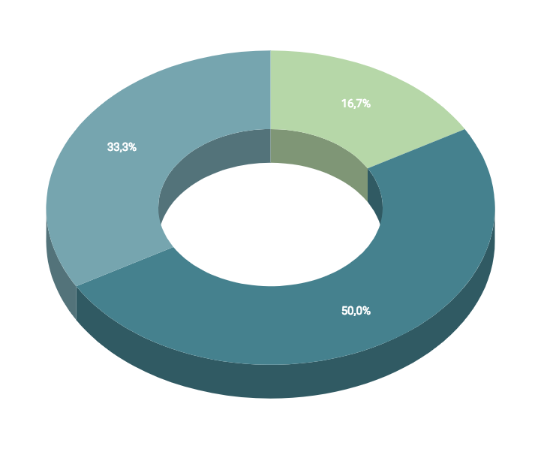
You can insert graphs from Google Sheets

Slide 77
ANDROID PROJECT
Show and explain your web, app or software projects using these gadget templates.
Place your screenshot here

Slide 78
iPHONE
PROJECT
Show and explain your web, app or software projects using these gadget templates.
Place your screenshot here

Slide 79
TABLET
PROJECT
Show and explain your web, app or software projects using these gadget templates.
Place your screenshot here

Slide 80
DESKTOP PROJECT
Show and explain your web, app or software projects using these gadget templates.
Place your screenshot here

Slide 81
THANKS!
Any questions?
You can find me at:
@username
user@mail.me

Slide 82
CREDITS
Special thanks to all the people who made and released these awesome resources for free:
Presentation template by SlidesCarnival
Photographs by Unsplash

Slide 83
PRESENTATION DESIGN
This presentation uses the following typographies and colors:
Titles: Dosis
Body copy: Titillium Web
You can download the fonts on these pages:
http://www.impallari.com/dosis
http://www.campivisivi.net/titillium/
Pastel green #d3ebd5 · Green #80bfb7 · Teal #0b87a1 · Navy #01597f · Dark navy #003b55
You don’t need to keep this slide in your presentation. It’s only here to serve you as a design guide if you need to create new slides or download the fonts to edit the presentation in PowerPoint®

Slide 84
SlidesCarnival icons are editable shapes.
This means that you can:
Resize them without losing quality.
Change fill color and opacity.
Change line color, width and style.
Isn’t that nice? :)
Examples:

Slide 85
😉
Now you can use any emoji as an icon!
And of course it resizes without losing quality and you can change the color.
How? Follow Google instructions https://twitter.com/googledocs/status/730087240156643328
✋👆👉👍👤👦👧👨👩👪💃🏃💑❤😂😉😋😒😭👶😸🐟🍒🍔💣📌📖🔨🎃🎈🎨🏈🏰🌏🔌🔑 and many more...

