Slide 1


Slide 2
About
Problem
Proposed Solution
Target Beneficiaries
Key Features
Deliverables/Outcomes
Why SWASTHJEEVAN Matters?
Prototype Image or Video

Slide 3
About
SwasthJeevan: Your Partner in Well-being Across Generations
SwasthJeevan provides comprehensive healthcare assistance to families in India, ensuring a smooth and supportive experience for all ages. We cater to the needs of young children, working adults, senior citizens, and NRIs, offering a helping hand throughout every stage of life.

Slide 4
Problem
In India, accessing quality healthcare services is often hindered by challenges such as
limited infrastructure,
long waiting times,
complex administrative procedures,
Expensive Treatment
particularly for those in rural areas or facing socioeconomic constraints.

Slide 5
Proposed Solution
SwasthJeevan acts as a single point of contact for families, offering a range of services to simplify healthcare experiences:
Hospital Checkup Assistance: We provide transportation, registration assistance, sample collection for tests, results collection, and even medication pick-up if needed.
Multilingual Support: Our team is fluent in Hindi and English, ensuring clear communication for all clients, regardless of their language background.
Technology Integration: We're exploring the development of a mobile application that allows clients to schedule appointments, track their healthcare journey, and access health information resources (in development, not currently available).

Slide 6
Target Beneficiaries
SwasthJeevan's services are designed to benefit a wide range of individuals and families in India:
Working Parents: We understand the time constraints faced by working parents. Our services alleviate the stress of managing hospital visits and childcare during medical needs.
Senior Citizens: We offer assistance with navigating the healthcare system, ensuring a safe and supported experience for elderly individuals.
Young Children: Our services ensure a comfortable and stress-free experience for young children during medical checkups.
NRIs: We provide guidance and support to NRIs seeking medical care in India, helping them bridge the gap in familiarity with the local healthcare system.

Slide 7
Key Features
Key Features:
Convenience: We take care of the logistics, allowing families to focus on their health and well-being.
Accessibility: We cater to all age groups and language preferences.
Reliability: We ensure trustworthy and professional service providers.
Transparency: We provide clear communication and keep families informed throughout the process.
Technology Integration (Future): Our website (under development) will further enhance accessibility and offer valuable resources.

Slide 8
Deliverables/Outcomes
Deliverables/Outcomes:
By utilizing SwasthJeevan's services, families can expect:
Reduced Stress: Our support minimizes the burden associated with healthcare logistics.
Improved Efficiency: We save families valuable time and streamline the healthcare experience.
Enhanced Well-being: We contribute to a more positive and stress-free healthcare journey for all.
Peace of Mind: Families can focus on their health knowing we're taking care of the details.

Slide 9
Why SWASTHJEEVAN Matters?
Millions Face Healthcare Gaps: Across India, millions lack access to quality healthcare, especially in rural areas where long wait times, limited facilities, and complex processes create barriers to timely medical attention. Swasth Jeevan bridges these gaps by leveraging technology to provide convenient access to healthcare services.
Beyond Location: Even in urban areas, certain demographics, such as the elderly, NRIs, and corporate employees, struggle to find personalized healthcare solutions. Swasth Jeevan caters to diverse needs, offering tailored care plans and seamless interactions with healthcare providers regardless of location.
Improved Health, Enhanced Lives: With Swasth Jeevan, quality healthcare becomes easily accessible, leading to significantly improved health outcomes for all. This translates to a healthier, happier, and more productive population, ultimately enhancing the overall well-being of individuals and communities across the nation."

Slide 10
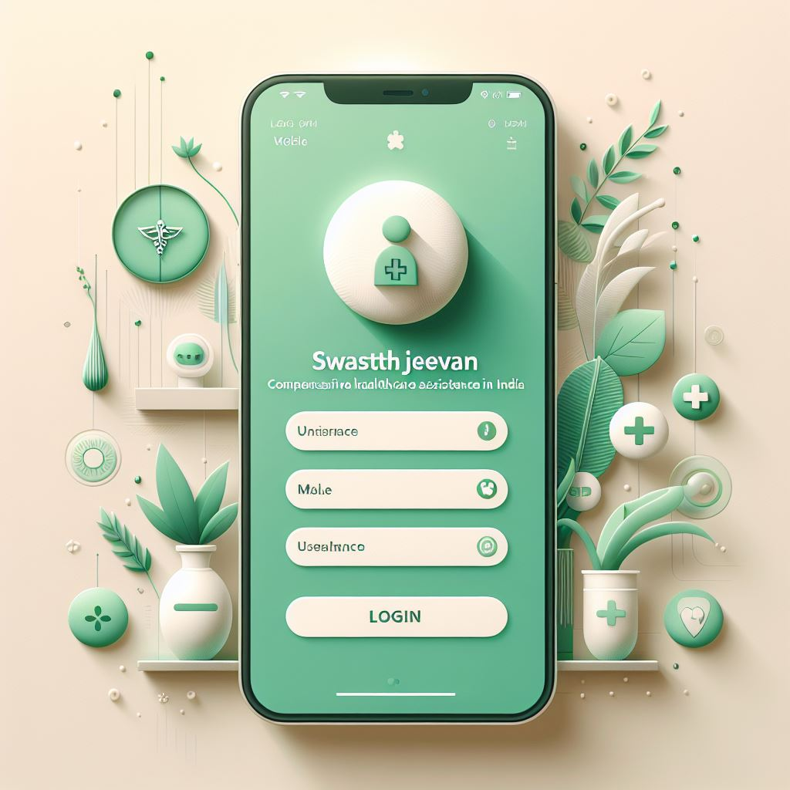
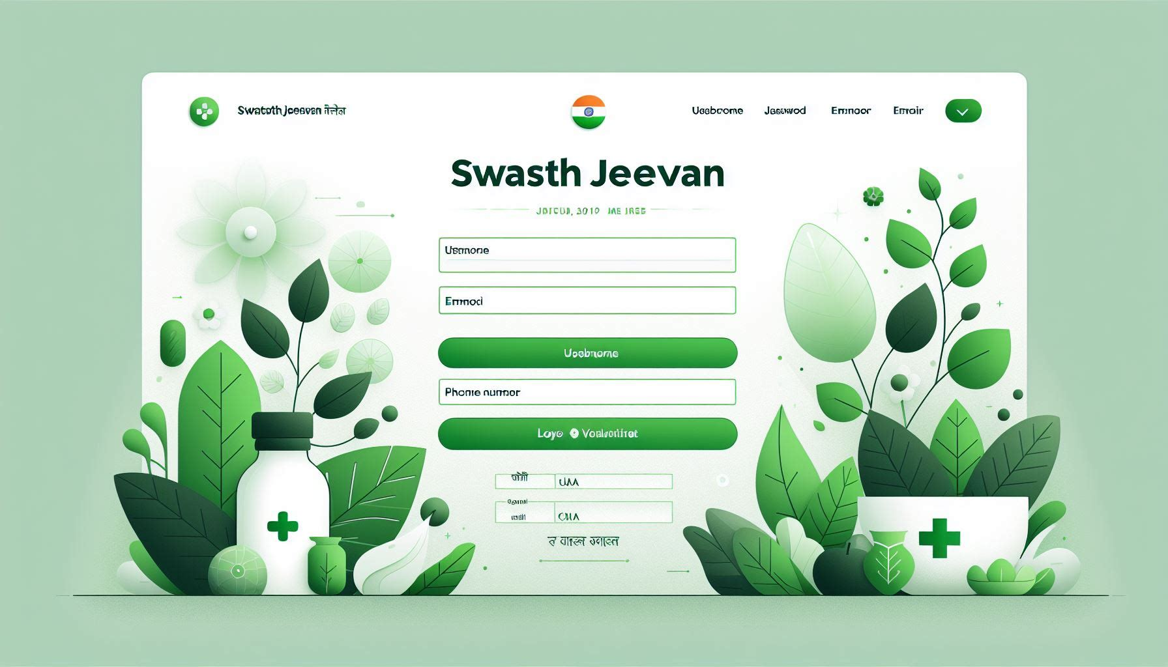
Prototype Image or Video
APP UI/UX WEBSITE UI/UX

Slide 11
THANK YOU

