Slide 1
Independent Study
Maanit Malhan

Slide 2
Fall Semester

Slide 3
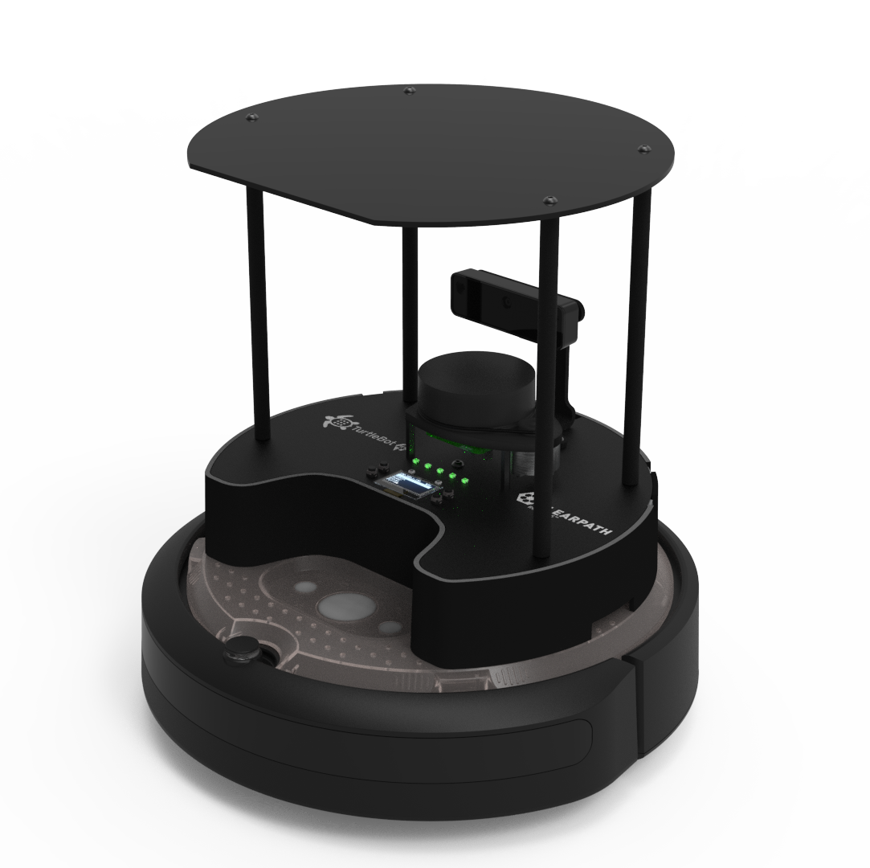
Introduction
Throughout this year I have looked at 10+ research papers and created multiple custom ML models.
All of these papers look at the application of Machine Learning in robotics. More specifically about deep reinforcement learning algorithms.

Slide 4
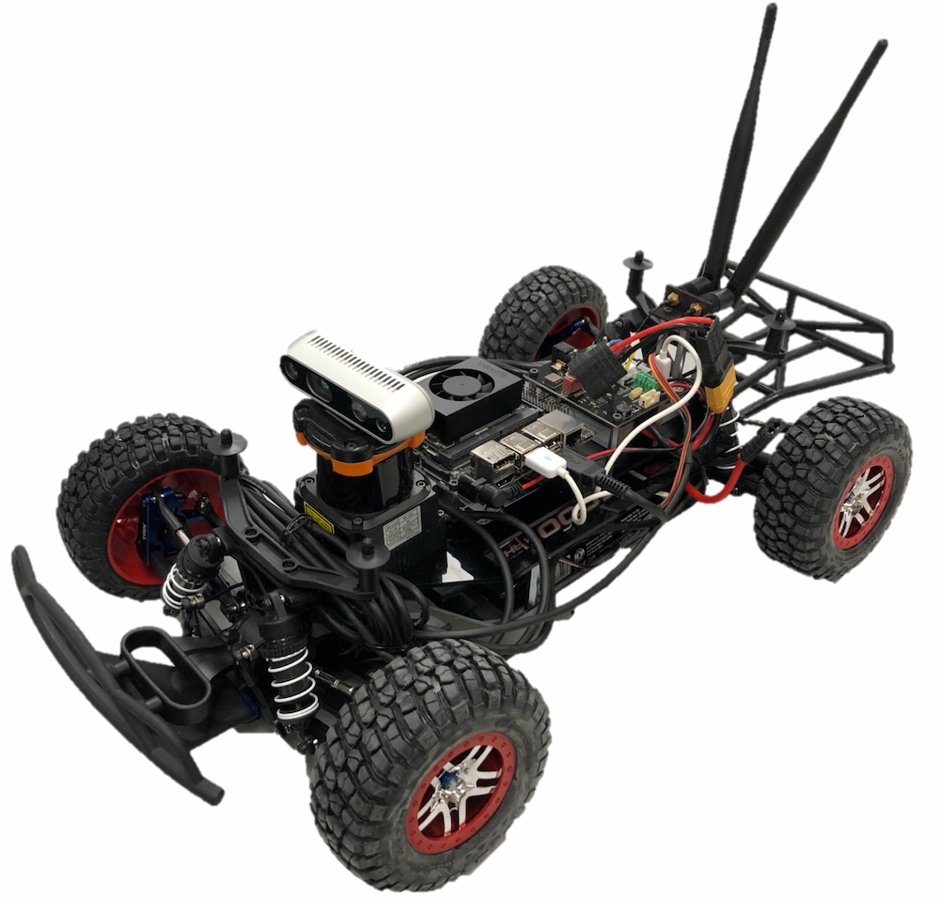
Common Themes
Some of the common themes throughout all the papers include:
Topic: Navigation Systems powered by Deep Learning Algorithms
Hardware: LiDAR sensors, Kinect Sensors, RGB Cameras, TurtleBot Chassis
Testing: Gazebo Simulator, Real-World
Software: ROS, Training models in simulators then transferring them over, Deep Reinforcement Learning, Q-Learning, CNN, Feed-Forward Networks, etc.

Slide 5
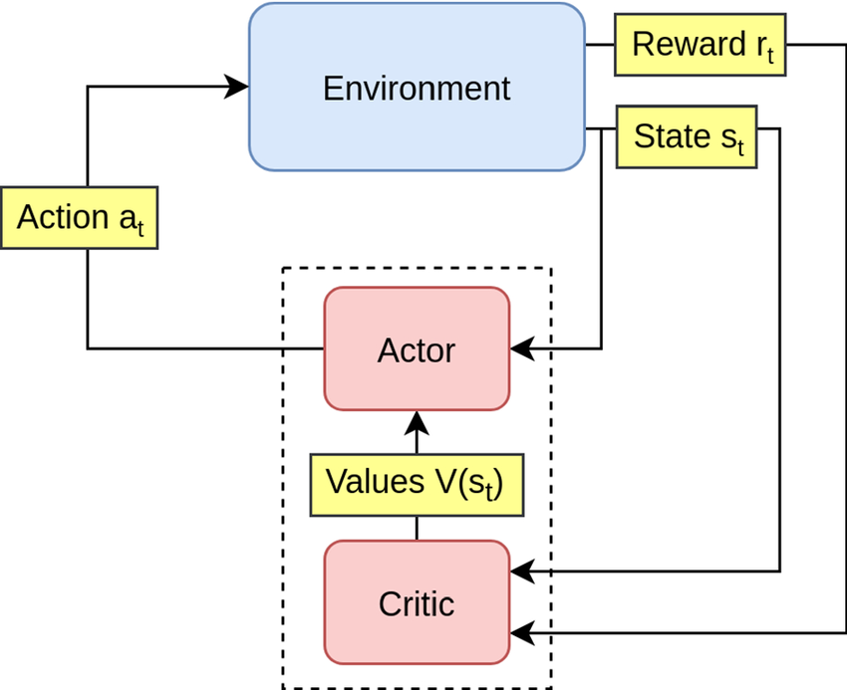
Actor-Critic Model
A DRL architecture that is used in some form for all models in these papers.
Actor: Decides the action to take based on the current state.
Critic: Evaluates the action by calculating the value function or advantage.

Slide 6
Week 2-3 Summary
Week - 2
Topic: Using robots with GPR for monitoring concrete structures.
Problem: Aging civil infrastructure (concrete wastewater pipes).
Solution: Ground Penetrating Radar (GPR) with deep learning.
Methodology: FDTD simulation and preprocessing of GPR signals.
Results: Low error rates in predictions; promising for real-world applications.
Week – 3
Topic: High-speed autonomous racing with deep reinforcement learning.
Problem: Limitations of classical racing algorithms.
Solution: Deep Deterministic Policy Gradient (DDPG) for autonomous control.
Methodology: LiDAR-based trajectory tracking with DRL.
Results: Better lap times and completion rates than classical methods

Slide 7
Week 4 and 5 Summary
Week - 4
Topic: End-to-end deep reinforcement learning for real-world navigation.
Problem: Map-based navigation limitations.
Solution: Visual navigation using RGB cameras and DRL.
Methodology: Actor-critic architecture with fine-tuning on real-world data.
Results: 86.7% success rate in noisy real-world environments.
Week - 5
Topic: Multi-Goal Navigation with Deep Reinforcement Learning
Problem: Difficulty in efficiently achieving multiple navigation goals in dynamic environments.
Solution: Introduced Inverse Dynamics Model (InvDM) and Multi-goal Co-learning (MgCl) to enhance multigoal navigation.
Methodology: End-to-end deep reinforcement learning with modular architecture:
Feature extraction using convolutional layers.
Action prediction with A3C modules.
Results: Superior goal-dependent navigation performance in varied indoor scenes.

Slide 8
Week 6 and 7 Summary
Week - 6
Topic: Vision-Based UAS Landing Using Deep Reinforcement Learning
Problem: Challenges in safely landing unmanned aircraft systems (UAS) on moving platforms.
Solution: Applied Deep Regularized Q Version 2 (DrQv2) with custom reward functions. Combined domain randomization for real-world adaptability.
Methodology: State: Grayscale camera images and velocity data. Actions: UAS velocity control for precise platform landing. Rewards: Balanced safety, descent efficiency, and visibility maintenance.
Results: Effective simulation-to-reality transfer with 6% performance reduction. Consistent successful landings across varied environmental conditions.
Week - 7
Topic: Efficient Deep Reinforcement Learning Using Knowledge Distillation
Problem: Resource constraints limit the performance of DRL models in real-time applications.
Solution: Combined DRL with knowledge distillation to create resource-efficient models.
Methodology: Environment: CartPole-v1 for balancing tasks. Architectures: Tested Double DQN, DRQN, and Dueling DQN. Knowledge Distillation: Teacher-student model for enhanced training.
Results: Distilled models improved learning speed and convergence rates. Dueling DQN and DRQN outperformed DQN in all scenarios.

Slide 9
Week 8 and 10 Summary
Week – 8
Topic: Learning to Herd Agents Amongst Obstacles Using Deep Reinforcement Learning.
Problem: Rule-based and learning-based methods for robot herding face issues like fragility and oversimplified environments.
Solution: Developed a Deep Q-Learning algorithm for herding agents in complex environments with obstacles.
Methodology: Environment: Simulated with the Boids model and probabilistic roadmaps. Components: Action space with eight directions, reward function with movement, violation, and goal-reaching incentives. Training: Random noise and replay buffers for robust training.
Results: High success rates in herding with faster completion times than previous methods. Limitations: Can only handle 2-4 agents compared to dozens in rule-based methods.
Week – 10
Topic: Deep Reinforcement Learning Integrated RRT Algorithm for Path Planning
Problem: RRT struggles with optimal pathfinding due to random sampling.
Solution: Enhanced RRT with Deep Reinforcement Learning for better path optimization.
Methodology: Dynamic Waypoint Selection: Adjusts intervals for smoother paths. Reward Function: Exponential distance-based rewards to improve performance. Optimization: Iterative experience replay for continuous improvement.
Results: Outperformed RRT-star and RRT-connect in path length and obstacle handling in 2D/3D. Demonstrated scalability and adaptability in complex scenarios.

Slide 10
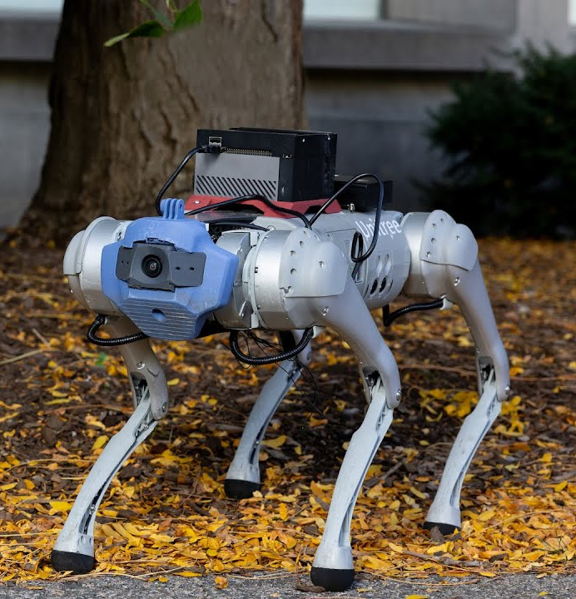
Week 11 Summary
Week - 11
Topic: Socially Aware Robot Navigation Using Deep Reinforcement Learning
Problem: Traditional navigation systems fail to ensure human safety and comfort.
Solution: Developed a Q-Learning-based framework for socially aware robot navigation.
Methodology: Environment: Simulated office-like space with static and dynamic obstacles. Components: Replay memory for enhanced training, Kinect sensor, and laser rangefinder for perception.
Results: Maintained low collision index (< 0.14), ensuring safety and comfort. Authors plan to validate the model in real-world scenarios.

Slide 11
Spring Semester

Slide 12
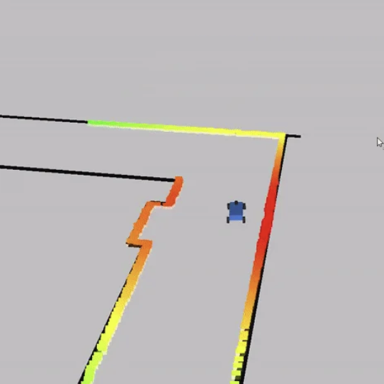
The Start
At the start of the semester. I choose to pursue the creation of a neural network ensemble to create a self driving car.
The inspiration for this was a paper from week 3 paper called: High-Speed Autonomous Racing Using Trajectory-Aided Deep Reinforcement Learning

Slide 13
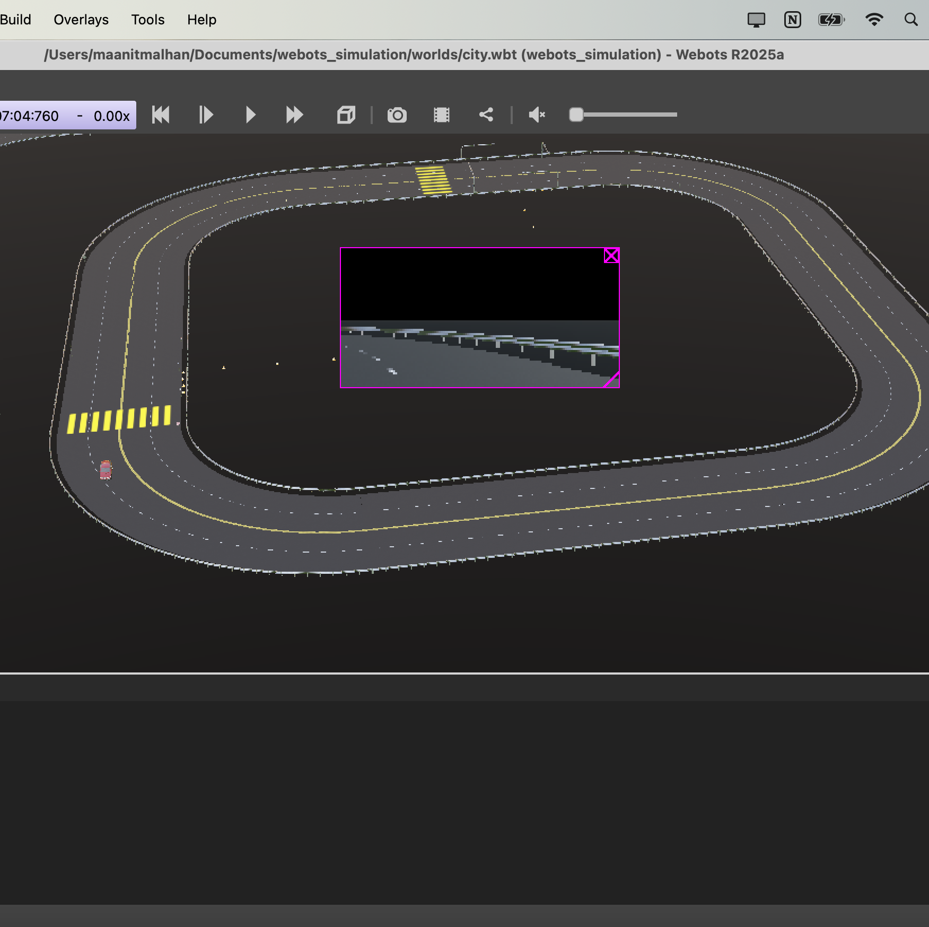
My Approach
Neural Network Ensemble:
The ensemble is made of 3 models: Gas model, Steering model, Brake model.
Environment:
The Environment from the base paper did not work after weeks of trying. This was due to compatibility issues and possibly corrupted source code for the simulator.
I then choose Webots simulator. Within this simulator. This is a reputed lightweight simulator. I used the a pre-made vehicle(BMW X5) and modified the pre-made world(city) to turn it into more of a “racetrack style” environment.(shown on side)

Slide 14
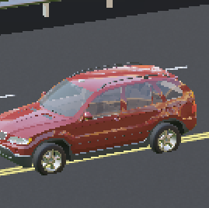
Ensemble information
Network ensemble: Distributes the work of one model into 3 separate ones.
I chose different sensor inputs for different models which lead to better performance in certain situations.
One subsystem failure does not bring the whole system down. Which made it easier to retune and remake one model.
One negative with this ensemble is it will be slower in real-time compared to one larger model. Due to three forwards instead of one.

Slide 15
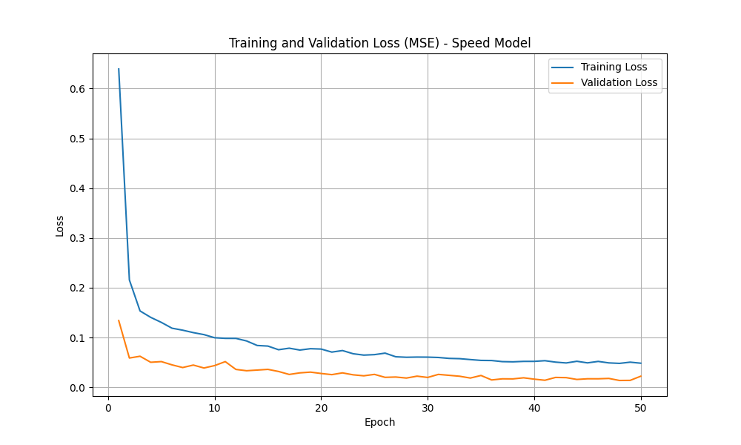
1st Model – Gas
Use case: Predict how fast the vehicle should go based on vision + current speed + dynamics
Inputs:
Camera Image
Actual Speed (GPS) (normalized)
Gyro (yaw rate) (optional, normalized)
Architecture:
CNN for image
Dense layers for actual speed + gyro
Combined features passed to FC layers
Output: Normalized commanded speed
Use case: Predict gas using road visuals and vehicle GPS

Slide 16
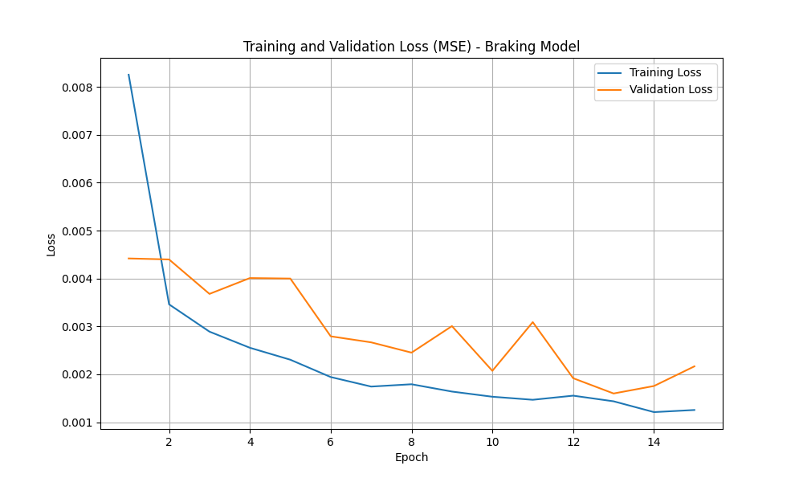
2nd Model – Brake
Inputs:
Camera Image (RGB, resized 200×66)
Lidar Scan (2048 range points, normalized)
Architecture:
CNN for camera
1D CNN for Lidar
Features concatenated and passed through fully connected layers
Output: Single scalar for brake intensity (0 to 1)
Loss: Mean Squared Error (MSE)
Use case: Learn braking behavior based on what the car sees (image) and detects (lidar)

Slide 17
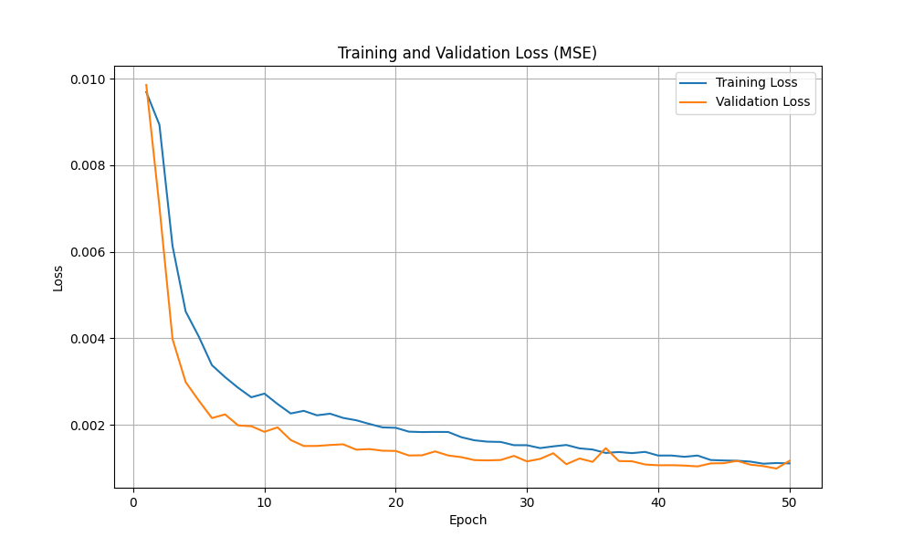
3rd Model – Steering
Inputs:
Camera Image
Gyro (yaw rate) (normalized)
Architecture:
CNN for image
Dense layer for gyro
Combined and passed through FC layers
Output: Steering angle (regression)
Loss: MSE
Use case: Predict steering angle using road visuals and vehicle rotation

Slide 18
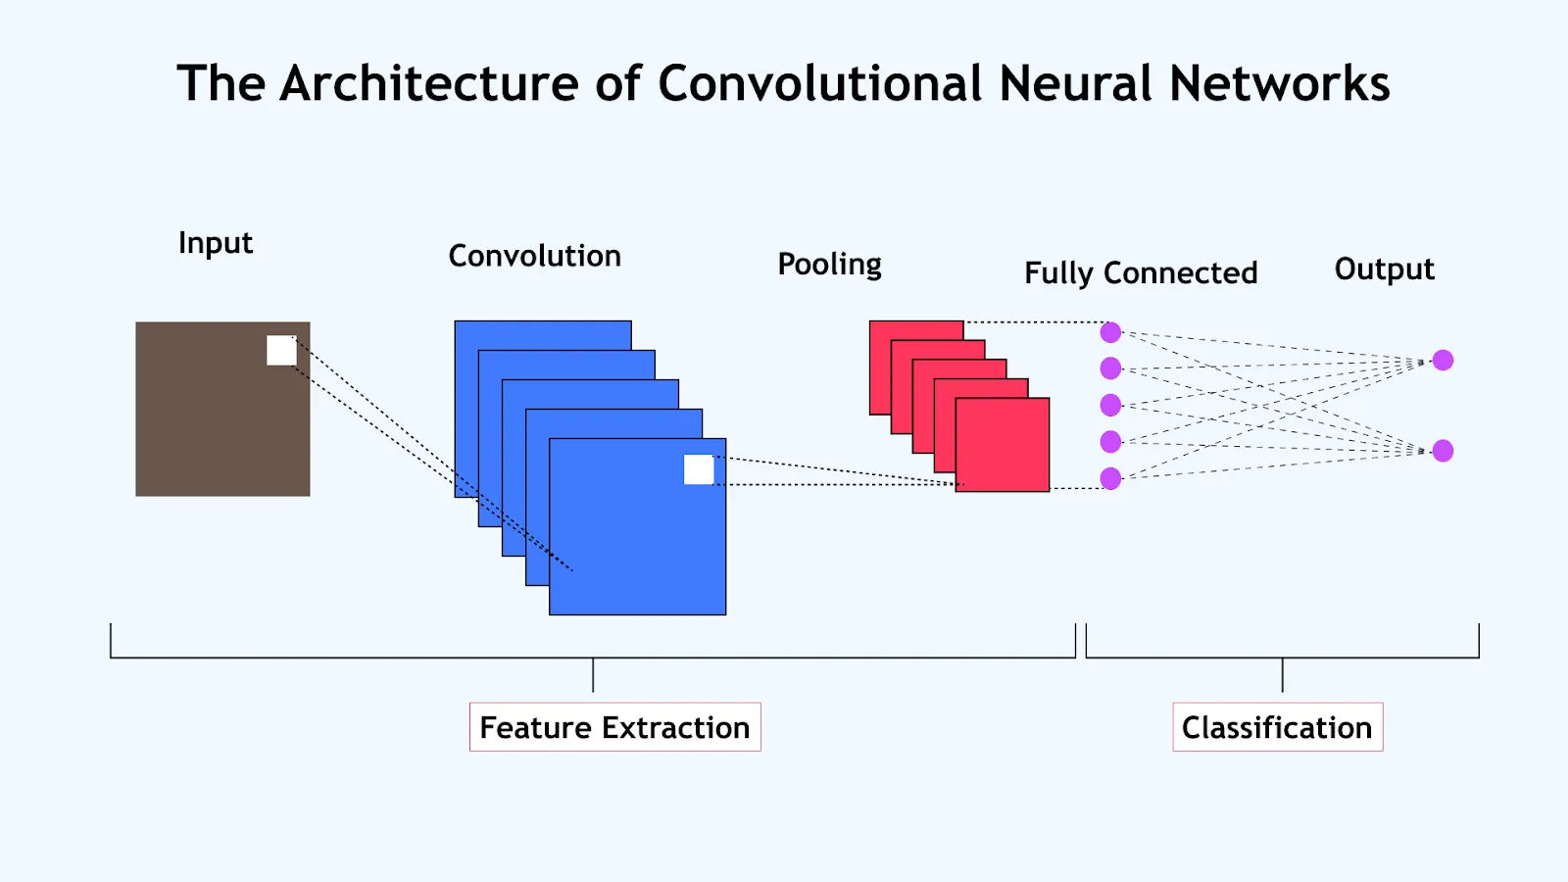
Improvements
Increase dataset size.
The dataset used to train this model was 10 minutes of manual driving done by me. This worked due to the simple nature of the environment. However, for a more complicated environment and general robustness a larger dataset is important.
Fuse outputs to detect conflicting predictions.
In the outputs you can see the conflicting gas and braking outputs at times. This can be solved for better driving by adding a check for conflicting outputs.
Add recurrent layers(LSTM/GRU).
This would help make the model act in a more ‘human’ way since it would be able to remember the past events and which can help with issues like steering jitter with single-frame predictions, especially on curves or lane merges.

Slide 19
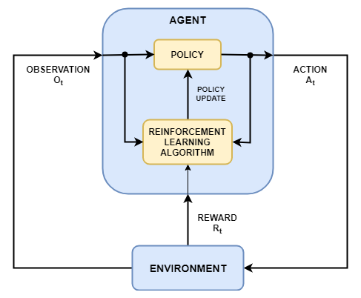
Future Work
Add Reinforcement learning.
I conducted some preliminary testing with a SAC(soft actor critic) for Pretraining + RL adaptation. This would help the car bridge the gap between imitation and full autonomy. However, this model is not complete yet.
More complicated environment.
Getting a larger dataset and driving the car in a more complicated environment will make the final model a lot more capable. This also helps it move over to the much more complicated real-world.

Slide 20
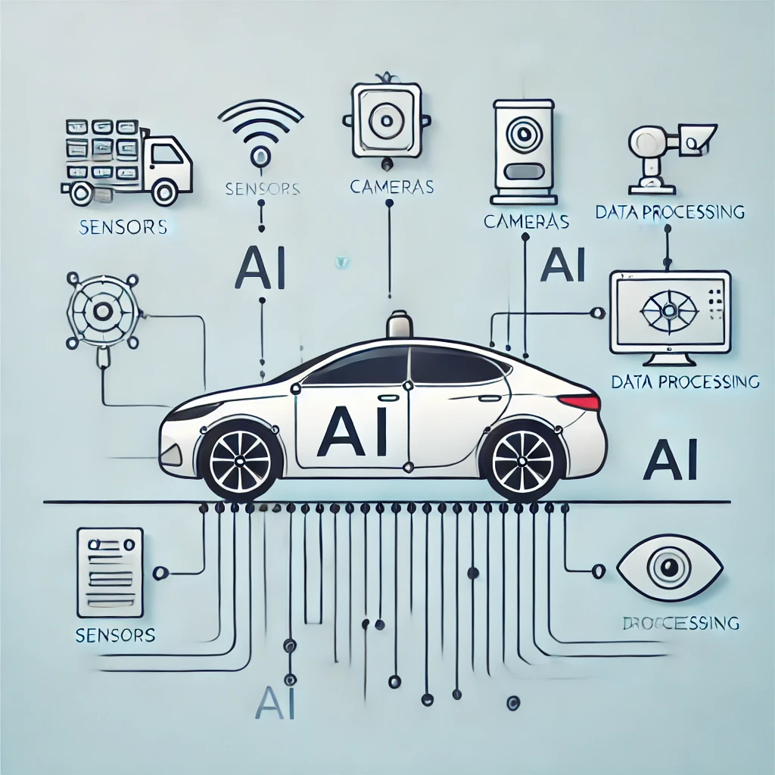
Conclusion
Successfully built a modular self-driving system with dedicated deep learning models for:
Braking (camera + lidar)
Speed control (camera + speed + gyro)
Steering (camera + gyro)
The modular architecture enabled:
Clear specialization per control task
Independent tuning and debugging
Flexibility to adapt each model individually (e.g., RL fine-tuning for braking)
Employed multi-sensor fusion and task-specific preprocessing to learn effective control behaviors from data.
Achieved strong baseline performance using supervised learning on synchronized sensor logs.
Identified key areas for improvement:
More diverse data from complex driving environments
Integration of recurrent layers(e.g., LSTM)
RL-based fine-tuning to optimize for long-term safety and efficiency

