Slide 1
Currency Convertor In Java
NAME- Manvi Jain
class roll.No- 22
section- iot
mentor name- mr.Pramod mehra

Slide 2
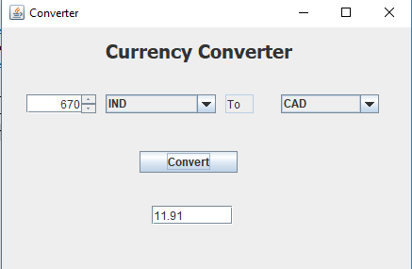
INTRODUCTION
A currency converter in Java allows users to convert amounts between different currencies using predefined exchange rates. This simple tool doesn't rely on real-time data, making it easier to implement and test. Users input the amount and select the currencies to convert between, and the program applies fixed exchange rates to calculate the converted amount. This approach is ideal for educational purposes and small applications.

Slide 3
PROBLEM STATEMENT
To develop a Java-based currency converter application that automates currency conversion with a user-friendly interface.

Slide 4
METHODOLOGY
GUI DESIGN
We use the Java Swing to design the graphical user interface.
The components used are dropdown menus for selecting currencies, text fields for inputting amounts, and buttons for conversion, reset, and exit functionalities.

Slide 5
Currency Conversion Logic
Implement conversion logic using fixed exchange rates as constants
Capture user inputs and calculate conversions based on selected currencies.
Error Handling
Validate user inputs to ensure both currencies and amounts are selected before conversion.
Display error messages using JOptionPane for invalid inputs to guide users appropriately.
User Interaction
Allow users to interact with the application by selecting currencies and inputting amounts.
Display converted amounts in a clear format to enhance user experience.
Testing and Refinement
Test the application for different scenarios, including edge cases and invalid inputs.
Refine the interface and functionality based on user feedback and testing results.

Slide 6
RESULT AND DISCUSSION
The currency converter application employs a Java Swing-based graphical interface featuring dropdown menus and text fields for selecting currencies and entering amounts. It utilizes fixed exchange rates to convert input amounts from the chosen source currency to pounds and subsequently to the target currency. User interaction is facilitated through intuitive controls, allowing seamless conversion with validation for input completeness and accuracy through informative error messages. The application supports essential functionalities such as resetting inputs and exiting.
Discussion points include evaluating usability in terms of interface clarity and user experience, assessing conversion accuracy using fixed rates, and exploring scalability for future integration of real-time exchange rates and additional currency options. Insights from user testing are crucial for refining usability, while future development focuses on enhancing functionality with dynamic exchange rate integration and expanded feature sets.

Slide 7
CONCLUSION AND FUTURE WORK
Conclusion The currency converter application demonstrates robust functionality with a Java Swing interface, facilitating intuitive currency selection and accurate conversion using predefined exchange rates. User feedback and testing have highlighted its usability and effectiveness in handling currency conversions.
Future Work Moving forward, enhancements could include integrating real-time exchange rates to improve accuracy and relevance, expanding currency options beyond the current fixed rates, and refining error handling to provide more informative user feedback. Additionally, exploring mobile or web-based versions could broaden accessibility and usability across different platforms.

Slide 8

REFERENCES
[1] Oracle. JavaFX Documentation. Available at: https://openjfx.io/ (Example: Website)
[2] ExchangeRate-API. ExchangeRate-API Documentation. Available at: https://www.exchangerate-api.com/docs/ (Example: Website)
[3] Oracle. Java HttpClient Documentation. Available at: Java HttpClient Documentation (Example: Text Book/ Magazine)
[4] Investopedia. Financial Technology Overview. Available at: Financial Technology Overview (Example: Website)
[5] Oracle. Java Advanced Topics. Available at: Java Advanced Topics (Example: Text Book/ Magazine)

Slide 9
THANK YOU

