Slide 1
SMART GARBAGE MONITORING SYSYEM
NAME- Manvi Jain
class roll.No- 30
section- iot
mentor name- dr. Sachin sharma

Slide 2
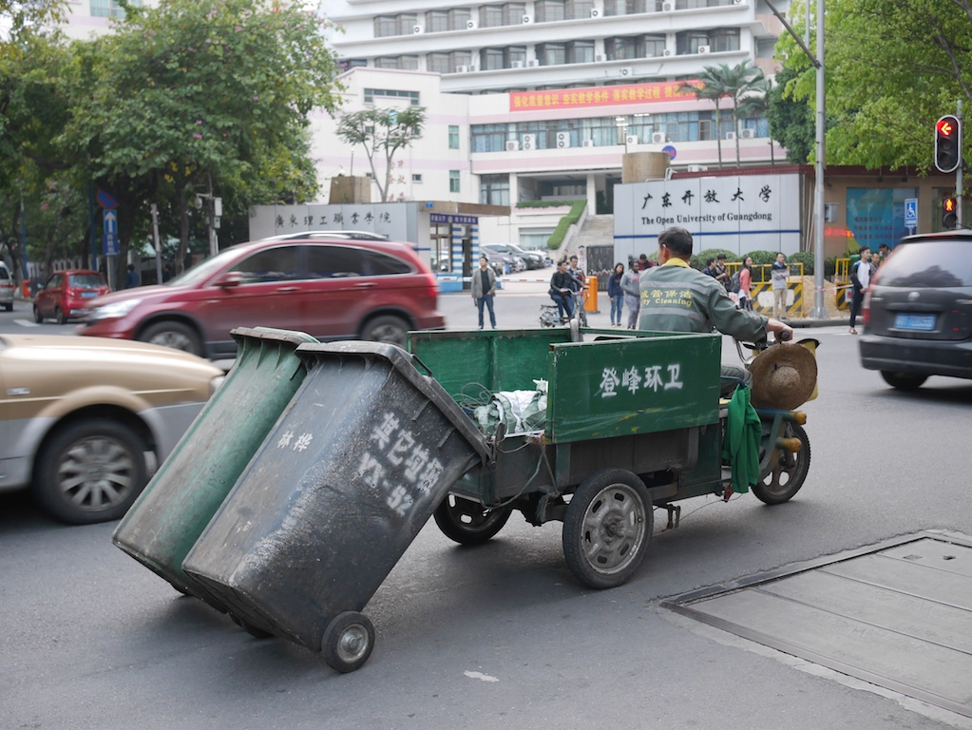
INTRODUCTION
Welcome to the future of waste management! My project introduces the approach to streamline garbage monitoring through cutting-edge technology. By using ultrasonic sensors, we can developed an innovative system capable of efficiently detecting the fill level of dustbins. This simple yet powerful solution aims to revolutionize traditional waste management practices by providing real-time insights into bin capacity

Slide 3
PROBLEM STATEMENT
Designing an Efficient Smart Garbage Monitoring System Using Arduino and Ultrasonic Sensors for Urban Areas in India

Slide 4
METHODOLOGY
Proposed System
The current system is time consuming and requires trucks to empty the containers, even if they are empty. It also costs a lot of money to maintain an unclean environment. Even the smell of the containers can cause an unhealthy environment. The proposed model discusses how to make use of the latest advances in technology to keep our place clean and clean.

Slide 5
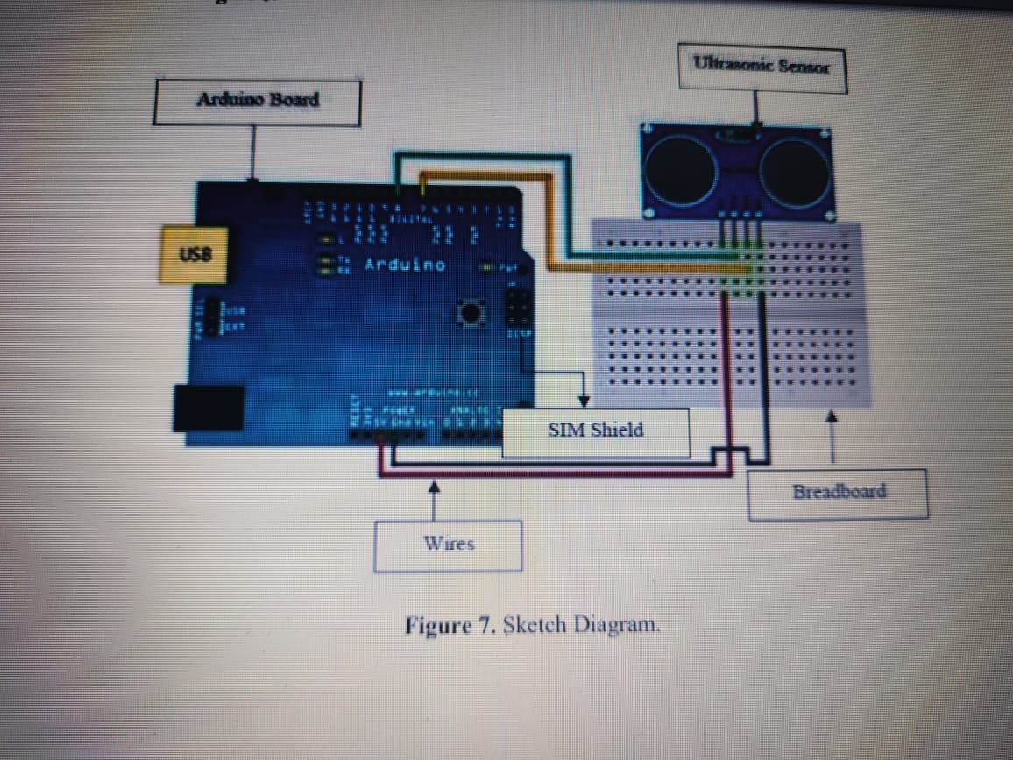
The trigPin and echoPin are defined as the trigger and echo pins for the ultrasonic sensor.
In the setup() function, serial communication is started, and the sensor pins are defined as output and input, respectively.
In the loop() function, the ultrasonic sensor is triggered to send a pulse, and the duration of the pulse is measured.
The duration is converted to distance using the speed of sound, and the result is printed to the Serial Monitor.
Based on the calculated distance and the fullThreshold, it determines whether the dustbin is full or not and prints the corresponding message to the Serial Monitor.
A delay is added before the next measurement to avoid rapid readings.

Slide 6
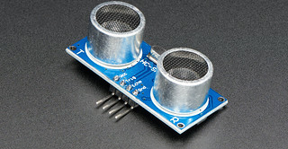
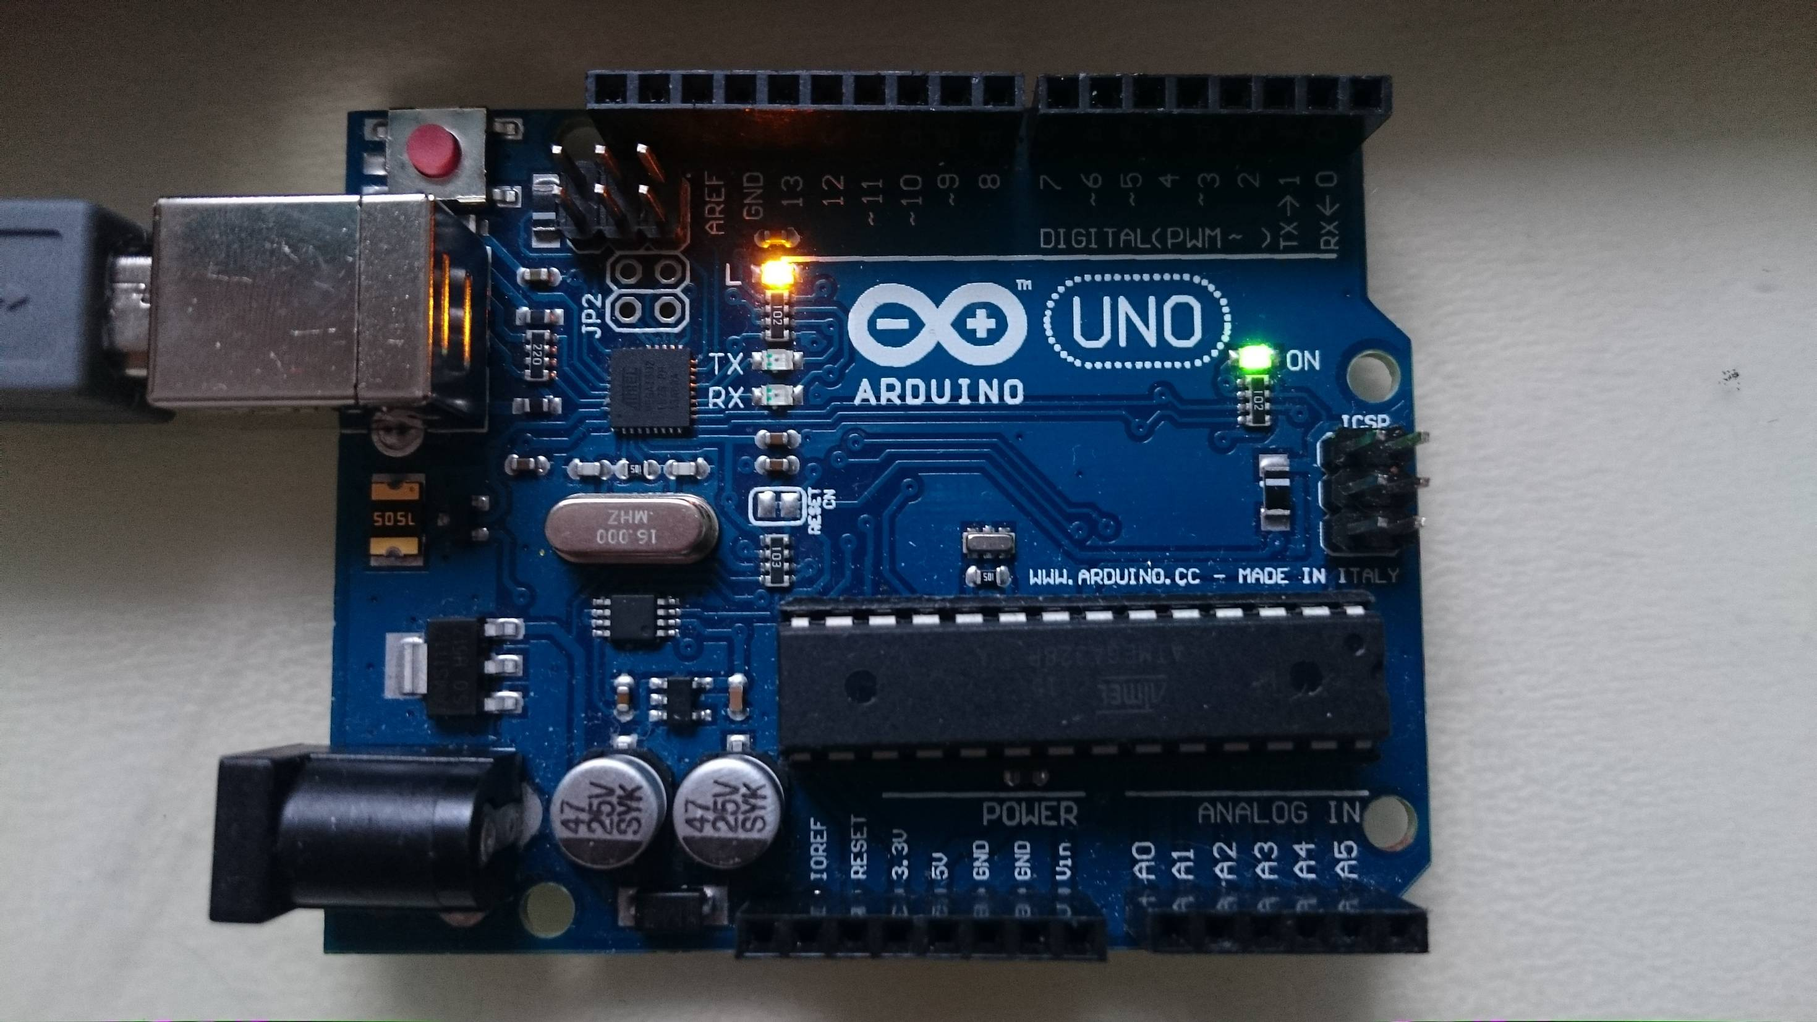
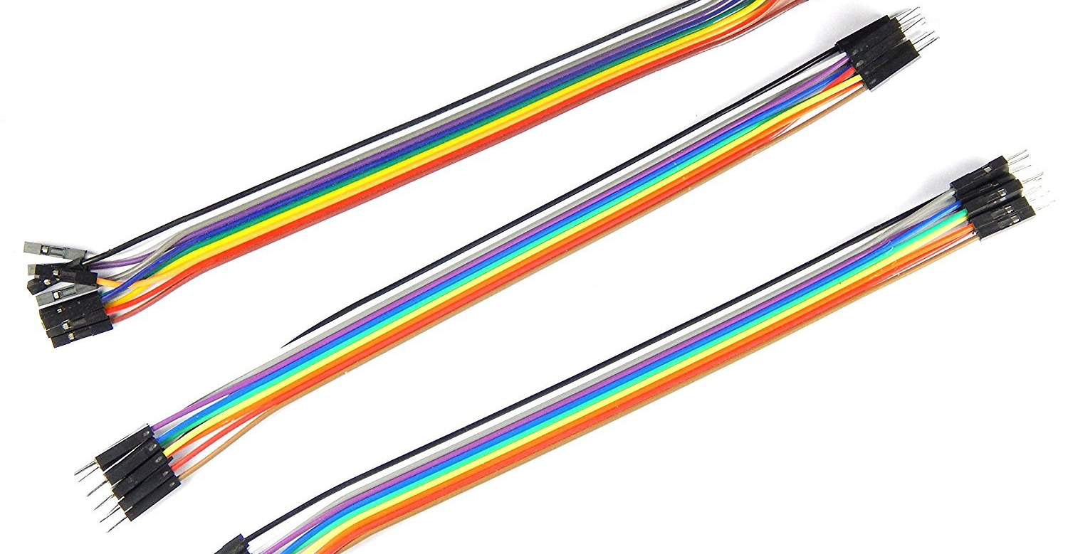
HARDWARE COMPONENTS
ULTRASONIC SENSOR
ARDUINO UNO
JUMPER WIRE
An ultrasonic sensor is used to detect the level of garbage inside the bin. It sends out high-frequency sound waves that bounce off the surface of the garbage and return to the sensor. Based on the time it takes for the sound waves to return, the sensor can determine the level of garbage inside the bin
The Arduino is a versatile microcontroller board. A microcontroller is used to process the data received from the ultrasonic sensor and send it to the cloud for analysis. It also manages the power supply to the sensor.
Jumper wires are essential components in electronics and prototyping. They are used to establish electrical connections between different components on a breadboard or between a microcontroller and other electronic modules.

Slide 7
RESULT AND DISCUSSION
The amount of trash in the bin was constantly increased and decreased to test the mechanism. Every time a level was altered, the message displayed changed accordingly. It can be concluded that the system operated as intended . The hardware components were also properly secured in order to ensure the accuracy of the output, which is necessary for taking further action based on.
The system's dependability and efficacy are demonstrated by the successful testing process, which involved purposefully manipulating the waste levels in the bin. The system's real-time responsiveness is demonstrated by the timely change in response to every change in the garbage level. Furthermore, the precise and safe operation of the hardware components guarantees the accuracy of the output data, which is essential for forming well-informed judgements and putting effective waste management plans into practice. With its strong performance, the smart waste monitoring system establishes itself as a solid answer to waste management's problems, opening the door for more resource- and sustainability-conscious methods.

Slide 8
ADVANTAGES
EFFICIENT WASTE MANAGEMENT
The smart garbage monitoring system ensures efficient waste management by providing real-time information about the fill-level of the dustbins. This helps in optimizing the collection routes and schedules, reducing the number of unnecessary trips and saving time and resources.
COST SAVINGS
The system helps in reducing the operational costs by minimizing the labor and fuel expenses required for garbage collection. It also prevents overflowing of the dustbins, which can lead to additional cleaning and maintenance costs.
IMPROVED HYGIENE
ENVIRONMENTAL BENEFITS
The system helps in maintaining better hygiene by preventing the overflow of garbage and reducing the risk of pests and diseases. It also enables timely collection and disposal of waste, preventing the accumulation of garbage and foul odors.
The system promotes environmental sustainability by reducing the carbon footprint of garbage collection and disposal. It also encourages recycling and waste reduction by providing insights into the types and quantities of waste generated in different areas

Slide 9
CONCLUSION AND FUTURE WORK
Maintaining the city's degree of cleanliness and creating a more livable environment are the primary goals. We can continuously monitor the amount of trash in the dustbins located across the city by using this method. Employees can be alerted when a dustbin reaches its full capacity so they can take prompt action to empty it as soon as feasible. Using their smartphones, the staff members can always see how these bins are doing. When implemented appropriately, this approach can prove to be highly beneficial.
Those who are prepared to go above and beyond in order to improve the cleanliness in their respective sectors can utilize the system as a benchmark. This system uses an ultrasonic sensor to measure the amount of waste in the dustbins, but in the future, it can be enhanced with a variety of other sensors to provide more accurate results and increase system performance. This technology can currently be utilized in certain places, but after it establishes its reliability, it will be able to be used in all major areas. Since this method also minimizes human labor, it is possible to make some adjustments to it to advance it and increase its utility.

Slide 10

REFERENCES
Monika K A, Rao N, Prapulla S B and Shobha G 2016 Smart Dustbin-An Efficient Garbage Monitoring System International Journal of Engineering Science and Computing 6 7113-16
Navghane S S, Killedar M S and Rohokale D V 2016 IoT Based Smart Garbage and Waste Collection Bin International Journal of Advanced Research in Electronics and Communication Engineering (IJARECE) 5 1576-78
Kasliwal Manasi H and Suryawanshi Smithkumar B 2016 A Novel approach to Garbage Management Using Internet of Things for smart cities International Journal of Current Trends in Engineering & Research 2 348-53.
Medvedev A, Fedchenkov P, Zaslavsky A, Anagnostopoulos T and Khoruzhnikov S 2015 Waste management as an IoT-enabled service in smart cities In Conference on Smart Spaces Springer International Publishing 104-15
Schafer G 1994 U.S. Patent No. 5,326,939. Washington DC: U.S. Patent and Trademark Office.
Anitha A, Paul G and Kumari S 2016 A Cyber defence using Artificial Intelligence International Journal of Pharmacy and Technology 8 25352-57
Anitha A, Kalra S and Shrivastav 2016 A Cyber defense using artificialhome automation system using IoT International Journal of Pharmacy and Technology 8 25358-64

