Slide 1
Path Planning Using Reinforcement Learning
NAME- Manvi Jain
class roll. No- 22
section- iot
mentor name-Dr. Upma jain

Slide 2
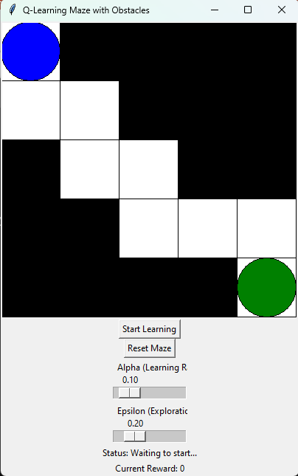
INTRODUCTION
Path planning is a critical task in robotics and autonomous systems, where the goal is to find an optimal route from a starting point to a target while avoiding obstacles. Traditional methods often rely on pre-defined algorithms and static environments, limiting adaptability.
This project leverages Reinforcement Learning (RL), where an agent (robot) learns to navigate the maze through trial and error. Using techniques like Q-Learning, the robot explores the environment, receives rewards for favorable actions, and improves its strategy over time. The result is an adaptive, efficient, and scalable approach to solving path-planning problems in dynamic and complex environments

Slide 3
PROBLEM STATEMENT
Mobile robots require effective path planning to navigate complex environments. Traditional algorithms like A* and Dijkstra’s are computationally expensive and struggle with dynamic, uncertain conditions. This project aims to use Reinforcement Learning to develop an adaptive path planning strategy for a robot navigating a grid-based maze, enabling it to learn optimal paths through trial and error

Slide 4
METHODOLOGY
GUI DESIGN
The graphical user interface (GUI) for this project is built using Tkinter in Python.
The components used include:
Canvas for displaying the grid-based maze, robot, obstacles, start, and exit positions.
Buttons for controlling the flow of the simulation, such as starting the learning process and resetting the maze.
Sliders for adjusting key Q-learning parameters (learning rate, exploration rate).
Labels for displaying real-time information such as current reward and status updates.

Slide 5
Path Planning Logic
Implement path planning using Q-Learning, where the robot learns the optimal path to reach the goal while avoiding obstacles.
The robot interacts with the grid-based environment, taking actions (up, down, left, right) and receiving rewards based on its movements.
The Q-table is updated based on the Q-learning formula to improve the robot's navigation strategy over time.
User Interaction
The graphical user interface (GUI) allows users to control the learning process, reset the maze, and adjust Q-learning parameters (learning rate, exploration rate).
The robot’s movement is visualized in real-time, with the status and reward being displayed to enhance the user experience.
Users can start the learning process by pressing the "Start Learning" button and track the robot's progress as it learns to navigate the maze.

Slide 6
RESULT AND DISCUSSION
The application uses a Tkinter-based graphical interface to visualize a grid-based maze, allowing the user to control the learning process. The robot navigates the maze using Q-Learning, adapting its path over time based on rewards and penalties. Key functionalities include starting the learning process, resetting the maze, and adjusting parameters like the learning rate and exploration rate.
Discussion points:
Usability: The interface provides clear visual feedback, showing the robot’s movement and progress in real-time. The controls are intuitive, but further refinement can enhance user experience.
Path Planning Efficiency: The robot gradually learns the optimal path to the exit. The accuracy of the learning process depends on the chosen parameters (learning rate, exploration rate). In some cases, more exploration may be needed to avoid getting stuck.
Scalability: The current implementation can be extended to larger mazes or more complex environments. Future enhancements can include dynamic maze generation and additional learning algorithms for improved performance.

Slide 7
CONCLUSION AND FUTURE WORK
Conclusion
The path planning application demonstrates the effectiveness of Reinforcement Learning in navigating a robot through a grid-based maze. Using Q-Learning, the robot learns to find optimal paths while avoiding obstacles. The Tkinter interface provides an intuitive way for users to interact with the system, adjust learning parameters, and visualize the robot's progress. Testing has shown that the robot can successfully navigate simple environments, and the system is responsive to changes in learning settings.
Future Work
Future improvements could include expanding the environment to larger and more complex mazes, integrating additional learning algorithms for enhanced performance, and allowing dynamic maze generation for more challenging scenarios. Additionally, improving the robot’s decision-making byfine-tuning exploration and exploitation balance will increase the learning efficiency. Future work may also explore implementing real-time environment feedback and extending the project to mobile or web-based platforms for wider accessibility.

Slide 8

REFERENCES
[1] Mnih, V., Kavukcuoglu, K., Silver, D., Rusu, A. A., Veness, J., Bellemare, M. G., … & Hassabis, D. (2015). Human-level control through deep reinforcement learning. Nature, 518(7540), 529-533.
[2] Lillicrap, T. P., Hunt, J. J., Pritzel, A., Heess, N., Erez, T., Tassa, Y., … & Wierstra, D. (2015). Continuous control with deep reinforcement learning. arXiv preprint arXiv:1509.02971.
[3] Schulman, J., Levine, S., Abbeel, P., Jordan, M., & Moritz, P. (2015). Trust region policy optimization. In International Conference on Machine Learning (pp. 1889-1897).
[4] Silver, D., Huang, A., Maddison, C. J., Guez, A., Sifre, L., Van Den Driessche, G., … & Hassabis, D. (2016). Mastering the game of Go with deep neural networks and tree search. Nature, 529(7587), 484-489.
[5] Lillicrap, T. P., et al. (2015). "Continuous Control with Deep Reinforcement Learning." arXiv preprint arXiv:1509.02971.

Slide 9
THANK YOU

