Slide 1

Project Title –SEASONAL AGRICULTURE PERFORMANCE DATA ANALYSIS
Student Name-Maanya K
College Name- M S Ramaiah Institute of Technology
AICTE STU ID : STU6a4fbd29908081783610665

Slide 2

PROBLEM STATEMENT
Agricultural activities are influenced by seasonal variations in environmental conditions, farming practices, resource availability and market conditions. As a result, agricultural performance may differ from one season to another. However, raw agricultural data does not clearly explain how agricultural performance changes across seasons or what patterns can be observed in different seasonal conditions. The problem is to analyze the given agricultural dataset and investigate seasonal differences in agricultural performance by identifying meaningful patterns, trends, relationships and variations within the available data.

Slide 3
Project Description
Project Overview:
Analyzes agricultural data across different seasons, crops, regions, environmental conditions, farming practices, resource usage, and economic factors to identify meaningful patterns and variations in agricultural performance.
What We Analyze:
🌦️ Environmental Factors: Rainfall, temperature, humidity, soil conditions
🌱 Farming Factors: Crop, irrigation, fertilizer, pesticide, seed quality
📊 Performance: Yield, production, water usage & efficiency
💰 Economics: Cost, revenue, market price & profit
📍 Regional & Seasonal: Comparison across states, crops and seasons
Approach:
Data Cleaning → Statistical Analysis → Visualization → Seasonal Comparison → Bivariate & Multivariate Analysis → Insights & Recommendations
Outcome:
Provides evidence-based insights to understand seasonal agricultural performance and support data-driven crop planning, resource management, and decision-making.

Slide 4

WHO ARE THE END USERS?
Farmers: To inform choices on crop and resource allocation for enhanced agricultural productions.
Agricultural Officers and Departments: For use as a decision-support tool in agricultural planning and management.
Researchers and Agronomists: To carry out crop yield analysis and determine the relationship between various environmental attributesand agricultural productivity.
Agricultural planners and decision-makers: To make informed decision on agricultural activities including; planting, harvesting, and allocation of resources.
Agribusiness and Resource Managers: To make sound decisions on production, profit margin, water utilization and geographical distribution of their products.

Slide 5

Technology Used
  Python – For data processing, analysis, and interpretation.
  Google Colab – It is used to execute Python codes and document the analysis work.
  Pandas – It is a library used to load data into Python, clean and wrangle data including handling missing data and group data.
  Numpy – It is used during data processing and analysis.
  Matplotlib – It is an external library used to generate basic graphics and graphs.
  Seaborn – It is used to generate statistical graphics including boxplot, scatter plot, pair plot, and heatmap.
  Statistical techniques – The study uses descriptive statistics including mean, standard deviation, interquartile range, and comparison to generate conclusions.
  🔄 Data Analysis Workflow
  Dataset → Data Cleaning → Statistical Analysis → Visualization → Seasonal Comparison → Insights

Slide 6
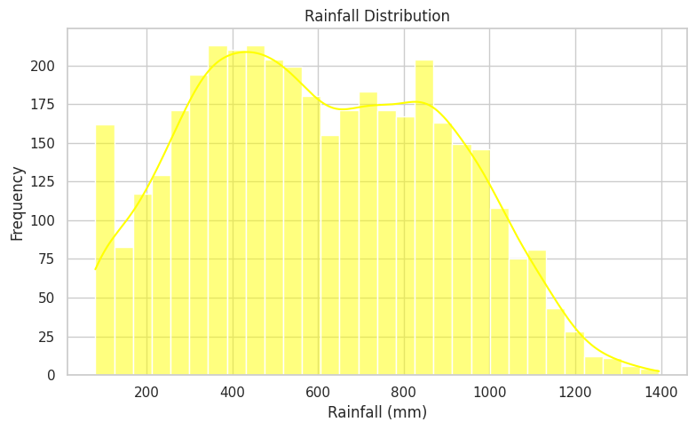
RESULTS (1)
# Univariate Analysis: Rainfall Distribution
plt.figure(figsize=(8, 5))
sns.histplot( df['Rainfall_mm'], bins=30,
kde=True, color='yellow' )
plt.title("Rainfall Distribution")
plt.xlabel("Rainfall (mm)")
plt.ylabel("Frequency")
plt.tight_layout()
plt.show()
# Univariate Analysis: Rainfall Distribution
plt.figure(figsize=(8, 5))
sns.histplot(
df['Rainfall_mm'],
bins=30,
kde=True,
color='yellow'
)
plt.title("Rainfall Distribution")
plt.xlabel("Rainfall (mm)")
plt.ylabel("Frequency")
plt.tight_layout()
plt.show()

Slide 7
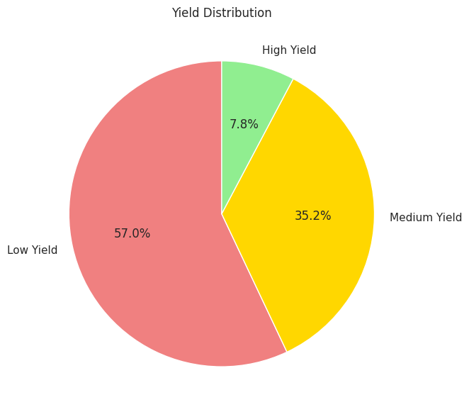
RESULTS (2)
# Pie Chart: Yield Distribution
yield_categories = pd.cut(
df['Yield_Tonnes_Ha'],
bins=[-np.inf, 2, 5, np.inf],
labels=['Low Yield', 'Medium Yield', 'High Yield']
)
yield_distribution = yield_categories.value_counts()
plt.figure(figsize=(7, 7))
plt.pie(
yield_distribution.values,
labels=yield_distribution.index,
autopct='%1.1f%%',
startangle=90,
colors=['lightcoral', 'gold', 'lightgreen']
)
plt.title("Yield Distribution")
plt.show()

Slide 8
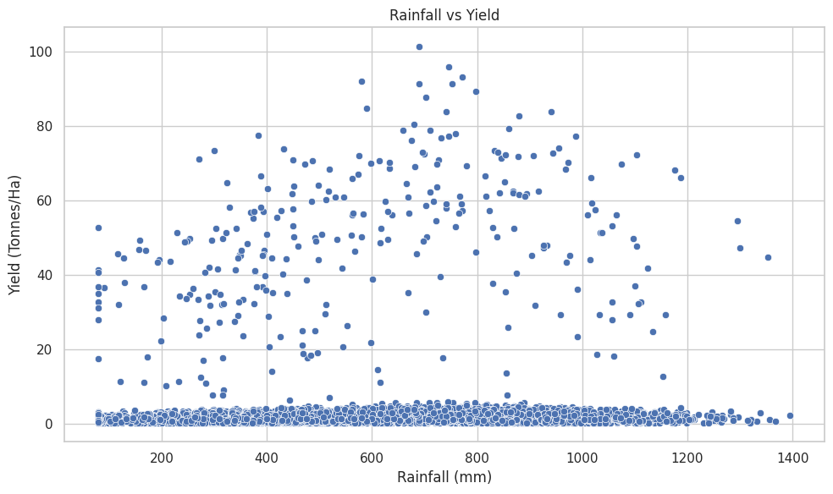
RESULTS (3)
Bivariate Analysis: Rainfall vs Yield - Scatter Plot
plt.figure(figsize=(10, 6))
sns.scatterplot( x='Rainfall_mm', y='Yield_Tonnes_Ha',
data=df )
plt.title("Rainfall vs Yield")
plt.xlabel("Rainfall (mm)")
plt.ylabel("Yield (Tonnes/Ha)")
plt.tight_layout()
plt.show()

Slide 9
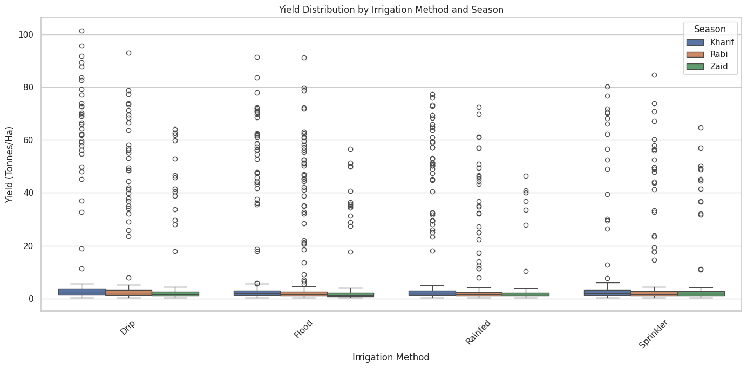
RESULTS (4)
# Multivariate Analysis: Season, Irrigation Method and Yield - Box Plot
plt.figure(figsize=(14, 7))
sns.boxplot(
x='Irrigation_Method',
y='Yield_Tonnes_Ha', hue='Season', data=df )
plt.title("Yield Distribution by Irrigation Method and Season")
plt.xlabel("Irrigation Method")
plt.ylabel("Yield (Tonnes/Ha)")
plt.xticks(rotation=45)
plt.legend(title="Season")
plt.tight_layout()
plt.show()

Slide 10
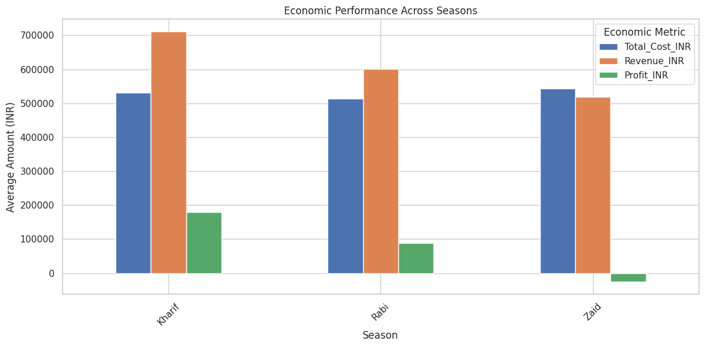
RESULTS (5)
Multivariate Analysis: Economic Performance by Season
economic_summary = df.groupby('Season')[[
'Total_Cost_INR', 'Revenue_INR',
'Profit_INR' ]].mean()
economic_summary.plot( kind='bar', figsize=(12,6))
plt.title("Economic Performance Across Seasons")
plt.xlabel("Season")
plt.ylabel("Average Amount (INR)")
plt.xticks(rotation=45)
plt.legend(title="Economic Metric")
plt.tight_layout()
plt.show()

Slide 11
Future scope
AI-Based Prediction: Creating models that can predict yield, profit, etc.
Crop Recommendation: Recommend the best crop to be planted on the basis of season and available resources like soil, water, weather conditions, etc.
Weather and Climate: Include weather and climate data in the program for more accuracy.
Optimized Requirement: AI can be used to find out the optimized requirementof water, fertilizer, and irrigation.
Prediction of Disease and Pests: The program can predict the possible
occurrence of disease and pests on the basis of weather and crop data.
Smart Dashboard: The project can be taken to the next level by developing a dashboard or mobile application that can give real-time suggestions to the farmer or agricultural department.
More Data Sets: The project can be trained on more data sets so that it can be used in different parts of the world and for different crops.
Future Vision
From analysis of past data to AI-based analysis, recommendation, and smart agriculture.

Slide 12
GitHub Link
LINK :
https://github.com/Maanyak13/Seasonal-Agriculture-Performance-Analysis-.git

Slide 13

VOIS Course completion certificate -
Course name- Data Visualization

Slide 14
Thank you
.
.

