Slide 1
Viterbi Decoder
CS6230: CAD For VLSI

Slide 2
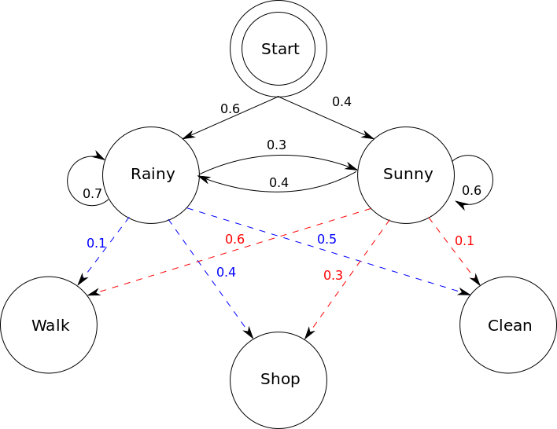
Hidden Markov Model
Markov Property: Future state depends only on the current state and not the the events that occurred before it.
Hidden States: Actual states of the system
are not directly observable.
Observations: Can only observe outputs
generated by the hidden
states

Slide 3
Viterbi Algorithm
A dynamic programming algorithm that finds the most likely sequence of hidden states for a given sequence of observations made.
Commonly used with Hidden Markov Models.
Viterbi path: Resulting sequence of hidden states.
Applications:
- Decoding convolutional codes in digital communication
- Parts of speech tagging

Slide 4
Mathematical Formulation
States: q₀,q₁,q₂,..q_{N} (q₀ = start state) N - no of states
Observations: k₁,k₂,....k_{M} M - no of observations
Transition probabilities: a_{ij} ( probability of transitioning from state q_{i} to state q_{j} )
Emission probabilities: b_{j}(o_{t}) ( probability of observing `o_{t}` given the current state q_{j} )
Viterbi Path Probability: v_{t}( j ) ( probability of the most likely path ending in state q_{j} at time t )
Input sequence of observations: o₁, o₂, o₃,....,o_{T} (o_{t} can be any of k₁,k₂,....k_{M})
( t > 1 )
When t = 1, V₁( j ) = a_{q0, j} * b_{j}(o_{t})
V_{t}( j ) = max_{(0<i<N+1)}( V_{t - 1}( i ) * a_{ij}* b_{j}(o_{t}) )
Study material: https://web.stanford.edu/~jurafsky/slp3/A.pdf

Slide 5
Example
N = 2 (Rainy, Sunny)
M = 4 (Walk, Shop, Study, Clean)
Observed for 3 consecutive days: 1,3,4 (W,S,C) Most probable sequence of weather?
Start
0.7
0.4
0.5
0.5
0.6
R
0.3
S
0.3
0.2
0.3
0.2
0.2
0.1
0.4
0.3
1
2
3
4

Slide 6
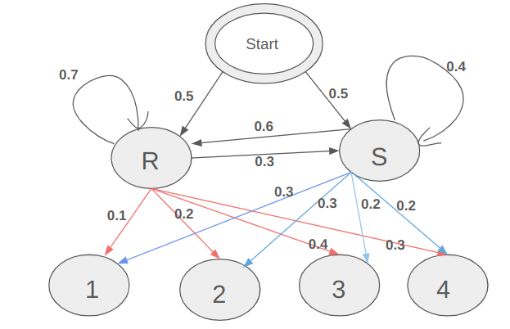
Observed for 3 consecutive days: 1,3,4 (W,S,C)
Most probable sequence of weather?
Ans: S,R,R (2,1,1) with prob = 0.15 * 0.24 * 0.21
v₂(R) = 0.15*0. 24
bt₂(R) = S
v₁(R) = 0.05
R
0.7 * 0.4
R
0.7 * 0.3
R
v₃(R) = 0.15*0. 24*0.21
bt₃(R) = R
0.3 * 0.2
v₁(S) = 0.15
0.3 * 0.2
0.6 * 0.3
0.5*0.1 = 0.05
0.6 * 0.4
S
S
0.4 * 0.2
S
v₃(S) = 0.15*0. 24*0.06
bt₃(S) = R
0.4 * 0.2
v₂(S) = 0.15*0.08
bt₂(S) = S
0.5*0.3 = 0.15
Start
1
3
4

Slide 7
Pseudocode
T - no of observations in input sequence
bt[t][j]: backtrace array which records prev state that led to the max probability ending at state j at time t
prob[]: current max path probability ending at each state
temp[]: temporary array to store updated values of probabilities at each time step
Initialization(t = 1): prob[j] = a[0][j] * b[j][o₁] for all j : 1 to N
bt[1][j] = q₀
Iterative step:
for each time step t from 2 to T do
for each state j from 1 to N do
{
max_val = 0
max_state = -1
for i in 1 to N:
{ val = prob[i] * a[i][j] * b[j][o_{t}]
if val > max_val then:
max_val = val;
max_state = i;
}
temp[j] = max_val, bt[t][j] = max_state
}
prob = temp; //copy temp array back to prob

Slide 8
Contd.
Termination:
path[]: final viterbi path of hidden states
vprob: final probability of mostly likely sequence
vprob =0;
for i in 1 to N:
{
if prob[i] > vprob:
vprob = prob[i] ;
path[T] = i ;
}
for t in T-1 -> 1:
{
path[t] = bt[t+1][path[t+1]];
}

