Slide 1
DGS-GraphQL

Slide 2
Topics
REST vs GraphQL
Domain Graph System (DGS)
REST to GraphQL
Demo
Apollo Federation

Slide 3
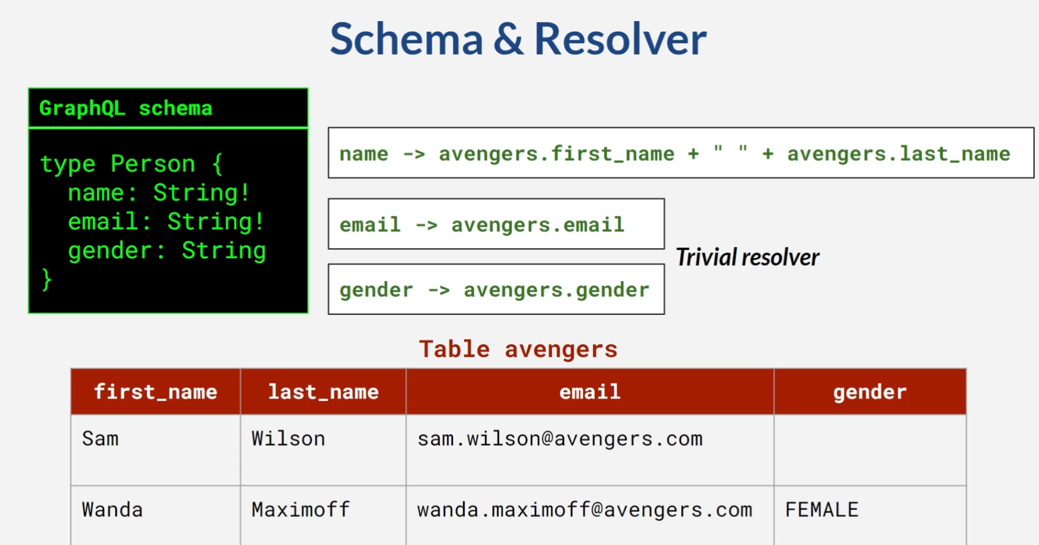
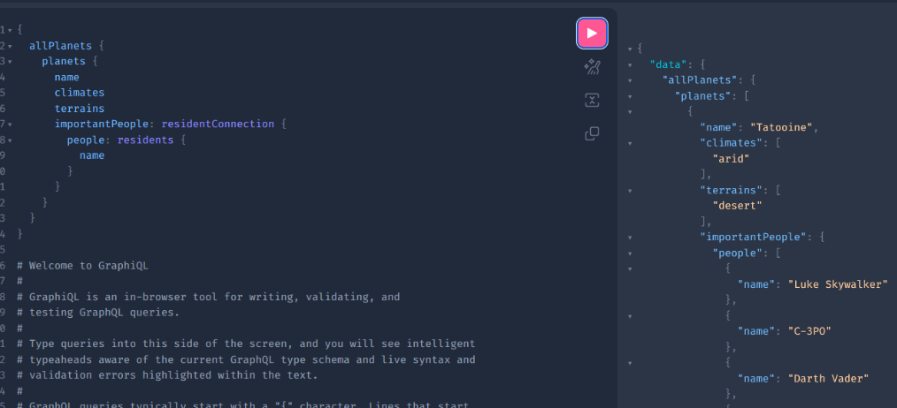
REST vs GraphQL
REST
No Schema
Overfetching
Many urls
Versioning
Only HTTP
GraphQL
Schema/Documentation
Projection
One url
Consumer defined
HTTP & GraphQL clients (Apollo)

Slide 4
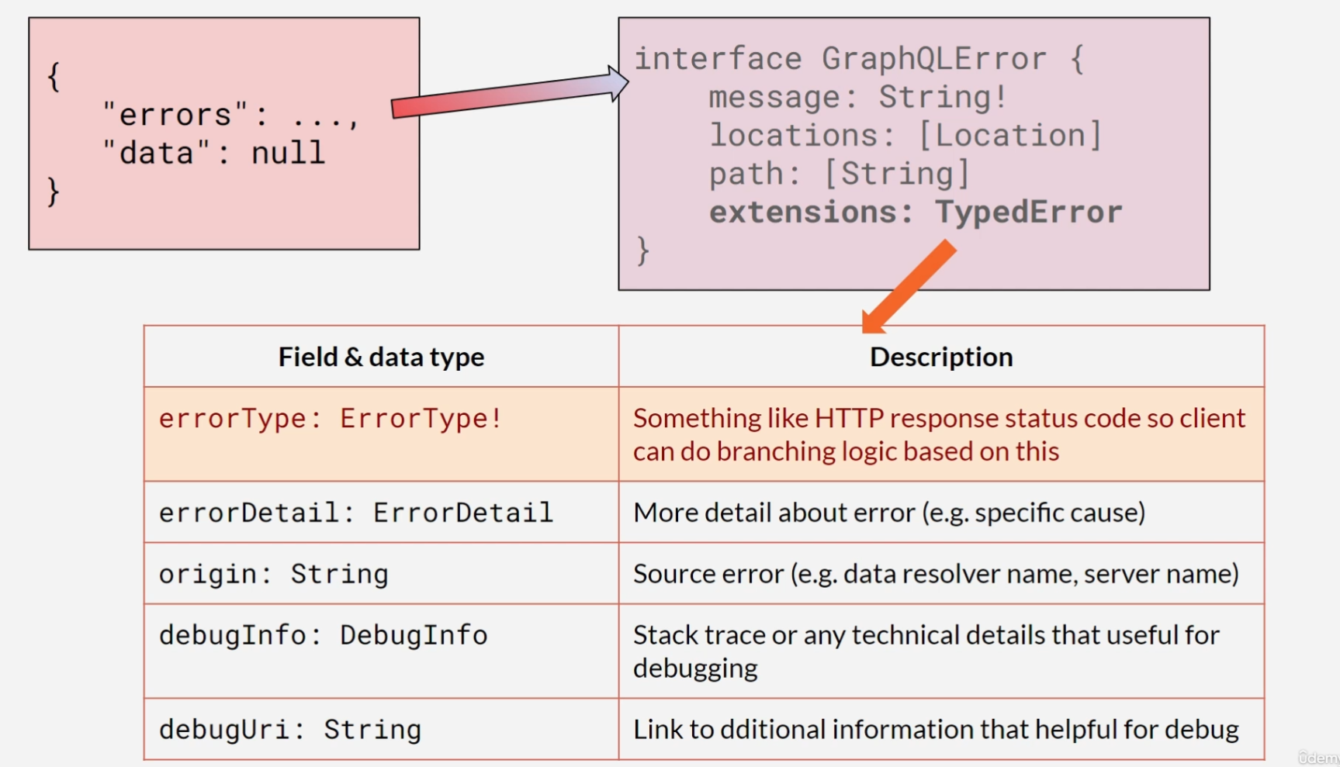
DGS
(Domain Graph System)
Netflix’s open sourced framework to implement GraphQL in Spring Boot
Plugin to generate code for GraphQL implementations
Test framework for writing GraphQL queries
Integration into federations
Interface, Unions, Subscriptions, Error Handling, Metrics, etc..

Slide 5
REST to GraphQL
The underlying concept of getting data to the consumer remains
“GraphQL is typically served over HTTP…” -https://graphql.org/learn/best-practices/
How the request is handled is where GraphQL shines
GET -> query
POST/UPDATE/PATCH -> mutation
Websocket -> subscription

