Slide 1


DEPARTMENT OF COMPUTER SCIENCE AND ENGINEERING
MANONMANIAM SUNDARANAR UNIVERSITY,TIRUNELVELI
Major Project Viva –Review III DATE : 27.03.2026
SeaConnect - A Web Based Fish Trading Platform
Under th guidance of
Dr.G.MUTHULAKSHMI, B.E.,M.E.,Ph.D.,
ASSOCIATE PROFESSOR,
DEPARTMENT OF COMPUTER SCIENCE AND ENGINEERING.
Presented by,
MARIAPPAN V
II MCA B
24084015300111217

Slide 2
PROBLEM STATEMENT :
Fishermen often depend on local middlemen who take a significant share of the profit, leaving the producers with low earnings.
Online buyers hesitate to purchase fish due to the freshness and hygiene.
small-scale fishermen lack proper infrastructure for packing and delivery, which limits their ability to reach wider markets.

Slide 3
OBJECTIVE :
To design and develop a web-based platform that directly connects fishermen and buyers for fish trading.

Slide 4
INTRODUCTION :
Fishing is a key livelihood for coastal communities, but the existing fish selling process is mostly manual and unorganized.
Fishermen depend heavily on intermediaries, leading to reduced profit and lack of price transparency.
SeaConnect is a web-based platform designed to enable transparent fish trading with quality verification and auction-based selling.

Slide 5
SYSTEM ANALYSIS:
Existing System:
Fish trading is mainly done through traditional markets and local middlemen
Pricing is decided manually, often without transparency, which affects fishermen’s income.
There is no proper quality verification or digital record of transactions.
Proposed System:
SeaConnect introduces a centralized web-based fish trading platform connecting fishermen and buyers directly.
Fish is physically verified at a warehouse before being listed for sale.
The system supports fixed-price and auction-based selling with fast, time-bound processing

Slide 6
SOFTWARE REQUIREMENTS:
    Frontend : React.js
    Backend :Node.js
    Database :MongoDB
HARDWARE REQUIREMENTS:
    Processor :Intel Core i5/AMD Ryzen 5
    RAM :8 GB

Slide 7
SYSTEM ARCHITECTURE :
SeaConnect
User
Admin
Login
Buyer
Manage Users
Seller
Login/Register
Login/Register
Quality check
List fish
Browse categories
Place order
Process Orders
View status
View status
Manage Delivery

Slide 8
DATA FLOW DIAGRAM (LEVEL 0):
Register,list fish,
Browse & order fishes
Login,Manage users,process orders,
Manage delivery
User
Database
SeaConnect
Admin

Slide 9
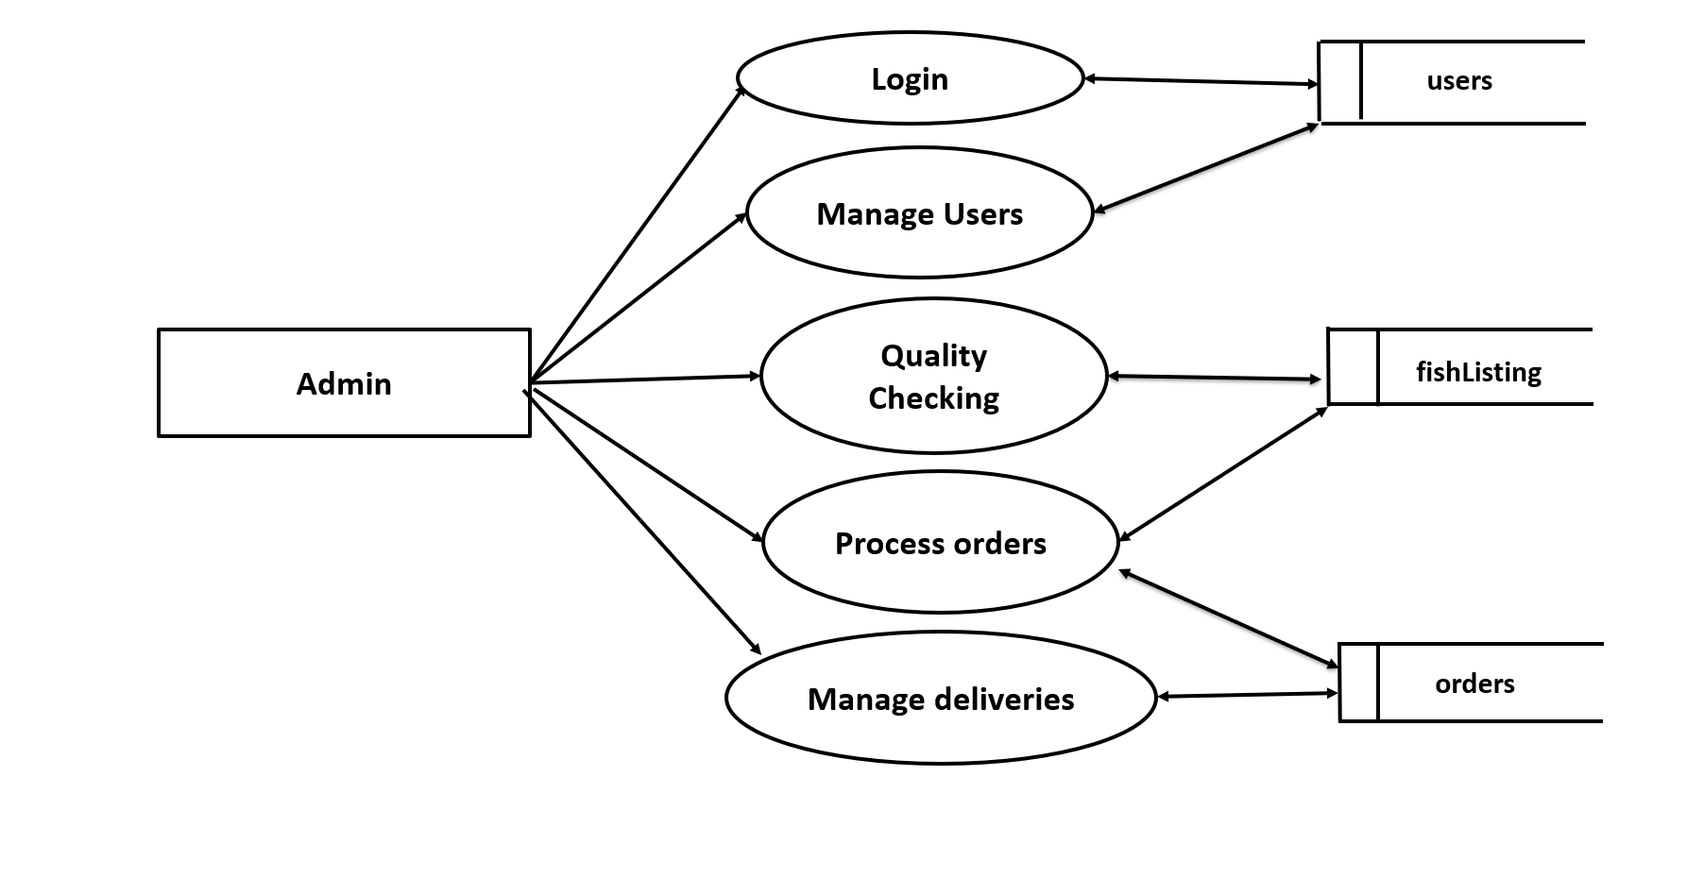
DFD LEVEL 1 (Admin):

Slide 10
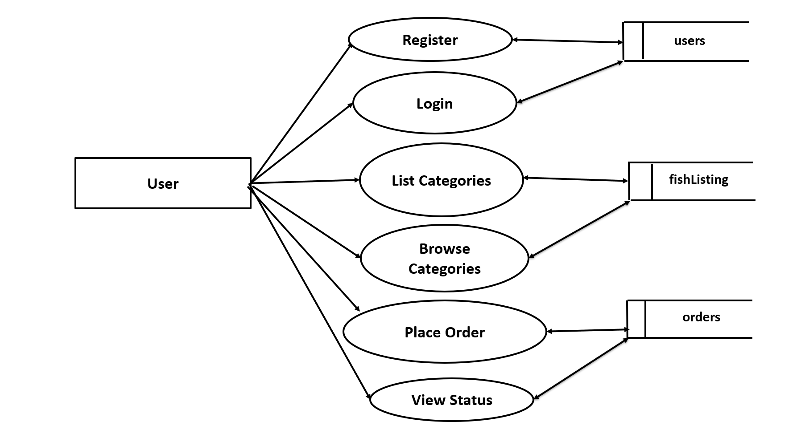
DFD LEVEL 1 (User):

Slide 11
DATABASE DESIGN:
users Collection:
Field | Type | Description
_id | ObjectId | Unique identifier (Primary Key)
name | String | Full name of the fisherman or buyer
email | String | Unique email for login
password | String | password
phone | String | Contact number for delivery/alerts
role | String | 'Fisherman', 'Buyer'
upi_id | String | Payment address for transfers
status | String | 'Pending', 'Verified', or 'Suspended'

Slide 12
fishListing Collection:
Field Name | Type | Description
_id | ObjectId | Unique ID
fishname | String | Name of the fish (Seer, Prawns, Mathi…)
sellerId | ObjectId | Reference to users._id
quantity | Number | Quantity in kg
Price_kg | Number | Price per kg
Price_tot | Number | Total Price
status | String | "Pending" / "Verified" / "Rejected"
image | String | File path or URL of the fish image
postedAt | Date | Fish post timestamp
location | String | Seller location (city/area)

Slide 13
order Collection:
Field Name | Type | Description
_id | ObjectId | Unique ID
buyerId | ObjectId | Reference to users._id
fishId | ObjectId | Reference to fishListings._id
quantity | Number | Ordered quantity (kg)
from | String | Seller location
to | String | Buyer delivery location
status | String | "Pending" / "Delivered" / "Cancelled"
paymentStatus | String | "Paid" / "Pending"
orderDate | Date | Order timestamp

Slide 14
fishAuctions Collection:
Field Name | Type | Description
_id | ObjectId | Unique auction ID
fishId | ObjectId | Reference to fishListings._id
sellerId | ObjectId | Reference to users._id (seller)
startTime | Date | Auction start time
endTime | Date | Auction end time
startingPrice | Number | Minimum bid price per kg
currentBid | Number | Highest bid currently
currentBidder | ObjectId | Reference to users._id (highest bidder)
status | String | "Active" / "Completed" / "Cancelled"
bids | Array | List of all bids: [ { bidderId, amount, timestamp } ]

Slide 15
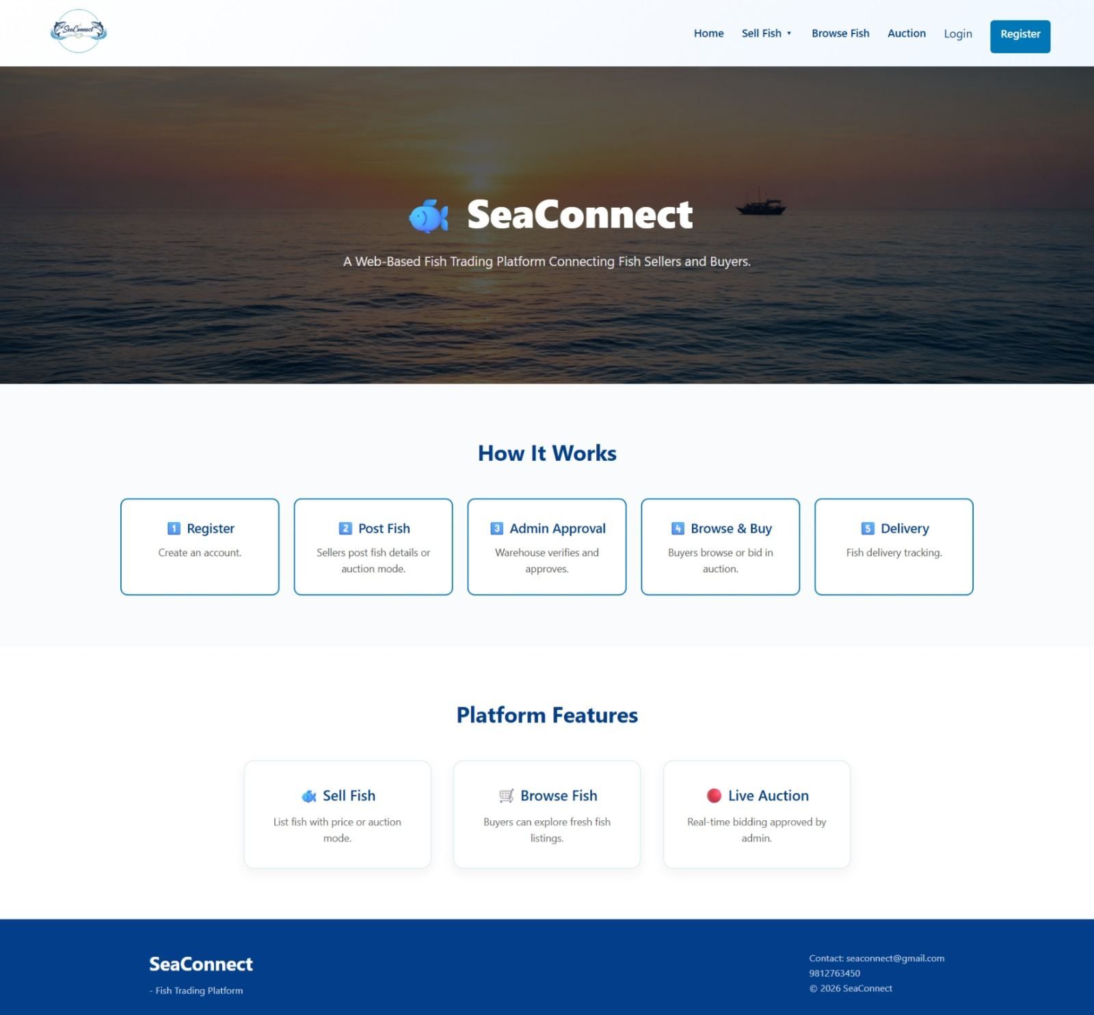
IMPLEMENTATION WORK:
Home Page:

Slide 16
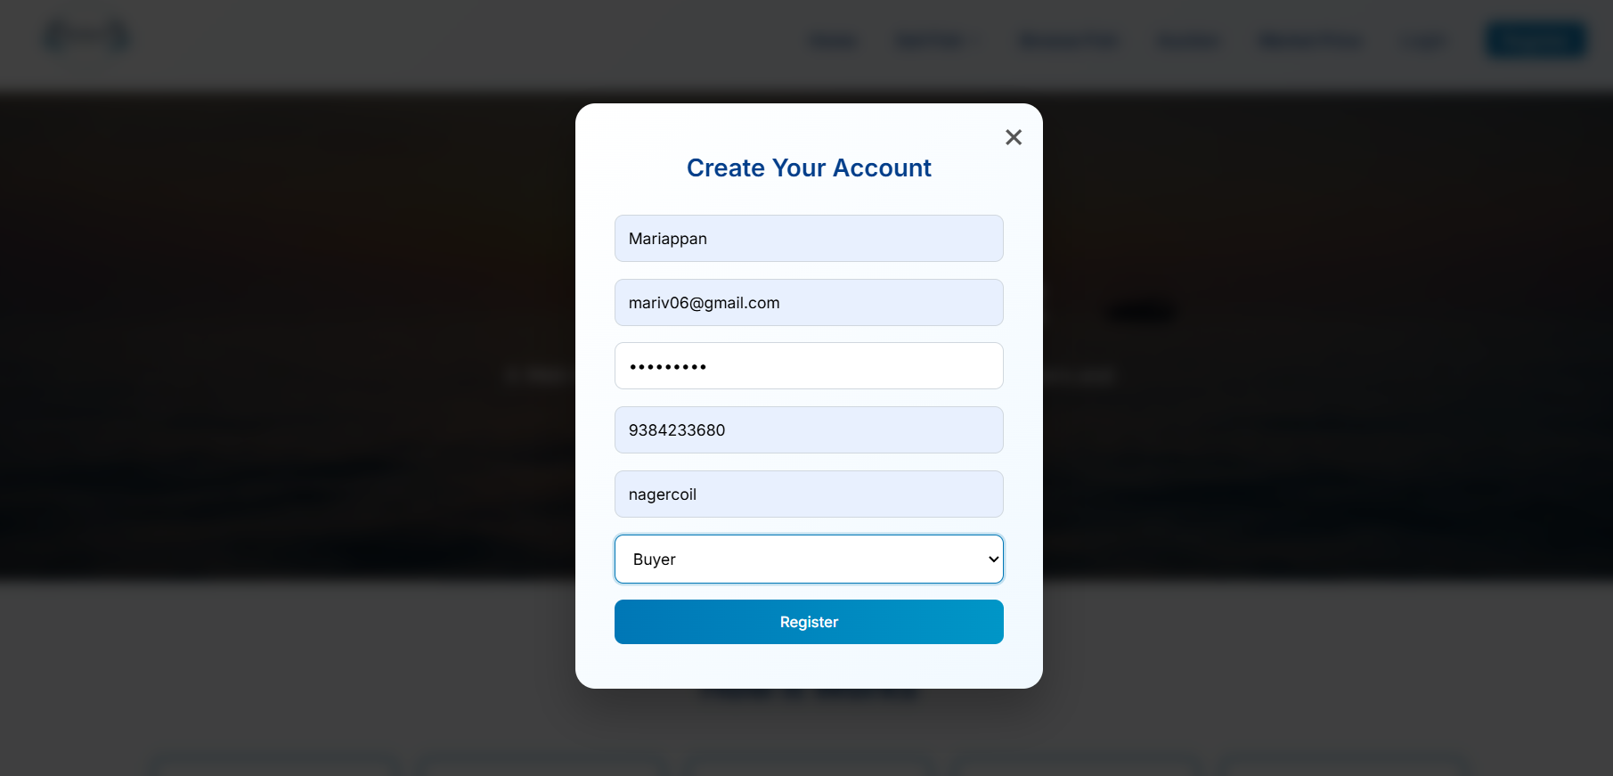
Register Page:

Slide 17
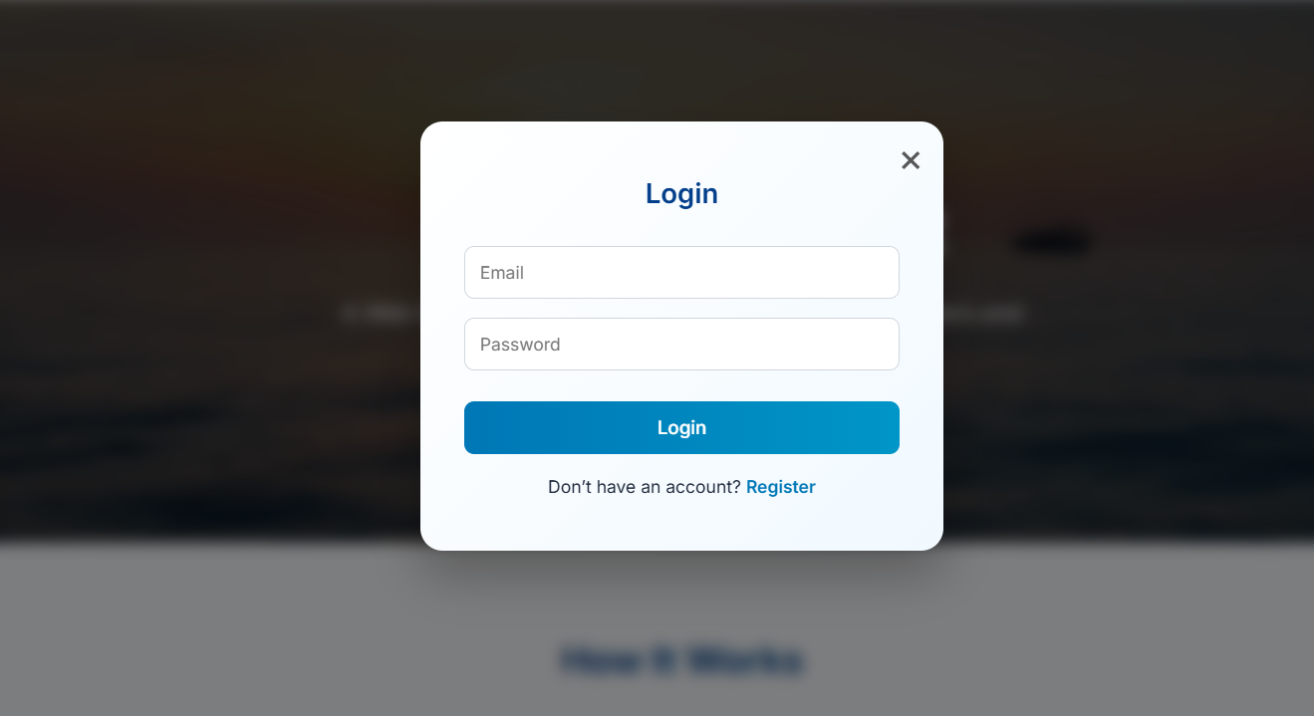
Login Page:

Slide 18
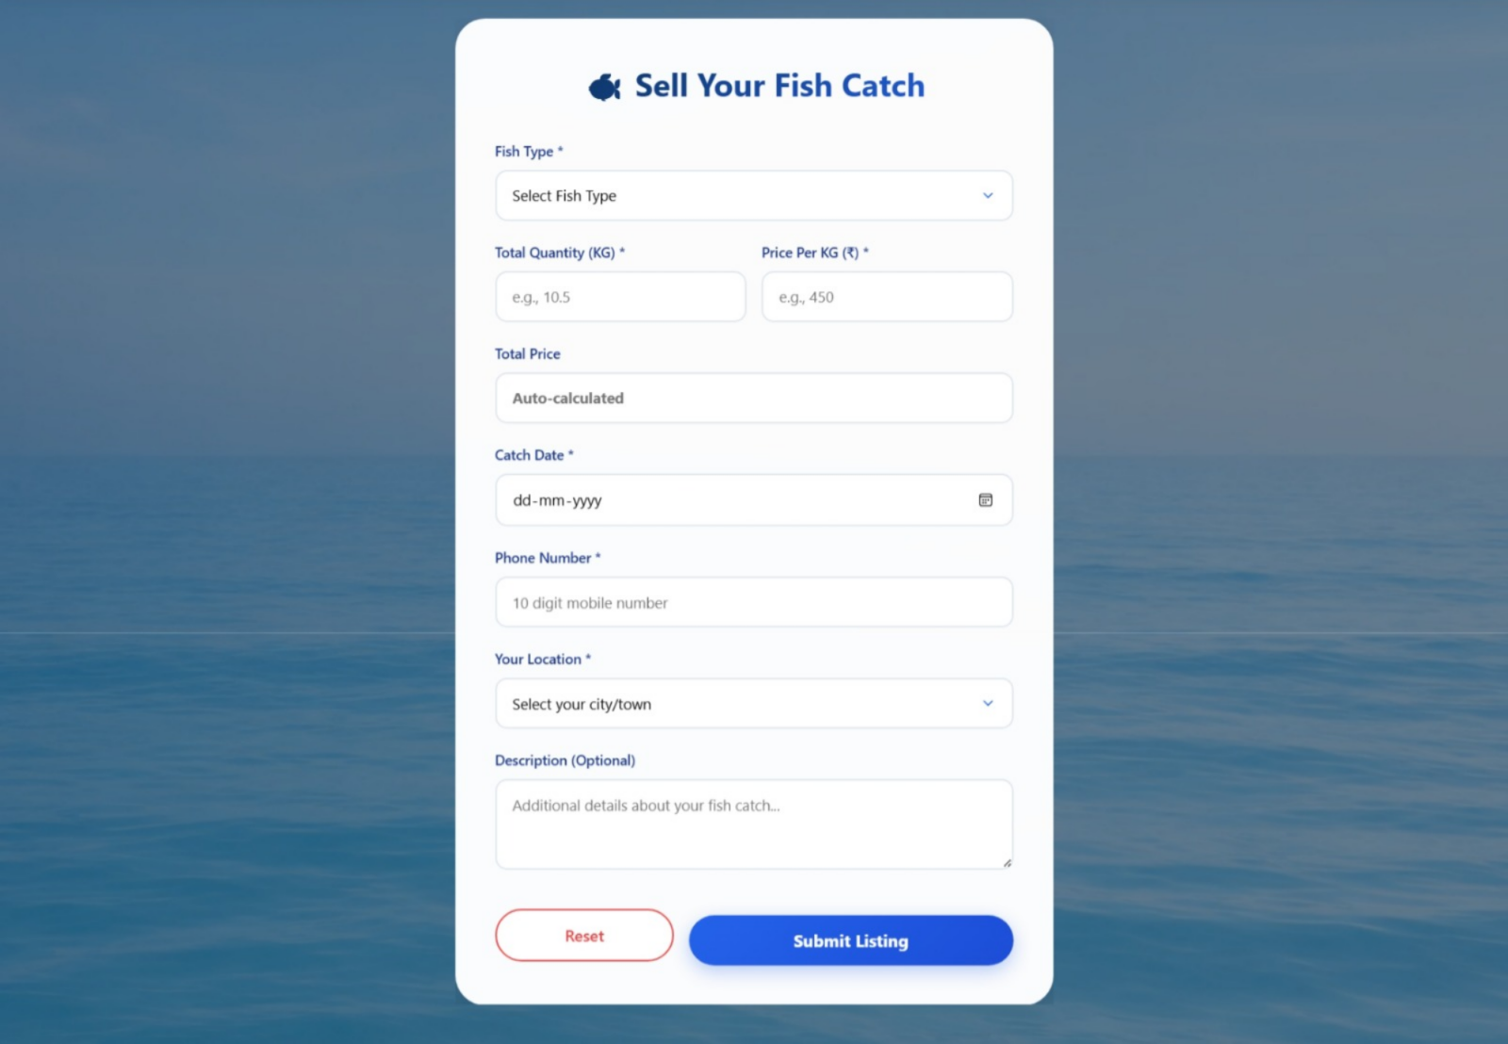
Create Fish List Page:

Slide 19
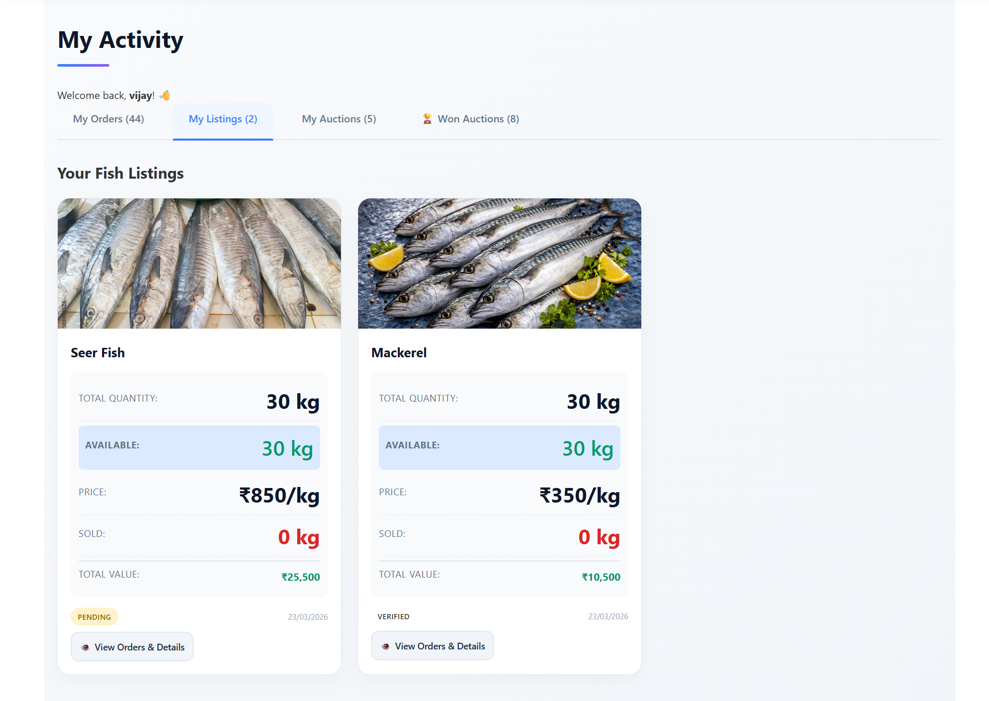
My Listing Page:

Slide 20
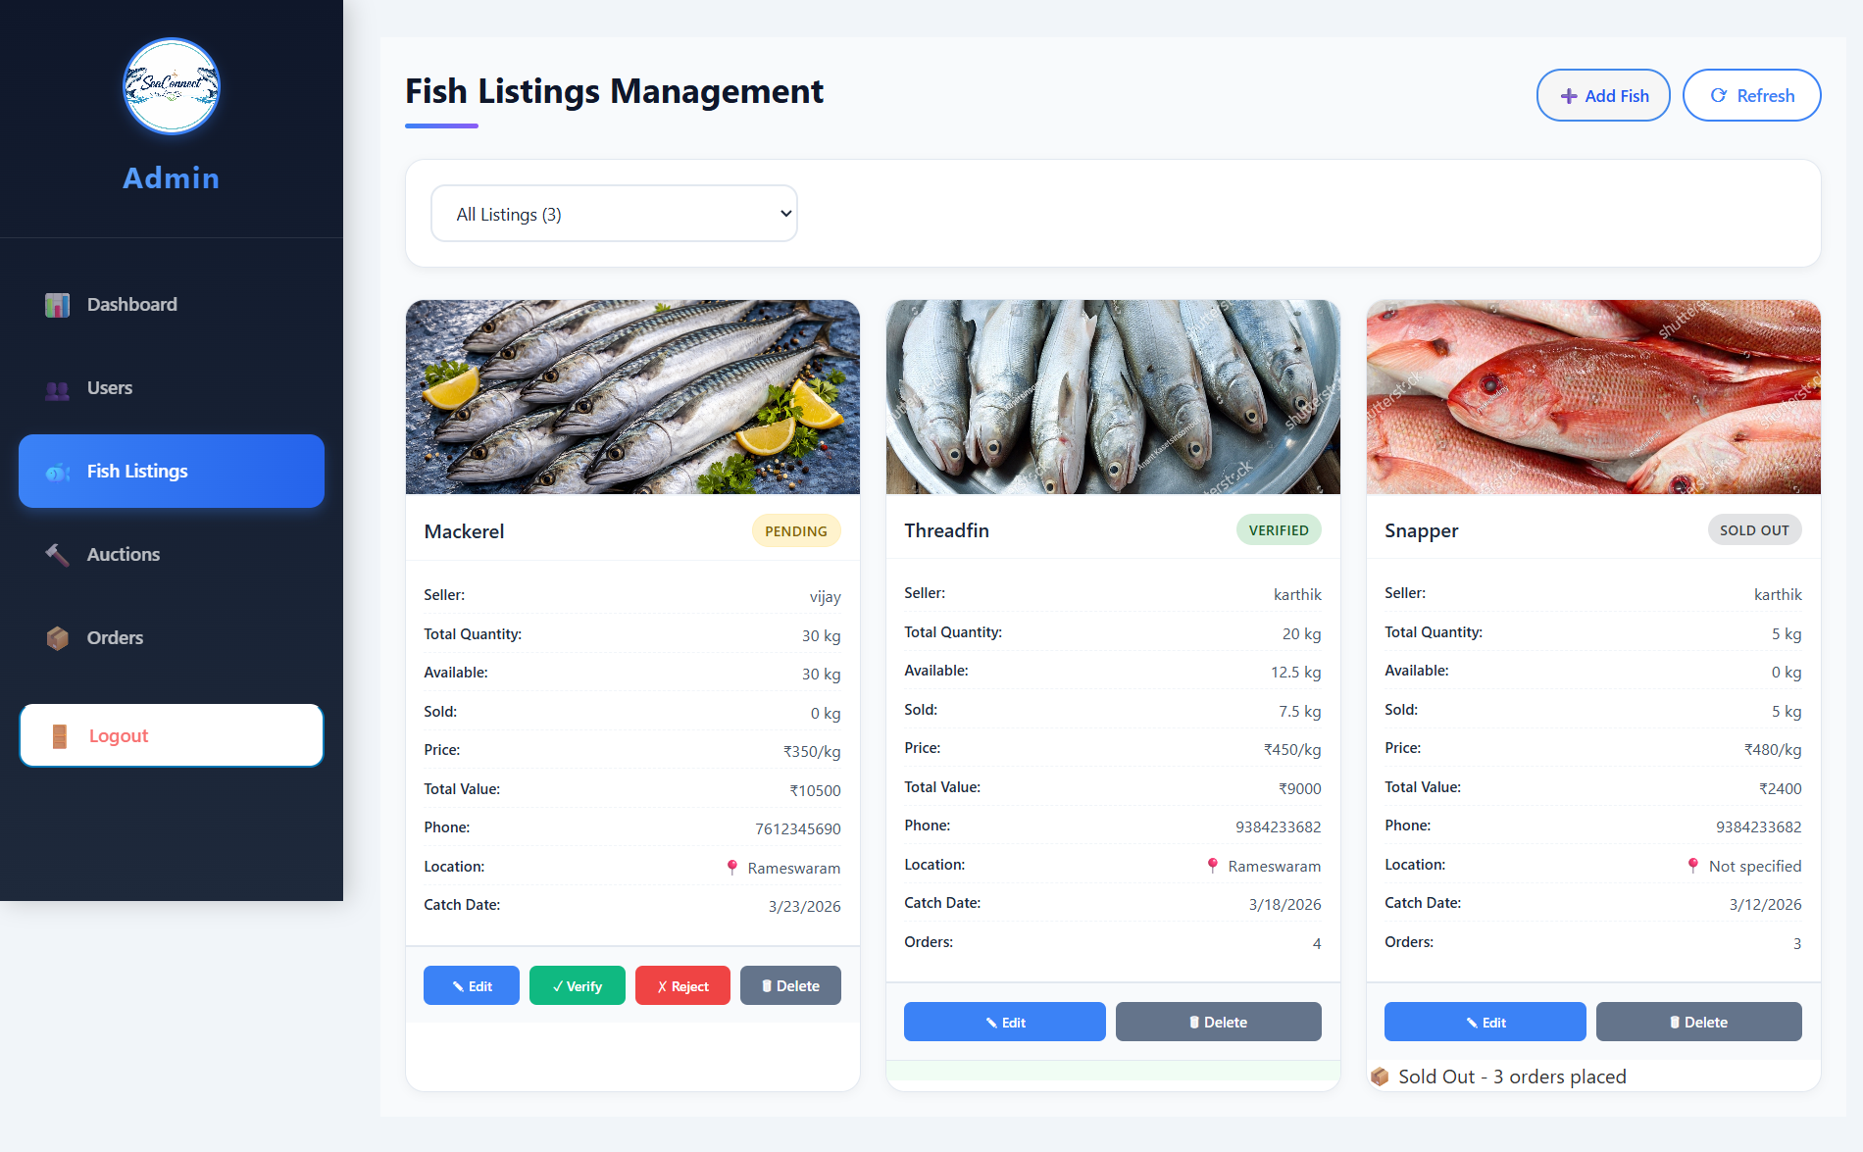
Fish Management(Admin) Page:

Slide 21
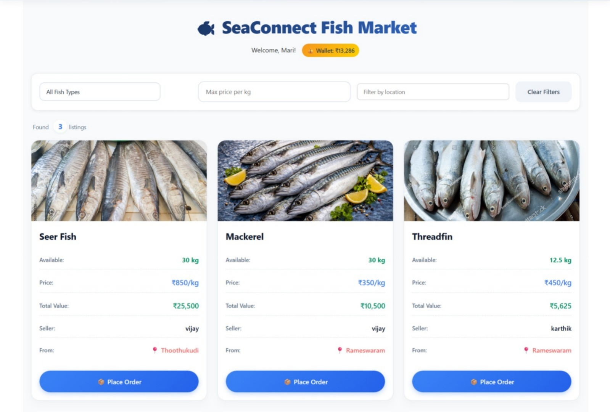
Browse Fish Page:

Slide 22
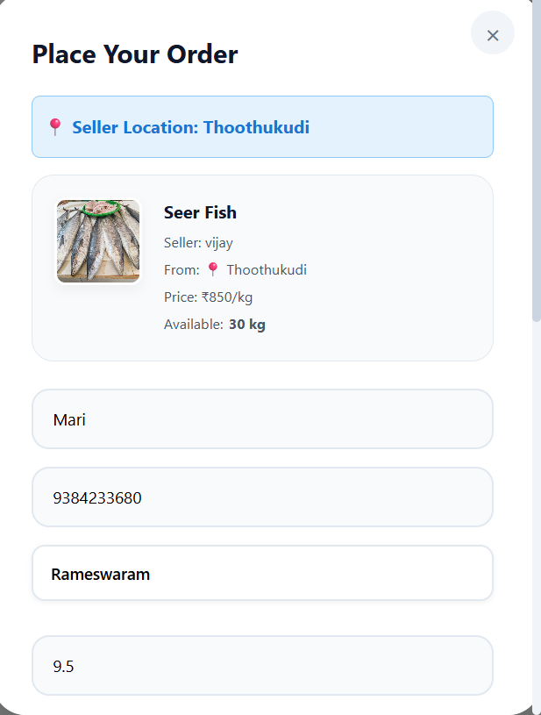
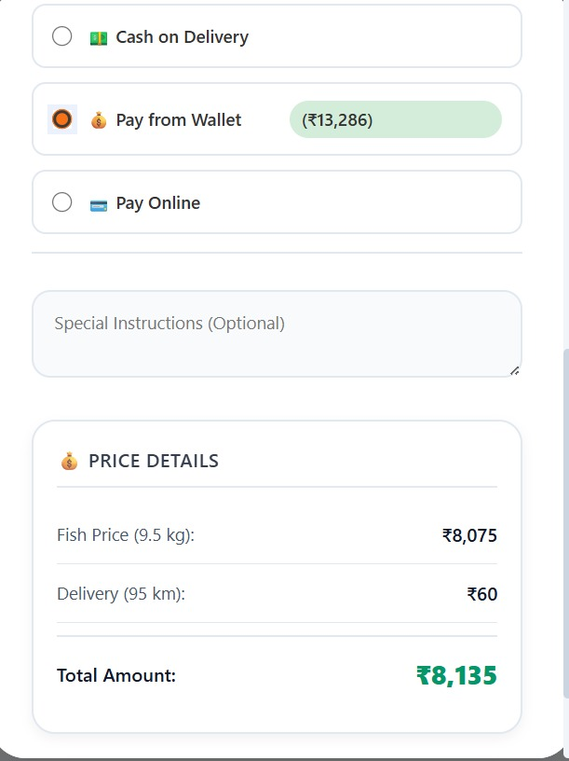
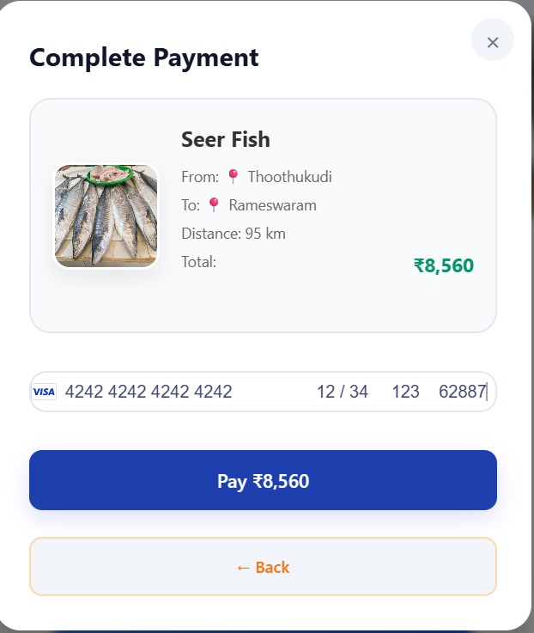
Place Order Page:

Slide 23
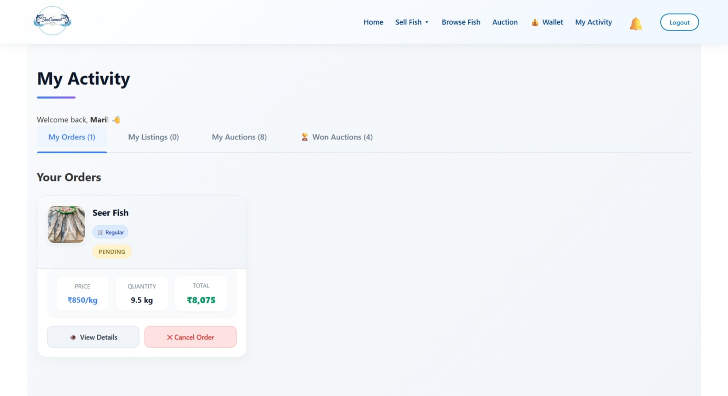
My Orders Page:

Slide 24
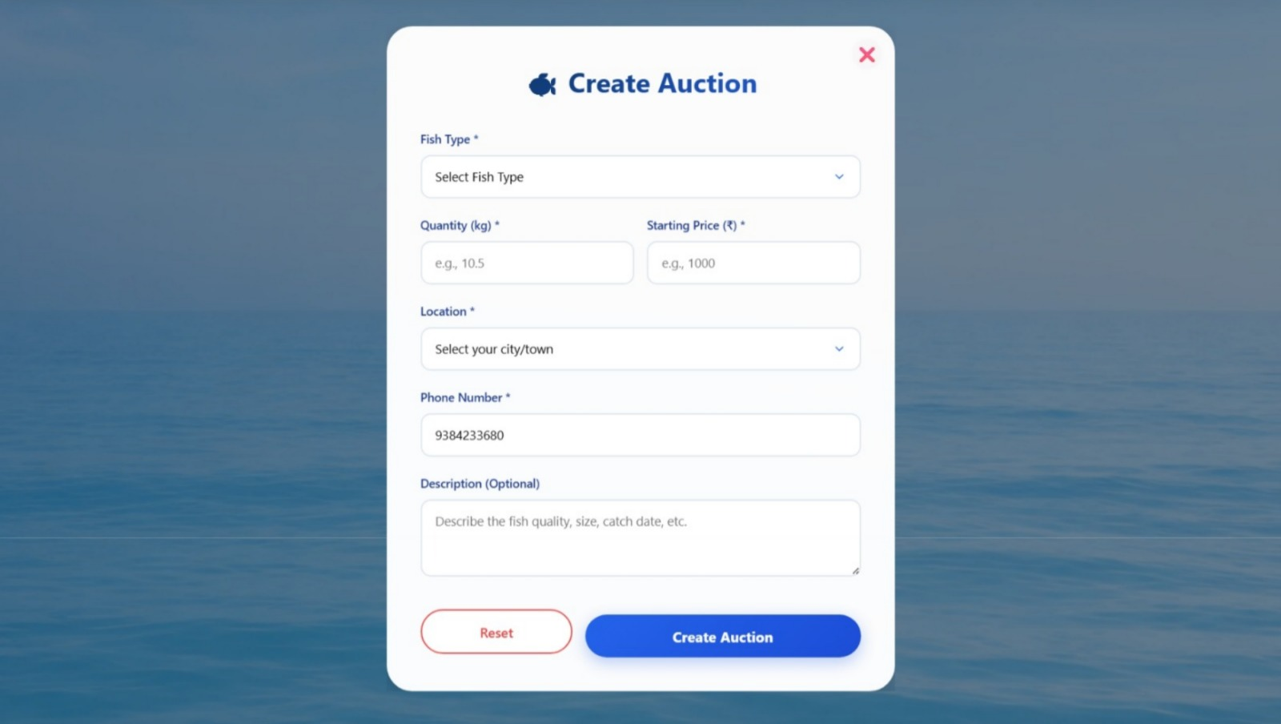
Create Auction Page:

Slide 25
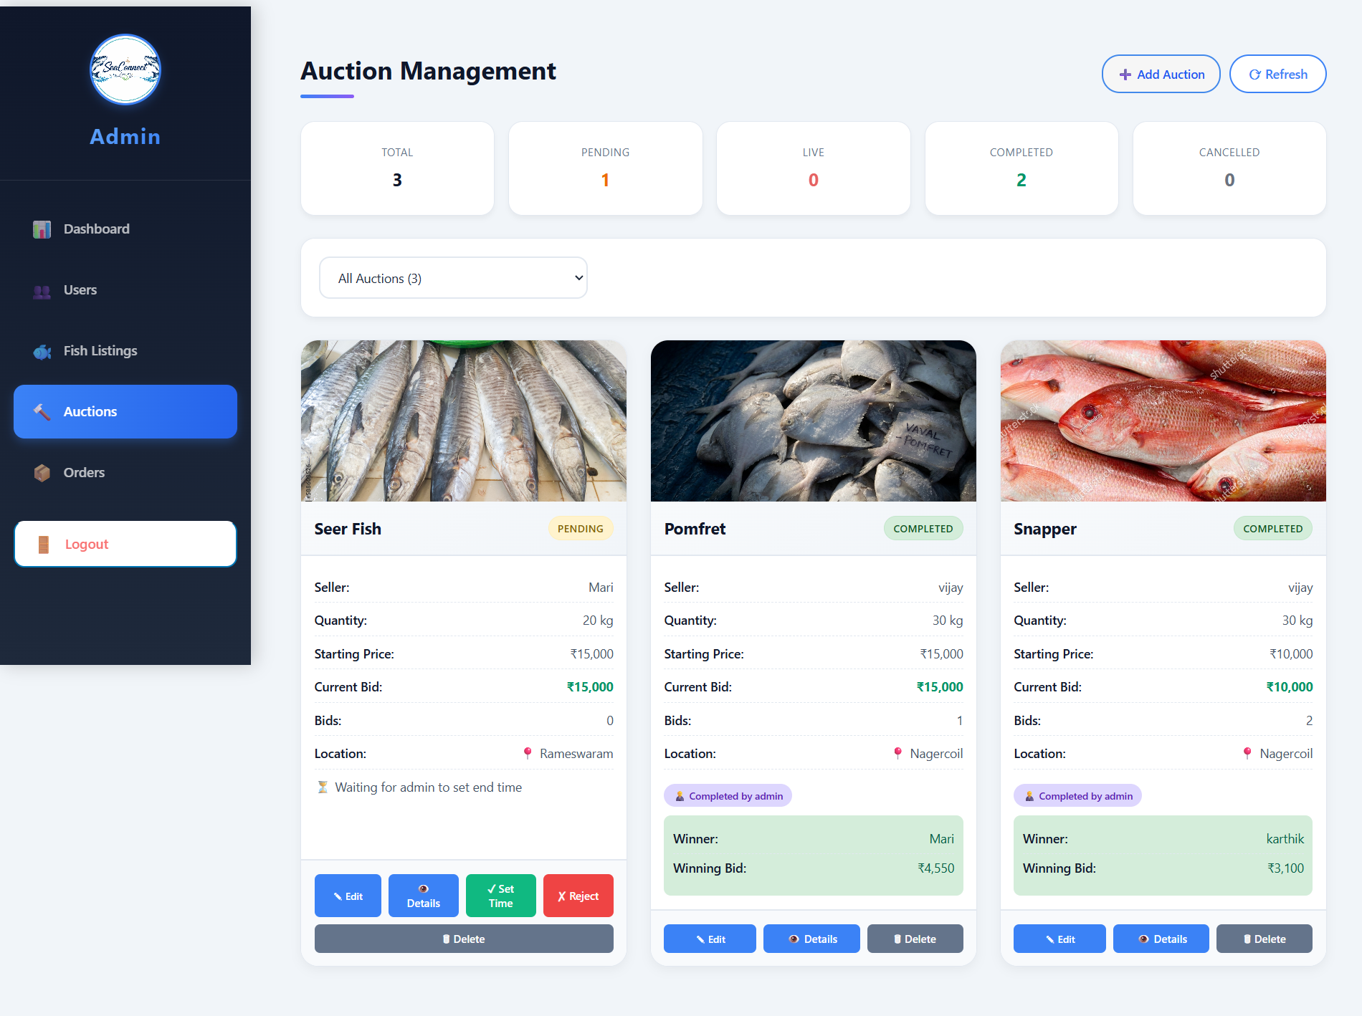
Auction Management (Admin) Page:

Slide 26
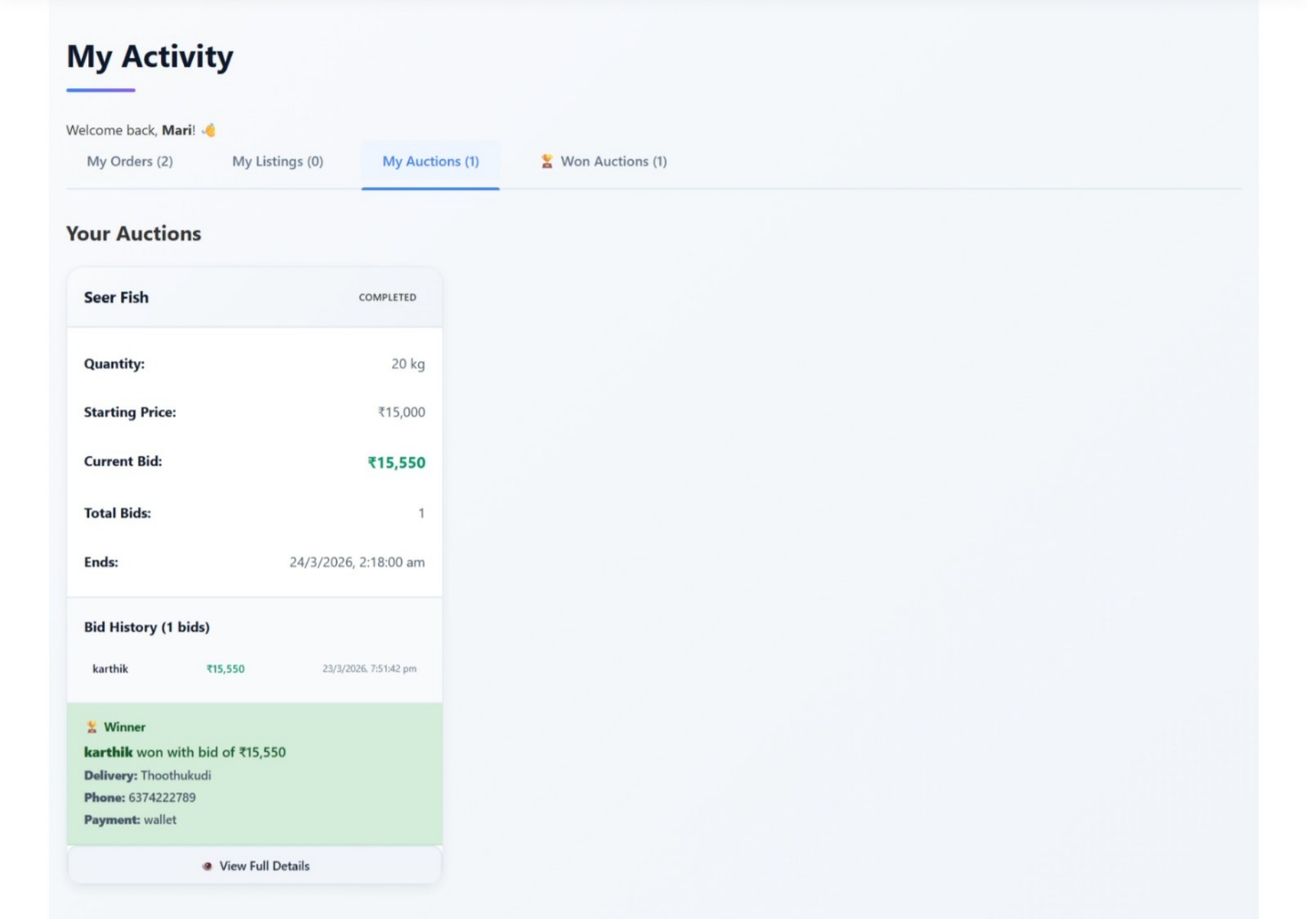
My Auction Page:

Slide 27
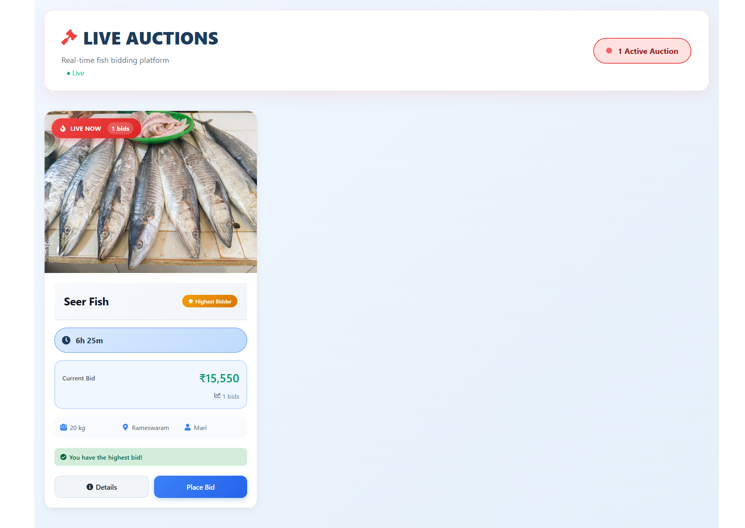
Auction Page:

Slide 28
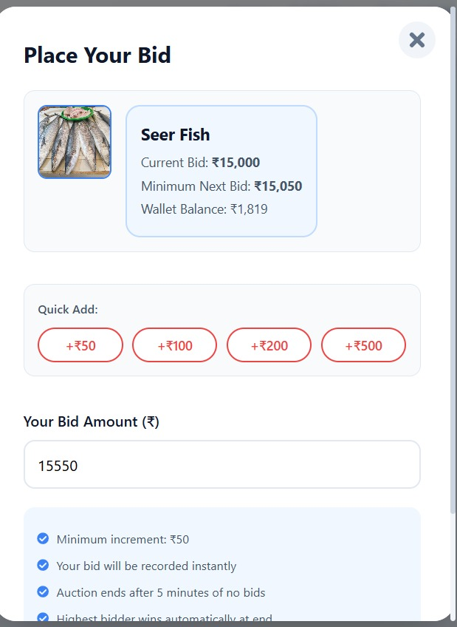
Bidding Page:

Slide 29
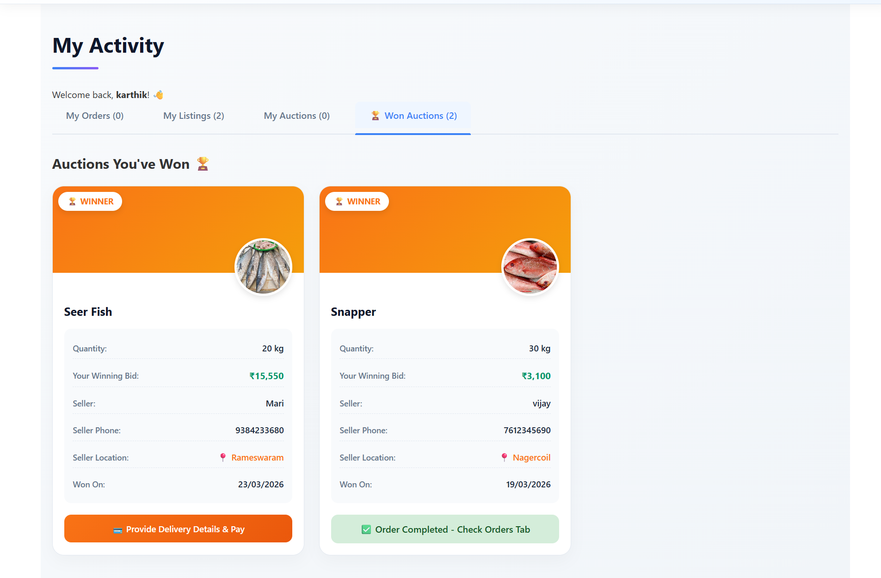
Won Auction Page:

Slide 30
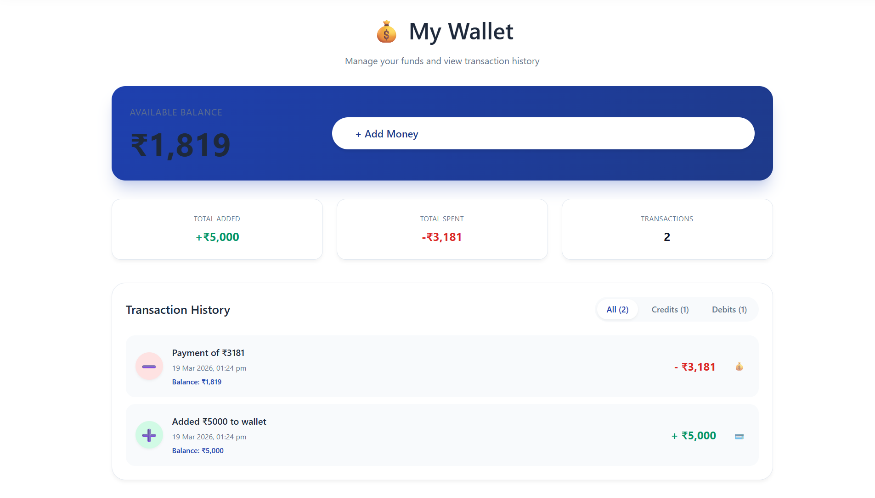
Wallet Page:

Slide 31
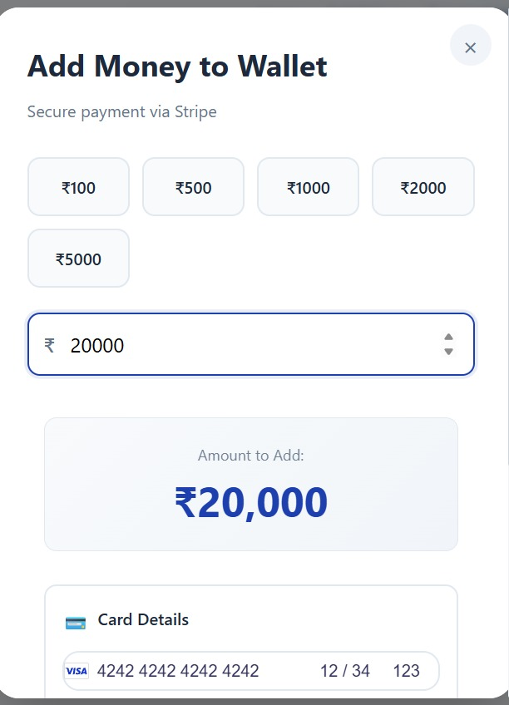
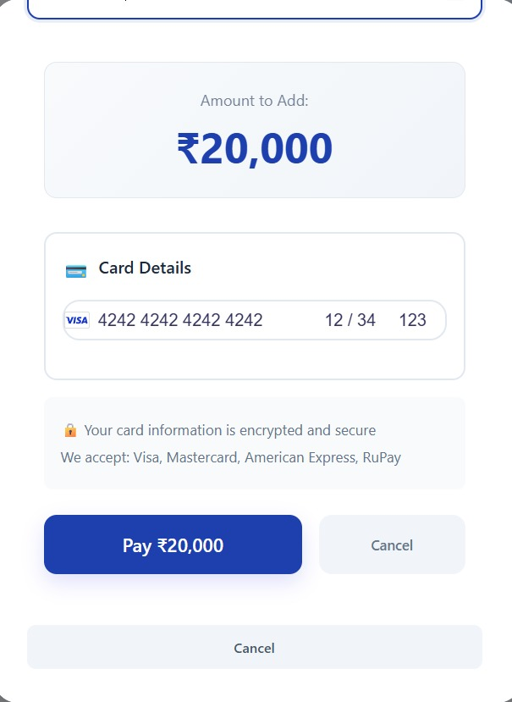
Wallet (Add Money) :

Slide 32
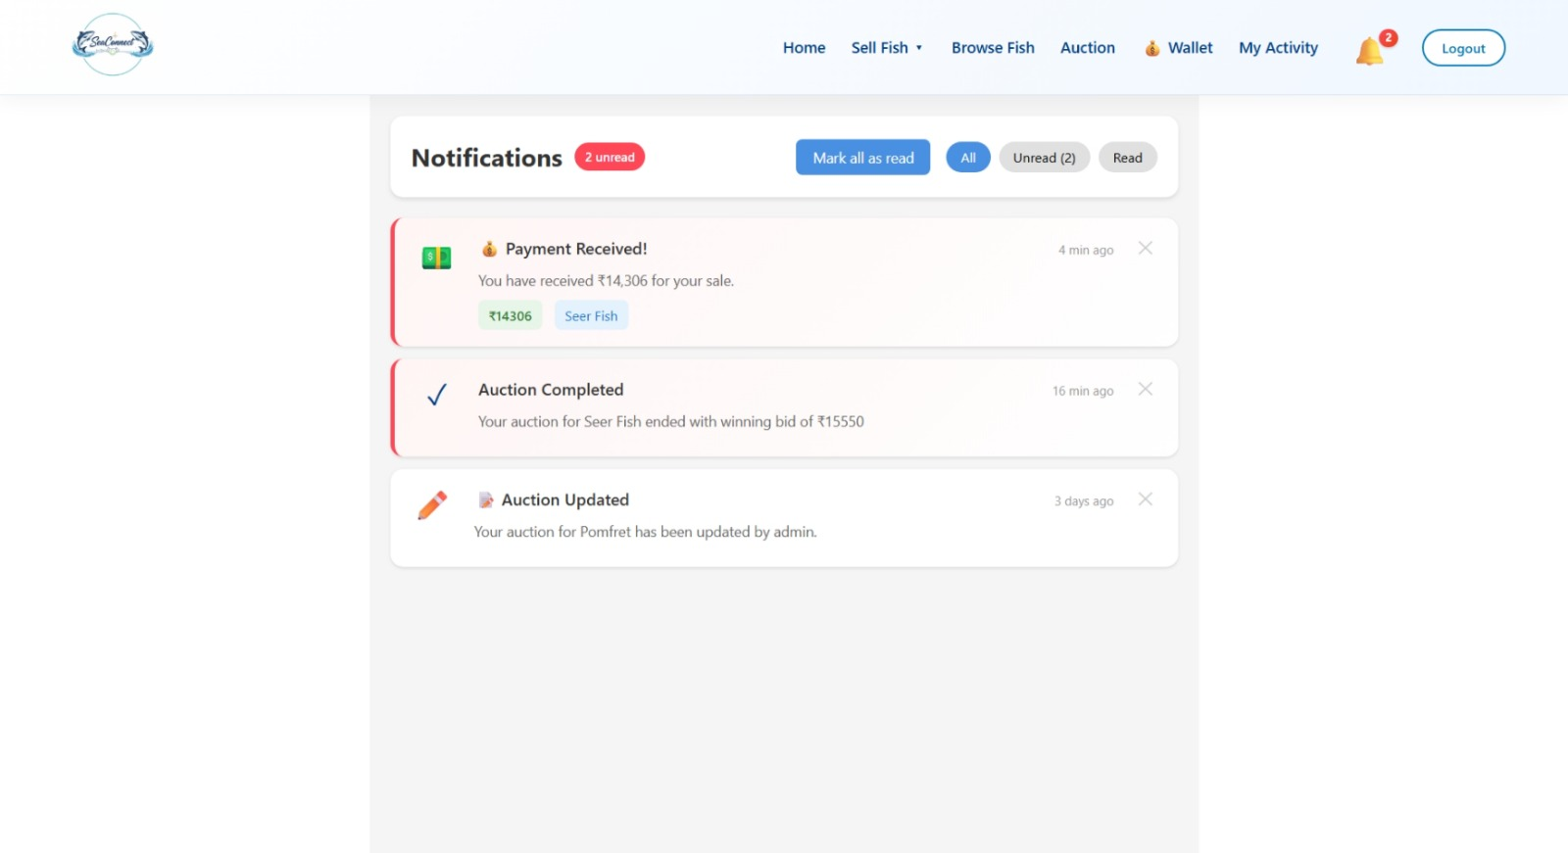
Notification Page:

Slide 33
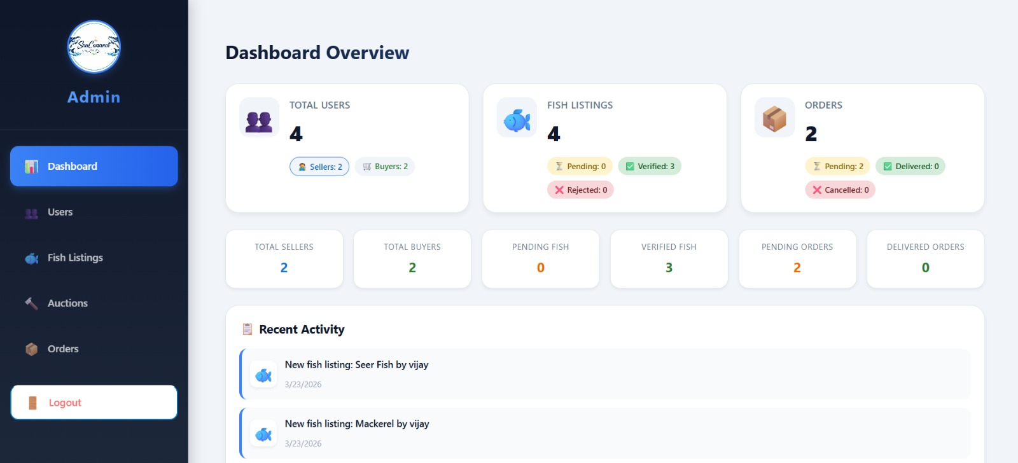
Admin dashboard:

Slide 34
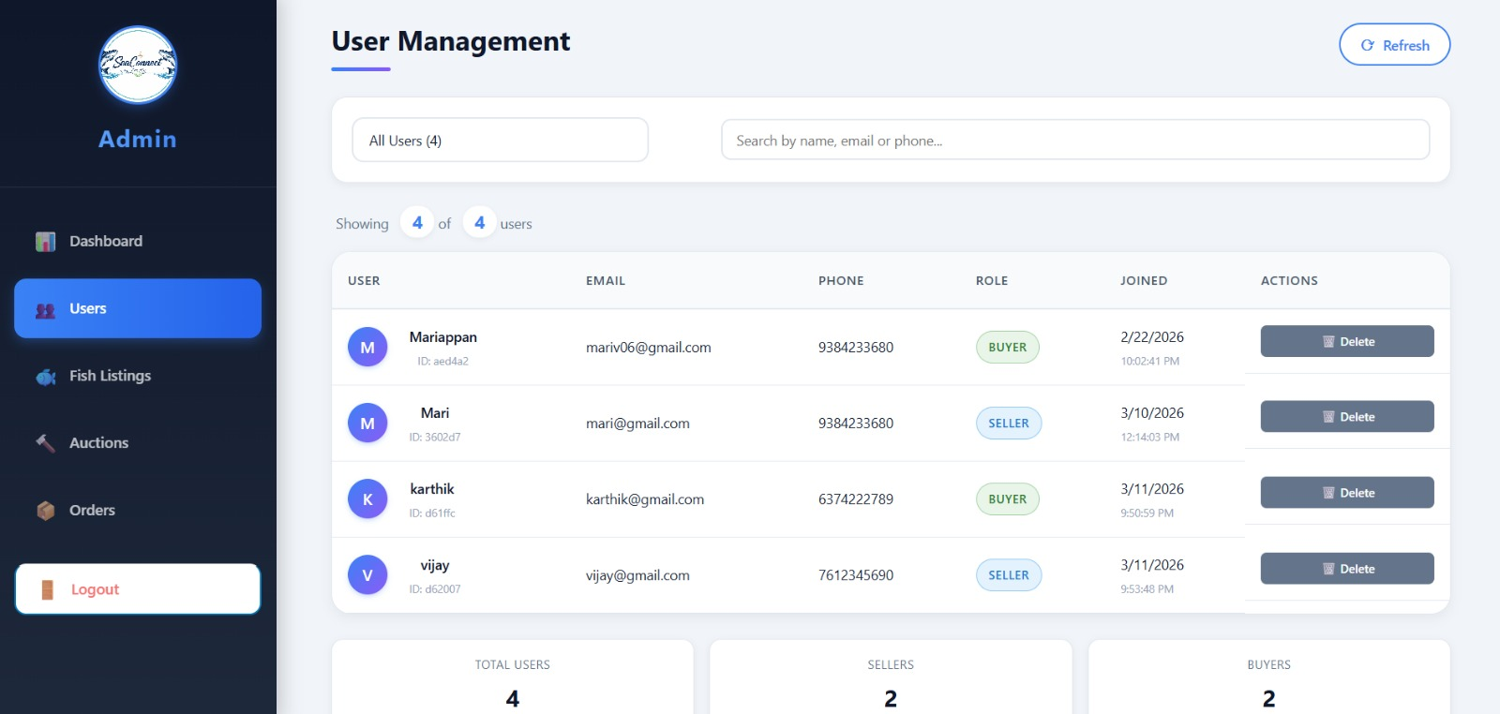
Users Page (Admin):

Slide 35
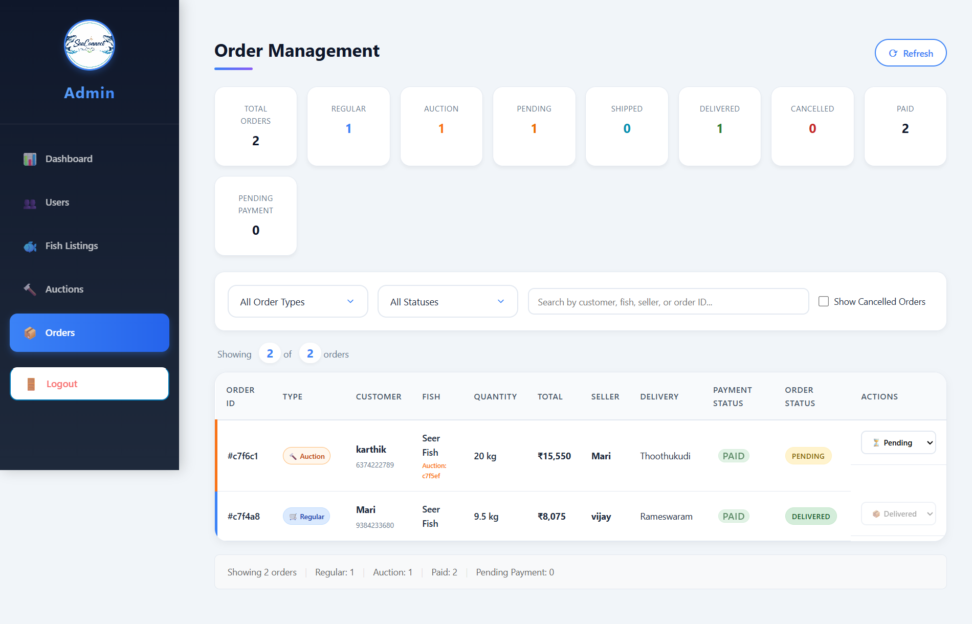
Orders Page (Admin):

Slide 36
THANK YOU

