Slide 1
Life Expectancy Analysis

Slide 2
Objective
To analyze global life expectancy data and explore the socio-economic and health-related factors affecting life expectancy across different countries and time periods, using exploratory data analysis techniques.

Slide 3
Technologies & Libraries
PANDAS - A Python library for easy data manipulation and analysis using DataFrames.
NUMPY - Enables fast numerical computations with multi-dimensional arrays.
MATPLOTLIB - A plotting library for creating static and interactive visualizations.
SEABORN - Simplifies statistical data visualization built on top of Matplotlib.
JUPYTER NOTEBOOK - An interactive environment to write, run, and share Python code and visuals.

Slide 4
Methodology
Data cleaning & preprocessing
Exploratory data analysis
Visualization of key findings

Slide 5
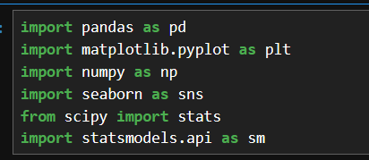
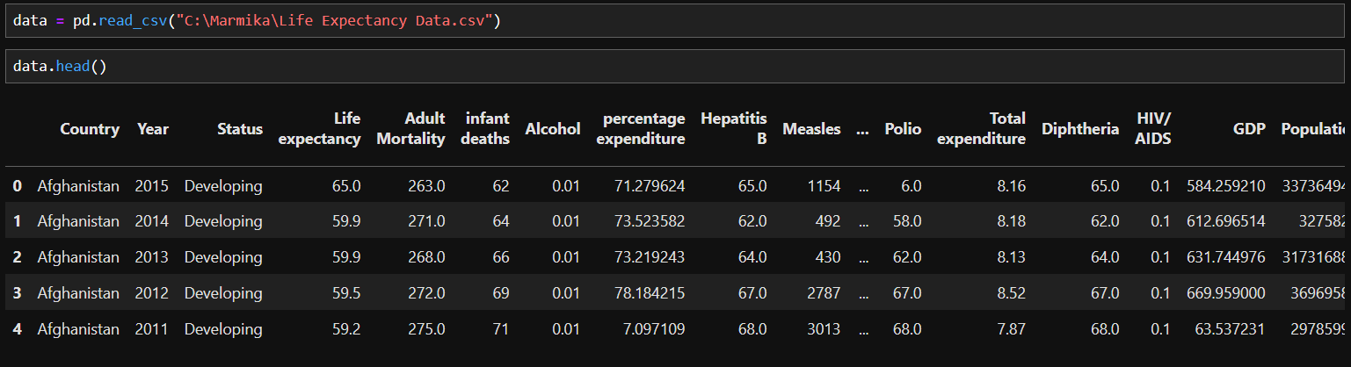
Importing Libraries and Reading Data

Slide 6
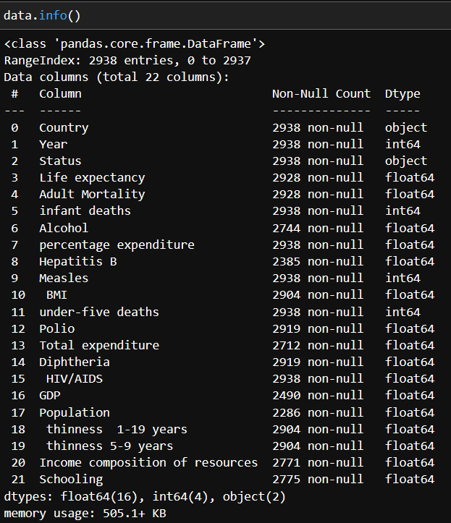
Concise Summary of DataFrame

Slide 7
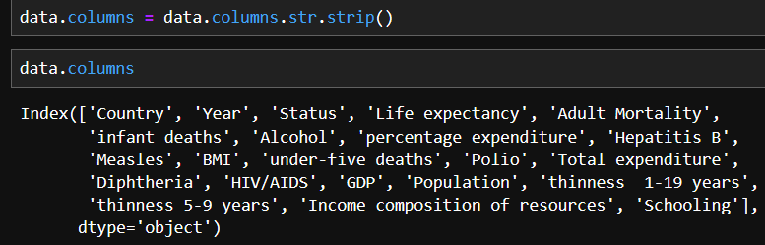
Removing Extra Spaces From Column Names

Slide 8
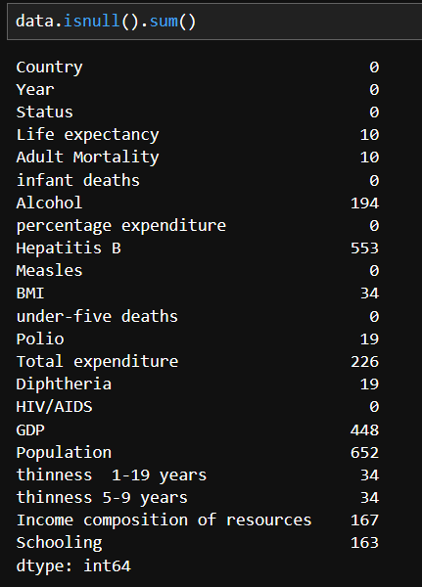
Checking Null Values

Slide 9
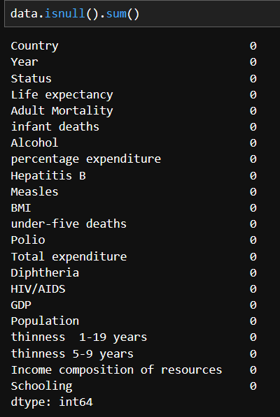
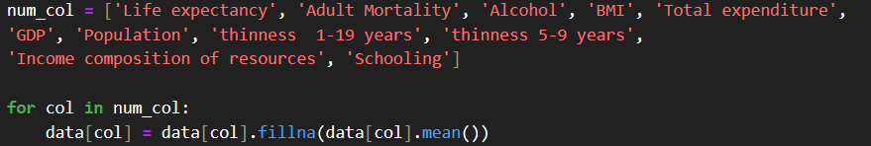
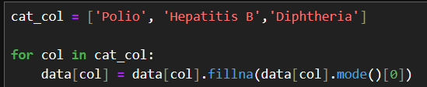
Handling Null Values for Numerical & Categorical Columns

Slide 10
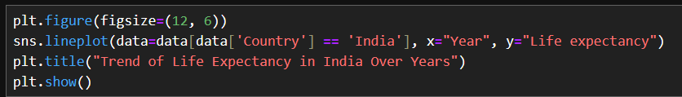
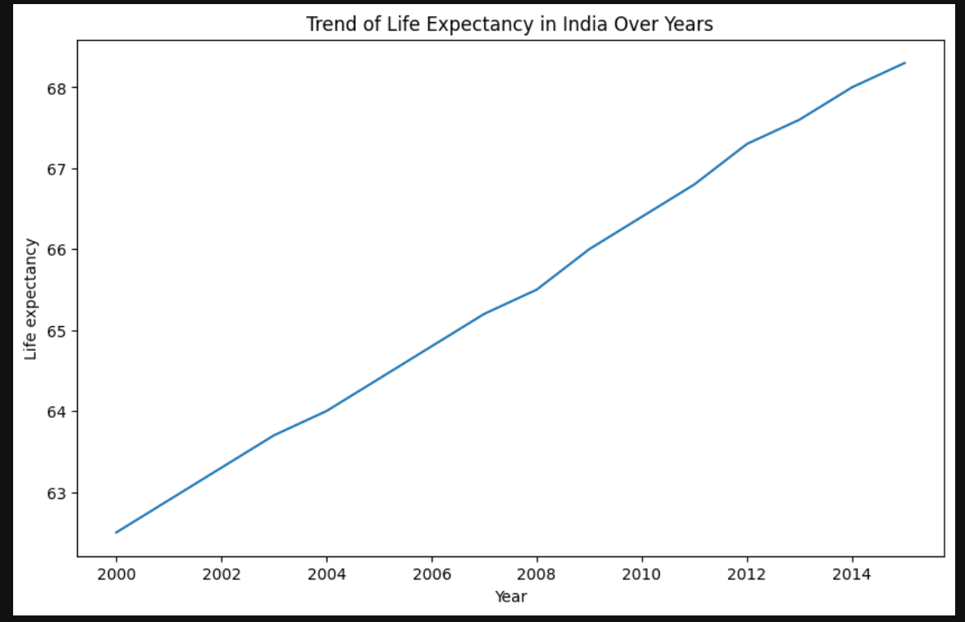
Trend of Life Expectancy in India Over Years

Slide 11
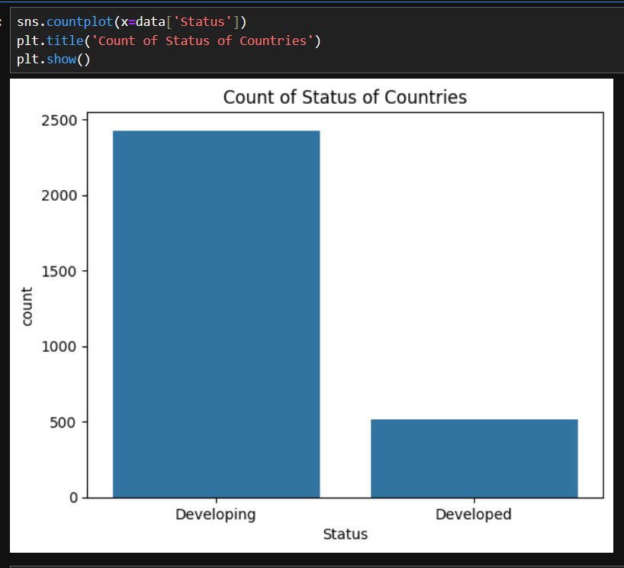
Count of Status of Countries

Slide 12
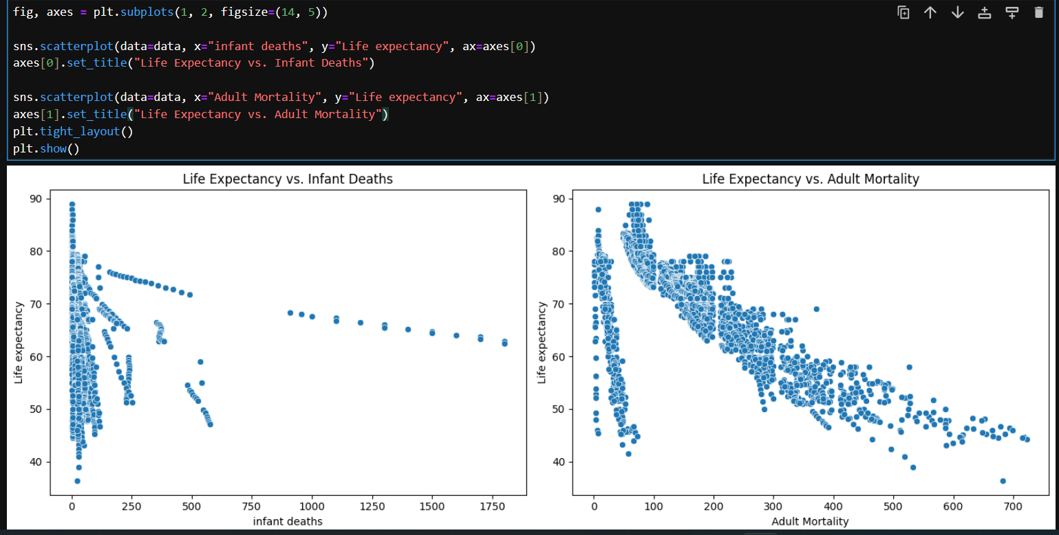
Impact of Infant and Adult Mortality on Life Expectancy

Slide 13
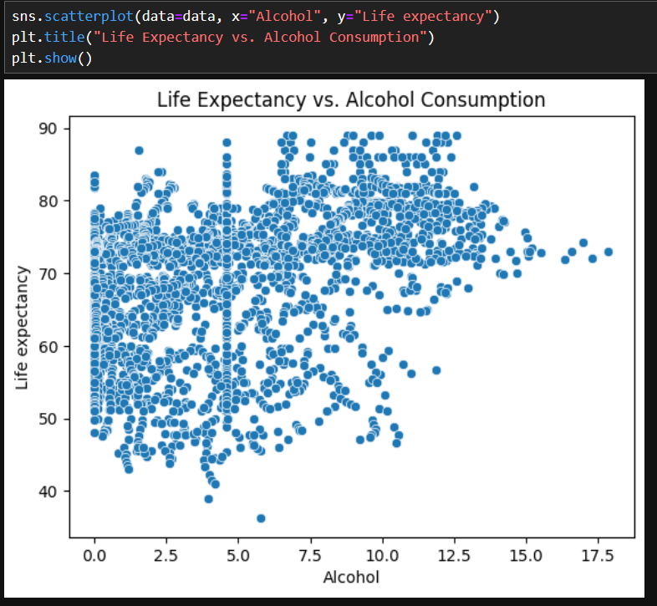
Life Expectancy vs Alcohol Consumption

Slide 14
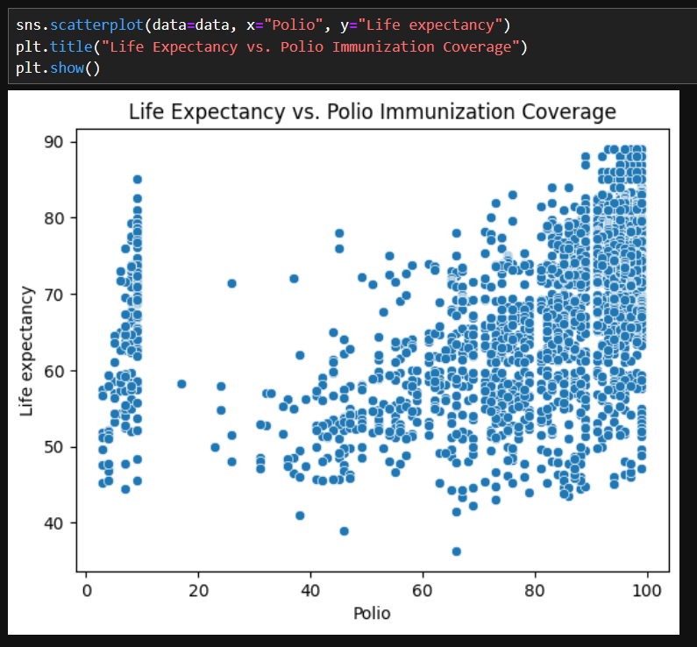
Life Expectancy vs. Polio Immunization Coverage

Slide 15
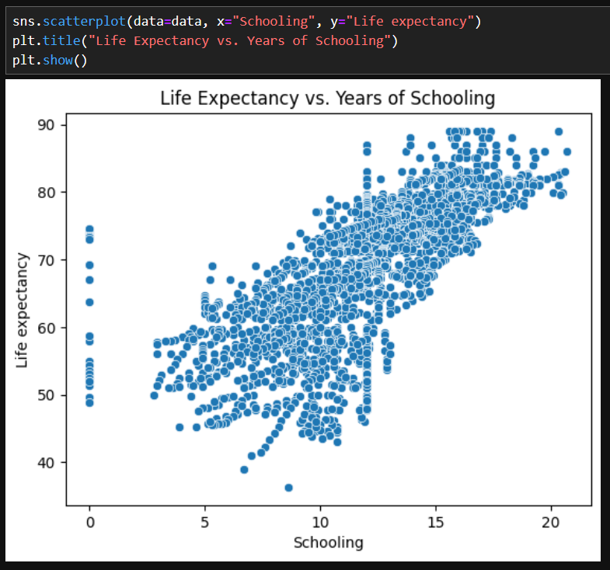
Life Expectancy VS Years of Schooling

Slide 16
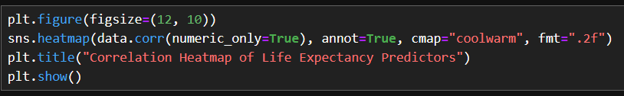
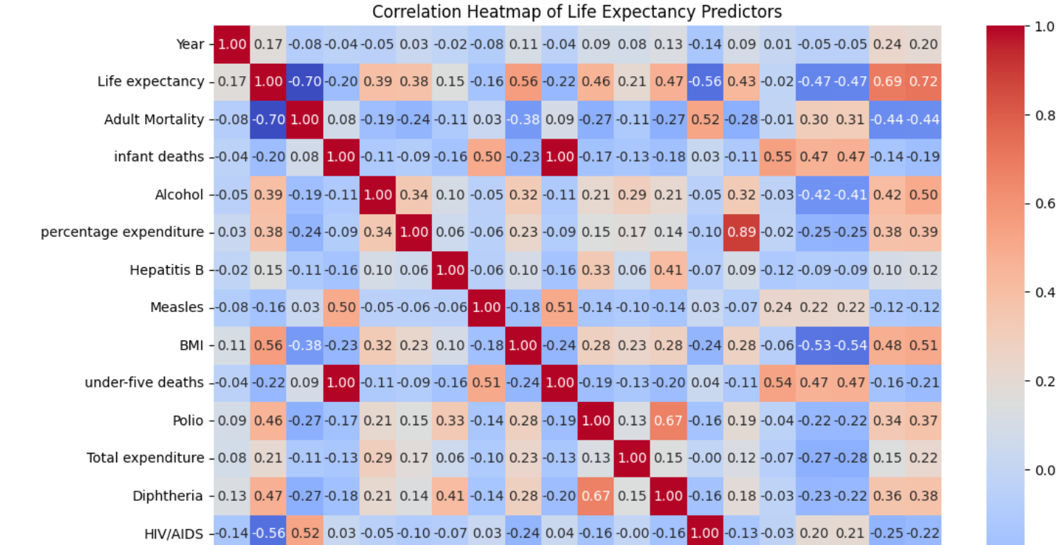
Correlation Heatmap of Life Expectancy Predictors

Slide 17
Conclusion
The analysis shows that GDP, Schooling, and BMI are significant positive predictors of life expectancy.
Alcohol consumption does not show a significant effect.
The findings shows education emerging as the impactful factor and suggests importance of investing in education and economic development to improve public health outcomes globally.
Vaccination coverage significantly improves longevity.
There are still big differences between regions, especially in poor countries.

