Slide 1
Netflix Data Analysis

Slide 2
Objective
To analyze the Netflix dataset and gain insights into the platform’s content strategy, popular genres, production trends, and the evolution of streaming content over time.

Slide 3
Technologies Used
PANDAS - A Python library for easy data manipulation and analysis using DataFrames.
NUMPY - Enables fast numerical computations with multi-dimensional arrays.
MATPLOTLIB - A plotting library for creating static and interactive visualizations.
SEABORN - Simplifies statistical data visualization built on top of Matplotlib.
JUPYTER NOTEBOOK - An interactive environment to write, run, and share Python code and visuals.

Slide 4
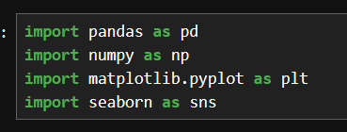

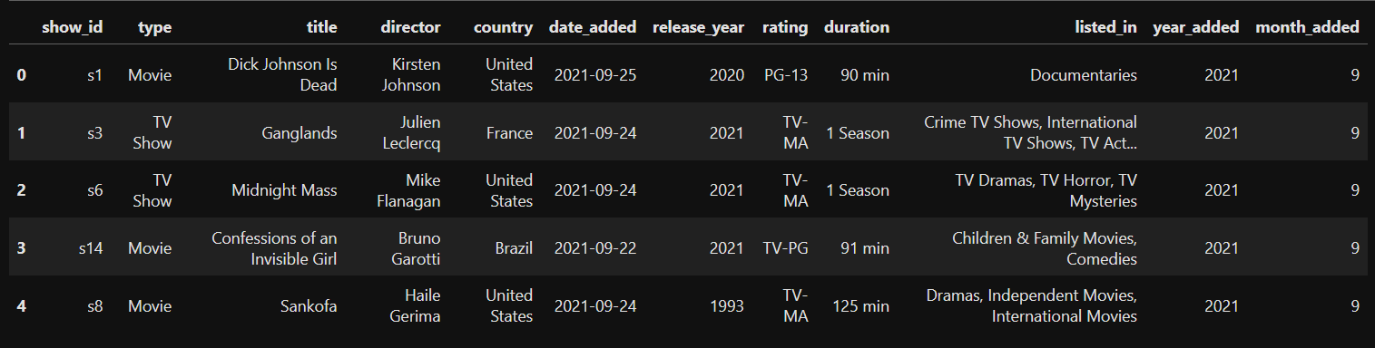
Importing Libraries and Reading Data
Content goes here...

Slide 5
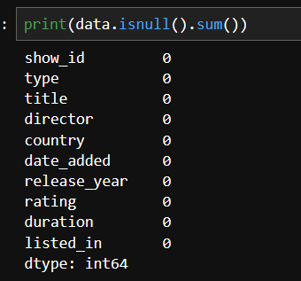
Checking Null Values

Slide 6

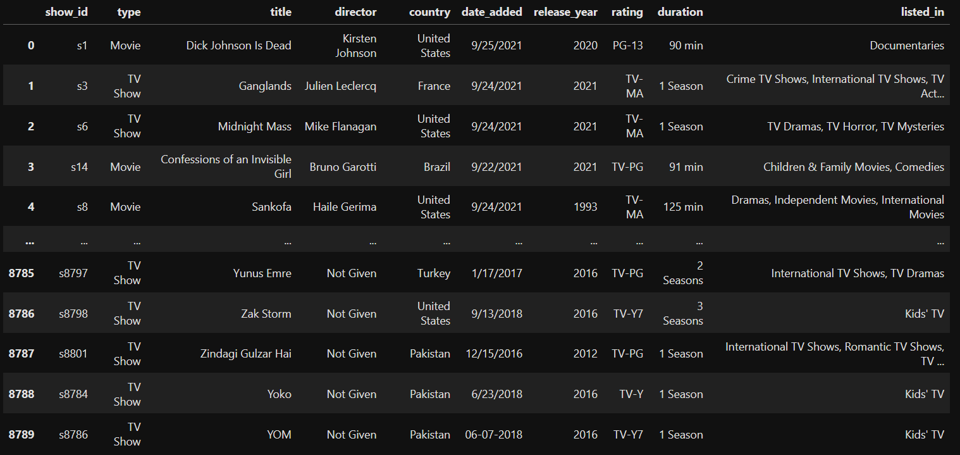
Dropping Duplicate Values

Slide 7
VISUALISATIONS

Slide 8
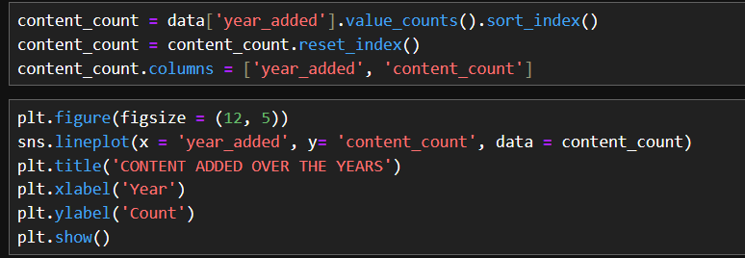
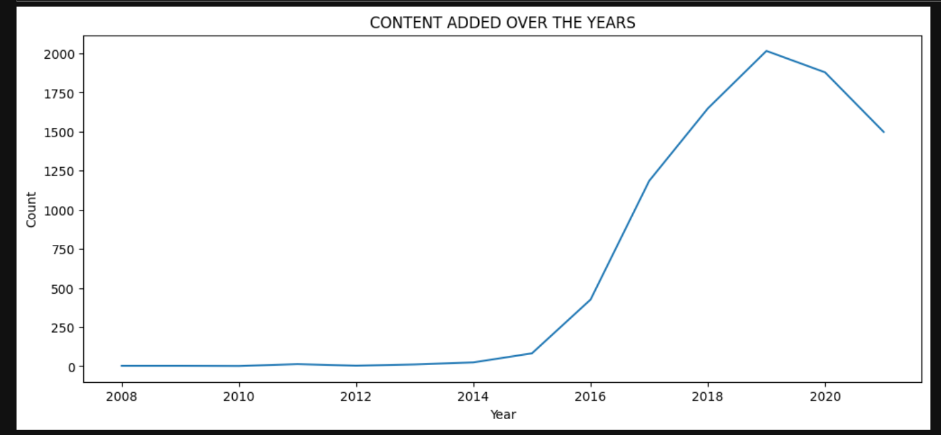
Content Added Over Years

Slide 9
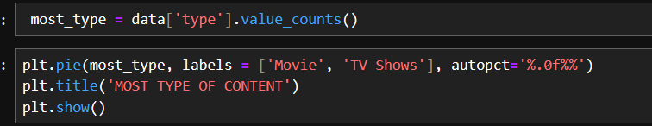
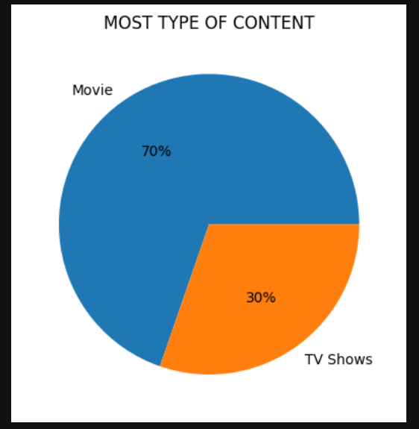
Most Type Of Content

Slide 10
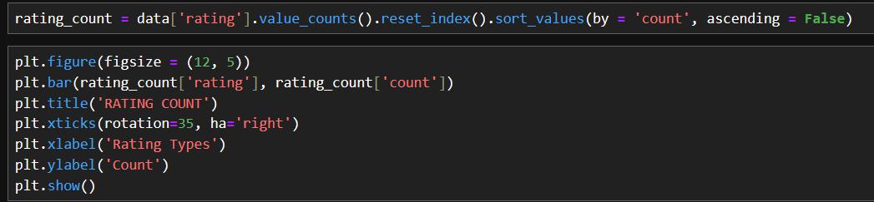
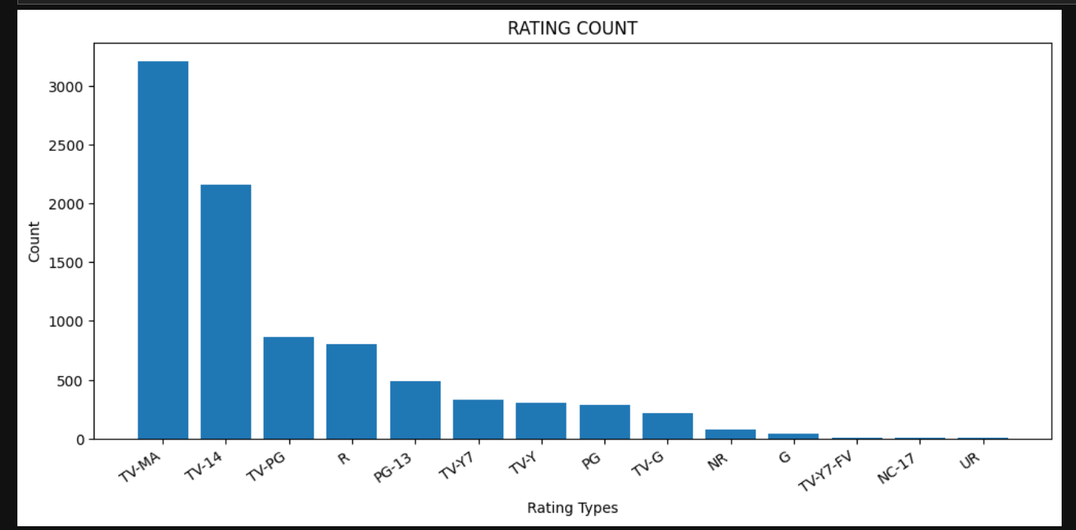
Rating Count

Slide 11
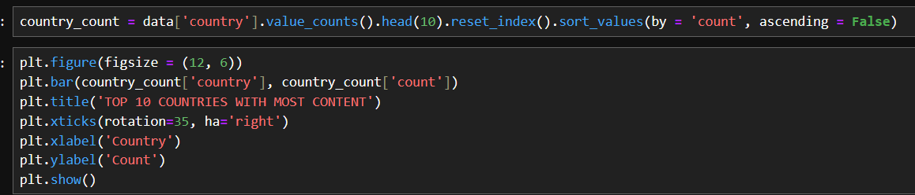
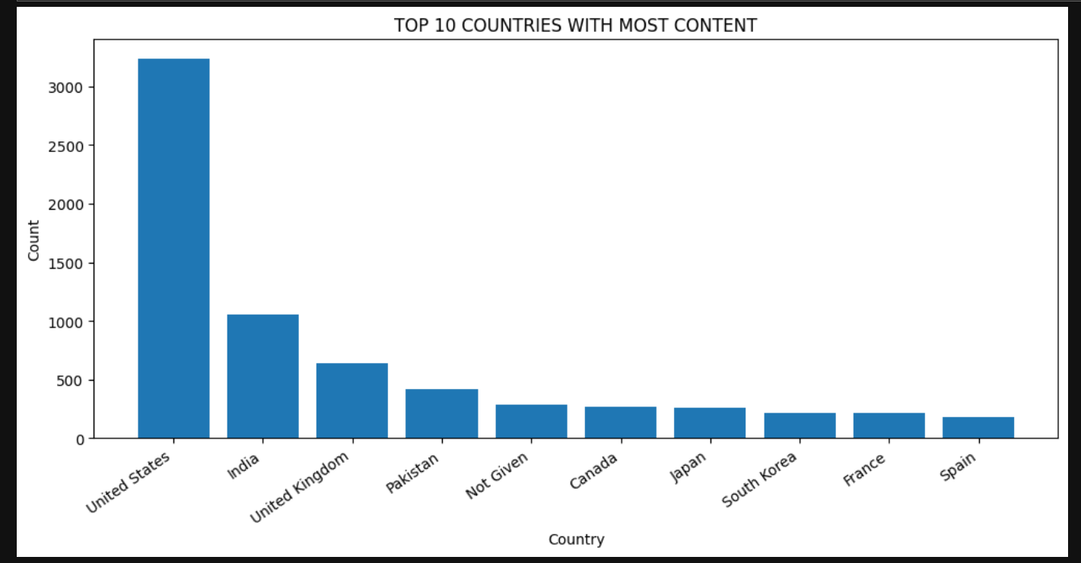
Top 10 Countries With Most Content

Slide 12
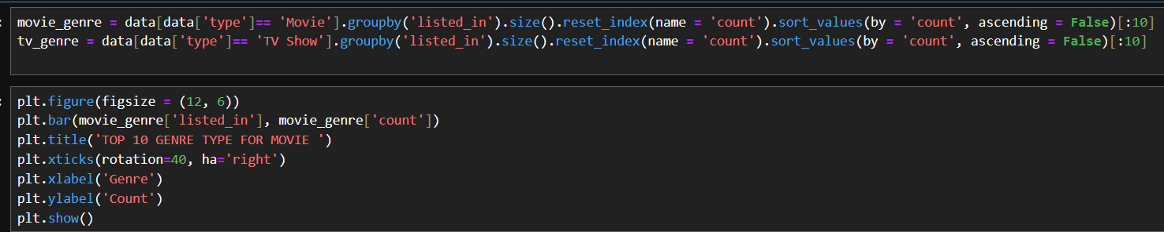
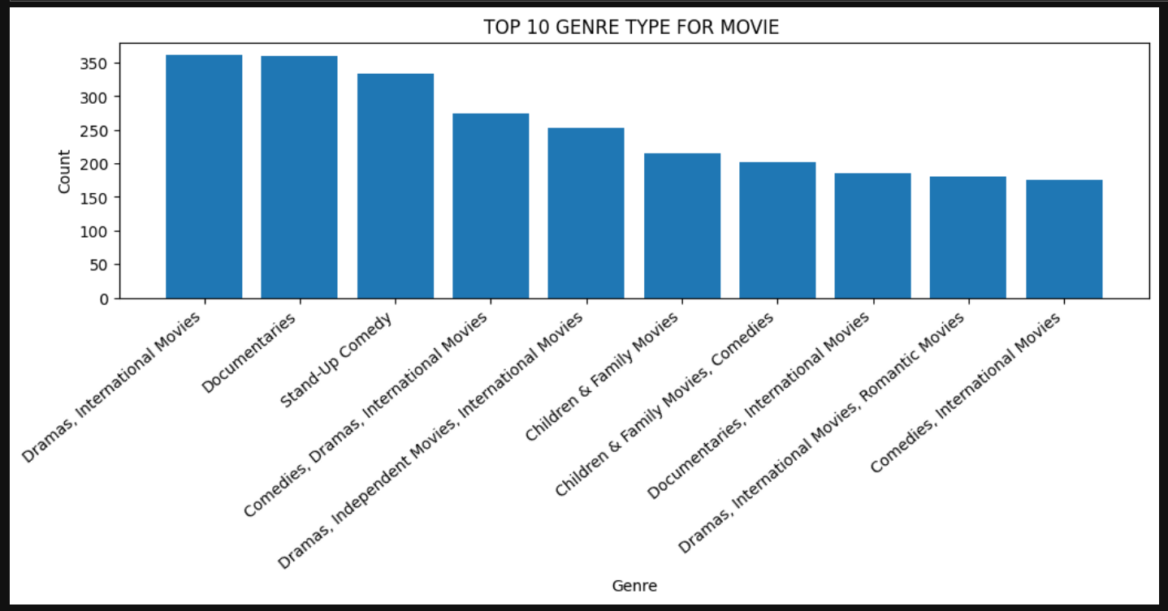
Top 10 Genre Type For Movie

Slide 13
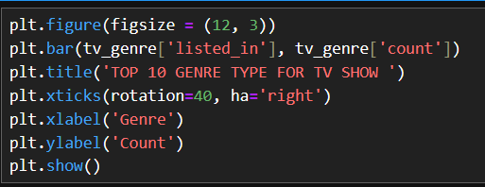
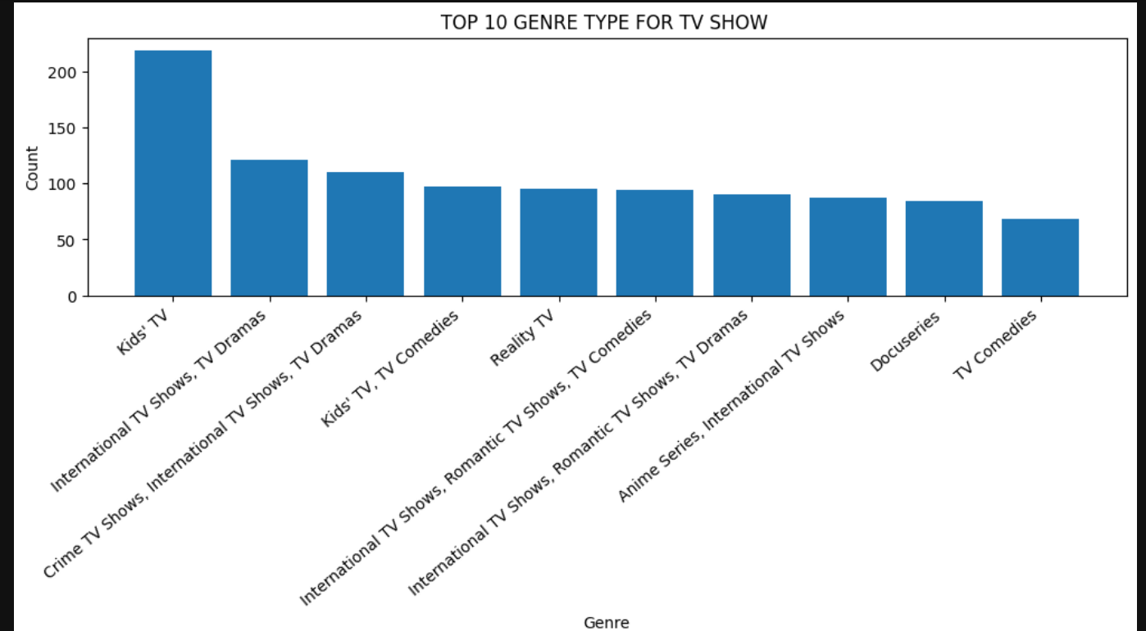
Top 10 Genre Type For TV Show

Slide 14
Conclusion
Netflix has been adding more and more shows and movies each year, which shows that its working hard to grow its content.
Netflix offers more movies than TV shows but both types are steadily growing.
Most content on Netflix falls under TV-MA and TV-14 indicating a large portion is targeted at mature or teen audiences.
The United States leads in content production on Netflix, followed by countries like India, UK and Canada.
For movies genres like Dramas, Comedies and Documentaries are most common.
For TV shows, International TV Shows, Crime TV Shows and TV Dramas are very popular.

