Slide 1

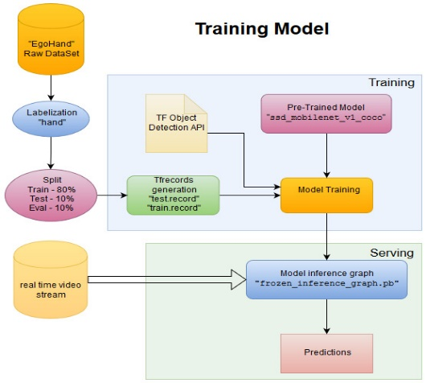
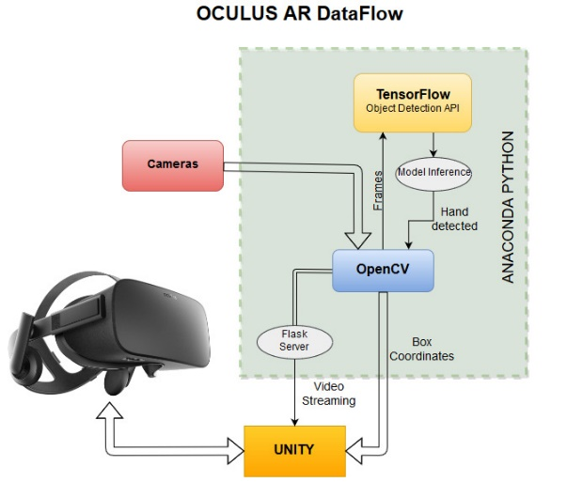
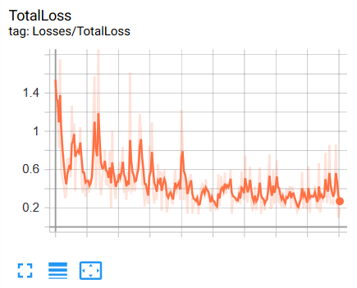
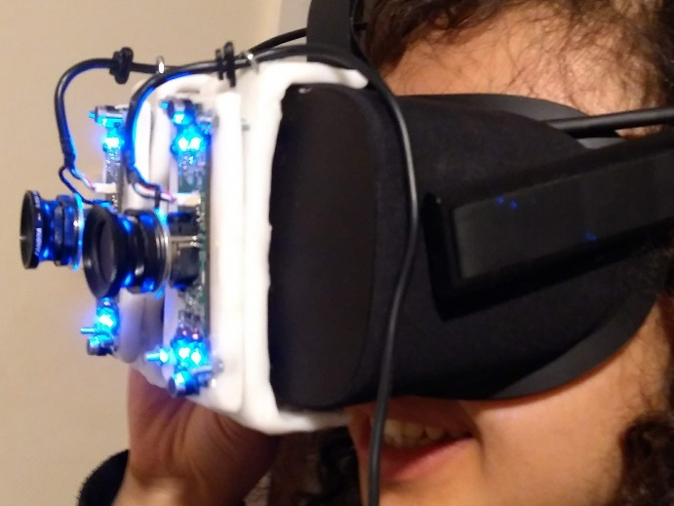
AR Hand Recognition
Mohamed Maaroufi - ID: 1429422 | Supervisor: Sarah Slater | University Of Wolverhampton
Problem / Question
Hand Recognition Training
Artefact Development
How could we use body gesture to interact with Computer/AR/VR devices without sensors on the user’s body using AI?
Purpose and background
Virtual and Augmented Reality is a growing technology, slowly adopted by the consumers. So far, the interaction between the users and the interface is assured by different sensors (position, remote), the motion sickness, the heaviest of the headset and the numerous of sensors, make the use of Oculus less comfortable and thus decrease the immersive experience, which unallowed the mass adoption.
Artificial intelligence, is another hot topic, this decade a lot of improvement have been done since the use of the “Neural Networks” and Machine learning new algorithms. Even if AI is still a new technology, it could be possible to use computer vision with machine learning to improve HCI especially in Virtual Reality.
This project aim to measure the way Machine Learning could be used to help Virtual Reality to recognize movement and therefore make sensors useless.
Methods
Test have been made by using:
Arduino UNO: 1 frame per second without recognition at low resolution (320x240px)
Galileo: 5 images per second (640x480px)
Raspberry PI 3B: 10 images per second with UV4L (640x480px)
Final choice is the Computer (i7 at 2.2 GHZ 16 GB RAM, GTX 1070 8GB VRAM) with use of multithreading: 15 frames per second ()
Real-time Hand-Detection using CNN Neural Networks (SSD) on TensorFlow, and Object Detection API with OpenCV
“EgoHand”[1] Dataset with egocentric view (45 videos). 4500 images labelled
Cloud Paperspace: 8 CPU Quadro P5000, 30 GB RAM
Literature Review
Tests Results
Conclusion
Oculus was used for the test. HD cameras (1920x1080px) has been mounted vertically on the Headset.
To use Machine learning to improve Human-Computer interaction, powerful computation must be used to make the system accurate and fast. AI computer vision is still at its infancy and need improvement (Algorithm) to be massively used. To make the VR system immersive the Frame rate should be at least at 30fps which is the double of what I have got, due to material limitation.
References
Bambach, Sven, et al. (2015) Lending a hand: Detecting hands and recognizing activities in complex egocentric interactions. Proceedings of the IEEE International Conference on Computer Vision.[1]
Total loss stabilized at an average of 0.3 after 5 hours of training. It took 72 hours for a total training.

