Slide 1
Presentation RDBMS

Slide 2
What is RDBMS?
A relational database management system (RDBMS) is a collection of programs and capabilities that enable IT teams and others to create, update, administer and otherwise interact with a relational database. RDBMSes store data in the form of tables, with most commercial relational database management systems using Structured Query Language(SQL) to access the database

Slide 3
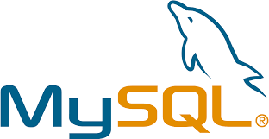
What is MySQL and why it is used?
MySQL is a relational database management system based on SQL – Structured Query Language. The application is used for a wide range of purposes, including data warehousing, e-commerce, and logging applications.
The most common use for mySQL however, is for the purpose of a web database. It can be used to store anything from a single record of information to an entire inventory of available products for an online store.
In association with a scripting language such as PHP or Perl (both offered on our hosting accounts) it is possible to create websites which will interact in real-time with a mySQL database to rapidly display categorised and searchable information to a website user.

Slide 4
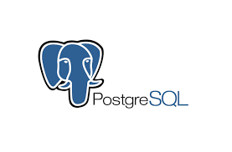
What is PostgreSQL?
PostgreSQL is an advanced, enterprise class open source relational database that supports both SQL (relational) and JSON (non-relational) querying. It is a highly stable database management system, backed by more than 20 years of community development which has contributed to its high levels of resilience, integrity, and correctness. PostgreSQL is used as the primary data store or data warehouse for many web, mobile, geospatial, and analytics applications. The latest major version is PostgreSQL 12.
PostgreSQL has a rich history for support of advanced data types, and supports a level of performance optimization that is common across its commercial database counterparts, like Oracle and SQL Server. AWS supports PostgreSQL through a fully managed database service with Amazon Relational Database Service (RDS). Amazon Aurora with PostgreSQL compatibility is also built using PostgreSQL.

Slide 5
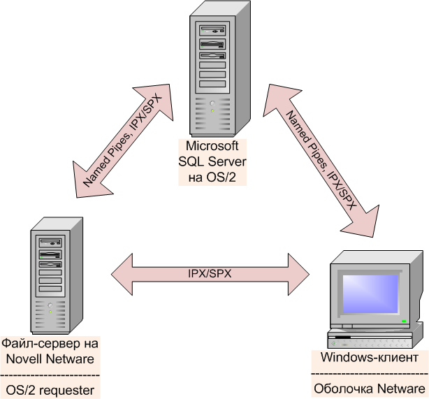
What is a SQL Server used for?
The SQL Server is a relational database management system from Microsoft. The system is designed and built is to manage and store information. The system supports various business intelligence operations, analytics operations, and transaction processing

Slide 6
The difference between MYSQL ,PostgreSQL, MYSQL SERVER
Historically, MySQL has had a reputation as an extremely fast database for read-heavy workloads, sometimes at the cost of concurrency when mixed with write operations.
PostgreSQL, also known as Postgres, advertises itself as “the most advanced open-source relational database in the world”. It was built to be feature-rich, extendable and standards-compliant. In the past, Postgres performance was more balanced - reads were generally slower than MySQL, but it was capable of writing large amounts of data more efficiently, and it handled concurrency better.
The performance differences between MySQL and Postgres have been largely erased in recent versions. MySQL is still very fast at reading data, but only if using the old MyISAM engine. If using InnoDB (which allows transactions, key constraints, and other important features), differences are negligible (if they even exist). These features are absolutely critical to enterprise or consumer-scale applications, so using the old engine is not an option. On the other hand, MySQL has also been optimized to reduce the gap when it comes to heavy data writes.
When choosing between MySQL and PostgreSQL, performance should not be a factor for most run-of-the-mill applications – it will be good enough in either case, even if you consider expected future growth. Both platforms are perfectly capable of replication, and many cloud providers offer managed scalable versions of either database. Therefore, it’s worth it to consider the other advantages of Postgres over MySQL before you start your next project with the default database setting.

