Slide 1




GSA Short Course
Age-Depth Modeling
of Sedimentary Deposits
Session 2a
Bayesian age-models - theory

Slide 2
Age-depth models
Classical and Bayesian age-models
Probabilities
Combining prior information with new data

Slide 3
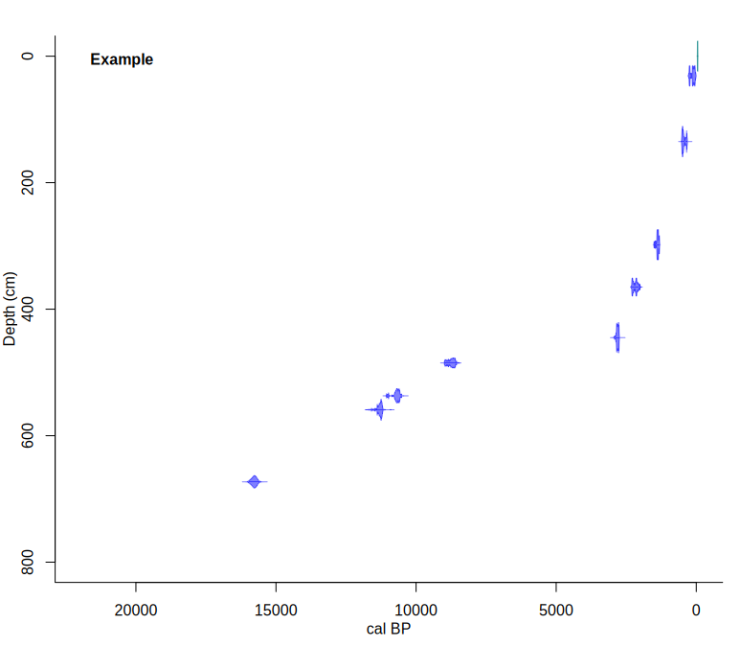
Which age-depth model?
800 cm core
9 ¹⁴C dates
surface = recent

Slide 4
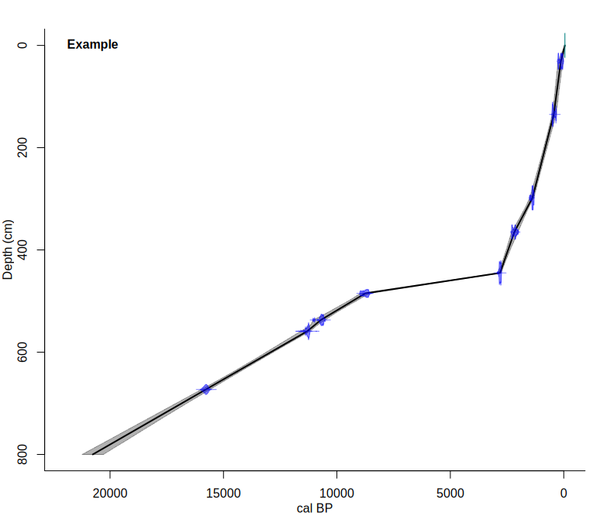
Which age-depth model?
800 cm core
9 ¹⁴C dates
surface = recent
“Classical” age-model
Linear interpolation
require(clam)
clam()

Slide 5
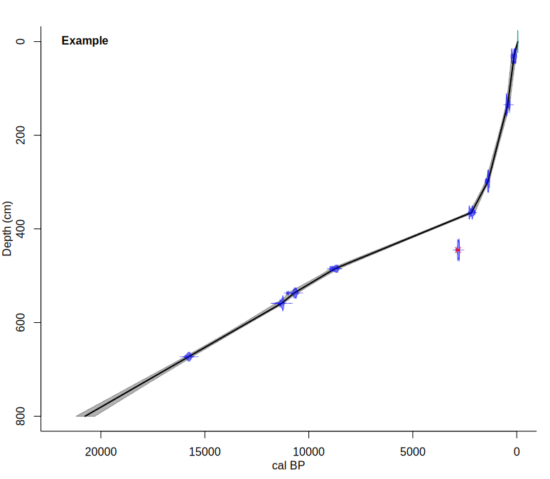
Which age-depth model?
800 cm core
9 ¹⁴C dates
surface = recent
Linear interpolation
  date 6 = outlier
clam(outliers=6)

Slide 6
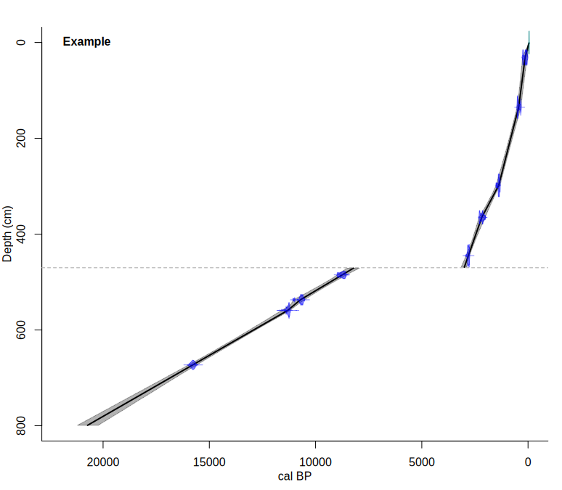
Which age-depth model?
800 cm core
9 ¹⁴C dates
surface = recent
Linear interpolation
  470 cm = hiatus
clam(hiatus=470)

Slide 7
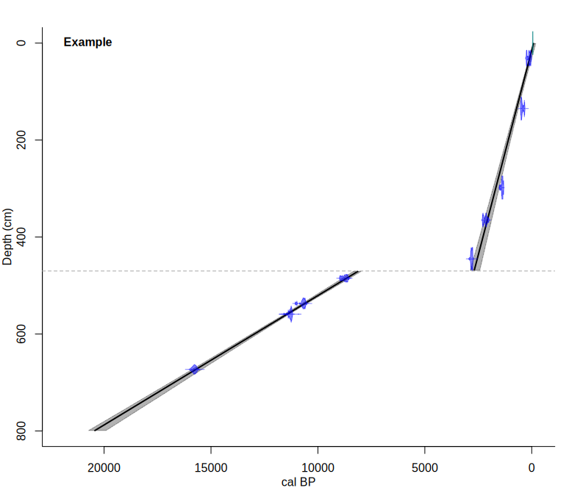
Which age-depth model?
800 cm core
9 ¹⁴C dates
surface = recent
Linear regression
  470 cm = hiatus
clam(,2, outliers=6)

Slide 8
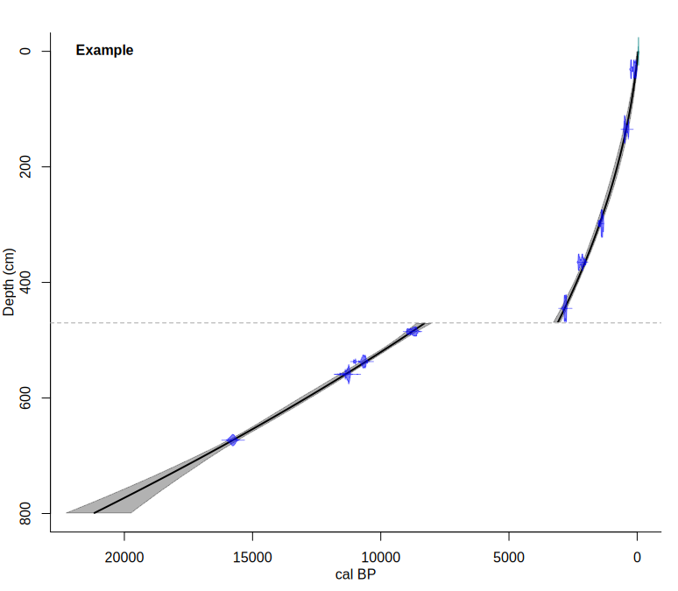
Which age-depth model?
800 cm core
9 ¹⁴C dates
surface = recent
Polynomial regression
  470 cm = hiatus
  second degree
clam(,2,2,hiatus=470)

Slide 9
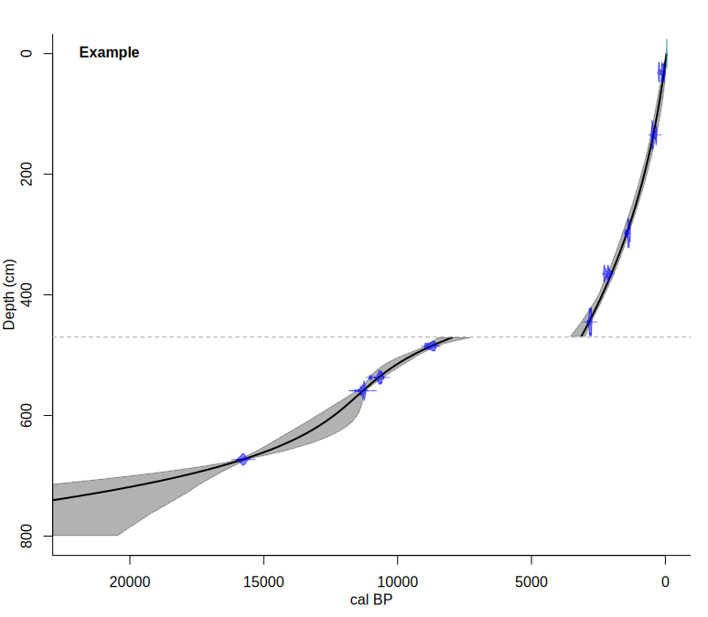
Which age-depth model?
800 cm core
9 ¹⁴C dates
surface = recent
Polynomial regression
  470 cm = hiatus
  third degree
clam(,2,3,hiatus=470)

Slide 10
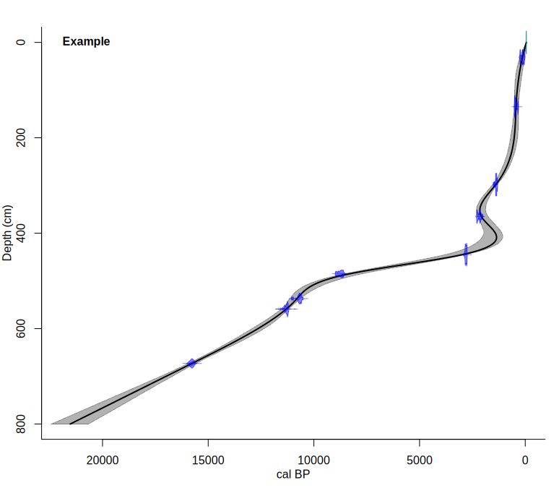
Which age-depth model?
800 cm core
9 ¹⁴C dates
surface = recent
Smooth spline
clam(,4)

Slide 11



Slide 12

Which age-depth model?
800 cm core
9 ¹⁴C dates
surface = recent
Smooth spline
  date 6 = outlier
clam(,4, outliers=6)

Slide 13
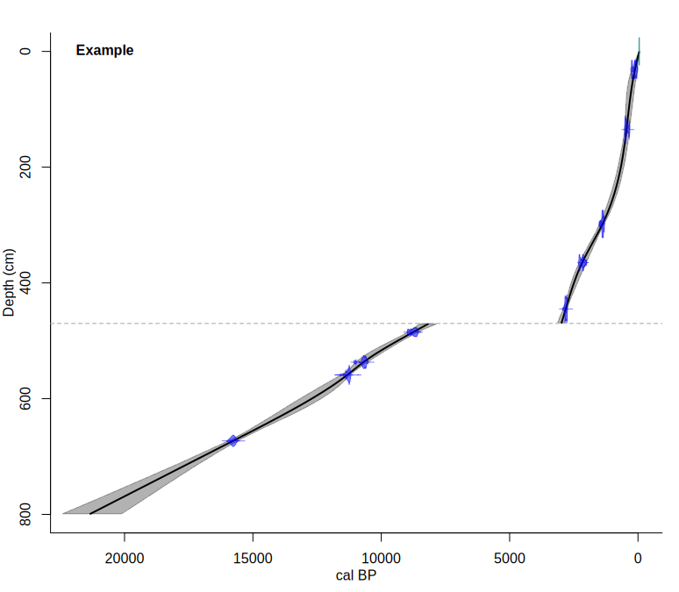
Which age-depth model?
800 cm core
9 ¹⁴C dates
surface = recent
Smooth spline
  470 cm = hiatus
clam(,4, hiatus=470)

Slide 14
require(clam)
clam(outliers=6)
clam(hiatus=470)
clam(hiatus=470, type=2)
clam(hiatus=470, 2, 2)
clam(hiatus=470, 2, 3)
clam(,4)
clam(,4, outliers=6)
clam(,4, hiatus=470)

Slide 15

Jason Salavon 100 Special Moments

Slide 16
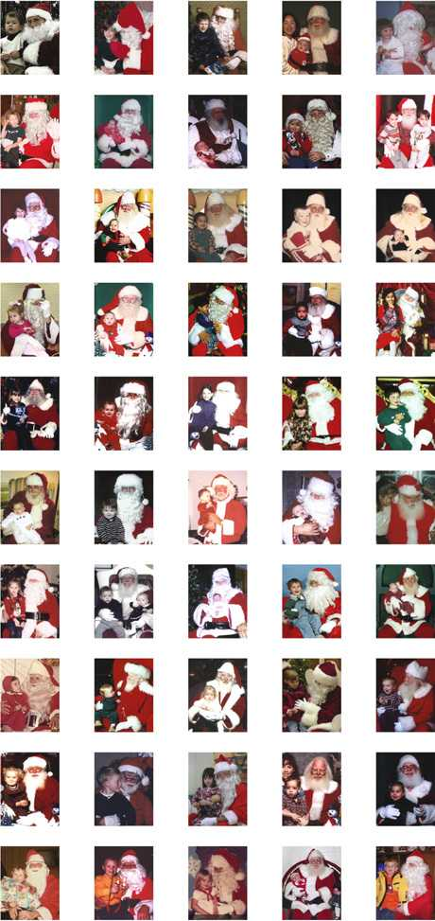
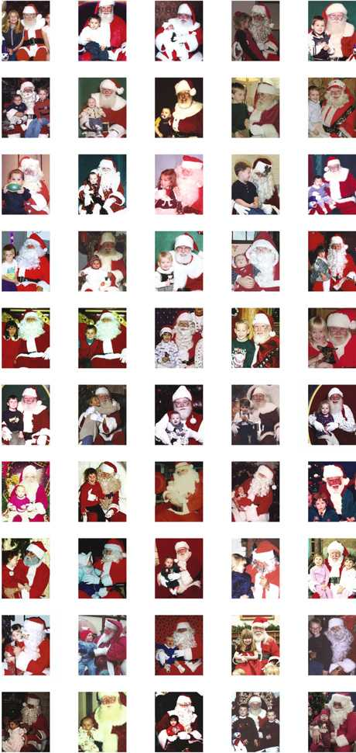

Slide 17
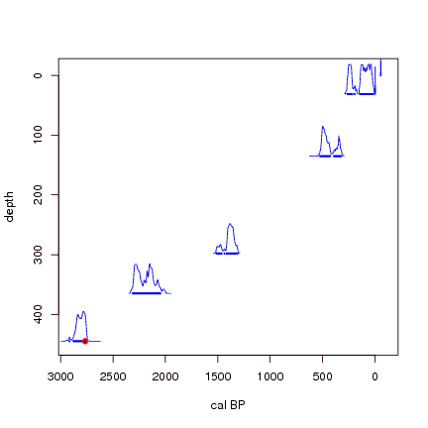
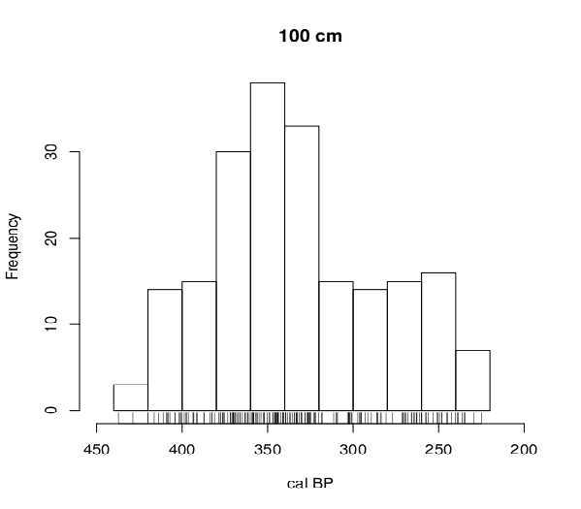
Uncertainties dates and models

Slide 18
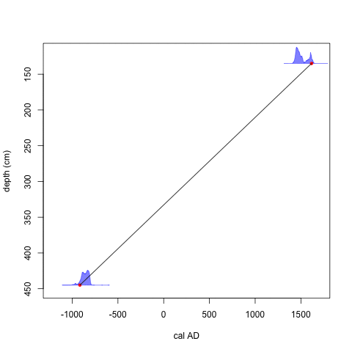

Slide 19
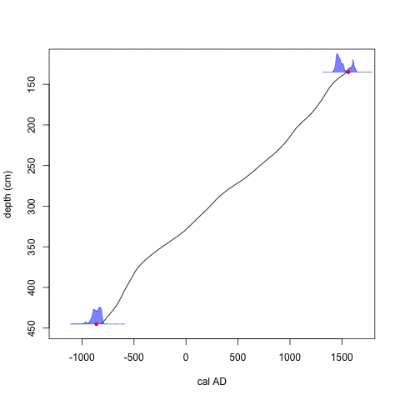

Slide 20
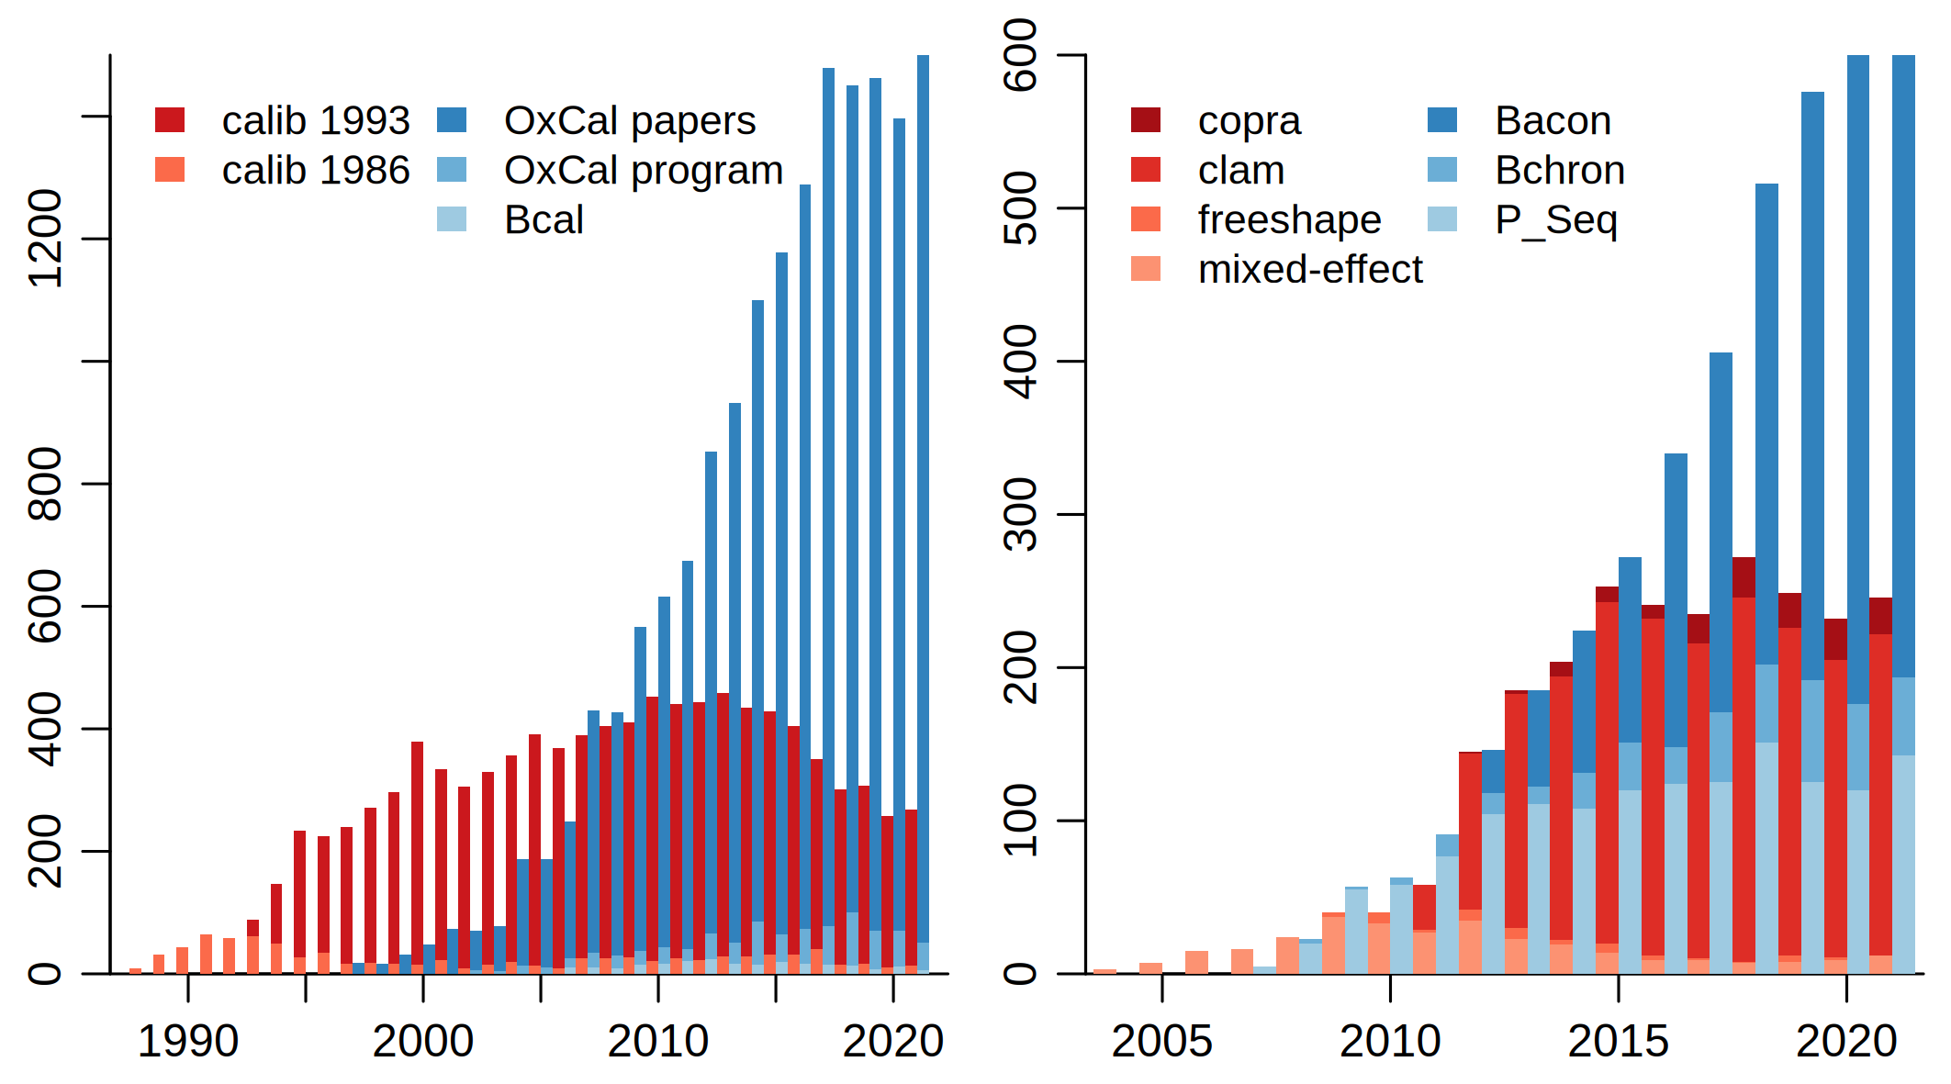
Scholar.google citations to calibration/age-modeling (left) and age-depth modeling (right) software

Slide 21
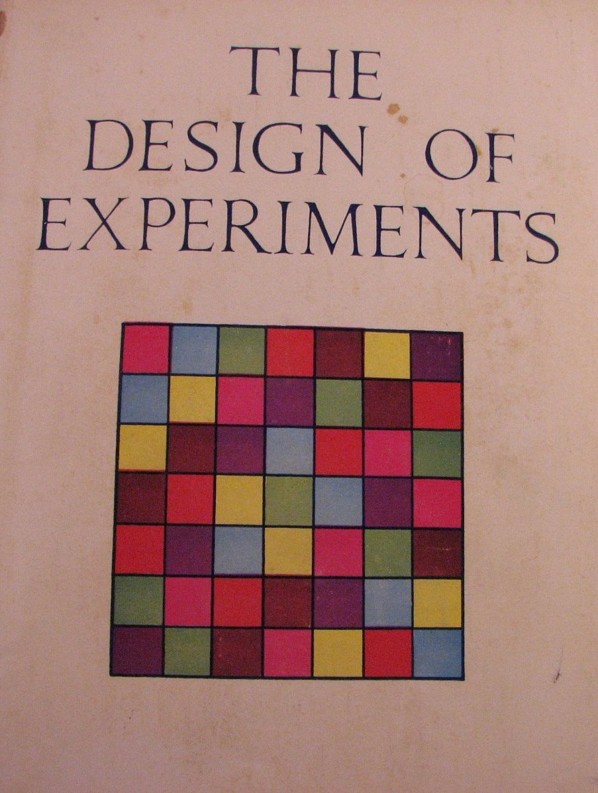
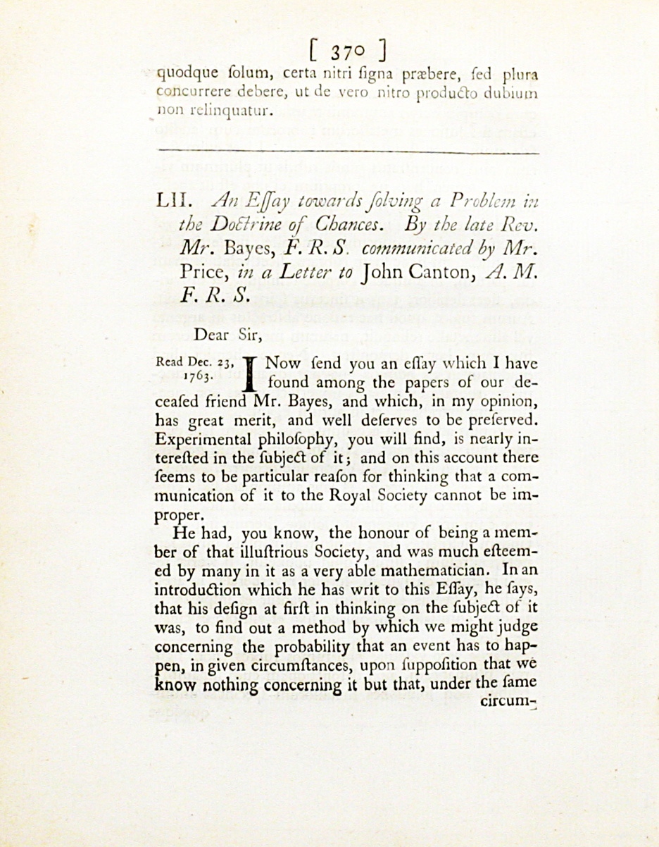
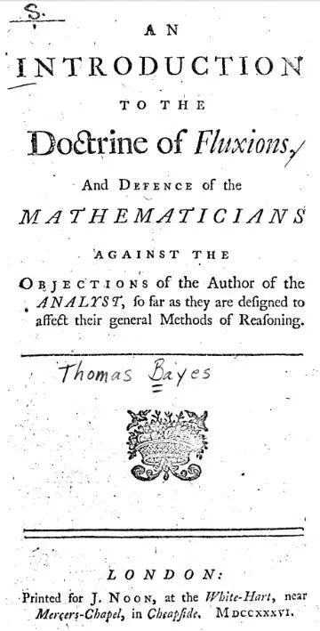
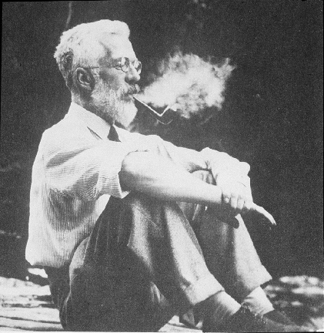
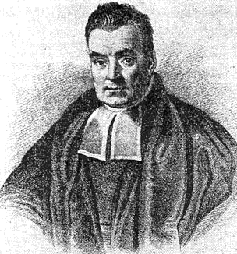
-introduced classical statistics
5% p-value, ANOVA
-fast and easy to calculate
-globally popular
(-defended eugenics)
Rev Thomas Bayes
1701-1761
Sir Ronald Fisher
1890-1962

Slide 22
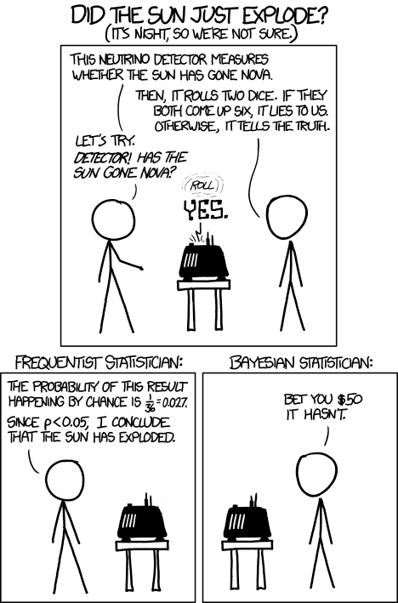
Classical / frequentist statistics
    tests whether an event (hypothesis) occurs or not
    calculates the probability of an event, if the experiment were to be repeated under the same conditions
Bayesian statistics
  expresses everything in probabilities
  Combine new data with existing knowledge, to update our understanding
      Prior knowledge: context, expert opinion
xkcd.com/1132/

Slide 23
Conditional probabilities
What is the probability that
    my coin lands on heads?
    I have >£20 in my pocket?
    it rains tomorrow?
    it rained yesterday in Bangor?
A couple has had 5 pregnancies and all 5 have been male
    What is the probability that their next child is female?

Slide 24

Bayesian approach to testing
“Imagine a very accurate test for a rare disease. If you have the disease (or don’t have it), it will correctly say so 99% of the time.
But the disease in question is very rare; just one person in every 10,000 has it. This is known as your “prior probability”: the background rate in the population.
So now imagine you test 1 million people. There are [10⁶/10⁴=] 100 people who have the disease: your test correctly identifies [99%*100=] 99 of them. And there are 999,900 people who don’t: your test correctly identifies [99%*999,900=] 989,901 of them.
But that means that your test, despite giving the right answer in 99% of cases, has told [999,000-989,901=] 9,999 people that they have the disease, when in fact they don’t. So if you get a positive result, in this case, your chance of actually having the disease is 99 in 10,098, or just under 1%.
If the disease was not so rare – if, say, 1% of people had it – your results would be totally different. Then you’d have 9,900 false positives, but also 9,990 true positives. So if you had a positive result, it would be more than 50% likely to be true.”
https://www.theguardian.com/world/2021/apr/18/obscure-maths-bayes-theorem-reliability-covid-lateral-flow-tests-probability

Slide 25
Bayesian statistics
Update our understanding, by combining prior information with new data
p( A | B ) ∝ l( B | A) * p(A)
p( prior | data ) ∝ l( data | prior) * p(prior)

Slide 26
Bayesian statistics
Difficult to calculate analytically
Only became popular in 1990s when computers and algorithms became fast enough
MCMC: Markov-chain Monte Carlo
    Produce initial series of values that fit the data and obey the prior
    For next iteration, randomly change one value by a bit
    Accept if this enhances the fit, otherwise possibly accept
    Repeat millions of times (thin to reduce similarity between iterations)
All iterations together approach the true distributions of the parameters

Slide 27
Distributions - normal
2 parameters:
    mean, sdev
Handy for modelling measurements with lab errors
MCMC approaches true distribution
https://vimeo.com/602543020

Slide 28
Distributions - gamma
2 parameters:
    mean, shape
Always positive
Handy to model accumulation rate
https://vimeo.com/602614709

Slide 29
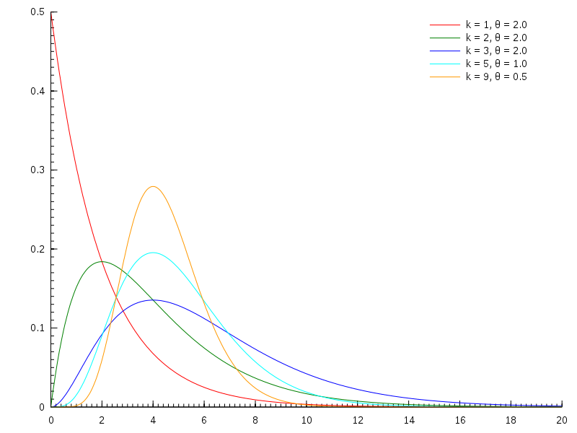

Slide 30
Distributions - beta
2 parameters:
    mean, strength
Between 0 and 1
Handy to model memory
https://vimeo.com/602585449

Slide 31
MCMC in age-models
Example: five radiocarbon dated depths from a sequence
    We model them to be in chronological order
Simulate 5 initial ‘ball-park’ values (years) in chronological order
Calculate how well they fit the calibrated radiocarbon dates
Now randomly change one of the values by a bit
    Check that the values remain in chronological order
    Accept if the fit has enhanced, possibly accept if not
Repeat millions of times (thin, remove burn-in)

Slide 32
https://vimeo.com/602585477

Slide 33
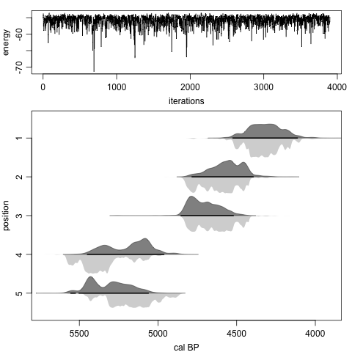
require(coffee)
sim.strat()
strat(1e4)
strat(its=1e7, burnin=100)

Slide 34
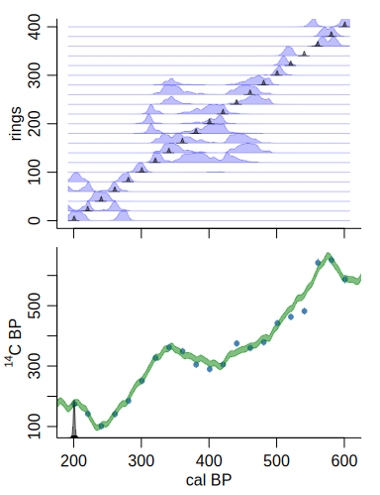
Gaps of exactly known age
require(coffee)
sim.rings()
rings()

Slide 35
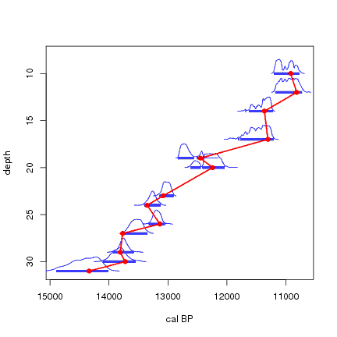
Stratigraphic order dates
Christen, 1994. Appl Stat 43:489-503
Only accept iterations with correct order
Reduces error ranges
Removes outliers
Easy to defend

Slide 36
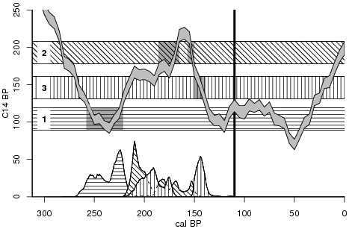
Stratigraphic order dates
3
2
1
Blaauw and Heegaard, 2012

Slide 37
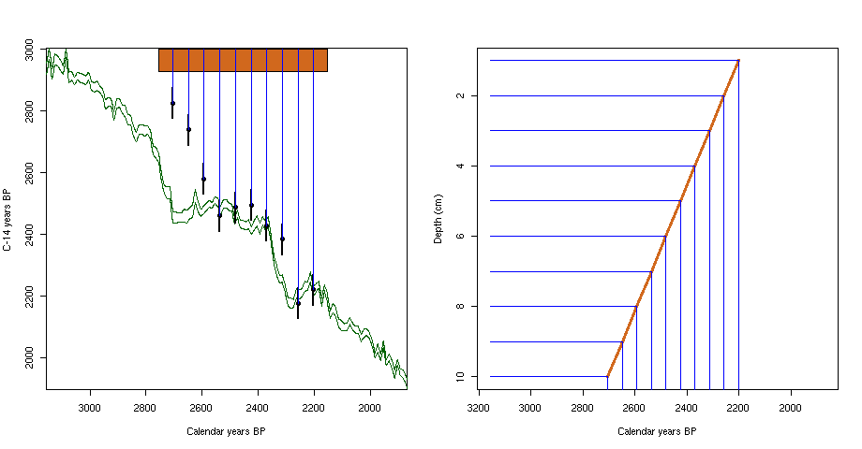
Wiggle-match dating
Assume linear accumulation
age = a*depth + b

Slide 38
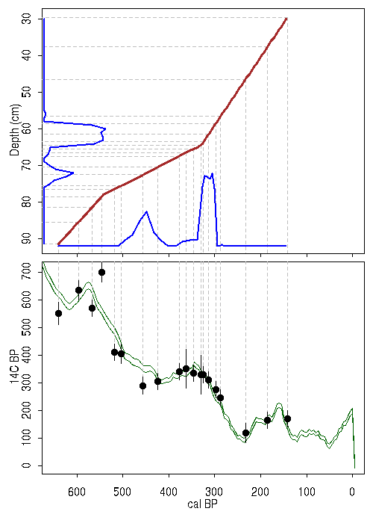

Slide 39
Piece-wise linear age-depth model
Divide 200 cm core into 4 50cm-sections (section elbows not necessarily where dates are)
Linear accumulation rate within each section (gamma prior distr)
4 ¹⁴C dates
For each iteration, calculate product of p(priors) * p(dates)

Slide 40
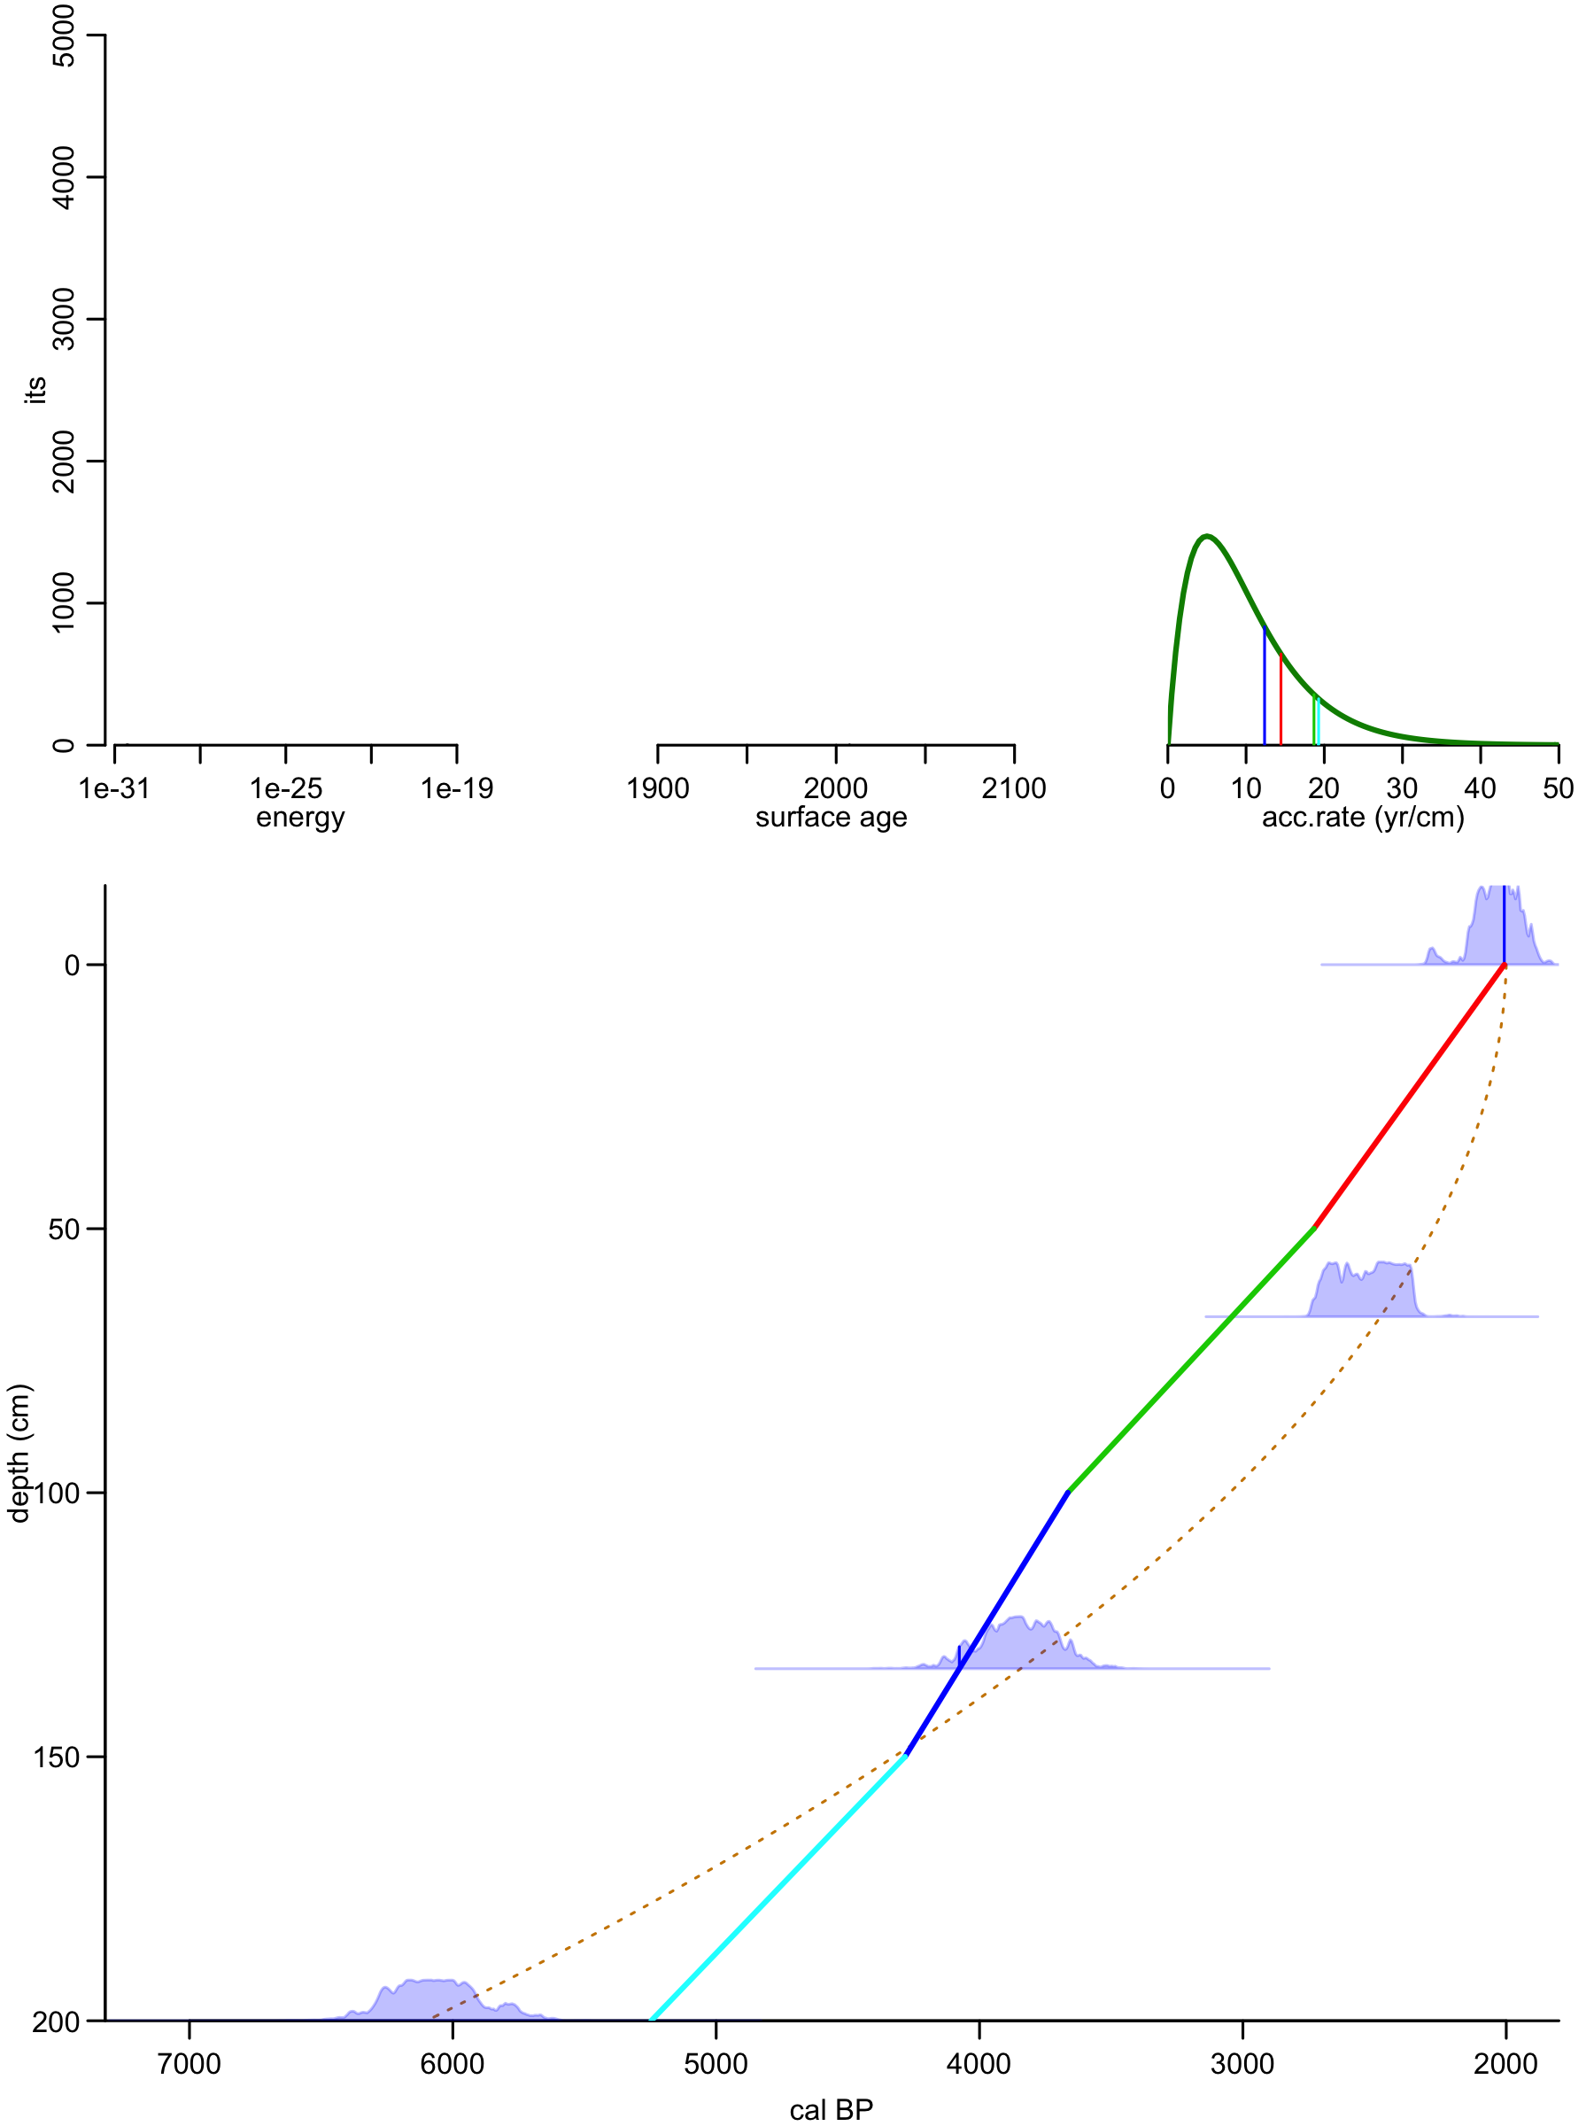
Markov-Chain Monte Carlo (MCMC)
Ballpark iteration: simulate accs. from gamma prior
4 likelihoods for accs (heights of prob. distr.)
Also simulate top date (uniform)
This defines the entire model
Now calculate fit of model w dates
4 likelihoods for dates

Slide 41
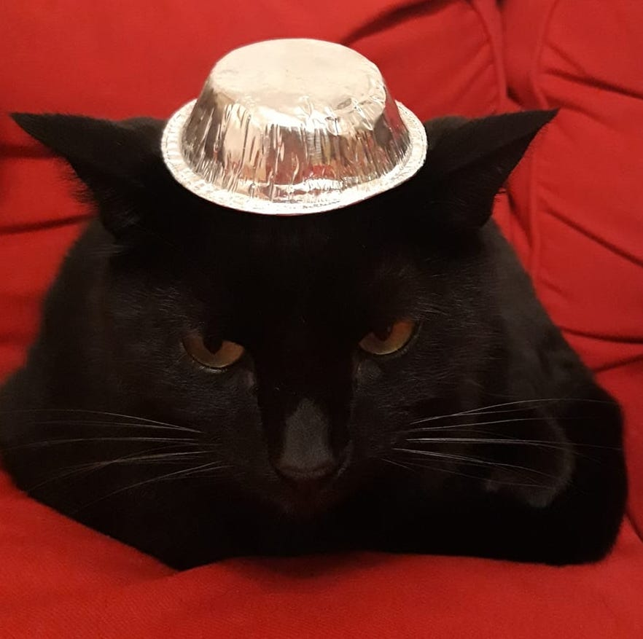
Markov-Chain Monte Carlo (MCMC)
Ballpark iteration: simulate accs. from gamma prior
4 likelihoods for accs (heights of prob. distr.)
Also simulate top date (uniform)
This defines the entire model
Now calculate fit of model w dates
4 likelihoods for dates
https://vimeo.com/548372489

Slide 42
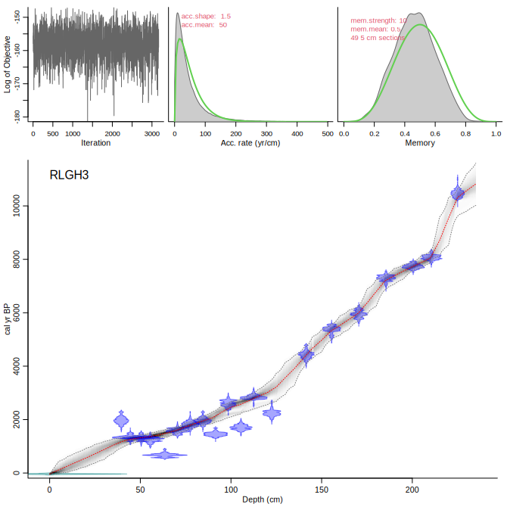

Slide 43
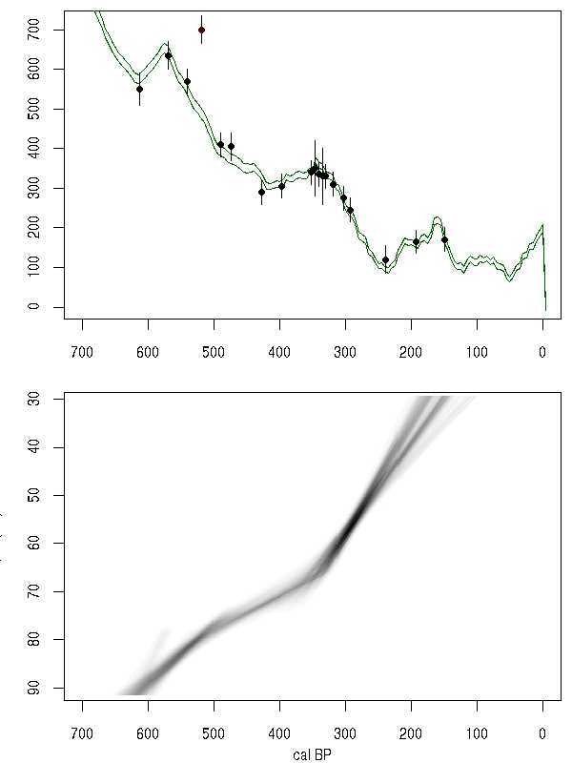
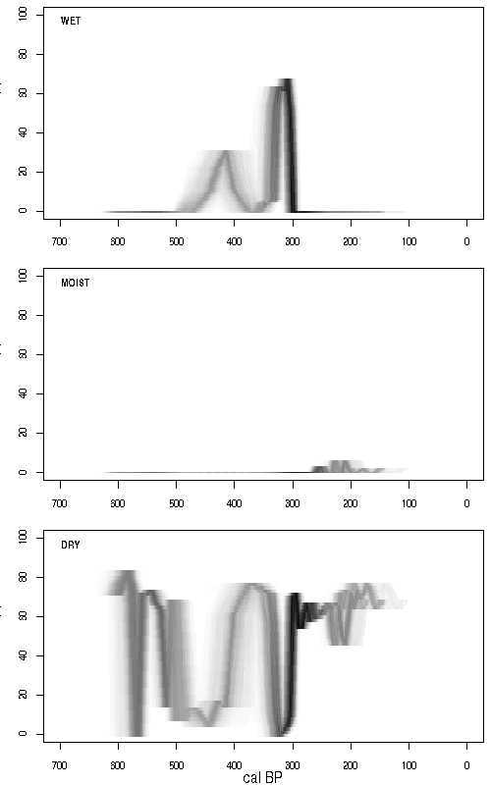
Grey-scale ghost graphs

Slide 44
Analysing age-model uncertainties
Check existing cores (neotomadb.org)
  Number of dates (per millennium)
  Age-model uncertainty estimates (min, mean, max)
    Classical and Bayesian

Slide 45
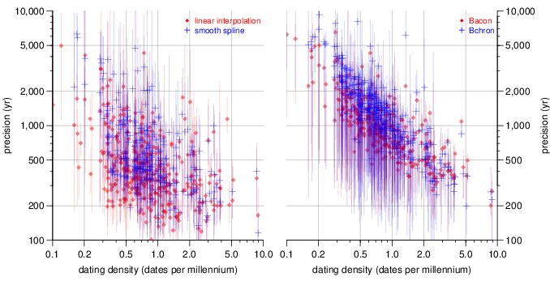
Meta-analysis of existing cores
Blaauw et al. 2018 QSR

Slide 46
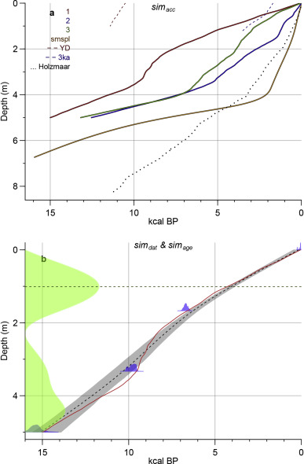
Blaauw et al. 2018 QSR

Slide 47
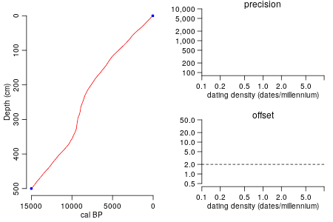
Linear interpolation
Blaauw et al. 2018 QSR

Slide 48
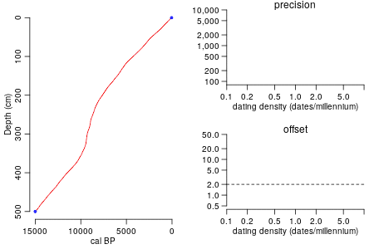
Bayesian: Bacon
Blaauw et al. 2018 QSR

Slide 49
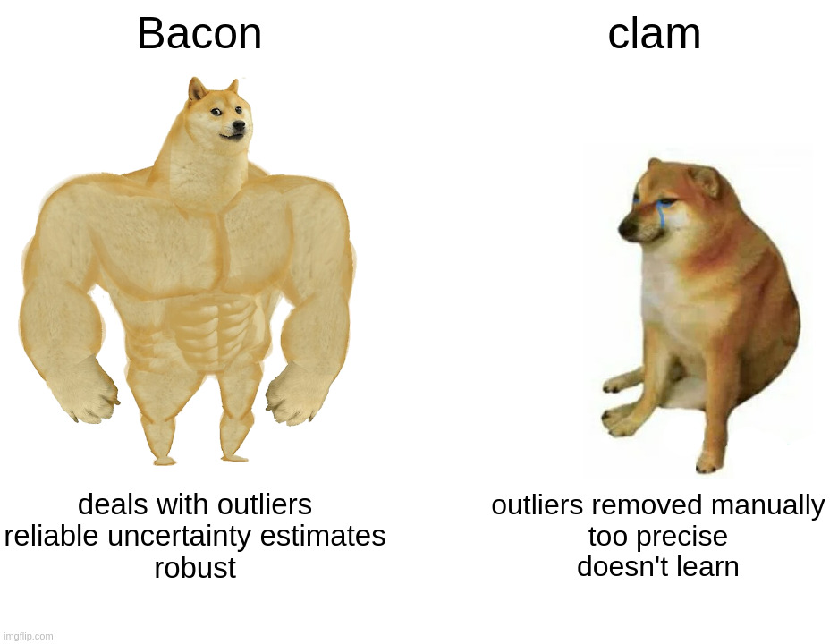
Classical vs Bayesian (Bacon/Bchron)
Classical models
  Fast and “conveniently” precise even at low dating densities
  But precision illusionary! Large offsets likely
  More dates do not increase precision
  Outliers can be disastrous
  Popular but not well suited to their tasks
Bayesian: Bacon/Bchron
  Slower, and larger uncertainties at low dating densities
  High accuracy, realistic precision estimates
  Each additional date will tell us more
  Handle outliers well
  Outperform classical models at all tested dating densities
Blaauw et al. 2018 QSR

Slide 50
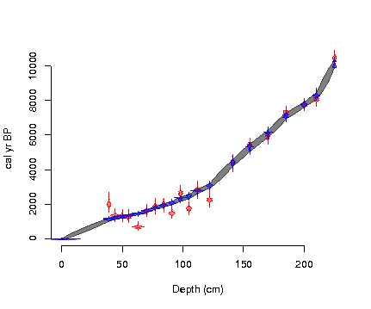
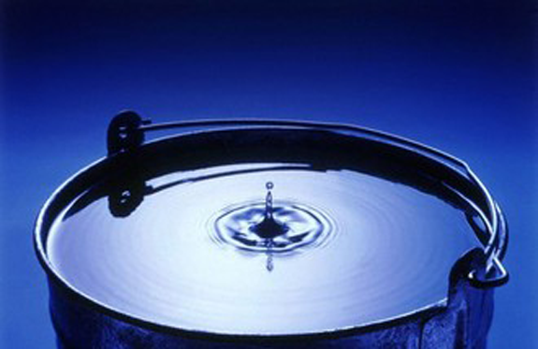
Bayesian age-depth model techniques
OxCal, Bchron, Bpeat, Bacon
Accumulation modelled as increments
k-value dictates degree of flexibility
k can be set fixed or adapting to data
Interpolation between dates or every cm

Slide 51
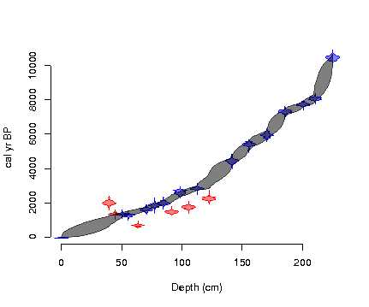
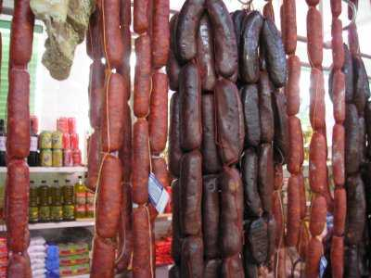
Bayesian age-depth model techniques
OxCal, Bchron, Bpeat, Bacon
Gamma jumps in depth and age
No adaptable settings

Slide 52
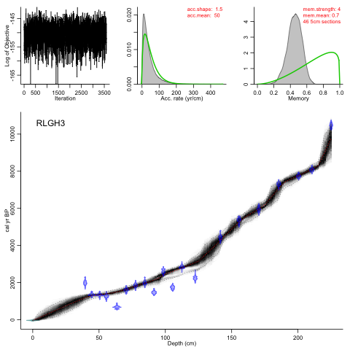
Bayesian age-depth model techniques
OxCal, Bchron, Bpeat, Bacon
If you will begin with certainties, you shall end in doubts, but if you will content to begin with doubts, you shall end in certainties.
After Francis Bacon (AD 1561 - 1626)
Adaptable priors:
Accumulation rate
Accumulation rate variability
Hiatus length

Slide 53
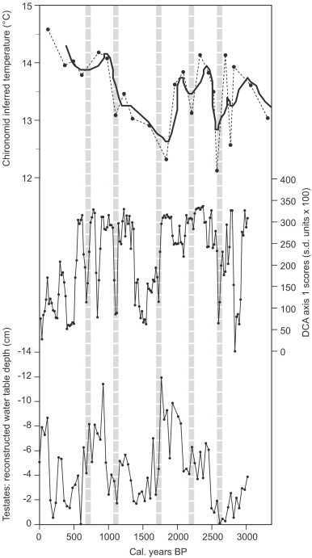
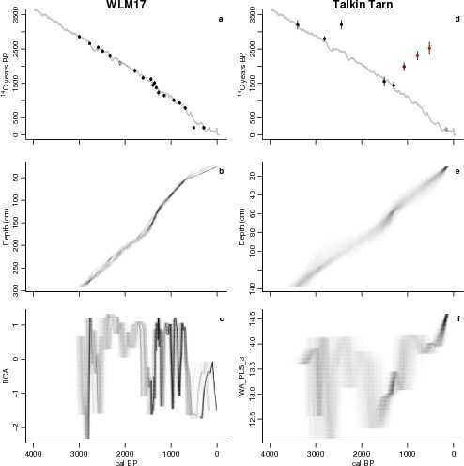
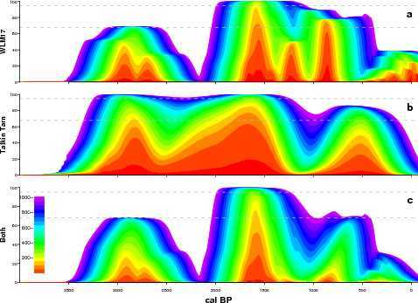
Barber and Langdon 2007, Quat. Sci. Rev.
Charman et al. 2009, Quat. Sci. Rev.

