Slide 1



GSA Short Course Age-Depth Modeling of Sedimentary Deposits
Session 3
Your own cores and Plum

Slide 2
Bacon – your own core
For your own core, produce a .csv file with 4 or 5 columns (or more, see manual)
Lab ID, age, error, depth, cc
Put it in a new folder under the umbrella folder:
Bacon_runs/SomeTephraCore/SomeTephraCore.csv
And run it:
Bacon(“SomeTephraCore”)

Slide 3
How to run Plum in R:
# install the package via R’s CRAN:
install.packages(‘rplum’)
# or a development version via github (updated more frequently, possibly less stable):
install.packages(‘devtools’)
require(devtools)
install_github(‘Maarten14C/rplum’)
# then load it and run the default core (accepting all suggestions with ‘y’):
require(rplum)
Plum()

Slide 4
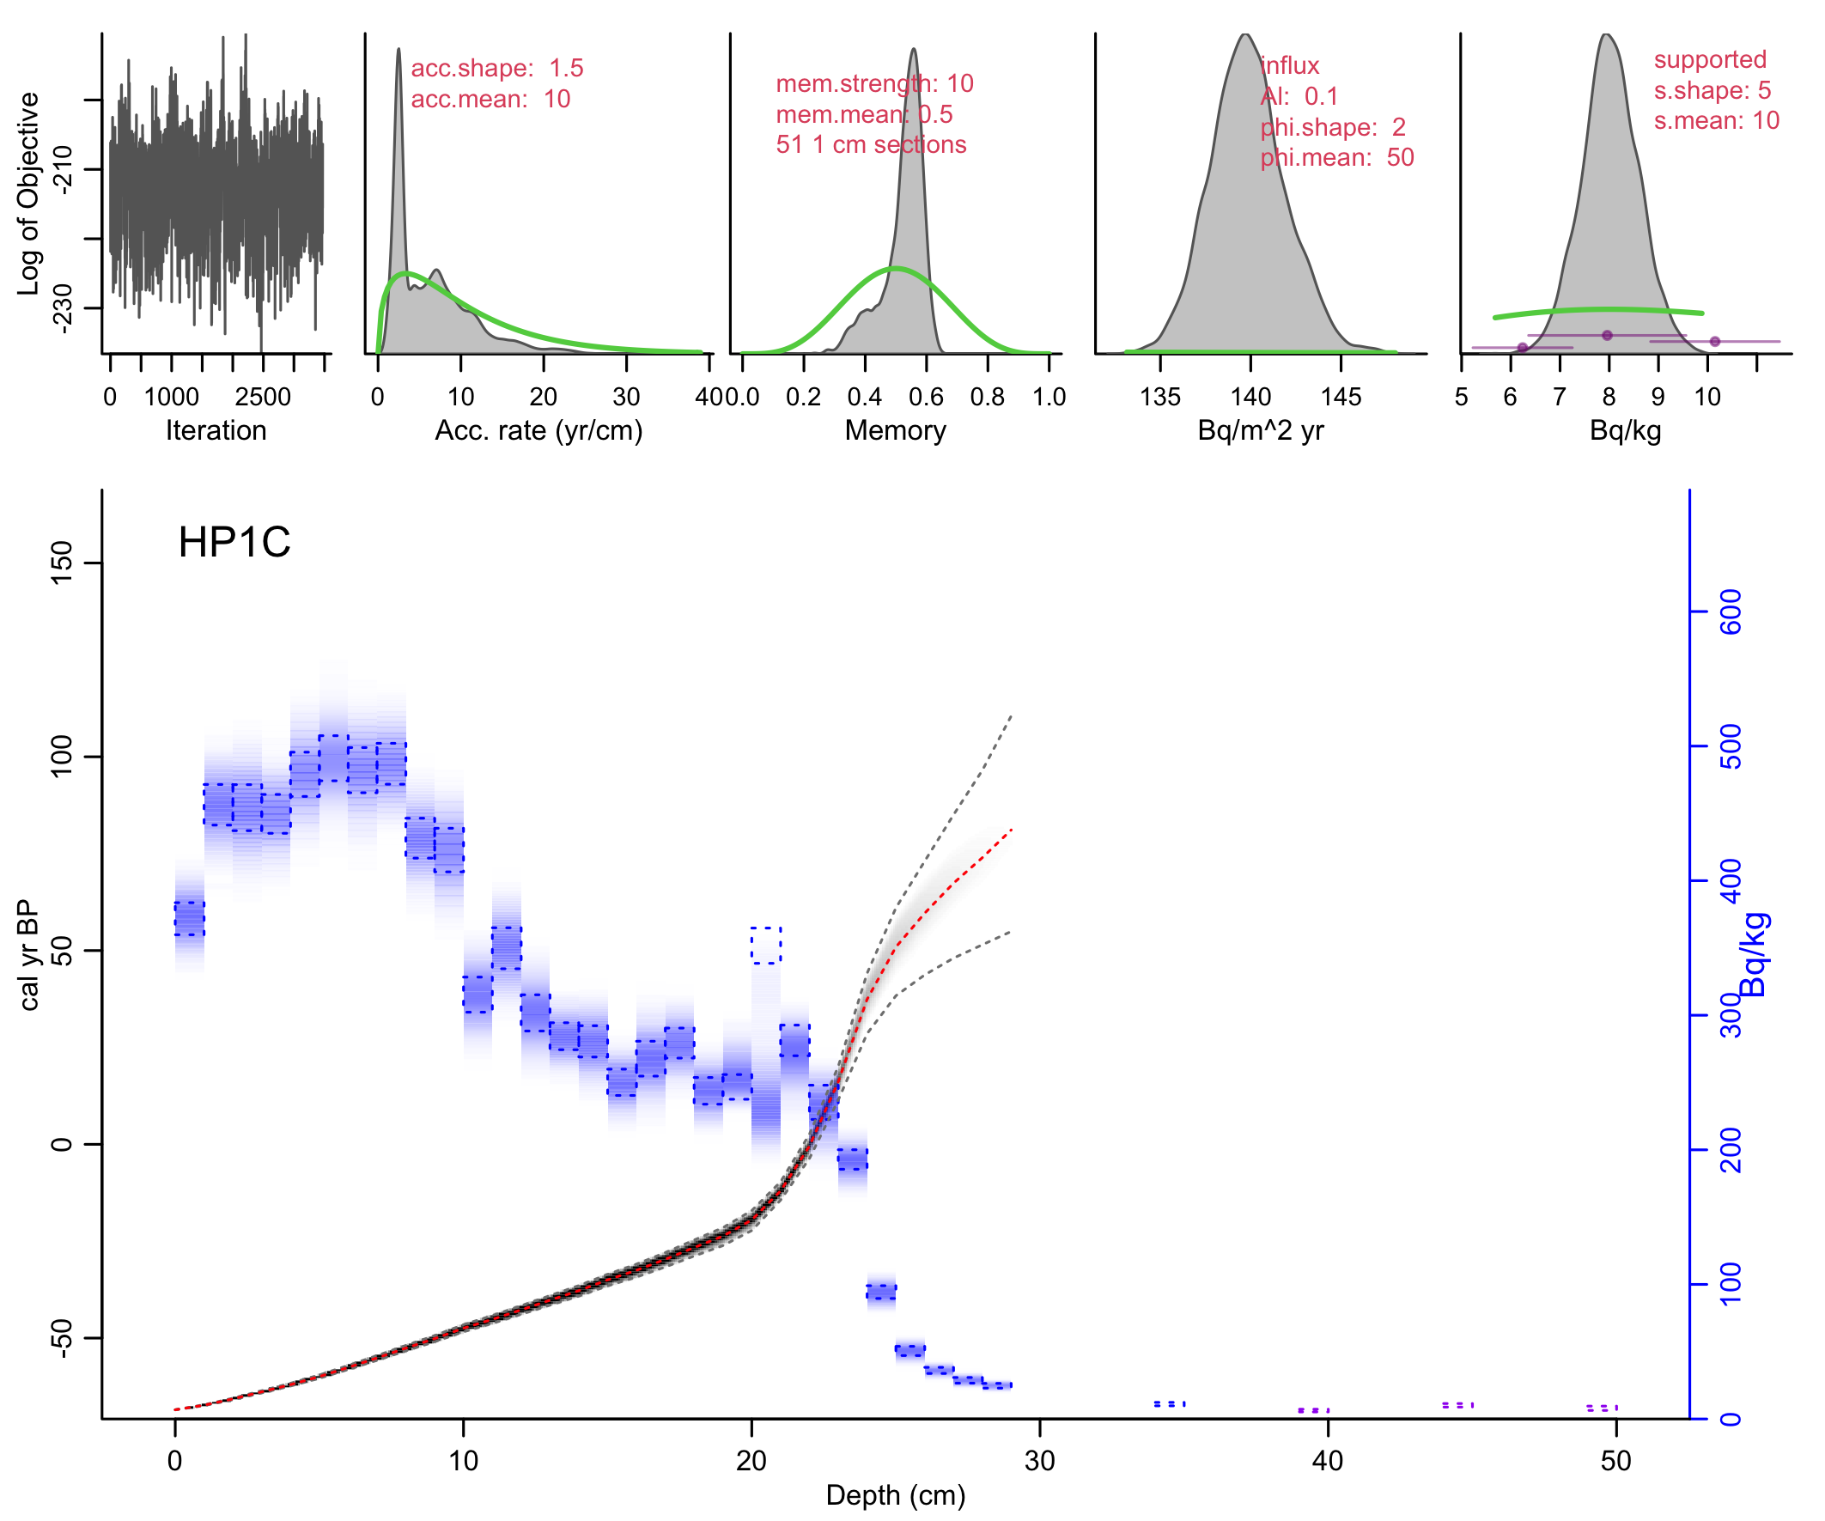
Plum()
Default core without ra measurements; supported ²¹⁰Pb estimated from tail ²¹⁰Pb measurements only.
Blue ²¹⁰Pb: measured in rectangles, modelled in “bluescale”.
Total ²¹⁰Pb modelled
All parameters involved in producing age-model and modelled ²¹⁰Pb

Slide 5
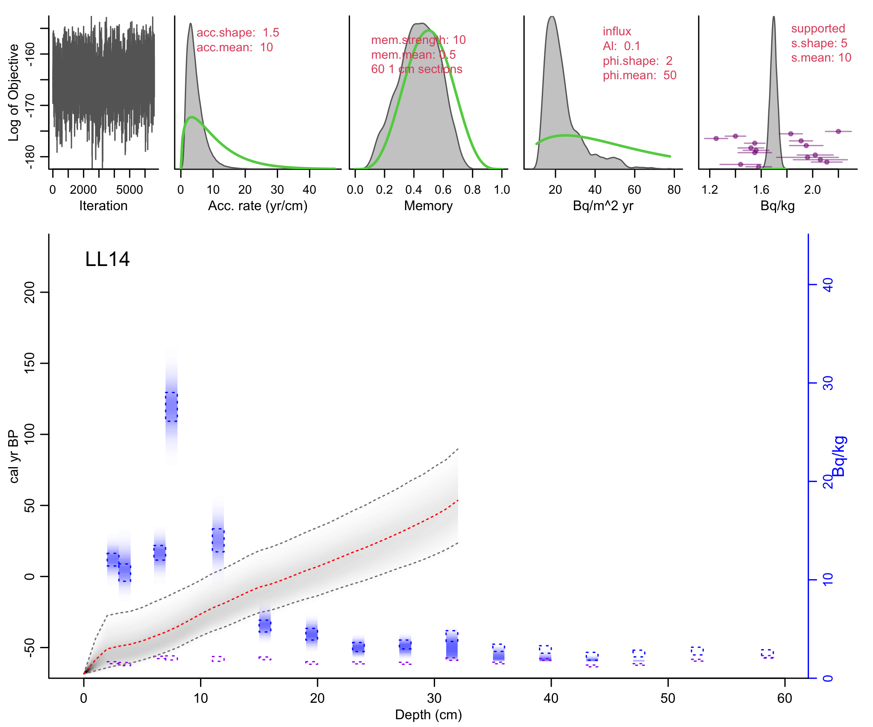
With ra-226 measurements as estimates of supported ²¹⁰Pb, either assuming that supported ²¹⁰Pb is constant along the core (ra case 1):
Plum(“LL14”, ra.case=1)

Slide 6
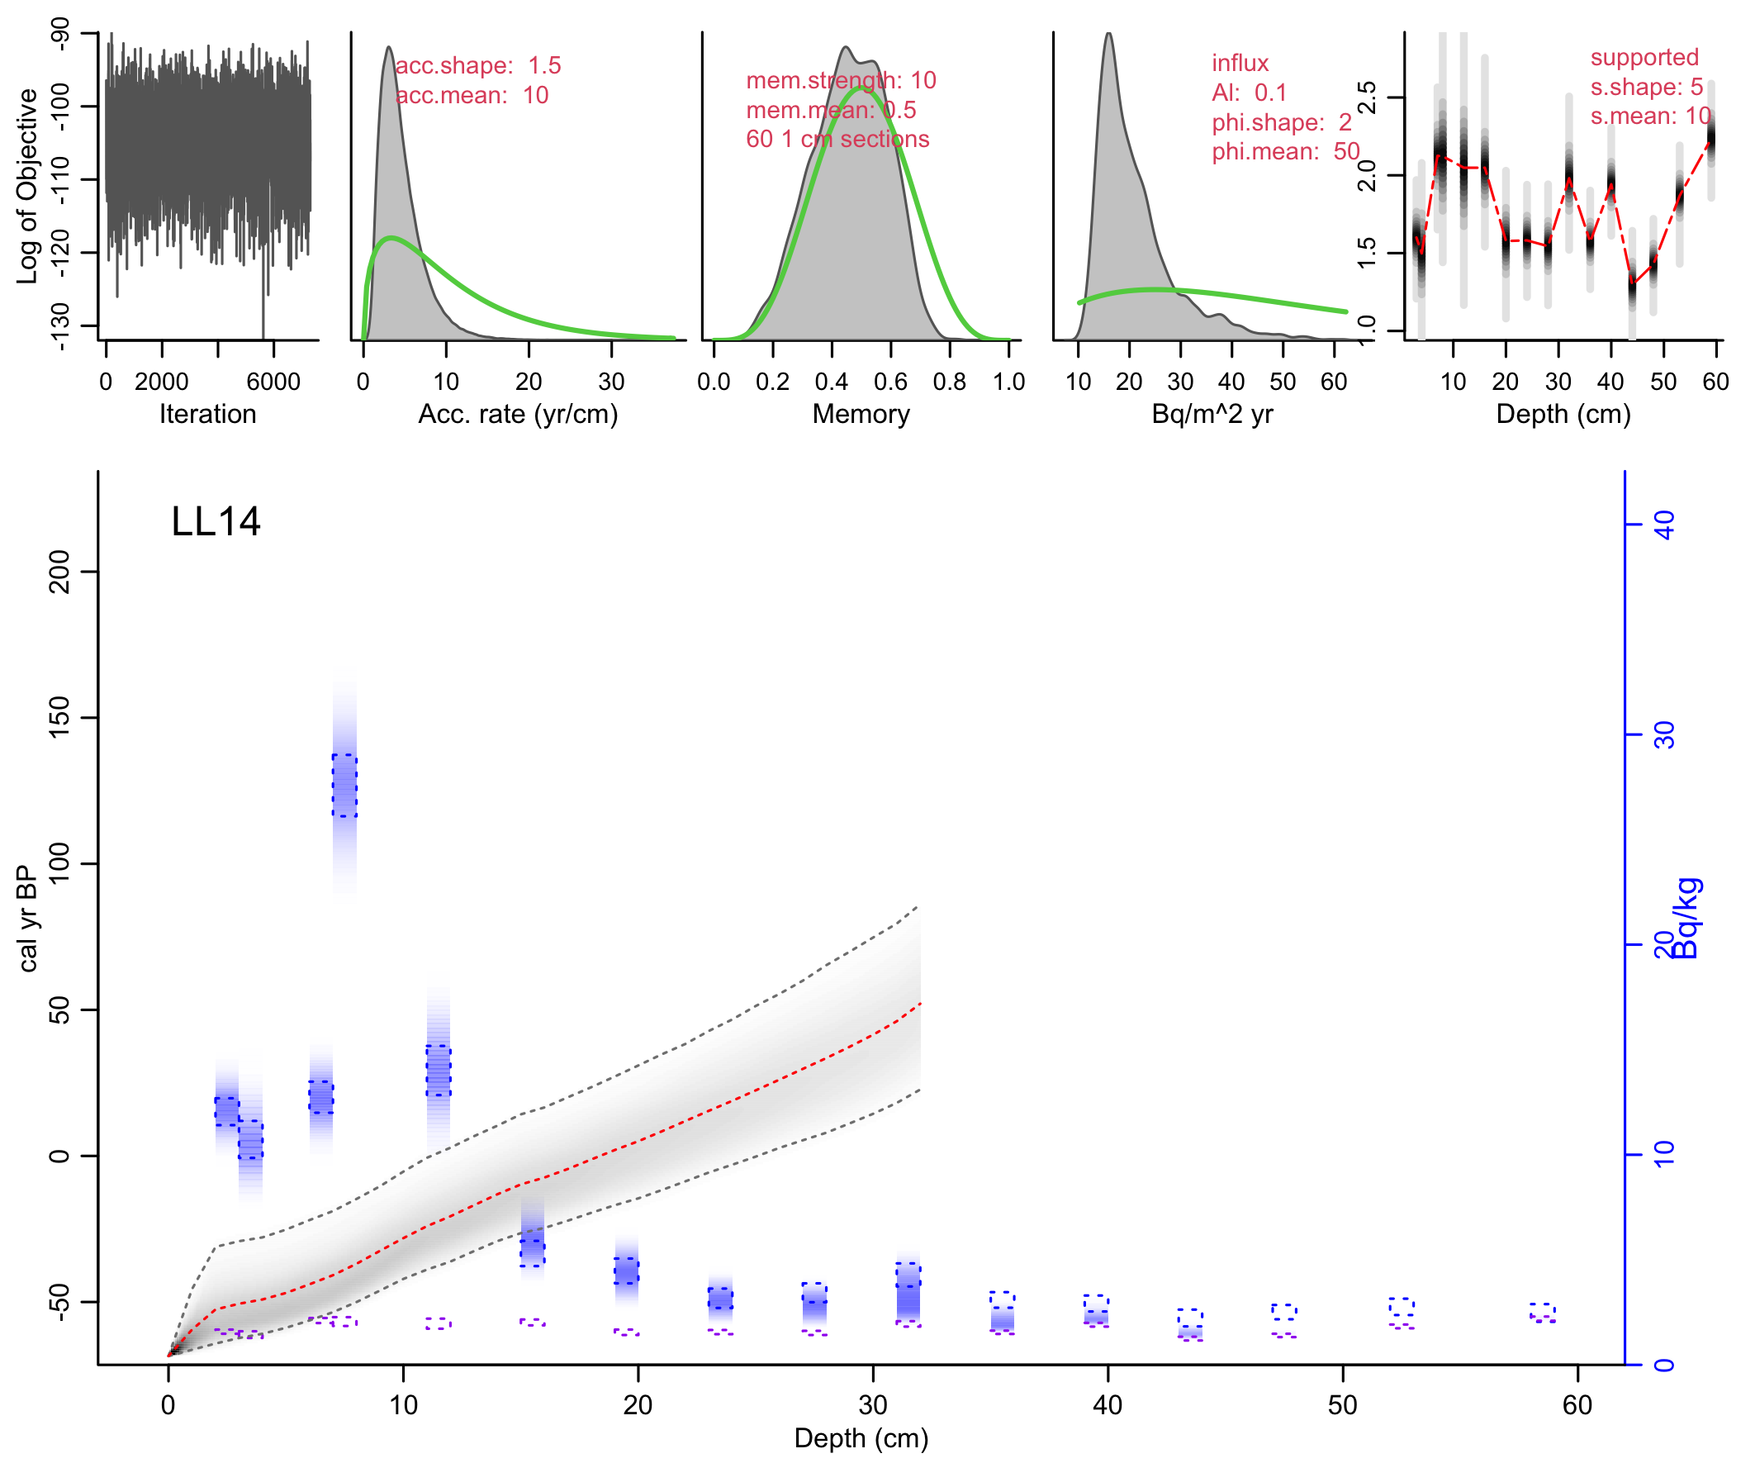
Or assuming that supported ²¹⁰Pb varies along with the ra-226 measurements (ra case 2; runs take longer as more parameters have to be estimated):
Plum(“LL14”, ra.case=2)

Slide 7
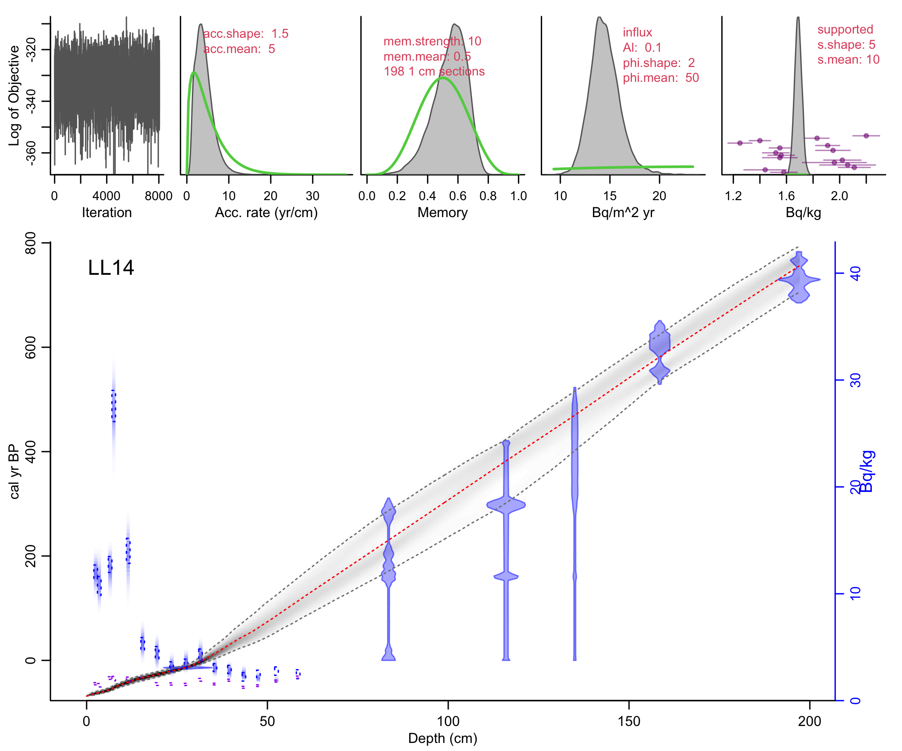
Plum’s age-depth model based on Bacon (piece-wise linear accumulation, constrained by prior information on accumulation rate and memory). Easy to include other dates such as radiocarbon or historical dates, by providing a Bacon file:
Plum(“LL14”, ra.case=1, otherdates=”LL14_14C.csv”)

