Slide 1




GSA Short Course
Age-Depth Modeling
of Sedimentary Deposits
Session 1
Radiocarbon dating and calibration
Intro to age-modeling

Slide 2
Schedule
Today: radiocarbon, intro to age-modelling
Next week: Bayesian age-models
Final session: Running your own cores, ²¹⁰Pb

Slide 3
Today
Radiocarbon dating
      History, assumptions
Radiocarbon calibration
Intro to age-modelling
Mixing Powerpoint slides with R code
Keep R open, try to run the blue R code on your own computer
Speak up (chat) when things go wrong, or if I go too slow/fast!
Amy and Lisa will look after the chat

Slide 4
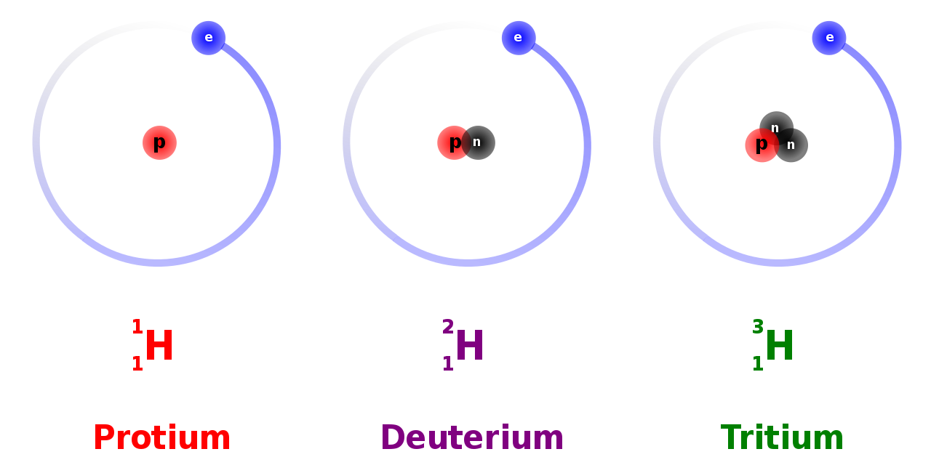
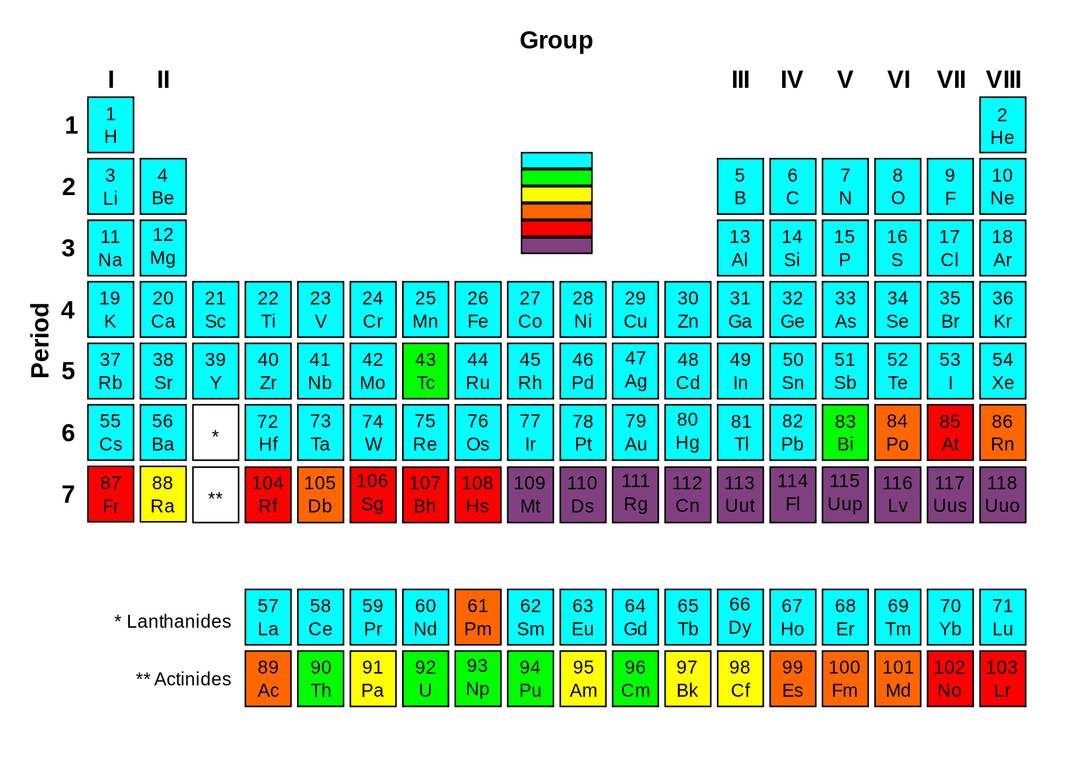
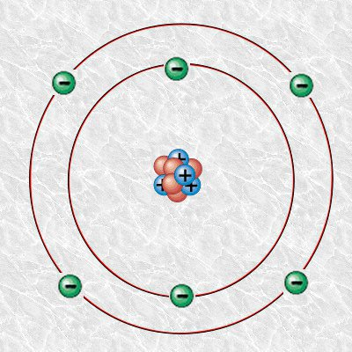
https://www.nuclear-power.com/nuclear-power/reactor-physics/atomic-nuclear-physics/nuclear-stability/

Slide 5
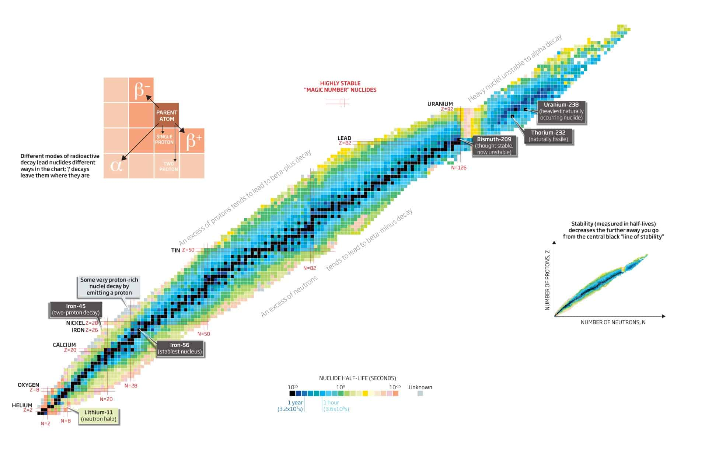
https://www.nuclear-power.com/nuclear-power/reactor-physics/atomic-nuclear-physics/nuclear-stability/

Slide 6
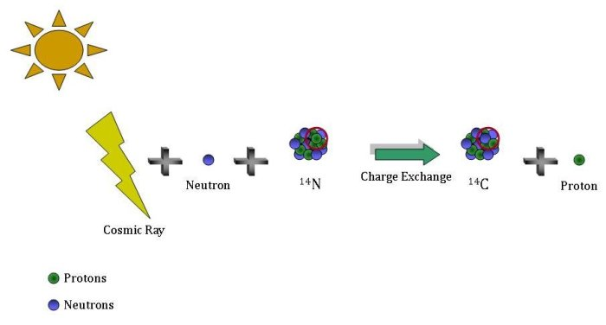
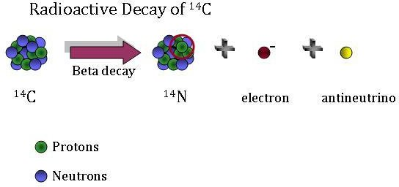
https://gml.noaa.gov/ccgg/isotopes/decay.html

Slide 7
Radioactive decay
Decay rates are constant as far as we know
  Not influenced by environment
Average lifespan ¹⁴C 8600 years – half-life 5730
100% at t=0 (AD 1950)

Slide 8
Radioactive decay
List ten half-lives (enter each of the below commands in your R terminal, followed by pressing Enter):
yr <- seq(0, by=5730, length=10)
halflives <- 0.5 ^ (0:9)
cbind(yr, 100*halflives)

Slide 9
C-12 99%
C-13 1%
C-14 10⁻¹²
https://maarten14c.github.io/

Slide 10
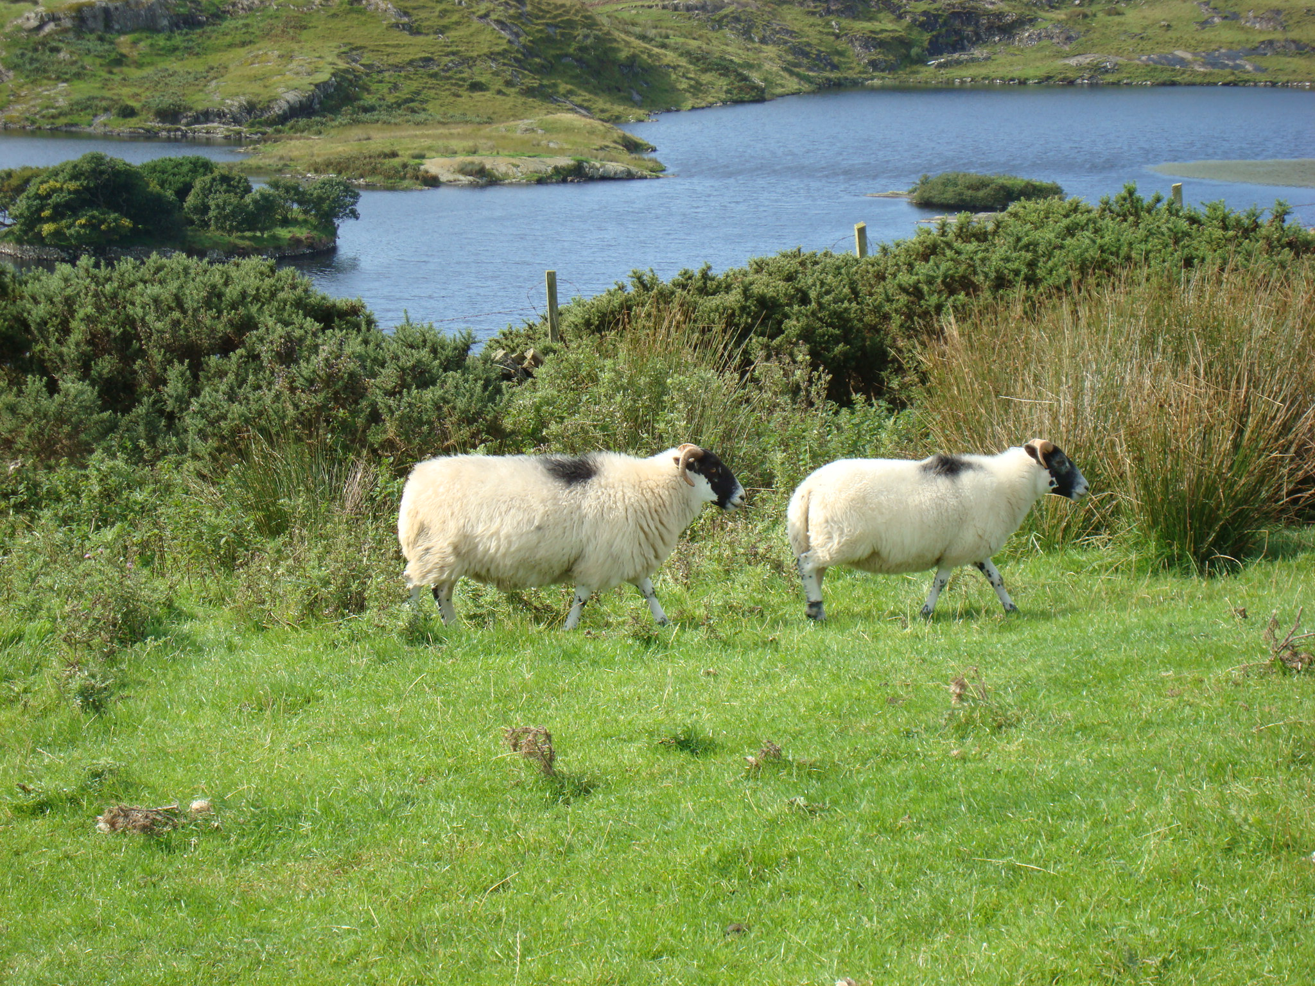
Cosmic rays
¹⁴N + n
¹⁴C + O₂
¹⁴C + p
¹²CO₂
¹⁴CO₂
¹³CO₂
¹⁴C/¹²C
Notes:
14C production
Exchange with reservoirs

Slide 11
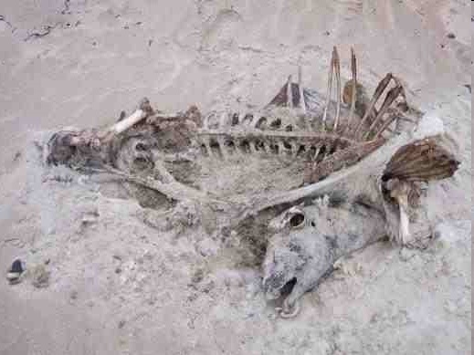
Cosmic rays
¹⁴N + n
¹⁴C + O₂
¹⁴C + p
¹²CO₂
¹⁴CO₂
¹³CO₂
¹⁴C/¹²C
Notes:
14C production
Exchange with reservoirs

Slide 12
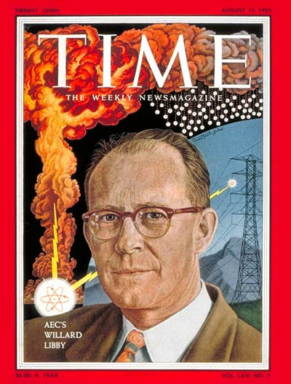
Libby’s ¹⁴C decay counter

Slide 13
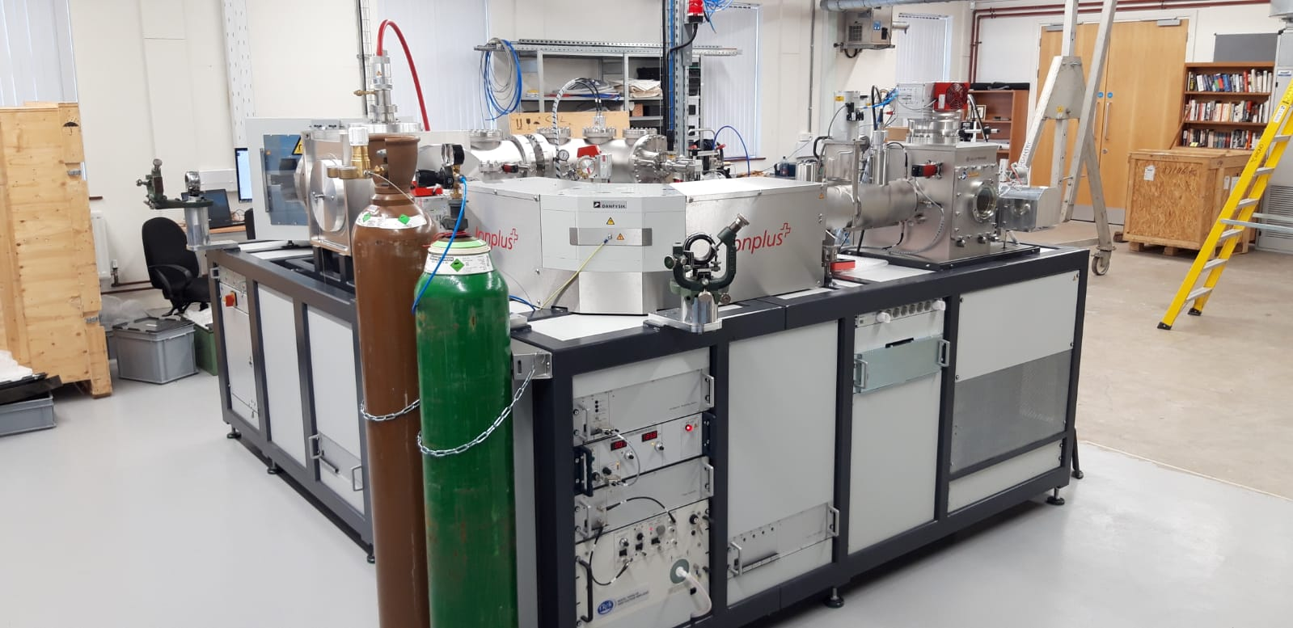
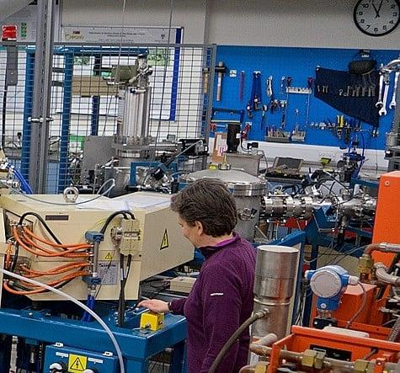
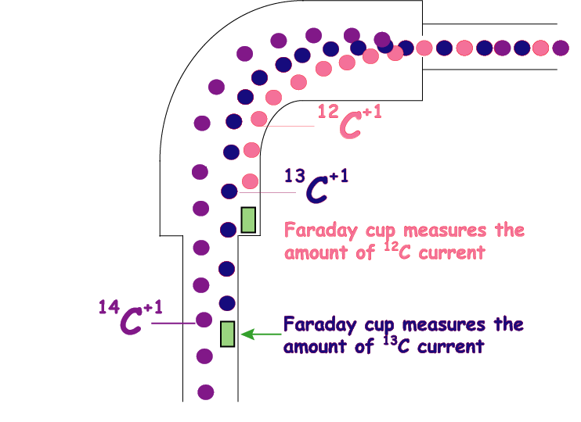

Slide 14
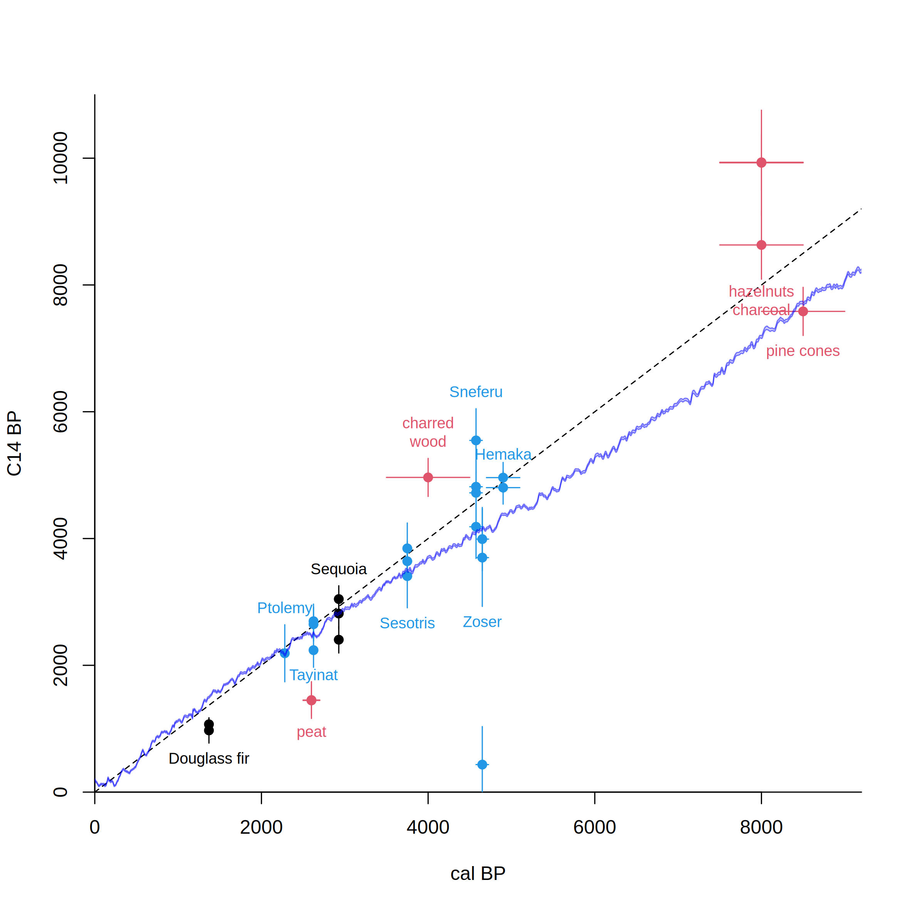
Libby’s Curve of Knowns vs IntCal20
After Arnold & Libby 1951
Science 113, 111-150
Notes:
sample of acacia wood from the tomb of the pharaoh Zoser (or Djoser; 3rd Dynasty, ca. 2700-2600 BC) was obtained and dated. Libby reasoned that since the half-life of C14 was 5568 years, they should obtain a C14 concentration of about 50% that which was found in living wood (see Libby, 1949 for further details). The results they obtained indicated this was the case.

Slide 15
Assumptions ¹⁴C
Constant atmospheric ¹⁴C levels
Well-mixed carbon reservoirs
The target event is dated

Slide 16
Radiocarbon calibration
CALIBRATION: verification that the method is accurate
Chunks of wood representing 10-20 years were taken from tree-ring dated US and European trees, and the ¹⁴C in them was measured
  The exact age of each tree ring was known
  This gave a continuous record of atmospheric ¹⁴C
  Wiggles reproduced between labs

Slide 17
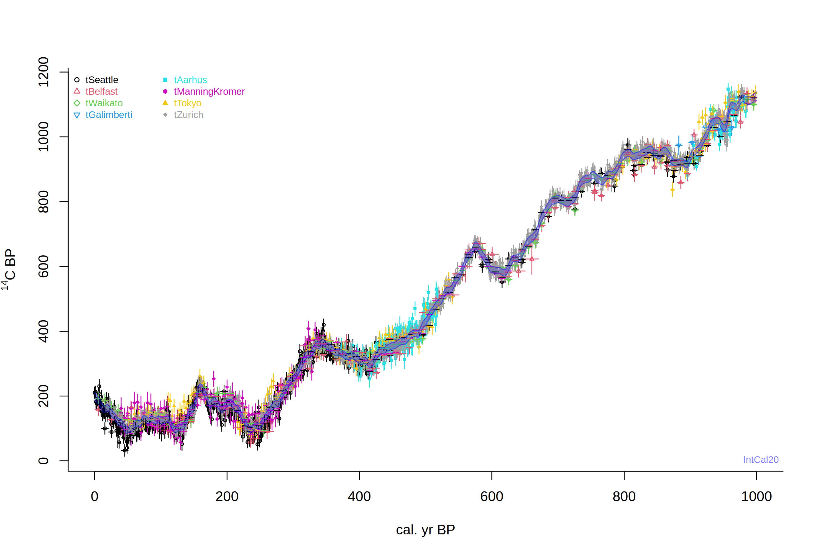
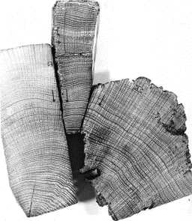
IntCal20. Levels of ¹⁴C fall over time, but because the formation rate varies, the shape of calibration curve is jagged.
Years before present, where Present = AD 1950

Slide 18
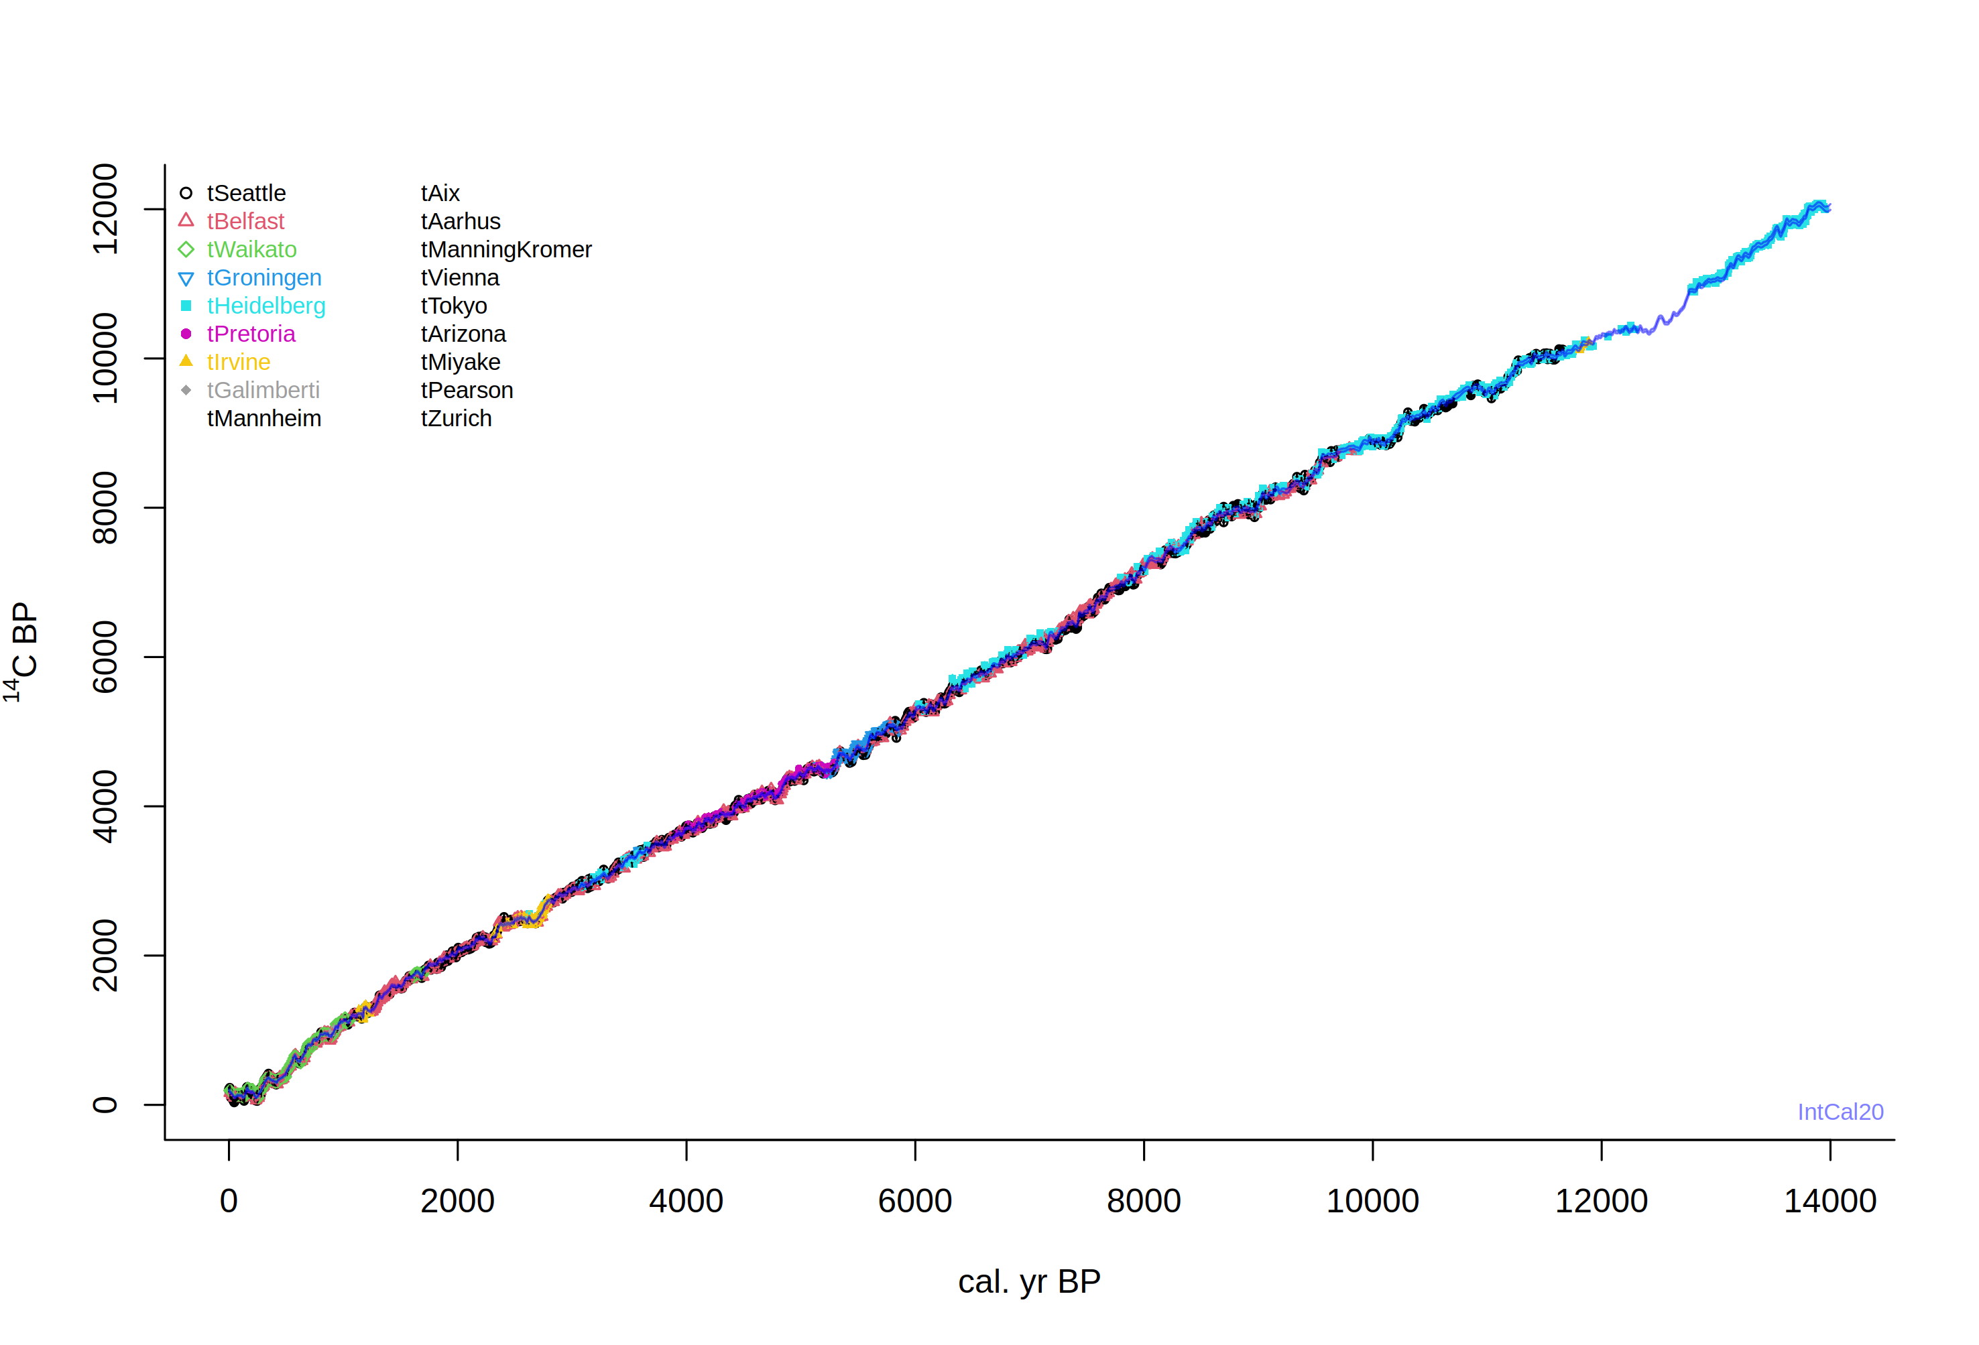

Slide 19
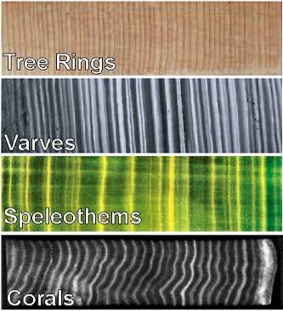
Extension of the ¹⁴C calibration curve
More tree rings
Varves (marine or lacustrine)
Speleothems
Corals

Slide 20
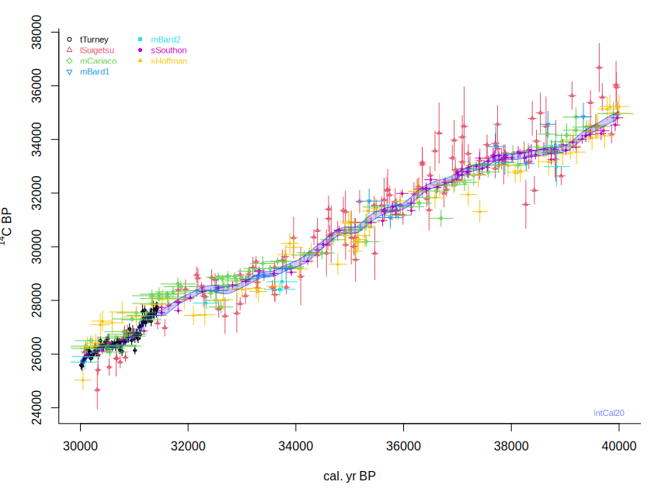

Slide 21
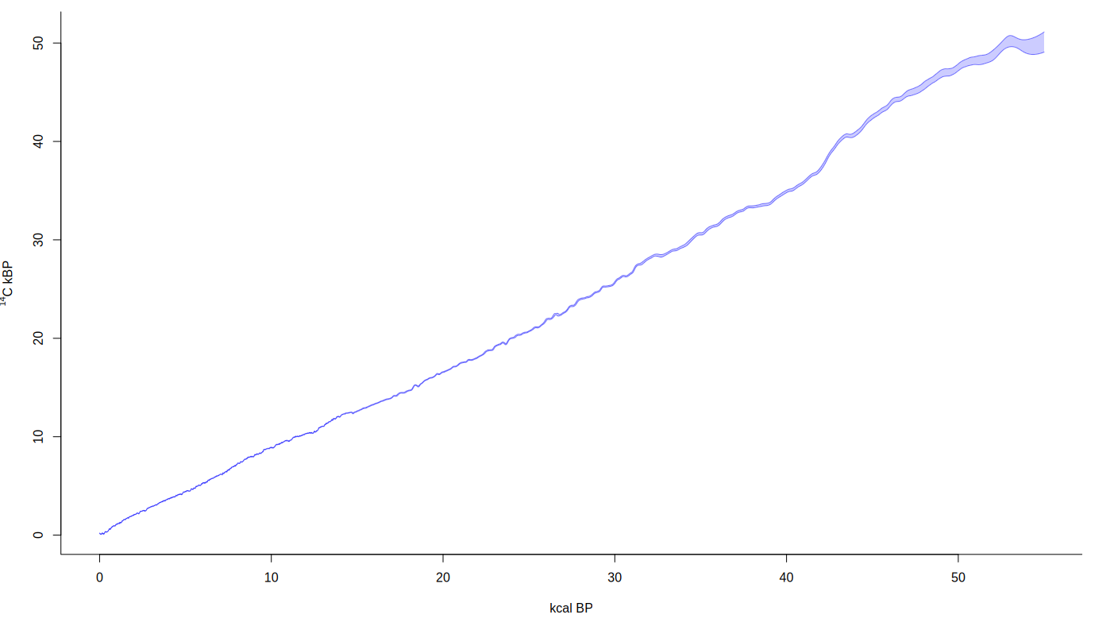
IntCal20
Reimer et al. 2020 Radiocarbon

Slide 22
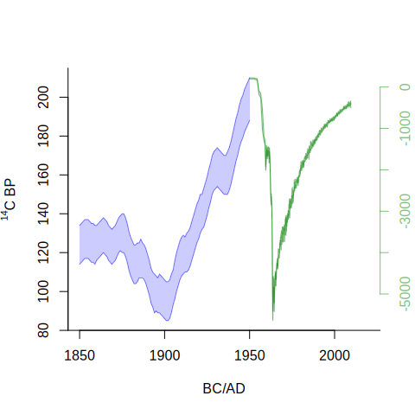
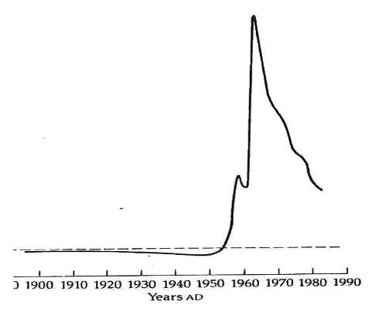
Factors influencing amount of ¹⁴C in the atmosphere
anthropogenic activity (burning of fossil fuels, bomb tests): release of ‘old’ or ‘new’ carbon
Bowman S., 1990
Notes:
de Vries found that 17-th century wood had a 2% higher activity than 19th century wood.

Slide 23
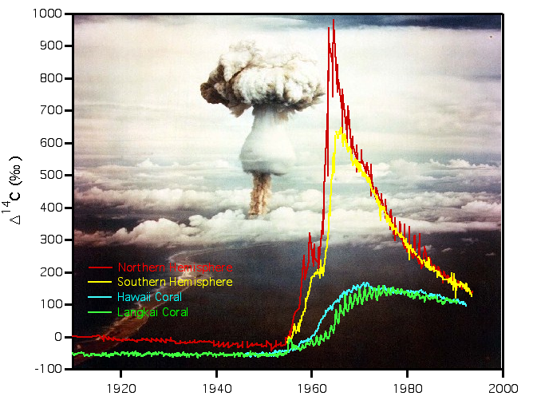
Atmospheric nuclear testing ¹⁴C
Courtesy Stewart Fallon, LLNL

Slide 24
require(IntCal)
intcal.data(0, 1000)
intcal.data(30e3, 40e3)
draw.ccurve()
draw.ccurve(1850, 2020, BCAD=T, cc2="nh1", add.yaxis=T)

Slide 25
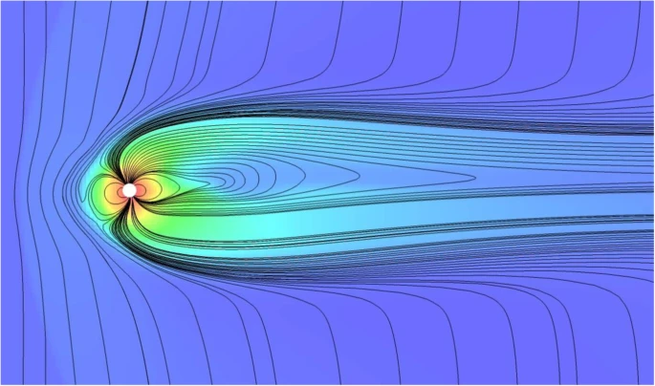
Factors influencing amount of ¹⁴C in the atmosphere
anthropogenic activity (burning of fossil fuels, bomb tests): release of ‘old’ and/or ‘new’ carbon
variations in solar activity
variations in the Earth’s magnetic field
changes in carbon cycle
Nandy et al. 2021 Prog Earth Planet Sci

Slide 26
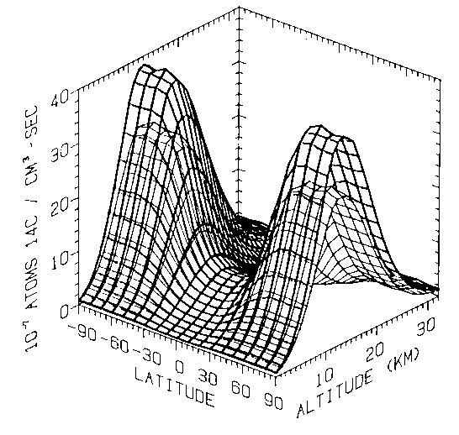
¹⁴C production
Sunspot minimum
Sunspot maximum
Braziunas et al. (1995) based on Lingenfelter (1963)

Slide 27
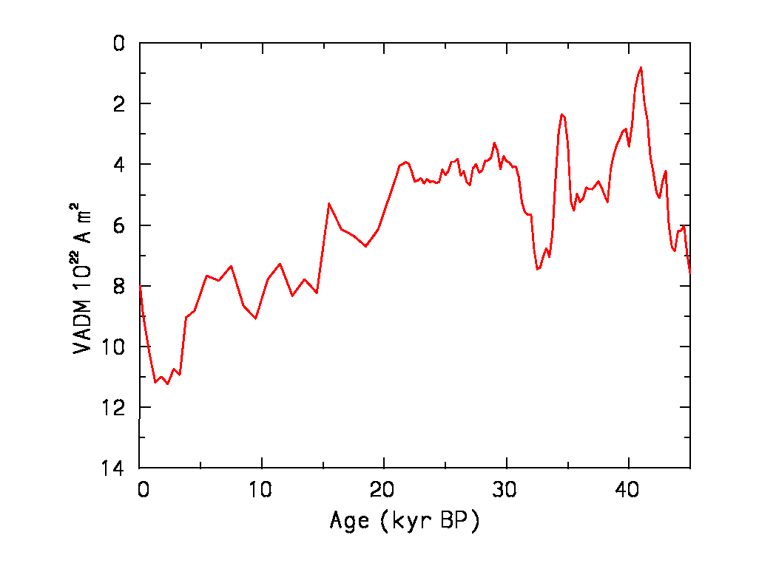
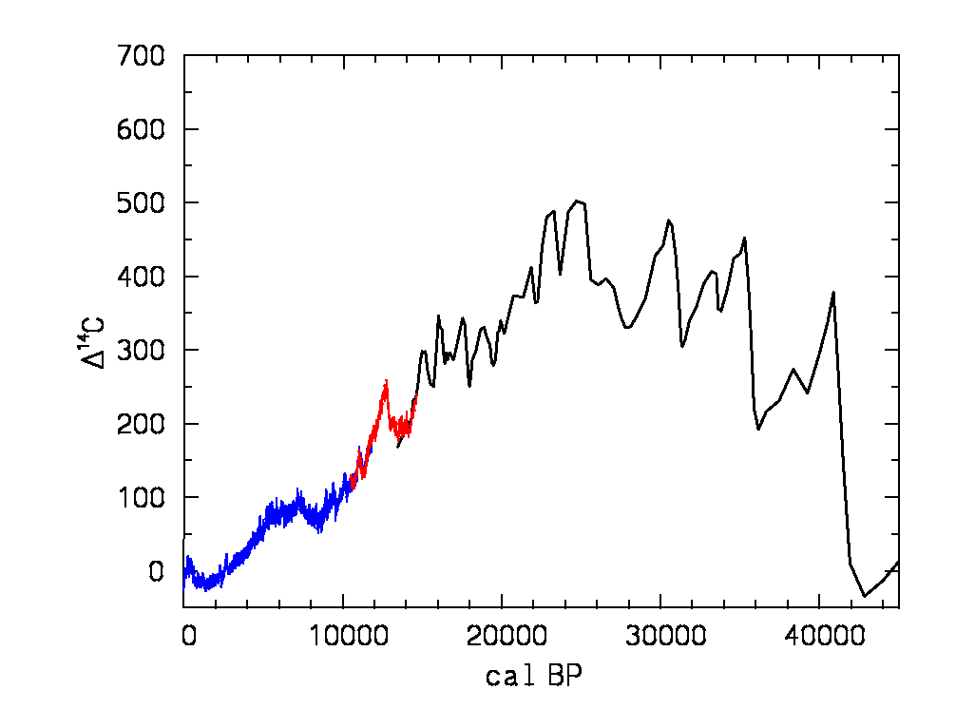
¹⁴C vs. geomagnetic strength
Dipole moment
¹⁴C
?

Slide 28
Assumptions ¹⁴C
Constant atmospheric ¹⁴C levels
Well-mixed carbon reservoirs
The target event is dated

Slide 29
Estimated Carbon Reservoir Sizes and Ages
Atmosphere 750 Gt
0
Plants 550 Gt
1 – 250 yrs
Soils & peat 2000 Gt
1 – 10,000 yrs
Millions of yrs
¹⁴C free
Fossil fuels 5000 Gt
Surface ocean 1000 Gt
400 – 1000 yrs
Deep ocean 38,000 Gt
1000 – 2000 yrs
1 Gigaton (Gt) = 10¹⁵ tons
IPCC 1990

Slide 30
Marine reservoir effect
Difference in radiocarbon age of surface water and atmosphere due to slow exchange
Average c. 500 years
+ Local upwelling of old water
0 to + 900 years
Example: Scott polar expedition (AD 1912)
Apparent age penguin 1390 ± 40 BP seal 1300 ± 50 BP

Slide 31
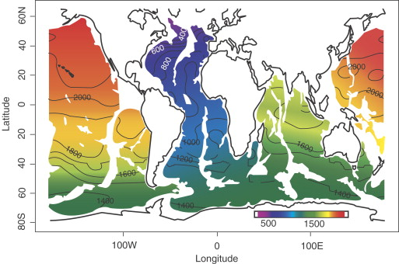
Hughen 2007, Developments in Marine Geology

Slide 32
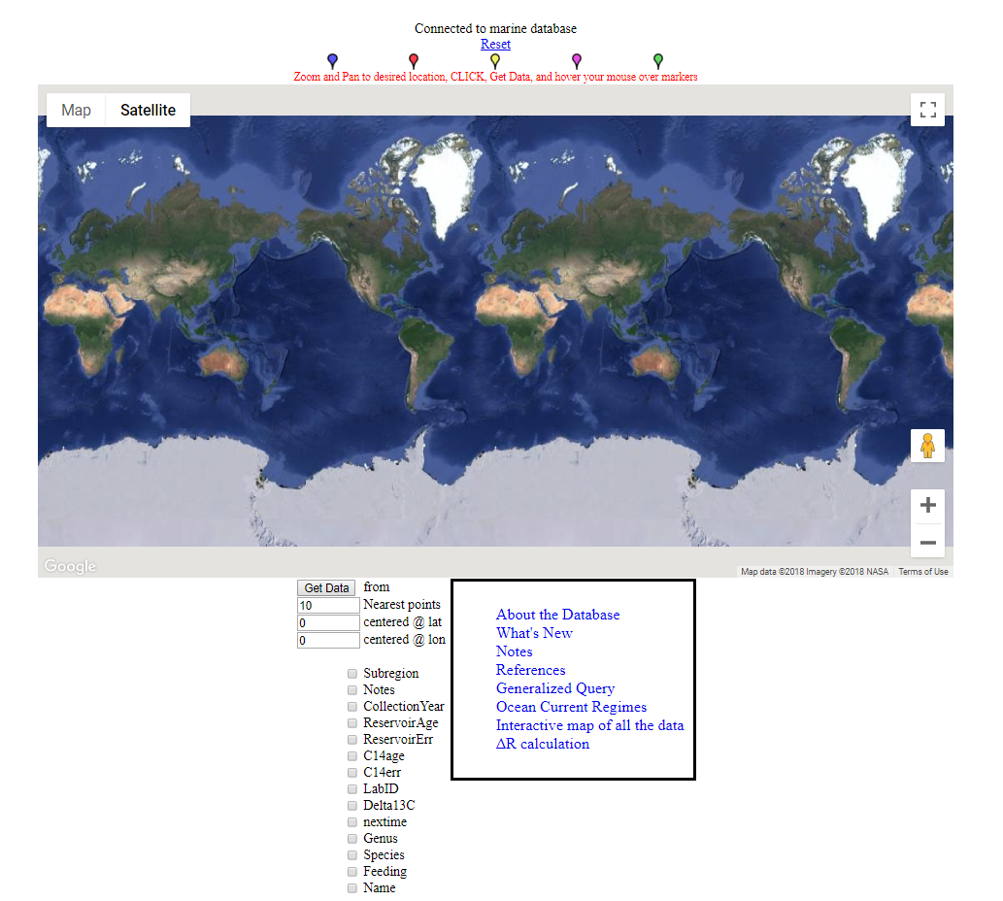
Marine Reservoir
Correction
Database
http://calib.org/marine/

Slide 33
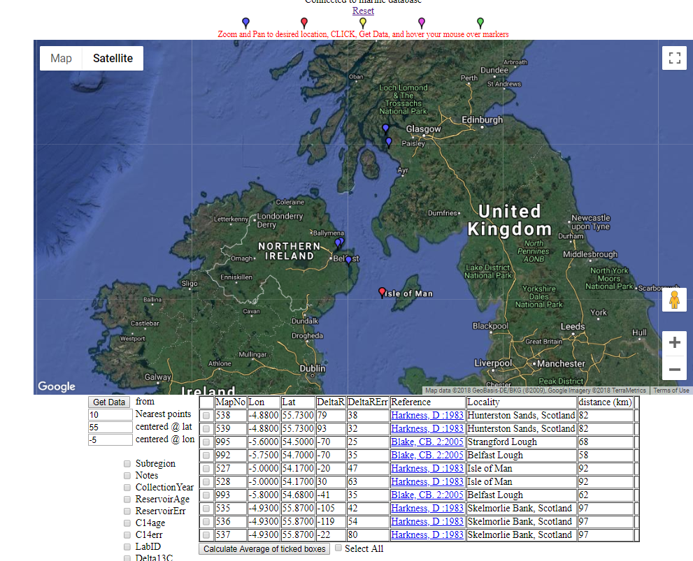
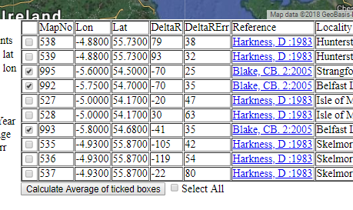
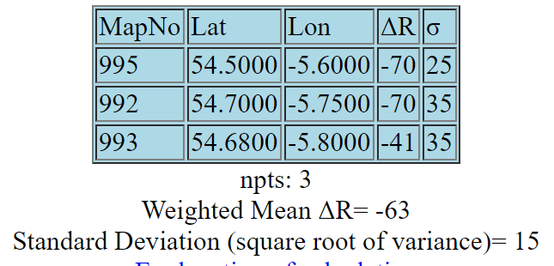

Slide 34
Lake reservoir effects
Lakes can also have large and varying ¹⁴C offsets
    Leaking of old C from carbonates
    Inwash old soils
    Volcanic CO2, etc.
Check bulk sediment dates through paired dating (pollen, charcoal, tephra, ²¹⁰Pb)

Slide 35
Assumptions ¹⁴C
Constant atmospheric ¹⁴C levels
Well-mixed carbon reservoirs
The target event is dated

Slide 36
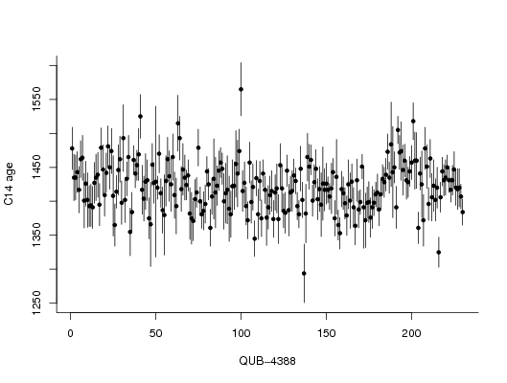
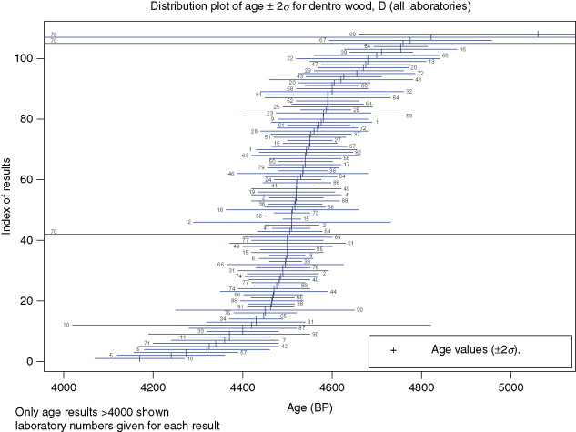
Scott, 2013 (Encycl. Quat. Sci.)

Slide 37
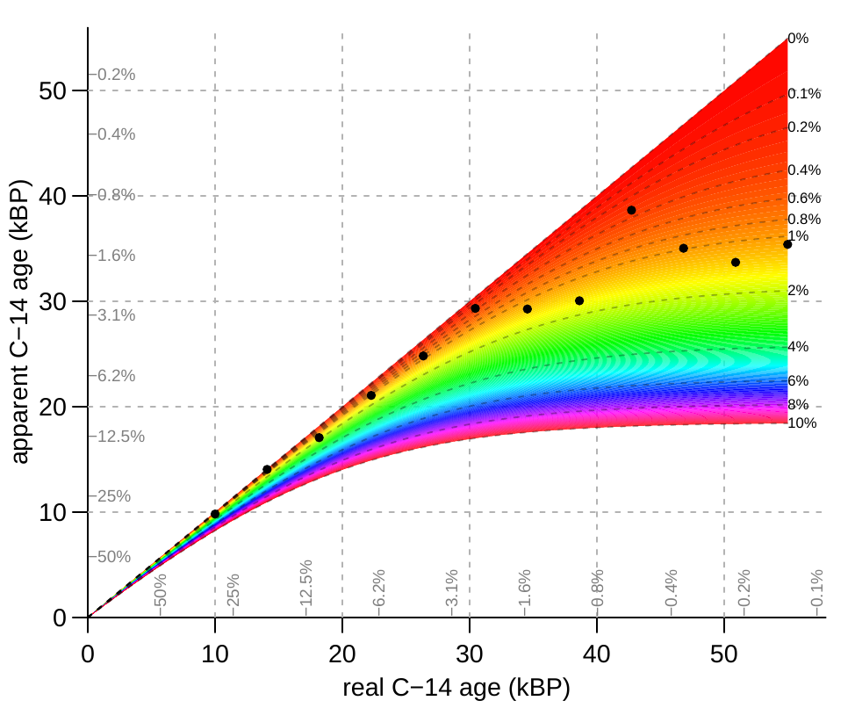

Slide 38
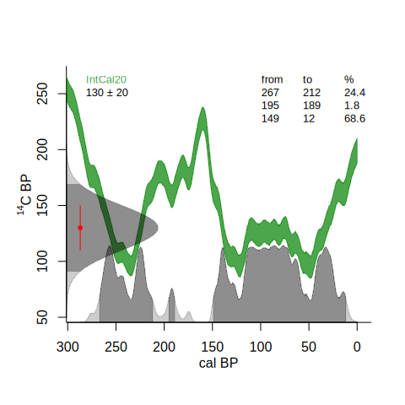
¹⁴C calibration
calibrate()

Slide 39
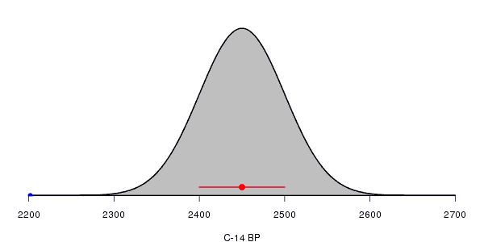
¹⁴C calibration
Each radiocarbon date comes with a lab error
Assumed to be distributed normally/Gaussian
    Or alternatively, a student-t distribution with longer tails

Slide 40
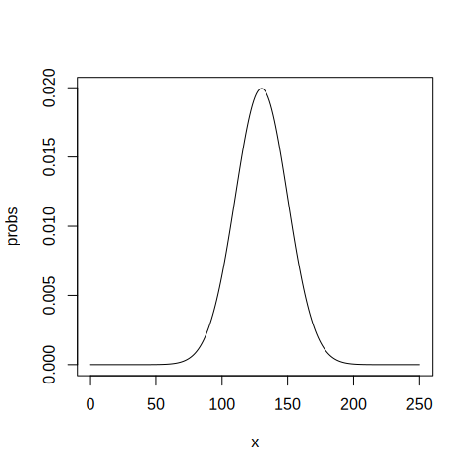
¹⁴C calibration
dnorm(125, 130, 20)
dnorm(130, 130, 20)
x <- 0:250
probs <- dnorm(x, 130, 20)
head(cbind(x, probs))
sum(probs)
plot(x, probs, type="l")

Slide 41
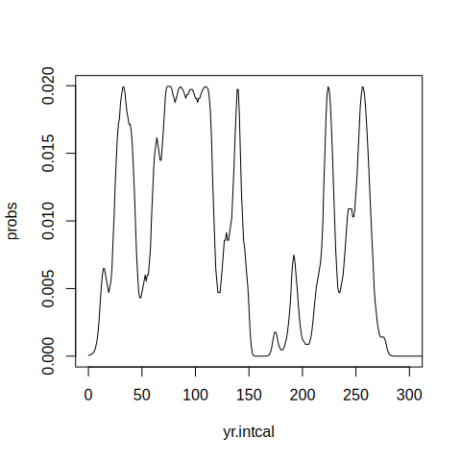
¹⁴C calibration
cc <- ccurve()
yr.intcal <- cc[,1]
c14.intcal <- cc[,2]
probs <- dnorm(c14.intcal, 130, 20)
plot(yr.intcal, probs, xlim=c(0, 300), type="l")

Slide 42
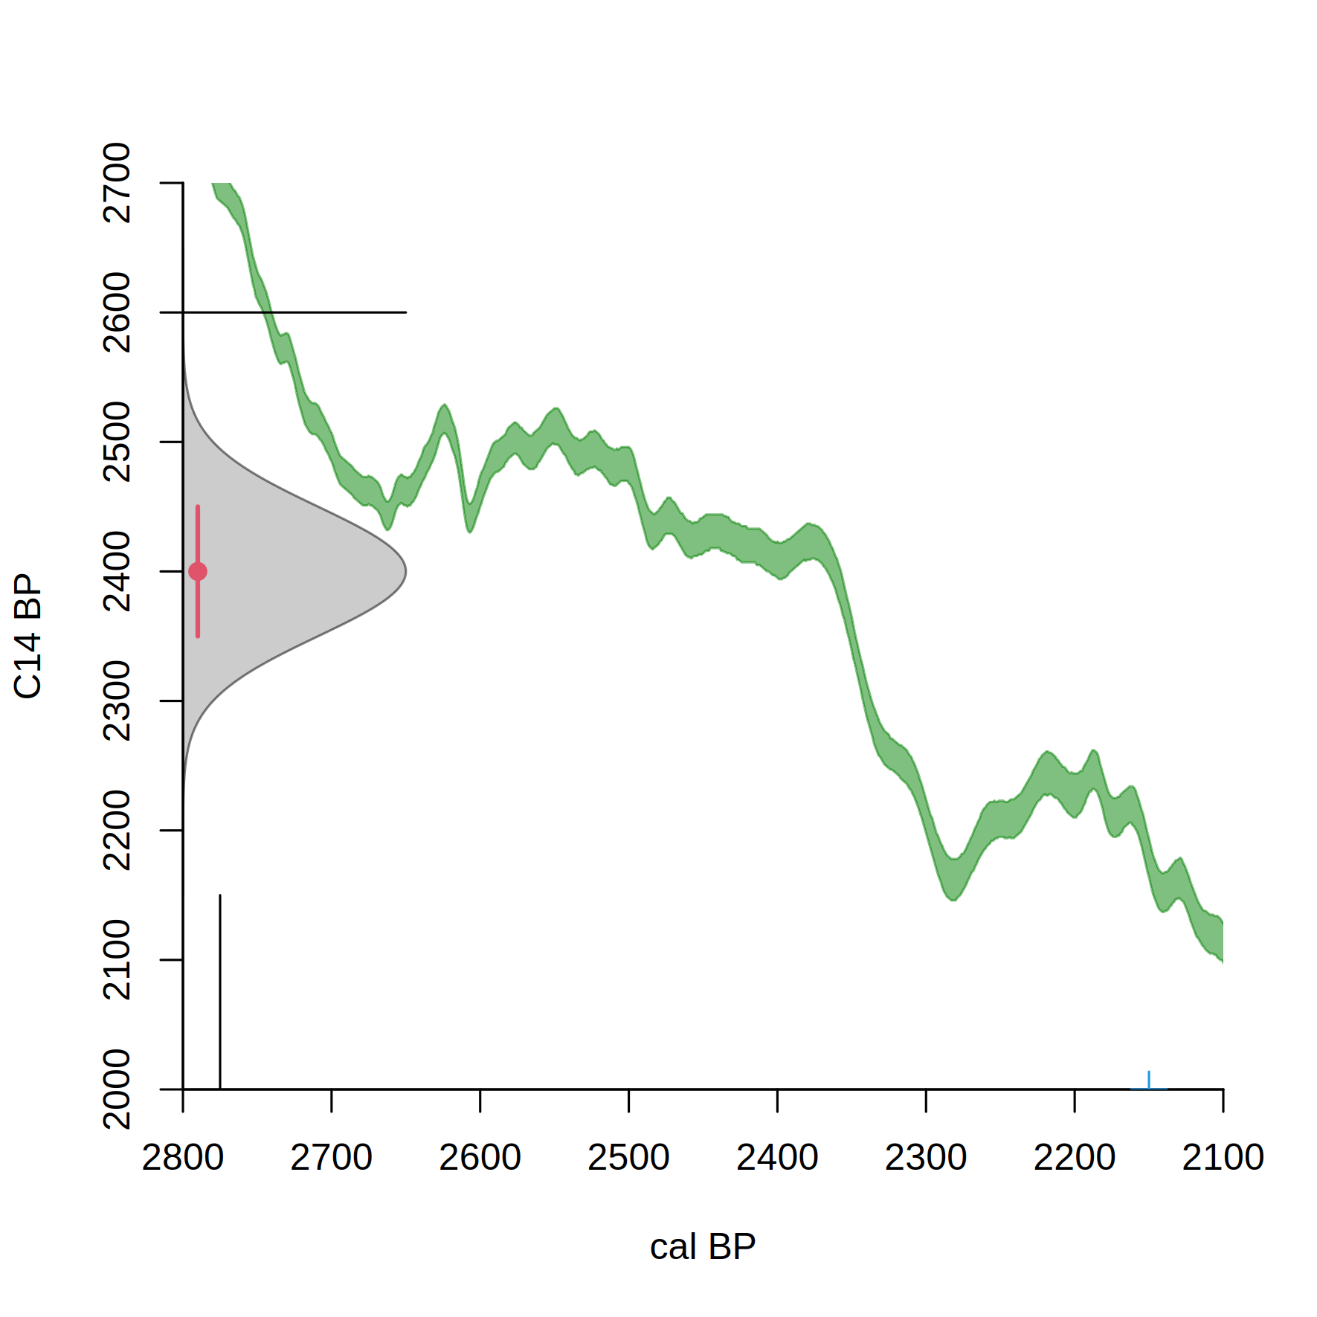

Slide 43


Slide 44


Slide 45
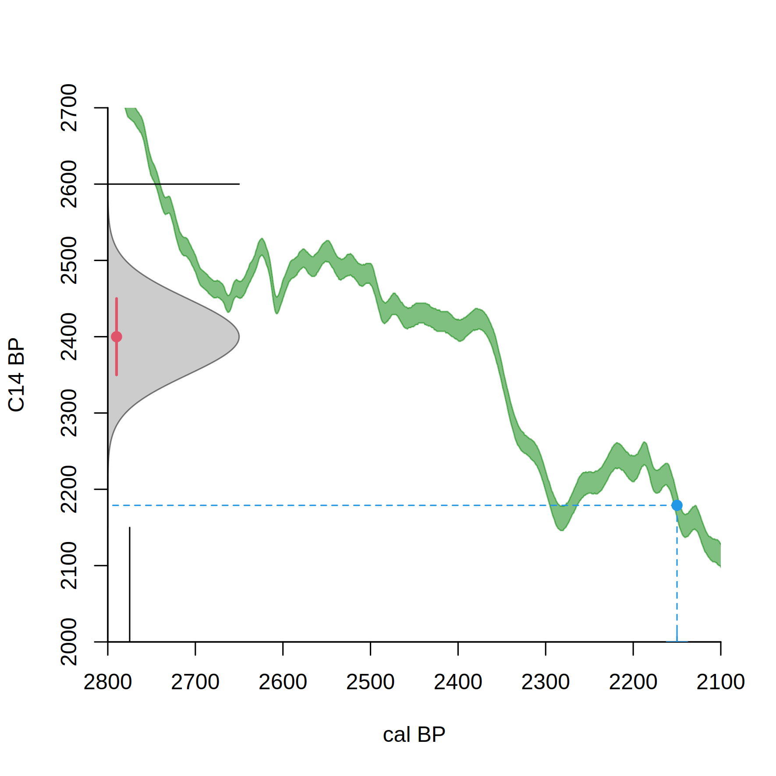

Slide 46


Slide 47


Slide 48
https://vimeo.com/603317968

Slide 49
calibrate()
cc <- ccurve()
head(cc)

Slide 50
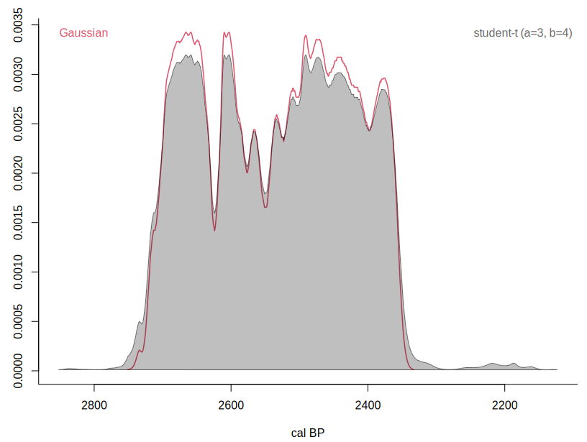
¹⁴C calibration – student-t

Slide 51
¹⁴C calibration – hpd ranges

Slide 52
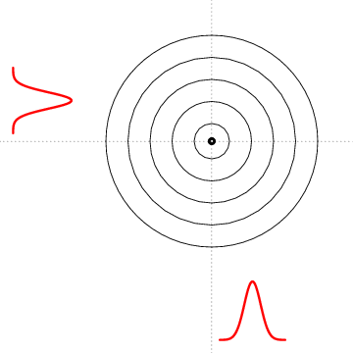
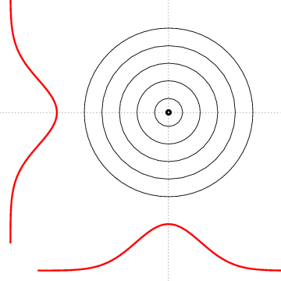
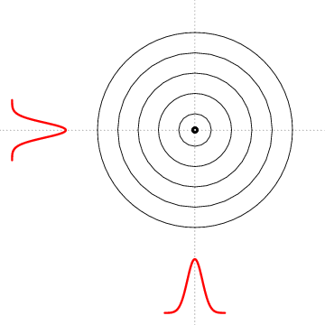

Slide 53
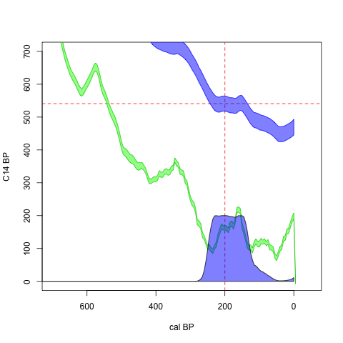
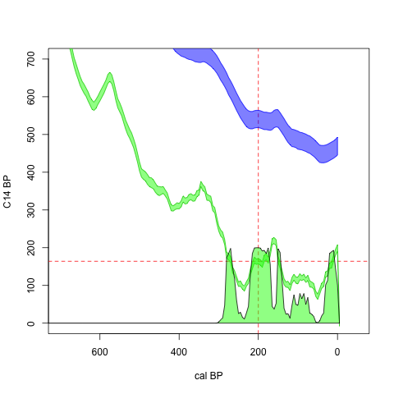

Slide 55
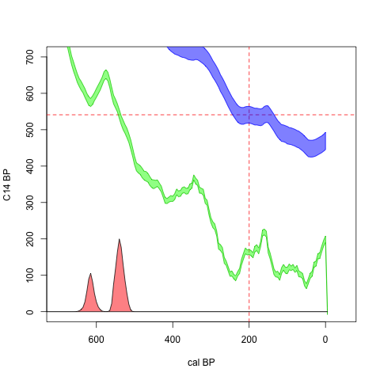

Slide 56
Schedule
Today: radiocarbon, intro to age-modeling

Slide 57
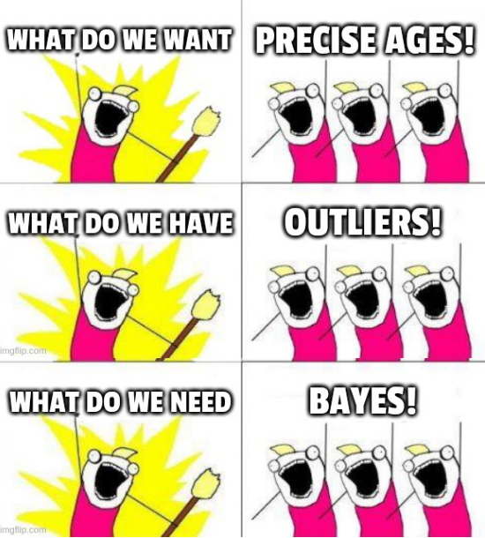
Age-depth modeling
What do we want?
    Precise ages for events/depths in a core
    Put site in context, common time scale

Slide 58
Age-depth modeling
What do we want?
    Precise ages for events/depths in a core
    Put site in context, common time scale
What do we have?
    Some dates along a core
    Uncertainties, biases, scatter, outliers

Slide 59
Age-depth modeling
What do we want?
    Precise ages for events/depths in a core
    Put site in context, common time scale
What do we have?
    Some dates along a core
    Uncertainties, biases, scatter, outliers
What do we need?
    Realistic and robust models of deposition
    Quantification of uncertainties

Slide 60
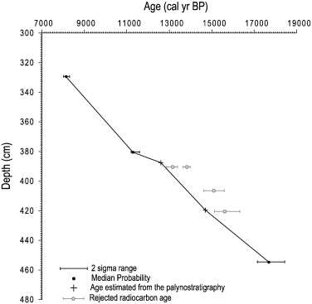
Googling for age-depth model
Millet et al. 2012. Chironomid-based reconstruction of Lateglacial summer temperatures from the Ech palaeolake record (French western Pyrenees). PalPalPal 315: 86-99

Slide 61
Googling for age-depth model
Millet et al. 2012. Chironomid-based reconstruction of Lateglacial summer temperatures from the Ech palaeolake record (French western Pyrenees). PalPalPal 315: 86-99

Slide 62
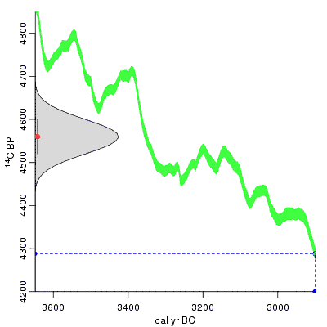
Googling for age-depth model
Which point estimates?
Millet et al. 2012. Chironomid-based reconstruction of Lateglacial summer temperatures from the Ech palaeolake record (French western Pyrenees). PalPalPal 315: 86-99

Slide 63
Googling for age-depth model
Which point estimates?
Reject dates?
Millet et al. 2012. Chironomid-based reconstruction of Lateglacial summer temperatures from the Ech palaeolake record (French western Pyrenees). PalPalPal 315: 86-99

Slide 64
Googling for age-depth model
Which point estimates?
Reject dates?
How connect points?
Millet et al. 2012. Chironomid-based reconstruction of Lateglacial summer temperatures from the Ech palaeolake record (French western Pyrenees). PalPalPal 315: 86-99

Slide 65
Googling for age-depth model
Which point estimates?
Reject dates?
How connect points?
Uncertainty?
Millet et al. 2012. Chironomid-based reconstruction of Lateglacial summer temperatures from the Ech palaeolake record (French western Pyrenees). PalPalPal 315: 86-99

Slide 66
Next session
Theory of age-depth modeling
Tutorial for running Bacon

