Slide 1
Radiocarbon wiggle-match dating
Explained through animations
Maarten Blaauw
Centro de Investigación en Matemáticas
www.cimat.mx/~blaauwm
blaauwm@cimat.mx

Slide 2
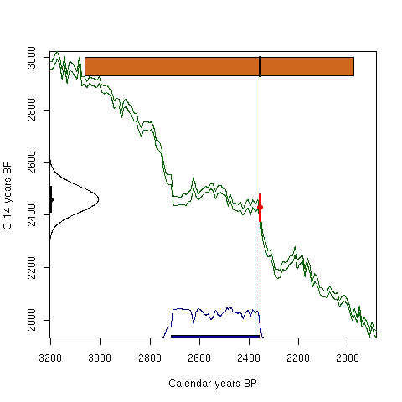
calibrate a single date…

Slide 3
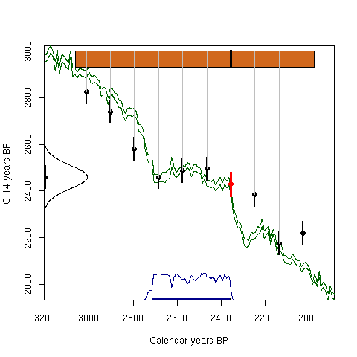
... or date more levels...

Slide 4
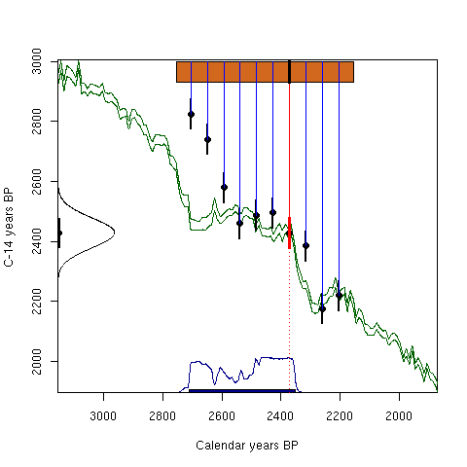
... and match the wiggles

Slide 5
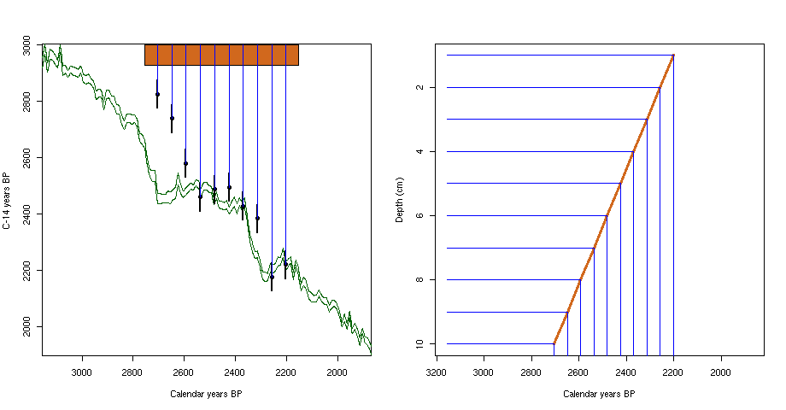
How? Linear accumulation,
estimate 2 parameters (age=a×depth+b)

Slide 6
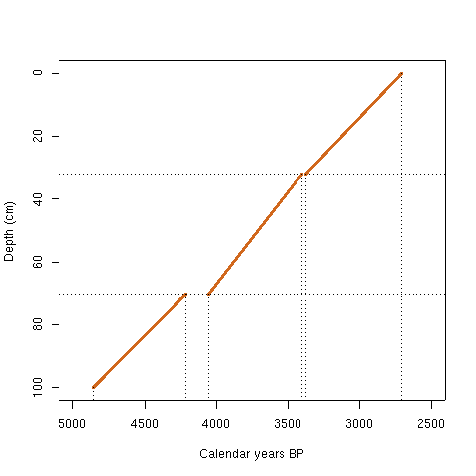
Several sections: more parameters

