Slide 1
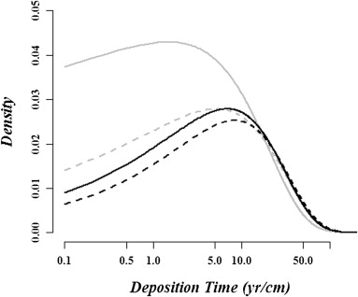
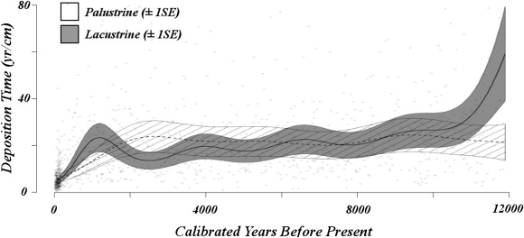
Priors – Accumulation rate
Goring et al. 2012 analysed sedimentation times from > classical age-depth models of >200 lakes/tidal wetlands in NE US
Gamma distribution with mean c. 20 yr/cm, shape between >1 and 2
Goring et al. 2012. Deposition times in the northeastern United States during the Holocene: establishing valid priors for Bayesian age models. Quat. Sci. Rev. doi: 10.1016/j.quascirev.2012.05.019

Slide 2
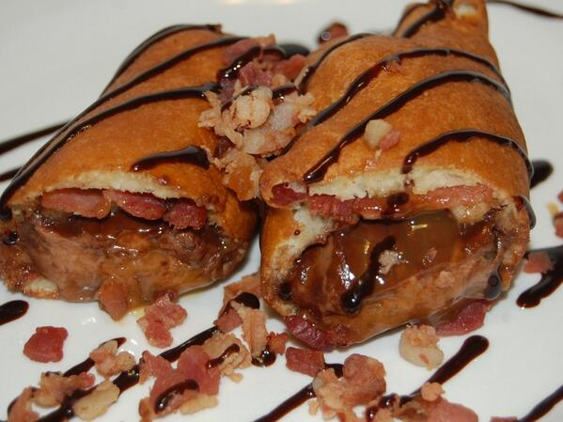
Bacon on Mars?

Slide 3
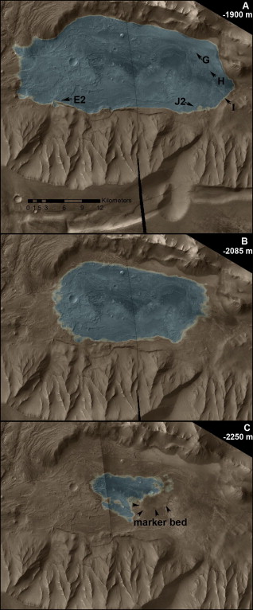
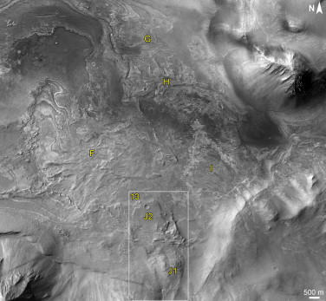
“Lacustrine deposition rates ranged from 0.02 to 1 cm/year over the last 10,000 years in eastern North America (Goring et al., 2012). To accumulate the ∼45 m of layered deposits below fan F using these sedimentation rates would take [4.5–230 ka]. Hence, the presence of lacustrine beds significantly increases the inferred timescale of lacustrine activity within Melas basin.”
Williams and Weitz 2014. Icarus, doi:10.1016/j.icarus.2014.06.030

Slide 4
Priors – Accumulation rate
Bacon’s default 20 yr/cm (mean), 1.5 (shape)
Based on Goring et al. 2012, who produced classical age-depth models of >200 lakes in NE US
Other sites could could have different rates
E.g., recent sites, older sites, deltas, oceans…
Bacon will do a quick initial check to see if the default prior fits
Suggest different prior if deemed necessary
Or provide your own prior values
Goring et al. 2012. Deposition times in the northeastern United States during the Holocene: establishing valid priors for Bayesian age models. Quat. Sci. Rev. doi: 10.1016/j.quascirev.2012.05.019

Slide 5
Priors – mean accumulation rate

