Slide 1
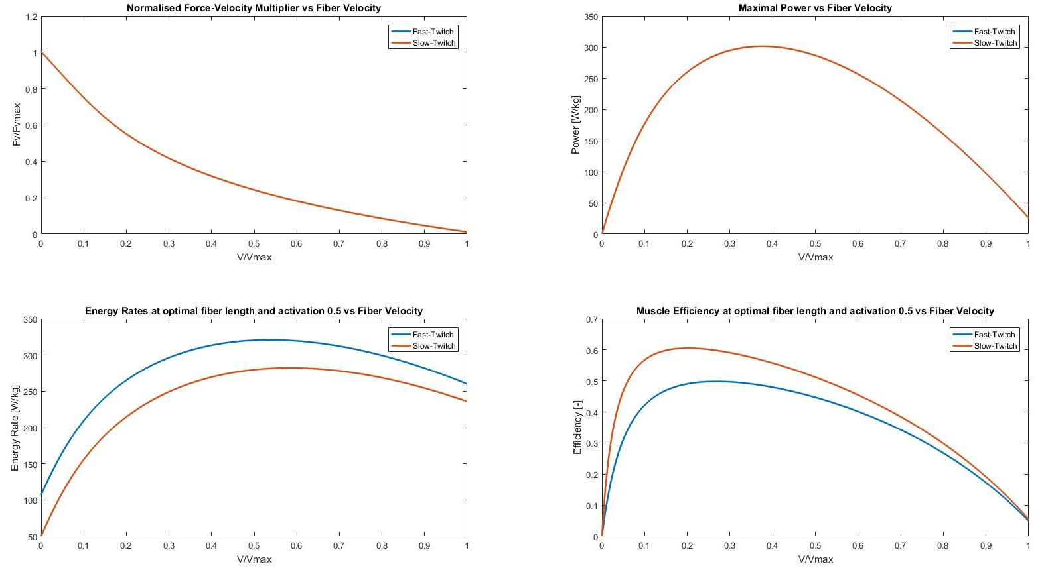
Difference in Force-Vel and Power-Vel?

Slide 2
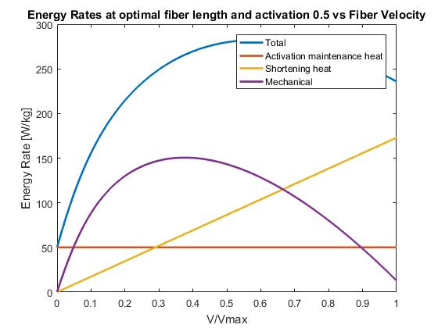
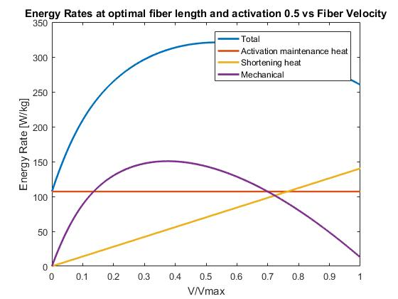
Change in % FT
Slow Twitch
Fast Twitch

Slide 3
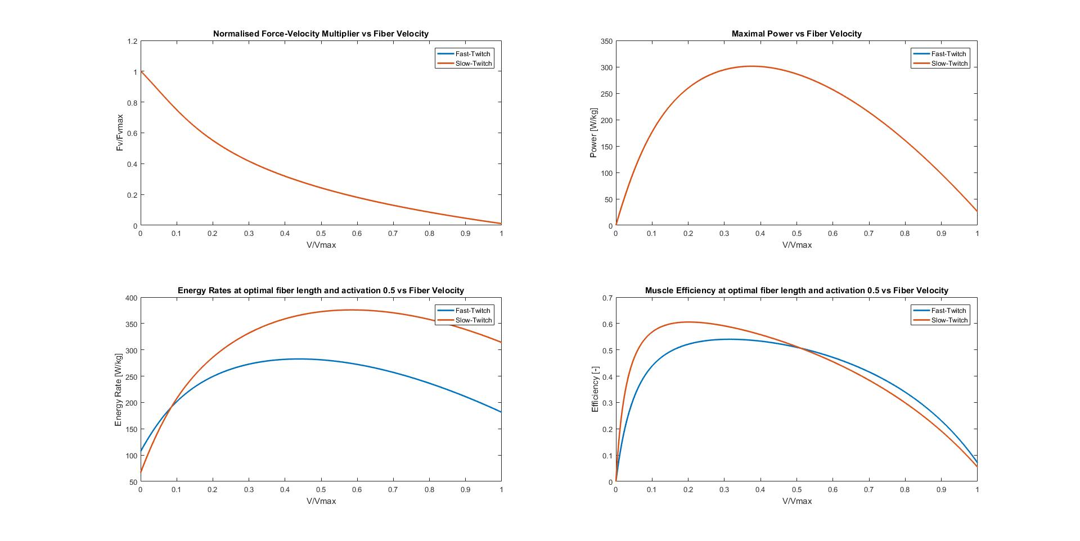

Slide 4
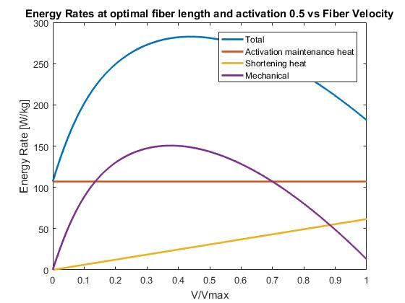
Change in % FT
Change in F_{iso,max}
Change in l_{opt}
Slow Twitch
Fast Twitch

