Slide 1

BITCOIN. AN ECONOMIC APPRAISAL
maarten brijker

Slide 2
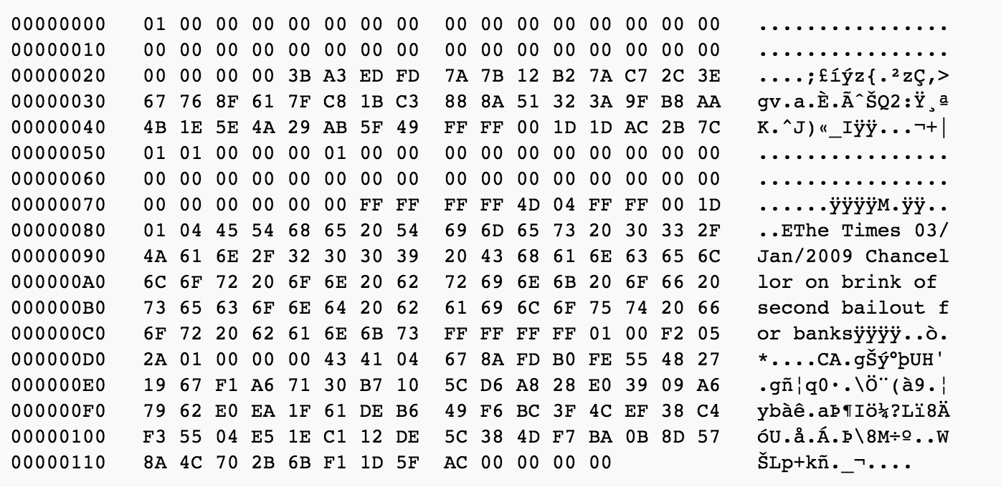

Slide 3
outline
goal
outline paper
monetary systems
gold standard
fiat money
bitcoin
comparisons
problems

Slide 4
goal
to examine Bitcoin’s potential as a dominant monetary system
by comparing it with our two main monetary systems:
gold standard
fiat money
literature review
quantity theory of money
IS-LM model

Slide 5
outline
paper
GOLD STANDARD
historical outline
economical outline
basic principles
role of the central bank
role of the government
international
FIAT MONEY
BITCOIN
COMPARISONS
money supply
money demand
inflation
output & income

Slide 6
monetary system:
GOLD STANDARD
historical:
classical gold standard
bretton woods
shift in policy

Slide 7
monetary system:
GOLD STANDARD
economical:
basic principles
commitment mechanism
long run stability
role of the central bank
lender of last resort
fractional reserve system
role of the government
a contingent rule
international
international gold standard
centrism

Slide 8
monetary system:
FIAT MONEY
historical:
development pattern
early forms of fiat money
after bretton woods
monetary policy

Slide 9
monetary system:
FIAT MONEY
economical:
basic principles
definitions (unbacked & intrinsically useless, m.o.e.)
market equilibrium
role of the central bank
policy
money creation
brand name
government
coordination failure
election cycles + seigniorage —> need regulation
international
optimum currency areas

Slide 10
monetary system:
BITCOIN
historical:
e-cash
ideology
financial return
crashes

Slide 11
monetary system:
BITCOIN
economical:
basic properties
mix of gold and fiat
constant money growth and a fixed money stock
low transaction fees
privacy
role of the blockchain
how it works
double spend problem
scalability of mining

Slide 12
comparisons:
INFLATION
money supply & money demand
refer back to monetary systems
inflation
use above & the quantity of money to examine this ?
compare gold with fiat
argument: bitcoin shares characteristics
literature: relation inflation and different money systems ?

Slide 13
comparisons:
OUTPUT & INCOME
IS-LM model
input: inflation
use previous comparison in model
relevant literature

Slide 14
problems
how to properly compare effect on inflation
IS-LM the right model?
thesis is too long (already 10.000 words)
how to scale down

