Slide 1


Introducing Apache Kafka – scalable, reliable Event Bus & essage queue
M
Maarten Smeets & Lucas Jellema
09 February 2017, Nieuwegein

Slide 2
Agenda
Introduction & overview
Demo
Handson part 1 - Producing and Consuming messages (pub/sub)
Dinner
Kafka: Some history, a peek under the hood, role in architecture and use cases
Kafka and Oracle
Handson part 2 – more complex scenarios and some background & admin

Slide 3
Consumers
Producers

Slide 4
Sending messages to consumers
Dependency on producer at design time and at run time
Deal with multiple consumers?
Synchronous (blocking) waits
(how to) Cross technology realms
(how to) Cross host, location, clouds
Availability of consumers
Message delivery guarantees
Scaling, high (peak) volumes

Slide 5
Messaging – to decouple pub and sub
Producers
Consumers

Slide 6
Messaging as we know it
JMS, Oracle Advanced Queuing, IBM MQ, MS MQ, RabbitMQ, WebSockets, …
Challenges
Costs
Scalability (size and speed)
(lack of) Distribution
Complexity of infrastructure
Message delivery guarantees
Lack of technology openness
Deal with temporarily offline consumers
Retain history

Slide 7

Consumers
tcp
Producers
tcp

Slide 8
Consumers
Producers
Topic

Slide 9
Kafka terminology
Message
Topic
Message
== ByteArray
Broker
Producer
Consumer
Key
Value
Time
Producer
Consumer
Broker
Topic

Slide 10
Key
Value
Time
Consumers
Producers
Broker
Topic

Slide 11
Consuming
Messages are available to consumers when they have been committed
Kafka does not push
Unlike JMS
Read does not destroy
Unlike JMS Topic
(some) History available
Offline consumers can catch up
Consumers can re-consume from the past
Delivery Guarantees
Ordering maintained
At least once (per consumer) by default; at-most-once and exactly-once can be implemented

Slide 12
Key
Value
Time
Consumers
Producers
Broker
Topic

Slide 13
What’s so special?
Durable
Scalable
High volume
High speed
Available
Distributed
Open

Slide 14



Consumers
tcp
Producers
tcp
Broker
Topic

Slide 15
10 min – Demo plus intro handson
Producing, Consuming from Kafka console
Monitoring

Slide 16
25 min –handson
Using VM
Producing, Consuming from Kafka console
Monitoring
Kafka tool
Kafka manager (browser based)

Slide 17
Agenda
Introduction & overview
Demo
Handson part 1 - Producing and Consuming messages (pub/sub)
Dinner
Kafka: Some history, a peek under the hood, role in architecture and use cases
Kafka and Oracle
Handson part 2 – more complex scenarios and some background & admin

Slide 18

History
..- 2010 – creation at Linkedin
It was designed to provide a high-performance, scalable messaging system which could handle multiple consumers, many types of data [at high volumes and peaks], and provide for the availability & persistence of clean, structured data […] in real time.
2011 – open source under the Apache Incubator
October 2012 – top project under Apache Software Foundation
2014 – several orginal Kafka engineers founded Confluent
2016
Introduction of Kafka Connect (0.9)
Introduction of Kafka Streams (0.10)
Octobermost recent stable release 0.10.1
Kafka is used by many large corporations:
Walmart, Cisco, Netflix, PayPal, LinkedIn, eBay, Spotify, Uber, Sift Science
And embraced by many software vendors & cloud providers

Slide 19
Use cases
Messaging & Queuing
Handle fast data (IoT, social media, web clicks, infra metrics, …)
Receive and save – low latency, high volume
Log aggregation
Event Sourcing and Commit Log
Stream processing
Single enterprise event backbone
Connect business processes, applications, microservices

Slide 20
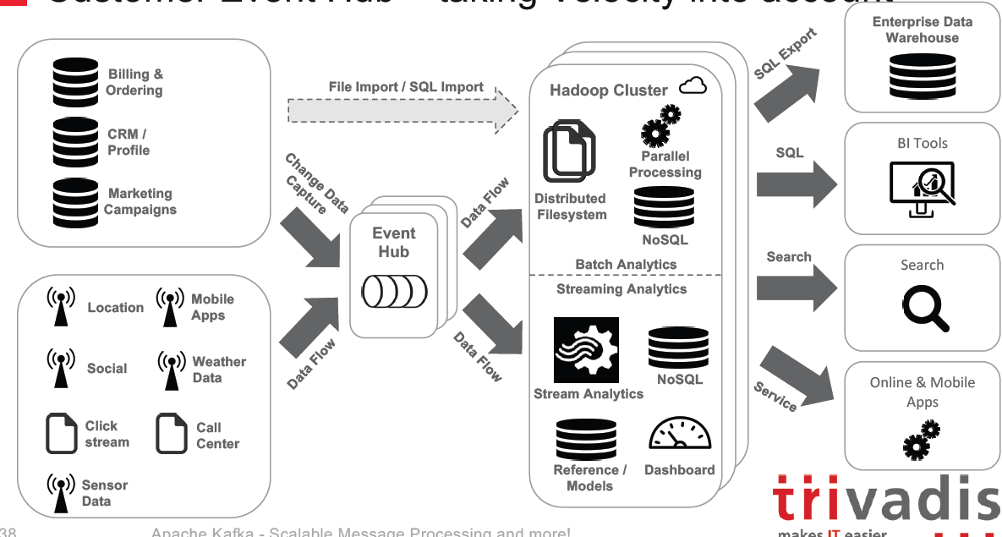
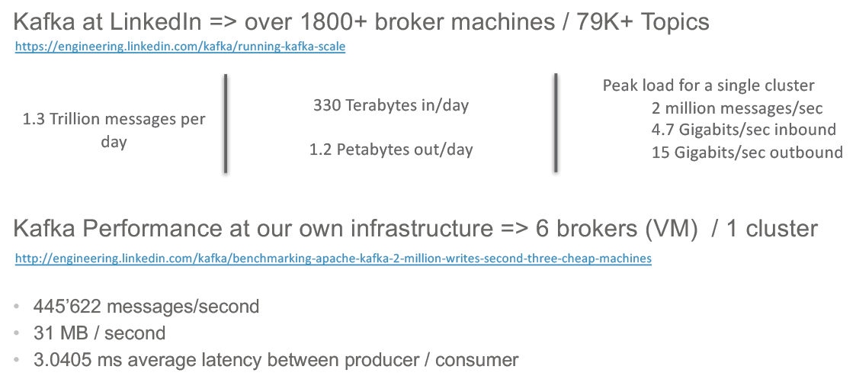
Plays nice with & Architecture

Slide 21
Kafka incarnations
Kafka Docker Images
Confluent (Spotify, Wurstmeister)
Cloud:
CloudKarafka
IBM BlueMix Message Hub
AWS supports Kafka (but tries to propose Amazon Kinesis Streams)
Google runs Kafka (though tries to push Google Pub/Sub)
Bitnami VMs for many cloud providers such as Azure, GCP, AWS, OPC
Kafka Connectors in many platforms
Azure IoT Hub, Google Pub/Sub, Mule AnyPoint Connector, …
Oracle ….
Notes:
http://stackoverflow.com/questions/35861501/kafka-in-docker-not-working
Docker images from Confluent: https://hub.docker.com/r/confluent/kafka/

Slide 22
Consumers
tcp
Producers
tcp
Broker
Topic

Slide 23
Kafka Eco system
Confluent
OpenSource: Native Clients, Camus (link to Hadoop), REST Proxy, Schema Registry
Enterprise: Kafka Ops Dashboard/Control Center, Auto Data Balancing, MultiData Center Replication ,
Community
Connectors
Client libraries
…
Notes:
http://docs.confluent.io/2.0.0/platform.html

Slide 24
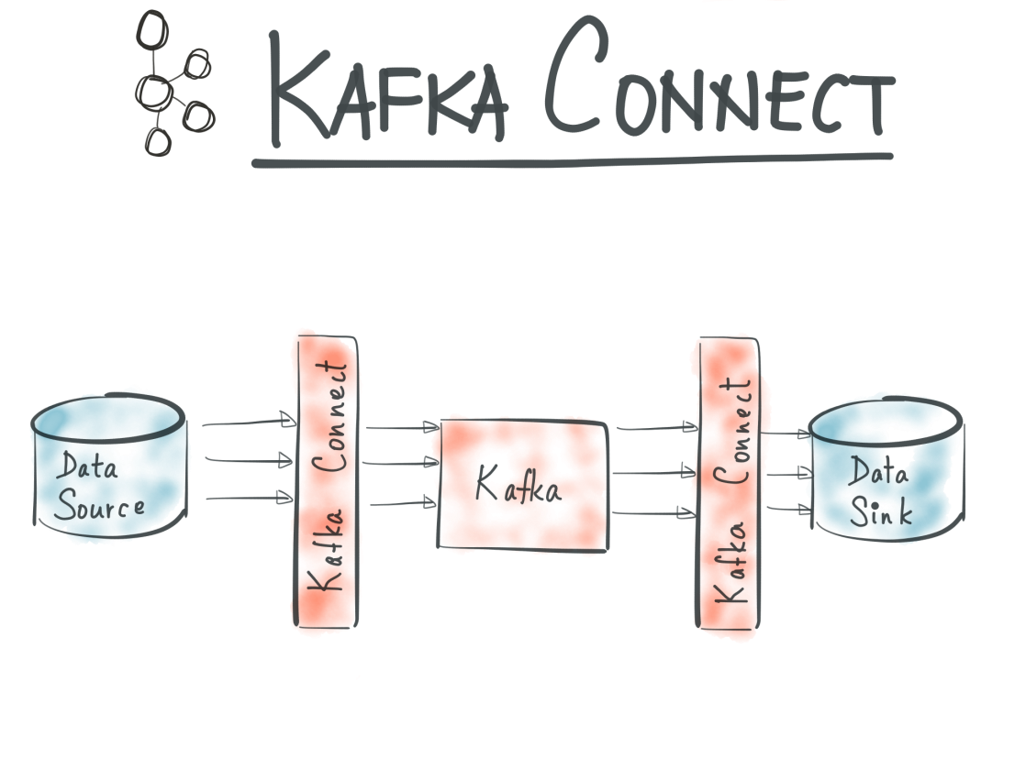
Kafka Connect
Kafka Connect is a framework for connectors (aka adapters) that provide bridges for
Producing from specific technologies to Kafka
Consuming from Kafka to specific technologies
For example:
JDBC
Hadoop
Notes:
http://docs.confluent.io/2.0.0/platform.html
https://www.confluent.io/blog/apache-kafka-getting-started/

Slide 25
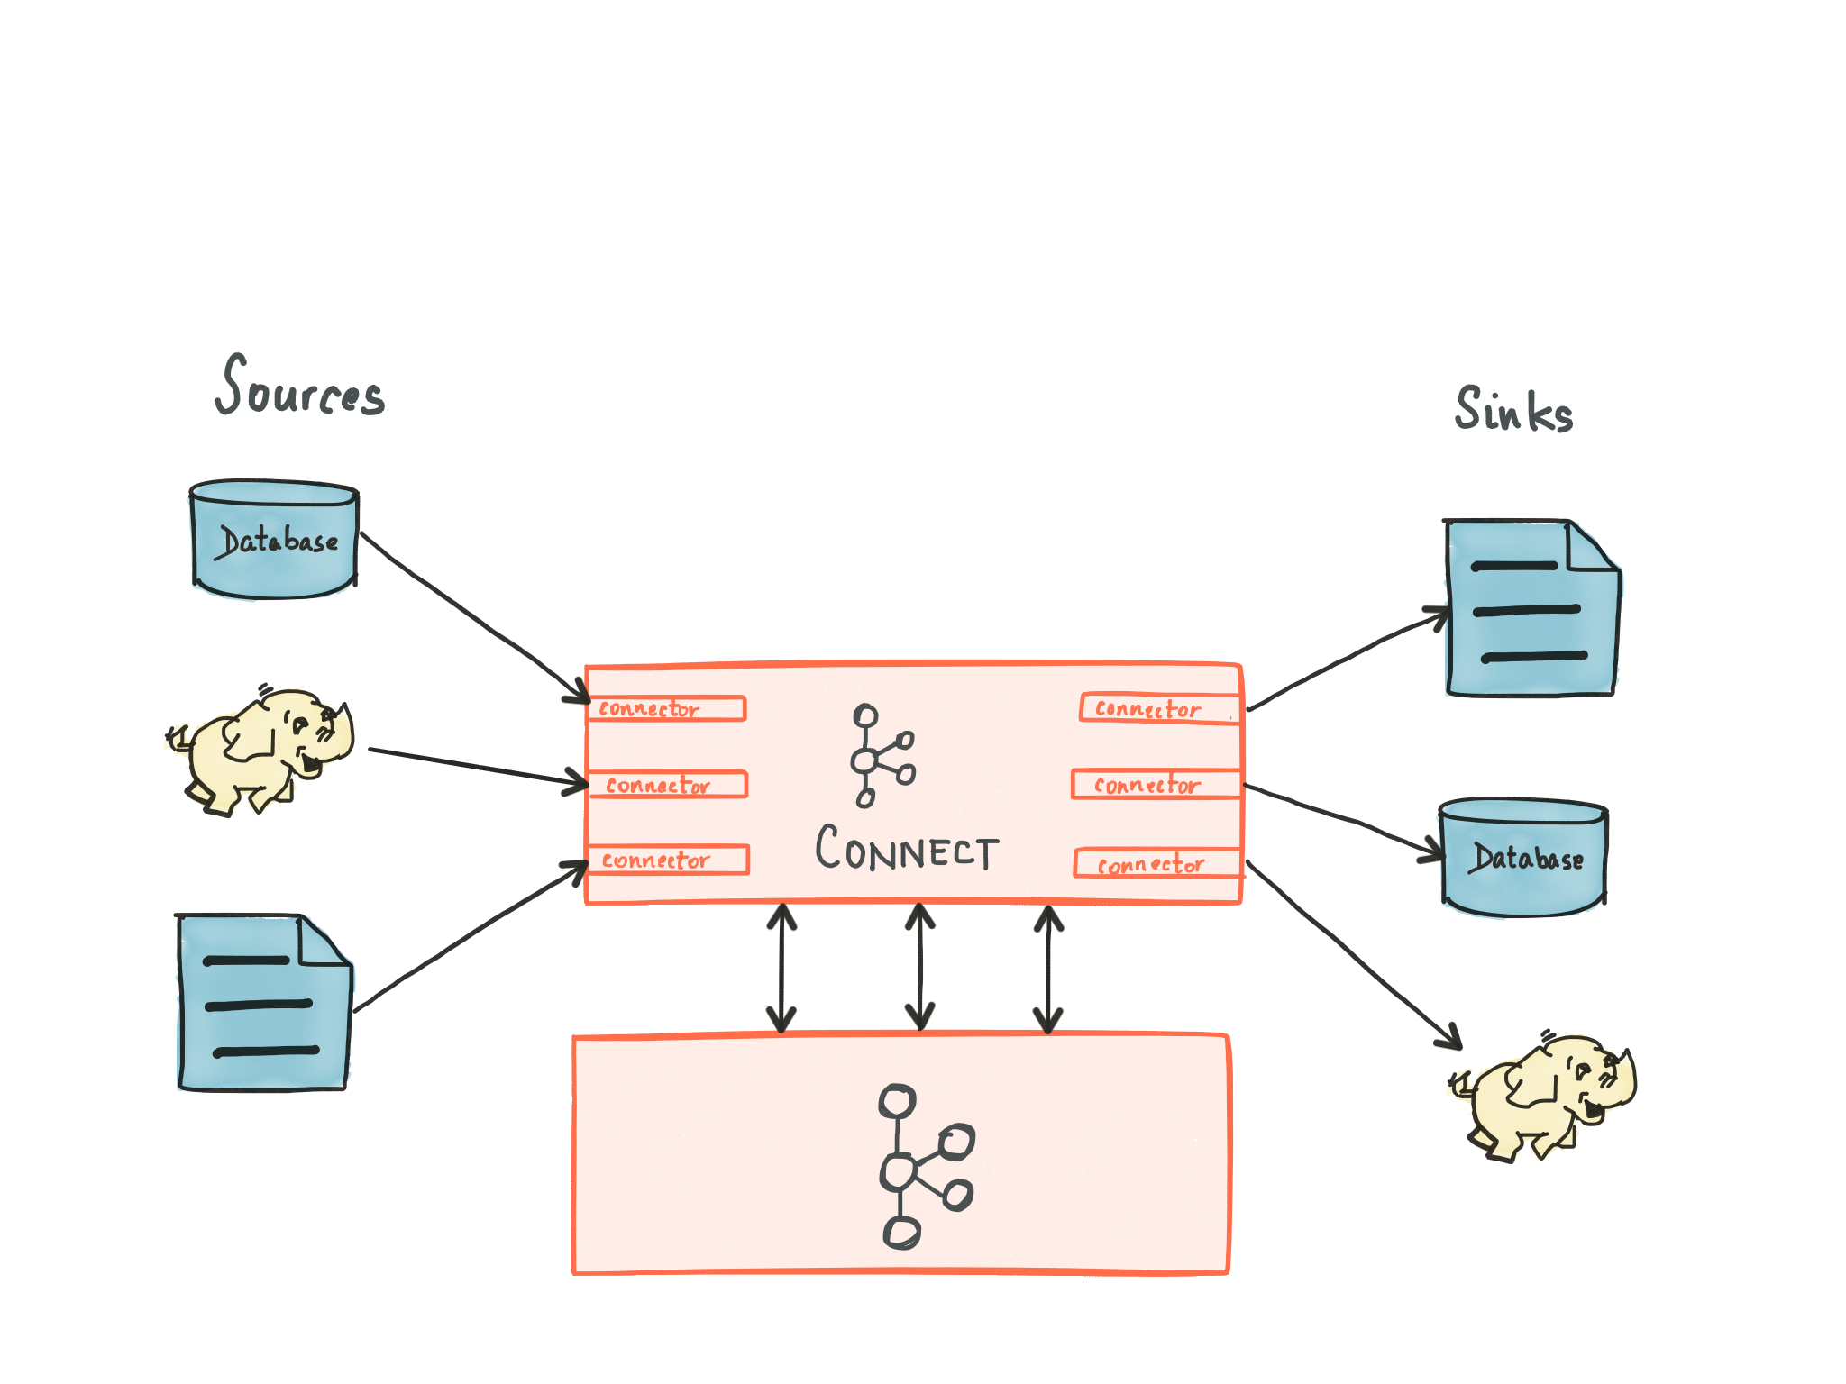
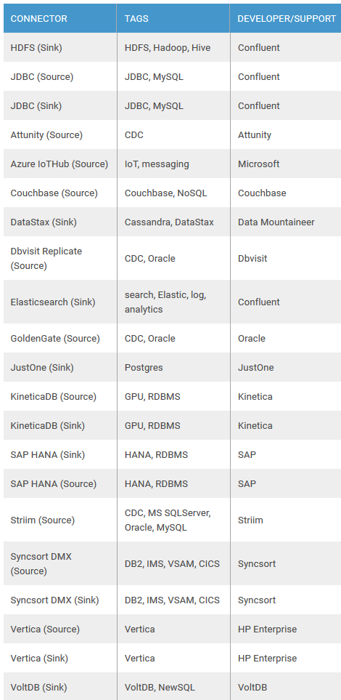
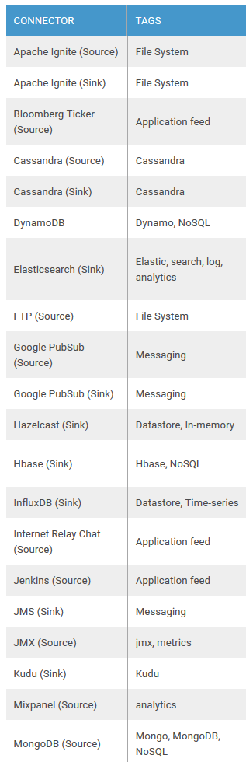
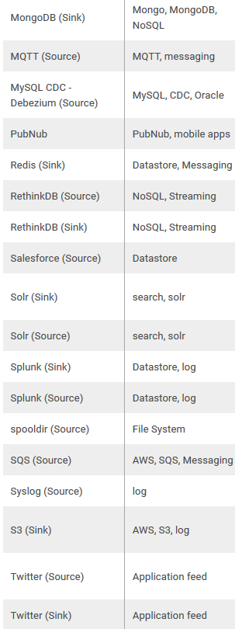
Kafka connect – connectors

Slide 26
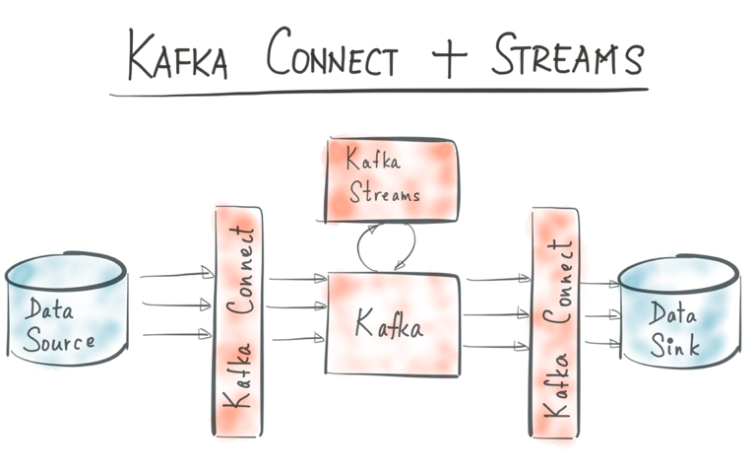
Kafka streams
Real Time Event [Stream] Processing integrated into Kafka
Aggregations & Top-N
Time Windows
Continuous Queries
Latest State (event sourcing)
Turn Stream (of changes) into Table (of most recent or current state)
Part of the state can be quite old
A Kafka Streams client will have state in memory
Always to be recreated from topic partition log files
Note: Kafka Streams is relatively new
Only support for Java clients

Slide 27
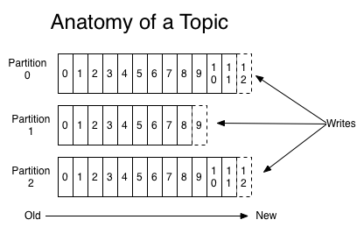
Partitions
Topics are configured with a number of partitions
Storage, serialization, replication, availability, order guarantee are all at partition level
Each partition is an ordered, immutable sequence of records that is continually appended to
Producer can specify the destination partition to write to
Alternatively the partition is determined from the message key or simply by load balancing
Multiple partitions can be written to at the same time

Slide 28
Producing messages
The producer sets the partition for each message
Note: it should talk to the broker who is leader for that partition
Messages can be produced one-by-one or in batches
Batches balance latency vs throughput
A batch can contain messages for different topics & partitions
Messages can be compressed
Producers can configure required acknowledgement level (from broker)
No (waiting for leader to complete)
Wait for leader to commit [to file log]
Wait for all replicas to complete
Note: messages are serialized to byte array as the wire format
Producers
tcp
Broker
Topic

Slide 29
Consuming
A consumer pulls from a Topic
Consuming can be done in parallel to producing
And many consumers can consume at the same time
Each consumer has a Message Offset per partition
That can be different across consumers
That can be adjusted at any time
Delivery Guarantees
At least once (per consumer) by default; adjust offset when all messages have been processed
At-most-once and exactly-once can be implemented (for example: maintain offset in the same transaction that processes the messages)
Message Retention
Time Based (at least for … time)
Size Based (log files can be no larger than … MB/GB/TB)
Key based aka Log Compaction (retain at least the latest message for each primary key value)
Consumers
tcp
Topic

Slide 30
Consumer groups for parallel message processing
Multiple consumers can be in the same Consumer Group
They collaborate on processing messages from a Topic (horizontal scalability)
Each Consumer in the Group receives messages from a different partition
Messages are delivered to only one consumer in the group
Consumers outside the Consumer Group can pull from the same Topic & Partition
And process the same messages
Consumers
tcp
Topic

Slide 31
Cluster – reliable, scalable
A cluster consists of multiple brokers, possibly on multiple server nodes
Each node runs
Apache ZooKeeper to keep track
One or more Kafka Brokers
Each with their own set of storage logs
Each partition lives on one or more brokers (and sets of logs)
Defined through topic replication factor
One is the leader, the others are follower replicas
Clients communicate about a partition with the broker that contains the leader replica for that partition
Changes are committed by the leader, then replicated across the followers
Broker
Broker
Broker
Topic
Topic
Topic
Partition
Partition
Partition
Partition
Partition
Partition
Broker
Topic
Partition
Partition

Slide 32
Cluster – reliable, scalable (2)
ZooKeeper has list of all brokers and a list of all topics and partitions (with leader and ISR)
Leader has list of all alive followers (in-synch replicas or ISR)
Follower-replicas consume messages from the leader to synchronize
Similar to normal message consumers
Note: message producers requesting full acknowledgement will get ack once all follower replicates have consumed the message
N-1 replicas can fail without loss of messages
Broker
Broker
Broker
Topic
Topic
Topic
Partition
Partition
Partition
Partition
Partition
Partition
Broker
Topic
Partition
Partition

Slide 33
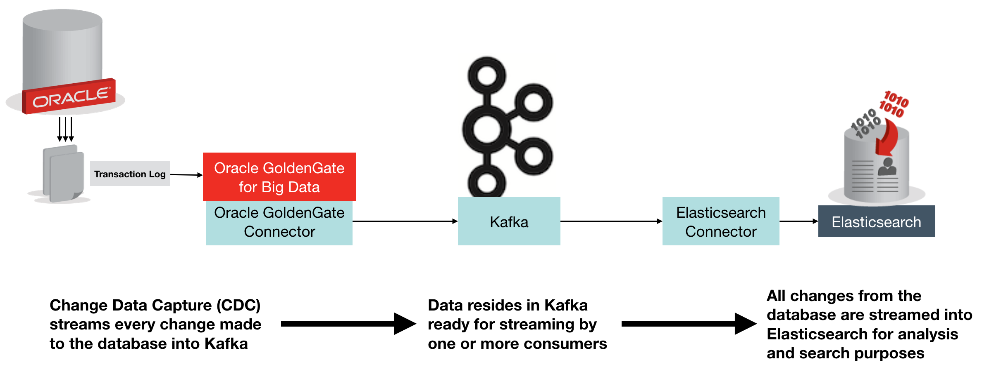
Kafka and Oracle
Oracle en Kafka - Kafka in de Oracle Cloud, Kafka in Oracle BigData arch, integratie Kafka <=> OSB, StreamExplorer
GoldenGate has Kafka Handler to publish Change Data Capture to (and consume from??) Kafka
demo OSB integratie?
Coming up: Event Bus on the Oracle Cloud
Notes:
Article on GolderGate Kafka Connect connector: https://www.confluent.io/blog/streaming-data-oracle-using-oracle-goldengate-kafka-connect/

Slide 34
Hands on part 2
Continue part 1
Java and/or Node consuming/producing
Some Admin & advanced stuff
Partitions
Multiple producers, multiple consumers
New consumer, go back in time
Expiration of messages
Multi-broker, Cluster configuration, ZooKeeper

Slide 35



Blog: technology.amis.nl
On Oracle, Cloud, SQL, PL/SQL, Java, JavaScript, Continuous Delivery, SOA, BPM & more
Email: maarten.smeets@amis.nl , lucas.jellema@amis.nl
: @MaartenSmeetsNL , @lucasjellema
: smeetsm , lucas-jellema
: www.amis.nl, info@amis.nl +31 306016000 Edisonbaan 15, Nieuwegein

