Slide 1
Looking inside Walrus
The plan. Is it shared, and is it physics?
Notes:
The plan of walrus_plan.pdf, as slides. Built up slowly. joint2 results are real; everything about Walrus is still to do (Walrus is being set up on DAIC now).

Slide 2
In one slide
Do different PDEs share the inside of a physics foundation model?
Part A, is it shared? Look inside Walrus and remove parts of it
Part B, is it physics? Only where Part A finds sharing
Our own model gave a first answer. Now a real foundation model
Notes:
Main question from our meeting. Part A uses the four tests built on joint2. Part B only starts where Part A finds sharing.

Slide 3
The question
1
Why would one big model for all physics make sense?

Slide 4
Foundation models for PDEs work
1
One large model, trained once on many kinds of physics, learns new problems from far fewer examples.
Poseidon
MPP
Walrus
trained on fluid flows, then fine-tuned to new PDEs
many 2D systems at once, one model
19 systems in 2D and 3D, 1.3 billion parameters
Nobody knows why. The model never sees an equation, only fields on a grid.
Notes:
Poseidon (Herde et al. 2024), Multiple Physics Pretraining (McCabe et al. 2023), Walrus (McCabe et al. 2025). All show that pretraining on many systems helps on new ones. None shows what is inside that makes it work.

Slide 5
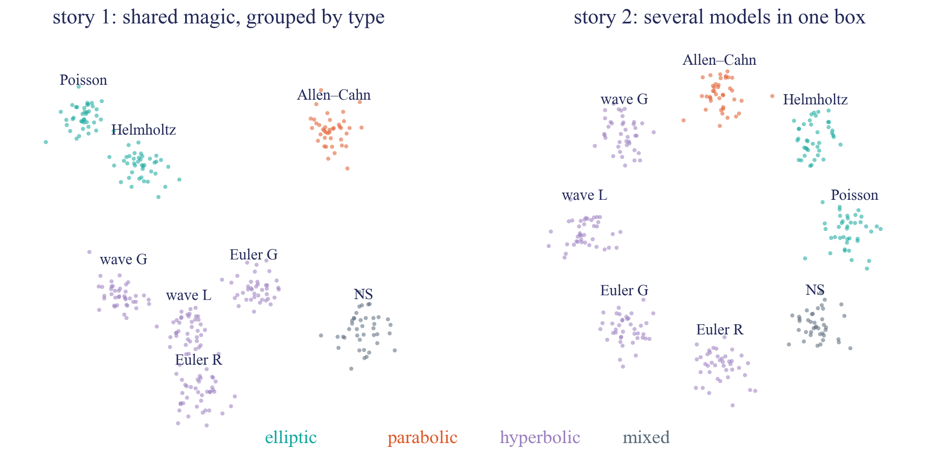
Two possible answers
1
Is there something inside that holds for many equations, or does every equation keep to its own corner?
Story 1 justifies one big model. Story 2 makes it mostly a convenient package.
Notes:
Cartoon, not data. Each cloud = the inside activity of one PDE. Story 1, shared magic: PDEs that behave alike (same textbook type) sit together, there is a common way to handle transport, diffusion, waves. Story 2, several models in one box: every PDE keeps to its own part, only generic things are shared (reading a field in, drawing one out, keeping numbers in range).

Slide 6
Why it matters
1
One big model?
Trust
Transfer
Shared inside, one model is justified. Separate inside, a few smaller models would do as well.
A model with one consistent picture of physics should behave sensibly on new settings. Separate shortcuts can fail without warning.
Knowing what is shared tells us what kind of pretraining helps, and why.
We do not test which design predicts better. We look inside.
Notes:
If the inside is shared, one model for all physics is well justified. If it is several models in one box, separate smaller models per type of physics make as much sense.

Slide 7
Shared is not yet physics
1
A shared part can be generic, like smoothing or taking differences. So the question has two parts, in this order.
Part A
is it shared?
shared somewhere
Part B
is it physics?
nowhere
story 2
several models in one box
If nothing is shared, that is the answer too. Story 2, and an interesting one.
Notes:
Part A decides whether and where there is sharing. Part B only looks there. If Part A finds every PDE in its own corner, Part B shrinks to one system as a smaller follow-up.

Slide 8
What we know from joint2
2
Our own small model, already tested

Slide 9
joint2
2
Poseidon-T design, 21 million parameters, trained by us from scratch on 8 PDEs.
type | how information travels | PDEs in joint2
elliptic | a steady state, every point depends on all others | Poisson, Helmholtz
parabolic | spreads and smooths over time | Allen–Cahn
hyperbolic | travels at finite speed, stays sharp | wave G, wave L, Euler G, Euler R
mixed | a bit of both | Navier–Stokes
It predicts all eight well, with test errors from 0.9% to 11.8%.
Notes:
Poseidon's recipe, 40 epochs, 8 datasets of Poseidon's collection. Test error one step ahead: Allen-Cahn 0.9, Poisson 1.3, wave L 2.6, Helmholtz 3.0, wave G 3.5, Euler G 5.6, Euler R 7.5, Navier-Stokes 11.8 (%).

Slide 10
Four ways to look inside
2
Neurons
Directions
Which neurons does each PDE use?
Which mixes of neurons does each PDE vary along?
Paths
Removal
Which neurons does each PDE's prediction depend on?
Take a part out. Whose error goes up?
Each test also has a control, random weights or random neurons.
Notes:
Neurons = outputs of the MLP inside each layer. Directions = principal components of a PDE's activations per layer (90% of the variance), overlap phi between two PDEs. Paths = top 10% of neurons by activation times gradient. Removal = take a PDE's directions out (or delete its neurons) while the model runs.

Slide 11
Neurons say shared
2
Every PDE uses almost all neurons. At most 0.8% of a layer is used by one type only.
almost all neurons used by every PDE
used by one type only, at most 0.8%
Counted neuron by neuron, everything is shared. But neurons can be used in different mixes.
Notes:
Used = mean |activation| above 1% of the layer's average. This is why neurons alone mislead, and why directions and paths are the main tests.

Slide 12
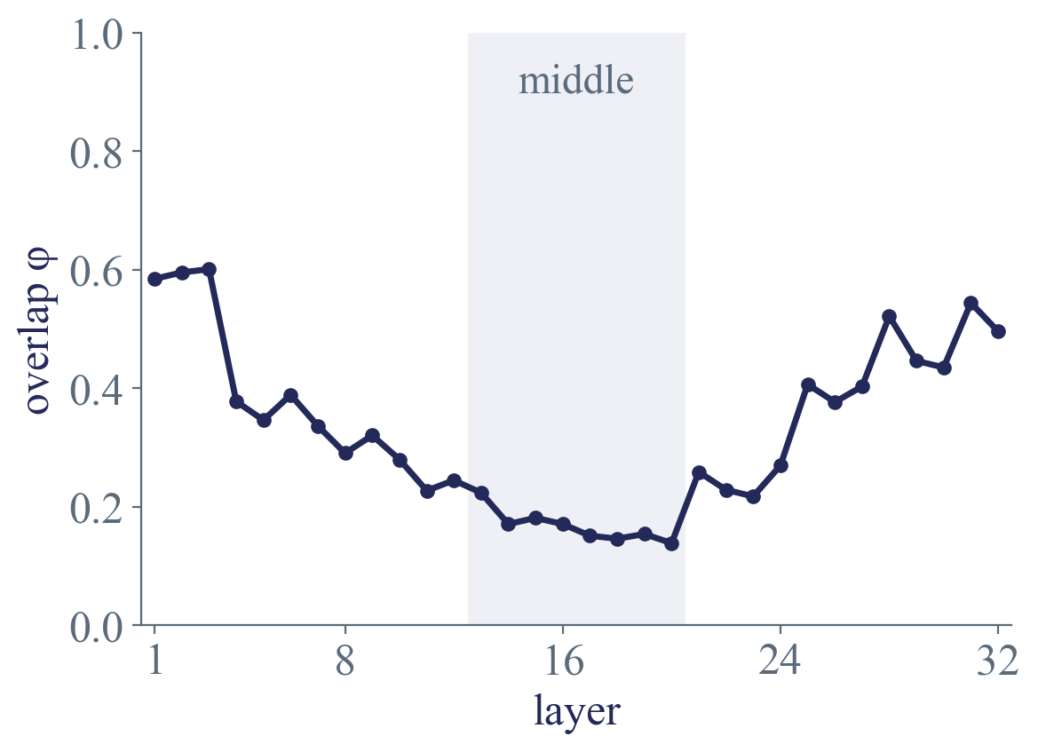
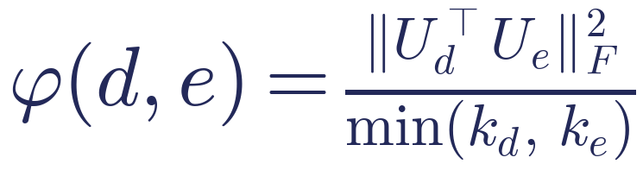
Directions split in the middle
2
Overlap of the PDEs' directions, layer by layer. 1 is the same directions, 0 is at right angles.
U_d holds PDE d's directions as columns, k_d of them
Start and end overlap. The middle, where the solving happens, much less.
Notes:
Real results, joint2 epoch 40. phi averaged over all 28 pairs of PDEs. Middle layers 13-20: 0.14 to 0.22. Start and end about 0.6.

Slide 13
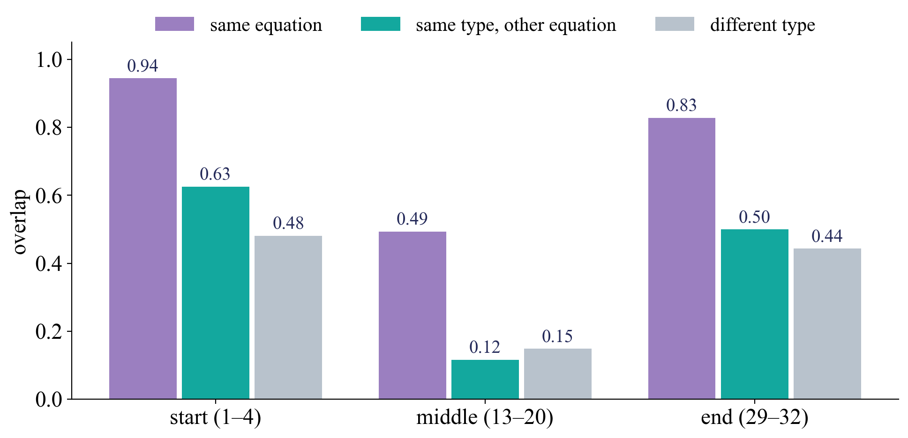
Grouped by equation, not by type
2
In the middle, two datasets of the same equation overlap. Two equations of the same type do not.
Wave and Euler are both hyperbolic, but overlap no more than elliptic and hyperbolic.
Notes:
Real results, joint2. Middle 13-20: same equation 0.49, same type other equation 0.12, different type 0.15.

Slide 14
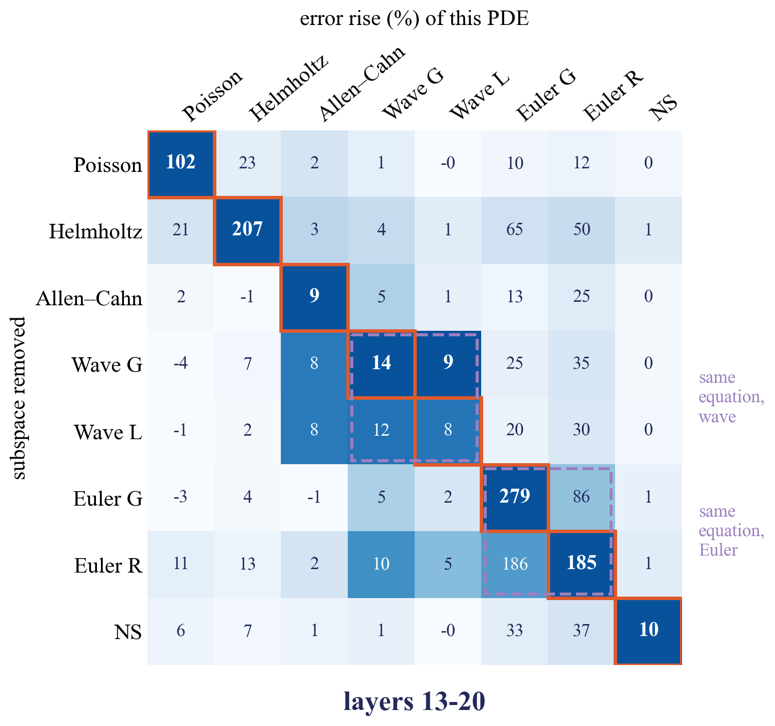
Removal agrees
2
Poisson, Helmholtz and Euler break most from their own directions.
The two Euler sets hurt each other.
Allen–Cahn, the waves and NS barely notice. They go around the middle.
The model needs its own directions, mostly separately per equation.
Notes:
Real results, layers 13-20. Row = whose directions are removed, column = whose error rises (% of normal). Read per column. Orange boxes = own. Random directions of the same number: 0-12% on the own PDE (Euler up to 31%). Allen-Cahn, waves and NS barely use the middle: they go around it through Poseidon's skips.

Slide 15
So, in joint2
2
The same neurons, used mostly separately per equation
Sharing follows the equation, not the PDE type
Story 2, for a small model
Notes:
Paths agree too: two PDEs share about 20% of their top neurons (unrelated lists 10%, random weights 44%), only the two waves 71%. Pruning too.

Slide 16
Why that is not the end
2
Small model
Room to spare
The U shape
21 million parameters, 8 PDEs. Real foundation models are 60 times bigger. Sharing could appear only at that scale.
All 8 PDEs together use at most half of a middle layer. Keeping them apart cost nothing.
Skips carry information around the middle. Some PDEs barely needed it.
So now a real foundation model, and a small model we can squeeze.
Notes:
Room: all 8 PDEs together use 316-761 of the 1,536 directions in a middle layer.

Slide 17
Walrus
3
The main model

Slide 18
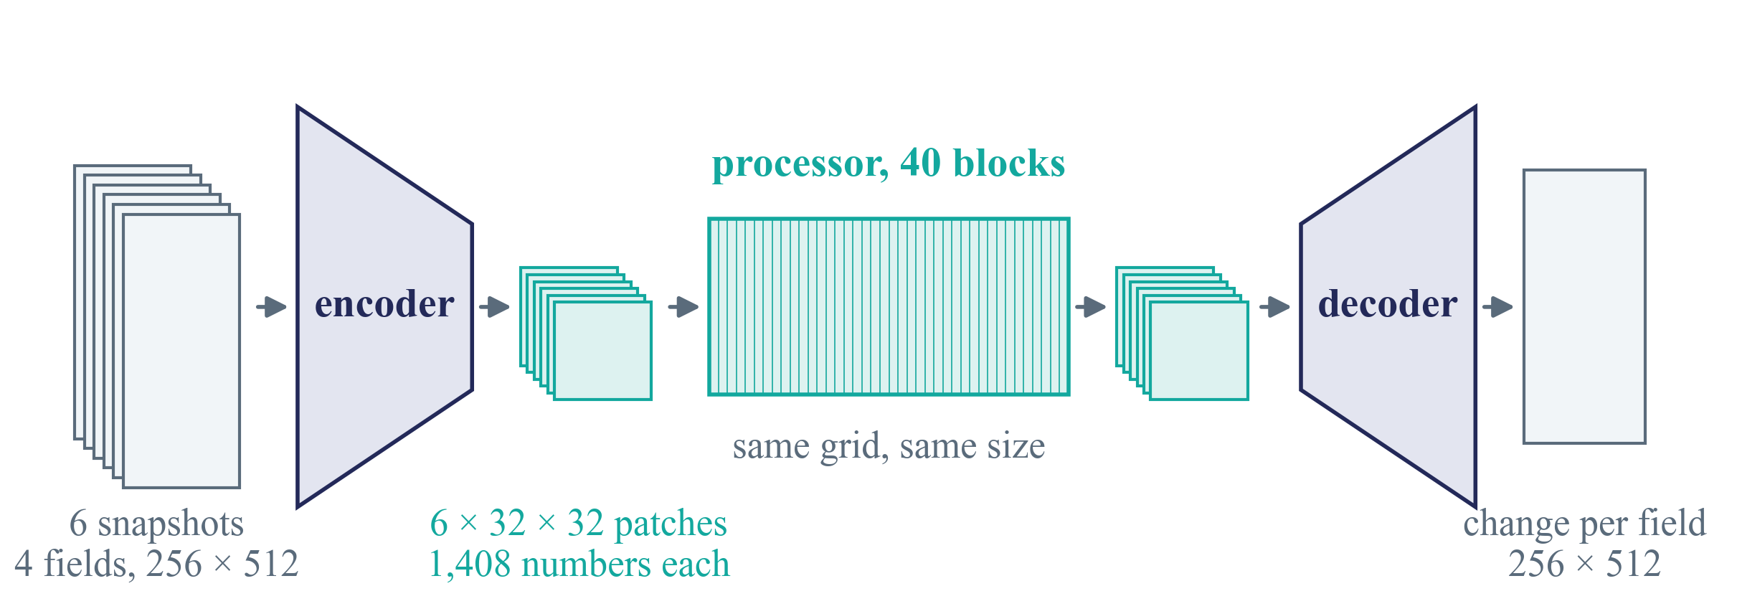
Walrus in one picture
3
Released in 2025 by Polymathic AI. 1.3 billion parameters, trained on 19 systems.
40 blocks of the same shape, and nothing goes around them.
Notes:
Given the last 6 snapshots it predicts the change to the next one. The encoder shrinks each field to 32 x 32 patches of 1,408 numbers, 40 blocks work on that grid, the decoder gives back a change per field. Example sizes for shear flow. The separate deck walrus_inside.pptx goes through the inside step by step.

Slide 19
Why Walrus
3
A real foundation model
Easy to look inside
Large, many kinds of physics, among the best on its benchmarks.
No U, no skips. Every block can be compared with every other, removal cannot be dodged.
Released and studied
We only need to run it
Two papers looked inside it, so we can compare.
Recording, removal, readouts all use the frozen model. One GPU is enough.
Notes:
Weights and code are public (github PolymathicAI/walrus, huggingface polymathic-ai/walrus). Trained on 96 H100 GPUs, so we cannot retrain it. Looking and removing only needs one GPU.

Slide 20
Eight systems
3
system (The Well) | equation | type | pair
acoustics, inclusions | wave equation | hyperbolic | same equation
acoustics, discontinuous | wave equation | hyperbolic | same equation
Euler quadrants, periodic | compressible Euler | hyperbolic | same equation
Euler quadrants, open | compressible Euler | hyperbolic | same equation
Gray–Scott | reaction and diffusion | parabolic
shear flow | Navier–Stokes | mixed | same family
Rayleigh–Bénard | Navier–Stokes plus heat | mixed | same family
Helmholtz staircase | Helmholtz | elliptic in space | borderline
Pairs of the same equation, so we can tell same equation from same type.
Notes:
All 8 are in Walrus's training data (Walrus Table 6). 2D only, to keep things comparable. Walrus has no steady elliptic system like Poisson; Helmholtz staircase comes closest. Elliptic PDEs can come in later by fine-tuning.

Slide 21
Two papers looked inside Walrus
3
study | what they did | what is left open
Physics Steering | A vortex direction from shear flow, pushed into the last block, also makes swirls in Euler and Gray–Scott | judged by eye, no random control, one block, a few concepts
Sparse probes | A sparse autoencoder on block 20, shear flow only. Features recur at first, but do not map cleanly onto physics | one system, no control, no test of use
Nobody has measured how much different PDEs share, or whether Walrus needs it.
Notes:
Physics Steering, Fear et al., NeurIPS 2025 (arXiv 2511.20798). Sparse probes and murky physics, Rosenfeld and Sonnewald, ICLR 2026 workshop (arXiv 2606.11657). Both read in full.

Slide 22
Part A, is it shared?
4
The joint2 tests, now on Walrus

Slide 23
Part A, step by step
4
From cheap to expensive. Each step reuses a test we built and checked on joint2.
A0
run, check
A1
record
A2
neurons
A3
directions
A4
paths
A5
removal
reproduce its errors
every block
who uses what
overlap, by pair
what it depends on
does it need it
Plus a lab model next to it, for what Walrus cannot tell us.
Notes:
A0 get Walrus running and check it. A1 record the inside. A2 neurons. A3 directions. A4 paths. A5 removal and pruning. A6 the lab model, in parallel.

Slide 24
A0, get it running and check it
4
Nothing counts until we reproduce Walrus's own errors.
Install
Reproduce
Control
Code and weights on DAIC, a few dozen test runs per system.
One-step errors on our 8 systems, against the paper's numbers.
The same model with random weights, for every test after this.
If we cannot reproduce them, something in our setup is wrong.
Notes:
Being set up on DAIC now. Check against Walrus Table 1, median one-step VRMSE per system. Typical traps: normalisation, time step, field order. Shear flow test data is the corrected v2.0 (v1.0 had test runs copied from training).

Slide 25
A1, record the inside
4
Run test examples through the frozen model and keep the 2,816 neurons of every block.
per block, 2,816 neurons for each of the 1,024 patches
block 1
block 40
The same recording as for joint2, now in all 40 blocks, 8 systems, and the random-weight copy.
Notes:
Neurons = the MLP's 2,816 numbers per patch after its gate. Newest snapshot only. Per example, each neuron's average over all 1,024 patches plus a sample of 64 patches. Also the block output at a few blocks, to compare with Physics Steering. Note: each system enters through the input weights of its own field names, so early blocks can tell systems apart by format alone. What counts is deeper in, and against random weights.

Slide 26
A2 and A3, neurons and directions
4
Per block, which neurons each system uses, and which directions it varies along.
Overlap per block
By kind of pair
Room
averaged over all pairs, like the joint2 curve
same equation, same type, different type
directions all systems need, against 2,816
Three pictures, from block 1 to block 40. Where is Walrus shared, and where split?
Notes:
Like joint2. Neurons: expected almost all used by all. Directions: overlap phi per block averaged over pairs; then by kind of pair (next slide); then room, the directions all systems need together against the 2,816 available. Overlap in a trained block must differ from the random-weight block to mean anything.

Slide 27
Kinds of pairs
4
We chose the 8 systems so every kind of pair is there.
kind of pair | example in our 8
same equation | acoustics with acoustics, Euler with Euler
same family | shear flow with Rayleigh–Bénard
same type, other equation | acoustics with Euler
different type | Gray–Scott with Euler
If same type sits clearly above different type, the textbook types exist inside.
Notes:
The direct test of story 1 versus story 2. In joint2: same equation 0.49, same type other equation 0.12, different type 0.15.

Slide 28
A4 and A5, does Walrus need it?
4
Remove a system's directions, or delete its top neurons, while Walrus runs. Then measure every system's error.
Read per column, whose error rises.
Own part on the diagonal.
Always against random parts of the same size.
Walrus has no skips around the middle, so a removal cannot be dodged.
Notes:
This is joint2's matrix, to show how it is read: row = removed, column = whose error rises, read per column, own on the diagonal. Controls: random directions, random neurons of the same number. Paths: importance = activation x gradient, top 10% per system. Pruning: delete least important first, 25-90%. Both directions (keeps each neuron's average) and deleting (sets to 0) are reported, they can differ.

Slide 29
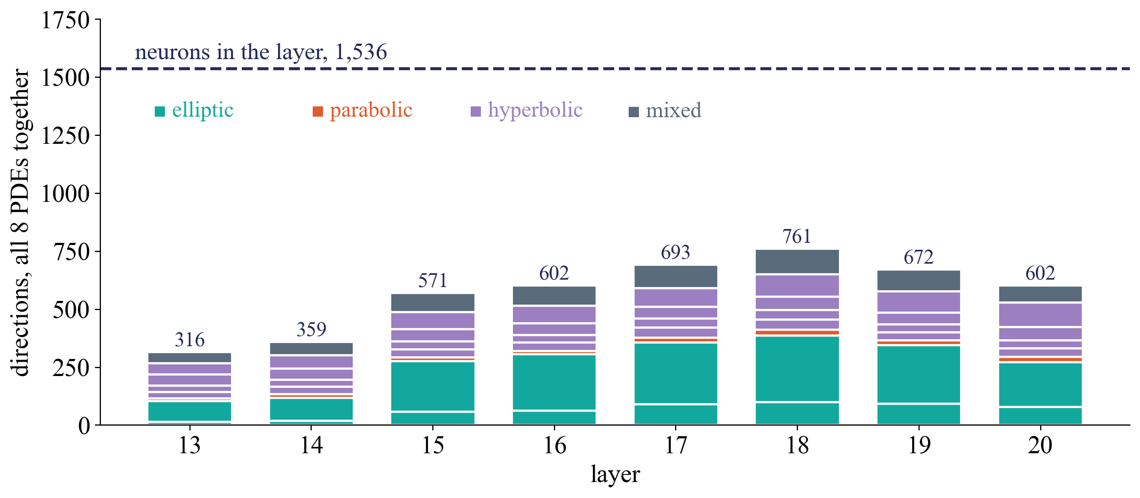
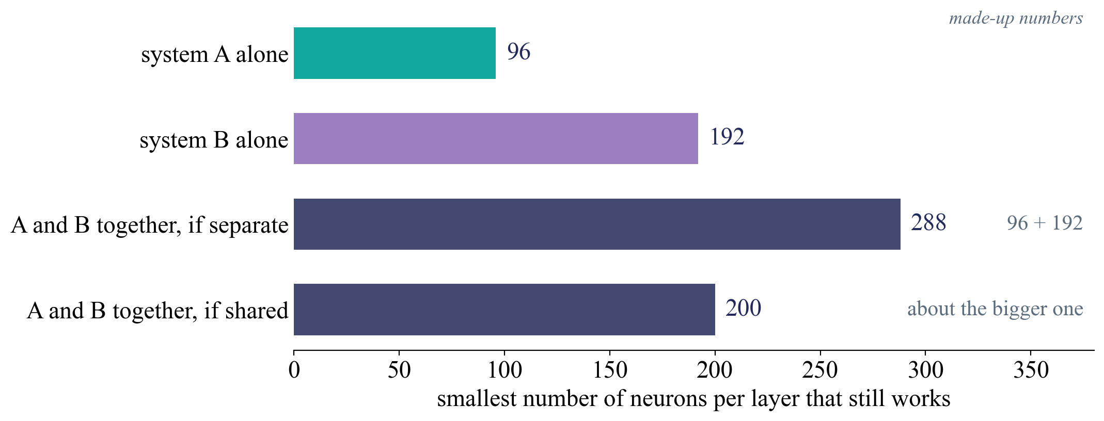
A6, a lab model we can squeeze
4
Walrus cannot be retrained. A small model can. Does it share when it has to?
Together needs the sum, they are separate. Together fits in the bigger one, they share.
Notes:
Left, real joint2 numbers: all 8 PDEs use 316-761 of 1,536 directions per middle layer. Right, made-up numbers, how the squeeze is read. Same design (Poseidon-T), only fewer MLP neurons (1,536, 384, 96, 24). System A alone, B alone, A and B together. First pair Poisson and Euler. Then the direction test on each squeezed model: does overlap rise as room shrinks?

Slide 30
What Part A can give
4
if we see | it means
overlap between types deep in Walrus, shared paths, removals that hurt several types | shared magic, story 1. On to Part B, in those blocks
overlap within a type clearly above between types | the textbook types exist inside
sharing only within an equation, as in joint2 | several models in one box, now for a large model
shared in some blocks, split in others | a map of where Walrus shares
lab, together fits in the bigger one | PDEs can share, separation is a luxury of room
Every row is a finding.
Notes:
joint2 showed story 2, so story 1 in Walrus would be the more surprising result. Story 2 again shows it is not a small-model accident.

Slide 31
Part B, is it physics?
5
Only where Part A finds sharing

Slide 32
Three properties, in this order
5
Each one can stop the line.
1. Readable
2. Coherent
3. Used
A simple formula can read physical quantities out of the shared part.
The read-out quantities agree with each other, the way the laws of physics say.
Changing them inside changes the prediction the way physics says.
Others tested readable and used, one quantity at a time. Coherent is new.
Notes:
Liao and Cao 2026 found energy readable but not used in Poseidon. Physics Steering showed used, by eye, for a few concepts.

Slide 33
Readable
5
A weighted sum of a block's activations, trained to read a quantity at every patch.
Only hard quantities
One readout, many systems
Ones that need multiplying fields, like kinetic energy, half density times speed squared. A weighted sum cannot do that by itself.
Train the kinetic energy readout on Euler. Test it unchanged on shear flow and Rayleigh–Bénard.
If one direction reads kinetic energy in three systems, Walrus has one shared idea of it.
Notes:
Linear readout (ridge). Train on some simulation runs, test on others. A weighted sum cannot multiply, so a quantity that needs multiplying fields can only be read if the model computed it. Candidates: kinetic energy, total energy, Mach number (Euler); shear |grad u|^2 (shear flow); heat carried up w times b (Rayleigh-Benard); reaction rate A B^2 (Gray-Scott). Controls: the input itself, random weights, every block.

Slide 34
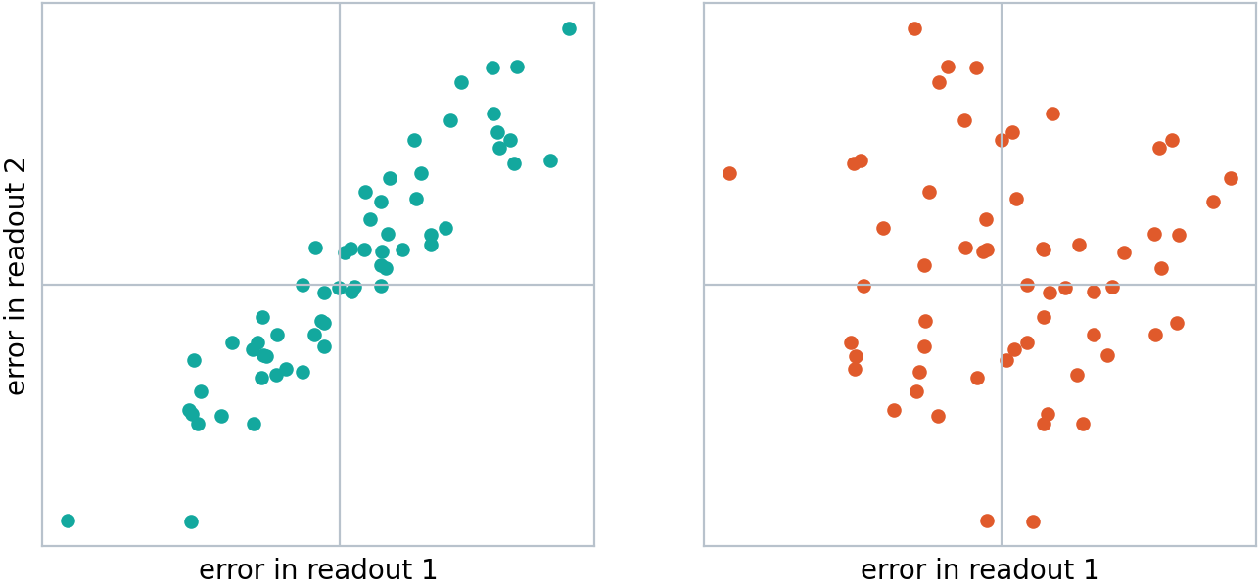
Coherent
5
Two models can read everything equally well. Do their errors hang together?
Shortcuts give unrelated errors. One picture of the world gives errors that fit together.
Notes:
Sketch. Each dot = one example, error of readout 1 against readout 2. Left: the errors go together. Right: the same errors paired with random other examples, the link is gone. A model with one picture of the world is wrong in one consistent way, in which the laws still hold.

Slide 35
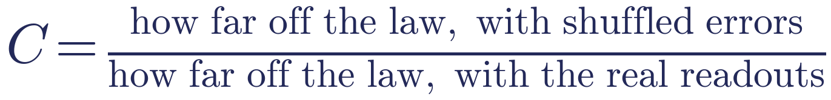
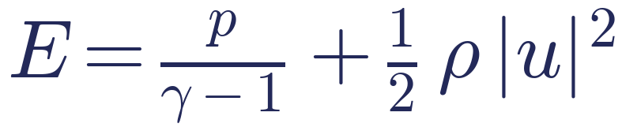
The coherence score
5
Put the readouts into a law of physics and see how far off it is. Then the same with the errors shuffled.
Energy in a gas
Heat in a slab
the heat in a band changes only through its top and bottom
C near 1, no shared picture. C much bigger than 1, the errors hang together.
Notes:
Fixed before we measure. Two laws to start. Energy in a gas: read out E and kinetic energy separately, does the difference match the pressure term? No derivatives. Heat budget of a slab in Rayleigh-Benard: heat in a band changes only through its edges; slopes are moved onto a smooth bump we draw ourselves. The comparison that counts is trained against random-weight Walrus.

Slide 36
Used
5
Push the activations along a readout's direction while Walrus runs. Does the prediction follow physics?
readout direction
push the activations
the prediction changes
check against physics
from step 1
while Walrus runs
and against a random push
And the reverse. Take the direction out, does the prediction lose exactly that physics?
Notes:
As in Physics Steering, but measured, not by eye, and with a random direction of the same size as control. Example: more heat carried up should cool the lower slab and warm the upper one faster. Also: build a vortex direction in shear flow and the same contrast in Euler and Rayleigh-Benard, and compare the directions against random ones.

Slide 37
What Part B can give
5
if we see | it means
readable, coherent and used, one readout across systems | a shared picture of the physics, and Walrus relies on it
readable, but errors do not hang together | separate shortcuts per quantity
readable and coherent, but not used | the picture is there, predictions run on something else
not readable | not in there, at least not in a simple form
Every row is again a finding.
Notes:
Liao and Cao found the third row for energy in Poseidon.

Slide 38
Order and risks
6
From cheap to expensive

Slide 39
Order
6
step | what | status
1 | read the two Walrus papers | done
2 | Walrus on DAIC, reproduce its errors, random copy | now
3 | record the inside, neurons, directions
4 | paths, removal, pruning
5 | lab squeeze, in parallel
6 | decision point with you
7 to 9 | Part B, readable, coherent, used
Steps 2 to 6 can be a first paper on their own. Part B builds on it.
Notes:
Optional later: elliptic PDEs into Walrus (look only, then fine-tune), and a mini-Walrus lab model if Walrus and joint2 disagree.

Slide 40
Risks, and what we do
6
risk | what we do
getting Walrus to run correctly takes time | nothing counts until we reproduce its errors
the input format separates systems on its own | judge deeper in, and against random weights
one neuron, many meanings | directions and paths are the main tests
no steady elliptic system | test types on the others, add elliptic later
lab model and Walrus differ in design | move to a mini-Walrus if they disagree
the answer is separate again | that is story 2 for a large model, a result
Notes:
Input format: in Walrus each field name has its own input weights, shared by systems with the same fields (pressure, velocity). So early blocks are partly separate by format alone. Superposition: one neuron, many meanings, so directions and paths are the main tests; a sparse autoencoder is a possible extra.

Slide 41
In one line
Part A says whether physics foundation models are one model or several in a box
Part B says, where they are one, whether what holds them together is physics
Next, Walrus running on DAIC and checked
Notes:
Next: Walrus running on DAIC and the sanity check, then the recording script.

