Slide 2
Verschillende sites
https://immo.vlan.be/nl/vastgoed?transactiontypes=te-huur&municipals=leuven&propertytypes=huis&propertysubtypes=huis,herenhuis,villa&page=2
https://www.zimmo.be/nl/leuven-3000/te-huur/?pagina=1#gallery
https://www.immoweb.be/nl/zoeken/huis/te-huur/leuven/3000?countries=BE&page=1&orderBy=relevance
https://www.living-stone.be/nl/te-huur
https://www.immoproxio.be/nl/te-huur/leuven/2/?c=1000876&h=1
http://www.immo-m.be/nl/te-huur/appartement/leuven-3000/497/

Slide 3
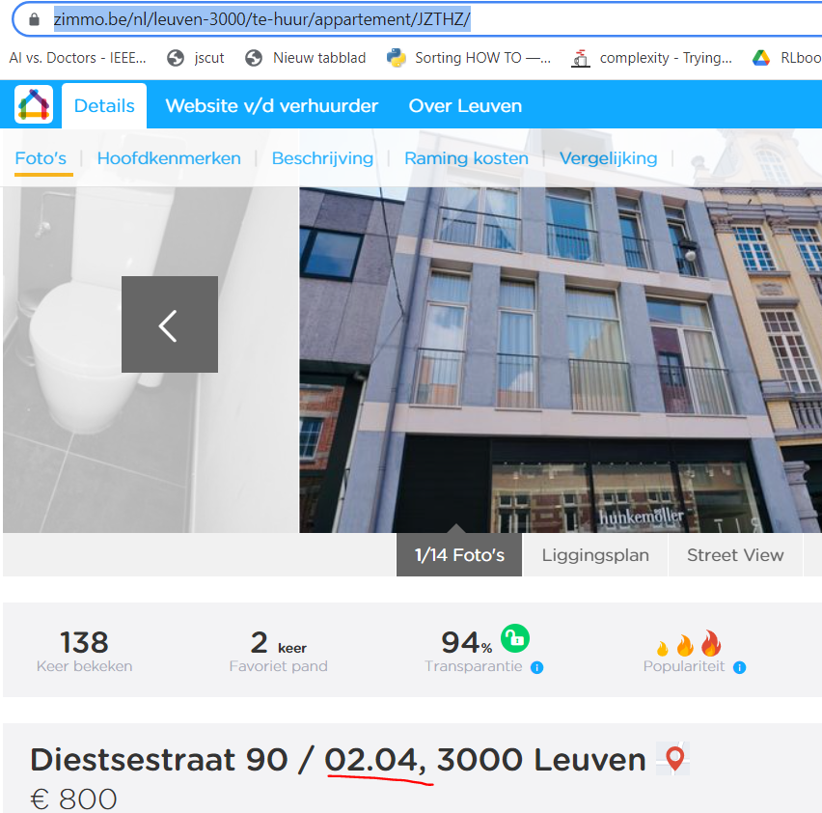
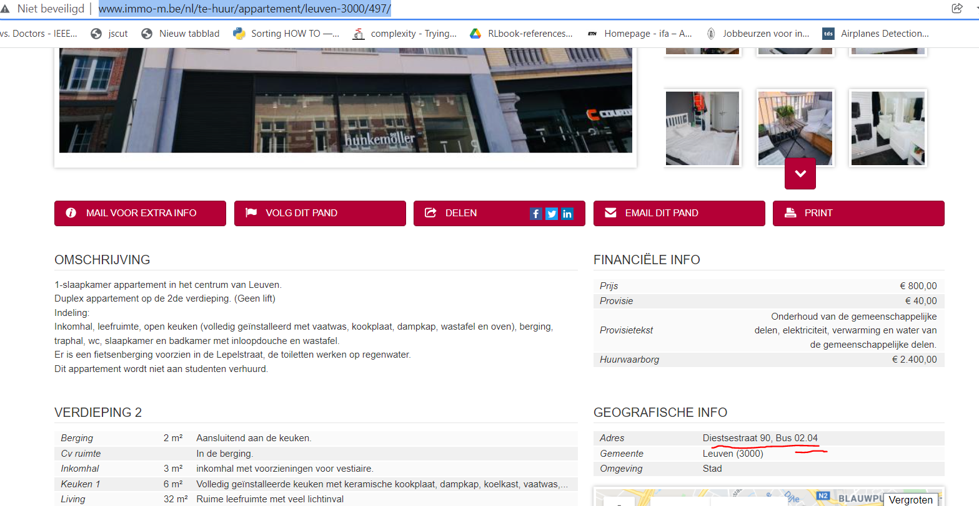
Voorbeeld outer references
https://www.zimmo.be/nl/leuven-3000/te-huur/appartement/JZTHZ/
http://www.immo-m.be/nl/te-huur/appartement/leuven-3000/497/

Slide 4
Dataflow
Start application
Site Scrape (Main page)
Basic data + links
Site Deep Scrape (Entity pages)

Slide 5
Scrape definitions per site type
SetDriver (url, driver)
Main
FindRoot(class_tag,driver) Necessary to find a focused collection
FindItems Find the main page house items, returns the selenium object links
getItemPrice()
getItemAdress()
getItemLink()
getItemTitle()

Slide 6
Scrape definitions per site type
Deep
List

