Slide 2
Robot scherm
Put link in stack and proceed -> intermediate or before next update notification + push from queue

Slide 3
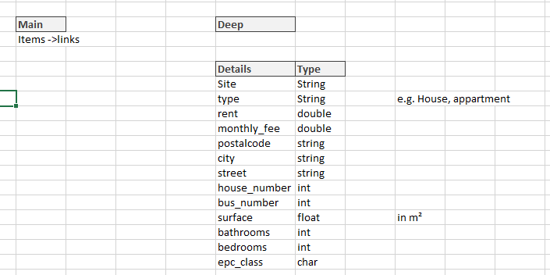
Scraper model
Import Scraper as Sc
Output = Sc.FetchData(Input)
Driver, url
excel file met volgende kenmerken
Roots, string formats

Slide 4
Fetch data -> put into pandas dataframe
Intermediate result merged database
final automatic updater

Slide 5
Verschillende sites
https://immo.vlan.be/nl/vastgoed?transactiontypes=te-huur&municipals=leuven&propertytypes=huis&propertysubtypes=huis,herenhuis,villa&page=2
https://www.zimmo.be/nl/leuven-3000/te-huur/?pagina=1#gallery
https://www.immoweb.be/nl/zoeken/huis/te-huur/leuven/3000?countries=BE&page=1&orderBy=relevance
https://www.living-stone.be/nl/te-huur
https://www.immoproxio.be/nl/te-huur/leuven/2/?c=1000876&h=1
http://www.immo-m.be/nl/te-huur/appartement/leuven-3000/497/

Slide 6
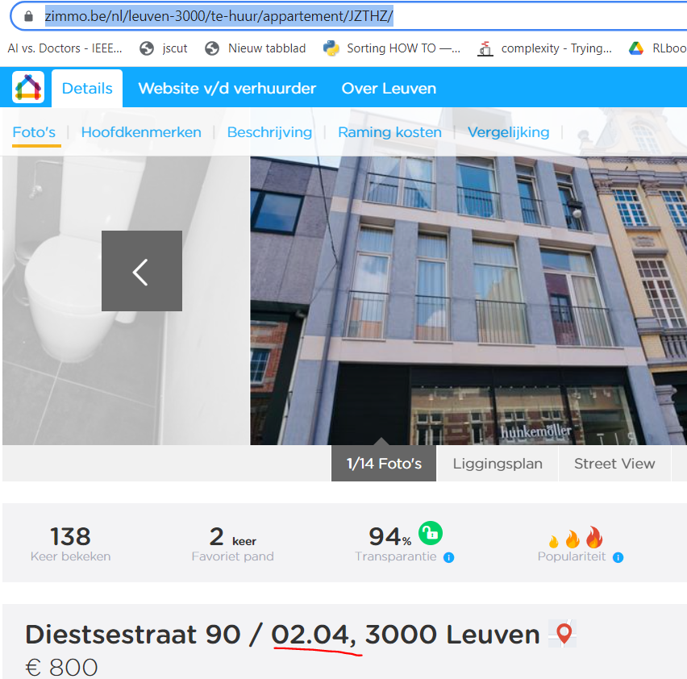
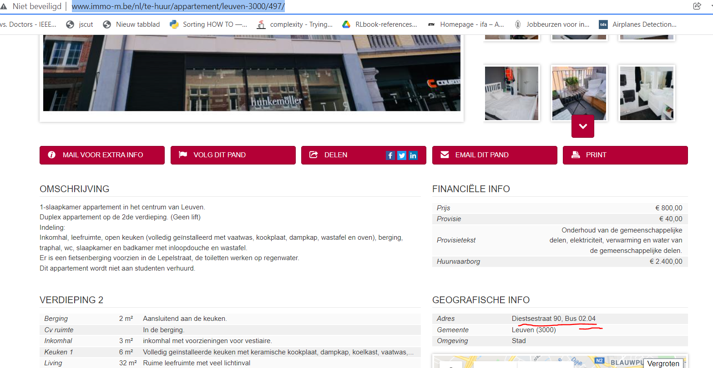
Voorbeeld outer references
https://www.zimmo.be/nl/leuven-3000/te-huur/appartement/JZTHZ/
http://www.immo-m.be/nl/te-huur/appartement/leuven-3000/497/

Slide 7
Site dependancies
URL (met filter)
Root -> itemlist structure (classes)

Slide 8
Dataflow
Start application
Site Scrape (Main page)
links
Site Deep Scrape (Entity pages) Fetch data
In pandas frame
Collect all panda items merge into 1 table, order on street and number (site first variable)
Site Postal City Street Nr. Price
Zimmo 3000 Leuven Arnould 32 3000
Immo-M 3000 Leuven Arnould 32 200

Slide 9
Scrape definitions per site type
SetDriver (url, driver)
Main
FindRoot(class_tag,driver) Necessary to find a focused collection
FindItems Find the main page house items, returns the selenium object links
getItemPrice()
getItemAdress()
getItemLink()
getItemTitle()

Slide 10
Scrape definitions per site type
Deep
List

Slide 11
Data vizualisation
Pandas data shown from streamlit

