Slide 1

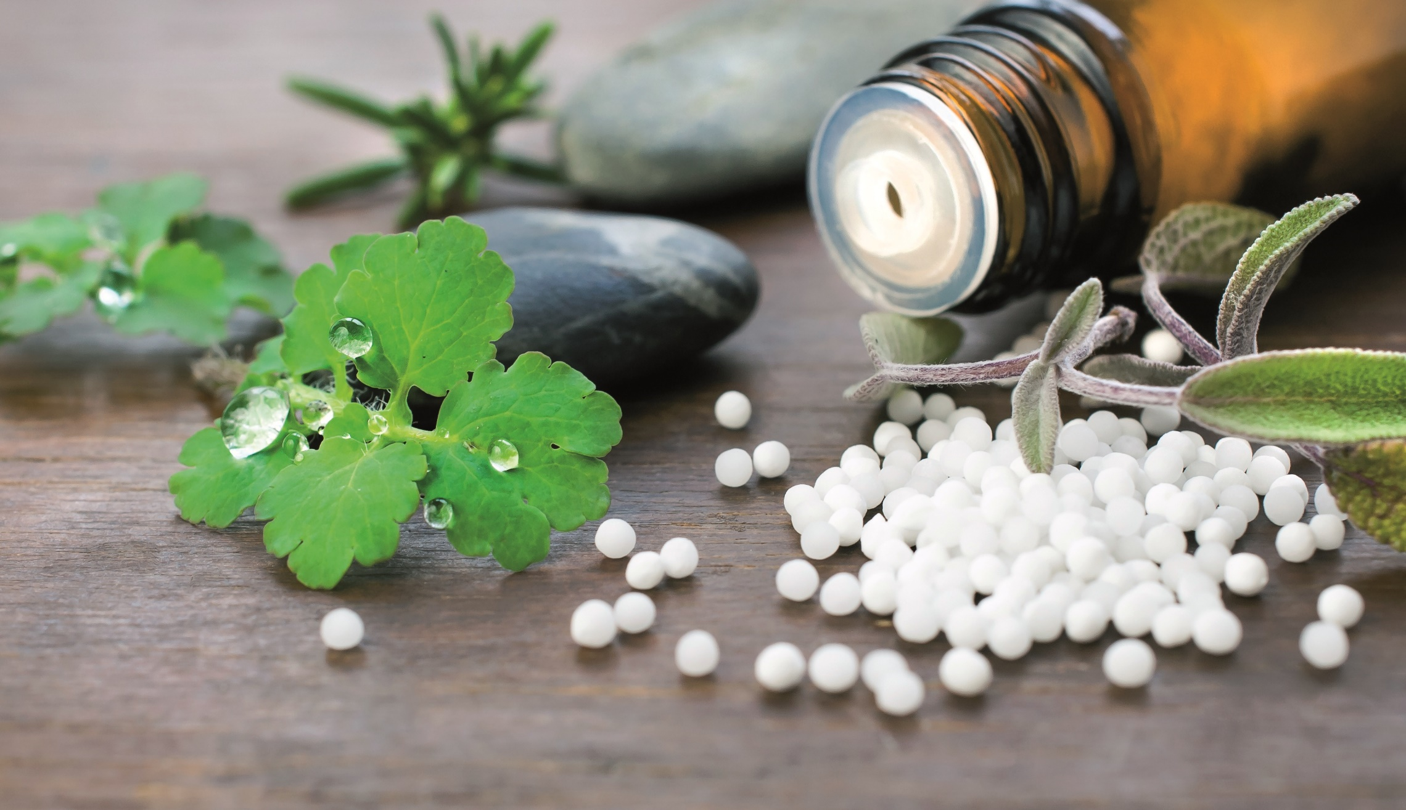
1mg Homeopathy Medicine
Data Analysis
Presented by:
Mayur Paunikar
Aayush Kataria
Maasahebbi Ustad

Slide 2
Project Aim :
We are undertaking this project to meet the increasing demand for reliable homeopathic medicines in the market.
Our goal is to provide high-quality and genuine products that are currently lacking or limited in availability.
We aim to support alternative healthcare options and cater to individuals seeking holistic remedies.

Slide 3
Objectives of this project
Scraped and Analyse data to identify the most effective and popular homeopathic medicines.
Choose the best products based on customer preferences.
Reduce costs and maximize profits.
Ensure customer satisfaction with a curated selection of quality offerings.
Gain a competitive advantage and achieve sustainable growth.

Slide 4
ABOUT 1mg
It is an online healthcare platform and a trusted name in the healthcare industry in India. They provide various services such as online medicine ordering, booking lab tests, consulting with doctors, and accessing reliable healthcare information.

Slide 5

Insights

Slide 6
Top 4 Brands (Rating > 4)
.
From this chart we can derive SBL Pvt Ltd, has major positive impact in homeopathy market followed by Dr. Reckeweg&Co. , Bakson Drugs & Pharmaceuticals Pvt Ltd and Dr. Willmar Schwabe Indai Pvt Ltd

Slide 7
Count of Products by key_benefits Area
.
The major number of medicines are for digestion and skin while joints, hair, blood and respiratory market is still underutilized.

Slide 8
Average Number of Ratings by Brand
Bhargava Phytolab has the highest number of customer ratings, indicating a strong reputation and trust among consumers. This highlights the company's commitment to producing high-quality products that meet customer expectations.
SBL Pvt Ltd and Dr. Reckeweg & Co are the leading brands. This suggests that these brands consistently deliver effective and reliable medications , making them popular choices among consumers. It also demonstrates their focus on quality and customer satisfaction.
Notes:
v

Slide 9
Price Range of Medicines Across Key_Benefit Areas
.
Prices differ for medicines in various areas, affecting how affordable and accessible they are for people.
Factors like market competition, health insurance coverage, research investments, and production costs influence these price variations.

Slide 10
Summary of Prices by Brands
The price range of brands such as Lord's Homoeopathic Laboratory Pvt Ltd, Dr Reckeweg & Co, and Dr Willmar Schwabe India Pvt Ltd varies significantly, with some products priced at a lower rate and others at a higher rate.
Similarly, we can observe that brands such as St. George’s Homoeopathy, Similia Homoeo Laboratory, and HASLAB might produce medicines with the same price range, as their minimum, maximum, and average values are identical

Slide 11
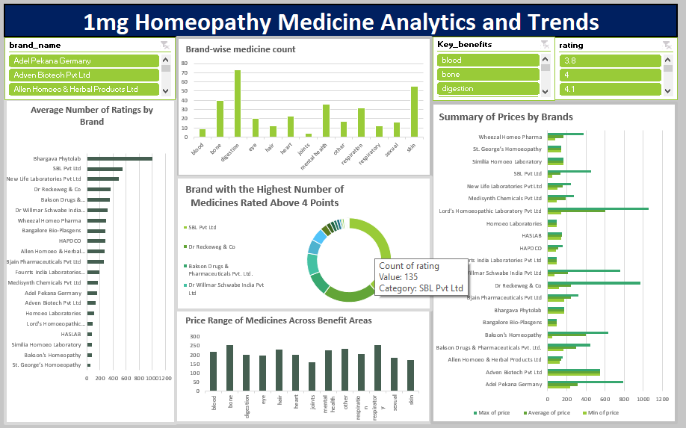
Dynamic Dashboard

Slide 12
Future Scope
Promising future scope: The industry shows potential for growth and development.
Market opportunities: Price variations across benefit areas indicate untapped potential for expansion.
Expanding product offerings: Targeting underutilized sectors like joints, hair, blood, and respiratory issues can tap into new markets.
Advancements and acceptance: Research, technology, and holistic healthcare trends improve industry growth and consumer accessibility.

Slide 13
Challenges
Find some difficulty while scrapping 1mg Data , Due to dynamic Site
Complex HTML
Time Management
Learnings
Web Scraping
Basic Understanding of HTML Script
New Python Library like BeautifulSoup
Effective Teamwork

Slide 14
Thank You

