Slide 1
KNOWLEDGE REPRESENTATION ON STRUCTURED CLINICAL DATA
VARSHA GOUTHAMCHAND

Slide 2
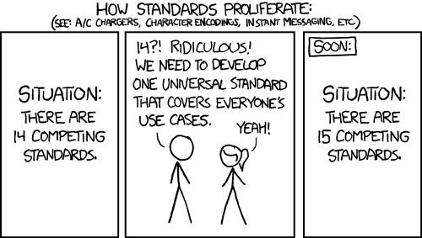

Slide 3
NEED FOR KNOWLEDGE REPRESENTATION
No standards followed while saving medical data
UNDERSTANDABILITY of medical data

Slide 4
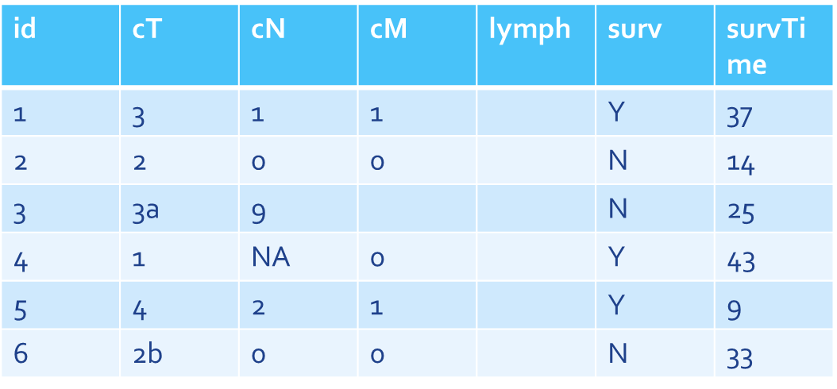
UNDERSTANDIBILTY OF DATA
Difference 3 and 3a?
What is 9 and NA?
What is blank?
Lymph nodes?
Lymphocytes?
Days/Weeks/
Months/Years?
Having open data by itself DOES NOT qualify as FAIR
Y means dead or alive?

Slide 5
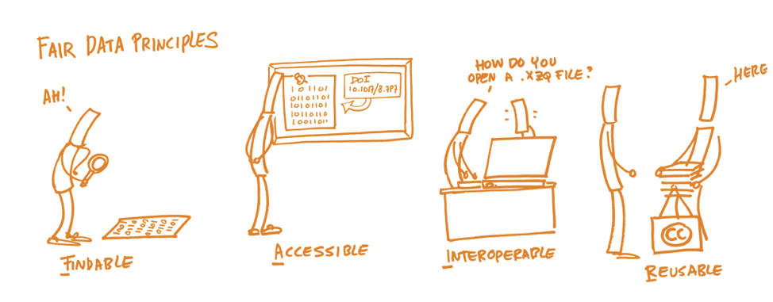
“FAIR” DATA

Slide 6
OUR GOAL
Create a FAIR-ification tool
Map structured data to an universal vocabulary
Connect datasets from different parts of the world
Single SPARQL query to retrieve data from all those different datasets
SPARQL – Query Language to retrieve and manipulate data stored in Resource Description Framework (RDF) format.

Slide 7
DEFINING SEMANTICS
Class : Patient
Instance : Patient_1
From private “codebooks”
To public ontologies
- GO (gene ontology)
- RadLex (radiology lexicon)
- FMA (anatomy)
- UO (physical units ontology)
- ROO (radiation oncology ontology)
- SEDI (semantic DICOM)
- RO (radiomics ontology)
Class : Clinical T Stage
Instance for Patient_1
Value = 3, ord. disc.
Class : Clinical M Stage
“M1” ⇔ “AJCC St. IV”

Slide 8
RESOURCE DESCRIPTION FRAMEWORK
Resource Description Framework (RDF) - A framework for describing data by defining relationships between data objects
Used for building Knowledge Graphs
Every resource is identified by a URI (universal resource identifier), to make the data ‘linkable’
RDF connects data pieces together via triples (Subject, Predicate, Object)
https://www.youtube.com/watch?v=OM6XIICm_qo

Slide 9
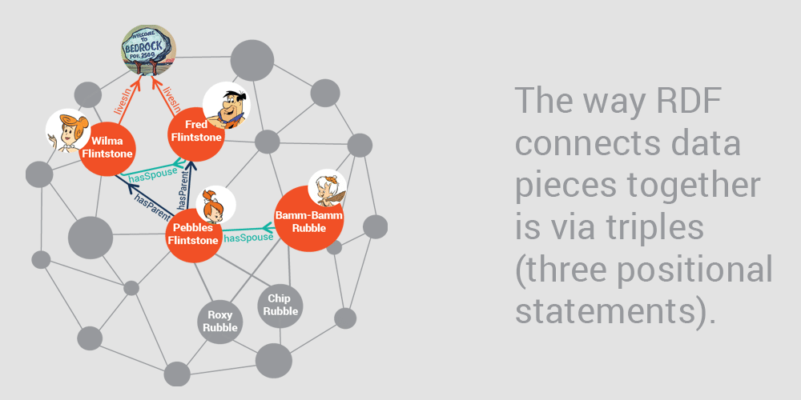
EXAMPLE
“Fred Flintstone is married to Wilma Flintstone” = > Here, Fred Flintstone is the subject of the statement: <fred> hasSpouse <Wilma>, where Fred is defined by another statement: <fred> type <person>

Slide 10
TRIPLIFIER
Application to build RDF TRIPLES from structured data files
OUTPUT FILE
<triplifier_test_HN_Maastricht/0/id> <has_value> "HN1004" .
ID | AGE
HN1004 | 56
HN1006 | 63
OWL FILE
<triplifier_test_HN_Maastricht.id> <rdf:type> <owl:Class>
<triplifier_test_HN_Maastricht.id> <dbo:table> <triplifier_test_HN_Maastricht>

Slide 11
CLINICIAN RUNS TRIPLIFIER ON LOCAL DATA
CLINICIAN SENDS US THE OWL FILE
MAP THE CLASSES TO THEIR SEMANTIC EQUIVALENCIES
UPDATE THE DEFAULT GRAPH BY INSERTING MEANINGFUL PREDICATES
IMPORT OWL FILE TO A GRAPH DATABASE
SEND THE MAPPING QUERY TO CLINICIAN
RUNS THE QUERY LOCALLY
KNOWLEDGE GRAPH
WORKFLOW

Slide 12
GRAPHDB
Semantic Graph Database
Allows linking data and building big knowledge graphs
Used for data modeling and knowledge representation
Stores data as RDF Triplestores in local or remote SPARQL endpoints

Slide 13
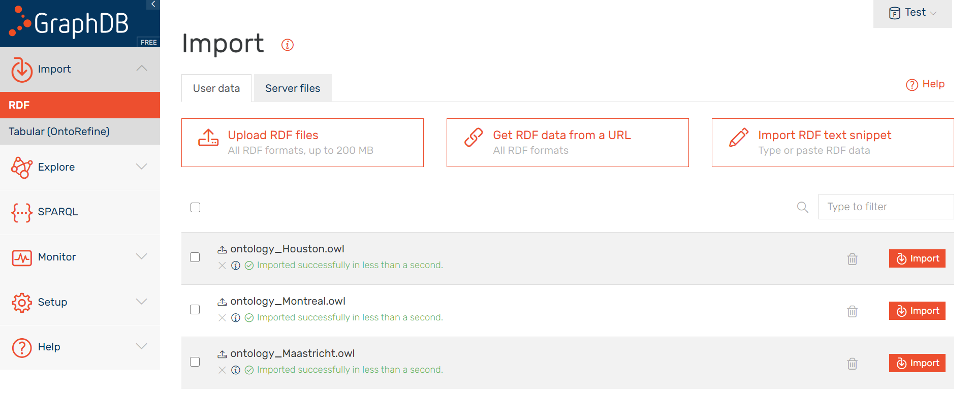
DATA IMPORT

Slide 14
CLASS EQUIVALENCIES
triplifier_test_HN_Maastricht.id | dbo:table | triplifier_test_HN_Maastricht
triplifier_test_HN_Maastricht.id | rdf:type | owl:Class
triplifier_test_HN_Maastricht.id | owl:equivalentClass | ncit:C25364
C25364 – CODE FOR PATIENT IDENTIFIER FROM NCIT

Slide 15
PREDICATE MAPPING
triplifier_test_HN_Maastricht/0 | has_column | triplifier_test_HN_Maastricht/0/id
triplifier_test_HN_Maastricht/0 | has_column | triplifier_test_HN_Maastricht/0/biological_sex
triplifier_test_HN_Maastricht/0 | roo:P100061 | triplifier_test_HN_Maastricht/0/id
triplifier_test_HN_Maastricht/0 | roo:P100018 | triplifier_test_HN_Maastricht/0/biological_sex
P100061 - HAS_IDENTIFIER FROM ROO
P100018 - HAS_BIOLOGICAL_SEX FROM ROO

Slide 16
VALUE MAPPING (CATEGORICAL)
Send a query to the clinicians that retrieves the count of instances of each category in a categorical class (e.g, Gender), without revealing any sensitive information
Map the categories to its respective vocabulary
genderValue | genderNumber
“male” | 110
“female” | 25
NA | 5

Slide 17
VALUE MAPPING (CATEGORICAL)
triplifier_test_HN_Maastricht.biological_sex | owl:equivalentClass | ncit:C28421
male
roo:P100042
roo:P100042
female
owl:equivalentClass
owl:equivalentClass
ncit:C20197
ncit:C16576
P100042 – HAS_VALUE FROM ROO
C20197 – CODE FOR MALE FROM NCIT
C16576 – CODE FOR FEMALE FROM NCIT

Slide 18
CONTINUOUS CLASS
Send a query to the clinicians that retrieves the range and average values of a continuous class (e.g, Age), without revealing any sensitive information
Map the column to its respective unit (i.e., years, months, weeks or days)
ageMax | ageMin | ageAverage
“82” | “48” | “60.690002”

Slide 19
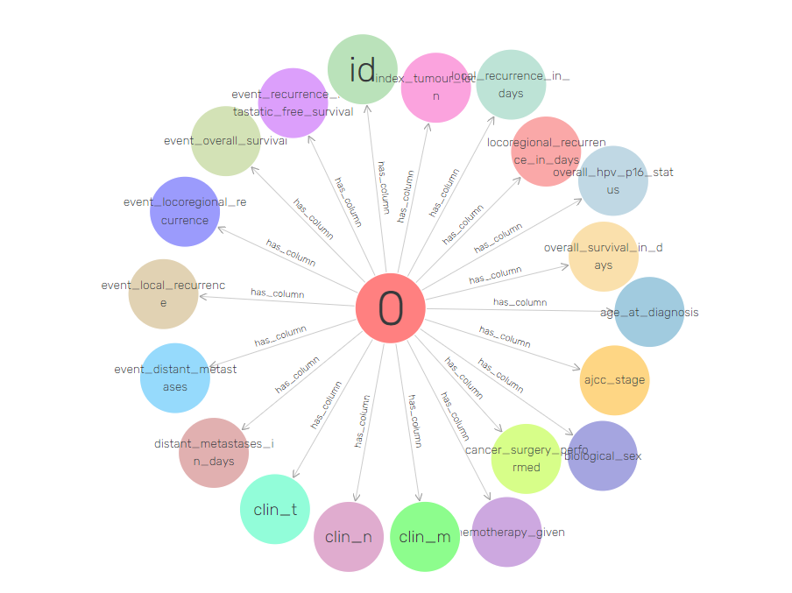
TRIPLIFIER’S GRAPH

Slide 20
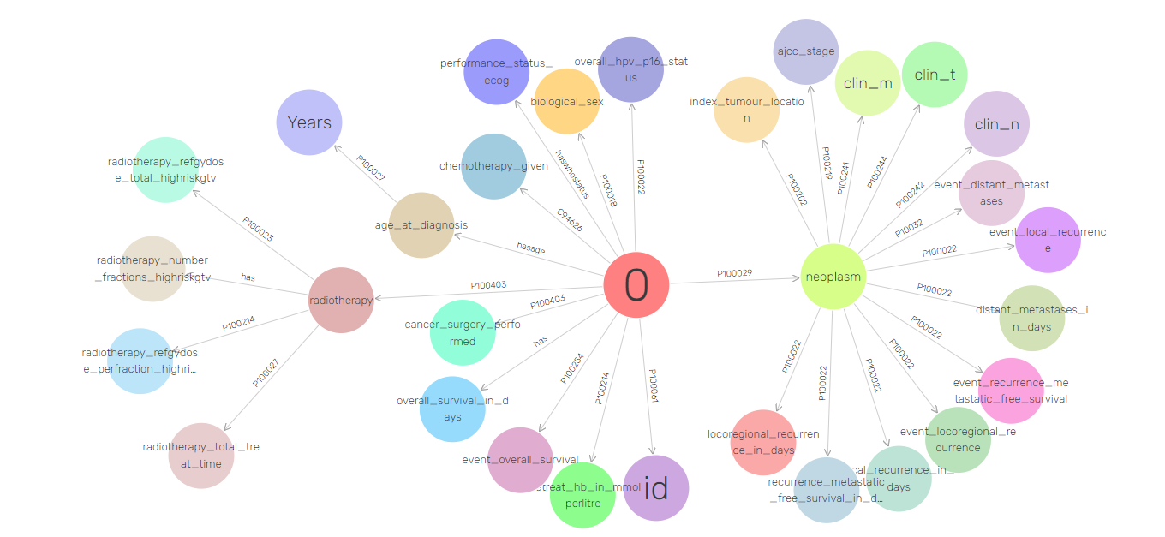
UPDATED GRAPH

Slide 21
KNOWLEDGE REPRESENTATION ON OTHER DATA
We repeat the process of knowledge representation on patient’s data from
Houston
Toronto
Montreal

Slide 22
SPARQL
SELECT ?tablerow ?patient ?IDvalue ?agevalue ?gendervalue
WHERE
{
?tablerow roo:P100061 ?patientID.
?tablerow roo:hasage ?age.
?tablerow roo:P100018 ?gender.
?patientID roo:P100042 ?IDvalue.
?age roo:P100042 ?agevalue.
?gender roo:P100042 ?gendervalue.
} LIMIT 10
SPARQL QUERY TO GET PATIENT ID, AGE AND GENDER

Slide 23
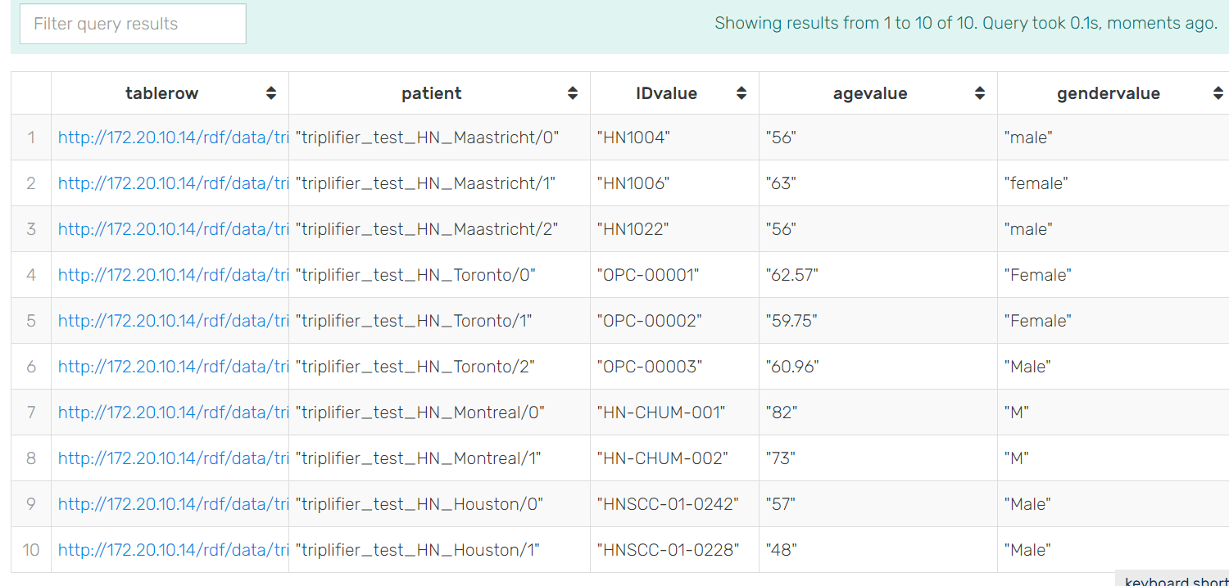
RESULTS

Slide 24
ADVANTAGES
Do not have to travel to the hospital to do manual mapping (R2RML)
No breach of privacy as we only require the OWL file for the semantic mapping
Easy knowledge representation with a bit of clinical advice from experts

Slide 25
LIMITATIONS
Time-consuming process (comparatively)
At the moment, there is no way of knowing the type and range of values stored, e.g. continuous or categorical, minimum or maximum values
Requires programming skills and clinical knowledge
Data saved in a different language might need some prior translation work

Slide 26
FUTURE WORK?
Triplifier to show the type and range of values stored in a particular column (without privacy breach)
As a person is still required to do the semantic mapping of every column of a dataset, making this process automatic – by creating an application with an User Interface to enable easy mapping for clinicians

Slide 27
QUESTIONS?

