Slide 1
Sound Ontology
Update and Challenges

Slide 2
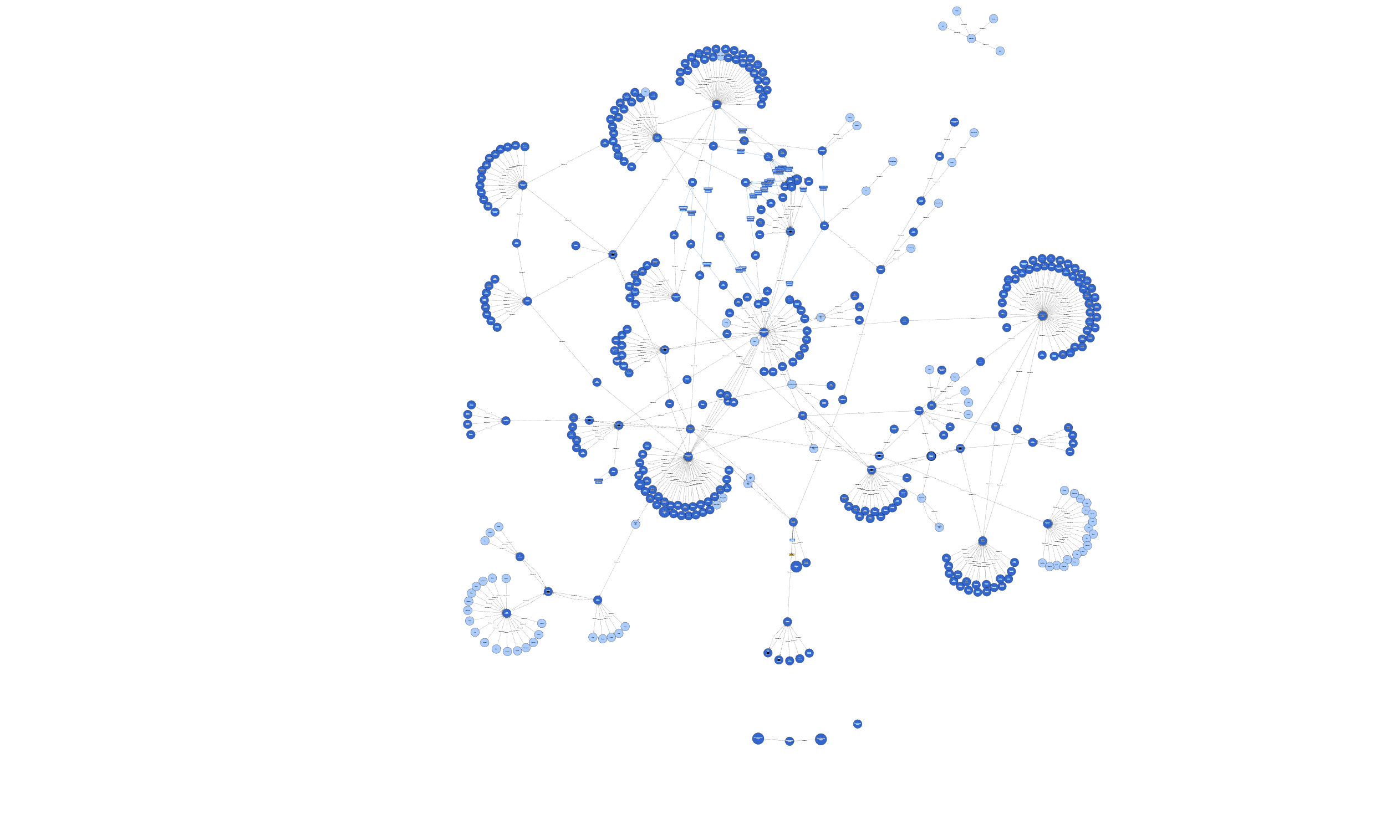
Current State

Slide 3
Questions
What is the difference between a sound and its mechanism?
Can a mechanism be defined for each sound?
How do categorize a sound unidentifiable sound? (Lobanova et al., 2007)

