Slide 1
Sound Ontology
Update and Challenges

Slide 2
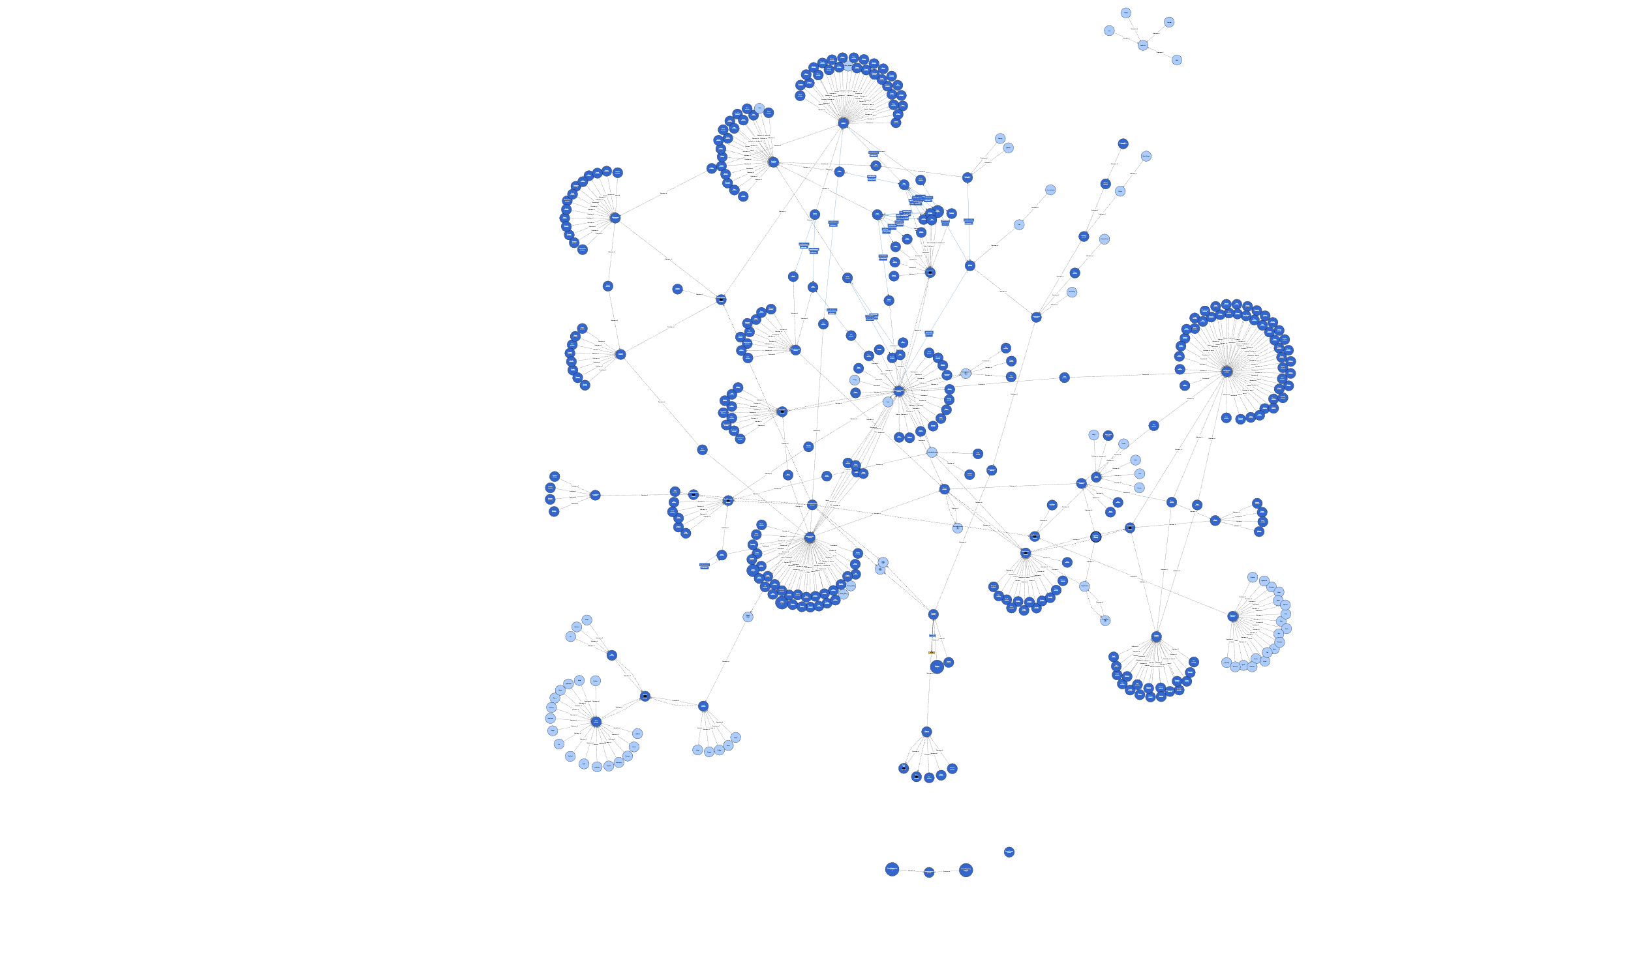
Current State

