Slide 1
Ontologies Workshop
---- Data Science Community Workshop Series
Institute of Data Science
24-05-2018

Slide 2
Kody Moodley
Postdoctoral researcher at Institute of Data Science at Maastricht University
PhD in Computer Science (Knowledge Representation) at the University of Manchester, UK
Master and Bachelor degrees in Computer Science at University of Pretoria and University of KwaZulu-Natal, SA
Research interests: ontologies, automated reasoning, legal analytics and decision making

Slide 3
Stuti Nayak
Master Student Intern at Institute of Data Science at Maastricht University
Background B.Tech.(ICT) Information and Communication Technology. Dhirubhai Ambani Institute of Information and Communication Technology, India.
M.Sc. Data Science in Decision Making, DKE, Maastricht University. (still to graduate)
Research interests: Data Quality, Machine Learning, Deep Learning, Ontologies, Semantic Web

Slide 4
Nadine Rouleaux
Research Assistant & Event Coordinator
Institute of Data Science at Maastricht University 🇳🇱
Research Master degree in Cognitive & Clinical Neuroscience,
Specialization Fundamental Neuroscience
FPN at Maastricht University 🇳🇱
Bachelor degree in Biomedical Sciences
Specialization Molecular Life Sciences
FHML at Maastricht University 🇳🇱
Research interests:
Using machine & deep learning to unravel the brain
Notes:
Predicting disease, treatment outcome, brain imaging
Ranging from clinical trials, drug development, to brain imaging in diagnosis, treatment and behaviour

Slide 5
Introduction
Who are you?
What’s your background?
Why did you register for this workshop?

Slide 6
Learning objectives
What is an ontology
How to construct an ontology
How to use an ontology editor
Popular uses for ontologies
How you can use ontologies

Slide 7
Agenda:
Morning:
09:30 - 10:15 Introduction to Ontologies
10:15 - 10:30 Break
10:30 - 12:00 Practical: how to build an ontology
Afternoon:
13:00 - 13:45 Ontology Applications
13:45 - 14:00 Break
14:00 - 15:30 Practical: using and extending an ontology-based application

Slide 8
Introduction to Ontologies
Notes:
When I created these slides, I asked myself where I should start, what makes machine learning be created, what makes it so popular now? I think machine learning is a combination of computer science and statistics.

Slide 9
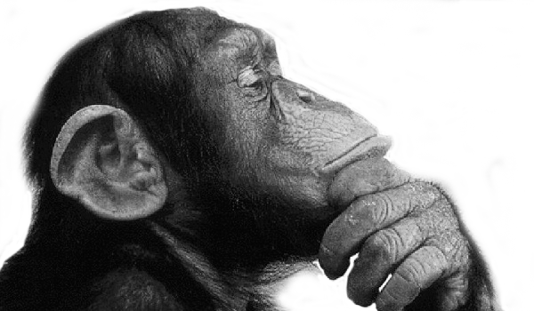
What are they?
Ontology
Onto
Logia
An ontology is a description of the world or some part of it
(“being” or “that which is”)
(“logical discourse”)
Notes:
Can include non-physical things
Concerned with defining things
What is something and how does it relate to other things

Slide 10
What are they?
Ontology in Information Science...
“An ontology is an explicit specification of a conceptualization”
Thomas R. Gruber, 1993
Notes:
Conceptual understanding of domain and we want to formally capture this understanding

Slide 11
What are they?
...and in Computer Science
“A formal specification of knowledge in a domain in a way that enables machines to derive implicit information from it”
Notes:
Formal here means logic-based

Slide 12
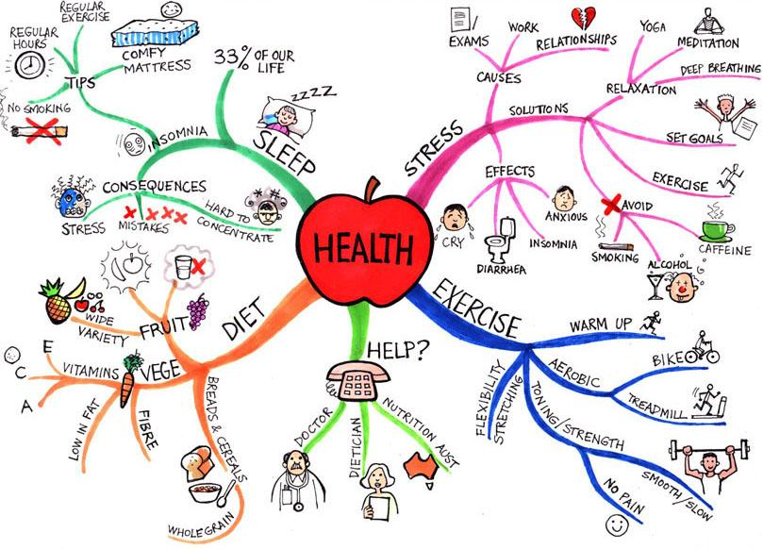
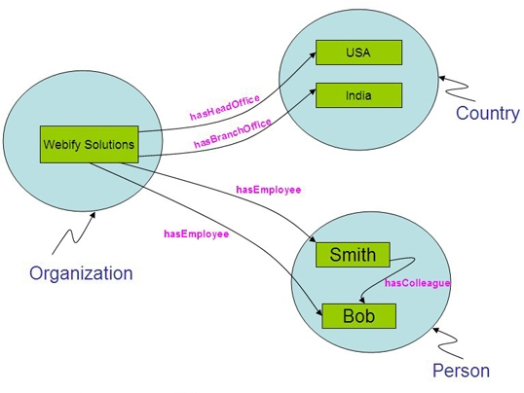
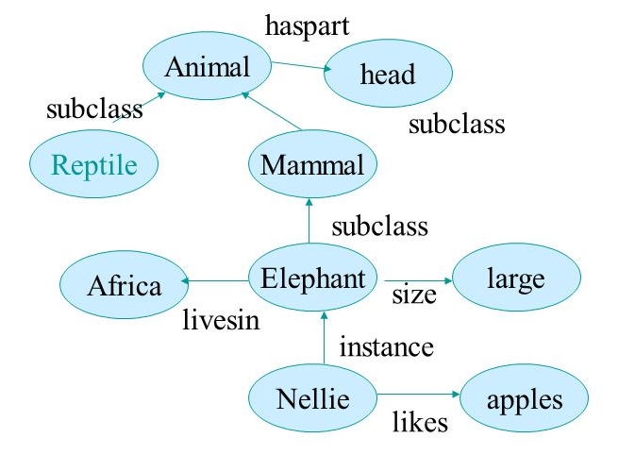
What do they look like?
Notes:
Graphical representations of ontologies meant for communicating among humans
They can also be in a more textual format
UML diagrams, conceptual models etc are ontologies

Slide 13
Why are they?
To share common understanding of a domain among people or software
To enable reuse of domain knowledge
To make domain assumptions explicit
To separate domain knowledge from the operational knowledge
To analyze domain knowledge
Notes:
Why develop an ontology?
Broad advantages (we will get into the more concrete ones later on)
Common understanding: different e-commerce websites like Amazon or Ebay use may use different terms to refer to the same things.
Reuse: if you publish some data (let’s say information about diseases or medical drugs) that you would like to be used by a community you can annotate your data with terms from an existing drug/disease ontology. Then any software tools that use this ontology to aggegrate information will be able to classify/categorise your information correctly as well. NOTE: sometimes reuse is not desired e.g. matching definitions and rules for dating websites
SNOMED CT (Systematized Nomenclature Of Medicine Clinical Terms) most comprehensive medical terminology in the world (millions of terms)
Domain assumptions explicit:

Slide 14
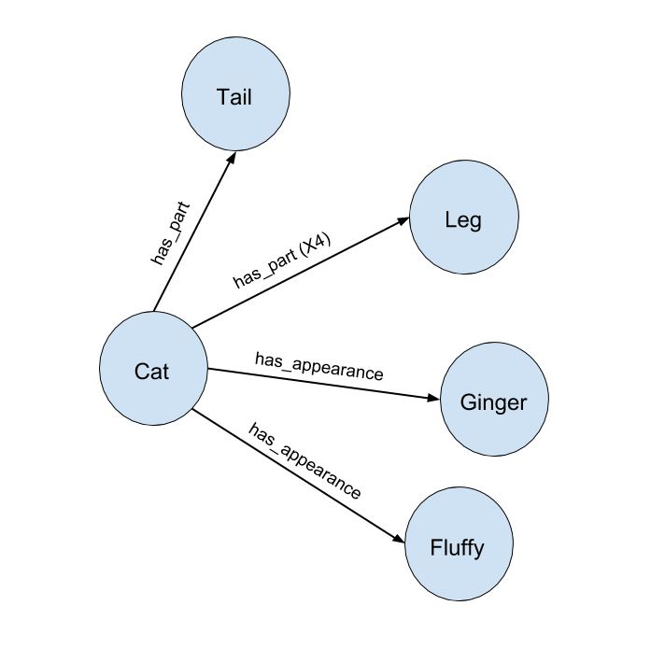
Why make ontologies formal?
“has_part (x4)” means cat has 4 parts in total? or 4 legs in total?
Cat is ginger in colour or is shaped like the vegetable ginger?
Cat refers to a specific cat or all cats?
OR
Cat has_part Tail
Cat has_part (x4) Leg
Cat has_appearance Ginger
Cat has_appearance Fluffy

Slide 15
Ontologies today

Slide 16
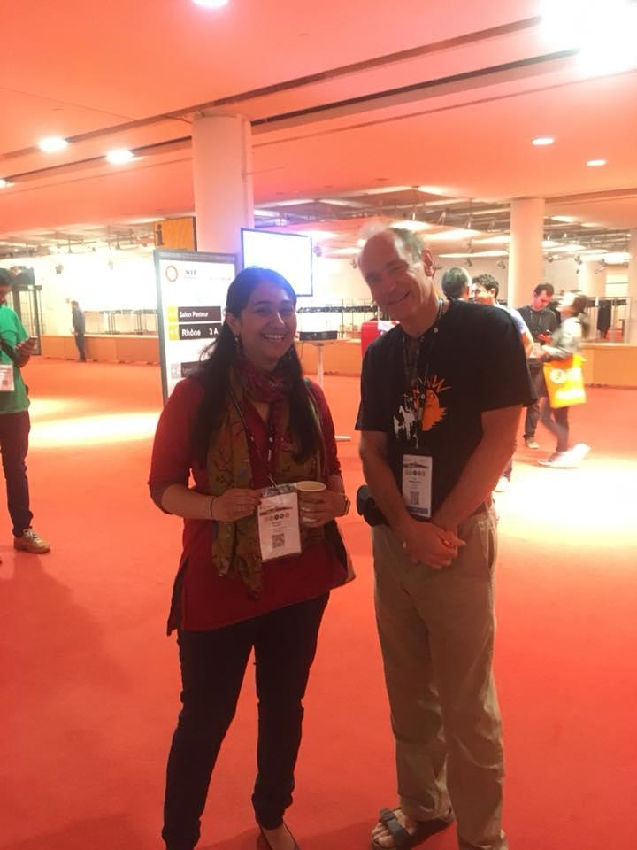
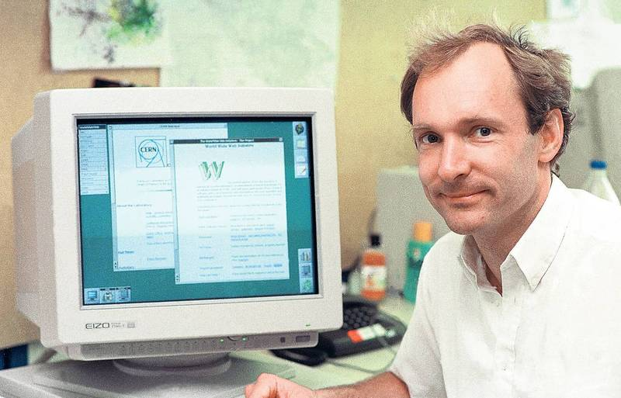
The Semantic Web Vision
Tim Berners-Lee
Inventor of the World Wide Web

Slide 17
What is the Semantic Web?
"...an extension of the current web in which information is given well-defined meaning, better enabling computers and people to work in cooperation."
Tim Berners-Lee et al., 2001
Notes:
Graphical representations of ontologies
They can also be in a more textual format

Slide 18
What is the Semantic Web?
Making the Semantic Web a reality requires linking your Web content (or data) to common terminology in ontologies - hence the “Linked Data” paradigm...
… but we need a Web-based language for specifying ontologies so we can publish them on the Web and link our content to the ontology terms
Notes:
Data can be anything, text, pictures and other media, scientific datasets etc.

Slide 19
OWL - The Web Ontology Language(s)
W3C recommendation in 2004 (OWL 1)
Latest major version: OWL 2
Profiles: OWL 2 Full, OWL 2 DL, OWL 2 RL, OWL 2 EL
Structural specification (no commitment to concrete syntax)
Concrete syntax examples: RDF/XML and OWL/XML (.rdf or .owl), Turtle (.ttl)
Notes:
- Before explaining what the languages look like say they do not need to know this if they are just going to apply ontologies (and not do research)
- Does not commit to any concrete representation syntax (or container format) because these may change with time
- The advantages of OWL/XML are: It conforms to an XML Schema and is regular so it is possible to use off the shelf tools for processing and querying it such as XPath and XSLT

Slide 20
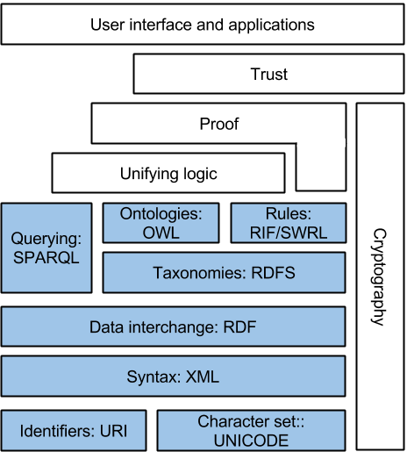
Web Ontology Language (OWL)
Description Logics (DLs)
Web Ontology Language (OWL)
Resource Description Framework (RDF)
Notes:
Graphical representations of ontologies
They can also be in a more textual format

Slide 21
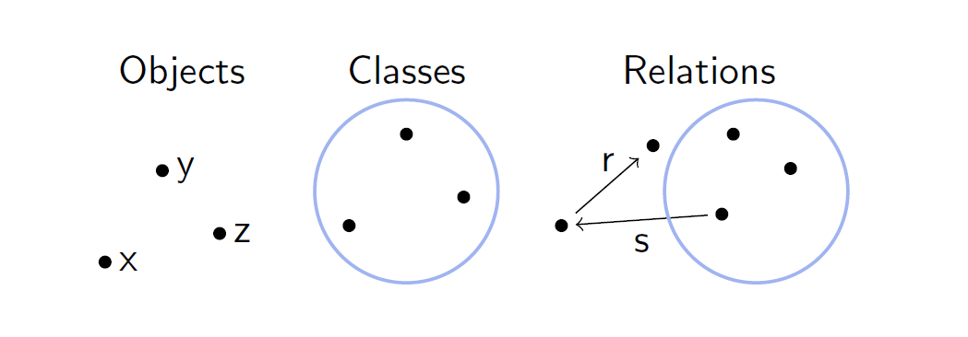
Ontology term types
E.g. john
E.g. Student
E.g. enrolledIn
Notes:
Objects: instances, individuals
Classes: concepts, categories
Relations: roles, relationships, object properties

Slide 22
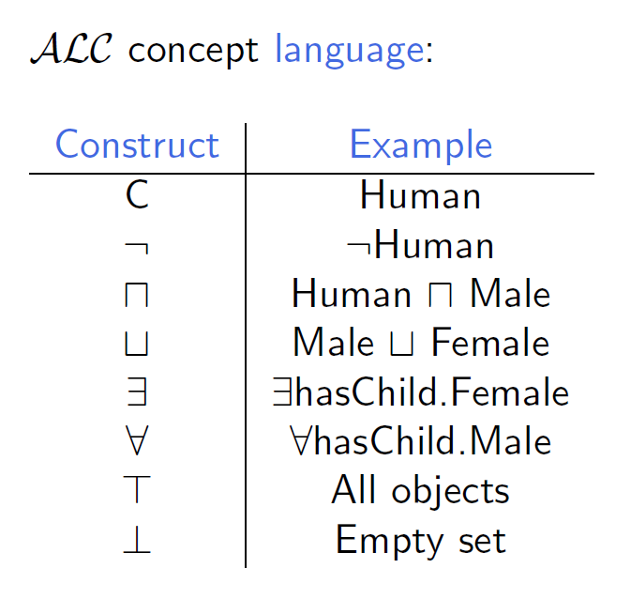
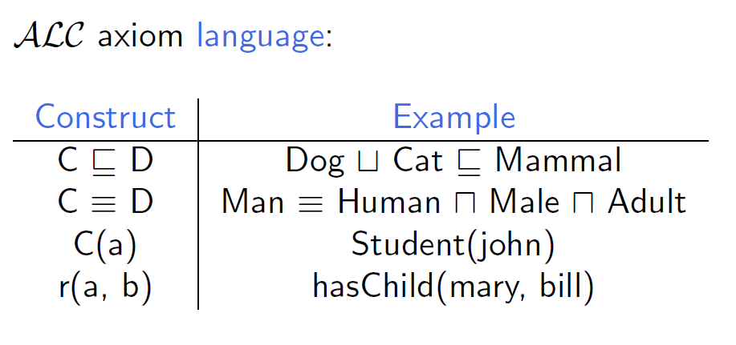
Description Logics (DLs)

Slide 23
Deductive vs. Inductive inference
… Machine learning vs. ontology-based reasoning

Slide 24
Foundational vs. Application Ontologies
…

Slide 25
Ontologies vs Databases
Formal Ontologies | Relational Databases
Structure knowledge for interoperability, integration and shared understanding | Structure instances for efficient storage and querying
Formal logic-based syntax and semantics | Less focus on formal semantics
Open-world assumption (OWA) | Closed-world assumption (CWA)
Knowledge-centric | Data-centric
Less focus on performance | Highly tuned for performance

Slide 26
Introduction to Practical 1

Slide 27
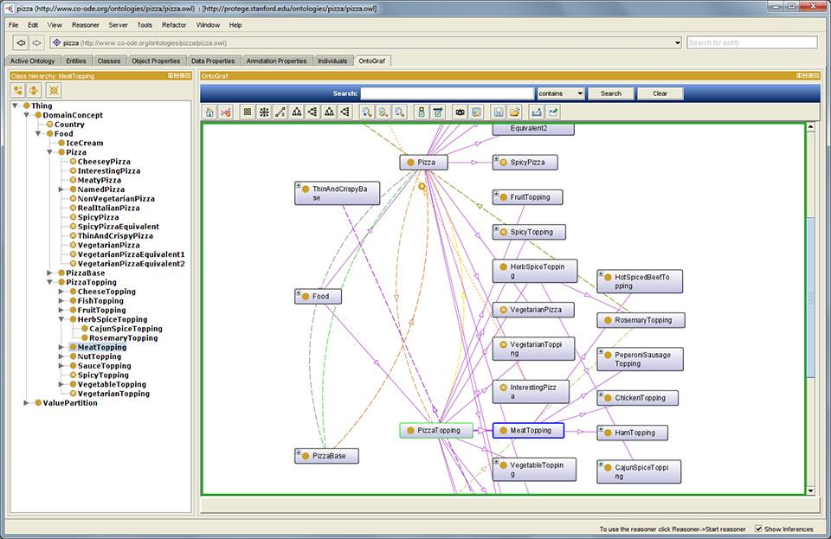

Building your first ontology!
Protégé
Developed at Stanford University

Slide 28
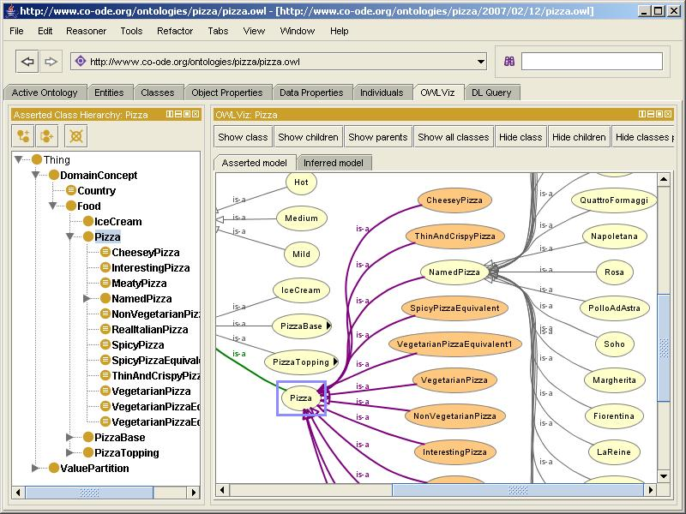
Protégé introduction

