Slide 1
FAIR Ontology Engineering with SULO
A Hands-On Tutorial
ESWC 2026 · May 10, 2026
Michel Dumontier · Chang Sun
Maastricht University · Department of Advanced Computing Sciences
🍕 The pizza domain as a vehicle for principled ontology engineering

Slide 2
The Challenge
Why does this tutorial exist?
⚠ Engineering Quality
▸ Ontologies are re-invented from scratch
▸ Inconsistent use of upper-level concepts
▸ ad hoc class/property naming
▸ Missing or wrong axioms
▸ Hard to reason over reliably
▸ Not interoperable by design
⚠ FAIRness Gaps
▸ No stable IRI / version IRI
▸ Missing metadata (title, license, creator…)
▸ Terms lack labels and descriptions
▸ Not registered in any catalogue
⚠ Tooling & Training Gap
▸ Learners need end-to-end workflow guidance
▸ Upper ontologies are under-used in teaching
▸ Few tutorials connect modelling → publishing
▸ Few practical frameworks for FAIR ontology projects

Slide 3
Goals & Learning Objectives
Domain Modelling with SULO & owlready2
▸ Master SULO's categories and design patterns
▸ Distinguish fundamental classes and relations
▸ Translate conceptual models into OWL axioms
▸ Validate designs with automated reasoning (HermiT / ELK)
What Participants Take Home
▸ End-to-end workflow: idea → axiom → reasoning → publication
▸ Practical owlready2 skills for programmatic ontology engineering
▸ Design patterns you can reuse in your own domain ontology
▸ A ready-to-use FAIR ontology template (OntoStart)
▸ Critical understanding of the Open World Assumption
▸ Ability to read and act on automated quality reports
FAIR Publication
▸ Add high quality ontology metadata
▸ Publish with OntoStart CI/CD GitHub pipeline to a persistent W3ID IRI
▸ Get FOOPS! FAIRness reports and close gaps

Slide 4
Methodology
How the tutorial works
Every concept is introduced through a worked pizza example, then immediately applied in an exercise. The ontology is built incrementally across notebooks — each session picks up where the last left off.
📖
💻
🔍
✅
🚀
Concept
Code
Reason
Verify
Publish
Upper-level category from SULO motivates the modelling approach
owlready2 cell: declare classes, axioms, individuals in Python
HermiT or ELK reasoner checks consistency and classifies terms
Query inferred relations; observe OWA behaviour; fix gaps
Export, annotate, push to OntoStart; assess with FOOPS!
→
→
→
→
Jupyter notebooks (owlready2) · Protégé (optional) · Python 3.10+

Slide 5
What is SULO?
Simplified Upper Level Ontology — https://w3id.org/sulo/
Why SULO?
▸ A lightweight, carefully engineered top-level ontology
▸ Provides foundational categories shared across all domains
▸ Designed to be small enough to learn in one session
▸ Grounds domain ontologies in a shared formal framework
▸ Enables cross-domain interoperability and reuse
▸ Aligns with BFO, DOLCE, and other upper-level ontologies
Key SULO Classes
SpatialObject
A thing that exists in space (pizza, oven, box)
Quality
An intrinsic feature (spiciness level)
Quantity
A measured feature with numeric value (SHU)
Process
A temporally extended event (baking, delivery)
Role
A relational property played by an entity
InformationObject
An entity whose function is to encode meaning
TimeInstant
A point on the timeline (order received)
Duration
An elapsed time quantity (30-min delivery)

Slide 6
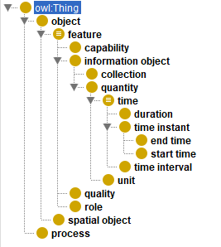
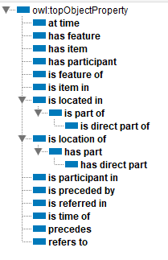

SULO – a minimal upper level ontology for everyday modeling
Simplified Upper Level Ontology — https://w3id.org/sulo/

Slide 7
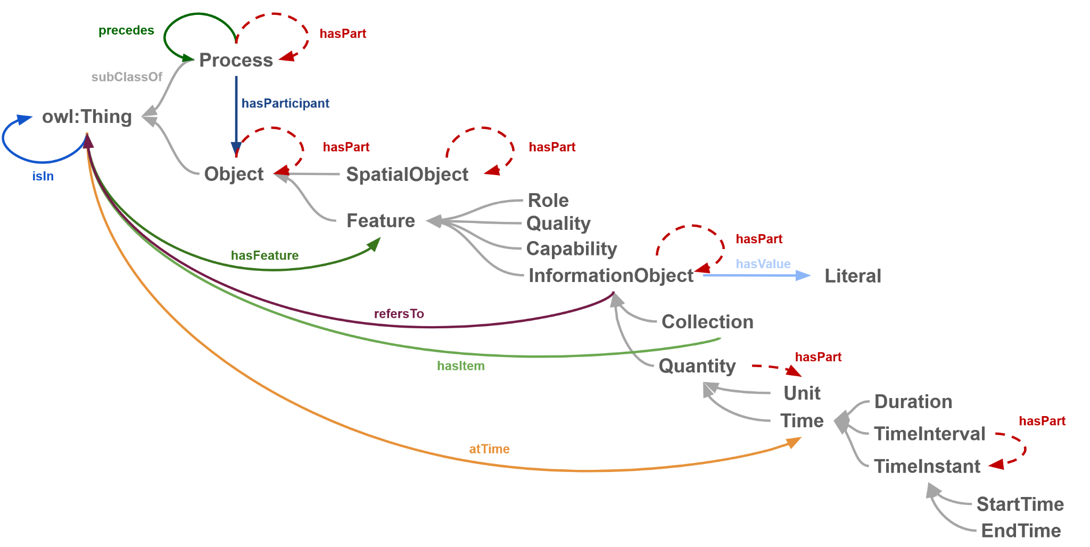
SULO fits on a postcard
Simplified Upper Level Ontology — https://w3id.org/sulo/
Quality
Quantity
Process
Role
InformationObject
TimeInstant
Duration

Slide 8
SULO fits on a postcard
Simplified Upper Level Ontology — https://w3id.org/sulo/
The Process-Role-Object (PRO) Ontology Design Pattern provides a way to represent the time and manner in which objects participate in processes through participation roles.
The SOLID pattern uses SULO’s single functional data property, hasValue, to assign a literal value to an InformationObject. This strictly enforces the use of SULO properties, but may require new domain-specific classes.
Process and hasParticipant some
(Role and isFeatureOf some Object)
hasParticipant o isFeatureOf -> hasParticipant
:alice hasTemperatureInCelcius "27.5" .
:m1 a sulo:Quantity, :TemperatureMeasurement
sulo:hasValue "27.5";
sulo:hasPart :Celsius_unit ;
sulo:refersTo :TemperatureQuality ;
:alice sulo:hasFeature :m1 .
The role chain enables the inference of the object participant

Slide 9
What is OWL?
Web Ontology Language — the formal backbone
OWL in a Nutshell
▸ W3C standard for knowledge representation on the Semantic Web
▸ Formally grounded in Description Logics, enables automated reasoning
▸ Three constructs: Classes, Properties, Individuals
▸ Axioms describe necessary and/or sufficient conditions for class membership
▸ Reasoners (HermiT, ELK) check consistency and infer new facts
Key Axiom Types Used
▸ SubClassOf
— every Pizza hasDirectPart some PizzaCrust
▸ EquivalentTo
— SpicyPizza ≡ Pizza and hasPart.some(hasFeature.some(SpicyHot))
▸ DisjointClasses
— Mozzarella, Salami, Basil cannot overlap
▸ ObjectPropertyCharacteristics
— hasPart is Transitive
▸ AnnotationProperty
— rdfs:label, rdfs:comment, dc:creator…

Slide 10
What is owlready2?
Python library for OWL ontology engineering
owlready2 at a Glance
▸ Python library for loading, editing, and reasoning over OWL ontologies
▸ Natural Python syntax maps directly to OWL axioms
▸ Embeds the HermiT and ELK reasoners (via JVM) — no separate install
▸ Saves in RDF/XML; combine with rdflib for Turtle export
▸ Supports SPARQL queries over the asserted graph
▸ Active development; pip-installable; widely used in research
from owlready2 import *
sulo = get_ontology('https://w3id.org/sulo/').load()
pizza = get_ontology('https://w3id.org/ontostart/pizza/')
with pizza:
class PizzaCrust(sulo.SpatialObject):
label = [locstr('pizza crust', 'en')]
class Pizza(sulo.SpatialObject):
is_a = [sulo.hasDirectPart.exactly(1, PizzaCrust)]
safe_call_reasoner(pizza) # HermiT

Slide 11

Tutorial Map
8 notebooks · 4 hours · one growing ontology
NB 00
NB 01
NB 02
NB 03
NB 04
NB 05
NB 06
NB 07
Setup & Orientation
Spatial Objects & Composition
Qualities & Quantities
Processes
Information Entities
Time
Spatial Containment
Deployment & FAIRness
Load SULO, explore the hierarchy, run reasoner
Declare OWL classes, organise them into a hierarchy, and express necessary and/or sufficient conditions for class membership using part-whole composition.
Represent intrinsic characteristics (qualities) and their numeric measurements (quantities)
Represent processes with typed participants, how to distinguish identity-preserving from identity-destroying change, and how to assert sequential ordering of processes.
What makes an information object ontologically distinct from a spatial object, how to relate to real world entities
Model time instants, durations, and constrained durations, how to anchor processes to time
parthood vs containment, containment transitivity does not propagate into part-whole relations, model object moving between containers.
The ontology gets a persistent IRI, full metadata, FOOPS! FAIRness score.
A pizza has exactly 1 crust, 1 sauce, ≥1 toppings. Parts have parts (dough, cornicione).
Spiciness is a quality. SpicyHot, SpicyMedium, SpicyMild are disjoint categorical levels.
Making dough transforms flour + water → dough. Baking is a developmental process.
A pizza order refers to a pizza. A receipt records a payment. A recipe describes a process.
Order received → baking starts → baking ends → delivered. Express delivery ≤ 30 min.
Pizza is in the oven. Oven contains box contains pizza. Containment ≠ parthood.
← Reference / warmup Core modelling notebooks → FAIR publication →

Slide 12
What You Will Leave With
🎁 Tangible Deliverables
▸ A complete, reasoned OWL ontology of the pizza domain
▸ Published at your own persistent IRI https://w3id.org/ontostart/pizza-{username}/
▸ Documented with DC, VANN, PAV, DCAT, FOAF, MOD metadata
▸ Assessed by FOOPS! with a score you can improve
▸ Version-controlled on GitHub with auto-generated HTML documentation
🧠 Skills & Knowledge
▸ End-to-end FAIR ontology workflow
▸ SULO design patterns for any domain
▸ owlready2 Python proficiency
▸ Reading and acting on reasoner output
▸ Reading FOOPS! reports
▸ OntoStart as a project template for your next ontology
▸ Critical awareness of OWA and its consequences for modelling

Slide 13
Schedule
Half-day · 4 hours · May 10/11, 2026
Time
Activity
Content
Notebook
10 min
Tutorial overview
Introduction and goals
10 min
Reference Materials
OWL, SULO, and owlready
30 min
Spatial Objects & Composition
hasPart, cardinality, OWA
NB 01
15 min
Qualities & Quantities
refersTo
NB 02
25 min
Process I
Transformation, development, participation roles
NB 03
30 min
BREAK
15 min
Process II
Parts, precedes
NB 03
15 min
Information entities
orders, receipts, identity
NB 04
15 min
Time
instants, durations, timelines
NB 05
15 min
Spatial containment
contains vs hasPart, SPARQL
NB 06
20 min
OntoStart & FAIRness assessment
metadata, export, GitHub, FOOPS!
NB 07
10 min
Q&A + wrap-up
Modelling discussion

Slide 14
Tools: OntoStart & FOOPS!
The publication and quality-assessment pipeline
🚀 OntoStart
▸ GitHub repository template for FAIR ontology projects
▸ Push a branch → GitHub Actions automatically:
▸ · Validates OWL DL profile
▸ · Converts to RDF/XML, Turtle, JSON-LD, N-Triples
▸ · Generates HTML documentation (Ontospy, PyLODE)
▸ · Runs FOOPS! and publishes a FAIRness badge
▸ · Deploys to GitHub Pages
▸ Serves ontology at w3id.org with full content negotiation
▸ github.com/micheldumontier/ontostart
✅ FOOPS! FAIRness Checker
▸ Automated FAIR ontology assessment tool by OEG-UPM (Madrid)
▸ Checks 24 indicators across all four FAIR dimensions
▸ Key checks:
▸ F: persistent URI, version IRI, namespace prefix
▸ A: content negotiation, HTML documentation
▸ I: standard vocabularies reused, OWL/RDF serialisation
▸ R: title, description, license, creator, labels, definitions
▸ Available at: foops.linkeddata.es

Slide 15
🍕
Let's Get Started
Open Jupyter Lab and run notebook 00-SULO-tutorial-setup.ipynb
github.com/micheldumontier/sulo-tutorial
Questions? → michel.dumontier@maastrichtuniversity.nl

