Slide 1
SULO – a simplified upper-level ontology

Slide 2
Upper Level Ontologies
Ontologies offer a formalization of a shared conceptualization of a domain. They provide machine interpretable descriptions of entities, their attributes, and their relations.
Upper Level Ontologies (ULOs), aka foundation ontologies, offer an overarching axiomatic framework for domain ontologies (DOs) so as to constrain the conceptualization and formalisation of a domain.
Many ULOs have been proposed: BFO, GFO, DOLCE, UFO, SUMO, and some such as SIO and BioTop contain and extend ULOs into domain specific classes and relations.

Slide 3
Domain ontologies and schemas
However, many domain ontologies (e.g. SNOMED) and data schemas (e.g. SPHN) are driven by immediate, pragmatic needs and ULOs are not typically used to guide their development.
The lack of adherence to an ULO leads to inefficient representations:
Inability to extend the domain ontology or schema by reusing domain and/or application-specific relations
leading to a proliferation of semantically ungrounded relations
leading to non-interoperable schemas around each target class

Slide 4
ULOs remain difficult to correctly apply
Most ULOs feature nuanced philosophical considerations and familiarity with logic.
ULOs adopt unfamiliar or technical labels: continuant, endurant, perdurant, specifically dependent continuant, which avoids meaning overload, but are difficult to grasp and correctly apply by non experts
ULOs have distinct, missing, underrepresented, or overconstrained areas. BFO and DOLCE focus on particulars, only BFO has time indexed relations (only in their common logic), immaterial bearers are not possible in BFO, BFO/GFO/DOLCE do not offer any data relations.

Slide 5
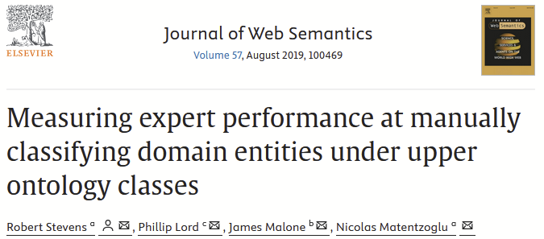
Even experts in a particular ULO don't consistently use it in the same way
8 BFO experts asked to classify 46 commonly known entities from the domain of travel with BFO entities.
0.52 inter-rater agreement
degree of classification consistency is correlated with the frequency the respective BFO classes are used in practice

Slide 6
SULO
We propose the Simplified Upper Level Ontology (SULO) take thats a minimalistic approach to guide the alignment, formalisation, and reusability of upper level and domain ontologies.
SULO attempts to balance formal rigour with
simplicity and practical usability.

Slide 7
Design Criteria
Minimalism: SULO proposes a small taxonomy of disjoint classes and a minimal set of constrained relations to ensure broad applicability across domains.
Compatibility: SULO maintains compatibility with core components of well-known ULOs while
remaining accessible to domain experts.
Accessibility: SULO aims to be accessible to users with no or little training in formal ontology
through friendly labeling, a simple taxonomy, and fits in a single diagram.
Composability: SULO provides the building blocks to construct complex, machine-readable
class expressions.
Interoperability: SULO fosters interoperability by providing a common semantic foundation,
including two ontology design patterns, that help domain experts adhere to explicit an implicit
semantics.
Data validation: SULO constrains real-world knowledge graphs through automated reasoning
and schema validation.

Slide 8
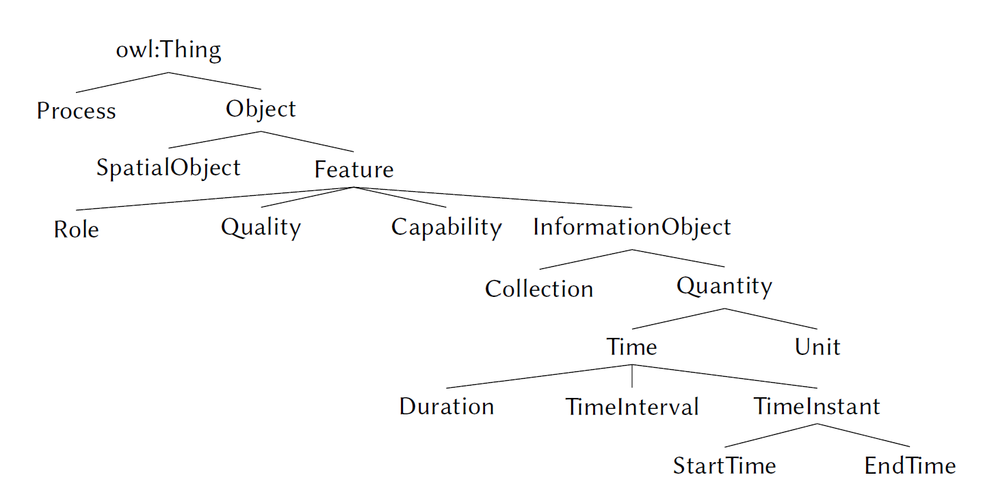
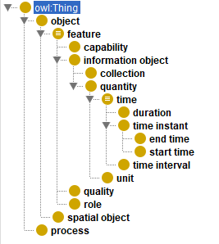
17 classes in SULO

Slide 9
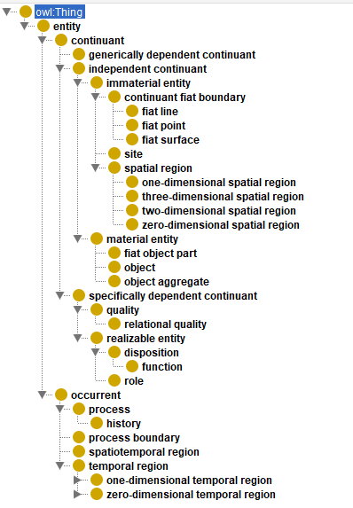
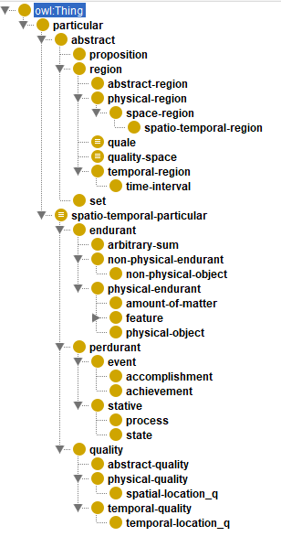
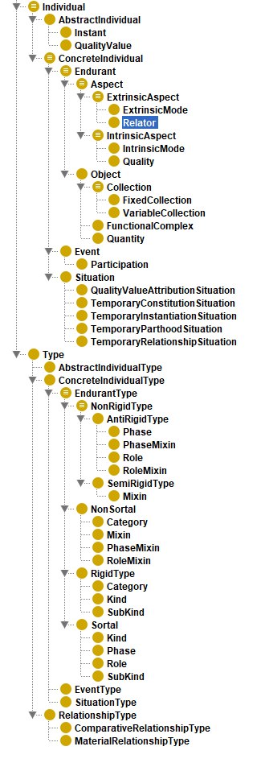
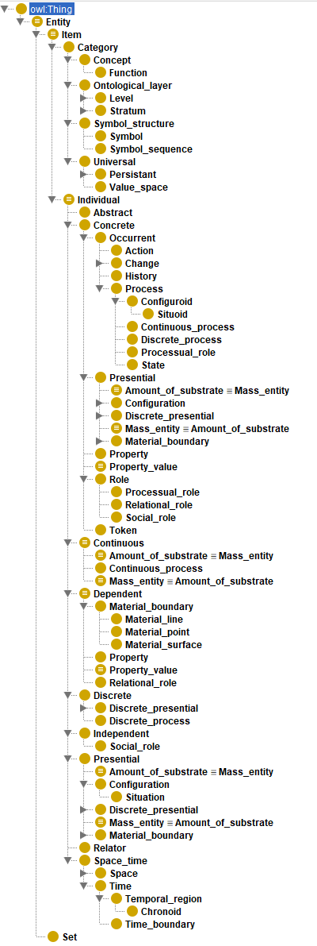
SULO
BFO
DOLCE
gUFO
GFO

Slide 10
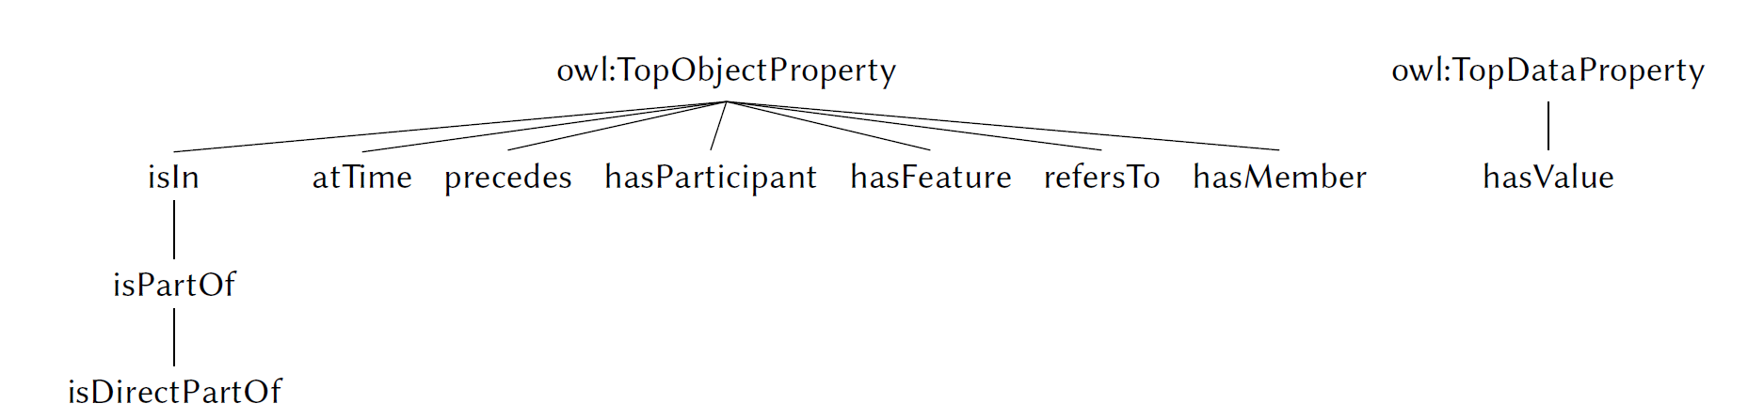
SULO Properties
18 object properties (9 direct + 9 inverses) and 1 data property.

Slide 11
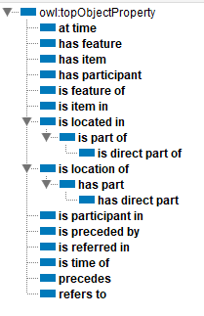
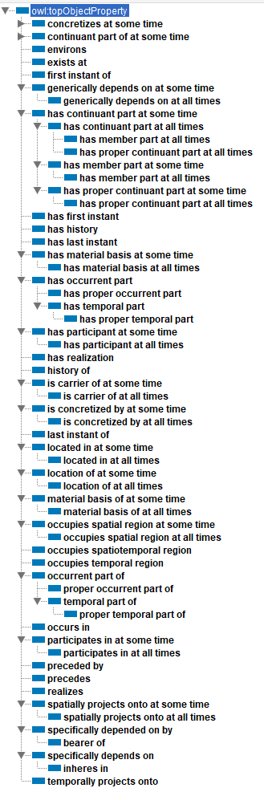
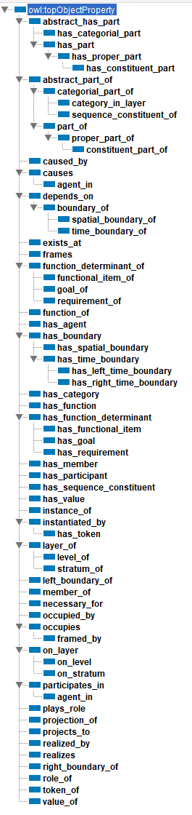
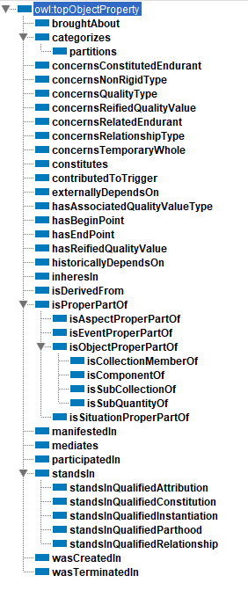
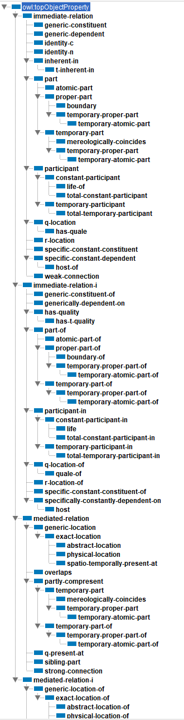
SULO
BFO
GFO
gUFO
DOLCE

Slide 12
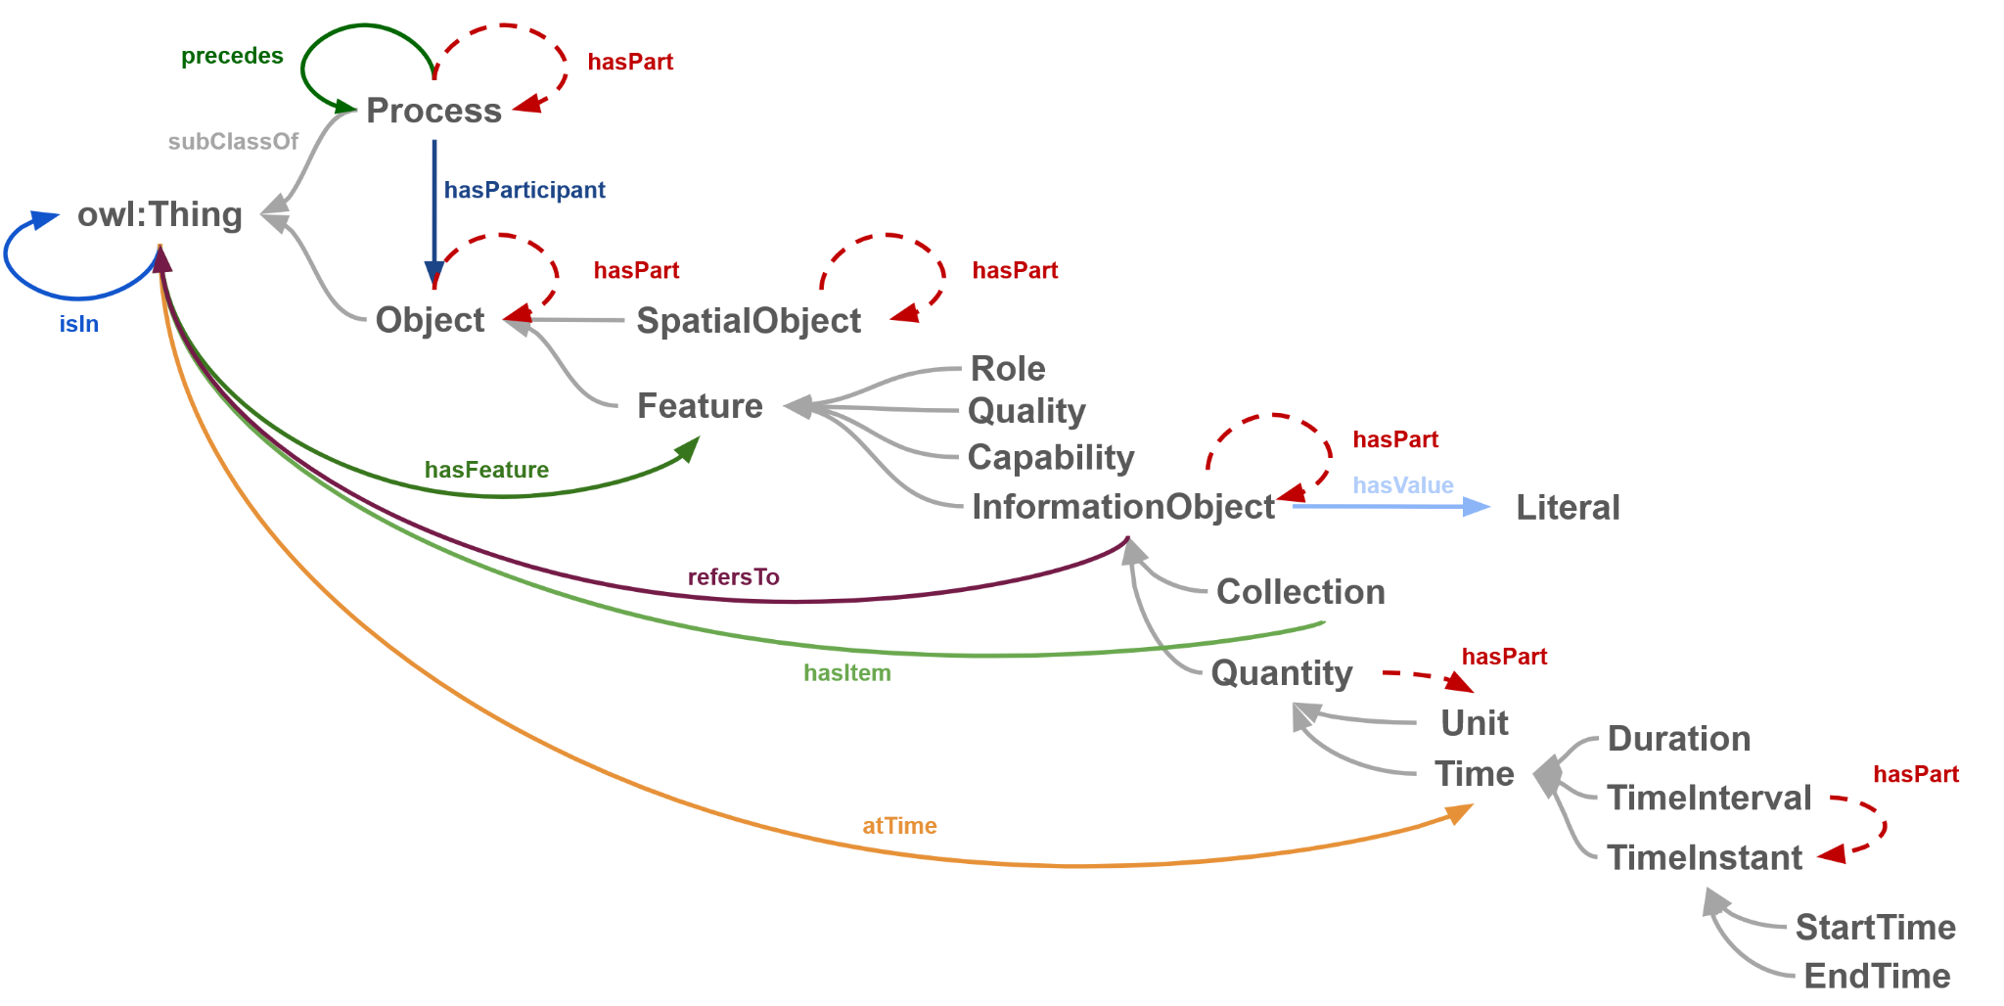
SULO in a postcard
solid lines show domain and range of properties
dotted lines show restrictions in class axioms

Slide 13
Ontology Design Patterns
Ontology Design Patterns (ODPs) can help to structure data graphs that foster semantic interoperability across domain-specific knowledge representations
We propose to key ODPs: SOLID and PRO
SOLID focuses describing literal containing relations
PRO focuses on describing role-based relations

Slide 14
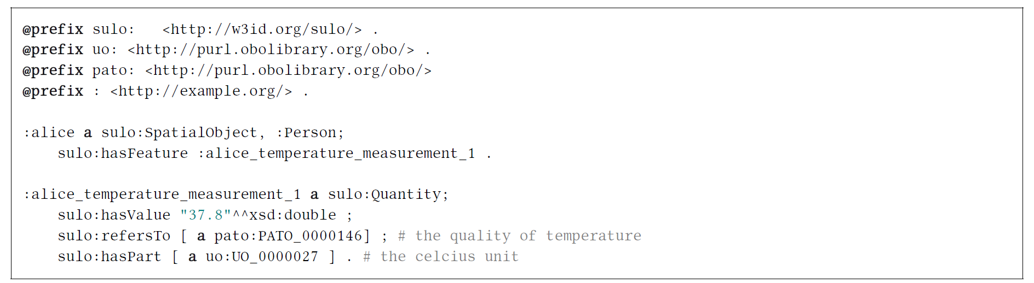
SOLID ODP
The SOLID pattern uses SULO’s single functional data property, hasValue, to assign a literal value to an InformationObject.
Example: Instead of using arbitrary relations such as hasTemperature or hasTemperatureInCelcius, the design pattern reuses SULO’s hasValue, hasFeature, refersTo, and hasPart properties in conjunction with two externally defined classes, namely Temperature from PATO and Celcius from the Unit Ontology
Hence, developing an ontology of InformationObjects is encouraged, rather than a proliferation of data properties.

Slide 15
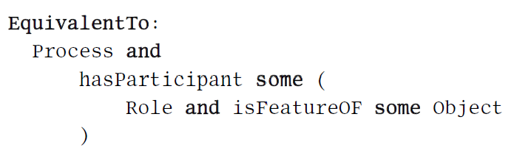
PRO ODP
The Process-Role-Object (PRO) ODP provides a way to represent the manner in which objects participate in processes through specified roles.
Applies to spatial objects and information objects!
Role chain to infer participation of role holding object
The pattern makes explicit the semantics for role-aligned object relations such as hasPatient, hasCareProvider. Hence, this pattern reduces the impulse to create and proliferate such relations.

Slide 16
healthcare encounter1
sulo:Process
sulo:hasParticipant
sulo:hasParticipant
alice's
patient role
dr. smith's health care provider role
sulo:hasParticipant
sulo:hasParticipant
sulo:Role
sulo:Role
sulo:isFeatureOf
sulo:isFeatureOf
alice
Dr Smith
sulo:SpatialObject
sulo:SpatialObject

Slide 17
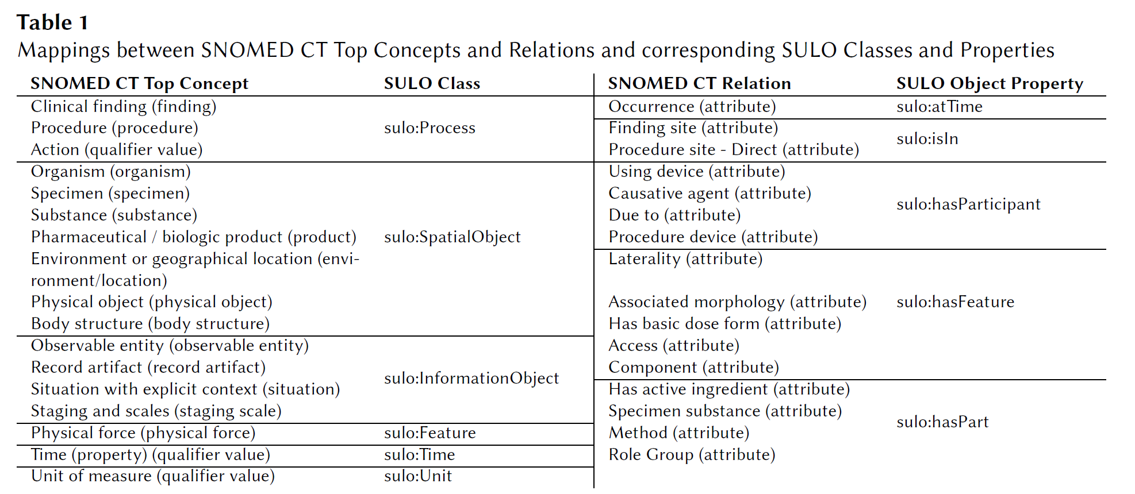
SNOMED CT is a formalised domain ontology
SNOMED CT is a formalised international clinical terminology used in coding health records.
SNOMED CT comprises 27 top level categories, 120+ relations.
Some classes in SNOMED have ambiguous meanings, and there is interest in refactoring.
Most SNOMED classes and relations can be mapped to SULO classes and relations, but some SNOMED relations are compound and map to a subgraph

Slide 18
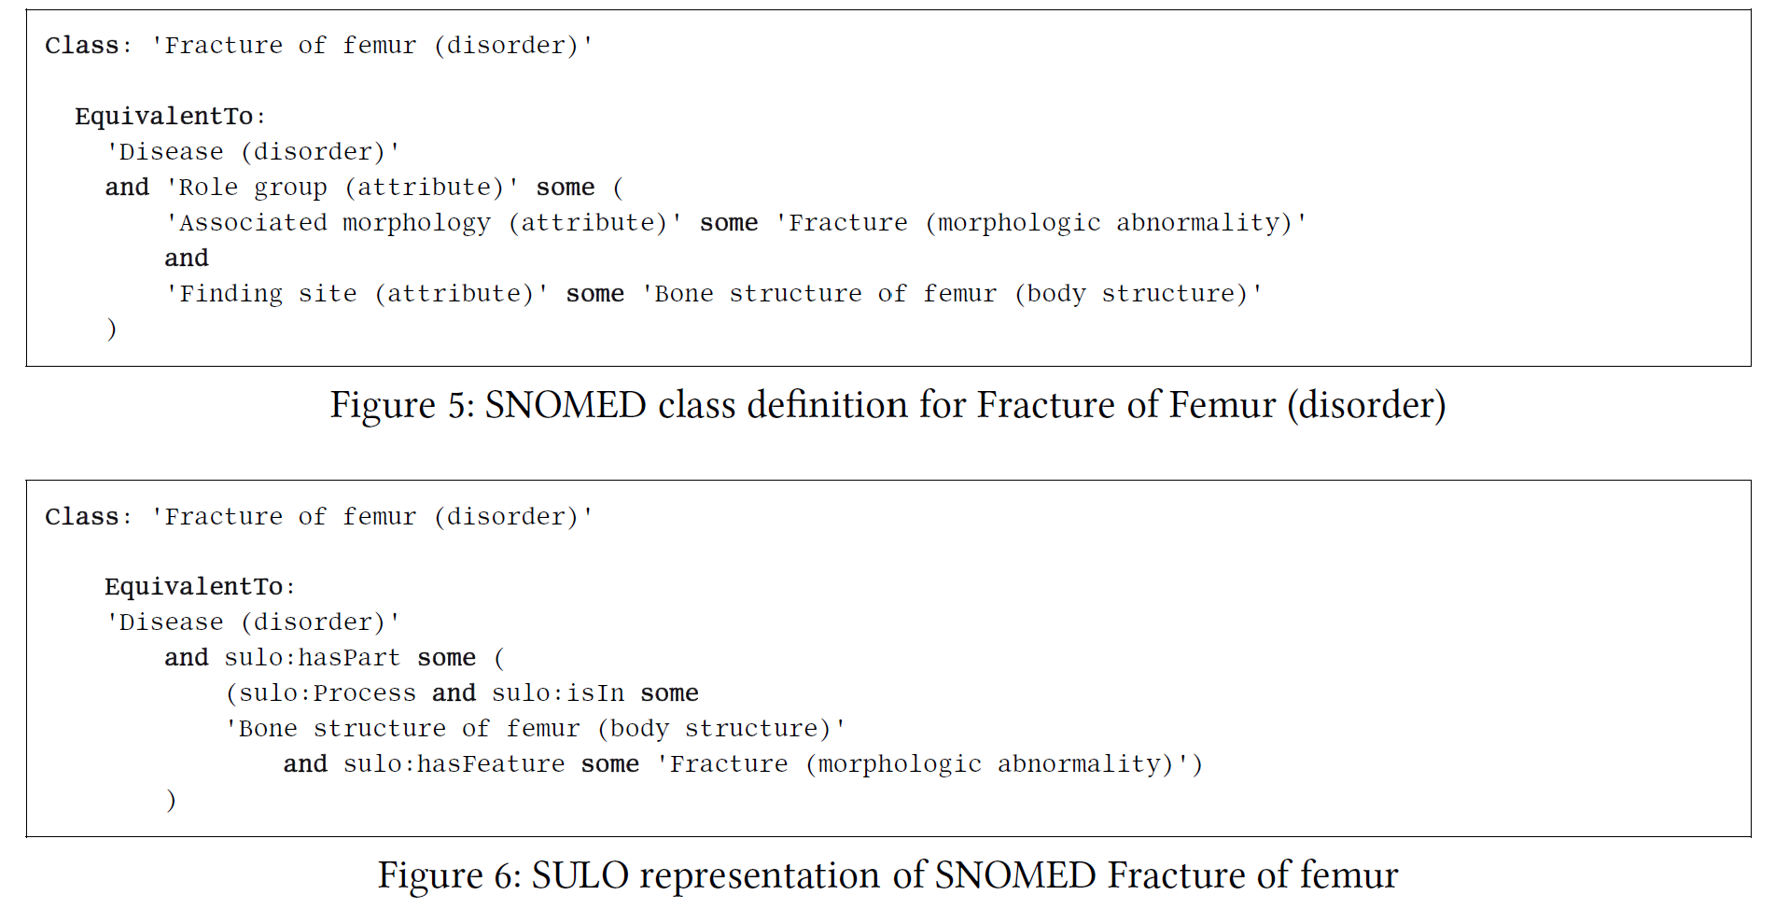
SNOMED axioms can be expressed with domain-independent SULO relations

Slide 19
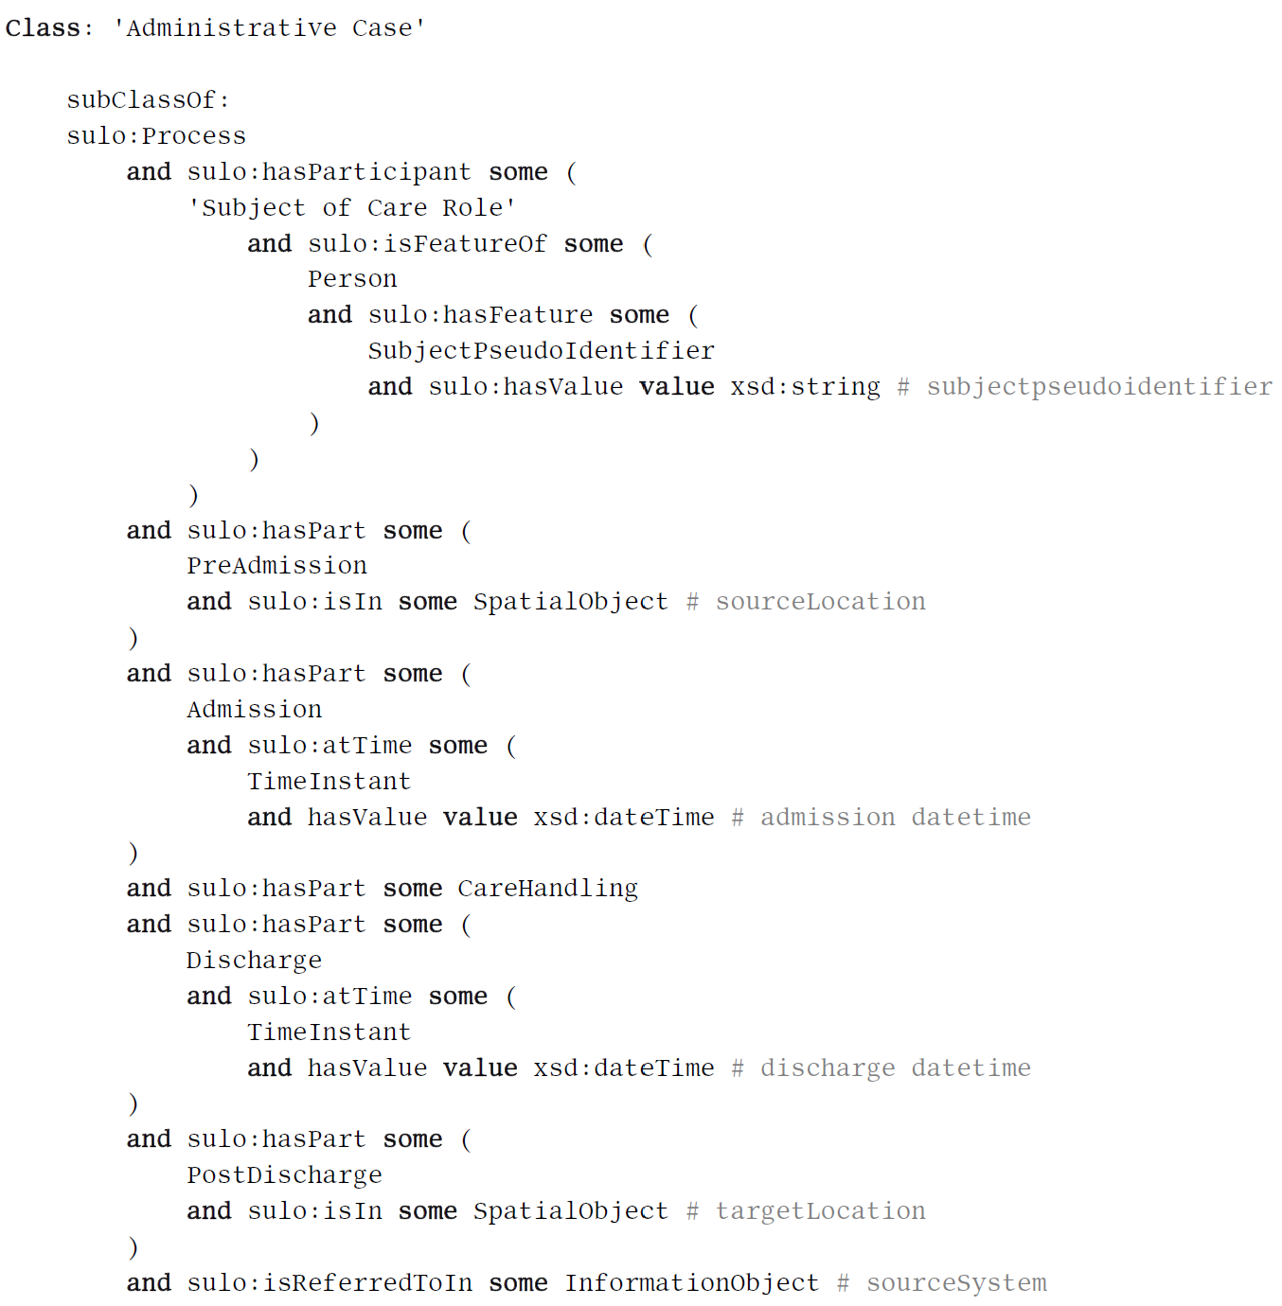
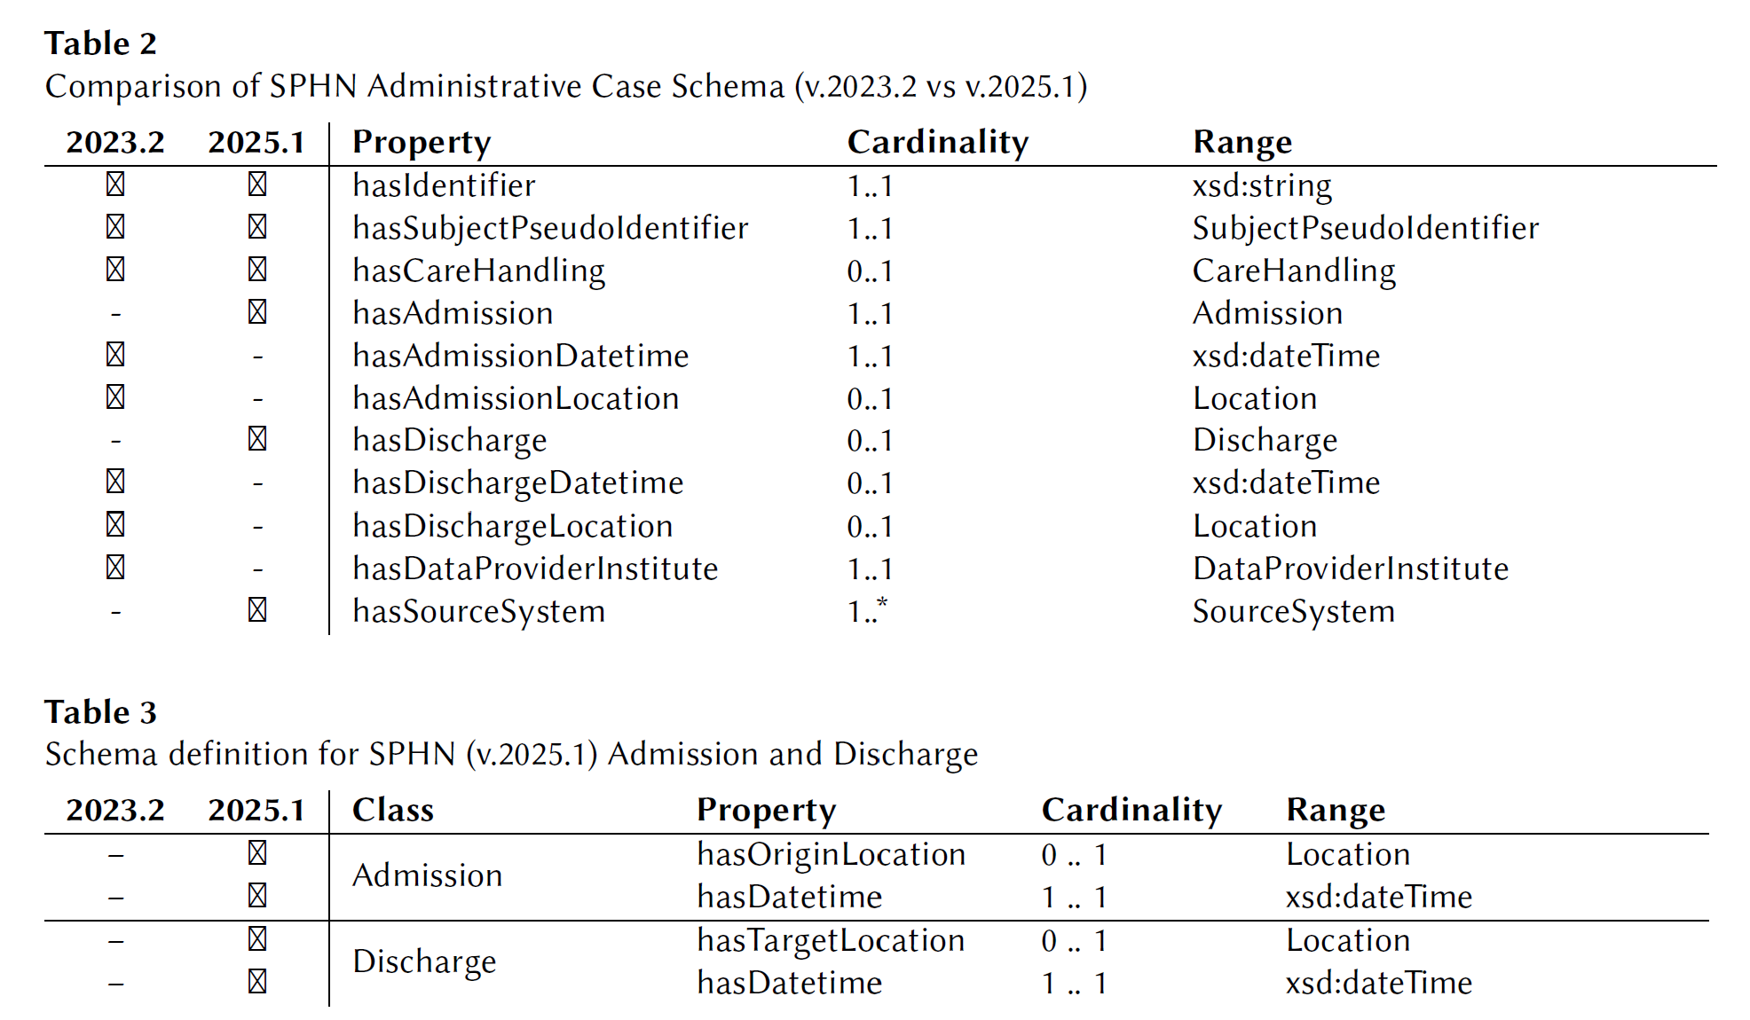
SULO-based SPHN schema contains a more robust semantic
SPHN uses hasX (object and data) properties, which are brittle when the schema is refactored. A SULO-based formalisation ensures predicate semantics are put into classes, whose instances are connected with domain-independent relations.

Slide 20
SULO to BFO
SULO more compact than BFO in both classes and properties
They share a top level binary division of Process (Occurrent) and Object (Continuant)
SULO's Object corresponds to GDC + SDC + IC
SULO includes InformationEntities including Quantity, Collection and Time, while BFO doesn't
SULO has data property, BFO doesn't.
BFO has spatial / temporal regions and boundaries, SULO doesn't.

Slide 22
have the design goals been met?
Minimalism: A small taxonomy of 17 classes and 19 relations: smallest of ULOs, and compatibility with 2 biomedical ontology/schema.
Compatibility: Conceptual and logical compatibility with core components of BFO with key simplifications (no regions, consolidation of SDC & GDCs into 1 class)
Accessibility: Simpler labeling, simpler taxonomy, and fits in a single diagram - user study being planned.
Composability: Building blocks to construct complex, machine-readable class expressions.
Interoperability: Interoperability through proposed to SULO axioms + SOLID and PRO design patterns to reduce arbitrary relations and constrain the data graph.
Data validation: automated reasoning and (planned) schema validation.

Slide 23
Summary
SULO takes a minimalistic approach to an ULO formulation that balances formal rigour with simplicity and practical usability.
This work supported by Horizon Europe Framework Program under Grant Agreement Nos. 101057062 (AIDAVA), 101112022 (iCare4CVD), 101095435 (REALM), 101057603 (RES-Q+), 101080875 (CMC), and the Spanish Research Agency Grant RYC2020-030190-I.

