Slide 1
Clinical Ontology Engineering with SULO
A Hands-On Tutorial — Mary's Clinical Odyssey
Medical Informatics Europe (MIE) 2026
Michel Dumontier · Remzi Celebi
Institute of Data Science, Maastricht University
From clinical timeline to querying an expressive ontology using SULO

Slide 2
Ontologies
Lie at the heart of semantic interoperability
Ontologies offer a formalization of a shared conceptualization of a domain. They provide machine interpretable descriptions of entities, their attributes, and their relations.
Upper Level Ontologies (ULOs), aka foundation ontologies, offer an overarching axiomatic framework for domain ontologies (DOs) as they constrain the conceptualization and formalization of a domain.
Many ULOs have been proposed: BFO, GFO, DOLCE, UFO, SUMO, and some such as SIO and BioTop contain and extend ULOs into domain specific classes and relations.

Slide 3
The Challenge
Clinical ontology engineering, today
⚠ ULOs remain difficult to understand and apply
▸ Nuanced philosophical considerations
▸Unfamiliar or technical labels
▸Requires familiarity with logic
▸Each has some distinct, missing, under-represented, or over-constrained elements
⚠ Modelling Deficiencies
▸ Inconsistent use of upper-level concepts and relations
▸ ad hoc class/property naming
▸ Classes rarely have rich descriptions amenable to automated reasoning
▸ Conflation between the role of ontologies and that of schemas
▸Domain ontologies are not interoperable by design
⚠ Unresolved Patterns
▸Is a condition a process or a state?
▸ How to refer to a process that hasn't happened yet? (prescriptions → administrations)
▸ How to link a measurement to the quality it measures?
▸How to deal with the gain and loss of parts, qualities, and quantities of a patient over time?
▸ When is parthood the wrong relation for anatomy?
▸ How to merge views from two EHR systems?

Slide 4
Goals of the Tutorial
🩺 Domain modelling with SULO
▸ Demonstrate that SULO's vocabulary is sufficient for clinical modelling
▸ Teach the SULO design patterns: PRO, SOLID
▸ Translate clinical reality into OWL axioms that the reasoner can use
▸ Apply automated classification to recover clinically meaningful statements
What Participants Take Home
▸ Workflow: idea → axiom → reasoning
▸ Fluent in SULO's top-level classes and properties
▸ Confident modeling with the PRO and SOLID design patterns
▸ Practical skills for programmatic ontology engineering
▸ Design patterns you can reuse in your own domain ontology
▸ Can query an ontology with SPARQL 1.1 property paths

Slide 5
What is SULO?
Simplified Upper Level Ontology — https://w3id.org/sulo/
Why SULO?
▸ A lightweight, carefully engineered top-level ontology
▸ Provides foundational categories shared across all domains
▸ Designed to be small enough to learn in one session
▸ Grounds domain ontologies in a shared formal framework
▸ Enables cross-domain interoperability and reuse
▸ Aligns with BFO, DOLCE, and other upper-level ontologies
Key SULO Classes
SpatialObject
A thing that exists in space (pizza, oven, box)
Quality
An intrinsic feature (spiciness level)
Quantity
A measured feature with numeric value (SHU)
Process
A temporally extended event (baking, delivery)
Role
A relational property played by an entity
InformationObject
An entity whose function is to encode meaning
TimeInstant
A point on the timeline (order received)
Duration
An elapsed time quantity (30-min delivery)

Slide 6
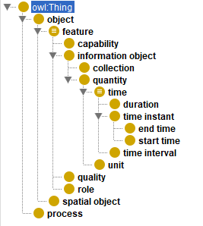
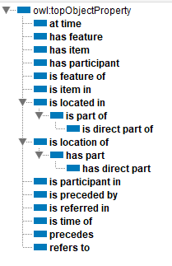

SULO – a minimal upper level ontology for everyday modeling
Simplified Upper Level Ontology — https://w3id.org/sulo/

Slide 7
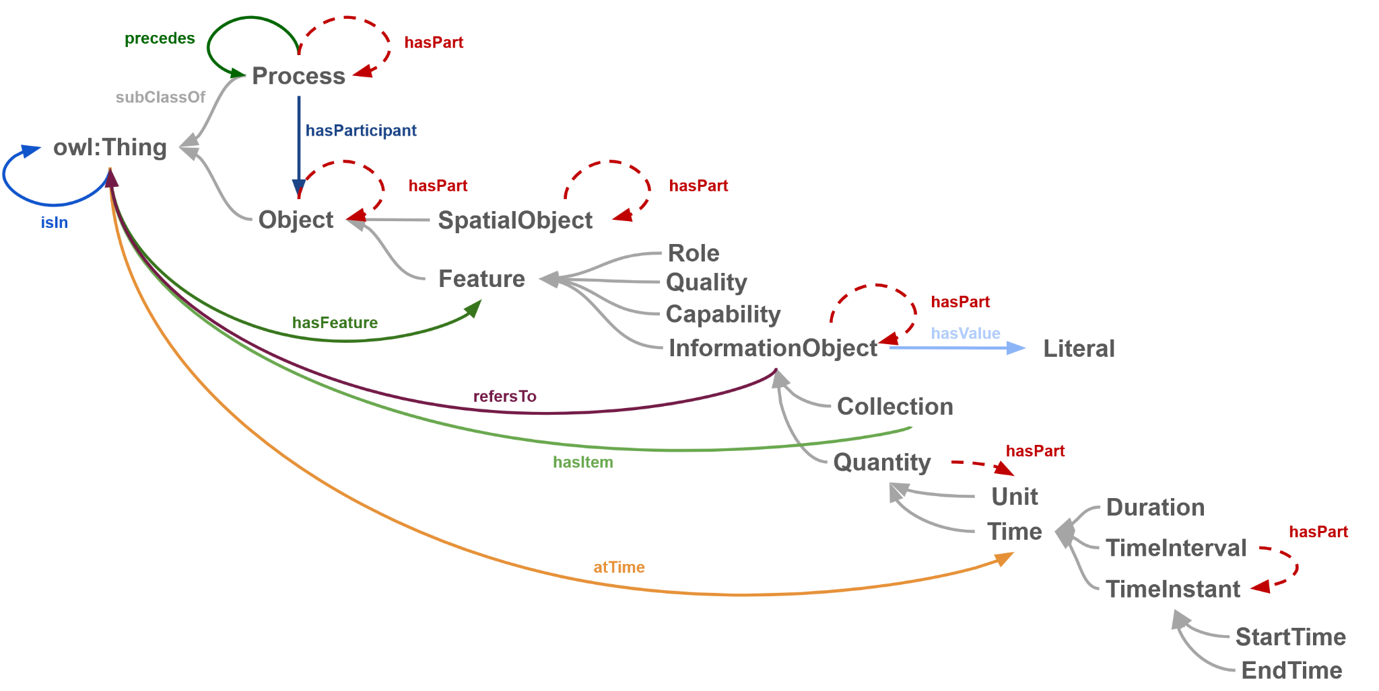
SULO’s postcard: Ontology simplified!
Simplified Upper Level Ontology — https://w3id.org/sulo/
Quality
Quantity
Process
Role
InformationObject
TimeInstant
Duration

Slide 8
Learning Objectives
What attendees will be able to do by the end of the half-day
▸ Classify clinical entities under SULO's top-level categories (Process, SpatialObject, Quality, Quantity, Role, InformationObject, Time, Unit, Collection)
▸ Apply the PRO pattern to model procedural participation without inventing new object properties
▸ Use the SOLID pattern to model numeric clinical measurements with units and thresholds
▸ Distinguish a disease (Process), the tumour (SpatialObject), and the diagnosis statement (InformationObject)
▸ Refer to not-yet-instantiated processes via the Collection / hasItem pattern
▸ Query the ontology with SPARQL — property paths, multi-hop joins, COUNT DISTINCT, sameAs

Slide 9
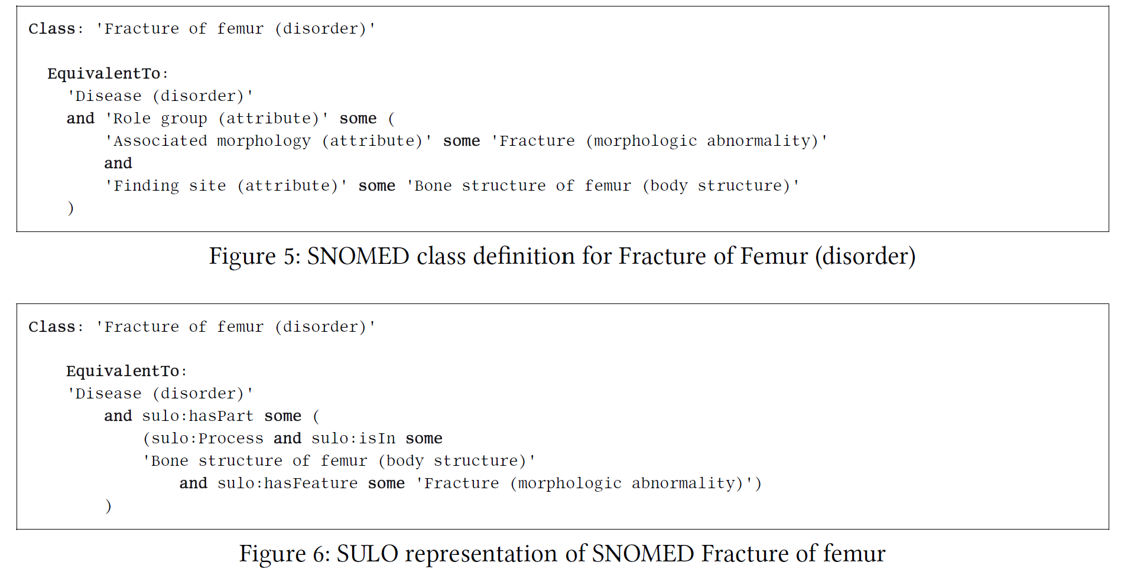
SNOMED axioms can be expressed with domain-independent SULO relations

Slide 10
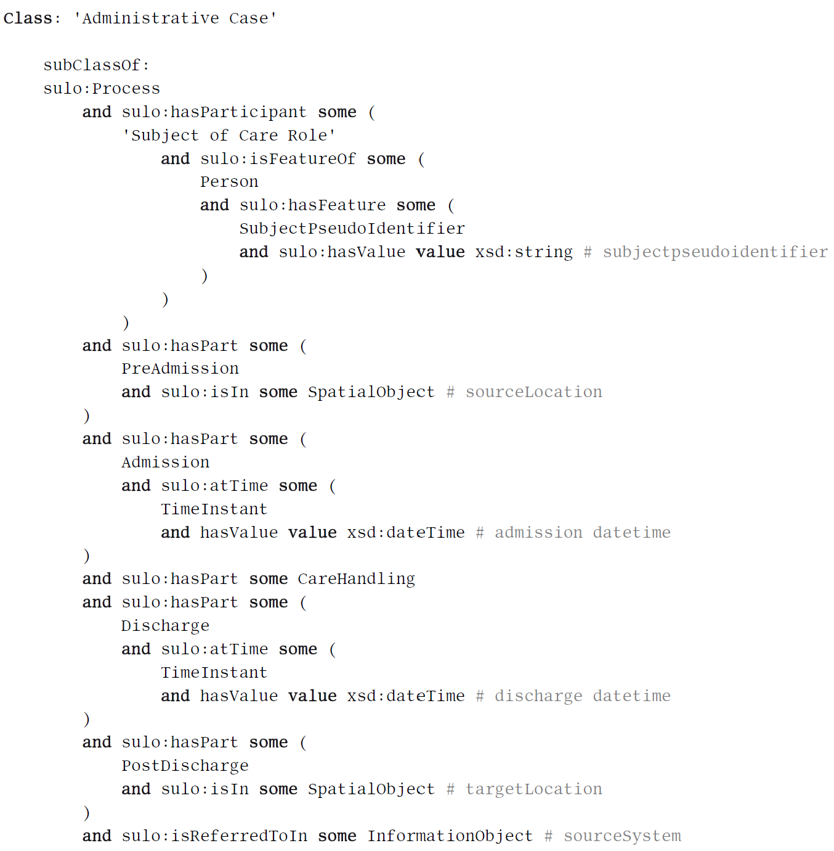
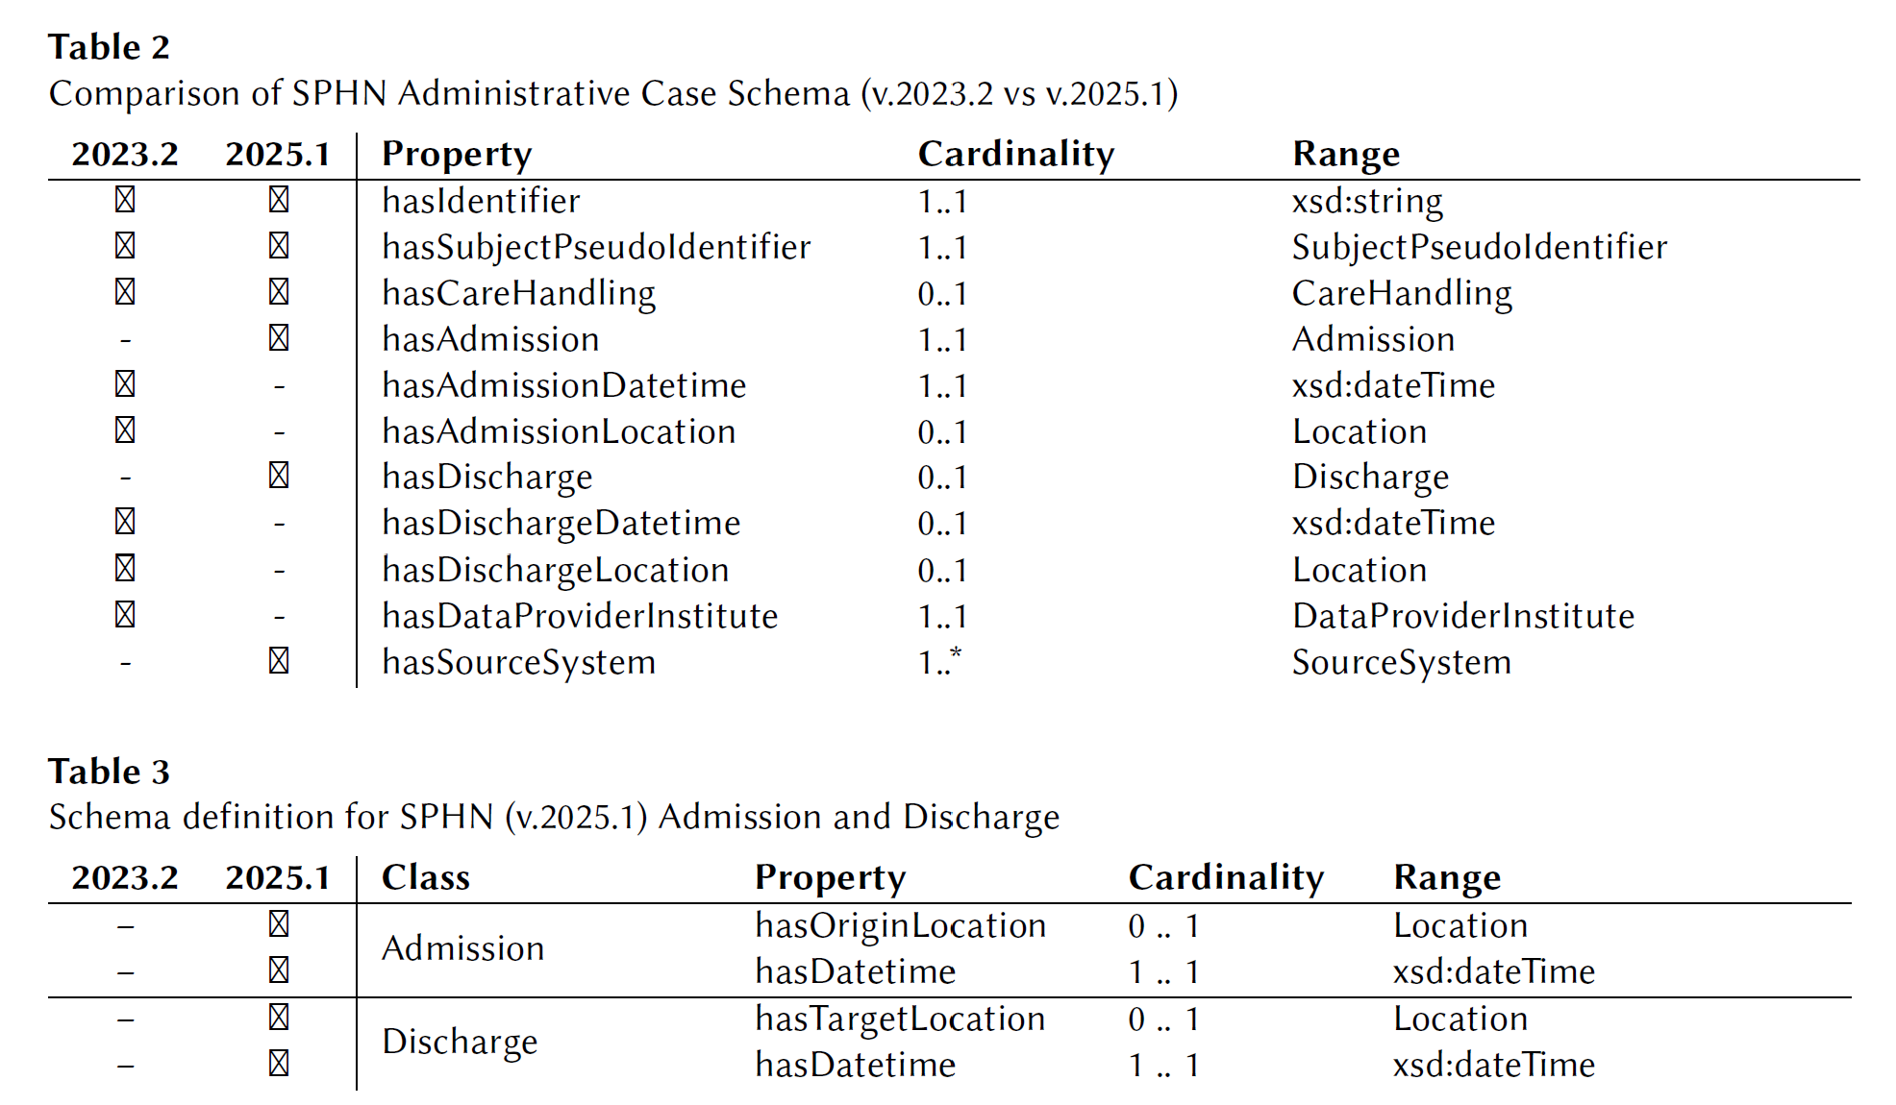
SULO-based SPHN schema comprises a more robust semantics
SPHN uses hasX (object and data) properties, which are brittle when the schema is refactored. A SULO-based formalisation ensures predicate semantics are put into classes, whose instances are connected with domain-independent relations.

Slide 11
The Running Case
Mary, 52 — breast cancer journey, Feb–Sep 2026
Feb 18
Feb 20
Feb 22
Feb 25
Mar 1
Mar 10
Jun 15
Jul 1
Sep 30
Routine visit + BP
Ultrasound
Preliminary diagnosis
Biopsy
Histopathology + confirmed dx
Chemotherapy starts
Chemo ends
Lumpectomy
Follow-up (remission)
One patient
▸ Nine clinical events on one timeline
▸ Two clinicians (radiologist Miller, gynecologist Smith)
▸ One anatomical site (left breast)
▸ One disease (invasive carcinoma)
▸ Four chemo administrations
One rich record
▸ Numeric features (BP measurements)
▸ Categorical features (tumour grade, receptor status)
▸ Information entities (diagnosis statements, prescription)
▸ Cross-system identity (FHIR Patientresource via owl:sameAs)
One pedagogic principle
▸ Each event lands a specific SULO category and OWL construct
▸ Each new construct produces a reasoner-derived classification
▸ No design pattern is rehearsed every scene teaches a new lesson
▸ Builds incrementally: NB1 → … → NB6

Slide 12
Methodology
How each notebook is built
The anchor pattern (per notebook)
① Clinical scene
Pick a dated event from Mary's odyssey
The SULO discipline
▸ Zero new object properties added
▸ Zero new data properties added
▸ Every relation is sulo:* or owl:*
▸ New domain content arrives as new classes
▸ Domain growth stays aligned with the upper-level ontology
② Identify the construct
What SULO category + OWL feature does this scene need?
③ Declare it
T-Box restrictions + A-Box assertions, using only SULO properties
④ Run the reasoner
HermiT consistency check + classification of defined classes
⑤ Verify with SPARQL
Query for the inferred answer — the lesson has landed

Slide 13
Tutorial Schedule
Seven notebooks · 3:00 pm – 6:00 pm · coffee break 4:30 – 5:00
·
Introduction to the tutorial & SULO
15:00 · 15 min
What we'll build · Mary's odyssey · SULO postcard tour
NB1
Processes, parts, time, ordering
15:15 · 25 min
Process, Time | SubClass, cardinality, SPARQL +/*
NB2
Roles & the PRO pattern
15:40 · 25 min
Role | Nested existentials, defined class
NB3
Spatial objects & their parts
16:05 · 25 min
SpatialObject | AllDisjoint, only, split definition
☕ Coffee break
16:30 · 30 min
NB4
Qualities, quantities, thresholds
17:00 · 20 min
Quality, Quantity, Unit | ConstrainedDatatype, union
NB5
Connections (containment, info, identity)
17:20 · 20 min
InformationObject, Collection | value restriction, AllDifferent, sameAs
NB6
Reasoning & SPARQL
17:40 · 20 min
(queries only) | property paths, UNION, COUNT DISTINCT

Slide 14
OWL Constructs Covered
~25 distinct constructs, each anchored to a clinical demo
Structural
▸ Class declaration
▸ SubClassOf
▸ Multiple typing
▸ owl:imports
▸ Named individuals
▸ AnnotationProperty declaration
▸ rdfs:label @en
▸ rdfs:comment
Class expressions
▸ Existential some
▸ Universal only
▸ Intersection ⊓
▸ Union ⊔
▸ Value hasFeature value …
▸ Cardinality exactly / max
▸ Nested existentials
▸ ConstrainedDatatype
Axioms
▸ EquivalentClasses (defined class)
▸ AllDisjoint (classes)
▸ AllDifferent (individuals)
▸ owl:sameAs (individuals)
▸ TransitiveProperty (inherited)
▸ FunctionalProperty (inherited)
SPARQL
▸ Property path +
▸ Property path *
▸ Parameter substitution
▸ COUNT(DISTINCT …)
▸ UNION (symmetric sameAs traversal)
▸ Multi-hop joins
▸ Type filtering
▸ ORDER BY

Slide 15
Speakers & Resources
Michel Dumontier
Remzi Celebi
Distinguished Professor of Data Science Maastricht University · Institute of Data Science Co-founder of the FAIR principles
· Co-creator of SULO
Assistant Professor Maastricht University · Institute of Data Science Biomedical knowledge graphs · semantic data integration · ML for health
· Co-creator of SULO
Resources
▸ Notebooks: github.com/MaastrichtU-IDS/sulo-tutorial — notebooks/mie2026/ ▸ SULO: w3id.org/sulo ▸ PRO: w3id.org/ontostart/pro/ ▸ OntoStart: github.com/micheldumontier/ontostart
Welcome — let's begin Mary's odyssey.

