Slide 1
Data Citation Examples from the Life Sciences

Slide 2
Examples of data citations in narrative

Slide 3
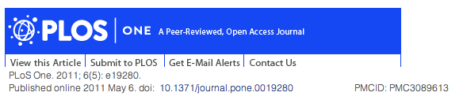
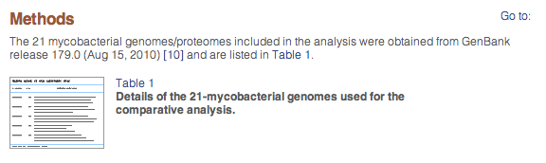
Large dataset:
http://europepmc.org/articles/PMC3089613

Slide 4

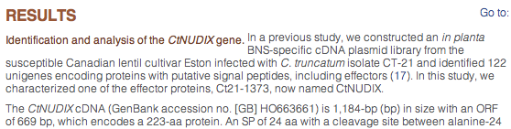
http://europepmc.org/articles/PMC3535838

Slide 5

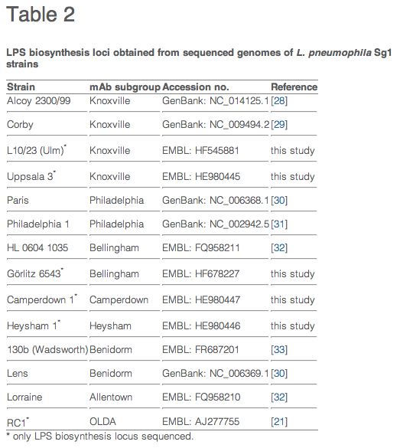
http://europepmc.org/articles/PMC3766260

Slide 6


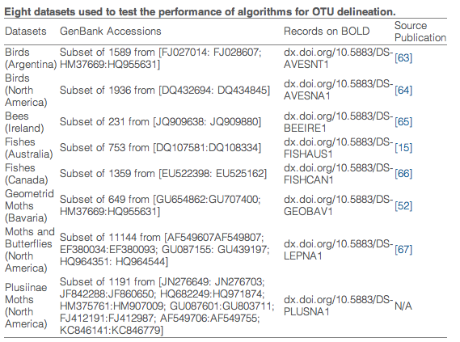
http://europepmc.org/articles/PMC3704603

Slide 7


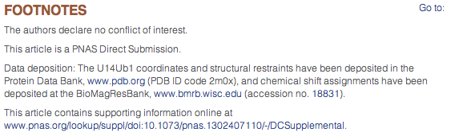
Fig. 2
http://europepmc.org/articles/PMC3710810

Slide 8
Examples of Data Citation: non-narrative displays

Slide 9

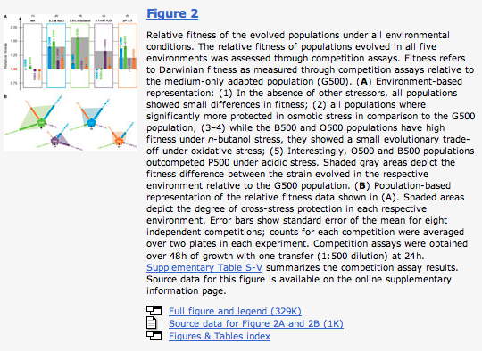

Slide 10

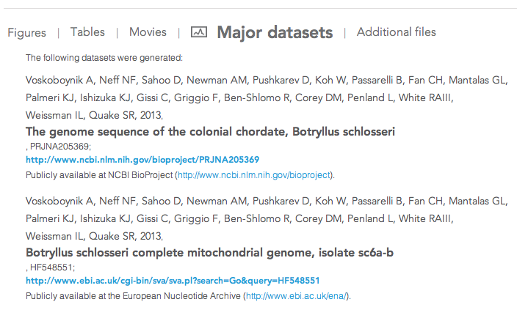
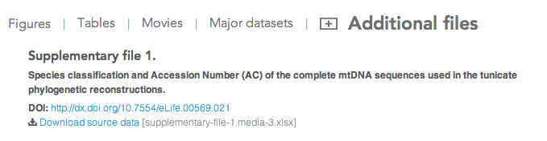

Slide 11

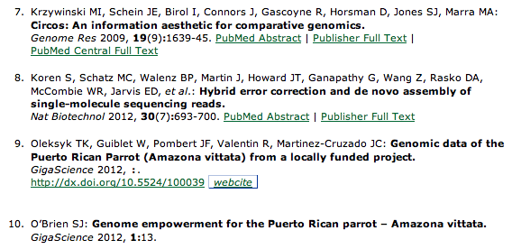

Slide 12

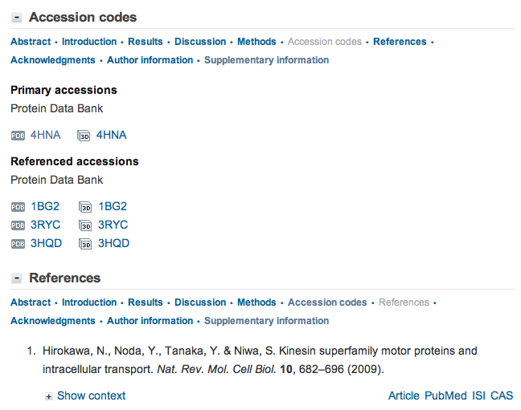

Slide 13
Examples of Implementations of Data Citations
in Reference Lists

Slide 14

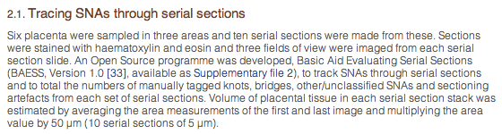

Occurrence in text:
Occurrence in reference list:
Tagged in reference list as:
<mixed-citation publication-type="other">
http://europepmc.org/articles/PMC3661987

Slide 15

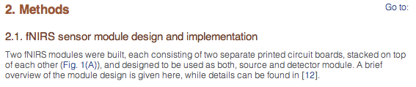
Occurrence in text:
Occurrence in reference list:
Tagged in reference list as:
<mixed-citation publication-type="thesis">
http://europepmc.org/articles/PMC3646594

Slide 16

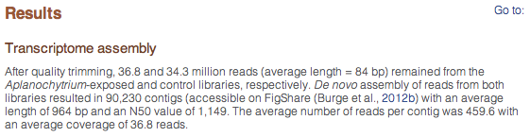
Occurrence in text:
Occurrence in reference list:
Tagged in reference list as:
<mixed-citation publication-type="webpage">
Also in this reference list: a non-DOI data citation
http://europepmc.org/articles/PMC3722494

Slide 17

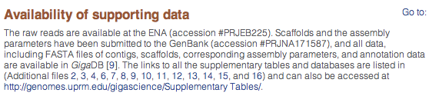
Occurrence in text:
Occurrence in reference list:
Tagged in reference list as:
<mixed-citation publication-type="journal">
http://europepmc.org/articles/PMC3626513

Slide 18
Context dependency: article or dataset?

Slide 19
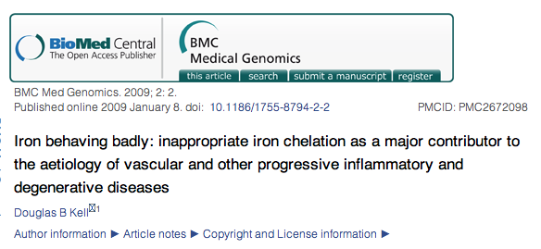
!! 2469 references !!
http://europepmc.org/articles/PMC2672098

