Slide 1

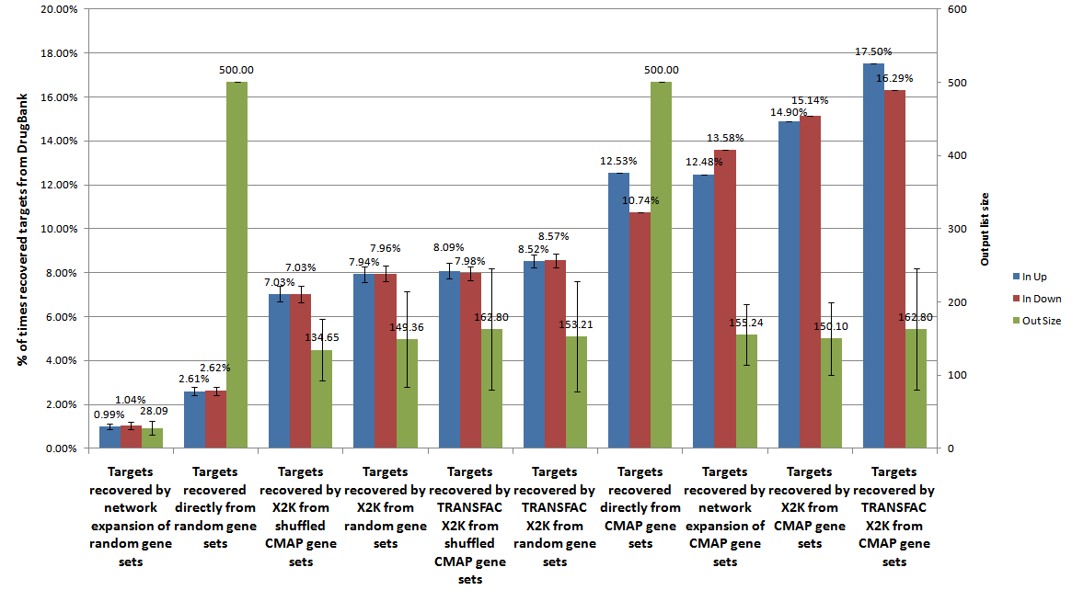
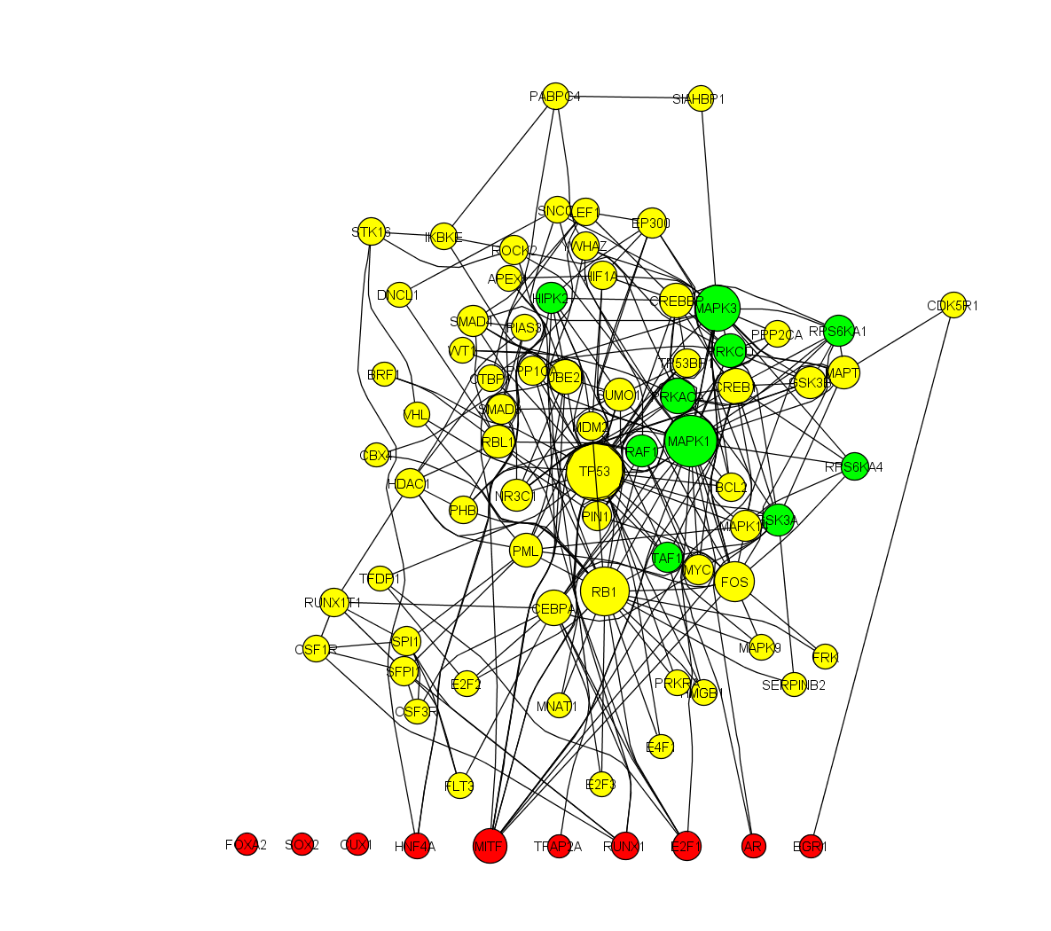
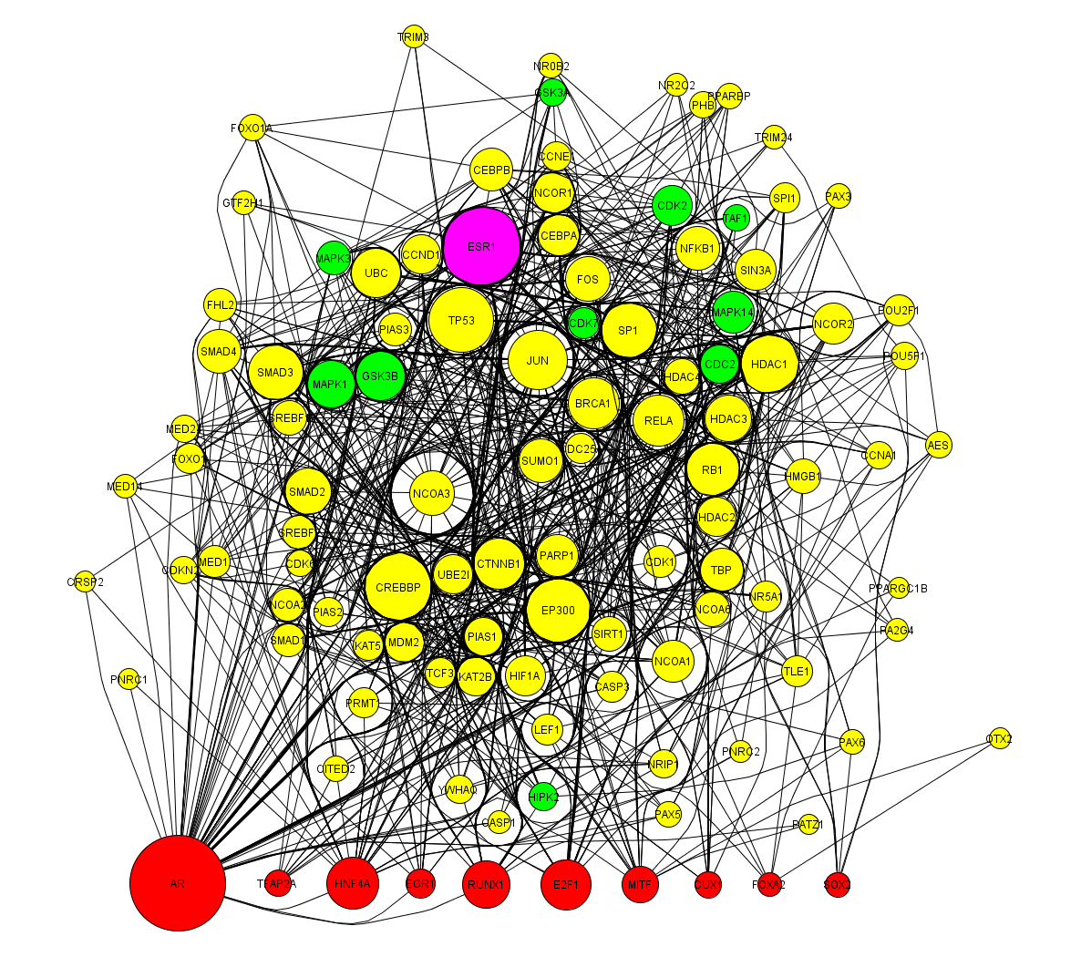
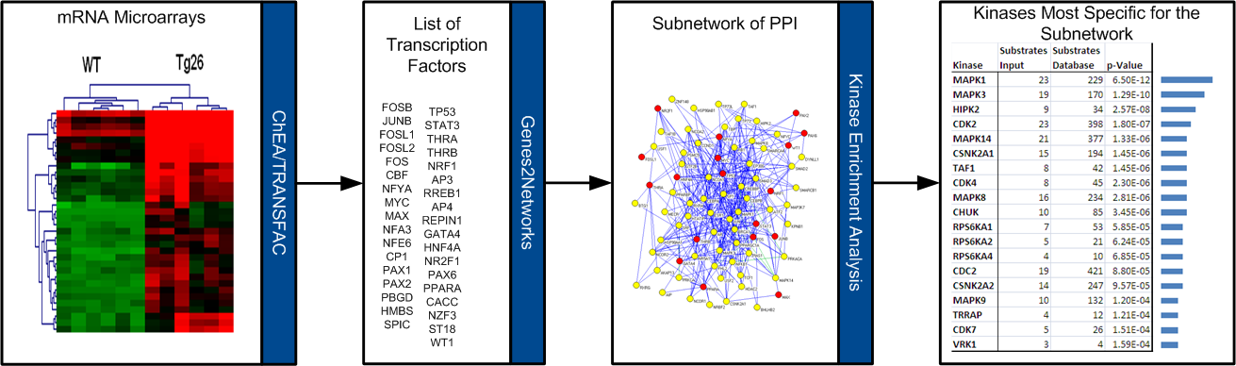

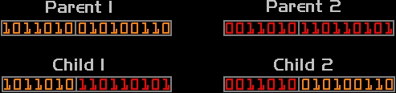
Expression2Kinases: mRNA Profiling Linked to Multiple Upstream Regulatory Layers Edward Y. Chen¹ and Avi Ma’ayan¹ ¹Department of Pharmacology and Systems Therapeutics, Systems Biology Center New York (SBCNY),
Mount Sinai School of Medicine, One Gustave L. Levy Place, New York, NY 10029 USA
Abstract
Validation
Genome-wide mRNA profiling provides a snapshot of the global state of cells under different conditions. However, mRNA levels do not provide direct understanding of upstream regulatory mechanisms. We hope to change this with a new approach called Expression2Kinases (X2K). X2K can be used to identify upstream regulators likely responsible for observed patterns in genome-wide gene expression. By integrating ChIP-seq/chip and position-weight-matrices (PWMs) data, protein-protein interactions, and kinase-substrate phosphorylation reactions, we can better identify regulatory mechanisms upstream of genome-wide differences in gene expression. The idea is to first infer the most likely transcription factors that regulate the differences in gene expression, then use protein-protein interactions to connect the identified transcription factors using additional proteins for building transcriptional regulatory subnetworks centered on these factors, and finally use kinase-substrate protein phosphorylation reactions, to identify and rank candidate protein-kinases that most likely regulate the formation of the identified transcriptional complexes.cThis pipeline has many options for selecting among different transcription-factor/target-gene databases, protein-protein interactions databases, as well as other options such as thresholds, ranking methods, and enrichment methods.
In order to find the best combination of options that best recover upstream regulators, we implemented a search heuristic based on genetic algorithms. Such an approach encodes the pipeline into a binary string that a computer simulation evolves to improve the prediction of the upstream regulators based on a fitness function. After running X2K through the genetic algorithm training process, we obtain settings for high performing pipelines. We demonstrate the approach by showing how we can improve on our ability to recover drug targets from drug induced gene expression signatures.
To prove that X2K works, we tested whether the program could recover the targets of drugs given drug-induced gene expression changes from CMAP. CMAP contains over 6000 microarray experiments where human cells are treated with ~1300 drugs [3]. The resulting recovered upstream subnetworks are then compared to the known drug targets as defined by DrugBank [4].
Fig 4: average and maximum fitness scores of two runs. Parameters 1 had a population size of 88, 50 generations, 0.6 crossover rate, and 0.001 mutation rate. Parameters 2 had a population size of 176, 50 generations, 0.9 crossover, and a mutation rate where each individual is expected to mutate once per generation.
Fig 2: X2K recovers more drug targets from gene sets from CMAP compared to other methods or better than what is expected randomly.
Fig 5: frequency distributions of each feature option from Table 1. Each colored bar represents the ratio of the frequency of an option for a feature selected for a run.
Genetic Algorithms
Genetic algorithms can be used
to find optimal solutions for
problems with large uneven search space.
Creation: create a population of random strings describing individuals with diverse attributes.
Selection: evaluate each of the individuals based on a criteria to determine their fitness and select individuals for the next generation with a probability proportional to their fitness.
Crossover: take two parent strings and pick a random spot for them to cross over and exchange “genetic material.”
Mutation: introduce additional variation into the population to prevent from being stuck at a suboptimal solution by flipping random “alleles.”
Termination: the fitness of solutions
will eventually converge to an
optimal solution at which further
evolution would no longer confer
improvement.
Before
Learning
Genetic Algorithms Flow
Controller
What is X2K?
Creation
Run X2K
Selection + Check Termination?
Controller-specific
Scorer
After
Learning
Fig 1: X2K pipeline [1] applied to gene expression data from Tg26 mice to recover HIPK2’s role in HIVAN [2].
Starting with a set of differentially expressed genes derived from the expression profile of microarrays or RNA-seq, the first module determines the most likely transcription factors (TF) upstream of those genes given a database of TF/target-gene interactions.
The next module takes the list of the top transcription factors and finds a sub-network comprising of the transcription factors and their intermediate proteins.
The last module takes the network of proteins and determines the most likely protein kinases upstream of them given a database of kinase-substrate interactions.
In addition to the pipeline, the application allows you to discover from a gene expression profile target drugs based on the drug expression profiles from CMAP.
X2K also has other gene-set libraries such Gene Ontology, OMIM, BioCarta, WikiPathways, KEGG, and MGI Mammalian Phenotype to perform gene-list enrichment analyses.
Mutation
Crossover
Statistics
Fig 3: flowchart for how genetic algorithms works
Bit | Description | Exceptions | Pipeline section
0 | Use Chip-X TF-gene database | Mutually exclusive | TF
1 | Use PWM-JT TF-gene database
2 | Use PWM-GB TF-gene database
3 | Use mouse portion of TF background | Mutually exclusive
4 | Use human portion of background
5 | Use both portion of TF background
6 | Use Fisher Exact Test to find TFs | Otherwise, use GSEA
7 | Sort TF results by p-value | Mutually exclusive
8 | Sort TF results by rank
9 | Sort TF results by combined score
10 | Select top 5 TFs | Mutually exclusive
11 | Select top 10 TFs
12 | Select top 20 TFs
13 | Include BIND in PPI network | Must select at least 7 | Intermediate Protein
14 | Include BioCarta in PPI network
15 | Include BioGRID in PPI network
16 | Include DIP in PPI network
17 | Include figeys in PPI network
18 | Include HPRD in PPI network
19 | Include InnateDB in PPI network
20 | Include IntAct in PPI network
21 | Include KEGG in PPI network
22 | Include MINT in PPI network
23 | Include MIPS in PPI network
24 | Include murphy in PPI network
25 | Include pdzbase in PPI network
26 | Include ppid in PPI network
27 | Include SNAVI in PPI network
28 | Include Stezl in PPI network
29 | Include vidal in PPI network
30 | Remove hub nodes with more than 50(?) links
31 | Use DFS algorithm to find intermediate proteins | Mutually exclusive
32 | Use MFPT algorithm to find intermediate proteins
33 | Use Steiner Tree algorithm to find intermediate proteins
34 | Resulting network should have at least 50 proteins | Mutually exclusive
35 | Resulting network should have at least 100 proteins
36 | Resulting network should have at least 200 proteins
37 | Include only top intermediates at ? Cutoff
38 | Sort kinase by p-value | Mutually exclusive | Kinase
39 | Sort kinase by rank
40 | Sort kinase by combined score
41 | Select top 5 kinases | Mutually exclusive
42 | Select top 10 kinases
43 | Select top 20 kinases
Fig 6: Examples of subnetworks before and after applying the genetic algorithms pipe-line. The program is capable of recovering the target for estradiol (ESR1) based on data from gene expression changes induced by this drug only after the training procedure.
Future Directions
Find ideal parameters for X2K to run as default.
Cancer Cell Line Encyclopedia (CCLE) has basal microarray expression profiles for 504 cancer cell lines as well as the pharmacologic profiles for 24 anticancer drugs applied to these cells. Use the expression profiles for the different cancer cell lines to see if X2K can recover the targets of the drugs that are most effective in stopping proliferation of these cells.
References
[1] Edward Y Chen, Huilei Xu, Simon Gordonov, Maribel P Lim, Matthew H Perkins, Avi Ma'ayan. (2011). Expression2Kinases: mRNA Profiling Linked to Multiple Upstream Regulatory Layers. Bioinformatics, 28(1), 105-111.
[2] Yuanmeng Jin, Krishna Ratnam, Peter Y Chuang, Ying Fan, Yifei Zhong, Yan Dai, Amin R Mazloom, Edward Y Chen, Vivette D'Agati, Huabao Xiong, Michael J Ross, Nan Chen, Avi Ma'ayan, John Cijiang He. (2012). A systems approach identifies HIPK2 as a key regulator of kidney fibrosis. Nature Medicine, 18(4), 580-588.
[3] Lamb J, Crawford ED, Peck D, Modell JW, Blat IC, Wrobel MJ, Lerner J, Brunet J-P, Subramanian A, Ross KN et al: The Connectivity Map: Using Gene-Expression Signatures to Connect Small Molecules, Genes, and Disease. Science 2006, 313(5795):1929-1935.
[4] Wishart DS, Knox C, Guo AC, Cheng D, Shrivastava S, Tzur D, Gautam B, Hassanali M: DrugBank: a knowledgebase for drugs, drug actions and drug targets. Nucleic Acids Research 2008, 36(suppl 1):D901-D906.
This work was supported by NIH grants R01DK088541-01A1, RC2 OD006536-01, P50GM071558-01A27398 (SBCNY), KL2RR029885-0109.
Table 1: Parameters of X2K to optimize.
Mutations
Cross-over

