Slide 1
ADO.NET
Prepared By Muhammad Akhlas Ahmed

Slide 2
What is Ado.net
ADO stands for Microsoft ActiveX Data Objects. ADO.NET is one of Microsoft’s Data Access Technologies, which we can use to communicate with different data sources.
The Data Sources can be SQL Server, Oracle, MySQL, XML, etc. ADO.NET consists of a set of predefined classes that can be used to connect, retrieve, insert, update, and delete data (i.e., performing CRUD operation) from data sources. ADO.NET mainly uses System.Data.dll and System.Xml.dll.

Slide 3
What Types of Applications Use ADO.NET?
ASP.NET Web Form Applications
Windows Applications
ASP.NET MVC Application
Console Applications
ASP.NET Web API Applications
ASP.NET Core Applications

Slide 4
Components of ADO.NET
Connection, Command, DataReader, DataAdapter, DataSet, and DataView

Slide 5
Connection: The Connection component establishes a connection to a data source, such as a database. It manages the underlying connection to the database server and provides methods to open and close the connection.

Slide 6
Command: The Command component represents a command that is executed against a data source. It encapsulates SQL statements, stored procedure calls, and other database commands. The two main types of command objects are SQLCommand, which is used for executing SQL queries and stored procedures against SQL Server databases, and OleDbCommand, which is Used for executing commands against OLE DB data sources, which include various database types.

Slide 7
DataReader: The DataReader component efficiently reads data from a data source. It provides a forward-only, read-only stream of data that is particularly useful for retrieving large datasets. Reading data with a DataReader is fast and memory-efficient.
DataAdapter: The DataAdapter bridges the application’s DataSet (in-memory cache of data) and the data source. It facilitates the retrieval of data from the data source into the DataSet and also allows changes to be updated in the DataSet back to the data source. Specific DataAdapter classes exist for different data sources, such as SqlDataAdapter and OleDbDataAdapter.
DataSet: The DataSet is an in-memory data cache that can hold multiple tables, relationships, and constraints. It allows disconnected data manipulation, meaning that data is retrieved from the data source, disconnected from the connection, and then manipulated without direct interaction with the data source. The Data Set can be considered an in-memory representation of the database.

Slide 8
DataTable: A data table is a component within a Data Set that represents a table of data. It consists of rows and columns and allows you to store and manipulate tabular data. DataTables can have relationships and constraints to maintain data integrity.
DataView: The DataView is used to filter, sort, and navigate through data within a DataTable. It provides a dynamic view of the data, allowing you to customize how it is presented to the user.
Transaction: The Transaction component provides support for managing transactions in ADO.NET. Transactions group multiple data access operations into a single unit of work that can be either committed (made permanent) or rolled back (undone) as a whole.
Connection String: The connection string is a configuration string that provides the necessary information to connect to a data source. It includes details such as the database server’s location, credentials, and other settings.

Slide 9
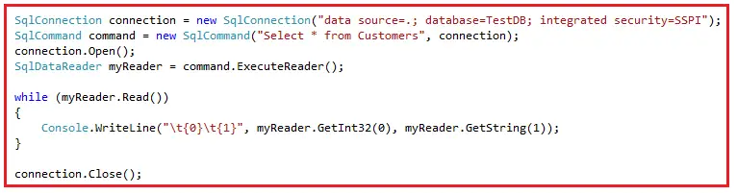

Slide 10
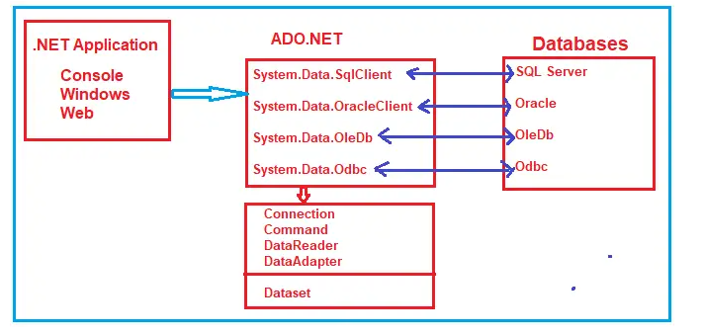

Slide 11
When to use ADO.NET?
Performance Optimization: If your application demands high performance and you need more control over data access operations, ADO.NET can provide more control over connection management, query execution, and data retrieval. This is useful when dealing with large datasets or complex queries.
Direct Interaction with the Database: In cases where you need to perform database-specific operations that might not be supported by ORMs, like executing certain stored procedures or utilizing database-specific features, ADO.NET provides direct control over those interactions.
Data Source Variety: ADO.NET’s flexibility to work with various data sources beyond relational databases, such as XML files, can be beneficial when dealing with heterogeneous data storage scenarios.
Ad Hoc Queries and Reports: If your application needs to generate dynamic or complex queries for ad hoc reporting or analysis, ADO.NET’s ability to dynamically construct and execute queries can be useful.
Low-Level Data Manipulation: ADO.NET’s DataSet and DataTable structures allow you to work with disconnected data and perform various operations, such as sorting, filtering, and data transformation.

Slide 12
Connected vs Disconnected Architecture in ADO.NET
In the case of Connection-Oriented Data Access Architecture, an open and active connection is always required between the .NET Application and the database.
For Connection Oriented Architecture, we generally use the object of the ADO.NET DataReader class.

Slide 13
In the case of Disconnection Oriented Data Access Architecture, an open and active connection is not required between the .NET Application and the database. In this architecture, connectivity is required only to read the data from the database and update the data within the database.
An example is DataAdapter and DataSet or DataTable classes

Slide 14
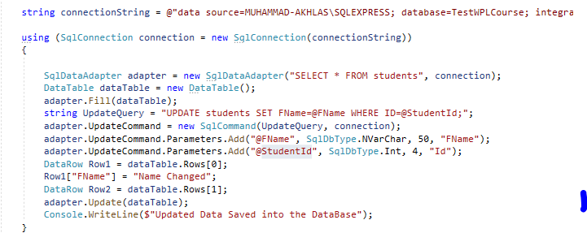

Slide 15
Entity Framework
Entity Framework (EF) Core is an ORM (Object-Relational Mapper) Framework for data access in .NET Core. It was released along with .NET Core and is an Extensible, Lightweight, Open Source, and Cross-Platform Version of Entity Framework data access technology. It works on multiple operating systems like Windows, Mac, and Linux.

Slide 17
What is ORM?
The term ORM stands for Object-Relational Mapper, and it automatically creates classes based on database tables and vice versa is also true

Slide 18
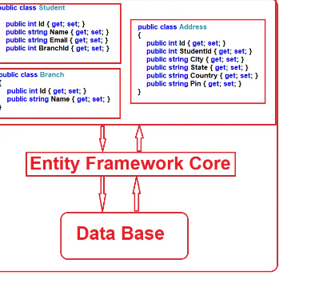

Slide 19
Why Entity Framework Core in .NET Applications?
Entity Framework Core is an ORM Tool that increases the developer’s productivity by reducing the redundant task of doing CRUD operations against a database in a .NET Core Application.
Entity Framework Core (EF Core) can generate the necessary database commands for doing the database CRUD Operation, i.e., it can generate SELECT, INSERT, UPDATE, and DELETE commands for us.
Entity Framework Core will generate and execute the SQL Command in the database and then store the results in the instances of your domain objects so you can do different types of operations on the data.

Slide 20
EF Core Development Approaches:
Code-First Approach
Database-First Approach

Slide 21
EF Core Code First Approach:
In the EF Core Code First Approach, first, we need to create our application domain classes, such as Student, Branch, Address, etc., and a special class (called DBContext Class) that derives from the Entity Framework DbContext class. Then, based on the application domain classes and DBContext class, the EF Core creates the database and related tables. For a better understanding, please have a look at the following diagram.

Slide 22
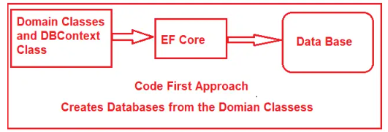

Slide 23
EF Core Database First Approach:
If you have an existing database and database tables are already there, you must use the EF Core Database First Approach. In the database-first approach, the EF Core creates the DB Context and Domain Classes based on the existing database schema using EF Core Command.

Slide 24
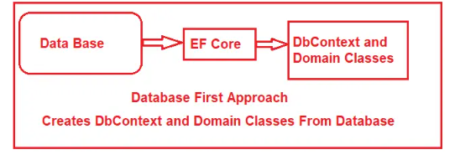

Slide 25
Different Entity Framework Core Database providers are available for the different databases. Some of them are as follows:
Azure SQL and SQL Server 2012 onwards: Microsoft.EntityFrameworkCore.SqlServer SQLite 3.7 onwards: Microsoft.EntityFrameworkCore.Sqlite EF Core in-memory database: Microsoft.EntityFrameworkCore.InMemory PostgreSQL: Npgsql.EntityFrameworkCore.PostgreSQL MySQL: MySql.EntityFrameworkCore Oracle DB 11.2 onwards: Oracle.EntityFrameworkCore

Slide 26
Differences Between EF Core and EF6:
Entity Framework (EF) has been a popular ORM (Object-Relational Mapper) in the .NET ecosystem. It has gone through two major iterations: EF6 and EF Core.
EF6: EF6 is a Windows-only framework within .NET, not compatible with other platforms.
EF Core: EF Core is part of the .NET Core Ecosystem, which means it is cross-platform and can be used in applications that run on Windows, Linux, and macOS.

Slide 27

DEPENDENCIES

Slide 28
Code First Commands FOR NG-CONSOLE
Add-migration “ANY NAME”
Update-database - verbose

Slide 29
Database First
Scaffold-Dbcontext “Server=MUHAMMAD-AKHLAS\SQLEXPRESS; Database=EFCoreDB; Trusted_Connection=True; TrustServerCertificate=True;” Microsoft.EntityFrameworkCore.SqlServer -OutputDir Models

Slide 30
Dependency Injection
Constuctor

Slide 31
Helpful Sites
https://israrali.com/

