Slide 1
Consuming .NET Core APIs in Blazor

Slide 2
Why consume APIs in Blazor?
Consuming APIs is essential for integrating external data and services into your Blazor app.

Slide 3
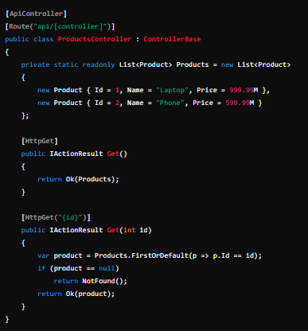

Slide 4

Using HttpClient in Blazor
HttpClient is used for making HTTP requests in Blazor.
Program.cs

Slide 5
Making API Requests
var response = await _httpClient.GetAsync("api/products");
var products = await response.Content.ReadFromJsonAsync<List<Product>>();

Slide 6
POST Request Example
var newProduct = new Product { Name = "Tablet", Price = 399.99M };
var response = await _httpClient.PostAsJsonAsync("api/products", newProduct);

Slide 7
Error Handling and Response Processing
if (!response.IsSuccessStatusCode) { // Handle error response var errorMessage = await response.Content.ReadAsStringAsync(); // Display or log the error }

Slide 8
var products = await response.Content.ReadFromJsonAsync<List<Product>>();

Slide 9
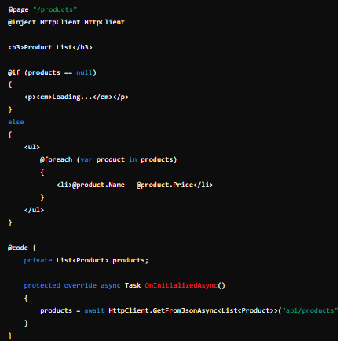
Example: Consuming a .NET Core API

