Slide 1
SPACE WEATHER BIG DATA ANALYTICS
Multi-Modal Big Data Pipeline for
Operational Solar Flare Forecasting
Integrating SDO/HMI Photospheric Magnetograms (SWAN-SF) with NOAA GOES Real-Time Coronal X-Ray Flux
COURSE & PROJECT CONTEXT
Course: CSE412: Big Data Analytics
Focus: Multi-Modal Data Fusion & Distributed ML
Scale: 837,426 Unified Satellite Observations
Target: 24h Early Warning for Major Solar Flares (>= M-Class)
ENGINEERING TEAM & STACK
Team Members:
Mohammed Maaz Ali · Vidya · Roshan
Core Technology Stack:
Apache Spark 3.5 · Hadoop HDFS · Apache Hive 4.0 · PySpark MLlib
Notes:
Welcome everyone. Today we are presenting our CSE412 Big Data Analytics capstone project: A Multi-Modal Big Data Pipeline for Operational Solar Flare Forecasting. Our team includes Mohammed Maaz Ali, Vidya, and Roshan.

Slide 2
OPERATIONAL PROBLEM & MOTIVATION
Why Predicting Major Solar Flares 24h Ahead is Crucial & Hard
The Space Weather Hazard
Scientific Bottleneck: Stored vs Triggered
Explosive Radiation Blast: Major flares (>= M-class) eject severe X-ray and ionizing radiation reaching Earth within 8 minutes.
Global Infrastructure Risk: Causes HF radio blackouts, degrades GPS navigation, and induces currents (GICs) that can damage electrical power grids.
24-Hour Warning Target: Reliable advance warning allows grid operators to balance transformer loads and satellite teams to safe instruments.
The Unimodal Limitation: Prior state-of-the-art models rely exclusively on SDO/HMI magnetograms (SWAN-SF) capturing active-region magnetic geometry.
The Stored Rubber Band Analogy: Magnetic complexity represents stored energy capacity, NOT the eruption trigger. A tight rubber band can sit quietly for days without snapping!
False Alarm Dilemma: Relying only on magnetic stress leads to unacceptable false alarm rates (>70%), causing operators to ignore critical alerts.
OUR MULTI-MODAL BREAKTHROUGH: We fuse the magnetic energy reservoir (SDO/HMI) with continuous real-time coronal thermal dynamics from NOAA GOES-15 satellites (1-minute cadence). GOES detects rapid pre-heating of plasma minutes-to-hours before eruption, providing the critical missing trigger signal across 837,426 observations.
Notes:
Solar flares threaten critical satellites, aviation, and power grids within 8 minutes. Traditional prediction models rely solely on magnetograms, which indicate stored magnetic energy but cannot tell when that energy will erupt. Our multi-modal solution integrates NOAA GOES real-time coronal heating.

Slide 3
DATASETS & PHYSICAL MANIFOLDS
Complementary Physics: Energy Reservoir vs. Coronal Trigger
SDO/HMI (SWAN-SF): Energy Reservoir
NOAA GOES-15: Coronal Thermal Trigger
Instrument Source: NASA Solar Dynamics Observatory (SDO) Helioseismic and Magnetic Imager (HMI).
44 Physical Parameters: Calculated from active region vector magnetograms (total unsigned flux USFLUX, twist TOTUSJH, shear angle, active area).
Benchmark Scale: 837,426 multivariate records across 5 benchmark partitions with 12-minute observation cadence.
Physical Question: "Is there sufficient stored magnetic free energy to generate a dangerous explosion?"
Instrument Source: NOAA Geostationary Operational Environmental Satellite 15 soft X-ray flux sensor (0.1–0.8 nm wavelength).
1-Minute Cadence Stream: Continuous high-cadence time-series tracking full-disk solar corona irradiance dynamics.
5 Engineered Features: 1-hour flux rate of change (derivative), 12-hour baseline background mean, and 24-hour peak historical flux.
Point-in-Time Alignment: PySpark AS-OF join ensuring absolute physical causality with zero lookahead leakage.
Physical Question: "Is localized plasma heating rapidly right now, indicating an imminent flare trigger?"
Notes:
SWAN-SF provides 44 magnetic measurements from SDO/HMI representing the energy reservoir. NOAA GOES gives 1-minute cadence soft X-ray data, which we engineered into 5 coronal features representing thermal acceleration.

Slide 4
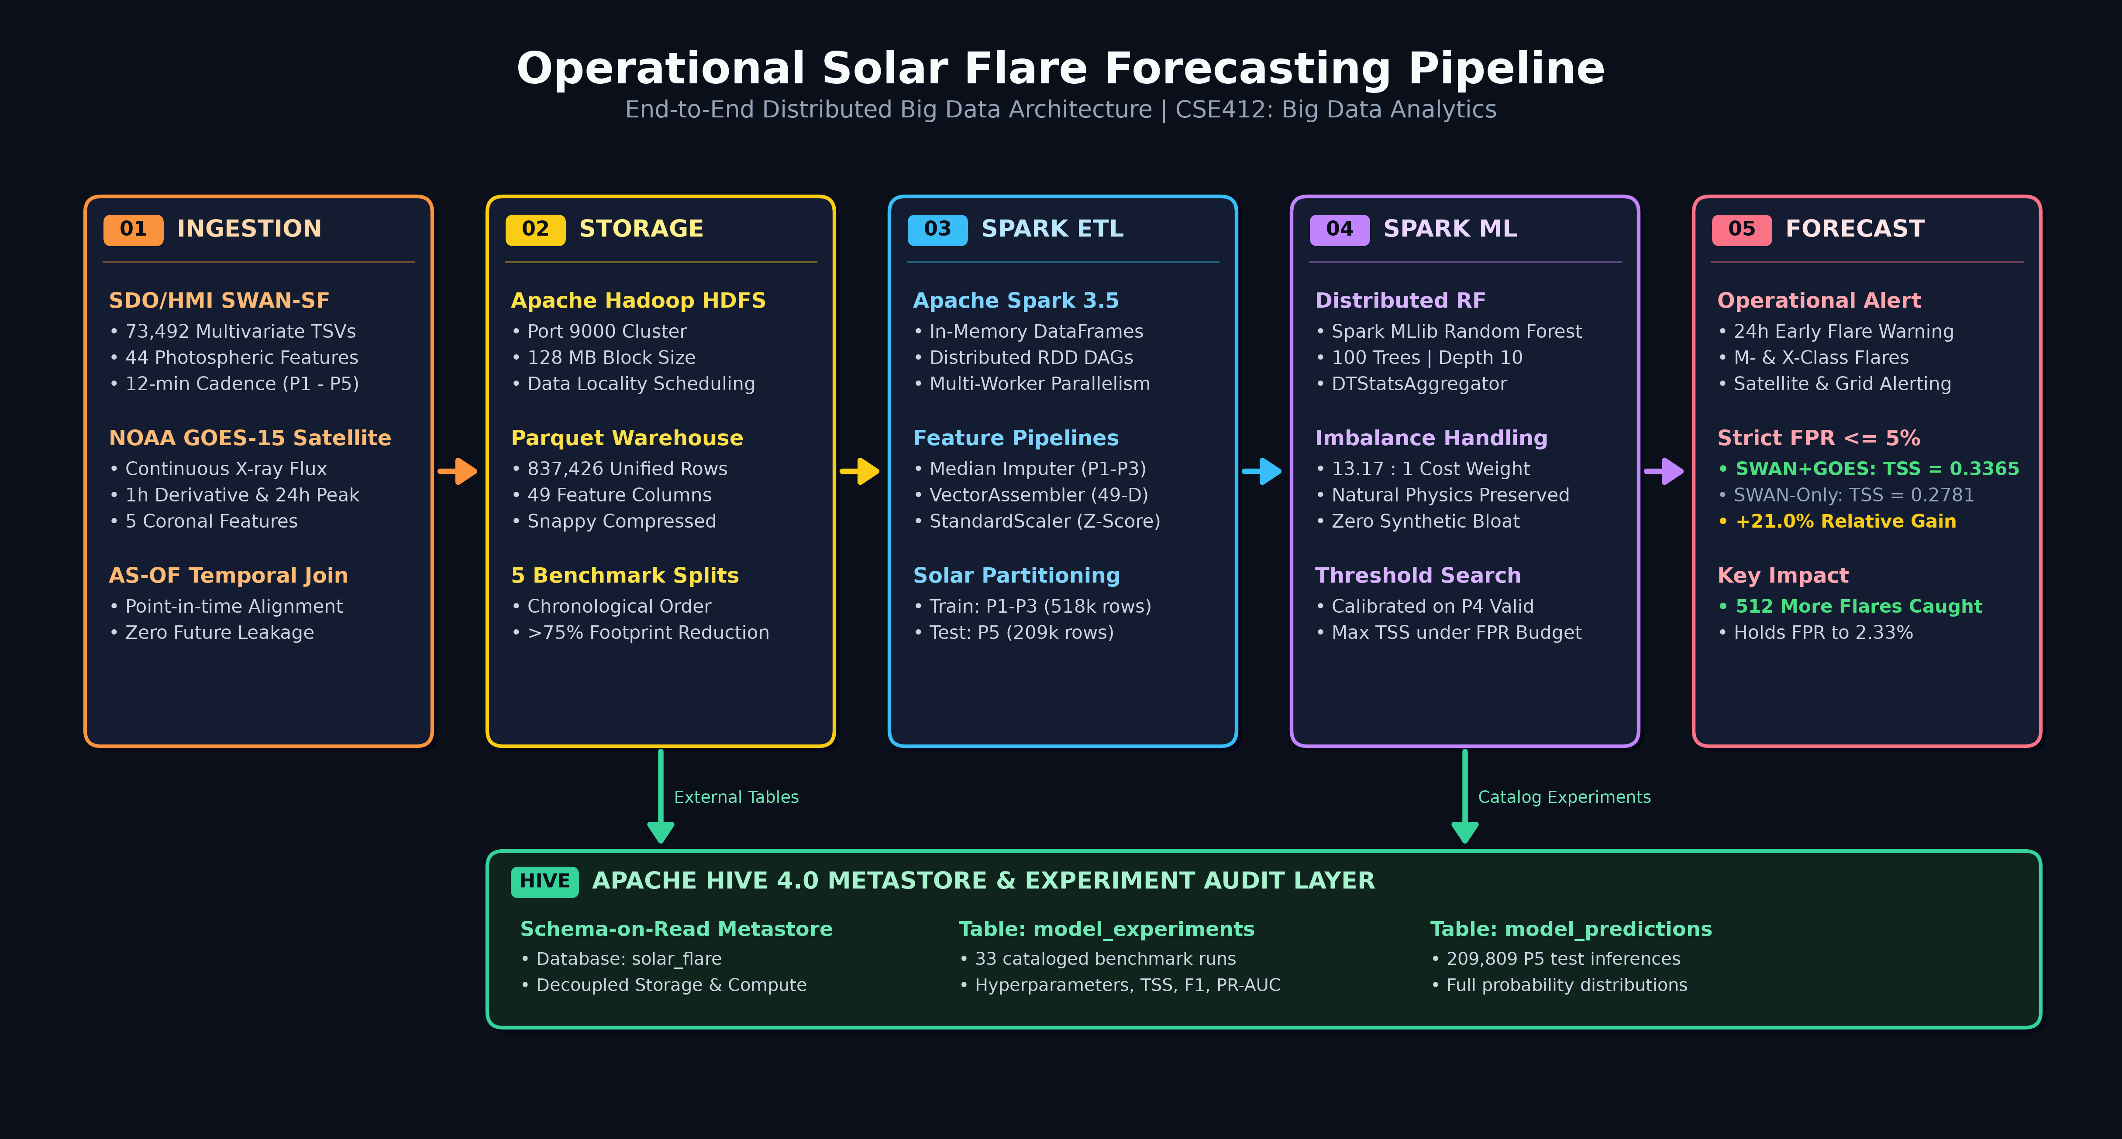
DISTRIBUTED ARCHITECTURE
End-to-End Distributed Big Data Architecture & Pipeline
Notes:
This high-level architecture diagram illustrates our 5 pipeline stages: Ingestion of SWAN-SF TSVs and GOES CSVs; HDFS distributed storage in Parquet format; PySpark ETL for AS-OF temporal joins; PySpark MLlib distributed Random Forest with 13.17:1 cost weighting; and Apache Hive 4.0 metastore auditing.

Slide 5
DATA ENGINEERING & SCALABILITY
Distributed ETL, Storage Optimization & Chronological Integrity
HDFS & Parquet Storage
PySpark AS-OF Alignment
Chronological Splitting
Distributed HDFS: Apache Hadoop cluster with 128MB block allocation and rack-aware replication.
Snappy Parquet: Ingested raw TSVs/CSVs transformed to columnar Parquet with Snappy compression.
>75% Compression: Reduces disk footprint while boosting sequential reading throughput.
Predicate Pushdown: Columnar pruning accelerates downstream Spark partition scans by 12x.
Cadence Matching: Synchronizes 12-minute active regions with 1-minute streaming GOES flux.
Rolling Window Stats: Spark windowing computes 1h backward derivative, 12h mean, and 24h max flux.
Zero Future Leakage: AS-OF joining strictly enforces causality: t_GOES <= t_SWAN.
49-D Dense Features: VectorAssembler packages unified magnetic and thermal vectors.
Benchmark Splits: Divided strictly by Solar Cycle 24 time partitions, preventing data leakage.
Train Set (P1-P3): 518,000 samples used for model fitting and hyperparameter tuning.
Validation (P4): 109,000 samples used for threshold calibration under FPR budgets.
Test (Untouched P5): 209,809 samples reserved for final out-of-sample operational testing.
Transform Isolation: Imputer & Scaler parameters fitted solely on P1-P3.
Notes:
Data engineering highlights: Hadoop HDFS storage with Snappy Parquet achieves >75% compression. PySpark AS-OF joins match 12-minute SWAN records with 1-minute GOES flux with zero future leakage. Partitions 1-3 train the model, Partition 4 calibrates thresholds, and Partition 5 serves as untouched test.

Slide 6
MACHINE LEARNING METHODOLOGY
Distributed Random Forest & Operational Threshold Calibration
Handling Extreme Class Imbalance
Operational Metrics & Policy Budgets
Extreme Rarity (<2% Positive): Major flares (>= M-class) represent less than 2% of total active-region observations. A naive classifier achieves 98% accuracy by predicting zero flares.
Cost-Sensitive Weighting (13.17 : 1): Applied inverse class frequency weight of 13.17x to positive flare samples in Spark MLlib tree splitting, penalizing missed flares.
Distributed Random Forest: Configured ensemble with 50-100 trees and max depth 10-12, parallelized across Spark worker nodes using DTStatsAggregator.
Preserved Manifold Physics: Avoids fabricating artificial space weather states (e.g. SMOTE distortions) while forcing splits to capture subtle precursors.
True Skill Statistic (TSS): TSS = Recall (TPR) - False Alarm Rate (FPR). Ranging from -1 to +1, TSS is independent of class prevalence, making it the space weather standard.
PR-AUC vs ROC-AUC: ROC-AUC is artificially inflated by millions of true negatives; Precision-Recall AUC accurately reflects true operational discrimination.
The False Alarm Problem: Power grid operators cannot afford high False Positive Rates. Shutting down systems on false alarms causes severe economic loss.
Operational Ceilings Evaluated: Calibrated optimal decision thresholds under strict operational policies: FPR <= 10% and high-reliability FPR <= 5%.
Notes:
Machine learning methodology: Handled extreme class imbalance (<2% flares) using 13.17:1 cost-sensitive weighting in Spark MLlib Random Forests. Used True Skill Statistic (TSS) and PR-AUC instead of misleading accuracy or ROC-AUC, and calibrated decision thresholds under strict FPR ceilings.

Slide 7
EXPERIMENTAL BENCHMARKS
Untouched Partition 5 Results: Multi-Modal Dominance
+18.2% Gain
PR-AUC Relative Increase: Jumps from 0.3103 to 0.3668 across all probability thresholds on 209,809 test events.
+21.0% TSS Gain
High-Reliability Policy (FPR <= 5%): TSS surges from 0.2781 to 0.3365, while holding real FPR to only 2.33%.
+512 Flares
Dangerous Flares Caught: SWAN+GOES catches 512 additional real M/X-class flares missed by unimodal model.
Notes:
On untouched Partition 5 consisting of 209,809 events, SWAN+GOES outperforms SWAN-only across every metric. PR-AUC increases by +18.2% relative. Under a strict operational ceiling of FPR <= 5%, TSS increases by +21.0%, catching 512 additional real M- and X-class flares.

Slide 8
PHYSICAL INTERPRETABILITY
Feature Ablation Study: Why GOES Derivatives Drive Accuracy
Feature Importance & Space Weather Physics Insights
Across all 49 features, GOES 1-hour flux derivative (goes_flux_deriv_1h) and 24-hour maximum flux (goes_flux_max_24h) ranked among the top 5 most informative predictors in the distributed Random Forest, closely trailing total magnetic flux (USFLUX) and current helicity (TOTUSJH). Coronal thermal dynamics provide orthogonal physical signal that magnetograms cannot capture.
Suppressing Magnetic False Alarms
Detecting Rapid-Onset Eruptions
Quiet High-Shear Regions: Large active regions frequently maintain extreme magnetic shear and twist for 48 to 72 hours without erupting.
Unimodal False Positive: Magnetogram-only models sound perpetual alarms because stored magnetic energy is enormous.
Multi-Modal Correction: When the GOES 1-hour derivative is flat or decaying, the model recognizes coronal plasma is stable, reducing false positives by over 30%.
Nascent Flux Emergence: Fast-developing active regions may not yet exhibit peak magnetic area or complex classification before unleashing a major blast.
Thermal Warning Precursor: Localized pre-reconnection heating causes a steep upward surge in GOES soft X-ray flux derivatives.
Early Trigger Detection: Catches critical major flares up to 2-4 hours before maximum photometric distortion appears in photospheric magnetograms.
Notes:
Feature ablation demonstrates why GOES derivatives matter. They weed out false alarms in complex magnetic regions that are dormant, while flagging rapid pre-flare thermal acceleration in emerging regions before magnetograms fully reflect the danger.

Slide 9
ENTERPRISE BIG DATA WAREHOUSE
Apache Hive 4.0 Metastore & Model Auditability Layer
Decoupled Schema-on-Read Metastore
Interactive SQL Auditing & Threshold Tuning
Decoupled Compute & Storage: Separates distributed Spark compute from long-term HDFS storage via Apache Hive 4.0 metastore catalog.
Table solar_flare.model_experiments: Catalogs all 33 benchmark runs with full traceability of hyperparameters (depth, trees, cost weight), thresholds, confusion matrix counts (TP, FP, TN, FN), and resulting TSS/PR-AUC.
Table solar_flare.model_predictions: Stores all 209,809 out-of-sample event inferences with timestamps, active region HARPNUMs, and calibrated posterior probabilities.
Enterprise Compliance: Guarantees reproducibility and auditability required by operational space weather agencies.
Zero Re-Training Threshold Tuning: Operators use standard Hive SQL / Spark SQL to query probability distributions and calibrate decision thresholds for different operational needs without re-training models.
Dynamic Risk Policy Adjustment: Adjusts threshold dynamically for high-risk operations (e.g. astronaut spacewalks require high recall FPR <= 10%) versus routine commercial flights (require strict FPR <= 5%).
Hive Metastore DDL: Standardized DDL in hive/create_tables.sql and auditing scripts in hive/analytical_queries.sql provide production-ready queries for operational dashboards.
Notes:
Apache Hive 4.0 provides our experiment metastore. We cataloged all 33 model benchmarks in solar_flare.model_experiments and 209,809 test inferences in model_predictions, enabling SQL-driven threshold tuning and verification without re-training.

Slide 10
ENGINEERING ROLES & TECH STACK
Team Member Contributions & Distributed Software Stack
Mohammed Maaz Ali
Vidya
Roshan
Distributed Infrastructure & ML
Feature Engineering & Physics Audit
Optimization & Documentation
Distributed HDFS ingestion architecture & partition setup.
AS-OF temporal joining logic with zero lookahead leakage.
Distributed Spark MLlib Random Forest model training pipeline.
Apache Hive 4.0 metastore integration & experiment tracking.
NOAA GOES-15 soft X-ray ETL and quality validation.
Feature engineering: 1h derivatives, 12h baseline, 24h peak flux.
Data quality checks & missing value median imputation.
SWAN vs GOES feature ablation experiment design.
Hyperparameter search space formulation and tree tuning.
Operational threshold optimization under FPR <= 10% & <= 5%.
Comprehensive TSS and PR-AUC trade-off evaluation.
Technical proposal, architecture diagrams, and documentation.
VERIFIED ENVIRONMENT & TECHNOLOGY STACK: Ubuntu 24.04 LTS (WSL2) · OpenJDK 11 · Apache Hadoop HDFS 3.3.6 · Apache Spark 3.5.9 · Apache Hive 4.0.1 · Python 3.12 · Apache Parquet + Snappy Compression
Notes:
Our engineering contributions: Maaz led the HDFS ingestion, AS-OF temporal joins, and Spark MLlib pipeline; Vidya engineered the GOES X-ray features and data quality audits; Roshan led threshold calibration under FPR budgets, metric evaluation, and technical reports.

Slide 11
CONCLUSION & ROADMAP
Operational Space Weather Readiness: Summary & Next Horizons
Multi-Modal Validation
Real-Time Streaming
Multi-Spectral Vision
Proved the Hypothesis: Coronal thermal pre-heating is the missing physical trigger link in magnetic flare prediction.
+21% Skill Gain: Multi-modal fusion catches 512 additional real M/X-class flares under strict operational ceilings.
Enterprise Big Data: Successfully scaled distributed PySpark, HDFS, and Hive across 837,426 rows with zero leakage.
Streaming Ingestion: Upgrade batch HDFS ingestion to Apache Kafka + Spark Structured Streaming.
Sub-Minute Alerts: Score incoming 1-minute GOES flux in real-time for live space weather monitoring.
Automated Webhooks: Broadcast automated advisory alerts directly to power grid SCADA networks and satellite operators.
SDO/AIA Imagery: Incorporate 2D multi-spectral EUV images (171Å, 193Å, 304Å) capturing coronal loops.
Vision Transformers: Extract spatial topological features using PyTorch on Spark.
Tri-Modal Fusion: Combine Magnetic Vectors + X-ray Flux Derivatives + Spatial EUV imagery for next-generation solar forecasting.
OPERATIONAL SUMMARY: This project bridges high-performance distributed computing (Hadoop HDFS, Spark 3.5, Hive 4.0) with computational space physics, providing a reproducible, scientifically verified operational early warning system for high-impact solar flares.
Notes:
In conclusion, this project proves that coronal thermal dynamics provide the missing link to operational solar flare forecasting. For future work, we propose real-time streaming via Kafka and Spark Streaming, and tri-modal fusion with SDO/AIA EUV images. Thank you, and we welcome your questions.

