Slide 1
Fundamental Data types

Slide 2
Agenda
Basic Structure of Program
Primitive Data Types
Variable declaration
Arithmetical Operations
Expressions
Assignment statement
Increment and Decrement operators
Short hand operators
The Math Class
Math Functions Example
Casting

Slide 3
Basic Structure of Java Program
public class MyFirstJavaClass
{
public static void main(String[] arg)
{
System.out.println(“Hello World!!!!");
}
}
The name of class and file must be same.

Slide 4
Parameters used in First Java Program
class keyword is used to declare a class in Java.
public keyword is an access modifier that represents visibility. It means it is visible to all.
static is a keyword. If we declare any method as static, it is known as the static method. The core advantage of the static method is that there is no need to create an object to invoke the static method. The main() method is executed by the JVM, so it doesn't require creating an object to invoke the main() method. So, it saves memory.
void is the return type of the method. It means it doesn't return any value.

Slide 5
Continued…
main represents the starting point of the program.
String[] args or String args[] is used for command line argument. We will discuss it in coming section.
System.out.println() is used to print statement. Here, System is a class, out is an object of the PrintStream class, println() is a method of the PrintStream class. We will discuss the internal working of System.out.println() statement in the coming section.
Notes:
In System.in, in is the static variable of InputStream.
In System.out, out is the static variable of OutputStream

Slide 6
Primitive Data Types
Java has eight primitive data types as described below.
Other information is represented in Java as an Object.
Type | Size/Format | Range
byte | 8-bit | -128 to 127
short | 16-bit | -32,768 to 32,767
int | 32-bit | about –2 billion to 2billion
long | 64-bit | about –10E18 to +10E18
float | 32-bit | -3.4E38 to +3.4E38
double | 64-bit | 1.7E308 to 1.7E308
char | 16-bit | A single character
boolean | true or false | true or false

Slide 7
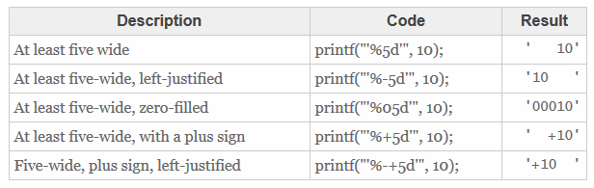
Format Specifiers
d: decimal integer [byte, short, int, long]
f : floating-point number [float, double]
c : characterCapital C will uppercase the letter
s : StringCapital S will uppercase all the letters in the string
b: To format boolean values, we use the %b format.

Slide 8
Variable Declaration
You can declare a variable to hold a data value of any of the primitive types.
int counter;
int numStudents = 583;
long longValue;
long numberOfAtoms = 1237890L;
float gpa;
float batchAverage = 0.406F;
double e;
double pi = 0.314;
char gender;
char grade = ‘B’;
boolean safe;
boolean isEmpty = true;

Slide 9
Variable Declaration (cont.)
public class Example1
{
public static void main ( String[] args )
{
int payAmount = 123;
System.out.println("The variable contains: " + payAmount );
}
}

Slide 10
Output functions
System.out.println()
System.out.print()
System.out.printf()
import java.lang;
Java compiler imports java.lang package internally by default.

Slide 11
Following are the Important Classes in Java.lang package
Boolean: The Boolean class wraps a value of the primitive type boolean in an object.
Byte: The Byte class wraps a value of primitive type byte in an object.
Character – Set 1, Set 2: The Character class wraps a value of the primitive type char in an object.
Double: The Double class wraps a value of the primitive type double in an object.
Enum: This is the common base class of all Java language enumeration types.
Float: The Float class wraps a value of primitive type float in an object.
Integer :The Integer class wraps a value of the primitive type int in an object.
Long: The Long class wraps a value of the primitive type long in an object.

Slide 12
Continued…
9. Math : The class Math contains methods for performing basic numeric operations such as the elementary exponential, logarithm, square root, and trigonometric functions.
10. Object: Class Object is the root of the class hierarchy.
11. Short: The Short class wraps a value of primitive type short in an object.
12. String- Set1, Set2: The String class represents character strings.
13. StringBuffer: A thread-safe, mutable sequence of characters.
14. StringBuilder: A mutable sequence of characters.
15. System: The System class contains several useful class fields and methods.
16. Thread: A thread is a thread of execution in a program.

Slide 13
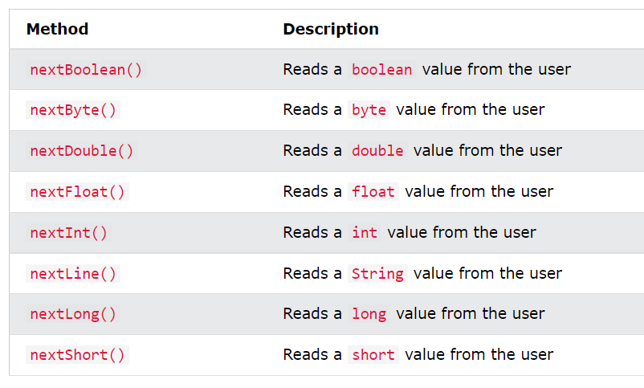
System.in
import java.util.Scanner;
Create Object of Scanner
Call the function nextInt
Notes:
In System.in, in is the static variable of InputStream.
In System.out, out is the static variable of OutputStream

Slide 14
Import Declaration
import declaration
Helps the compiler locate a class that is used in this program.
Rich set of predefined classes that you can reuse rather than “reinventing the wheel.”
Classes are grouped into packages—named groups of related classes—and are collectively referred to as the Java class library, or the Java Application Programming Interface (Java API).
You use import declarations to identify the predefined classes used in a Java program.

Slide 15
Scanner
Variable declaration statement
Scanner input = new Scanner( System.in );
This LHS declares a reference variable named input of type Scanner.
The RHS creates the object of scanner class.
Assignment Operator(=) assign the reference of object to input variable.
The Scanner object is associated with standard input device (System.in).
System.in is the static variable of InputStream class.
Notes:
In System.in, in is the static variable of InputStream.
In System.out, out is the static variable of OutputStream

Slide 16
Memory allocation of object

Slide 17
The Memory allocation in java is divided into parts, namely Heap, Stack, and Static.
Stack memory is used to store local variables and function calls.
Heap memory is used to store objects in Java. It doesn't matter where the object is created in code e.g. as a member variable, local variable, or class variable, they are always created inside heap space in Java.
Static memory persists throughout the entire life of the program, and is usually used to store things like global variables, or variables created with the static clause.

Slide 18
Continued…
The Memory allocation in java is divided into parts, namely Heap, Stack, and Static.
Stack memory is used to store local variables and function calls.
Heap memory is used to store objects in Java. It doesn't matter where the object is created in code e.g. as a member variable, local variable, or class variable, they are always created inside heap space in Java.
Static memory persists throughout the entire life of the program, and is usually used to store things like global variables, or variables created with the static clause.

Slide 19
Example
import java.util.Scanner;
public class MyFirstClass
{
public static void main(String[] args)
{
int x;
byte y=16;
Scanner input=new Scanner(System.in);
System.out.print("Enter Value of x..........");
x=input.nextInt();
System.out.println(y);
System.out.println("The printed value of x is"+x);
}
}

Slide 20
Arithmetic Operators
Operator Use Description
+ op1 + op2 Adds op1 and op2
- op1 - op2 Subtracts op2 from op1
* op1 * op2 Multiplies op1 by op2
/ op1 / op2 Divides op1 by op2
% op1 % op2 Computes the remainder of dividing op1 by op2

Slide 21
Continued…
public class Example2
{
public static void main ( String[] args )
{
int hoursWorked = 40;
double payRate = 10.0;
System.out.println("Hours Worked: " + hoursWorked );
System.out.println("pay Amount : "+ (hoursWorked*payRate));
}
}

Slide 22
Arithmetic Operation
Modes of operation :
If operand1 and operand2 are of same data type, then the resultant value of the operation will be of that same data type.
If operand1 and operand2 are of different data type like real and integer, then the resultant value of the operation will be of real data type.
e.g. 1/2 gives 0
1.0/2 gives 0.5
1.0/2.0 gives 0.5
Operand1 | Operand2 | Result
Real | Real | Real
Whole | Whole | Whole
Whole | Real | Real
Real | Whole | Real

Slide 23
Arithmetic Expressions
Definition: An expression is a sequence of variables, constants, operators, and method calls (constructed according to the syntax of the language) that evaluates to a single value.
In Java, Arithmetic expressions are evaluated very similar to the way they are evaluated in algebra.
Operator Meaning Precedence
- unary minus highest
+ unary plus highest
* multiplication middle
/ division middle
% remainder middle
+ addition low
- subtraction low

Slide 24
Associativity of Operators
In Java, all binary operators except for the assignment operators are evaluated in left to right order.
2 * 7 * 3 4 - 2 + 5
----- -----
14 * 3 2 + 5
------- -------
42 7

Slide 25
Assignment Statement
variable = expression;
The value of constants / variables / expression in the right side of the = operator, is assigned to the variable in the left side of the = operator.
Examples:
a = 5;
b = a;
c = a + b;
The left hand side of the = operator must be a variable.
It cannot be a constant or an expression.
Example of an invalid assignment statement :
a + b = c ;

Slide 26
Assignment Statement (cont.)
Java allows multiple assignment.
int width = 100, height = 45;
By default, Java takes whole numbers to be of type int and real numbers to be of type double. However, we can append a letter at the end of a number to indicate its type.
Upper and lower case letters can be used for ‘float’ (F or f), ‘double’ (D or d), and ‘long’ (l or L, but we should prefer L):
float maxGrade = 100f; // now holds ‘100.0’
double temp = 583d; // holds double precision
float temp = 5.5; // ERROR!
// Java treats 5.5 as a double
long x = 583l; // holds 583, but looks like 5,381
long y = 583L; // This looks much better!

Slide 27
Increment or Decrement Operators
Increment/decrement operations (count = count +1) are very common in programming. Java provides operators that make these operations shorter.
Operator Use Description
++ op++ Increments op by 1;
++ ++op Increments op by 1;
-- op-- Decrements op by 1;
-- --op Decrements op by 1;
Examples :
1. What is the value of j and i after executing the following code?
i = 1;
j = 5;
j = ++i;

Slide 28
Increment or Decrement Operators (cont.)
2. What is the value of j and i after executing the following code?
i = 10;
j = 50;
j = i--;
3. What is the value of j and i after executing the following code?
i = 5;
j = 10;
i++;
++j;

Slide 29
Shorthand Operators
Java also provides a number of operators that can be used as a short-cut for performing arithmetic operations on a variable and assigning the result to the same variable.
Operator Short-Form Equivalent to
+= op1 += op2 op1 = op1 + op2
-= op1 -= op2 op1 = op1 - op2
*= op1 *= op2 op1 = op1 * op2
/= op1 /= op2 op1 = op1 / op2
%= op1 %= op2 op1 = op1 % op2
Example :
Instead of writing a = a + 5; We can write a += 5;

Slide 30
Agenda
Comments in java
Format Specifiers
Escape Sequence
Math Class
Casting
Relational Operator

Slide 31
Comments in Java
Comments
// Fig. 2.1: Welcome1.java
// indicates that the line is a comment.
Used to document programs and improve their readability.
Compiler ignores comments.
A comment that begins with // is an end-of-line comment—it terminates at the end of the line on which it appears.
Traditional comment, can be spread over several lines as in
/* This is a traditional comment. It can be split over multiple lines */
This type of comment begins with /* and ends with */.
All text between the delimiters is ignored by the compiler.

Slide 32
Continued…
Javadoc comments
Delimited by /** and */.
All text between the Javadoc comment delimiters is ignored by the compiler.
Enable you to embed program documentation directly in your programs.
The javadoc utility program (Appendix M) reads Javadoc comments and uses them to prepare your program’s documentation in HTML format.

Slide 33
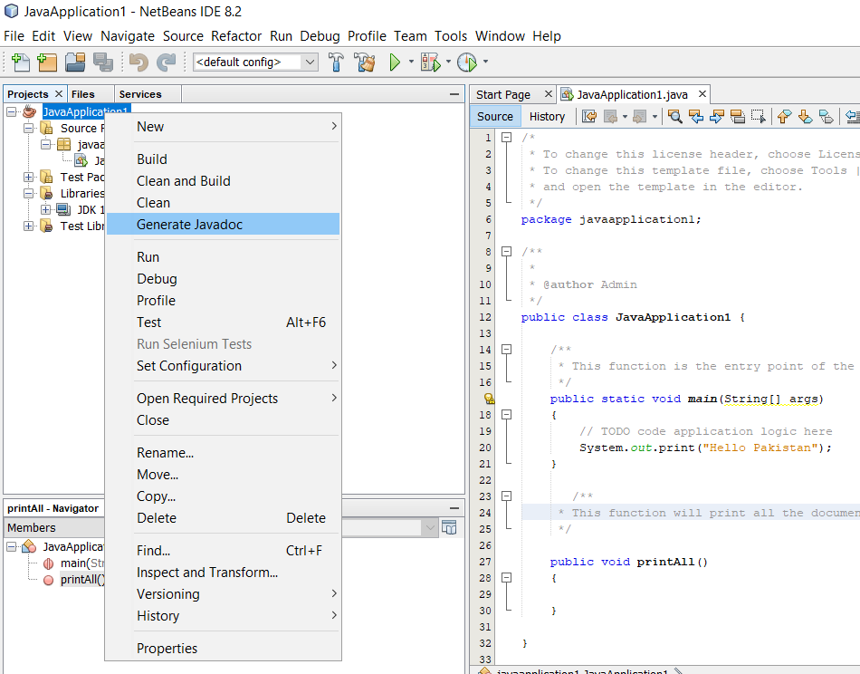
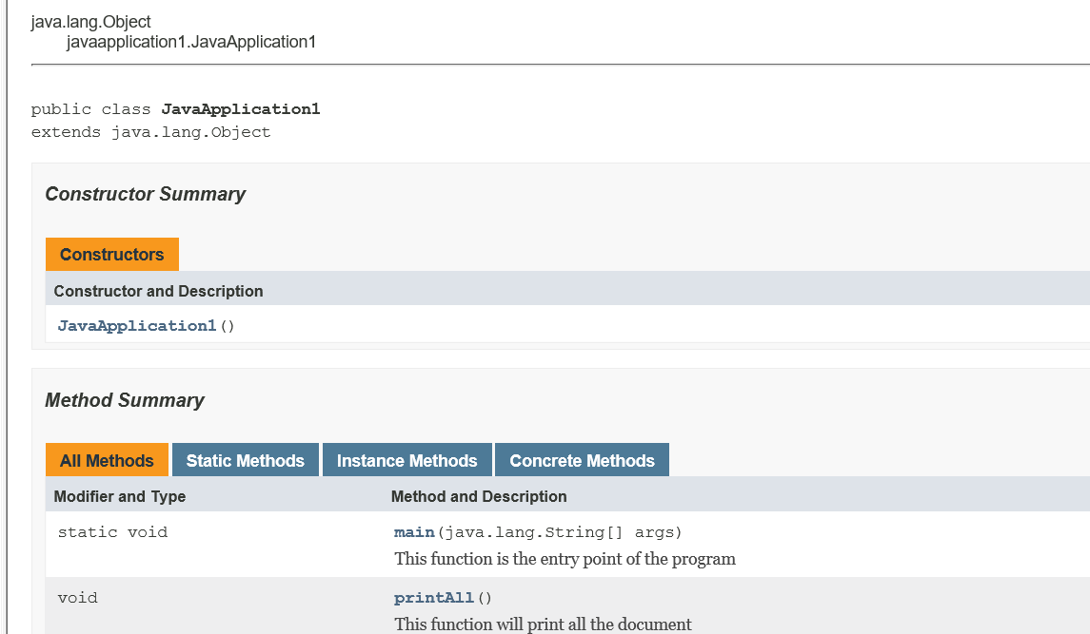

Slide 34
Format Specifiers
d: decimal integer [byte, short, int, long]
f : floating-point number [float, double]
c : characterCapital C will uppercase the letter
s : StringCapital S will uppercase all the letters in the string
b: To format boolean values, we use the %b format.

Slide 35
How to Read Char variable
Scanner input=new Scanner(System.in);
char b=input.next().charAt(0);
System.out.printf("%C",b);

Slide 36
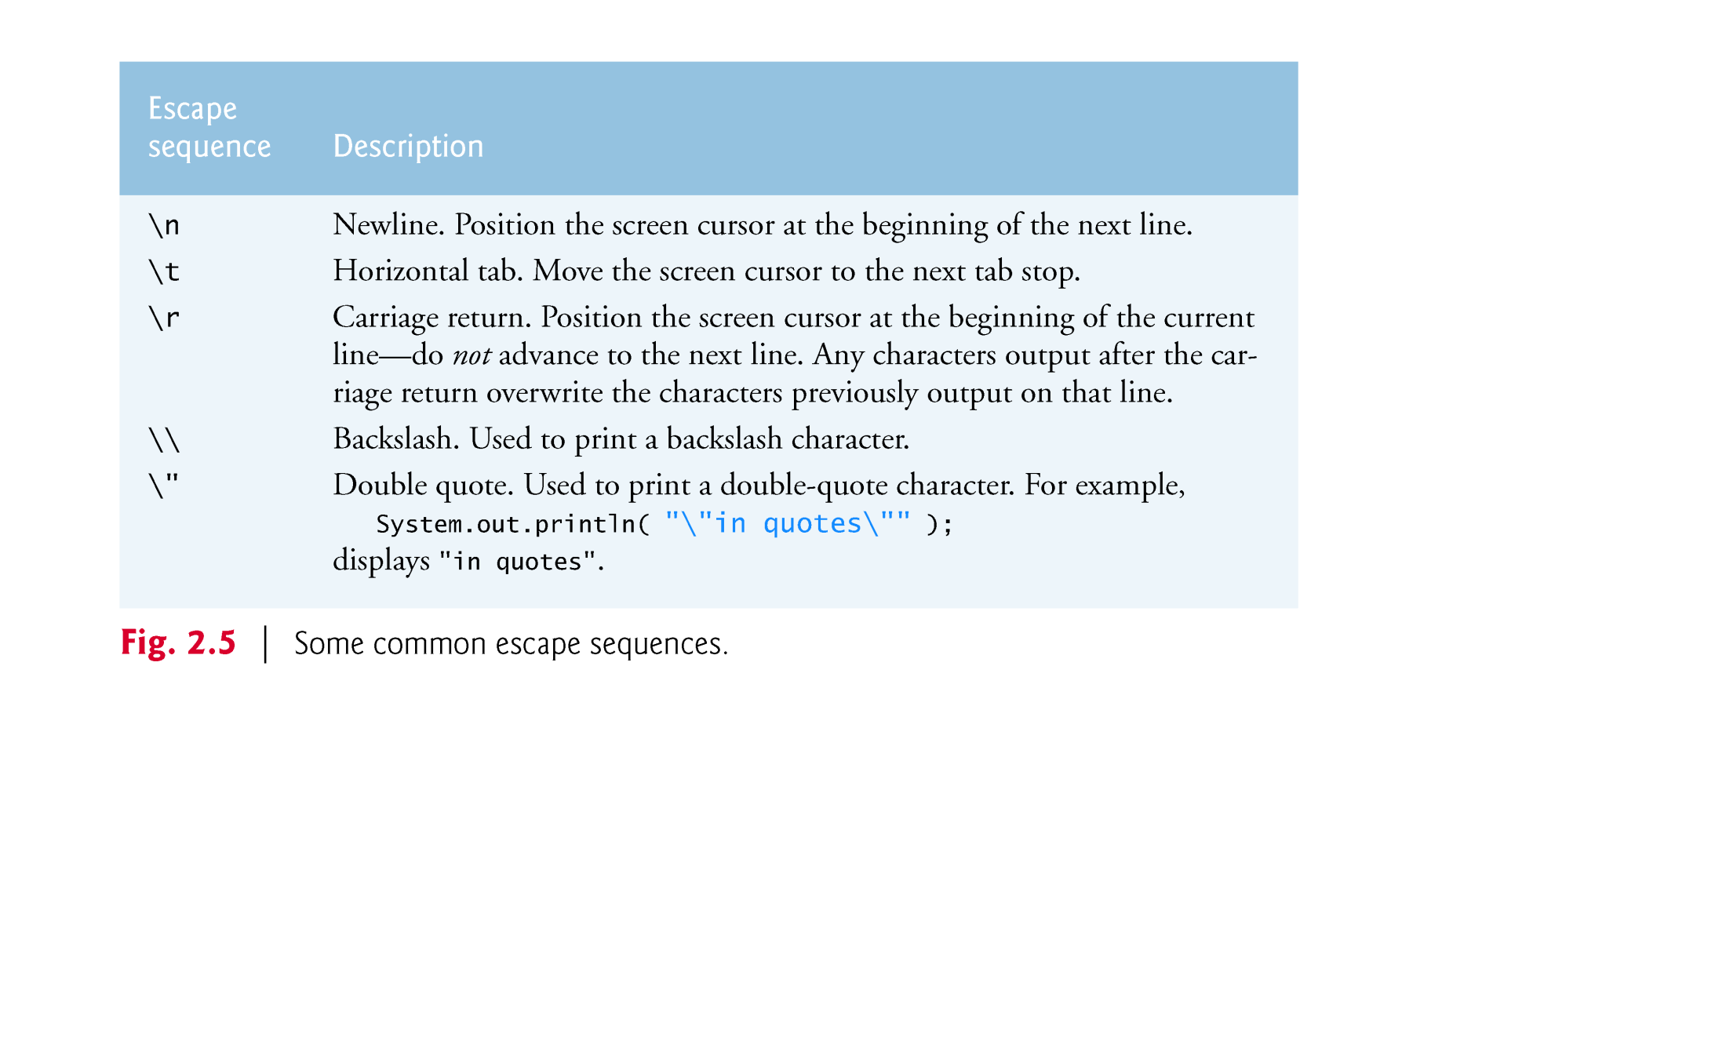
Escape Sequence
Escape sequence is two or more characters that often begin with an escape character that tell the computer to perform some action.

Slide 37
The Math class
PI | The best approximate value of PI
abs(a) | Returns the absolute value of a, a can be double, float, int or long.
cos(a) sin(a) tan(a) | Returns the trigonometric cosine/sine/tangent of an angle given in radians
exp(a) | Returns the exponential number e raised to the power of a
log(a) | Returns the natural logarithm (base e) of a
max(a, b) min(a, b) | Returns the greater/smaller of two values, a and b can double, float, int or long
pow(a, b) | Returns the first argument raised to the power of the second
random() | Returns a random value in the range 0.0 and 1.0
round(a) | Returns the closest long to the argument (double or float)
toDegrees(a) toRadians(a) | Converts an angle in radians to the degrees Converts an angle in degrees to the radians

Slide 38
Math Functions Example
Public class Expressions
{
public static void main(String[]args)
{
double area, circumference;
int radius=3;
area = Math.PI * Math.pow(radius, 2);
circumference = 2 * Math.PI * radius;
System.out.println("Area = " + area);
System.out.println("Circum. =" + circumference);
}
}
java.lang package is by default included in the project.

Slide 39

Example
The following example computes the roots of a quadratic equation, assuming that the equation has real roots.
It uses the formula:
public class QuadraticEquation
{
public static void main(String[] args)
{
double a = 1, b = -5, c=6;
double root1 = (-b + Math.sqrt(b*b - 4*a*c))/(2*a);
double root2 = (-b - Math.sqrt(b*b - 4*a*c))/(2*a);
System.out.println("The roots are: "+root1 + " ,"+root2);
}
}

Slide 40
Casting
We learnt earlier that the following division
5 / 2
results in 2
Because the / operator is operating between 2 integer type constants, the result will be an integer.
To get 2.5 , we need to convert either one or both the operands to double . Then the division will look like
5.0 / 2.0
But what if we have integer variables to divide each other, like a / b ?
For this, cast operator is used .
(double) a / (double) b

Slide 41
Casting (cont.)
Conversion of primitives is accomplished by (1) assignment and/or (2) explicit casting:
int total = 100;
float temp = total; //temp now holds 100.0
When changing type that will result in a loss of precision, an explicit ‘cast’ is needed. This is done by placing the new type in parenthesis:
float total = 100F;
int temp = total; // ERROR!
int start = (int) total;

Slide 42
Decision Making: Equality and Relational Operators
Condition
An expression that can be true or false.
if selection statement
Allows a program to make a decision based on a condition’s value.
Equality operators (== and !=)
Relational operators (>, <, >= and <=)
Both equality operators have the same level of precedence, which is lower than that of the relational operators.
The equality operators associate from left to right.
The relational operators all have the same level of precedence and also associate from left to right.

Slide 43
