Slide 1
Apache NetBeans
Lab # 03

Slide 2
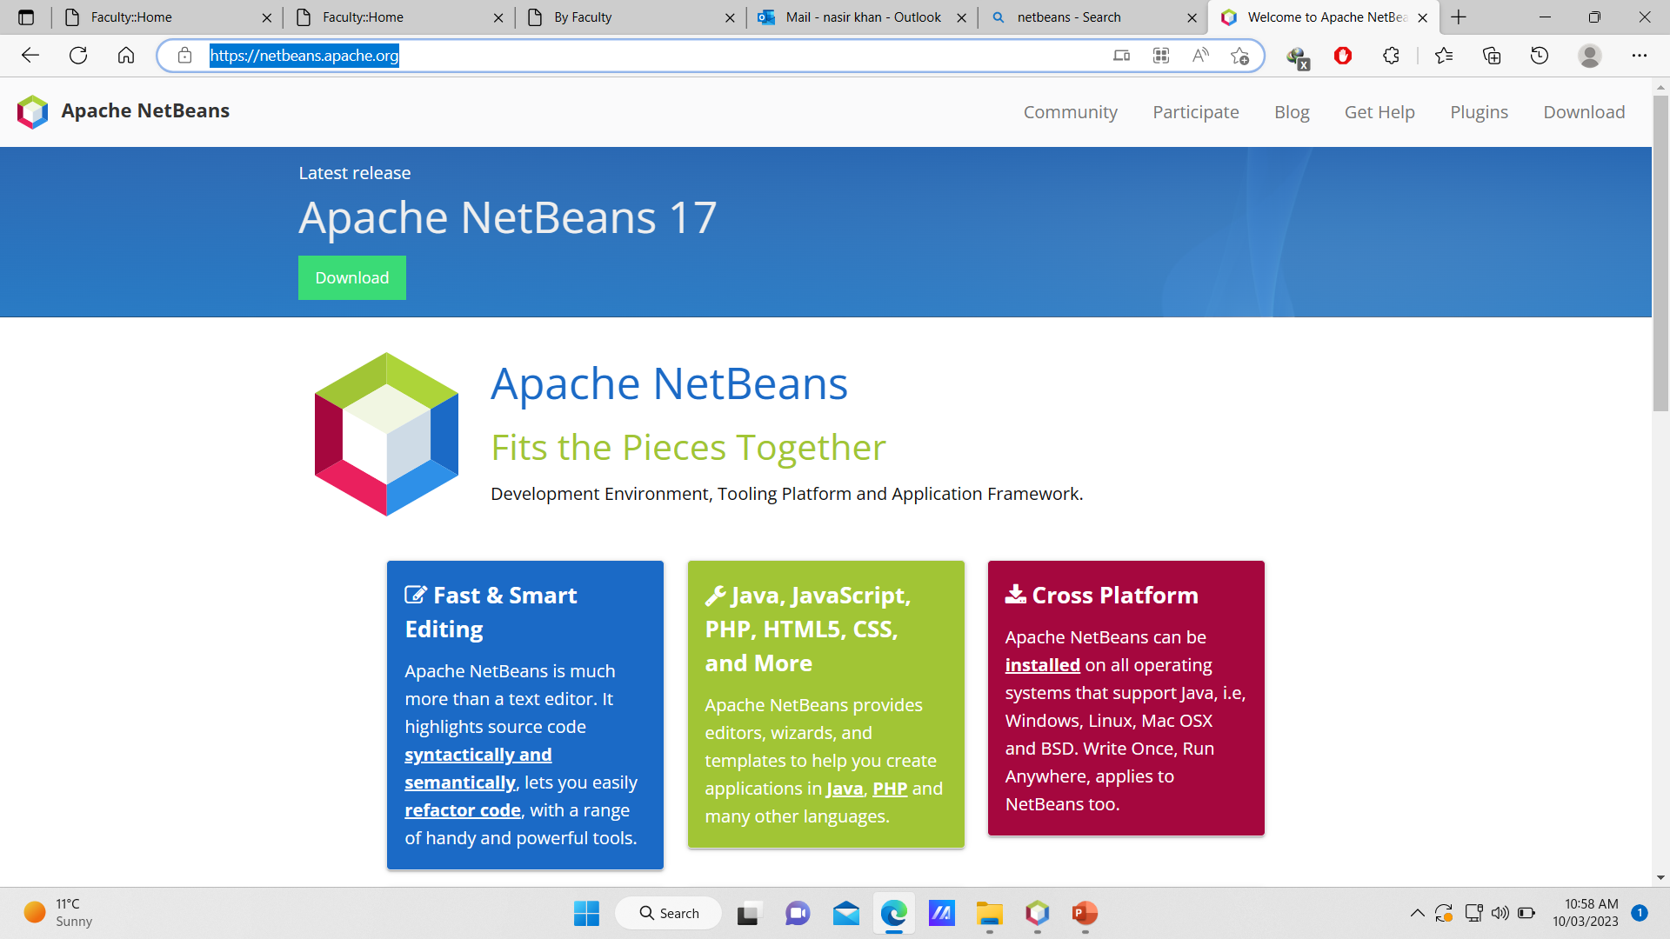
Installation and Environment Setting
https://netbeans.apache.org/ (Apache NetBeans)
Notes:
When Java was produced as an independent language, it was envisaged that it would help revolutionise the web, providing more dynamic features to web pages, e.g. animation, more complex user interfaces, etc. However its actually had more success as a server-side development language rather than for applets or desktop application development. That’s not to say it can’t do those things, and do them well, but it’s a niche that its occupies very well due to a number of features.
Dynamic web pages are now typically the realm of Macromedia Flash and similar tools.

Slide 3
How to Create New Project
Open Apache NetBeans IDE using Window Explorer
Click on File Menu
Create New Project
Select one of the following option from Categories Box
  Java with Maven
  Java with Gradle
  Java with Ant
Select Java Project from Projects Box
Press Finished

Slide 4
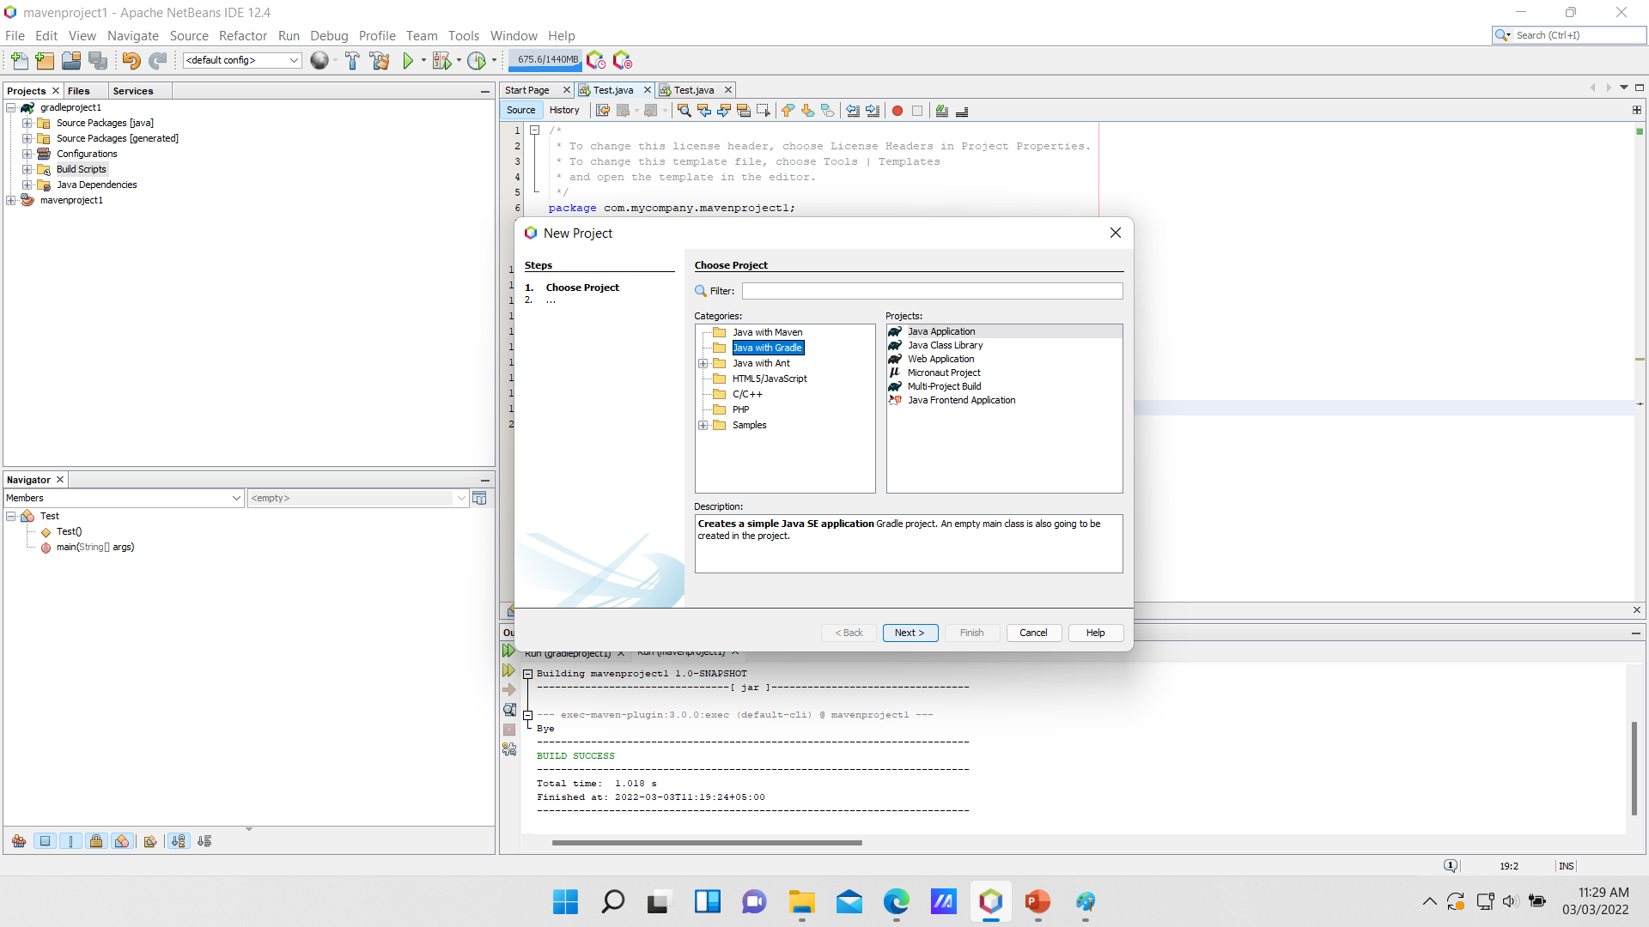
Continued…

Slide 5
Continued…
New Dialog box will be appeared on screen
Write a project name and then press finished

Slide 7
What are built tools

Slide 8
java Built Tool
A java build tool is a software the helps in built automation.
What is built automation?
The process of automating a wide variety of tasks that are required by the software developer to build the application like:
    Generating automatic source code
    Downloading dependencies.
    Compiling source code into binary code.
    Packaging that binary code (for delivering binary packages)
    Installing the packaged code on server
    Running Automated Tests
    Generating documentation

Slide 9
Build tools are programs that automate the creation of executable applications from source code (e.g.,.apk for an Android app).
Building incorporates compiling,linking and packaging the code into a usable or executable form.
Basically build automation is the act of scripting or automating a wide variety of tasks that software developers do in their day-to-day activities like:
    Downloading dependencies.
    Compiling source code into binary code.
    Packaging that binary code.
    Running tests.
    Deployment to production systems.
Notes:
Create JUnit Test Cases using Maven Project (javaguides.net)
https://www.javaguides.net/2018/07/junit-getting-started-guide.html

Slide 10
Ant vs Maven vs Gradle: Java Build Tools
According to the 2021 Java Developer Productivity Report, the majority of Java developers reported using Maven as their main build tool, at 67% of respondents. In a distant second and third place were Gradle at 20% of respondents and Ant at 11%.
These three build tools have consistently ranked in the top three build tools for Java developers.

Slide 11
Maven
Apache Maven is a powerful software project management tool used in the Java development environment to manage and build projects as well as to maintain dependencies.
Maven uses an XML (pom.xml) for project configuration.

Slide 12
Gradle
Gradle is a modern automation tool used in software development for project build automation.
Gradle has its own domain-specific language (DSL) based on a Groovy (build.gradle) or Kotlin (build.gradle.kts) code.

Slide 13
Ant
Apache Ant is the predecessor of Apache Maven.
First released in 2000, Ant was developed as a replacement for a build tool Make.

