Slide 1
Introduction to Java Programming
Lab# 01

Slide 2
Outline
Introducing Java
Key features of the language
Java Virtual Machine & Runtime Environment
Installation and Environment Setting
Useful Resources

Slide 3
Some History
Developed and maintained by Sun Microsystems
In 1990s
Java team members (also known as Green Team), initiated this project to develop a language for digital devices such as set-top boxes, televisions, etc.
Originally called Greentalk → Oak → Java
Aimed at producing an operating environment for networked devices and embedded systems
…but has been much more successful
Notes:
An embedded system is a microprocessor- or microcontroller-based system of hardware and software designed to perform dedicated functions.
A set-top box (STB), also colloquially known as a cable box and historically television decoder, is an information appliance device that generally contains a TV-tuner input and displays output to a television set and an external source of signal, turning the source signal into content in a form that can then be displayed on the television screen or other display device.
In 2005, Oracle acquired PeopleSoft, an ERP company, and in 2006 Siebel, a CRM company. In 2008 Oracle acquired BEA Systems, an enterprise infrastructure software company and in 2010 it acquired Sun Microsystems, a computer hardware and software company (famous for its Java programming language).

Slide 4
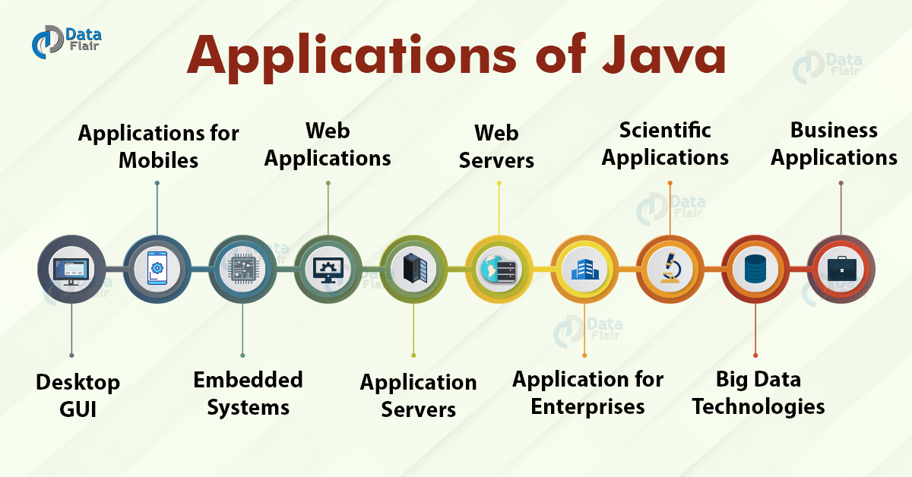
Applications of JAVA

Slide 5
Versions
JDK 1.0 (January 23, 1996)^{[37]}
JDK 1.1 (February 19, 1996)
J2SE 1.2 (December 8, 1998)
J2SE 1.3 (May 8, 2000)
J2SE 1.4 (February 6, 2002)
J2SE 5.0 (September 30, 2004)
Java SE 6 (December 11, 2006)
Java SE 7 (July 28, 2011)
Java SE 8 (March 18, 2014)
Java SE 9 (September 21, 2017)
Java SE 10 (March 20, 2018)
Java SE 11 (September 25, 2018)^{[38]}
Java SE 12 (March 19, 2019)
Java SE 13 (September 17, 2019)
Java SE 14 (March, 17th 2020)
Java SE 15 (September, 15th 2020)
Java SE 16 (March, 16th 2021)
Java SE 17 (September, 2021)
Java SE 18 (March, 2022)
https://www.oracle.com/in/java/technologies/downloads/#jdk19-windows

Slide 6
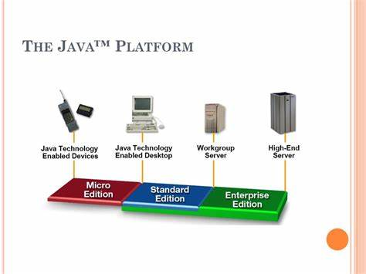
Java Language vs Java Platform
Core language plus additional APIs is called the Java platform
Three versions of the Java Platform, targeted at different uses
Java Micro Edition (Java ME)
Very small Java environment for development and deployment of portable code for mobile devices and other embedded systems.
Subset of the standard Java libraries aimed at limited size and processing power
Java Standard Edition (Java SE)
The basic platform, for desktop applications
Java Enterprise Edition (Java EE)
For business applications, web services, mission-critical systems, databases, distribution, replication

Slide 7
Basic Structure of java program
public class MyFirstClass
{
public static void main(String [] args)
{
System.out.println(“Hello World”);
}
}

Slide 8
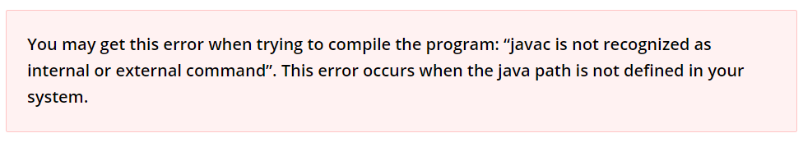
Compile
In this step, we’ll compile the program. To do this, open the Command Prompt (CMD) in Windows, if you are on Mac OS, open Terminal.
To compile the program, type the following command and press Enter.
javac filename.java

Slide 9
Run
After compilation, the .java file is translated to the .class file (byte code). We can now run the program. To run the program, type the below command and press Enter:
java filename

Slide 10
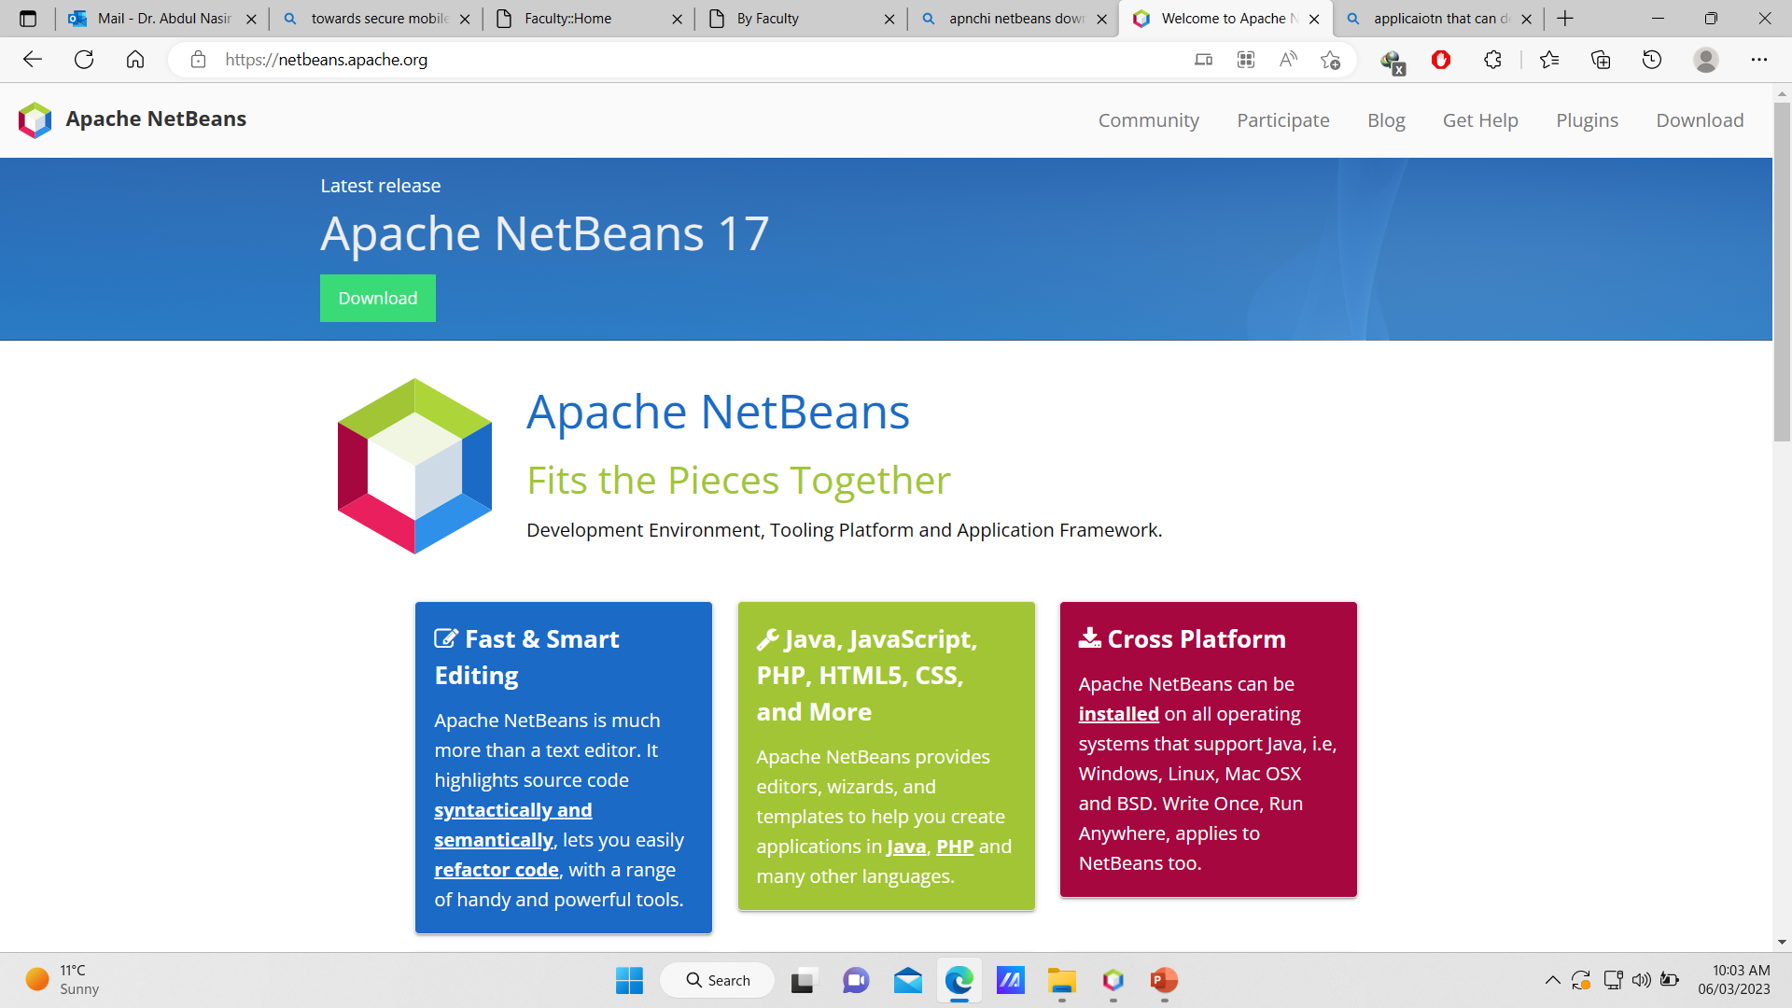
Installation and Environment Setting
https://netbeans.apache.org/ (Apache NetBeans)
Notes:
When Java was produced as an independent language, it was envisaged that it would help revolutionise the web, providing more dynamic features to web pages, e.g. animation, more complex user interfaces, etc. However its actually had more success as a server-side development language rather than for applets or desktop application development. That’s not to say it can’t do those things, and do them well, but it’s a niche that its occupies very well due to a number of features.
Dynamic web pages are now typically the realm of Macromedia Flash and similar tools.

Slide 11
Design objectives for the language
Simple: The Java programming language is easy to learn.
Object-oriented: Java is a fully object-oriented programming language. It has all OOP features such as abstraction, encapsulation, inheritance and polymorphism.
Distributed
Multi-threaded
Platform neutral
Robust: With automatic garbage collection and simple memory management model (no pointers like C/C++), Java guides programmer toward reliable programming habits for creating highly reliable applications.
Secure: A bytecode verifier is invoked to ensure that only legitimate bytecodes are executed in the Java runtime.
Notes:
مضبوط: Robust

Slide 12
Java and a Typical Java Development Environment (Cont.)
Java programs normally go through five phases
edit
compile
load
verify
execute.
Download the JDK and its documentation from
www.oracle.com/technetwork/java/javase/downloads/index.html

Slide 13
Java and a Typical Java Development Environment (Cont.)
Phase 1 consists of editing a file
Type a Java program (source code) using the editor.
Make any necessary corrections.
Save the program.
A file name ending with the .java extension indicates that the file contains Java source code.

Slide 14
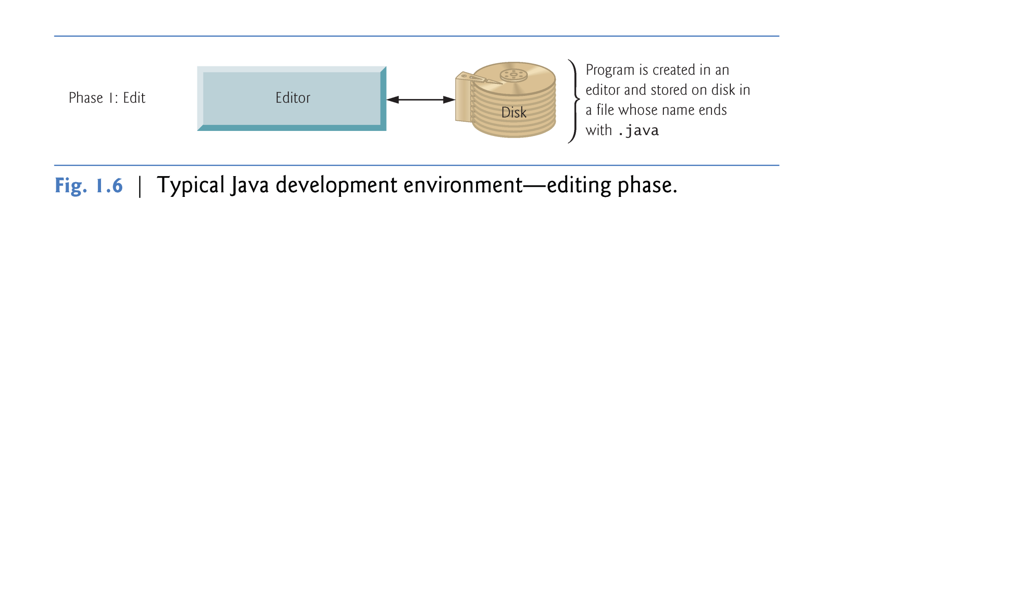

Slide 15
Java and a Typical Java Development Environment (Cont.)
Linux editors: vi and emacs.
MAC Editors: Sublime Text, BBEdit, UltraEdit
Windows editors:
Notepad
EditPlus (www.editplus.com)
TextPad (www.textpad.com)
jEdit (www.jedit.org).
Integrated Development Environments (IDEs)
Provide tools that support the software development process, including editors for writing and editing programs and debuggers for locating logic errors—errors that cause programs to execute incorrectly.

Slide 16
Java and a Typical Java Development Environment (Cont.)
Popular IDEs
Eclipse (www.eclipse.org)
NetBeans (www.netbeans.org).
jGRASP™ IDE (www.jgrasp.org)
DrJava IDE (www.drjava.org/download.shtml)
BlueJ IDE (www.bluej.org/)

Slide 17
Java and a Typical Java Development Environment (Cont.)
Phase 2: Compiling a Java Program into Bytecodes
Use the command javac (the Java compiler) to compile a program. For example, to compile a program called Welcome.java, you’d type
javac Welcome.java
If the program compiles, the compiler produces a .class file called Welcome.class that contains the compiled version of the program.

Slide 18
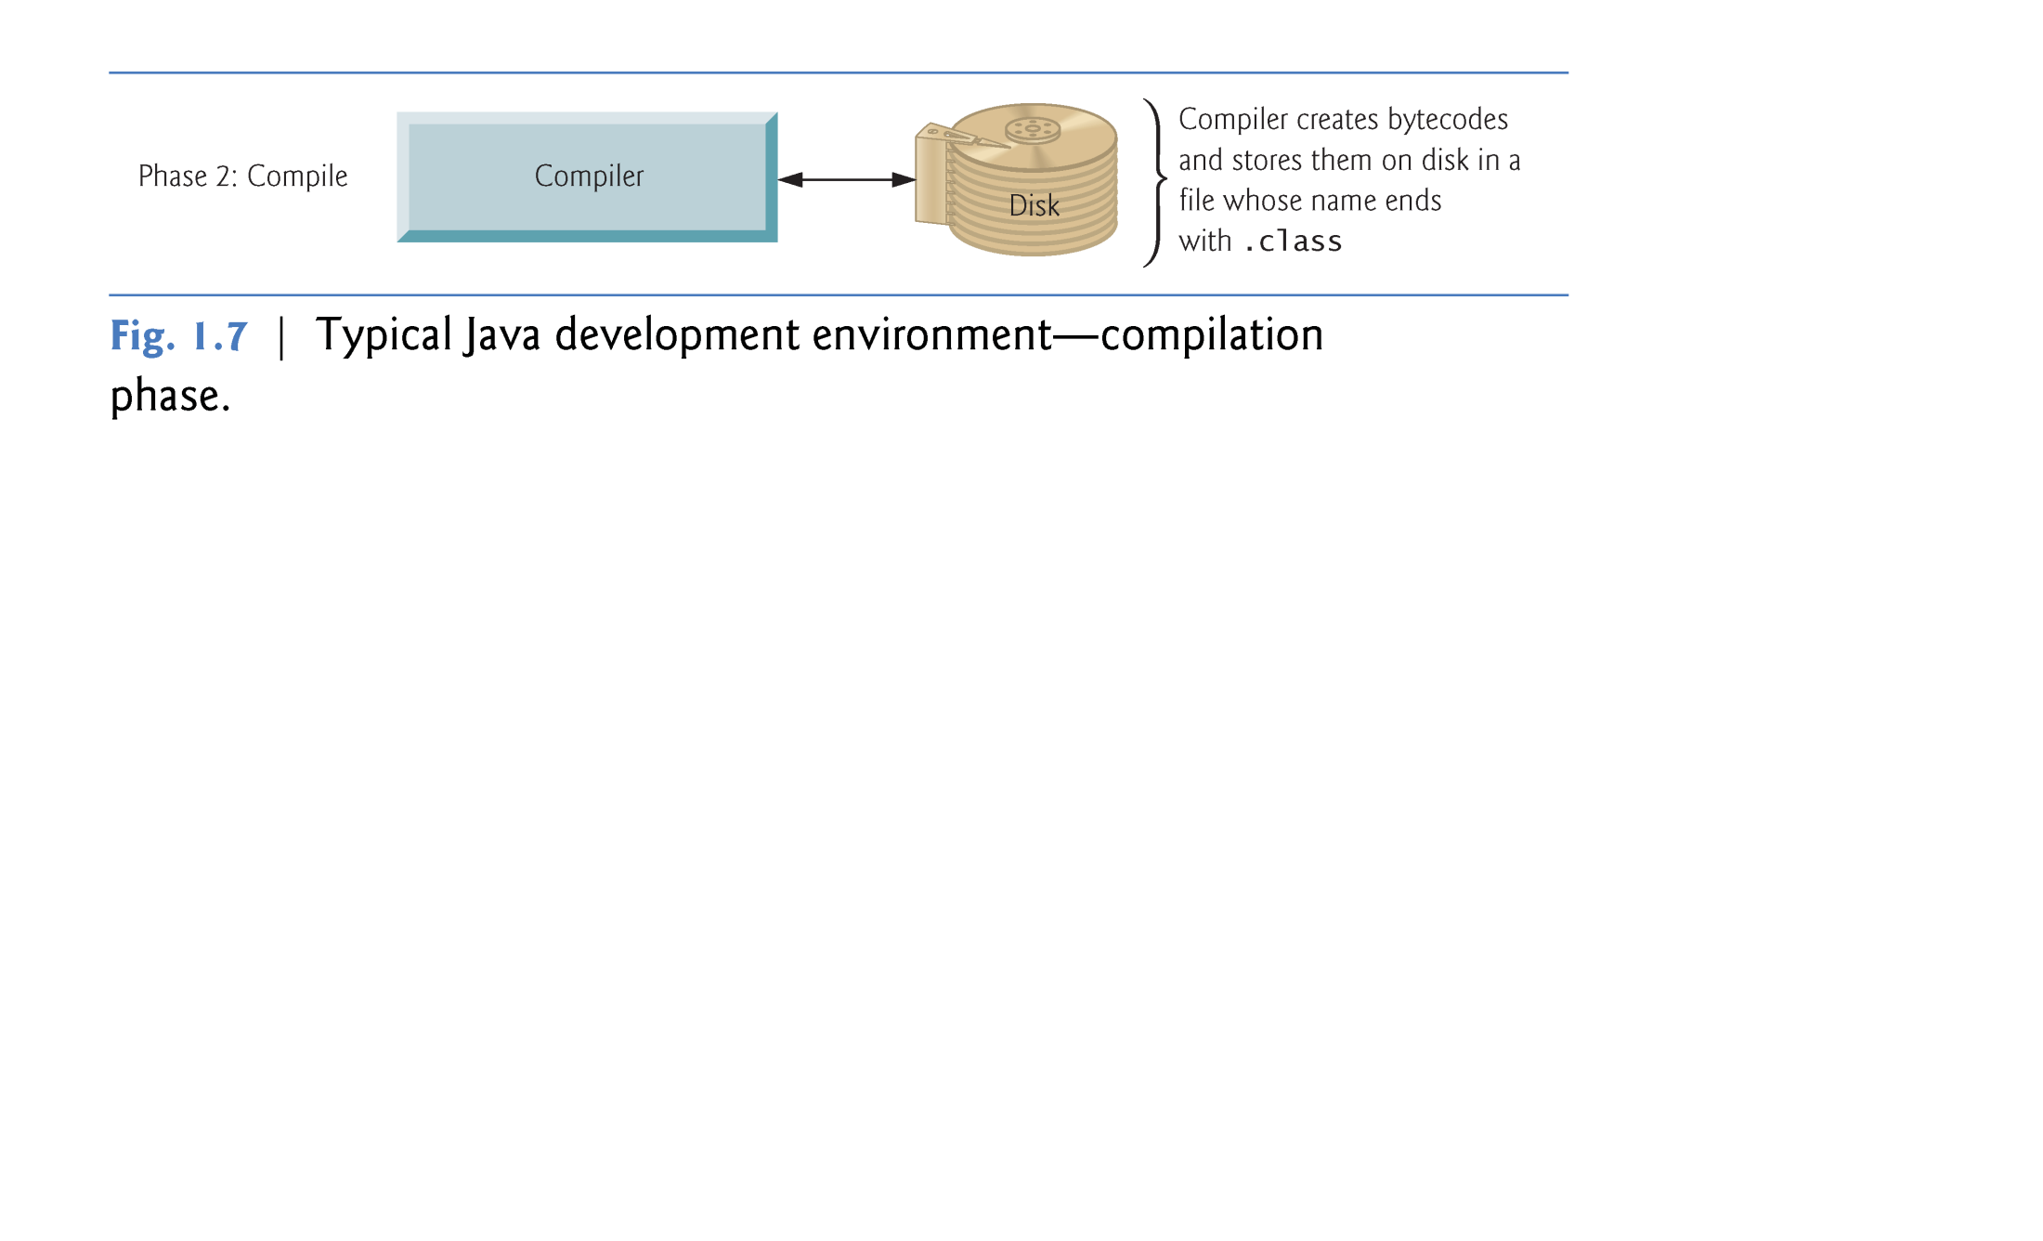

Slide 19
Java and a Typical Java Development Environment (Cont.)
Java compiler translates Java source code into bytecodes that represent the tasks to execute.
Bytecodes are executed by the Java Virtual Machine (JVM)—a part of the JDK and the foundation of the Java platform.
Virtual machine (VM)—a software application that simulates a computer
Hides the underlying operating system and hardware from the programs that interact with it.
If the same VM is implemented on many computer platforms, applications that it executes can be used on all those platforms.

Slide 20
Java and a Typical Java Development Environment (Cont.)
Bytecodes are platform independent
They do not depend on a particular hardware platform.
Bytecodes are portable
The same bytecodes can execute on any platform containing a JVM that understands the version of Java in which the bytecodes were compiled.
The JVM is invoked by the java command. For example, to execute a Java application called Welcome, you’d type the command
java Welcome

Slide 21
Java and a Typical Java Development Environment (Cont.)
Phase 3: Loading a Program into Memory
The JVM places the program in memory to execute it—this is known as loading.
Class loader takes the .class files containing the program’s bytecodes and transfers them to primary memory.
Also loads any of the .class files provided by Java that your program uses.
The .class files can be loaded from a disk on your system or over a network.

Slide 22
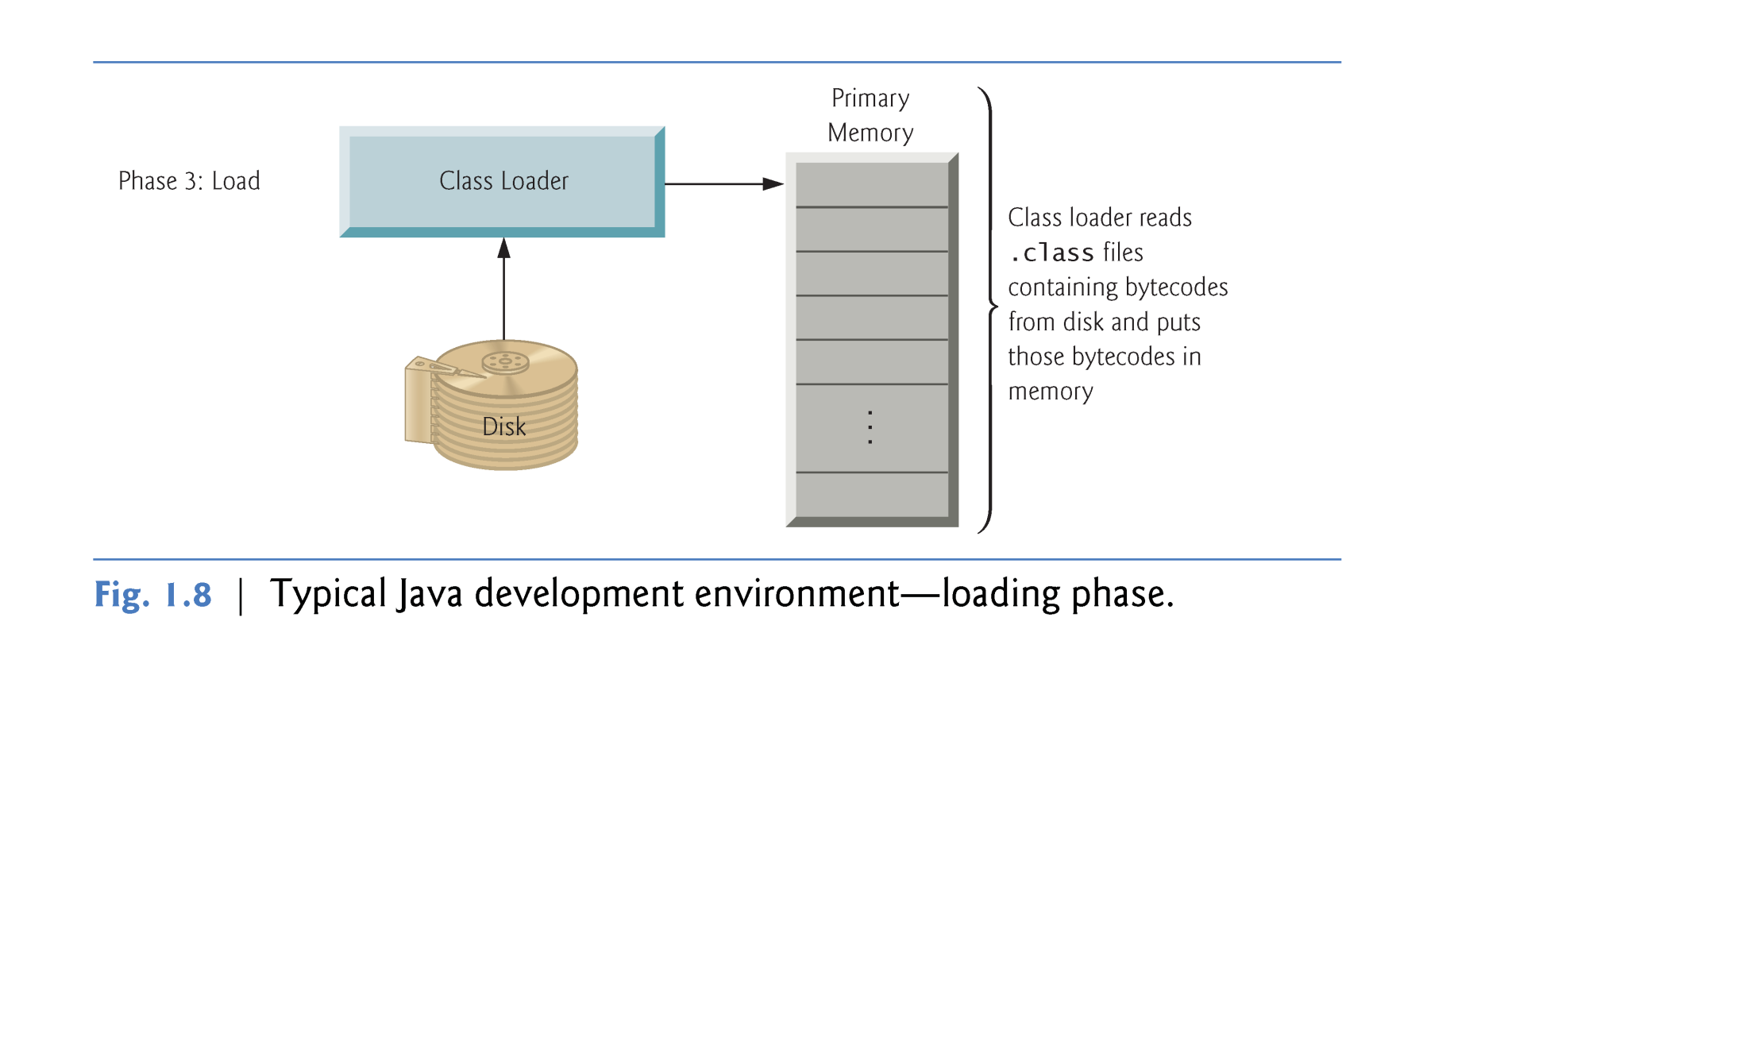

Slide 23
Java and a Typical Java Development Environment (Cont.)
Phase 4: Bytecode Verification
As the classes are loaded, the bytecode verifier examines their bytecodes
Ensures that they’re valid and do not violate Java’s security restrictions.
Java enforces strong security to make sure that Java programs arriving over the network do not damage your files or your system (as computer viruses and worms might).

Slide 24
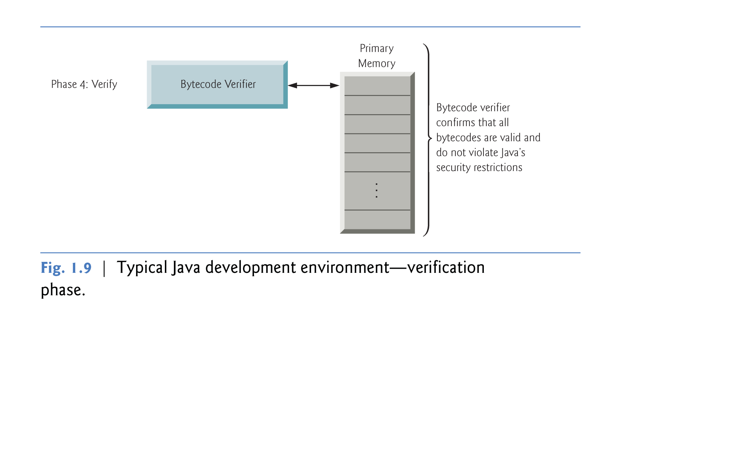

Slide 25
Java and a Typical Java Development Environment (Cont.)
Phase 5: Execution
The JVM executes the program’s bytecodes.
JVMs typically execute bytecodes using a combination of interpretation and so-called just-in-time (JIT) compilation.
Analyzes the bytecodes as they’re interpreted
A just-in-time (JIT) compiler—known as the Java HotSpot compiler—translates the bytecodes into the underlying computer’s machine language.

Slide 26
Java and a Typical Java Development Environment (Cont.)
When the JVM encounters these compiled parts again, the faster machine-language code executes.
Java programs go through two compilation phases
One in which source code is translated into bytecodes (for portability across JVMs on different computer platforms) and
A second in which, during execution, the bytecodes are translated into machine language for the actual computer on which the program executes.

Slide 27
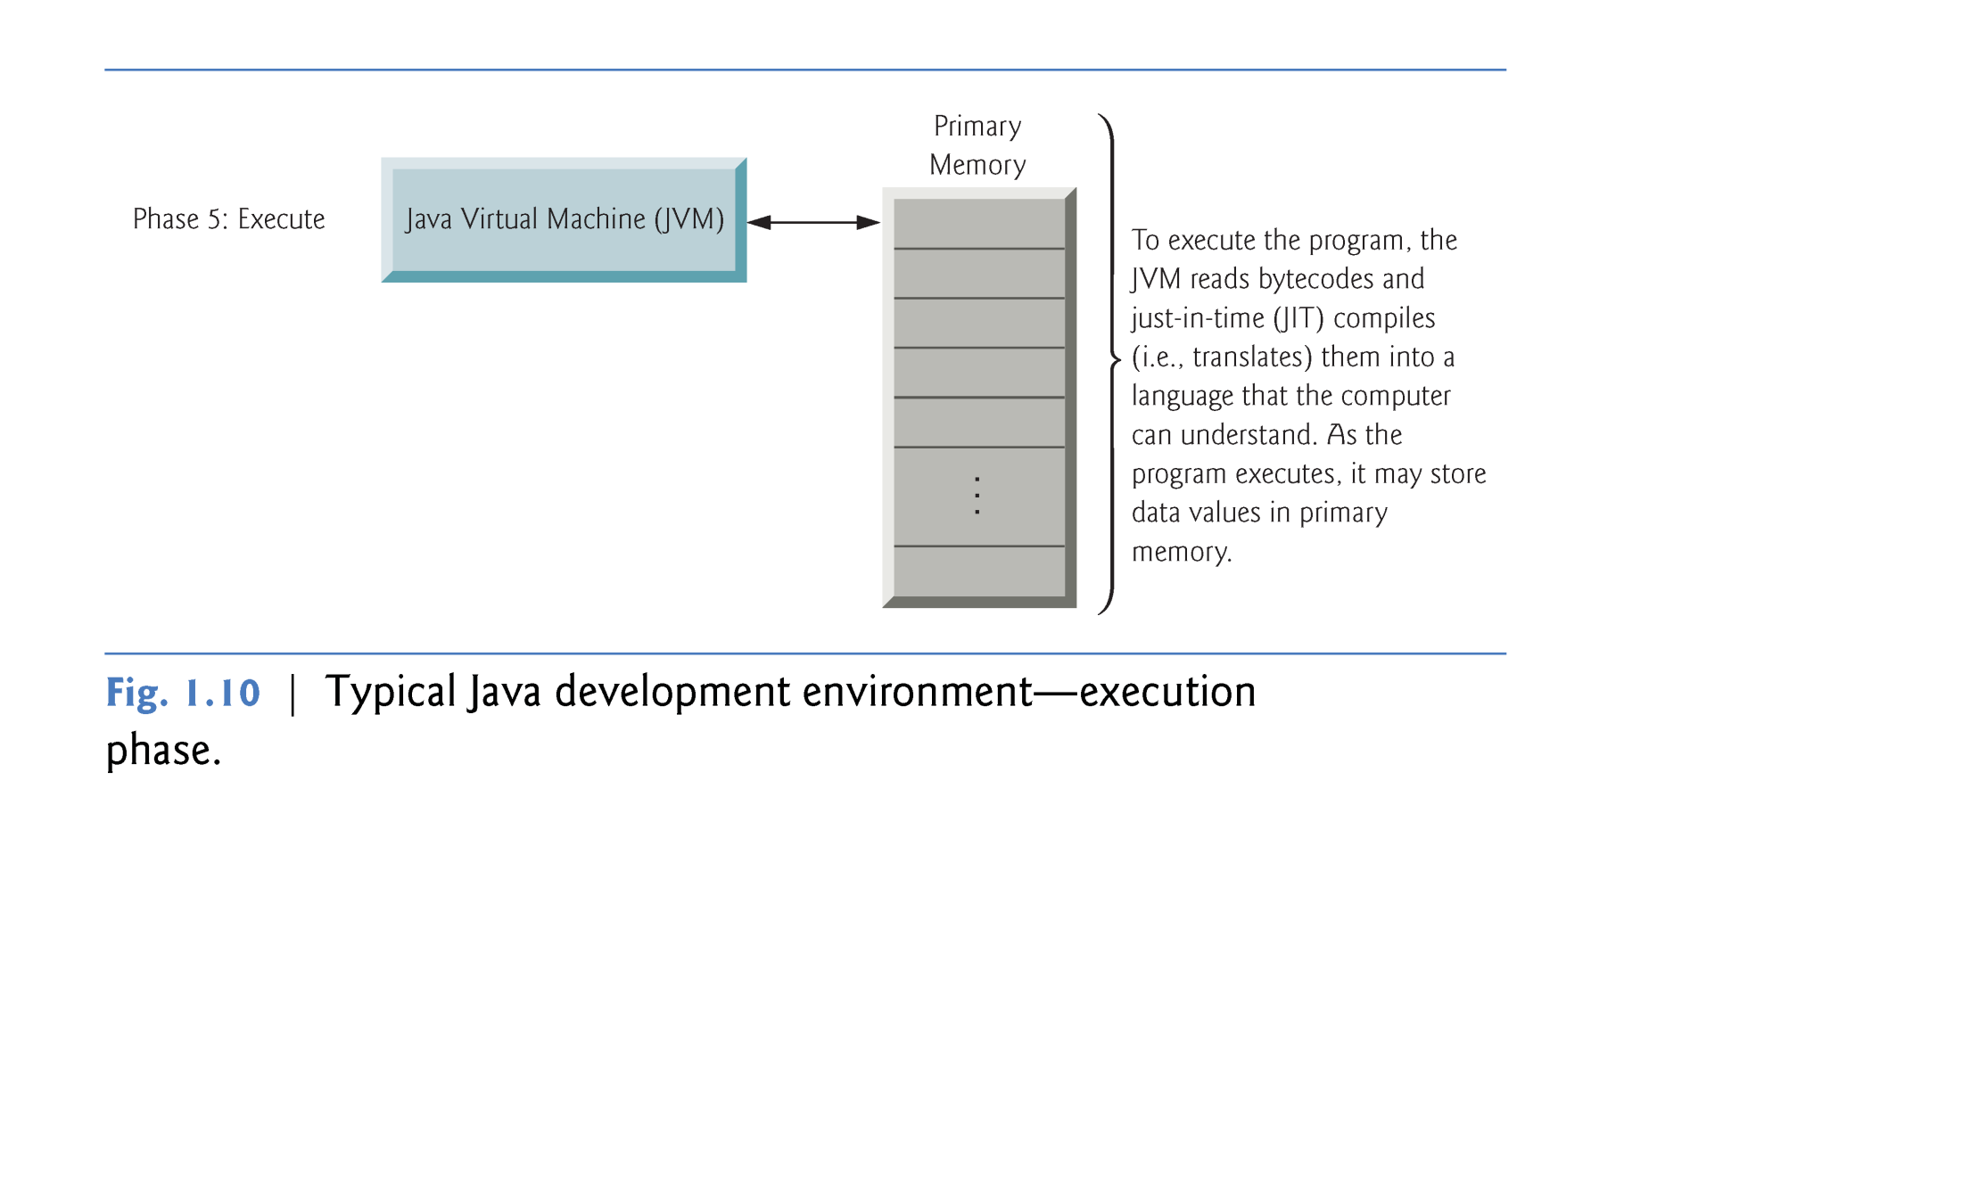

Slide 28
Language Features
Java is both compiled and interpreted
Source code is compiled into Java bytecode
Which is then interpreted by the Java Virtual Machine (JVM)
Therefore bytecode is machine code for the JVM
Java bytecode can run on any JVM, on any platform
…including mobile phones and other hand-held devices
Networking and distribution are core features
Makes Java very good for building networked applications, server side components, etc.

Slide 29
Language Features
The Garbage Collector
Java manages memory for you, the developer has no control over the allocation of memory (unlike in C/C++).
This is much simpler and more robust (no chance of memory leaks)
Runs in the background and cleans up memory while application is running
The Just In Time compiler (JIT)
Also known as “Hot Spot”
Continually optimises running code to improve performance
Can approach the speed of C++ even though its interpreted
Notes:
These two features provide some big advantages. Memory management can be error prone. Memory leaks are often difficult to diagnose properly (or even identify). Anyone who has worked with C/C++ is likely to have encountered these problems.
The JIT provides a task that the developer would otherwise have to do manually: profile the code to determine the performance critical sections. While this is still worthwhile, the basic JIT compiler in the JVM provides a good head-start. Again profiling is a tricky task as performance bottlenecks are never where you expect. Because the JVM has complete knowledge of what an application does, its in a position to adjust the code to provide some basic tuning.
This means performance testing a Java application needs to allow time for the JIT to kick in. Typically see slower performance early on, which then improves before reaching a plateau.

Slide 30
WORA
When you write a program in C++ it is known as source code. The C++ compiler converts this source code into the machine code of underlying system (e.g. Windows) If you want to run that code on Linux you need to recompile it with a Linux based compiler.
Due to the difference in compilers, sometimes you need to modify your code.
Java has introduced the concept of WORA (Write Once Run Anywhere).

Slide 31
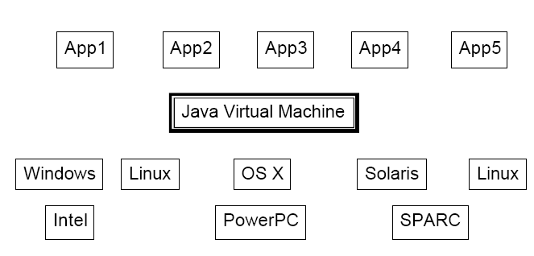
Java Virtual Machine (JVM)
JVM are available for almost all operating systems.
Java bytecode is executed by using any operating system’s JVM. Thus achieve portability.

Slide 32
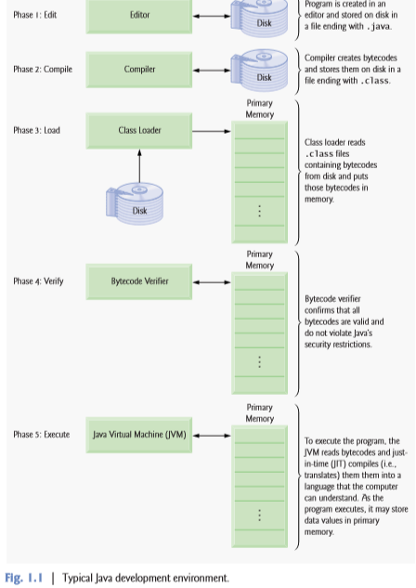

Slide 33
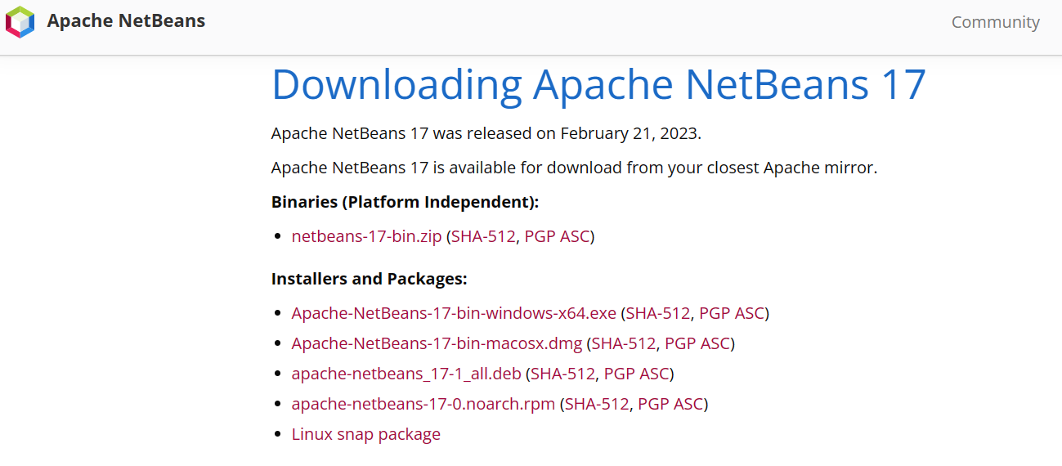
Installation and Environment Setting
https://netbeans.apache.org/download/nb17/index.html
Notes:
When Java was produced as an independent language, it was envisaged that it would help revolutionise the web, providing more dynamic features to web pages, e.g. animation, more complex user interfaces, etc. However its actually had more success as a server-side development language rather than for applets or desktop application development. That’s not to say it can’t do those things, and do them well, but it’s a niche that its occupies very well due to a number of features.
Dynamic web pages are now typically the realm of Macromedia Flash and similar tools.

Slide 34
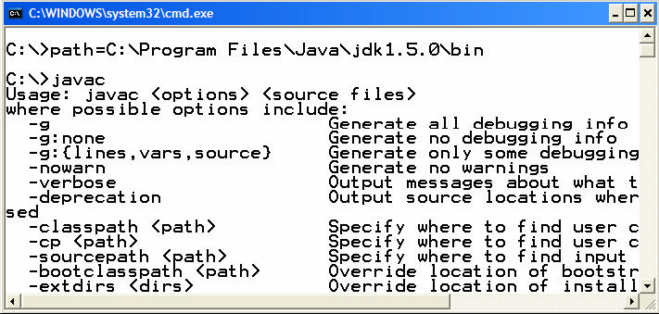
Installation and Environment Setting
Temporary Path Setting
path = < java installation directory\bin >
E.g.,
path = C:\Program Files\Java\jdk1.5.0\bin
To Test whether path has been set or not, write javac and press ENTER. If the list of options displayed as shown in the below figure means that you have successfully completed the steps of path setting.
Notes:
When Java was produced as an independent language, it was envisaged that it would help revolutionise the web, providing more dynamic features to web pages, e.g. animation, more complex user interfaces, etc. However its actually had more success as a server-side development language rather than for applets or desktop application development. That’s not to say it can’t do those things, and do them well, but it’s a niche that its occupies very well due to a number of features.
Dynamic web pages are now typically the realm of Macromedia Flash and similar tools.

Slide 35
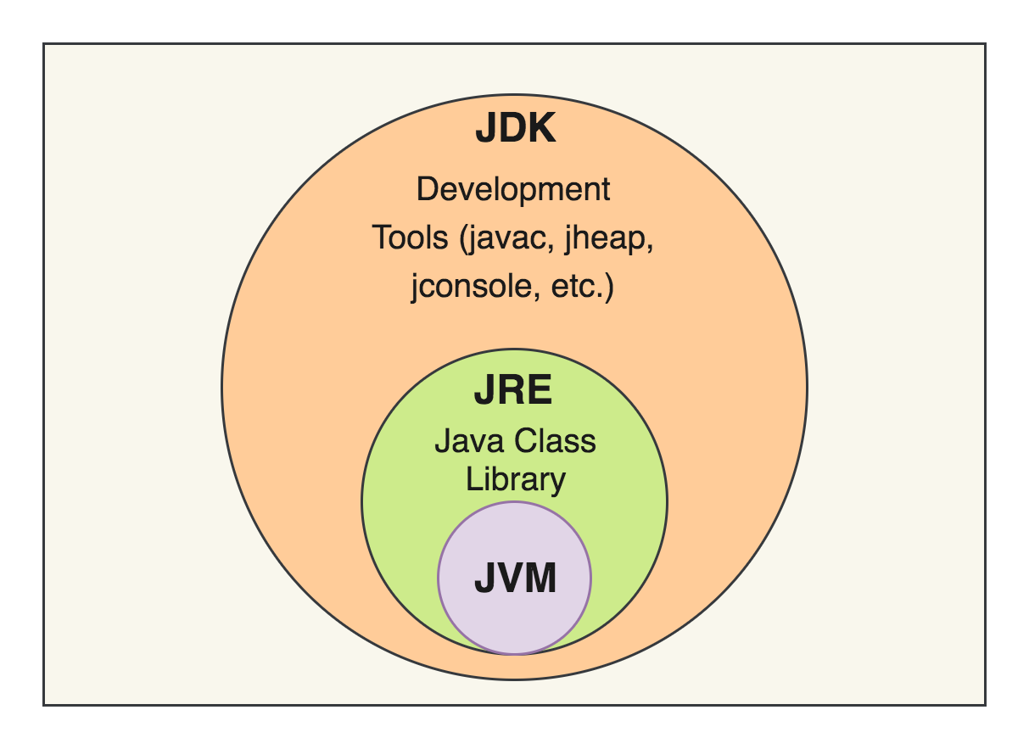
JDK, JRE and JVM

Slide 36
JVM
JVM (Java Virtual Machine) is an abstract machine. It is called a virtual machine because it doesn't physically exist.
It is a specification that provides a runtime environment in which Java bytecode can be executed. The JVM performs the following main tasks:
Loads code
Verifies code
Executes code

Slide 37
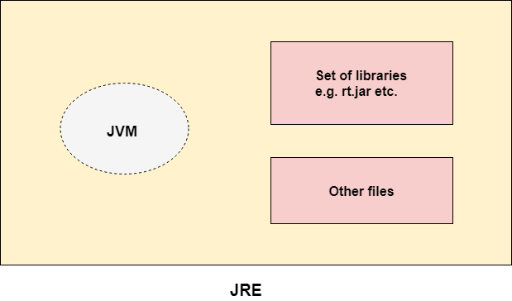
JRE
JRE (Java Runtime Environment) is used to provide the runtime environment.
It contains a set of libraries + other files that JVM uses at runtime.

Slide 38
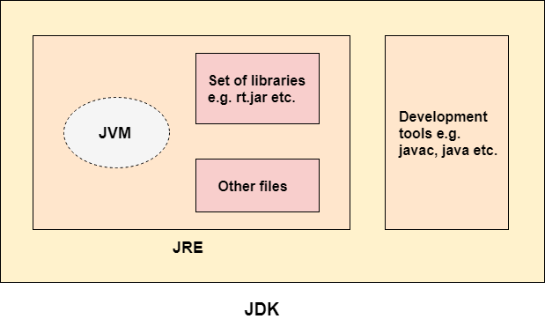
JDK

Slide 39
Useful Resources
Useful resources on the web
Java home (http://java.sun.com)
Articles, Software and document downloads, Tutorials
Java Developer Services http://developer.java.sun.com
Early access downloads, forums, newsletters, bug database
Javaworld (http://www.javaworld.com)
Java magazine site, good set of articles and tutorials
IBM developerWorks (http://www.ibm.com/developerWorks)
Technology articles and tutorials

Slide 40
Useful Resources
References
Java World: http://www.javaworld.com
Inside Java: http://www.javacoffeebreak.com/articles/inside_java

