Slide 1
Project Title & Aim
MalTwin: An AI-Based Framework for Malware Variant Detection in Industrial IoT Using Digital Twins and Visual Analysis
Project Aim To safely detect and classify evolving malware variants in Industrial IoT environments using Digital Twin based simulation, visual binary analysis, and intelligent learning-based detection.

Slide 2
Problem Statement
Industrial IoT (IIoT) systems are integral to critical infrastructure (e.g., manufacturing, energy grids, and transportation), making live malware testing highly risky and impractical. This is because detonating malware on real hardware could cause irreversible physical damage (e.g., equipment failure), operational downtime leading to economic losses, safety hazards to human operators, and cascading disruptions in interconnected systems, issues highlighted by attacks like Stuxnet on SCADA environments.
Traditional signature-based antivirus fails against polymorphic and zero-day malware, as even minor code modifications (e.g., obfuscation or packing) allow variants to evade detection without altering core functionality.
Existing image-based malware detection only analyzes static binaries and ignores runtime behavior, limiting its ability to capture how malware interacts with IIoT protocols or networks in real-time scenarios.
Public malware datasets lack IIoT-specific samples, industrial protocols (e.g., Modbus, MQTT), and realistic attack scenarios, resulting in imbalanced data that hinders model generalization and accuracy for industrial contexts.
There is no unified framework that safely combines static visual analysis with runtime behavioral validation for IIoT environments, leaving a gap in secure, scalable tools for detecting evolving threats without endangering physical assets.

Slide 3
Existing Solutions
Related Systems / Literature
Traditional signature-based antivirus solutions used in industrial environments
Image-based malware detection approaches (e.g., Malimg)
Learning-based malware detection frameworks
Digital Twin tools for industrial system monitoring
What Is Already Available
Signature-based malware scanners
Static or behavioral malware analysis tools
General-purpose malware image classification systems
Digital Twins focused on monitoring, not malware detection
Shortcomings / Gaps
Signature-based methods fail against polymorphic and zero-day malware
Unsafe to analyze malware on real IIoT hardware
Lack of IIoT-specific datasets and simulation environments
Limited integration of Digital Twins with AI-based malware variant detection

Slide 4
Objectives
To enable safe malware analysis in IIoT environments by developing a software-based Digital Twin that emulates devices, protocols (e.g., Modbus, MQTT), and network topologies without risking real hardware.
To address dataset scarcity and class imbalance by applying data enhancement and balancing techniques, such as augmentation (e.g., rotation, scaling) and synthetic generation via the Digital Twin, to improve diversity and model generalization.
To reveal structural patterns in executables resilient to obfuscation by converting binary files into grayscale images for visual analysis, treating malware families as distinct "textures" using tools like OpenCV.
To detect polymorphic, obfuscated, and unseen malware variants by designing and evaluating intelligent learning-based models, such as CNNs in PyTorch/TensorFlow, with metrics like accuracy, precision, recall, and F1-score.
To provide user-friendly access to analysis results by building an interactive dashboard for visualization, real-time predictions, confidence scores, system monitoring, and explainable AI outputs.

Slide 5
Complexity of Problem
The Challenge of High-Fidelity IIoT Simulation (Digital Twin)
Beyond Simple Simulation: We are not merely running a script; we are engineering a network-level Digital Twin that emulates the behavior of specific Industrial IoT (IIoT) components (PLCs, Sensors, Actuators).
Protocol Complexity: The system must simulate real-time data flow using industrial-specific protocols (e.g., Modbus, MQTT) rather than standard HTTP traffic. This requires constructing a virtualized topology (using Mininet/Docker) that mirrors the latency and bandwidth constraints of a physical industrial plant.
The "Air-Gap" Constraint: Real IIoT systems are critical infrastructure (e.g., power grids). We cannot detonate malware on live hardware. The complexity lies in creating a sandbox that is realistic enough to trick the malware into executing its malicious payload, generating high-fidelity behavioral logs that do not currently exist in public datasets.

Slide 6
Complexity of Problem ss The Challenge of Visual Malware Forensics
Obfuscation & Polymorphism: Attackers use packers and encryption to change the code signature of malware, rendering traditional antivirus useless. The complexity here is implementing Visual Fingerprinting, transforming binaries into 2D grayscale matrices.
Texture Analysis: We are solving a pattern recognition problem where we treat malware families as "textures." This involves complex preprocessing to ensure that minor code shifts (polymorphism) result in visually similar images, allowing our AI to detect variants it has never seen before.

Slide 7
Justification
Why a Digital Twin is Strictly Necessary
Complexity: The Digital Twin will emulate specific industrial protocols (Modbus/TCP, MQTT) and device behaviors (PLCs, Sensors) using Mininet and Docker. This goes beyond simple scripting; it requires constructing a virtual network topology that mirrors real-world latency and bandwidth constraints.
Addressing the "Runtime" Gap: Standard image-based detection is static, it does not see "what the malware does" (runtime behavior). Our Digital Twin bridges this gap. By detonating malware within the isolated Twin, we can capture live traffic logs and network behavior safely. This allows us to correlate the visual structure of the malware (static) with its network impact (dynamic), answering the critique that image analysis alone is insufficient.
Safety Criticality: In Industrial IoT (IIoT), we cannot analyze malware on physical infrastructure (e.g., power grids or factory arms) due to safety risks. The Digital Twin provides the only viable "sandbox" to generate data for dangerous, evolving malware variants without physical risk

Slide 8
Justification
Why Binary-to-Image Conversion is Superior
Overcoming Obfuscation: Traditional signature-based detection fails when attackers change a single bit of code (polymorphism). However, the structural layout of malware, its "texture“, often remains consistent even when obfuscated. By converting binaries to grayscale images, we transform the cybersecurity problem into a pattern recognition problem.
Reference Concept: This approach builds upon the foundational work seen in the Malimg Dataset research (Nataraj et al.), which demonstrated that malware families exhibit distinct visual textures. Our project advances this by applying it specifically to resource-constrained IIoT binaries, which are often smaller and more structured than general PC malware.
Efficiency: Visual analysis via CNNs (Convolutional Neural Networks) is computationally faster for inference on edge devices compared to running heavy, real-time behavioral sandboxes for every single file.

Slide 9
Addressing Limitations of Visual-Only Detection
Critiques often note that visual analysis can be fooled by packed/encrypted binaries or misses runtime behavior. MalTwin mitigates this by:
Hybrid Validation: The Digital Twin allows us to observe the network effect (logs) alongside the visual scan, providing a secondary layer of validation.
Visualizing Entropy: High entropy (randomness) in an image usually indicates encryption/packing. Our visual analysis can detect these "noisy" blocks as specific textures, flagging them as suspicious even if the specific malware signature is hidden.
Data Balancing: We use data enhancement techniques to ensure our model learns robust features, preventing it from memorizing simple, adversarial patterns.

Slide 10
Datasets & Limitations
Datasets Used
Malimg Dataset – Benchmark malware image dataset used for visual malware classification
IoT-23 Dataset – Realistic IoT network traffic for benign and malicious behavior analysis
Digital Twin–Generated Data – Synthetic IIoT traffic created using Modbus/MQTT simulation
Limitations of Existing Datasets
Public datasets focus mainly on IT/PC malware, not Industrial IoT firmware
Lack of industrial protocol–specific malware (e.g., PLC/Modbus attacks)
Class imbalance across malware families
No paired static (binary) and runtime (behavioral) data
How MalTwin Addresses This
Generates safe, IIoT-specific infected traffic via Digital Twin
Applies data augmentation to balance malware classes
Combines static visual features + dynamic network behavior

Slide 11
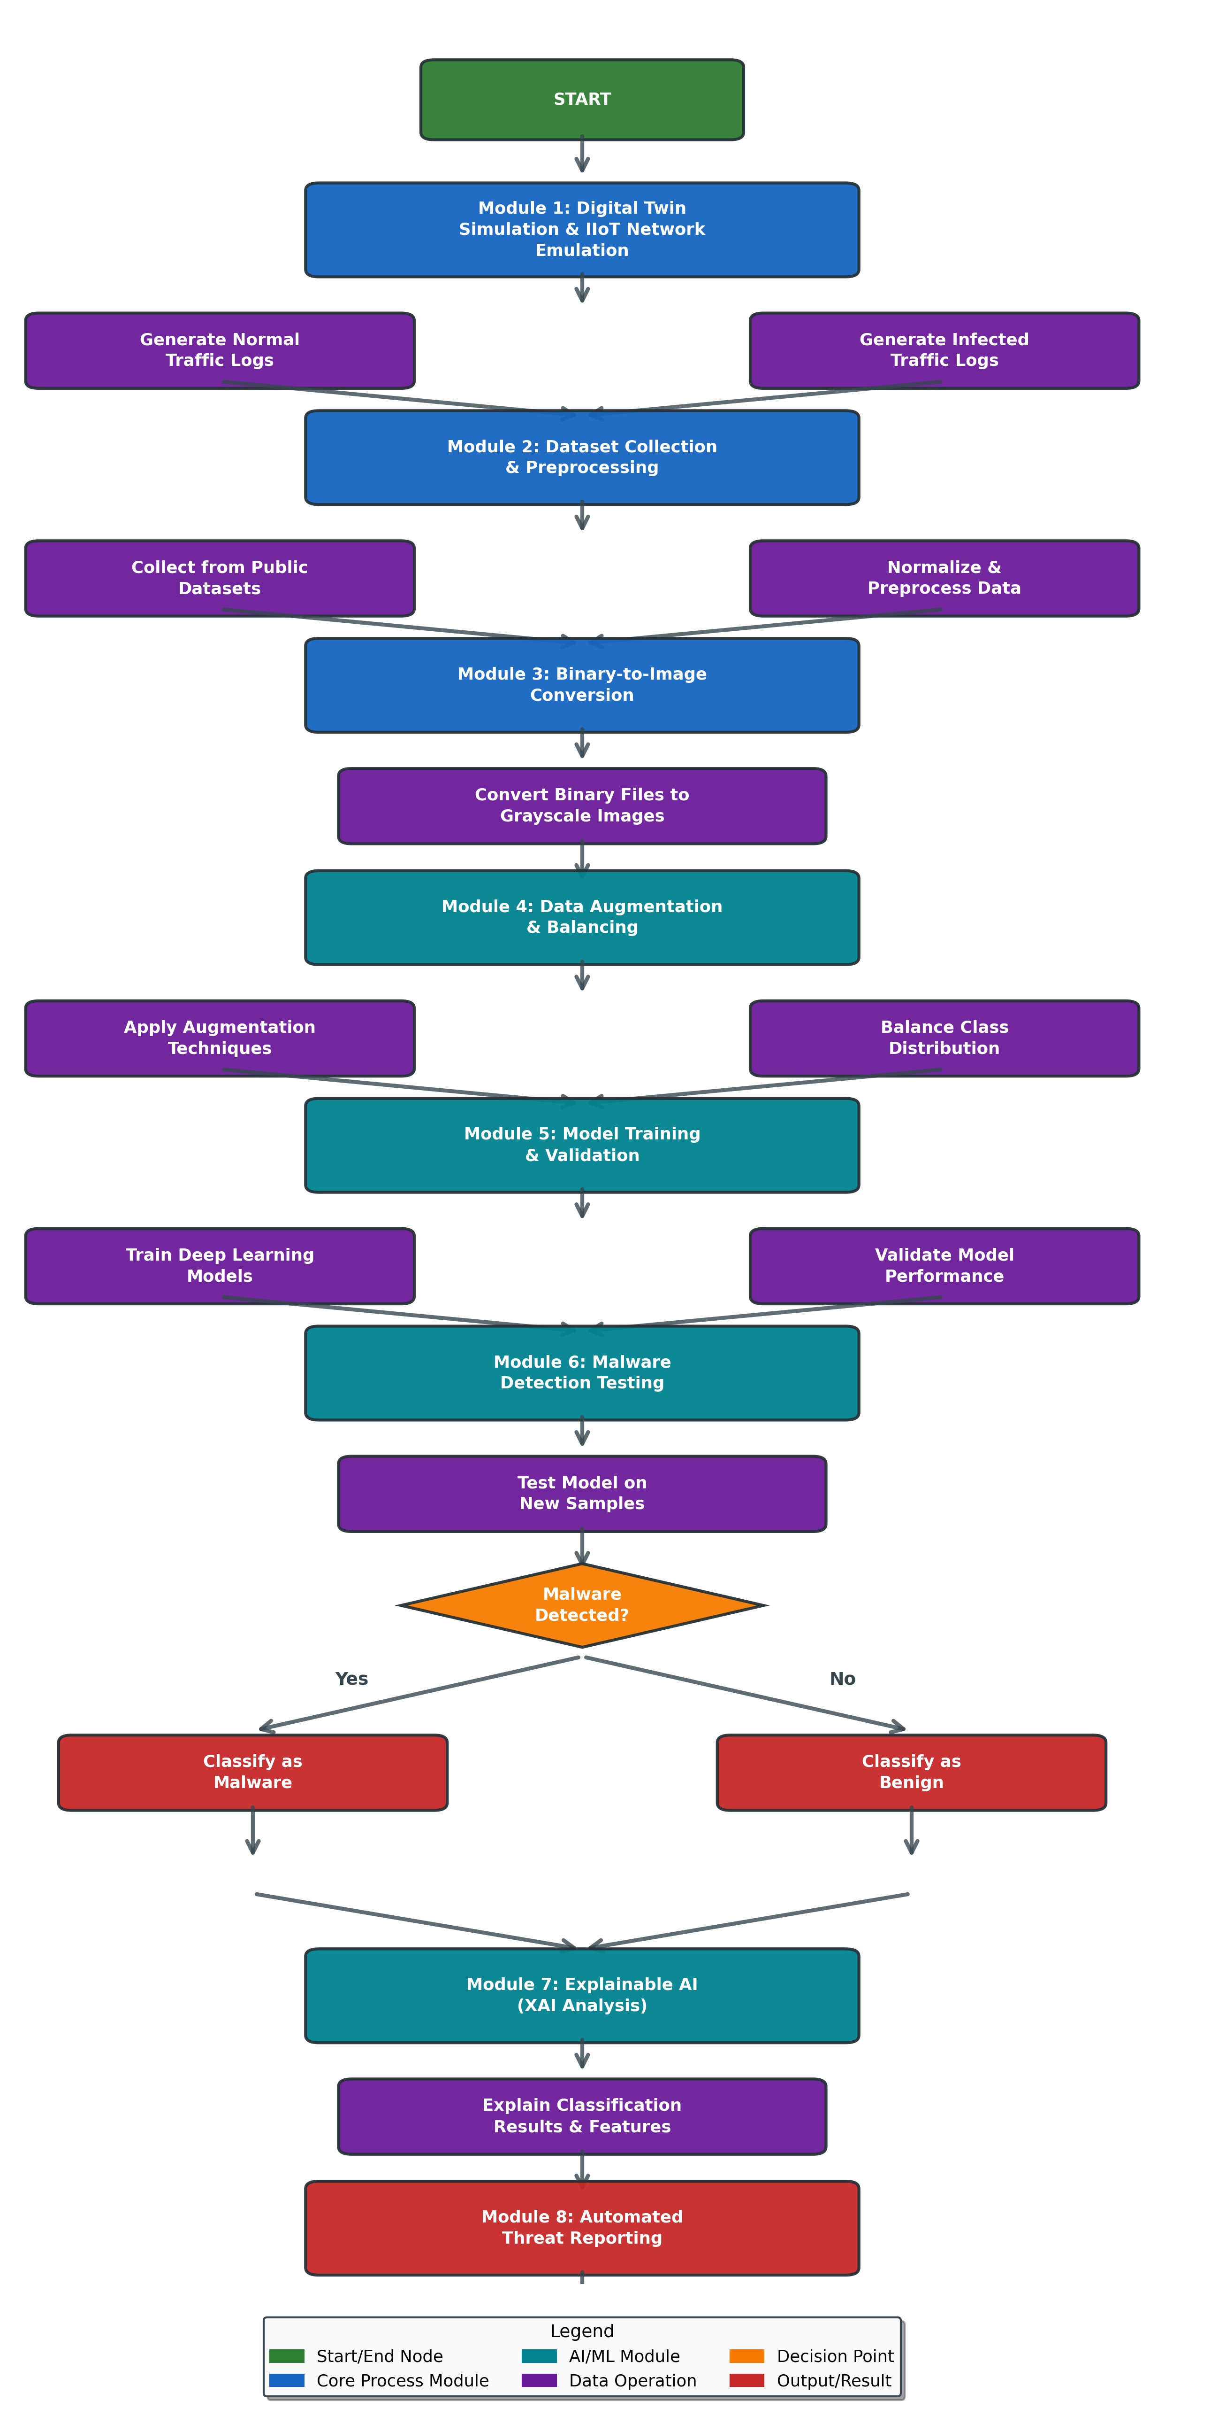
Methodology
Dataset Collection & Preprocessing Module Collect public datasets (Malimg, IoT-23, EMBER, VirusShare); normalize pixels, label samples (benign/malware family); split into train/validation/test sets.
Binary-to-Image Conversion Module Convert executable binaries (PE/ELF) to grayscale images: read byte streams, reshape into fixed-size 2D matrices (e.g., 128×128), generate visual fingerprints resilient to obfuscation.
Data Enhancement & Balancing Module Apply image augmentation (rotation, scaling, flipping); generate synthetic IIoT-infected samples via Digital Twin; balance class distribution to reduce imbalance and improve generalization.
Digital Twin Module Simulate IIoT network using Mininet + Docker; emulate devices (PLCs, sensors), protocols (Modbus, MQTT); generate safe normal and infected traffic logs for runtime behavior capture (used to create synthetic data and validate detections).
Intelligent Malware Detection Module Train CNN-based models (PyTorch/TensorFlow) on enhanced image dataset; validate during training (tune hyperparameters, early stopping); test on unseen samples; output predictions + confidence scores.
Dashboard & Visualization Module (incl. XAI & Reporting) Streamlit-based interface: file upload, grayscale preview, real-time predictions, metrics display; apply XAI (Captum saliency/Grad-CAM heatmaps) after every detection to explain results (whether benign or malicious); generate automated reports (PDF/JSON) with threat context.

Slide 12
Tools & Technologies
Programming Languages
Python
Frameworks & Libraries
PyTorch / TensorFlow (model training)
OpenCV, Pillow (image processing)
Scikit-learn (evaluation metrics)
Captum (Explainable AI)
Platforms & Tools
Docker (Digital Twin & simulation)
Mininet (IIoT network emulation)
Streamlit (dashboard & UI)
Linux (secure analysis environment)
Relevance
Supports scalability, reproducibility, and safe experimentation
Suitable for AI research and cybersecurity analysis

Slide 13
Expected Outcomes & Relevance
Expected Outcomes
A functional prototype for IIoT malware variant detection
Accurate detection of obfuscated and unseen malware samples
Interactive dashboard with visualization, explainability, and reporting
Enhanced and balanced malware image dataset
Relevance
Improves security of critical industrial infrastructure
Enables safe malware research without physical risk
Useful for academic research, training, and experimentation in IIoT security

Slide 14
Conclusion / Future Work
Conclusion
MalTwin provides a safe, intelligent, and adaptive framework for IIoT malware variant detection
Moves beyond signature-based methods toward visual and learning-based analysis
Combines Digital Twins, AI, and cybersecurity into a unified research platform
Future Work
Integrate dynamic behavioral analysis alongside static visual analysis
Extend to real-time IIoT traffic monitoring
Support additional malware families and protocols
Deploy as a cloud-based research platform

