Slide 1
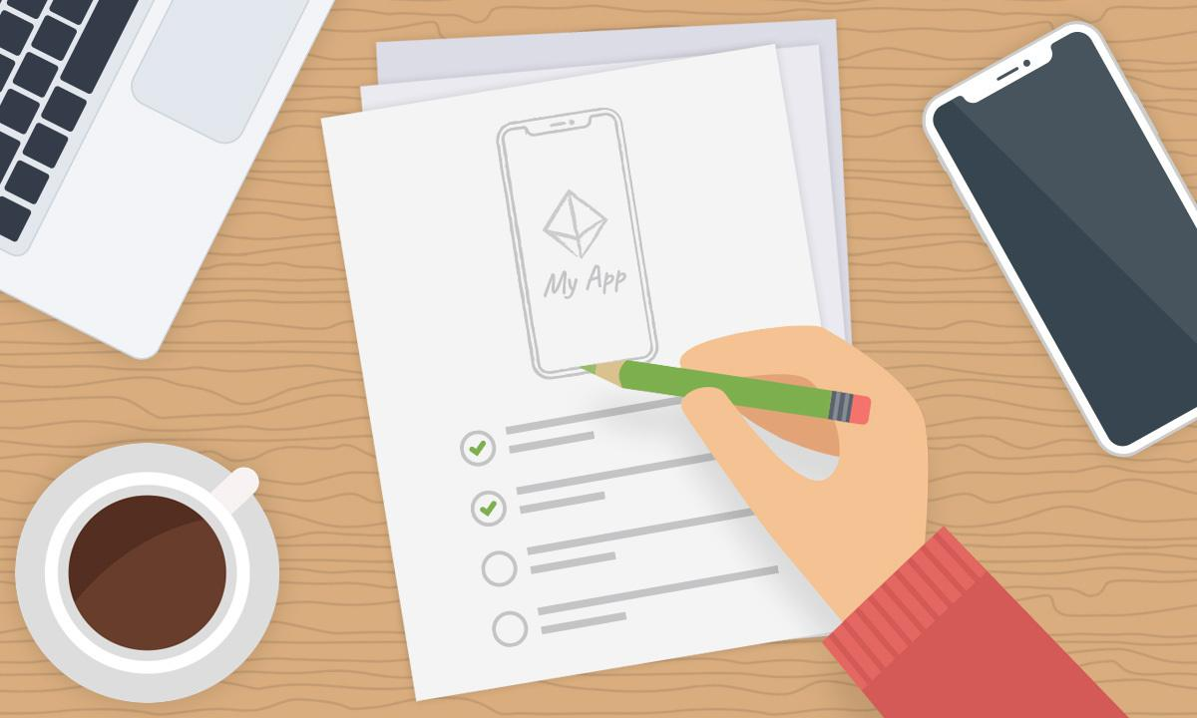
Pressure Ulcer Application
Final presenation
Group : 1
By:
Saad Ahmed
Maaz Qureshi
Hasan Orkan
Mustafa. M

Slide 2
Overview
Introduction
Interface
Diagrams
Testing
Conclusion
References

Slide 3
Introduction
Decubitus ulcers, also termed bedsores or pressure ulcers, are skin and soft tissue injuries that form as a result of constant or prolonged pressure exerted on the skin
Develop a Mobile application that offers medical help to patients who suffer from Pressure Ulcers
By Scanning the affected area of the skin, provides them with treatment and and reports about there sore’s condition.
Makes healthcare getting easier and reduces the cost of the service.

Slide 4
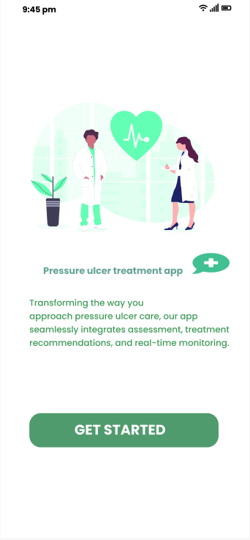
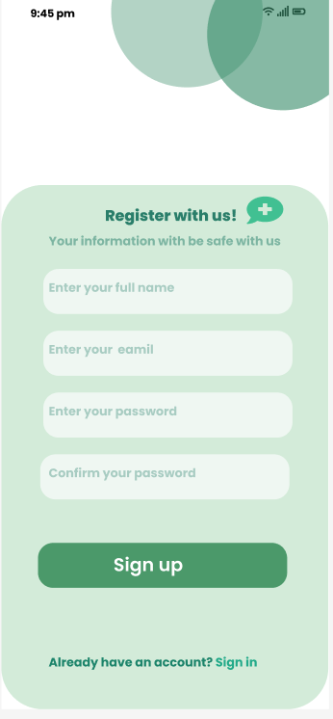
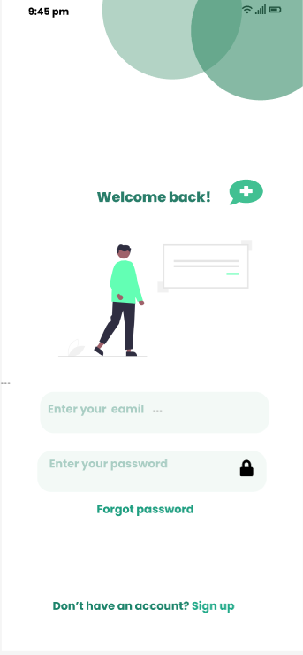
Interface Design

Slide 5
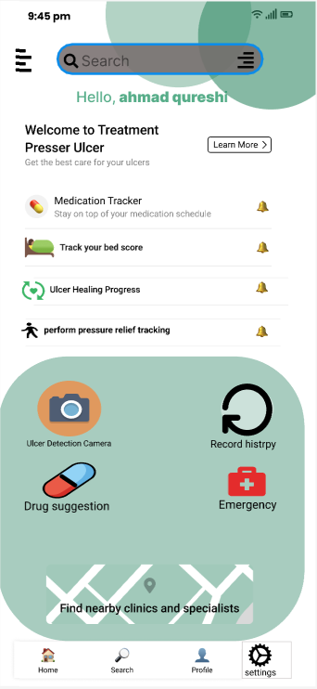
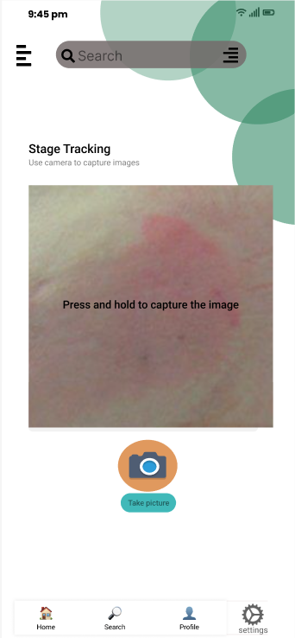
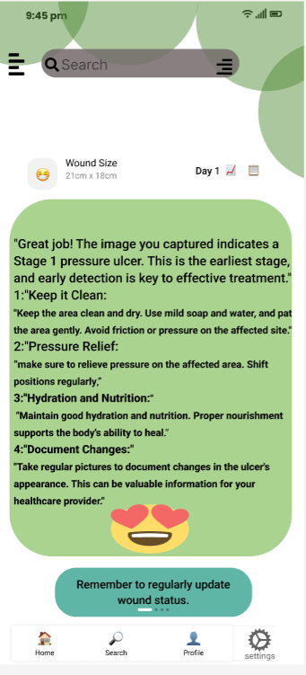

Slide 6
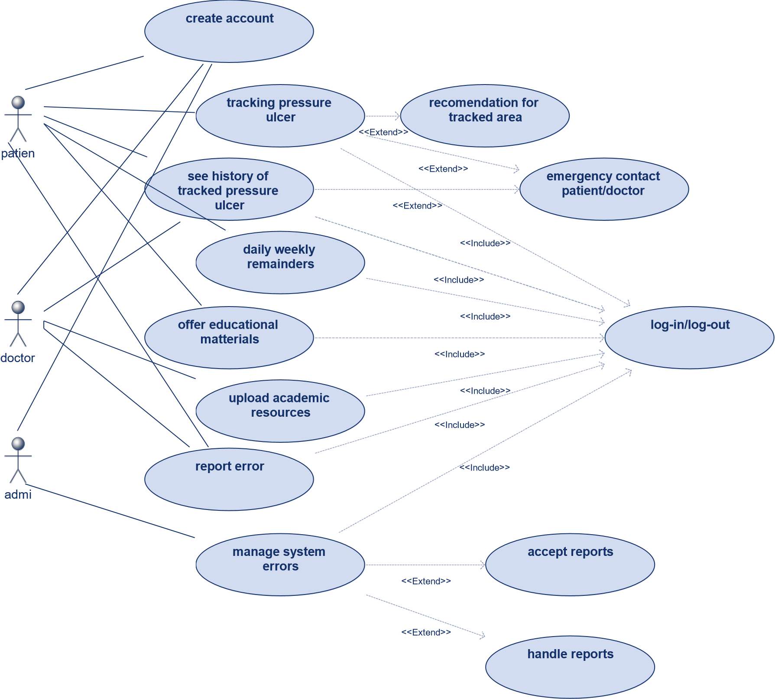
Use Case Diagram

Slide 7
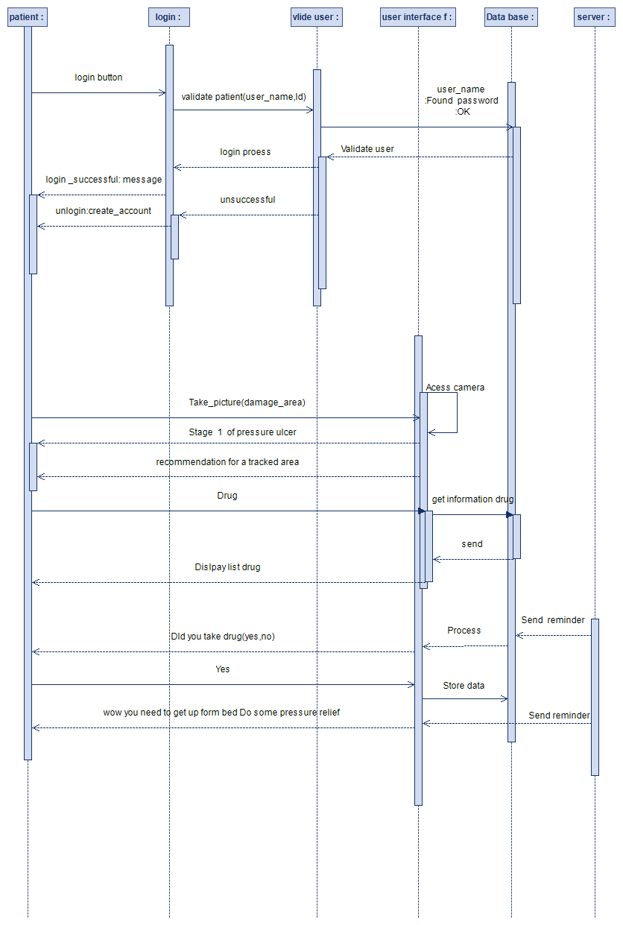
Sequence Diagrams For Patient

Slide 8
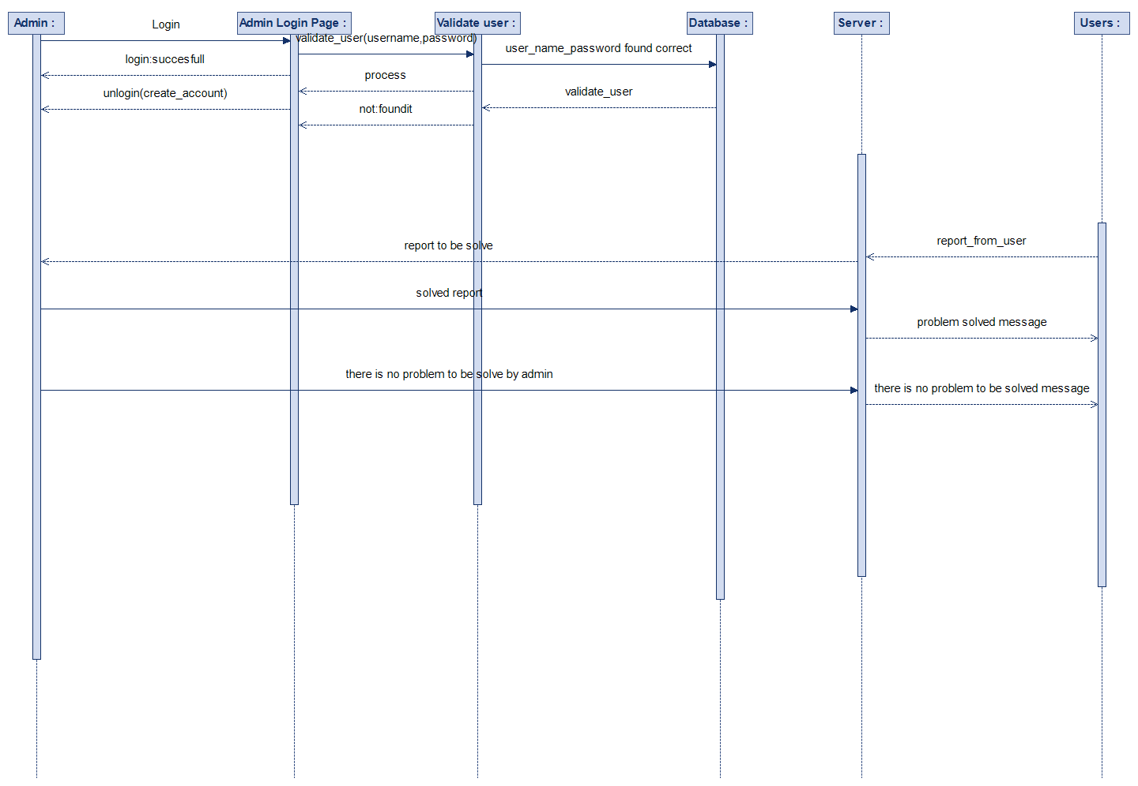
Sequence Diagrams For Admin

Slide 9
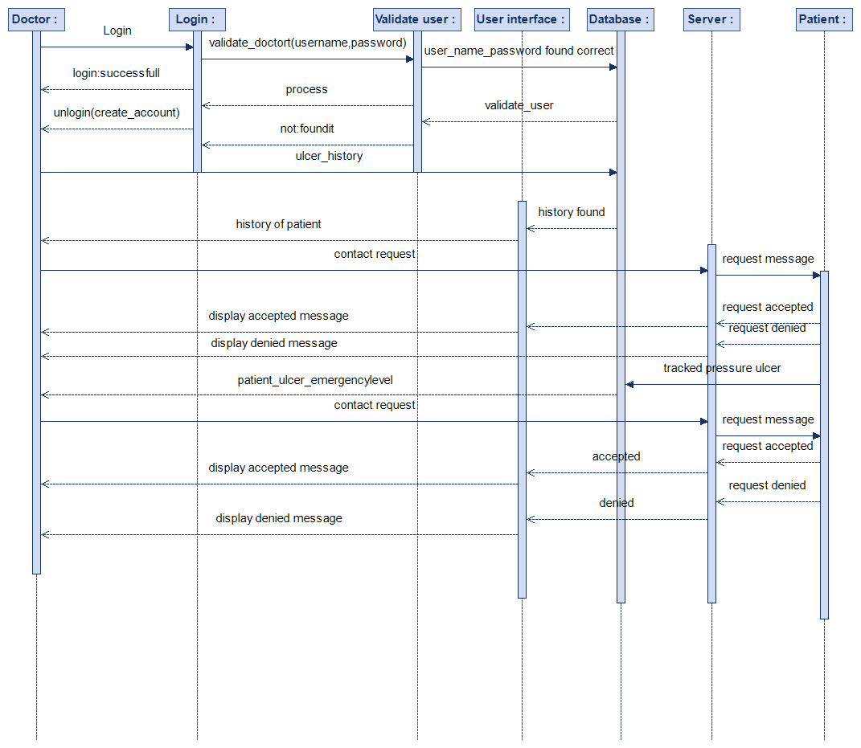
Sequence Diagrams For Doctor

Slide 10
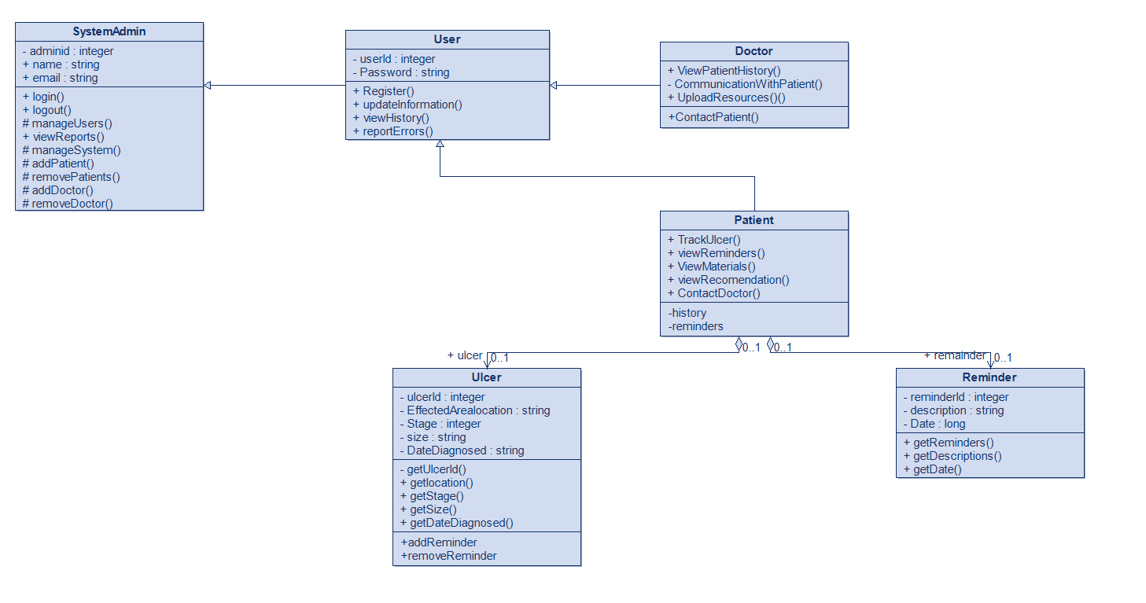
Class Diagram

Slide 11
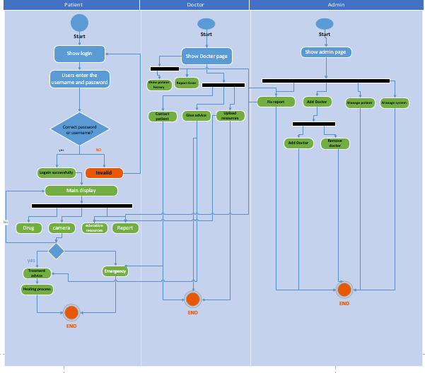
Activity Diagram

Slide 12
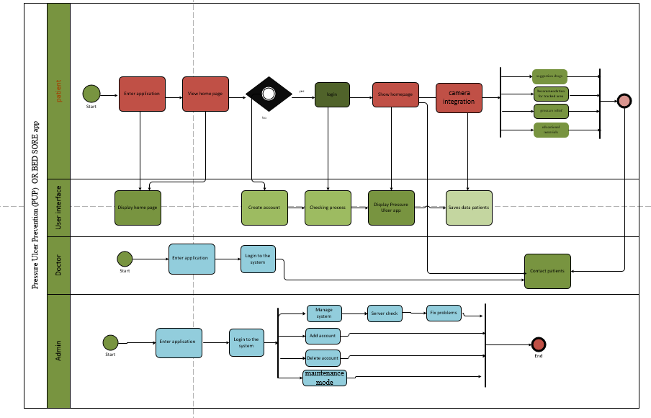
Business Process Modeling (BPMN)

Slide 13
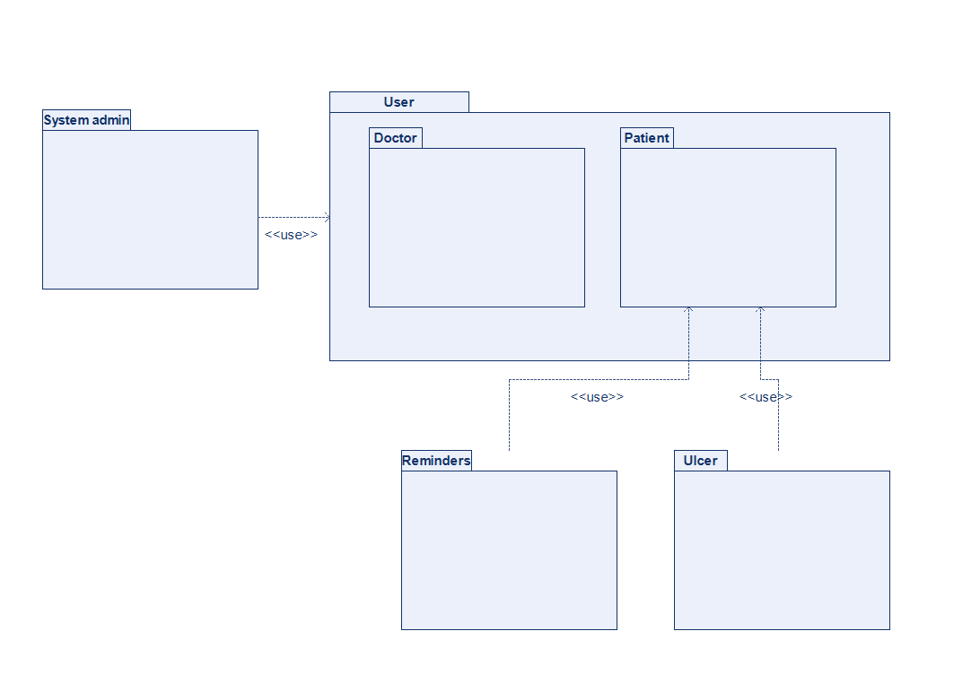
Package Diagram

Slide 14
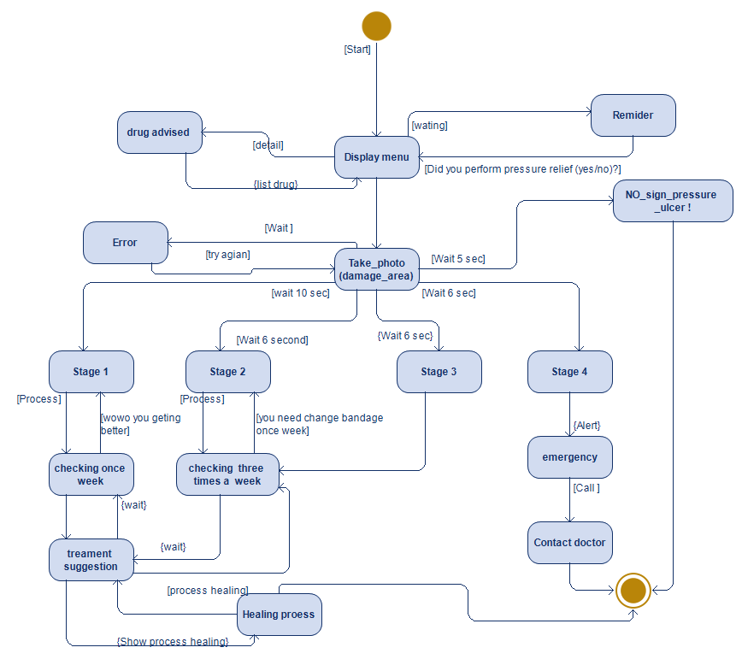
State Diagram

Slide 15
Testing
User testing will be used.
Our project uses an agile development model so user testing is used as it is involved in this cycle.
This testing process will require our input to be exactly like what the customer will have
Tests will be defined by my customers and users. The outputs will be compared to expected outputs
During testing, subsequent changes and modifications can be made if there is a case of mismatch.

Slide 16
Camera Integration
Test – Case ID: | TC – 05
Test Case Name | Camera Integration Test
Pass/Fail Criteria | System should track ulcercorrectly and identify the right stage
Input Data: | Camera scans the effected area
Test Procedure | Test Results
Step1 click on camera button | System opens camera. Scans area
Step2 shows Stage | System tracks ulcers and shows stage and treatment

Slide 17
Update Information
Test – Case ID: | TC - 04
Test Case Name | Updateaccountinformation
Pass/Fail Criteria | System should change userinformation based on what they change and save it to database.
Input Data: | Name surname email password
Test Procedure | Test Results
Step1: click modify account | System should display page with patient’s information and be able to change their information
Step2:press okay | System saves changes
Step3:press cancel | System cancels changes and doesn’t save them.

Slide 18
Reminders
Test – Case ID: | TC – 06
Test Case Name | Reminder Test
Pass/Fail Criteria | System should sendPatient reminderaccording to their scheduleand their treatment correctly
Input Data: | Treatment and schedule plan selected
Test Procedure | Test Results
Step1 click on treatment plan | System redirects you to a page that shows you treatment plans
Step2 select plan | Patients inputs all data needed and select treatment schedule
Step 3 send reminders | Systems sends reminder according to the schedule.

Slide 19
Conclusion
In summary, our mobile pressure ulcer tracking device is an innovative new way to provide in-home care, a useful aid both for patients and caregivers on the one hand and ultimately for healthier people and a higher standard of living on the other.

Slide 20
References
IEEE Std 610.12-1990, IEEE Standard Glossary of Software Engineering Terminology.
IEEE Std 730-1998, IEEE Standard for Software Quality Assurance Plans.
IEEE Std 828-1998, IEEE Standard for Software Configuration Management Plans.https://www.nhs.uk/conditions/pressure-sores/
Yarkony, Gary M. "Pressure ulcers: a review." Archives of physical medicine and rehabilitation 75.8 (1994): 908-917.

